Slide 1
ALTERNATIVE SECURITIES
Topic 8: Introduction to hedge funds

Slide 2
Student learning objectives
8.1 Define a hedge fund and distinguish hedge fund from mutual fund
8.2 Describe the main characteristics of a hedge fund
8.3 Describe current status of the hedge fund industry
8.4 Briefly describe the investment strategies of hedge funds
8.5 Understand the issues of capacity and performance sustainability in the hedge fund industry
8.6 Understand the concepts of arbitrage and be able to explain arbitrage using examples.
8.7 Be able to explain short selling strategy and understand the relevant issues such as the risks and the regulations.

Slide 3
8.8 Understand the contrarian indicators
8.9 Understand the historical performance of the short selling strategy

Slide 4
References
Stefanini, F. (2006). Investment strategies of hedge funds. John Wiley & Sons Inc. England. Chapter 1, 2&3.

Slide 5
Objective 8.1
Define a hedge fund and distinguish hedge fund from mutual fund
“A hedge fund is an investment instrument that provides different risk/return profiles compared to traditional stock and bond instruments”
Differences between hedge fund and mutual fund
  The performance measurement
  Mutual fund: performance is measured against a benchmark.
  Hedge fund: No benchmark, seeks to guarantee an absolute return under any circumstance.
  Capital protection
  Mutual fund cannot protect portfolio from descending markets.
  Hedge funds can protect portfolio by short selling strategy.

Slide 6
Objective 8.1
Define a hedge fund and distinguish hedge fund from mutual fund
Differences between hedge fund and mutual fund
  Correlation with the market
  Mutual funds have a strong correlation with the markets in which they are invested.
  Hedge funds tend to have a very low correlation with the direction of financial markets.
  Regulation
  Mutual funds are regulated and supervised by Regulatory Authorities. Mutual funds are restricted on the makeup and permitted instruments in their portfolio.
  Hedge funds are less regulated. Mangers have a great flexibility to employ different strategies and financial instruments in their portfolio.

Slide 7
Objective 8.2
The main characteristics of a hedge fund
The manager is free to use a wide range of financial instrument.
The manager can short sell.
The manager can use leverage.
The manager’s profit comprises a management fee, 1.5-2.5%, and a incentive fee. 20-25% on profit.
  The incentive fee applies if the value of the unit exceeds its historical peak in absoluter return or over a one-year period.
  Align the interest of the manger with his//her clients.
The manager invests a sizable part of his/her personal assets in the fund he/she manages.

Slide 8
Objective 8.3
Describe the current status of the hedge fund industry
The growth of the hedge fund industry
  The number of hedge funds has gone from 610 in 1990 to 7436 in 2004. The growth rate is 20%p.a.The Asset under management (AuM) grows at 26% p.a. from $38.9billion to $973billion in 2004. (Insert Figure 1.1)
  Hedge funds accounts for 3.5% (including the leverage) of the total capitalization of financial markets, but hedge funds make up 10% of market trading volumes.
  The cumulative returns of hedge fund industry measured by CS/Tremont Hedge Fund Index exceeds that of stock and bond markets over the period 1994-2004. In particular, hedge funds were able to protect the capital in the bear market during the period between 2000 and 2002. (Insert Figure 1.2)

Slide 9
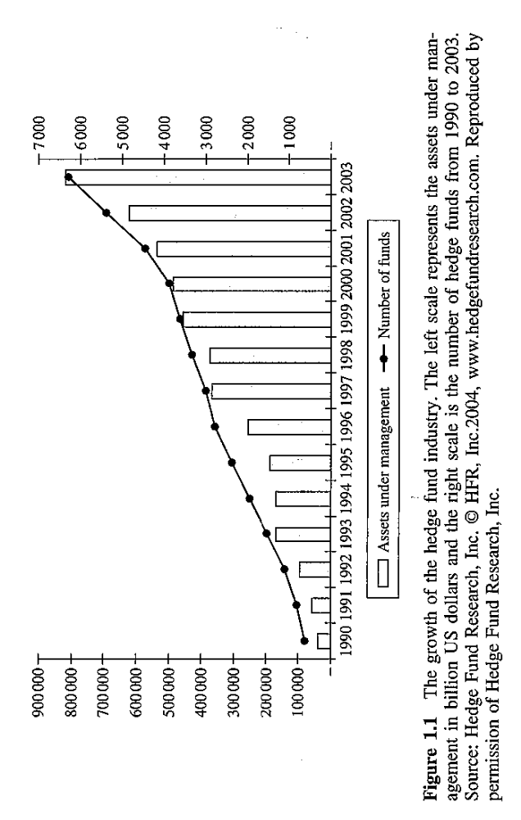

Slide 10
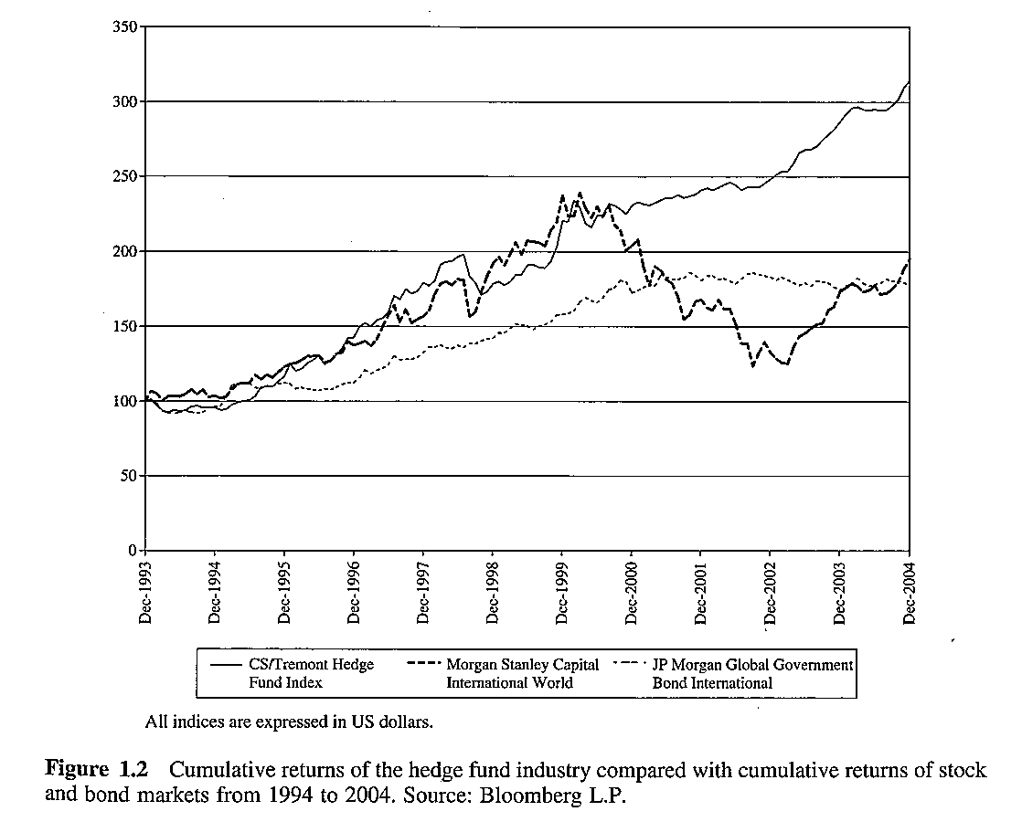

Slide 11
Objective 8.3
Describe the current status of the hedge fund industry
The main characteristics of the current hedge fund industry
  Hedge fund industry proves to be heterogeneous in terms of fund size (insert Figure 1.4)
  Low barriers to entry and an appealing fee structure. Investment banks are willing to provide facilities to hedge fund managers as the hedge fund managers are great clients.
  Commissions: normally the management fee is within 1-2%, but some funds may charge as high as 6-7%. Normally, the performance fee is 20% , but some funds may charge 50%!

Slide 13
Objective 8.4
Briefly Describe the investment strategies of hedge fund
Investment strategies
  Hedge fund=traditional beta + alternative beta + structure alpha +skill alpha
  Traditional sources of beta are the stock market, bond duration and credit spreads.
  Alternative sources of beta are liquidity, volatility, correlations, the risk inherent in corporate events
  Structural alpha is linked to the structural advantages enjoyed by hedge funds, e.g., the greater regulatory freedom, no benchmark needed, flexibility and limited size.
  Skill alpha is linked to a manager’s investment skills.

Slide 14
Objective 8.4
Briefly Describe the investment strategies of hedge fund
Investment strategies
  Relative value
    Relative value are arbitrage transactions that seek to profit from the spread between two securities. Relative strategies include merger arbitrage, convertible bond arbitrage, fixed income arbitrage, mortgage-backed arbitrage and capital structure arbitrage.
  Event driven
  Event driven strategies seek to profit on opportunities arising due to corporate events, such as spin-offs, mergers, acquisition,, liquidation and restructuring.

Slide 15
Objective 8.4
Briefly Describe the investment strategies of hedge fund
Investment strategies
  Directional trading
  Directional trading strategies seek to take advantage of major market trends rather than focusing on individual stocks, These strategies include the managed futures and macro strategies.
  Long/short equity
  This strategy involves taking a long position on stocks which are believed to be undervalued and a short position on stocks which are believed to be overvalued.
  Other strategies

Slide 16
Objective 8.4
Briefly Describe the investment strategies of hedge fund
  Currently, long/short equity and event driven strategies dominate in the hedge fund industry. Now approximately 34% of the hedge fund industry is comprised of long/short equity based funds. Event driven funds represent about 16% of the hedge fund industry. (insert figure 1.3)

Slide 17
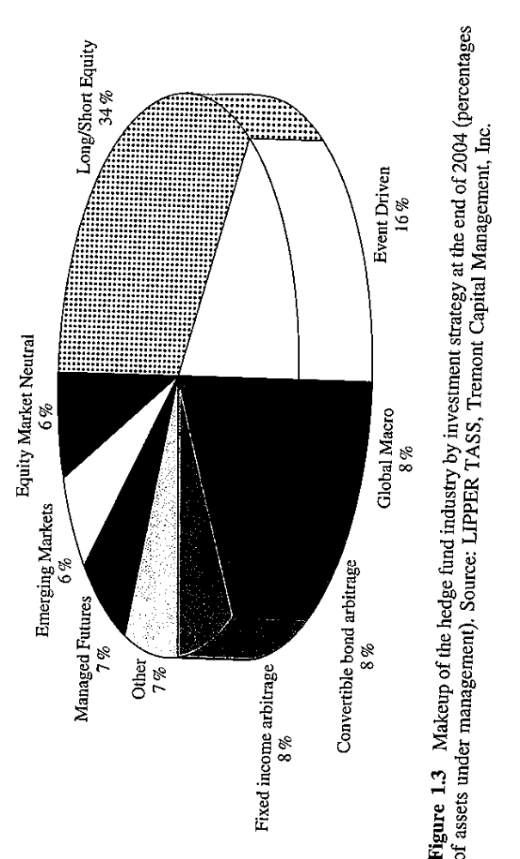

Slide 18
Objective 8.5
Understand the issues of capacity and performance sustainability
Imagine a macro fund staring managing $5billion and generate a 30% return per year for 32 years. At the end of year 32, the amount of capital under management will be approximately $22000billion, which is equal to the current capitalization of US equity markets. The high performance can be sustained only on a relatively small AuM.
Hedge fund managers can only collect their performance fee when the assets value exceeds its historical high. Often, hedge funds are “underwater”, which means the assets value is less then its historical high, hence, the managers cannot collect performance fee.(Figure 1.8)
If a hedge fund suffer a significant loss, the fund may be liquidated if the manage believes it is very hard to recover. The attrition rate (the rate of liquidation) is about 5% per year.

Slide 19
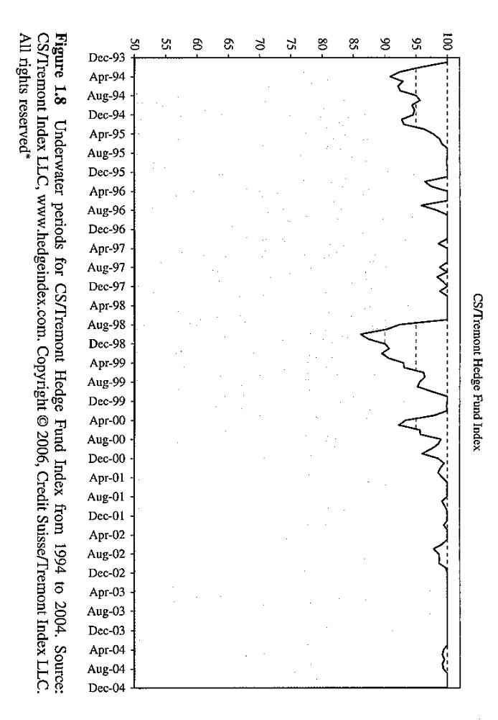

Slide 20
Objective 8.6
Arbitrage and examples
Academic view of arbitrage: arbitrage should have zero risk. For example, buy a stock at a lower price and immediately sell the same stock on another market at a higher price.
Hedge fund arbitrage: it is a directional bet on spreads: if the spread narrows or widens as anticipated, the manager wins; otherwise the manager loses.
A hedge fund may suffer a loss even when it has constructed an arbitrage position!

Slide 21
Objective 8.6
Arbitrage and examples.
In a perfect world, there should be no arbitrage opportunities.
In the real world, an arbitrage opportunity may appear when technical, geographical, legal or administrative barriers prevent a security from having the same price on two different markets.
Arbitrage opportunities tend to disappear quickly because the action done by arbitragers will narrow down the price difference until it disappears.
The greater the number of arbitragers in the market, the higher the competition between arbitragers, the lower the returns that will by realized by the arbitragers.

Slide 22
Objective 8.6
Arbitrage and examples
Arbitrage opportunities generate profits only if they are large enough to offset transaction costs.
Transaction costs are the brokerage fee paid to brokers to buy and sell securities.
If a hedge fund manager can negotiate a lower transaction cost, then an additional profit may be earned.
Normally, the greater the size of the fund, the greater the trading frequency, and the lower the transaction costs that the manager is able to negotiate with the broker. This explains why the largest funds with the highest trading frequency will enjoy more arbitrage opportunities. (Figure 2.1)

Slide 23
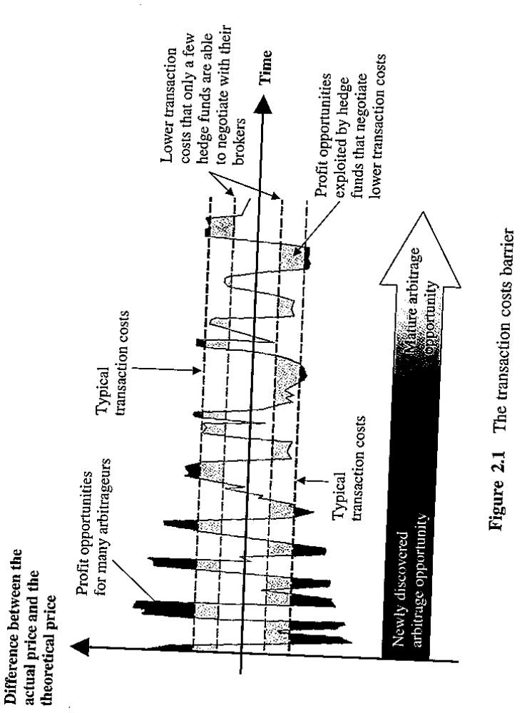

Slide 24
Objective 8.6
Arbitrage and examples
Examples of arbitrage:
  ADR (GDR) arbitrage
  American Depositary Receipt is a certificate issued by a US bank, traded in the U.S. as domestic shares. It represents the number of shares of a foreign company held by the US bank in the country of origin.
  Global Depositary Receipt is a certificate issued by a bank and traded in the same country as the bank of issue as domestic shares. It represents the number of shares of a foreign company held by the bank in the country of origin.

Slide 25
Objective 8.6
Arbitrage and examples
Examples of arbitrage:
  ADR and GDR may trade at a premium or at a discount against its local share prices.
  This is an arbitrage opportunity between the two same shares, traded simultaneously on two different markets.
  Strategy: sell high and buy low.
  Insert Figure 2.2.

Slide 26
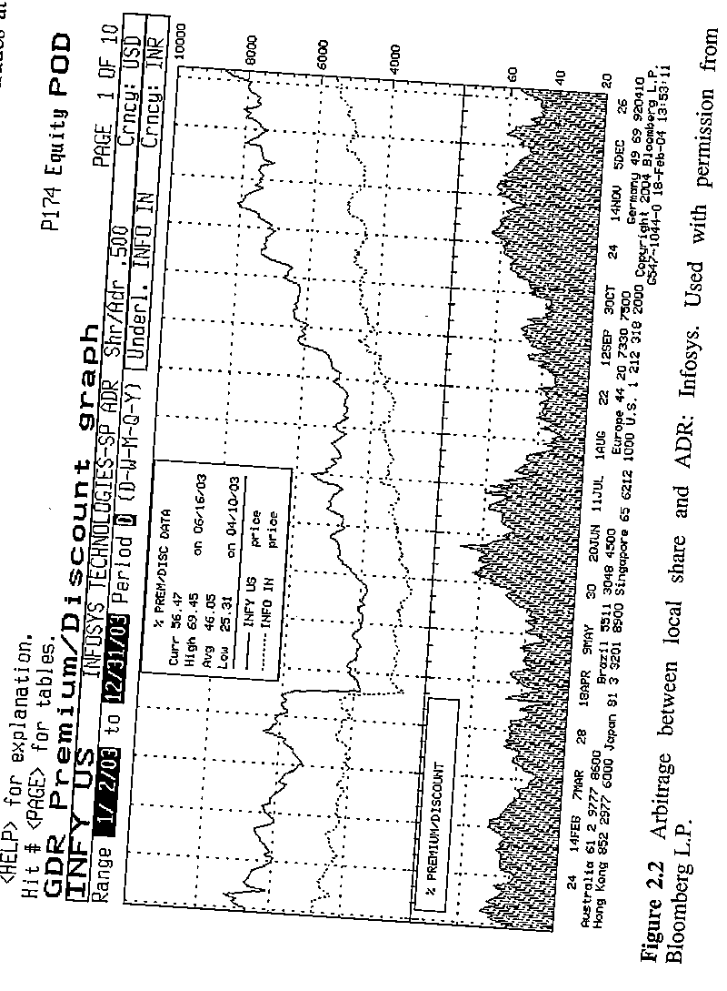

Slide 27
Objective 8.6
Arbitrage and examples
Examples of arbitrage:
  Arbitrage between off-the-run and on-the-run thirty-year treasury bonds.
  The treasury notes issued a few months earlier are said to be off-the-run, whereas the newly issued ones are called on-the-run.
  Since the off-the-run notes are less liquid, they are traded at a slight discount over on-the-run notes.
  An arbitrager will open a convergence position on the spread between the two treasure note. If the spread narrows, the arbitrage will make a profit, otherwise he/she loses. (Insert Figure 2.3)

Slide 28
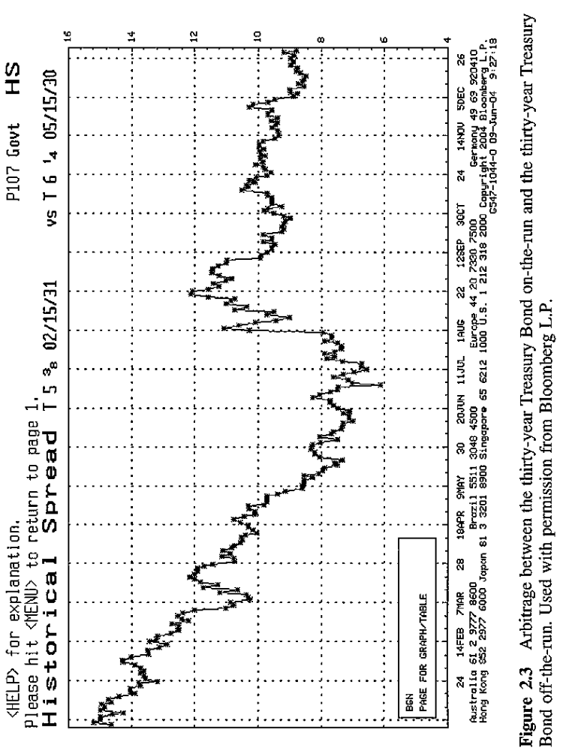

Slide 29
Objective 8.7
short selling strategy and some relevant issues
What is a short selling?
  Short sellers borrow shares and sell them on the market with the idea of buying them back later at a lower price.
Who is the lender and why the lender is willing to lend the shares?
  The lenders are Institutional investors who hold the shares in their portfolio.
  Lending the share can earn an additional lending fee, and annualized return between 1%-5% for compensation.
  The lender can still get the dividends from the borrower if the stock pays dividend during the lending period.
  In addition, the lenders have the right to call in the shares at any time.

Slide 30
Objective 8.7
short selling strategy and some relevant issues
What is a short selling?
  Short sellers borrow shares and sell them on the market with the idea of buying them back later at a lower price.
Who is the lender and why the lender is willing to lend the shares?
  The lenders are Institutional investors who hold the shares in their portfolio.
  Lending the share can earn an additional lending fee, and annualized return between 1%-5% for compensation.
  The lender can still get the dividends from the borrower if the stock pays dividend during the lending period.
  In addition, the lenders have the right to call in the shares at any time.

Slide 31
Objective 8.7
short selling strategy and some relevant issues
The process of a short sell
  The hedge fund borrows a security from a broker.
  The hedge fund sells the security on the open market.
  Under Regulation T, Federal Reserve requires short sellers to deposit 50% of the short sell proceeds in their margin account
  The hedge fund decides to close out the short position by buying back the security on the open market.
  The hedge fund close the margin account.
  Insert Figure 3.1.

Slide 33
Objective 8.7
short selling strategy and some relevant issues
A simple numerical example
  A hedge fund manager short sells 100 shares at $100 per share. He has set up a margin account with his broker.
  $10000 Cash from short sell
  $5000 Additional margin required under Regulation T
  Balance at short sell inception=$15000
  If the share price goes gown to 80, then the balance is as follows:
  $15000-8000(the cost to buyback the shares)=7000.
  The profit is $7000-5000(additional margin put into the account)=$2000.

Slide 34
Objective 8.7
short selling strategy and some relevant issues
A simple numerical example
  Balance are short sell inception=$15000
  If the share price goes up to 120, then the balance is
  $15000-12000=$3000
  The loss is $3000-5000=2000
  NYSE requires a minimum 30% margin, so the manager needs to deposit additional 600 into his account. (3000+600=12000*0.3)
Note the above example ignores the short rebate which is the interest earned on the cash proceeds deposited into the margin account.

Slide 35
Objective 8.7
short selling strategy and some relevant issues
Short interest:
Short interest is the number of shorted shares that have not been bought back yet.
High short interest levels indicates that many sellers have sold short in anticipation of a bearish trend. But many traders believe that a high level of short interest may indicate an impending rise in the share price because the sellers will have to repurchase their shares in the future, which will push the share price up.

Slide 36
Objective 8.7
short selling strategy and some relevant issues
Short interest ratio:
Short interest ratio is the ration between short interest and the average daily volume over a given period (generally 30 days).
Short interest ratio represents the number of days it will take for short sellers on average to repurchase their shares.
A high short interest ratio may indicate it will be difficult for short sellers to cover their positions.
If a good news are announced on a share with a high short interest ratio, it may force the sellers to buy back their shares before the share price goes up further.

Slide 37
Objective 8.7
short selling strategy and some relevant issues
What makes a company a good target for short sell?
  Deteriorating fundamentals and onset of a catalytic event, an event that may have a negative impact on the company in the short term.
  Companies belonging to distressed industries negatively affected by external changes
  Changes in the equity structure
  Companies with inflated share prices characterized by:
    Low cash flows, high P/E ratio, high leverage.
  Companies whose managers lie to the investors, e.g, accounting tricks.
  Companies who are destroying value, e.g. low ROE and high P/E.
  Companies with a high insider selling.

Slide 38
Objective 8.7
short selling strategy and some relevant issues
A example of a successful short selling (Insert Figure 3.4)
  A fund manager recognized the accounting trick made by Enron. Based on the 1999 Form 10K filing, he found that Enron’ ROE was about 7% , while the cost of capital was 9%, which indicated that Enron had been destroying value.
  The manager stated short selling Enron’s shares on Nov 2000 at $79. He also suspected the high amount of insider selling by Enron’s management.
  At the end of 2000, the manager questioned about the Enron’s announcement about its bandwidth capacity trading initiatives in the telecom industries.
  In Spring 2001, some top management left Enron and the CEO resigned in Aug 2001. The hedge fund manager increased his short positions.
  In Dec 2001, Enron filed bankruptcy, when its share price was at $0.6.

Slide 39
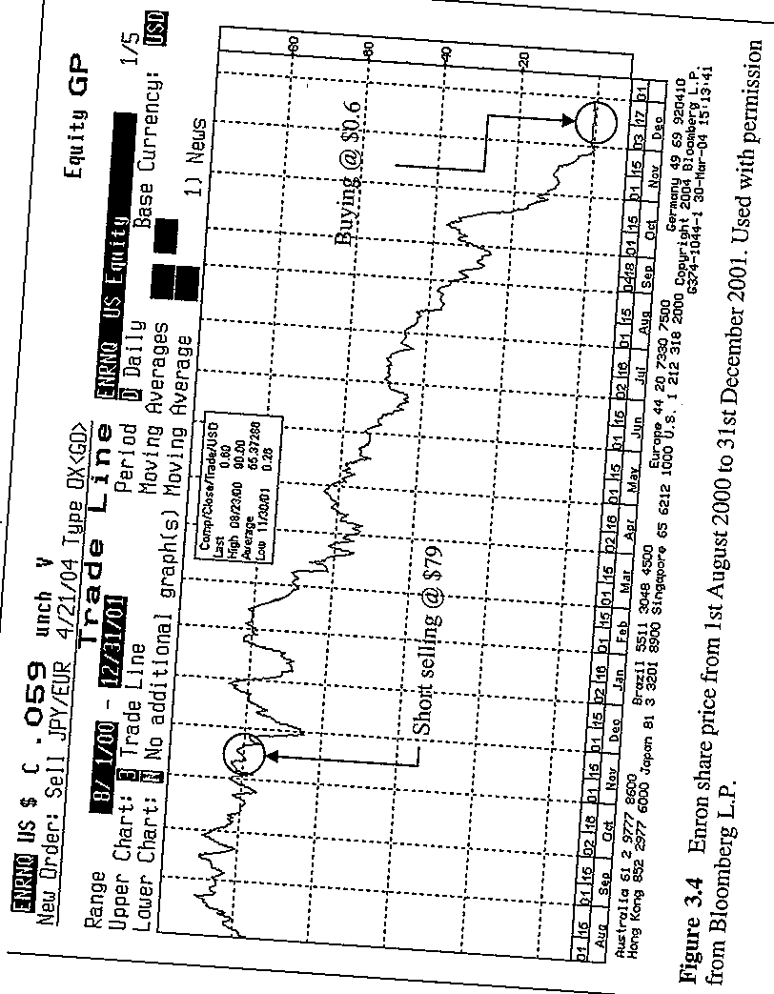

Slide 40
Objective 8.7
short selling strategy and some relevant issues
The risks of short selling
  The downside risk of a short sale is potentially unlimited because a share price can theoretically increase forever. Whereas, the potential profitability of a short sell is limited because a share price can only drop to zero.
The risk of a “short squeeze”
  The lender have the right to call in all the shares at any time.
The risk of a dividend payout
  The short sellers have to pay dividend if the stock pays dividend during the lending period.
The liquidity shortage risk.
  Generally only large-cap firms can be shorted because of a high liquidity. In the case of very severe financial crisis, there may be a lack of liquidity in the market.

Slide 41
Objective 8.7
short selling strategy and some relevant issues
The regulations:
  The open short interest is published monthly by the NYSE and NASDAQ for each listed company
  Short sales are subject to the up-tick rule, which allow short sales only when the price is $0.01 higher than the best bid quote.
  Regulation T requires a deposit of 50% margin of the value of the shorted securities.
  Many institutional investors, such as mutual funds and pension funds, cannot short sell.

Slide 42
8.8 Understand the contrarian indicators
“Often the best bargains are reached by buying when everybody else wants to sell or selling when everybody else wants to buy…..Humans, by their very nature, tend to feel a greater level of fear following a dreadful event, and a greater sense of optimism after a pleasant event”
The rule-of-thumb of the art of contrary thinking is that in times of market turning points most investors take the wrong move.

Slide 43
8.8 Understand the contrarian indicators
Percentage of shares in balanced mutual funds: when the percentage hits the ceiling, optimism on the market is also flying high;
Percentage of capital allocated on equity funds compared to fixed income funds on the global mutual market: when this percentage is at the top, optimism on the market is also at its peak.
Oversold and overbought indicators that can point to trend reversals;

Slide 44
8.8 Understand the contrarian indicators
Market consensus surveys: when optimism is at the top, it may signify that a trend reversal is about to occur;
Short interest: when this indicator shows high levels it points at a deeply negative market sentiment, yet also a future demand for stock to close out short sells;
Put/call ratio: This indicator is the ratio of trading volume in index and equity put options to the trading volume in index and equity call options. A high ratio (put/call>1.0) points at a very negative market sentiment whereas a low ratio (put/call <0.4) points to an excessive optimism. When investors nurture positive expectations, they buy more call options than put options.

Slide 45
8.8 Understand the contrarian indicators
8.8 Understand the contrarian indicators
Contrarian indicators are most useful when they hit extreme values, but they say nothing of the timing of the trend reversal. It is not a scientific theory bur it can turn people’s attention to market hypes. Being a contrarian on the market is inevitable going to be extremely uncomfortable and it takes courage and high stress tolerance.
The investors who have a long position in shorted companies is an obstacle to the short seller’s work. The investors and the CEO may repeat that the short sellers are wrong.

Slide 46
8.9 Understand the historical performance of the short selling strategy
The performance of the hedge funds specialized in short selling is historically the worst among all the other hedge fund strategies, with an annualized return of -3.6% between 1994 and 2004.
The volatility of monthly returns is higher than the selected equity and fixed income benchmark.
The percentage of positive months is very low. The largest drawdown is -46.5% and lasts very long (more than 76 months). Between 1994 and 2004 this type of hedge funds are often “under the water”.
Insert Table 3.1 here.

Slide 47
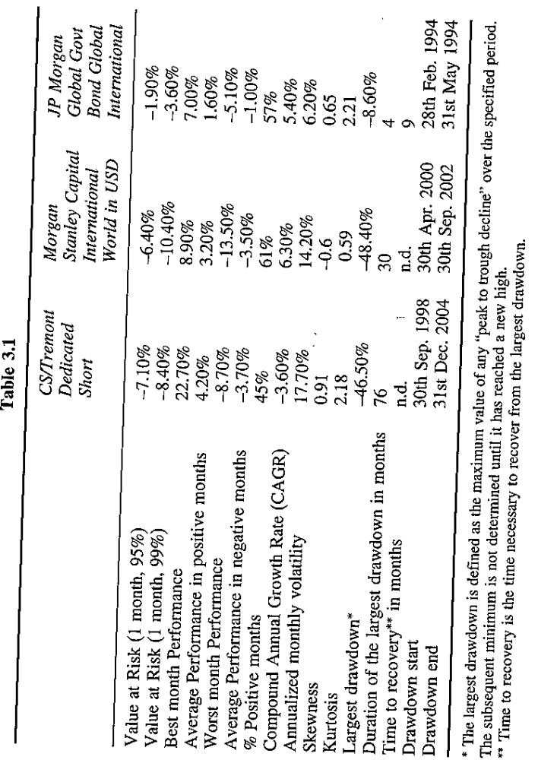

Slide 48
ALTERNATIVE SECURITIES
Who charges more: hedge funds or mutual funds

Slide 49
Mark Kritzman (2008), Who charges more: hedge funds or mutual funds, Applied corporate finance, 20:1, 121-123.

Slide 50
What is the conclusion of this article?
How does the author get the conclusion?
What is the hedge fund strategy described in this article?
What is the strategy of 90/10 mix of index fund and hedge fund?
How does the author calculates alpha, cumulative return, information ratio, standard deviation and strategy fees?
Find a mistake (s) in this article.

