Slide 1
ALTERNATIVE SECURITIES
Topic 9: Long/Short equity and fixed- income arbitrage

Slide 2
Student learning objectives
9.1 Describe the main characteristics of Long/Short equity strategy
9.2 Understand the market exposure of Long/Short equity strategy
9.3 Identify different management styles of Long/Short equity strategy
9.4 Describe main Long/Short equity strategies.
9.5 Describe historical performance for long/short equity fund.
9.6 Describe historical performance for market neutral equity fund.
9.7 Understand the various strategies of fixed-income arbitrage.
9.8 Describe historical performance for fixed-income arbitrage.

Slide 3
References
Stefanini, F. (2006). Investment strategies of hedge funds. John Wiley & Sons Inc. England. Chapter 4&7.

Slide 4
Objective 9.1
Describe the main characteristics of Long/Short equity strategy
Buy the undervalued shares and short sell the overvalued shares (or sell the equity index derivatives). A manager uses his/her investment skills to justify whether a stock is undervalued or overvalued.
A Long/Short hedge fund manager uses the same fundamental, technical and statistical method employed by traditional mutual fund managers. However, a mutual fund manager cannot short sell and usually cannot use leverage as well. The hedge fund manager’s performance fee is also different from that of mutual fund.
A long/short hedge fund manager focuses on absolute returns rather than a relative return to a benchmark.

Slide 5
Objective 9.1
Describe the main characteristics of Long/Short equity strategy
Long/short equity managers make money when long positions go up and short positions go down. If the reverse occurs, they lose money.
A short position provides a negative exposure to overvalued securities and reduce the portfolio’s market exposure by hedging the systematic risk.
Long/Short equity funds represent about 1/3 of the whole sector.

Slide 6
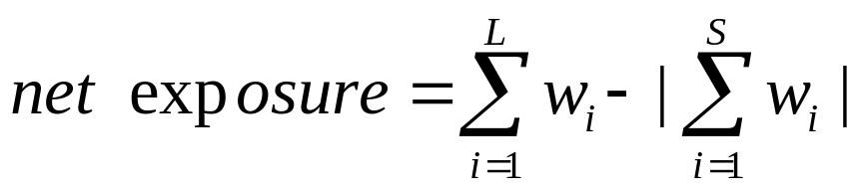
Objective 9.2
Understand the market exposure of Long/Short equity strategy
The net market exposure equals the sum of the weights (the percentage of the fund’s net asset value) of the long positions less the absolute value of the sum of the weights of short positions.
A zero net market exposure doesn’t mean the fund is hedged. On the contrary, the fund might lose money on both the long and the short positions.

Slide 7
Objective 9.2
Understand the market exposure of Long/Short equity strategy
Generally, the net market exposure is positive (long bias) . As a result, the performance of long/short equity hedge funds tends to show a positive correlation to the performance of the reference equity markets. When markets are bearish, these types of funds generally tend to be negatively correlated with the market, and yet outperform the markets due to its profit from short positions.
If a manager is short bias, in a bullish market, the hedge fund will under-perform the market and investors probably demand a redemption.

Slide 8
Objective 9.2
Understand the market exposure of Long/Short equity strategy
An ideal hedge fund (long bias) should be able to earn two thirds of the market return when the market performs well and lose only one thirds of the market loss when the market perform bad.
In the long-term, it is more important to preserve the capital during bear markets than to participate completely in bull markets.
Insert figure 4.1

Slide 9
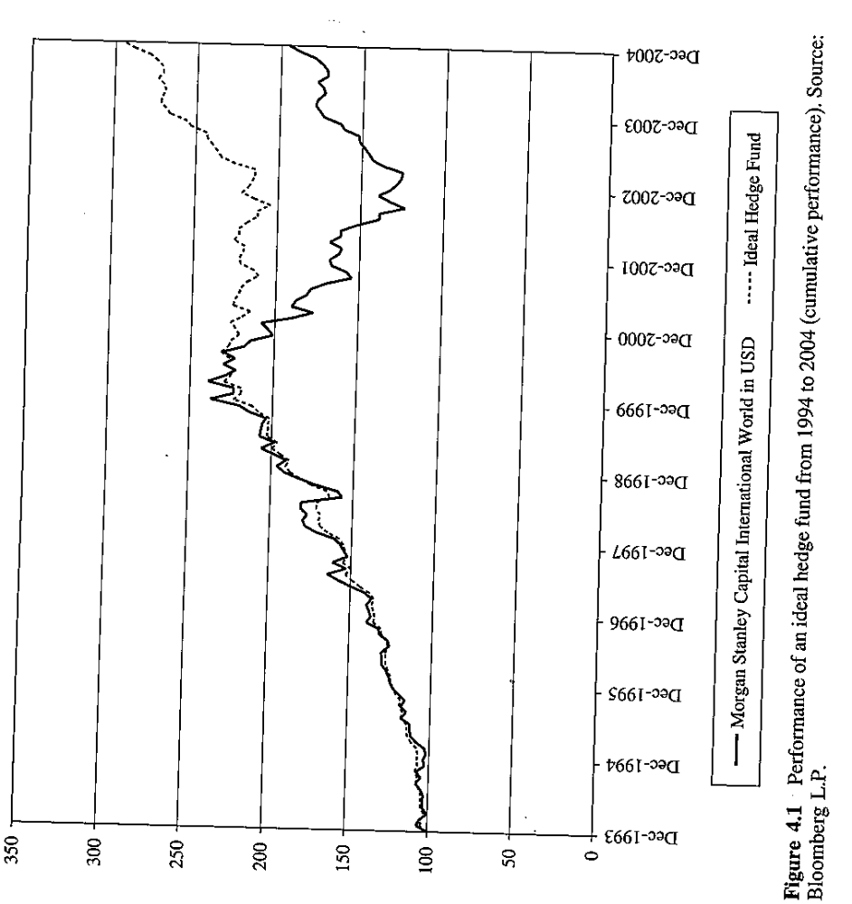

Slide 10

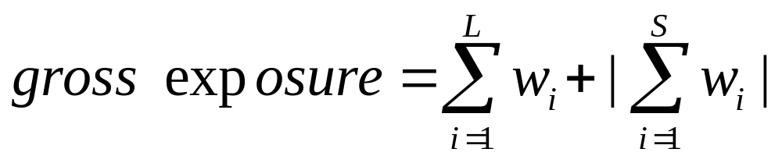
Objective 9.2
Understand the market exposure of Long/Short equity strategy
The gross market exposure equals the sum of the weights of long positions plus the absolute value of the sum of the weights of short positions.

Slide 11
Objective 9.2
Understand the market exposure of Long/Short equity strategy
A hedge fund manager has a long position of 80% of the fund’s net assets and short position of 40% of the fund’s net assets. This means that the net market exposure is positive 40% and that the gross market exposure 120%! (Inset figure 4.2)
The hedge fund managers actually uses leverage.
Typically, the maximum leverage used by a long/short equity manager is 200% of their capital (up to100% long and 100% short)

Slide 12
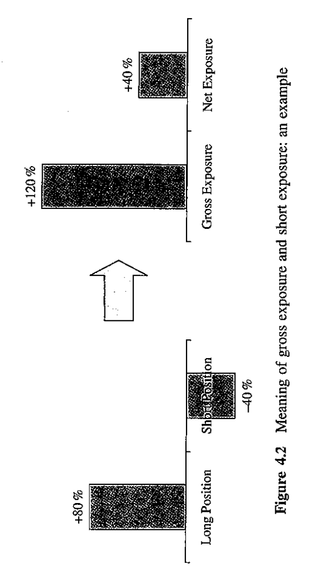

Slide 13
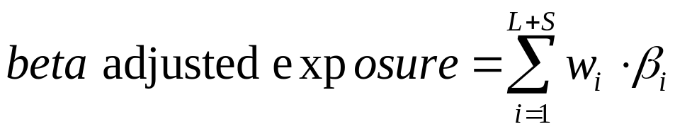
Objective 9.2
Understand the market exposure of Long/Short equity strategy
A weakness of the measurement of net market exposure is that it ignores the individual position’s (long or short) sensitivity to market changes by giving equal weight to all positions.
It is necessary to uses beta adjusted net market exposure to analyze a portfolio’s exposure to systematic risk.

Slide 14
Objective 9.2
Understand the market exposure of Long/Short equity strategy
Using the previous example and assuming the beta of the long position is 0.5 and the beta of the short position is 1.5, the beta adjusted net exposure equals to
80%*0.5-40%*1.5=-0.2
Although the portfolio has a net long market exposure, the portfolio actually has a negative sensitivity to the market changes.

Slide 15
Objective 9.2
Understand the market exposure of Long/Short equity strategy
In addition, a manager needs to monitor two important factors:
  The beta adjusted exposure of each single sector comprising the portfolio.
  The portfolio's liquidity measured by the average number of days necessary to liquidate a portfolio without affecting the stock price.
The weights of long and short positions are dynamic due to the market change, hence it is important for a manager to actively monitor the next exposure and do a possible rebalancing based on the target net exposure.

Slide 16
Objective 9.3
Identify different management styles of Long/Short equity strategy
Net long or net short
  Hedge funds usually have a net long exposure and rarely have a net short exposure.
Bottom-up, top down or stereoscopic
  Bottom-up: the manager closely examines the fundamentals of individual companies and selects the stocks to buy or sell based on his/her analysis.
  Top down: the manager constructs his/her positions based on macro-economic view, deciding the geographical and sector allocation first, and then select stocks.
  Stereoscopic: the manager combines the above tow approaches.

Slide 17
Objective 9.3
Identify different management styles of Long/Short equity strategy
Value or growth
  Value managers seek to identify companies whose intrinsic value has not been appreciated by the market.
  Company trade under the sum-of-the-parts evaluation
  Companies trade at discounted market multiples compared to peer companies. E.g.., low relative P/E, EV/EBITDA.
  Director dealing, deals in their company’s shares by top management is a widely used indicator for selecting an undervalued company. The management will buy their shares only when the shares are undervalued!
  Sometimes, market is in favor of “value stocks”, sometimes market is in favor of “growth stocks” (insert figure 4.3)

Slide 18
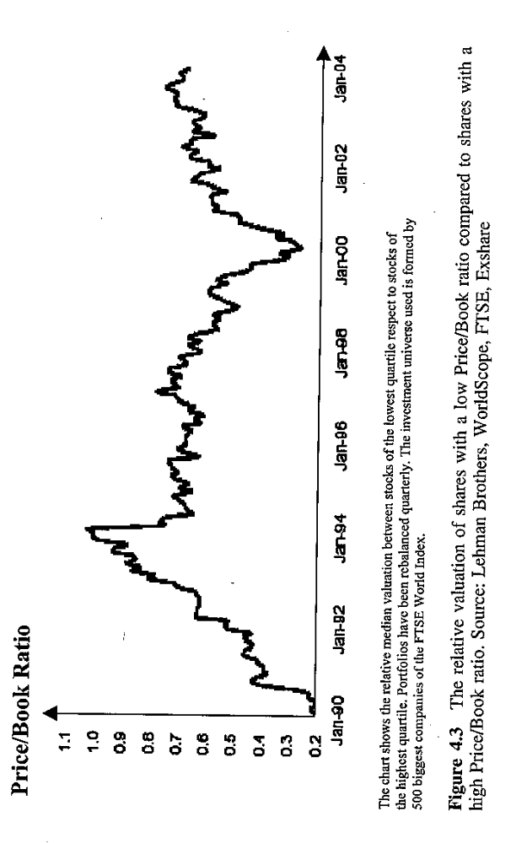

Slide 19
Objective 9.3
Identify different management styles of Long/Short equity strategy
Large cap or small cap
  Small caps are defined on the US market as shares with market capitalization below $1billion. There are about 5000 small caps in the US. These firms typically have a low liquidity.
  A S&P 500 company typically is covered by 14 analysts, while a Russell 2000 company (market capitalization below $500million) is only covered by 3 analysts.
  Typically, a long/short equity manager has a larger cap bias.
  Sometimes, market is in favor of “small caps”, sometimes market is in favor of “large caps” (insert figure 4.4)

Slide 20
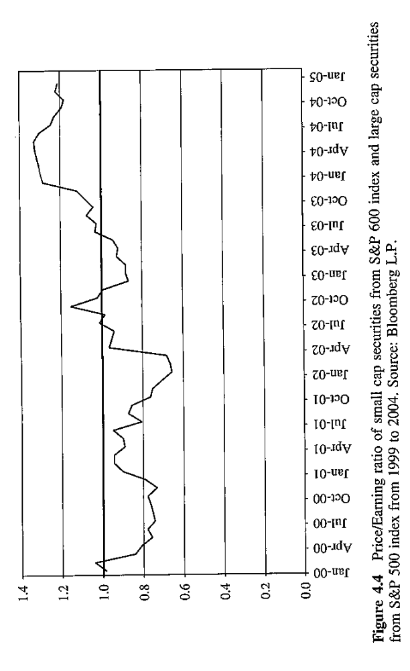

Slide 21
Objective 9.3
Identify different management styles of Long/Short equity strategy
Short-term oriented or long-term oriented
Diversified or concentrated
  Hedge fund managers are heterogeneous in terms of the degree of diversification. Some hedge funds hold 30-40 securities, some hold 200-300 securities.
Momentum or contrarian
  Momentum managers seek to make a profit from a performance persistence effect- industries that have outperformed will continue to win.
  Contrarian managers seek to make a profit from a trend reversal.
Market generalists or industry specialists.

Slide 22
Objective 9.4
Describe some Long/Short equity strategies.
Specialized Long/Short equity funds
  Long/short technology-media-telecommunication (TMT)
    There are few winners and many losers in this sector.
    Product cycles are more important than economic cycles.
    Technology stocks are generally volatile.
  Managers seek to spot the winners and losers when there are emerging new technologies. (E.g., 3G, LCD, GPS, NANOTECH)

Slide 23
Objective 9.4
Describe some Long/Short equity strategies.
Specialized Long/Short equity funds
  Long/short equity biotech
    For example, oncology, stem cells, cardiovascular diseases, inflammatory diseases, infectious diseases and biomedical equipment.
    The approval or rejection of a drug by FDA (Food and Drug Association) has a big impact on the price of manufacturing companies.
    Big pharmaceutical companies tend to buy small and successful biotech companies that are going to develop new drugs.
    Assessing the treatment efficiency of the drugs is very important in valuing the manufacturing companies.
  Hedge funds seek to assess the potentials of the new drugs and treatments so as to correctly predict the changes in the manufacturing companies’ value.

Slide 24
Objective 9.4
Describe some Long/Short equity strategies.
Specialized Long/Short equity funds
  Long/short equity gold
  The manager takes long or short positions when gold or precious metals exceed the threshold beyond which they are not supported by fundamentals. Commodities are another choice of investment in this strategy.
  Long/short equity on emerging markets
  China, India, Brazil, Russia, etc. Growth will depend on numerous factors: political stability, reforms, the construction of infrastructure, foreign trade and investment, pubic debt, exchange rates, and interest rate, etc.,

Slide 25
Objective 9.4
Describe some Long/Short equity strategies.
Straight long: A example
  British Land Company is a real estate company specializing in commercial property in the UK.
  A hedge fund manager bought shares of BLC based on the following fundamental analysis:
    The commercial real estate industry was outperforming the bond market.
    The property portfolio is of high quality (high quality tenants)
    The share price was at a discount of 30% to shareholder’s equity.
  The share price went up by 20%.

Slide 26
Objective 9.4
Describe some Long/Short equity strategies.
Straight short: A example
  There is strong empirical evidence suggesting that companies that make large acquisitions relative to their market capitalizations outside their domestics markets are unlikely to reach their profit targets set by the management.
  Scottish Power is a company that produces and sells electric power in the UK and has been diversifying its production outside the UK. In 1999, it acquired PacifiCorp in the USA.
  The fundamental analysis based on adjusted cash flows to account for lower returns form the US market showed that the share price of Scottish was overvalued.
  The short sale was executed at 436. The manager closed his positions at 393 in less than one month.

Slide 27
Objective 9.4
Describe some Long/Short equity strategies.
Share class arbitrage
  Common stock, preferred stock, and saving stock.
    Common stock has voting right but has no privilege on dividend or capital distribution in case of liquidation.
    Preferred stock has limited voting power but has privilege on dividend or capital distribution in case of liquidation.
    Saving stock has no voting right but it enjoys capital privilege over common stock. Saving stock has a minimum annual dividend and a minimum difference on the dividend of common stock in case of liquidation.

Slide 28
Objective 9.4
Describe some Long/Short equity strategies.
Share class arbitrage
  As a result of market forces and in particular corporate events, these three share classes may be traded at prices that deviate their fundamental values. Hence, a hedge fund manager can take long positions on those overvalued shares and short positions on those undervalued shares.

Slide 29
Objective 9.4
Describe some Long/Short equity strategies.
Pairs trading
  Pairs trading is a relative value strategy created by matching a long position on a stock with a short position on another stock belonging to the same industry.
  If the two positions have the same size, the position will have a zero net exposure. Otherwise, it will be a long or short net exposure.
  An example for this strategy: Long Wal-Mart, Short Alberston. Both are in retail business. The investment assumption made is that Wal-Mart has a relative advantage over Alberston in terms of economies of scale. The competitive pressure will decrease Alberston’s margin.

Slide 30
Objective 9.4
Describe some Long/Short equity strategies.
Pairs trading
  In Jan 1, 2003, Puchase of $1200 worth of Wal-Mart shares and
  short sell of $1000 worth of Alberston’s shares.
  In July 31, 2003, the long position went up by +8.4%, generating a $100 profit. The short position went down by -19.9%, generating a $199 profit. (Insert figure 4.9)
  The profit or loss of a pairs trading depends on the relative strengths of the two shares and not on their absolute performance. The return source is less dependent on the market risk, but more dependent on the manager’s skills.

Slide 31
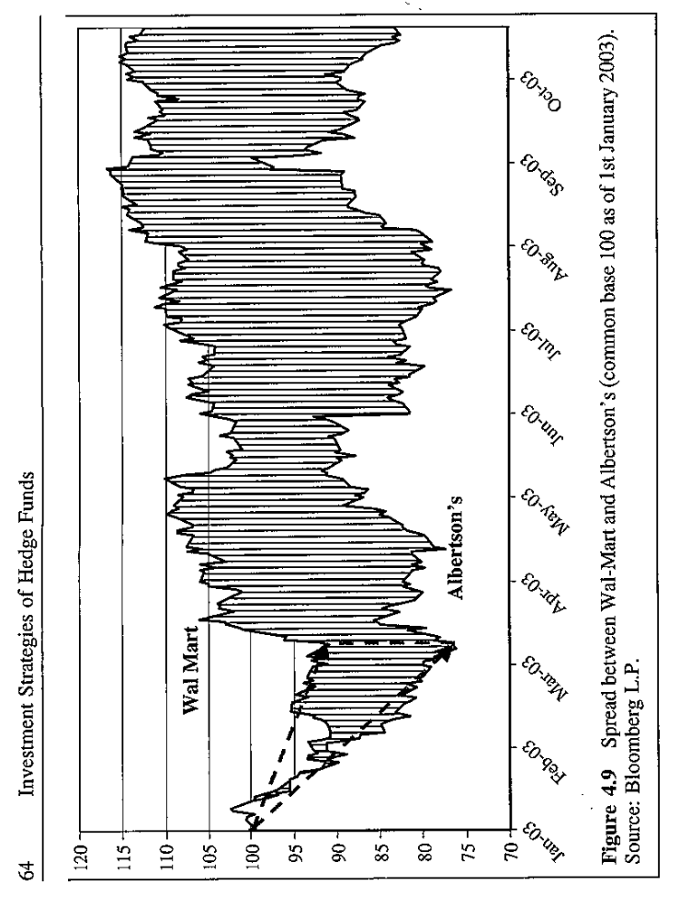

Slide 32
Objective 9.4
Describe some Long/Short equity strategies.
Covered call and covered put options sale
  Sale of “out-of-the-money” call options.
  Example: A manager buys Microsoft at $25 and expects the share price goes up to $30. The manager also sells a European call option whose exercise price is $30 and receives the option premium. (the exercise price is higher than the current market price, so it is an out-of-the-money call option).
  What happens at the maturity date of the option?

Slide 33
Objective 9.4
Describe some Long/Short equity strategies.
Covered call and covered put options sale
  If share price is greater than 30, the buyer of the call option will exercise the right to buy the shares at $30 and the manager has to deliver the shares to the buyer. The manager will lose any gain above $30, but still achieves the goal of selling at $30.
  If the share price is equal to 30. the buyer will be neutral. So the manager can sell the share at $30 on the market or to the buyer if the buyer wants to exercise the call.
  If the share price is less than 30, the call will not be exercised. The manager has earned the premium and thus improves the performance.

Slide 34
Objective 9.4
Describe some Long/Short equity strategies.
Covered call and covered put options sale
  Sale of “out-of-the-money” put options.
  Example: A manager short sells Intel at $24 and expects the share price goes down to $20. The manager also sells a European put option whose exercise price is $20 and receives the option premium. (the exercise price is lower than the current market price, so it is an out-of-the-money put option).
  What happens at the maturity date of the option?

Slide 35
Objective 9.4
Describe some Long/Short equity strategies.
Covered call and covered put options sale
  If share price is less than 20, the buyer of the put option will exercise the right to sell the shares at $20 and the manager has to buy the shares. The manager will lose any gain below $20, but still achieves the goal of selling at $20.
  If the share price is equal to 20. the buyer will be neutral. So the manager can buy the share at $20 on the market or from the buyer if the buyer wants to exercise the put.
  If the share price is greater than 20, the call will not be exercised. The manager has earned the premium and thus improves the performance.

Slide 36
Objective 9.4
Describe some Long/Short equity strategies.
Equity market neutral
  Equity market neutral strategy is a variation of long/short equity strategy. Its performance is not correlated to market movements. Hence, equity market neutral funds and long/short equity funds differ in the level of their systematic risk.
  During market uptrend, if the long positions rises more than the losses by short positions, the market neutral funds make a profit and vice versa.
  Equity market neutral funds seek a zero bet adjusted net exposure.
  Normally Equity market neutral funds hold a very diversified portfolio (more than 100 equities)
  But it still cannot eliminate the sector-specific or country-specific risks.

Slide 37
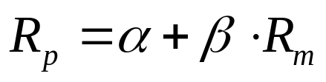
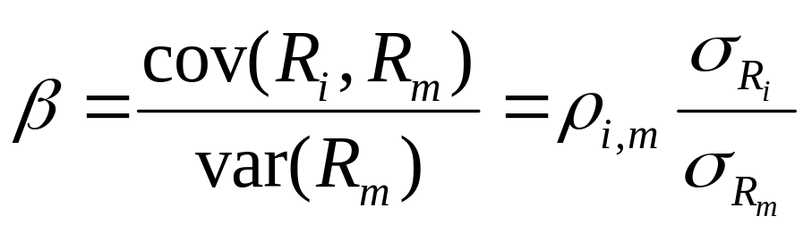
Objective 9.4
Describe some Long/Short equity strategies.
Equity market neutral
  However, does a zero beta fund guarantee its market-neutral property?

Slide 38
Objective 9.4
Describe some Long/Short equity strategies.
Equity market neutral
  Beta is equal to the correlation between the portfolio and market times a scale factor which is equal to the ratio between the portfolio risk and market risk.
  Even if beta can be very close to zero, it still cannot guarantee
  a very low correlation between the portfolio and the market.
  In fact, it is impossible to keep the beta always down to zero as the changes of the value of stocks change the weights. One need to immediately adjust the weights to keep the beta close to zero. Often, the transaction cost will stop the manager from doing so.

Slide 39
Objective 9.5
Describe historical performance for long/short equity fund.
Historically, the CS/Tremont Long/short equity index had an annualized rate of return 12.2% with a monthly annualized volatility of 10.6%. (1994-2004). The percentage of positive months is 67%.
Insert table 4.1.
The largest drawdown is -15% and lasted for more than two years.
Insert figure 4.12.

Slide 40
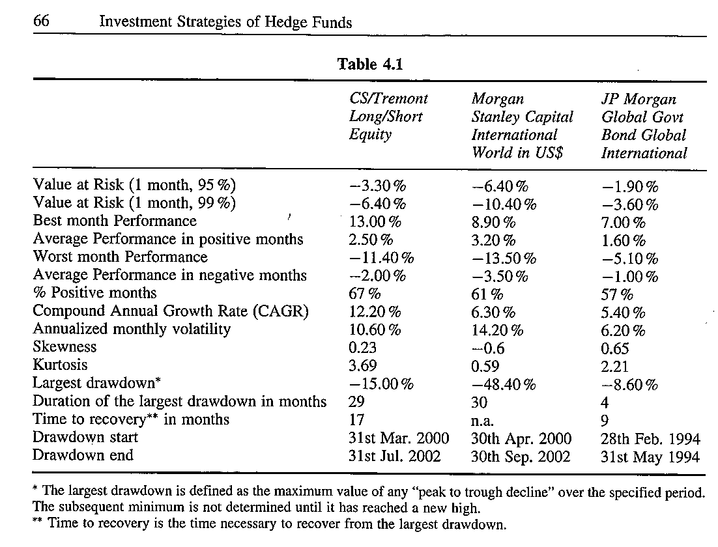

Slide 41
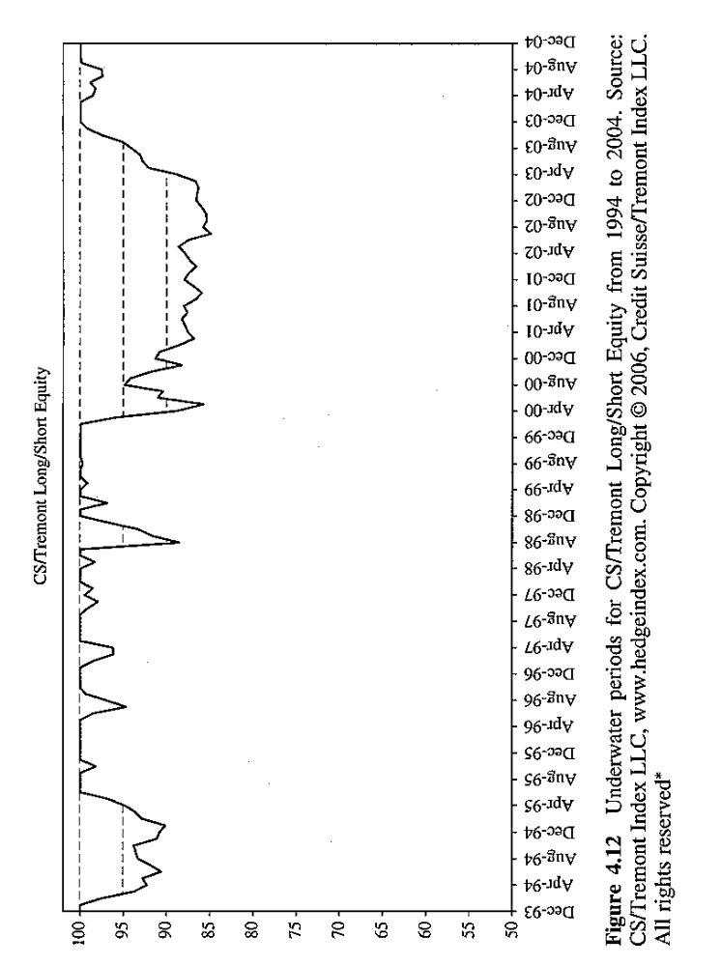

Slide 42
Objective 9.6
Describe historical performance for market neutral equity fund
Equity market neutral accounts for 6% of the hedge fund industry.
Historically, the CS/Tremont equity market neutral index had an annualized rate of return 10.3% with a monthly annualized volatility of 3%. (1994-2004) .The percentage of positive months is 84%.
Insert table 4.2.
The largest drawdown is -3.6% and lasted for five months.
Insert figure 4.15.

Slide 43
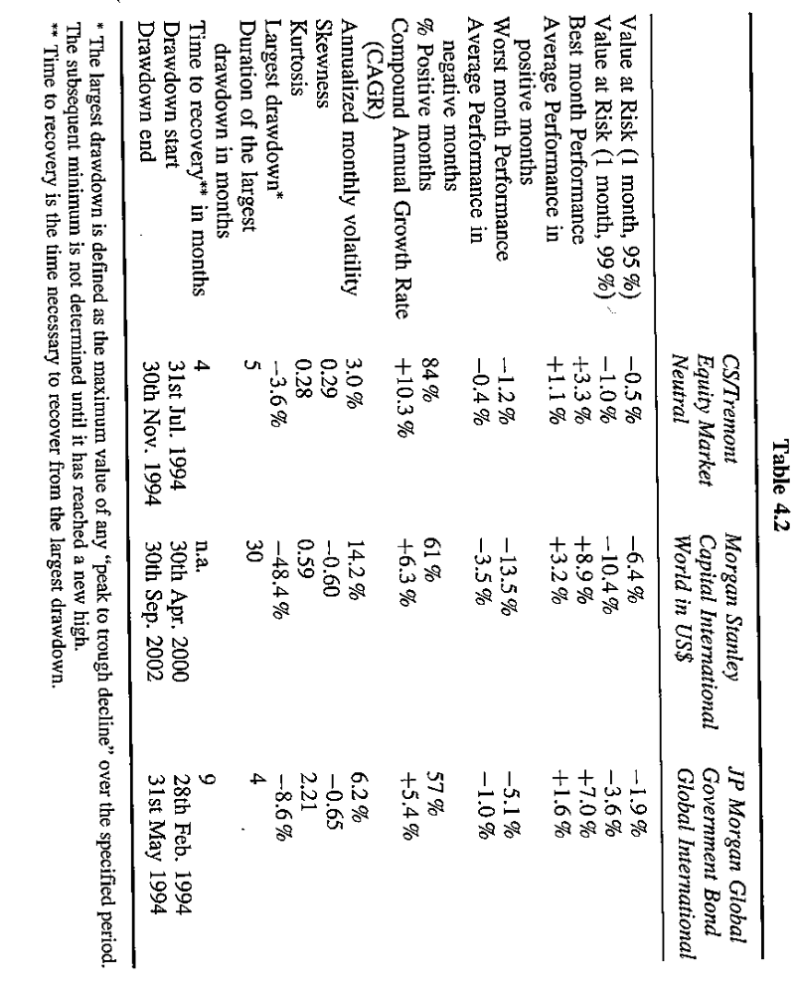

Slide 44
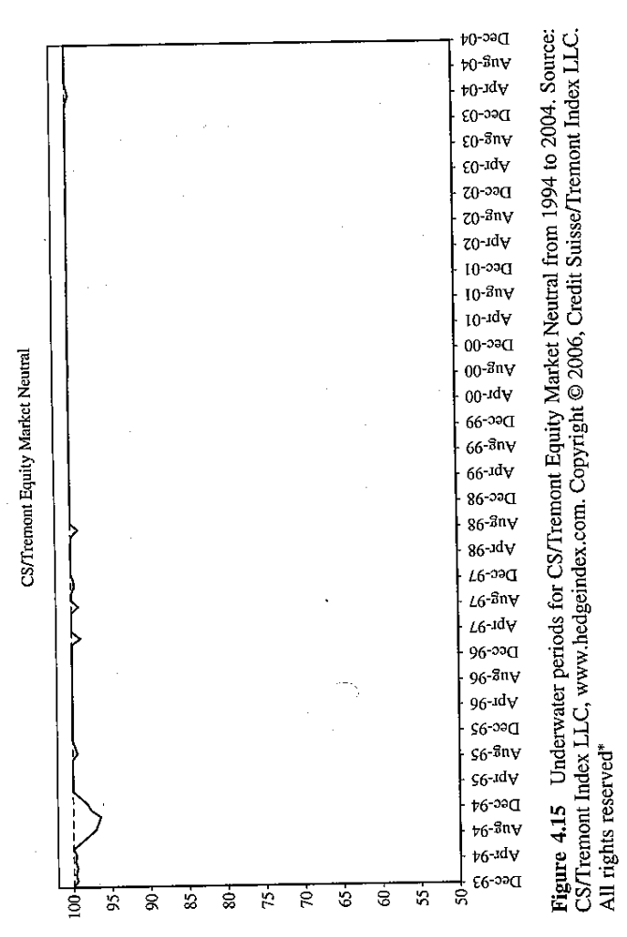

Slide 45
Fixed-income arbitrage
Fixed-income arbitrageurs take long and short positions seeking to take advantage of temporary mismatches between related securities. The arbitrageurs seek to seize the opportunities arising from minor misprices while being hedged against an interest rate change risk.
The fixed income market is segmented because large institutional investors, such as pension funds, insurance companies and central banks, generally have different investment objectives and constraints. Hedge fund managers try to exploit the segmentation effects in fixed-income markets around the world.

Slide 46
Fixed income arbitrage
In general, the misprices are very small, fixed income arbitragers use leverage. The arbitrager who is taking the short position on a bond must pay the coupons to the lender of the bond. This means that a bond short sale has a negative carry, the more the fund manager keeps the position open, the more he loses.
The arbitragers profit from the complexity of the valuation of fixed-income securities and from their ability to analyze factors affecting the prices of these securities. They typically use sophisticated analytical models run by powerful computers to indentify existing misprices on the market.

Slide 47
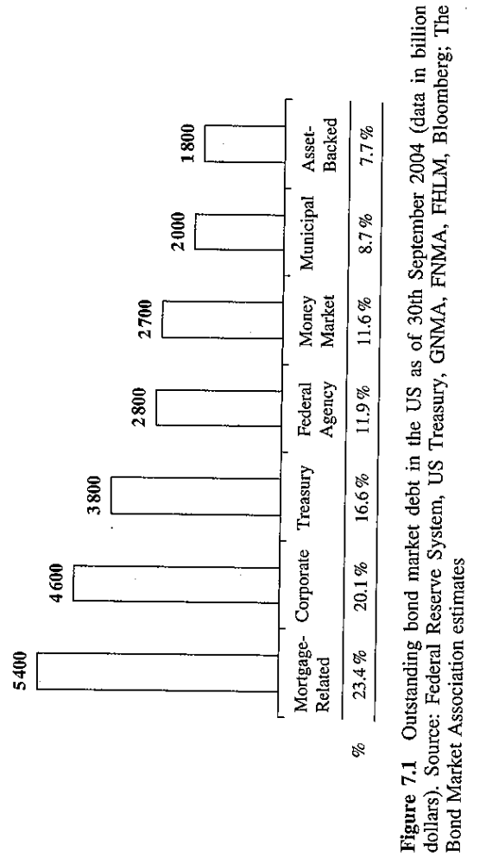
The outstanding bond market

Slide 48
Average daily trading volume

Slide 49
Issuance driven arbitrage or snap trade:
  The performance of trades on securities with close maturity dates depends on factors associated with the issuance cycles. These arbitragers seek to profit from distortions in the yield curve rather than from the slope of the curve.
  A classical example of this arbitrage is the arbitrage between 30-year off-the-run and on-the-run Treasury bonds.
Yield curve arbitrage
  A yield curve arbitrage is an arbitrage whereby the trader takes long and short positions on different points of the yield curve of the treasuries of a given country so as to profit from treasuries misprices along those different points.
  Intra-curve: the fund manager trades securities of the same country within one yield curve.
  Inter-curve: the fund manager trades securities issued by different countries, i.e., between two yield curves of different currencies.

Slide 50
yield curve arbitrage
There are three intra-curve arbitrages:
  Yield curve flattener- short the bonds that are closer to expiration and long the bonds with a longer expiration.
  Yield curve steepener-long the bonds that are closer to expiration and short the bonds with a longer expiration.
  Yield curve butterfly- When the yield curve displays a trough, the arbitrage will require to go long the bonds whose expirations lie on the butterfly’s wings and short the bond in the butterfly’s body. If the yield curve displays a hump, the arbitrage will require go short the bonds with maturity dates on the wings of the butterfly and long the bond on the body of the butterfly.

Slide 51
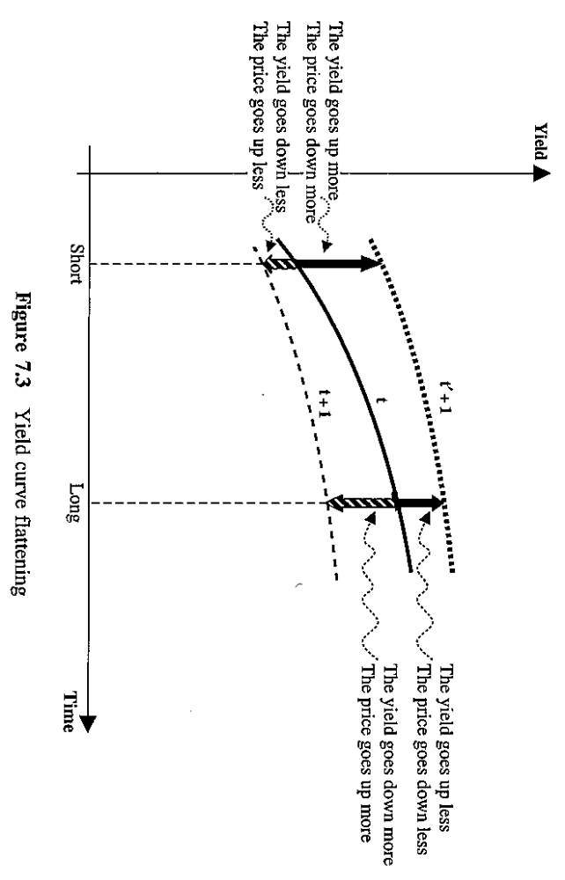

Slide 53
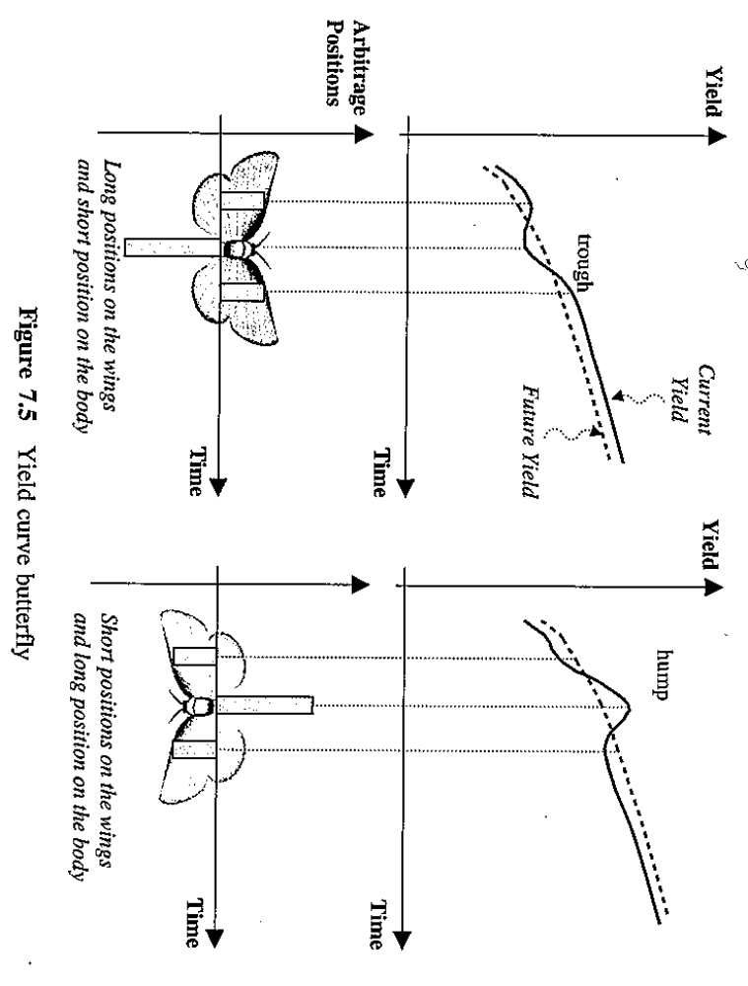

Slide 54
yield curve arbitrage
The flattening or steepening of the yield curve depends on macroeconomic factors, like inflation, GDP growth and the monetary policy pursued by central banks. These are directional positions that express the fund manager’s macroeconomics view.
Through the arbitrage positions, the fund manager makes a forecast as to the shape of the yield curve and not a forecast on interest levels.

Slide 55
Intermarket spread trading:
  The intermarket spread trading is an inter-curve yield curve arbitrage where the fund manager traders securities of different governments.
Capital structure arbitrage:
  The capital structure arbitrage strategy seeks to capture price differentials between the various components of the capital structure of a single issuer.
  A hedge fund manager can invest simultaneously on all the securities of a company (bonds, convertibles, shares, preferred shares, senior debt and mezzanine or subordinate debt).
  The strategy is based on the relative value of the two securities, which allows the fund manager to hedge against the systematic market risk.

Slide 56
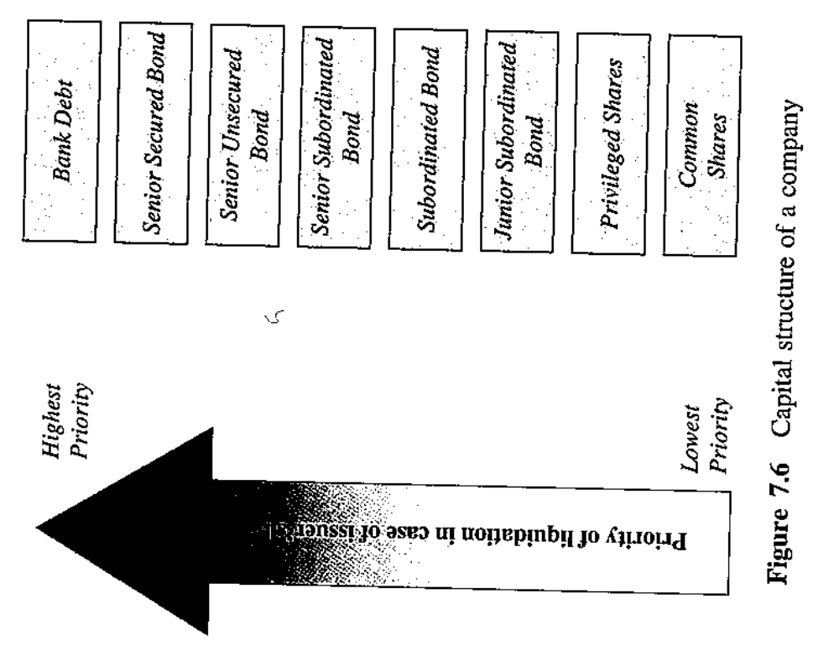

Slide 57
Carry trade:
  A carry trade consists in buying with yield higher than the cost of money borrowed to purchase them.
  Intra-curve: borrowing at the 3-month rate to purchase 10-year bonds.
  Inter-curve: borrowing in dollars in the U.S. and purchasing Turkish Treasuries in Turkish Liras.
  Carry trade is favored by a low cost of capital, when it is easy to obtain funds at a good interest rate.
Break-even inflation trades:
  It is a directional position on a macroeconomic variable-inflation.
  If the hedge fund manager believes that inflation will rise (fall), he/she will buy (short seel) TIPS (Treasury Inflation Protection Securities) ands sell (buy) the traditional treasuries short.

Slide 58
Cross-currency relative value trade:
  A directional bet on the spread of the credit spread between the two bonds, with different currencies denominated, of the same company.
Strategy’s historical performance analysis

Slide 59
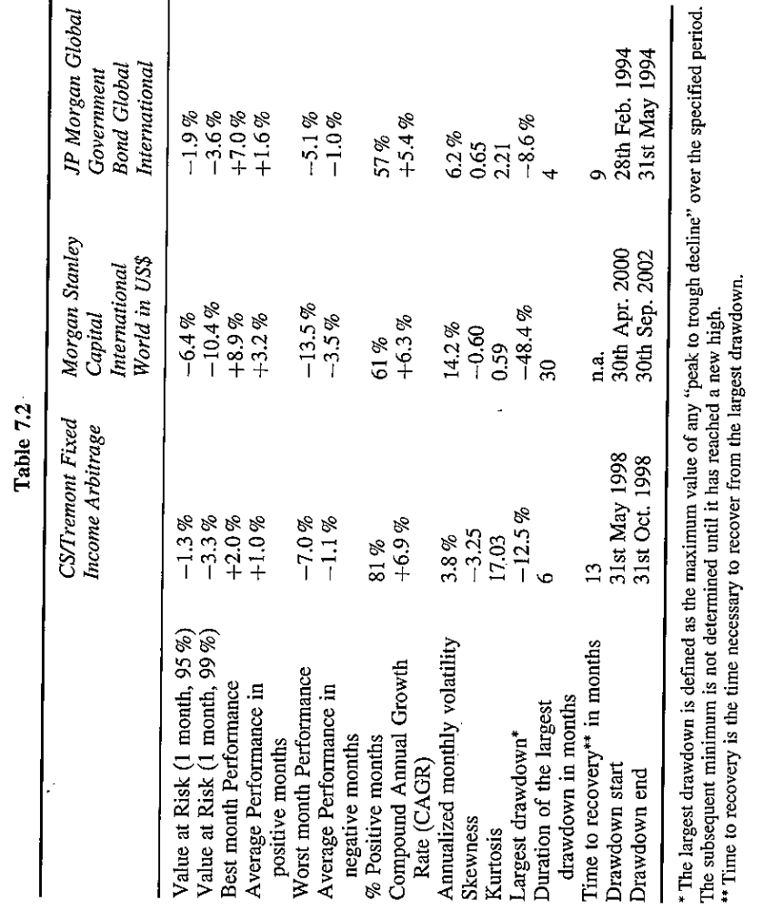

Slide 60
