Slide 1
ALTERNATIVE SECURITIES
Topic 4: Introduction to mezzanine debt
Notes:
Alternative Securities
Introduction to mezzanine debt
These slides have been drafted by the La Trobe University, School of Economics and Finance based on Anson (2006).

Slide 2
Student learning objectives
4.1 Describe three general purposes of mezzanine financing.
4.2 Compare mezzanine funds to venture capital funds.
4.3 Identify advantages of mezzanine debt to the investor.
4.4 Identify advantages of mezzanine debt to the borrower.
4.5 Describe restrictions on the senior creditor and the mezzanine investor that may be included in the inter-creditor agreement.
These slides have been drafted by the La Trobe University, School of Economics and Finance based on Anson (2006).
4.<number>
Notes:
Alternative Securities
Introduction to mezzanine debt
These slides have been drafted by the La Trobe University, School of Economics and Finance based on Anson (2006).

Slide 3
References
Anson, Mark J.P. (2006). Handbook of Alternative Assets. John Wiley & Sons Inc. New Jersey. Chapter 18.
These slides have been drafted by the La Trobe University, School of Economics and Finance based on Anson (2006).
4.<number>
Notes:
Alternative Securities
Introduction to mezzanine debt
These slides have been drafted by the La Trobe University, School of Economics and Finance based on Anson (2006).

Slide 4
Objective 4.1
Definition
“Mezzanine debt is a hybrid security that has features of both debt and equity.”
  [Anson]
  Unsecured intermediate term note, coupled with stock warrants to purchase the stock of the acquiring company. Coupon payments may be in cash or as ‘payment-in-kind’, in the form of additional notes and warrants.
  Convertible preferred stock with a set dividend payment and conversion rights.
These slides have been drafted by the La Trobe University, School of Economics and Finance based on Anson (2006).
4.<number>
Notes:
Alternative Securities
Introduction to mezzanine debt
These slides have been drafted by the La Trobe University, School of Economics and Finance based on Anson (2006).

Slide 5
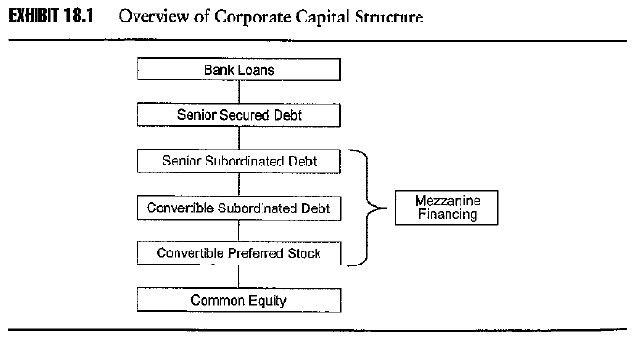
Objective 4.1
Definition
Mezzanine debt fills the gap between senior secured debt and equity capital
Mezzanine financing might include several tranches of junior debt or preferred equity
These slides have been drafted by the La Trobe University, School of Economics and Finance based on Anson (2006).
4.<number>
Notes:
Alternative Securities
Introduction to mezzanine debt
These slides have been drafted by the La Trobe University, School of Economics and Finance based on Anson (2006).

Slide 6
After 2001-2002 recession, banks and other lenders became less aggressive about providing capital. There are fewer lending institutions in the bank market because of many mergers and consolidations in the banking sector.
It is NOT used to provide cash for day-to-day operations of the firm
It fills a void when senior creditors (banks) do not wish to lend any more and the firm does not wish to issue additional stock
It fills the void between “story credits” and junk bonds. Story credits are senior financings with good credit and an interesting story tell the lenders.
It offers unsecured finance for companies larger than venture capital companies but smaller than those with ready access to bank financing
Its market value is normally within the middle market range, i.e., 200m-2billion.
These slides have been drafted by the La Trobe University, School of Economics and Finance based on Anson (2006).
4.<number>

Slide 7
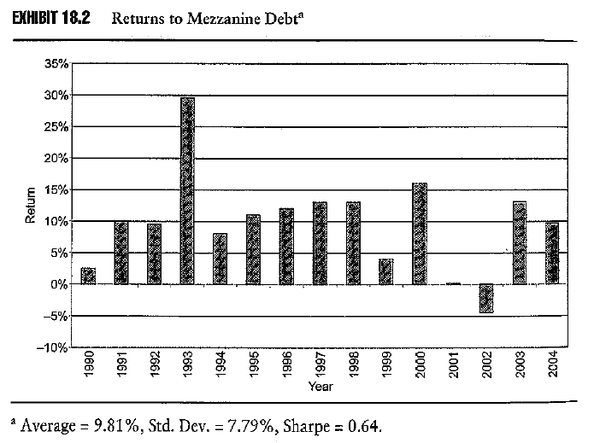
Objective 4.1
Returns from mezzanine debt
Returns from mezzanine debt have varied though tend to be in the range of 10-15%
Return is less than offered by LBO funds as it does not translate into control of the firm
Return is less than offered by venture capital funds as risk is lower due to the existence of cash flow
Coupon provides major portion of total return
It does not have a J curve effect
These slides have been drafted by the La Trobe University, School of Economics and Finance based on Anson (2006).
4.<number>
Notes:
Alternative Securities
Introduction to mezzanine debt
These slides have been drafted by the La Trobe University, School of Economics and Finance based on Anson (2006).
INSERT EXHIBIT 18.2
.

Slide 8
Objective 4.1
Purposes of mezzanine debt
To bridge a gap in time
  To get a company through to its IPO, in a period of economic uncertainty
    The slowdown in the US economy post the tech crash in 2000 saw the deferral of IPOs
    It involves equity risk, hence will be priced accordingly.
These slides have been drafted by the La Trobe University, School of Economics and Finance based on Anson (2006).
4.<number>
Notes:
Alternative Securities
Introduction to mezzanine debt
These slides have been drafted by the La Trobe University, School of Economics and Finance based on Anson (2006).
To get a company through to its IPO, in a period of economic uncertainty
To get a company through development stage of a major project

Slide 9
  To get a company through development stage of a major project
    A bank may not want to take the construction risk, hence mezzanine finance may be used to build the building on which the building can be used to secure long term senior debt
    May be negotiated quickly without full due diligence hence it will be priced accordingly usually with a coupon rate of 12% to 14% with an equity kicker bringing the total return to 20% to 30%
    e.g. Hilton Hotel Corp $235m issues to construct an 800 room hotel in Austen Texas - $100m in Series A senior debt and $135m in Series B mezzanine debt. The senior debt bonds mature in 2015, 2020 and 2030, whereas the mezzanine debt can be called sooner
These slides have been drafted by the La Trobe University, School of Economics and Finance based on Anson (2006).
4.<number>

Slide 10
Objective 4.1
Purposes of mezzanine debt
To bridge a gap in capital structure
  Provides a layer of financing beyond that which senior lenders are prepared to lend without diluting the company’s outstanding equity
  e.g. Superior Candy Company, a 45 year old candy company that wanted to acquire a similar sized competitor for $12m. Banks were only willing to lend $7.7m as senior debt. The remainder is too little to raise as a bond offering. So the rest was raised from a mezzanine fund in return for issuing subordinated debt with warrants attached that gave the mezzanine investor less than 20% of the combined company
These slides have been drafted by the La Trobe University, School of Economics and Finance based on Anson (2006).
4.<number>
Notes:
Alternative Securities
Introduction to mezzanine debt
These slides have been drafted by the La Trobe University, School of Economics and Finance based on Anson (2006).

Slide 11
Objective 4.1
Purposes of mezzanine debt
To bridge a gap in an LBO
  LBO companies may not have the audited history to access bond markets, nor may they have sufficient collateral to secure bank debt
  e.g. Hertz LBO, in 2005 Carlyle Group and Clayton Dubliner and Rice engineered a $15bn buyout of Hertz from Ford Motor Company. To finance the deal a full spectrum of leveraged loans, high-yield bonds and mezzanine debt was used. The deal was highly competitive with a well known underbidder. Moreover the strong brand recognition and cash flows of the company ensured the rates were competitive
These slides have been drafted by the La Trobe University, School of Economics and Finance based on Anson (2006).
4.<number>
Notes:
Alternative Securities
Introduction to mezzanine debt
These slides have been drafted by the La Trobe University, School of Economics and Finance based on Anson (2006).

Slide 12
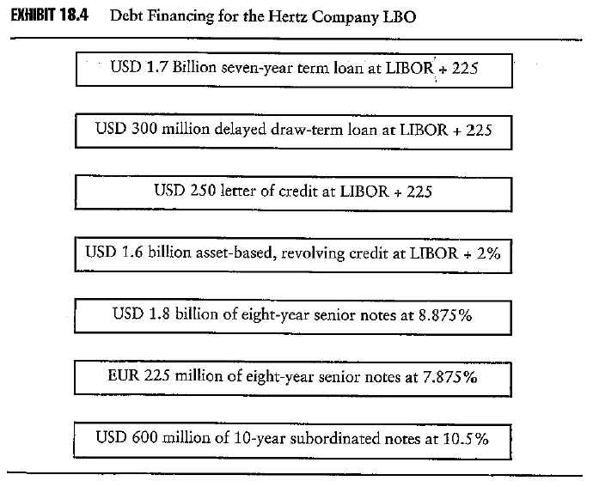
Objective 4.1
Purposes of mezzanine debt
These slides have been drafted by the La Trobe University, School of Economics and Finance based on Anson (2006).
4.<number>
Notes:
Alternative Securities
Introduction to mezzanine debt
These slides have been drafted by the La Trobe University, School of Economics and Finance based on Anson (2006).
INSERT EXHIBIT 18.4
The 10-year subord notes at 10.5% were the mezzanine component, the floating rate loans the leveraged loans and the remainder the high yield

Slide 13
Objective 4.1
Purposes of mezzanine debt
Mezzanine debt in real estate
  A popular investment vehicle in real estate financing. Banks are generally not willing to lend more than 60% on a loan to value ratio. There is a considerable room for mezzanine financing.
  Real estate financing typically does not have an equity kicker.
  Example, a company needs 15million to build a warehouse. It can be financed by 11.1 million senior secured loan, a 1.5million mezzanine loan, and the owner’s contributed equity.
These slides have been drafted by the La Trobe University, School of Economics and Finance based on Anson (2006).
4.<number>
Notes:
Alternative Securities
Introduction to mezzanine debt
These slides have been drafted by the La Trobe University, School of Economics and Finance based on Anson (2006).

Slide 14
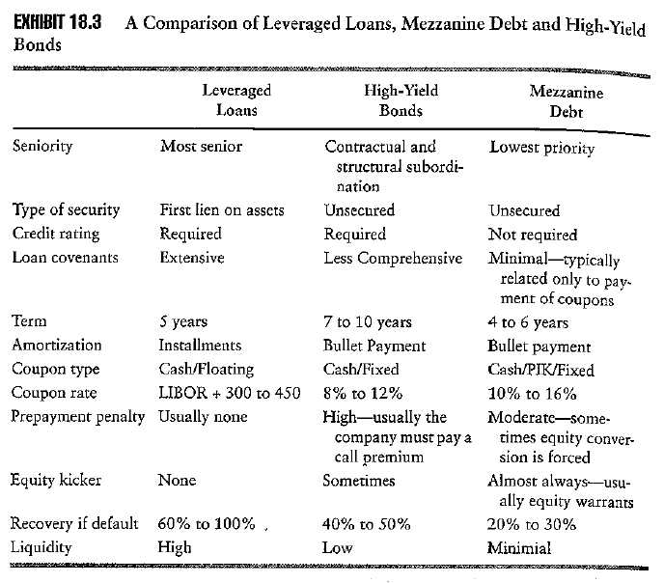
Objective 4.1
Mezzanine debt compared with leveraged loans
These slides have been drafted by the La Trobe University, School of Economics and Finance based on Anson (2006).
4.<number>
Notes:
Alternative Securities
Introduction to mezzanine debt
These slides have been drafted by the La Trobe University, School of Economics and Finance based on Anson (2006).
INSERT EXHIBIT 18.3

Slide 15
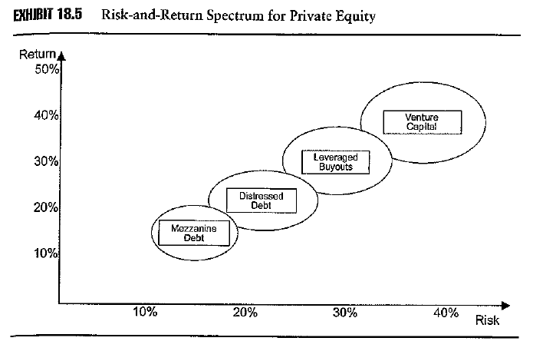
Objective 4.2
Mezzanine debt funds compared with other forms of Private Equity
Returns on mezzanine funds are at the lower end of the private equity spectrum
  Whereas venture capital and LBO funds exhibit a J-curve effect, this is not the case with mezzanine debt funds due to the existence of a fixed coupon
  Whereas distressed funds are faced with a distressed situation
These slides have been drafted by the La Trobe University, School of Economics and Finance based on Anson (2006).
4.<number>
Notes:
Alternative Securities
Introduction to mezzanine debt
These slides have been drafted by the La Trobe University, School of Economics and Finance based on Anson (2006).

Slide 16
Senior bank debt in a private equity situation would normally attract 200 to 300 basis points over LIBOR
Mezzanine debt will attract 400 to 600 basis points over LIBOR, plus an equity kicker bringing total return towards 20%
Mezzanine creditors are at the bottom of the risk profile, just above equity, hence its returns are close to equity and can be as volatile as equity
These slides have been drafted by the La Trobe University, School of Economics and Finance based on Anson (2006).
4.<number>

Slide 17
Objective 4.2
Mezzanine debt funds compared with other forms of private equity
Mezzanine funds are staffed with different expertise than are venture capital funds
  Venture capital funds are staffed by people with operational experience
  Mezzanine funds are staffed with people with financial and banking experience who can negotiate the best equity kicker and the most favourable credit terms
Experienced slower growth than LBO and venture capital funds
Smaller than LBO and venture capital funds, reflecting a middle market phenomenon and the lower returns on offer when compared to LBO and venture capital funds
These slides have been drafted by the La Trobe University, School of Economics and Finance based on Anson (2006).
4.<number>
Notes:
Alternative Securities
Introduction to mezzanine debt
These slides have been drafted by the La Trobe University, School of Economics and Finance based on Anson (2006).

Slide 18
Objective 4.3
Mezzanine debt fund investors
Pension funds
Endowments
Foundations
Insurance companies
Traditional senior lenders
Traditional venture capital funds
These slides have been drafted by the La Trobe University, School of Economics and Finance based on Anson (2006).
4.<number>
Notes:
Alternative Securities
Introduction to mezzanine debt
These slides have been drafted by the La Trobe University, School of Economics and Finance based on Anson (2006).

Slide 19
Insurance companies like mezzanine debt due to the long duration, which matches the duration of their liabilities. They lend to high quality credit names and focus more of the preservation of capital and the high yield rather than the equity kicker
Senior lenders may “stretch” their loans beyond normal limits if the equity can be increased to in excess of 30%
The lines between venture capital and mezzanine finance can become blurred. Often difficult to determine where venture capital ends and mezzanine debt begins in a pre IPO situation
These slides have been drafted by the La Trobe University, School of Economics and Finance based on Anson (2006).
4.<number>

Slide 20
Objective 4.3
Mezzanine debt funds structure
Similar to that of venture capital funds
  Limited partnership
  General partner, usually a merchant bank with mezzanine experience
  Limited partners are the investors
These slides have been drafted by the La Trobe University, School of Economics and Finance based on Anson (2006).
4.<number>
Notes:
Alternative Securities
Introduction to mezzanine debt
These slides have been drafted by the La Trobe University, School of Economics and Finance based on Anson (2006).

Slide 21
Objective 4.3
Mezzanine debt funds fees
Similar to that of venture capital funds
  Management fee of 1% to 2%
  Profit sharing fee of 20%
These slides have been drafted by the La Trobe University, School of Economics and Finance based on Anson (2006).
4.<number>
Notes:
Alternative Securities
Introduction to mezzanine debt
These slides have been drafted by the La Trobe University, School of Economics and Finance based on Anson (2006).

Slide 22
Objective 4.3
Mezzanine debt advantages to investor
High equity like returns
  Mezzanine debt is a hybrid security
  It appeals to conservative investors but like some opportunity for capital appreciation
  Mezzanine debt typically has a coupon rate that is 200 to 300 basis points over that of senior secured debt (Hertz was 167.5bp). It also has a kicker in the form of warrants which may have a strike price as low as $0.01. The number of warrants is inversely proportional to the coupon.
Priority of payment
Schedule of repayment
These slides have been drafted by the La Trobe University, School of Economics and Finance based on Anson (2006).
4.<number>
Notes:
Alternative Securities
Introduction to mezzanine debt
These slides have been drafted by the La Trobe University, School of Economics and Finance based on Anson (2006).

Slide 23
Instant returns
  Mezzanine debt is senior to trade creditors and other unsecured debt and equity
  No J-curve
Board representation
  Mezzanine debt lenders may request board representation or observation rights
Restrictions on the borrower
  Mezzanine debt lenders may have the right to veto additional debt, acquisitions, changes in the management team and the payment of dividends
These slides have been drafted by the La Trobe University, School of Economics and Finance based on Anson (2006).
4.<number>

Slide 24
Objective 4.4
Mezzanine debt advantages to borrower
Flexibility
  Mezzanine debt is a tool to fill gaps in the company’s funding. Flexibility may include the deferral of repayment of principal for several years and the timing of principal payments to meet the company’s cash flow predications.
Semi-equity
  Being considered semi-equity there is less concern with collateral or short-term earnings fluctuations. Focus one the total return over the life of the debt.
Lengthening of maturity
  The borrower can improve its cash flow by deferring debt payments. Mezzanine debt can be deferred 5 or 6 years and may be repaid as a bullet payment
These slides have been drafted by the La Trobe University, School of Economics and Finance based on Anson (2006).
4.<number>
Notes:
Alternative Securities
Introduction to mezzanine debt
These slides have been drafted by the La Trobe University, School of Economics and Finance based on Anson (2006).
.

Slide 25
No collateral
Pay in kind (PIK)
  Repayment may be made in kind in the form of additional debt, which can provide the company with flexibility if there is a demand on cash flow
Less equity dilution
  Has not immediately dilute the equity. Kicker may not kick in in several years. In addition, the company can refinance the mezzanine debt at a later date with traditional bond before the equity kickers kick in.
Cheaper than common equity
  As mezzanine debt does not carry all the risks of equity it is cheaper than equity
These slides have been drafted by the La Trobe University, School of Economics and Finance based on Anson (2006).
4.<number>

Slide 26
Objective 4.5
Mezzanine debt restrictions on mezzanine creditor
Subordination
  Blanket subordination prevents any repayment until the senior debt is fully repaid
  Springing subordination is activated if a covenant is violated or a default occurs. The subordination springs up to stop all payments to mezzanine investor.
Acceleration
  A violation of any covenant may allow the senior debt holder to declare the senior debt due and payable
Drawdown
  Senior lenders require the mezzanine debt to be fully drawn before senior debt is released
These slides have been drafted by the La Trobe University, School of Economics and Finance based on Anson (2006).
4.<number>
Notes:
Alternative Securities
Introduction to mezzanine debt
These slides have been drafted by the La Trobe University, School of Economics and Finance based on Anson (2006).

Slide 27
Restrictions to amending credit facility documents
Assignment
  Senior lenders typically restrict the rights of the mezzanine investor to assign its interest to a third party.
Insurance proceeds
  Mezzanine investors want any insurance proceeds to be used to buy assets rather than to replay senior lenders.
Takeout provision
  Takeout provision allow the mezzanine lender to purchase senior debt once it has been repaid to a certain level
These slides have been drafted by the La Trobe University, School of Economics and Finance based on Anson (2006).
4.<number>

Slide 28
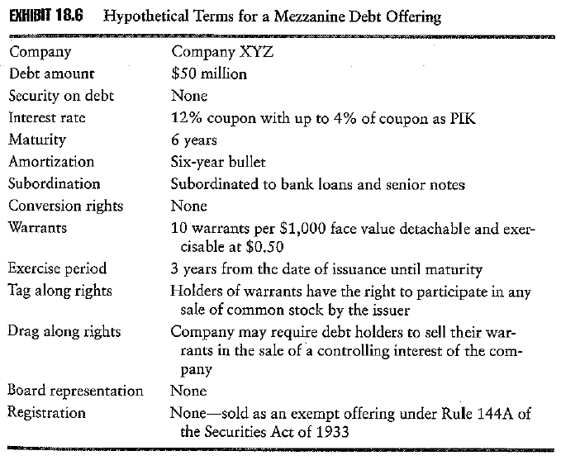
Objective 4.5
Example of mezzanine debt terms
These slides have been drafted by the La Trobe University, School of Economics and Finance based on Anson (2006).
4.<number>
Notes:
Alternative Securities
Introduction to mezzanine debt
These slides have been drafted by the La Trobe University, School of Economics and Finance based on Anson (2006).
INSERT EXHIBIT 18 6

Slide 29
ALTERNATIVE SECURITIES
Adventures in Unrated Debt Investing: Acting Like an Owner
Notes:
Alternative Securities
Introduction to mezzanine debt
These slides have been drafted by the La Trobe University, School of Economics and Finance based on Anson (2006).

Slide 30
References
Yager II and Connor, Adventures in Unrated Debt Investing: Acting Like An Owner. Journal of Private Equity, Spring 2006, 9, 2: 97-101
These slides have been drafted by the La Trobe University, School of Economics and Finance based on Anson (2006).
4.<number>

Slide 31
What are the objectives of this article?
What is the typical capital structure of a middle-market typical LBO?
What agreements govern senior debt and mezzanine debt respectively? What is the subordination agreement? Briefly describe a typical subordination agreement.
What are the situations that the mezzanine debtholders face if the company is in trouble?
What actions can the mezzanine debtholders to rescue themselves?
What are the possible consequences if the mezzanine debtholders fail to take action?
These slides have been drafted by the La Trobe University, School of Economics and Finance based on Anson (2006).
4.<number>

