Slide 1
ALTERNATIVE SECURITIES
Topic 7: Performance measurement for private equity and trends in private equity

Slide 2
Student learning objectives
7.1 Discuss how asymmetry of information and illiquidity in the private equity markets presents problems for performance measurement.
7.2 Compare and contrast “stale pricing” with “managed pricing” in the private equity markets.
7.3 Describe the method used by Gompers and Lerner to mark to market investments in a private equity portfolio.
7.4 Explain the concept of excess risk-adjusted returns earned by private equity managers.
7.5 Describe a test for managed pricing and the evidence of managed pricing for venture capital, LBOs, mezzanine debt, and distressed debt.
7.6 Describe the recent trends in Private equity.

Slide 3
References
Anson, Mark J.P. (2006). Handbook of Alternative Assets. John Wiley & Sons Inc. New Jersey. Chapter 21&22.

Slide 4
Objective 7.1
Difficulties in measuring performance of private equity
The pricing of private equity is confounded by:
  The private nature of the market means that there is no semi strong form of market efficiency in the market
    “Semi strong” form of market efficiency states that security prices reflect all past and current publicly available information
  The lack of public market for the trading of private equity securities and the lack of market liquidity due to the small number of holders of private equity in any single investment means that the value of the securities must be by appraisal rather than being by reference to an objective market price
  The general partner of a private equity limited partnership has a great discretion to determine the “fair value” of the assets. If the general partner’s incentive fee is related to the value of the portfolio, then the general partner will be slow to adjust the value of the portfolio down.

Slide 5
Objective 7.2
Difficulties in measuring performance of private equity
  Many general partners are reluctant to adjust the value of their portfolios until there is an objective market event that allows repricing. The events could be IPO, OTC trade, or additional fund raising.
  Funds invested through limited partnerships may be invested in OTC private equity securities and hence not have an objective market price or Publicly traded securities, which may be infrequently traded, and hence not have a current market price
  The flow of funds into private equity may create an environment where too much money is chasing too few deals may result in inflated private equity valuations
  Private equity limited partnerships that are in the process of fund raising tend to be aggressive in the pricing of their portfolios

Slide 6
Objective 7.2
Stale pricing and manager pricing
“stale pricing”, where the prices of private equity securities may not reflect current market value. They may lag the price movements with a observable public benchmark.
“managed pricing”, where the prices are determined, or updated at the discretion of the general partner. The general partner may price illiquid asset when it is convenient or profitable to do so. This can also lead to a lag between private equity price and a public benchmark.

Slide 7
Efforts have been made to mark-to-market private equity portfolios. Nonetheless, there is still considerable flexibility to the private equity fund mangers. The general partners have considerable discretion to determine the valuation of their portfolios.
The established guidelines generally emphasize the principle of conservatism, which means that the private equity portfolio should not be marked to market until and observable event that provides an objective valuation point. Conservatism also marks portfolio values down quickly and up slowly.
Conservatism makes it difficult to compare the private equity returns to other asset classes

Slide 8
One solution to stale or managed pricing is to mark to market each investment in a private equity portfolio on a periodic basis. Gompers and Lerner (1997) apply this approach to examine the returns from a single private equity group.
First, they use a single period CAPM regression model where the returns of the private equity are measured against the stock market. The residual return represented by the intercept determines whether the market adjusted return earned by private equity is superior to or inferior to the performance of the stock market index.

Slide 9
r
Gompers and Lerner find that the intercept is equal to 2.68% per quarter.
In their second regression, they use the same single-period CAPM model, but they mark to market the private equity portfolio.
Mark to market is accomplished by assigning every company in the portfolio into a industry (defined by the industry classification code). They then use the equal-weighted industry index constructed from public firm in that industry to mark the values of the private firms to the market.
The explanatory power of the second regression is improved also the intercept declined to 1.97%.

Slide 10
Objective 7.3
Measuring private equity performance
Private equity managers provide a package of returns:
  The return earned for exposure to market risk
  A return premium for a portfolio that is less liquid and subject to stale pricing
  The private equity manager’s active skill
  Leverage applied to that skill

Slide 11

Objective 7.3
Measuring private equity performance
The problem most investors face is distinguishing the return due to market exposure and that earned from the private equity manager’s skill
A solution can be found by regressing the historical returns from private equity investments on the concurrent returns of a broad market index
where
  R_{it} (PR) = return to private equity investment at time t
  R_{mt} = return to broad market or benchmark index at time t
  ε_{it} = residual return
  α = the return due to the private equity manager’s skill

Slide 12
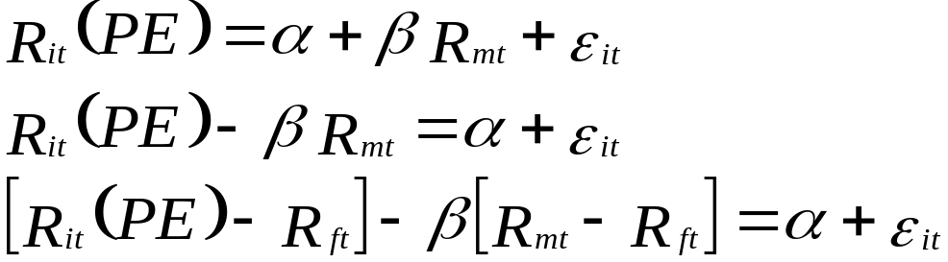
Objective 7.3
Measuring private equity performance
The single factor regression model can be rearranged and restated as follows:
where
  R_{it} (PR) = return to private equity investment at time t
  R_{mt} = return to broad market or benchmark index at time t
  R_{ft} = risk free rate at time t
  ε_{it} = residual return
  α = the risk adjusted return due to the private equity manager’s skill

Slide 13
The regression model states that the contribution of the manager of the private equity fund is given by the total return of the private equity fund less the risk-free rate less its exposure to the excess return of the market
This equation can be used as a performance measure for private equity funds

Slide 14
Objective 7.3
Measuring private equity performance
Beta
  A measure of the systematic risk of the private equity portfolio in relation to the market index, or a measure of the sensitivity of the portfolio to changes in the market index
Alpha
  The return earned by the private equity manager after taking into account the effects of the broad market index and the risk free rate
  It measures the excess risk-adjusted return earned by the private equity manager over and above that for the market return and for the risk free rate
Epsilon
  Random noise in the data, which is the residual effects that are not explained by the data

Slide 15
Objective 7.3
How do we know if the residual is alpha or epsilon?
If the residual is statistically significant then this is a demonstration of a consistent economic effect, that is, alpha or manager skill
If the residual is not statistically significant then it is a demonstration of random noise and not representative of the manager’s skill

Slide 16
Objective 7.3
Private equity benchmarks
Venture capital
  Returns are linked to OTC stock market, hence NASDAQ might be best, but also include Russell 1000, Russell 2000 and the S&P 500 as potential benchmarks.
Leverage buyouts
  Often involve buyouts of mature listed stocks, hence Russell 1000 or S&P 500 might be best, but also might include Russell 2000 and NASDAQ
Mezzanine debt
  A hybrid product including both equity and debt components, hence Russell 2000 and NASDAQ might capture the equity returns and Salomon Cash Pay index might capture the debt components and Salomon Convertible index might capture the systematic risk of mezzanine debt
Distressed debt
  Russell 1000 and 2000, Salomon Cash Pay High Yield and Salomon Convertibles

Slide 17
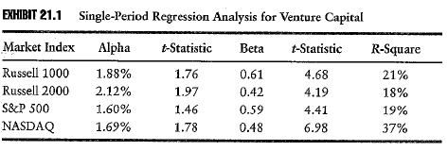
Objective 7.3
Private equity benchmarks: Venture capital
In all cases the beta is statistically significant at the 1% level, hence 99% confident beta explains the sensitivity of private equity returns
Alpha is either weakly significant at 5% or 10% level or not significant in the case of the S&P 500, hence there is some question as to the level of skill venture capitalists add beyond achieving stock market returns
The R-Squares are all reasonable, hence a reasonable portion of the variation in venture capital returns are explained by variation in benchmark returns
Notes:
INSERT EXHIBIT 21.1

Slide 18
The regression model is the same as above on slide 9
The regression is based on quarterly returns over the period 1985 to 2005
As beta is lower than one in all cases the returns of venture capital are less sensitive to a change in benchmark values than a well diversified portfolio.
An alpha, a risk-adjusted return in excess of the risk-free rate of 1.69% per quarter or 6.8% per annum is an indication of manager skill, albeit not as significant as one might like
The statistically significant results suggest that a considerable portion of the returns to venture capital are dependent on the stock market returns, which is intuitive as a strong stock market means a strong IPO market and higher returns to venture capital

Slide 19
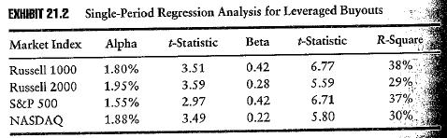
Objective 7.3
Private equity benchmarks: Leverage buyouts
In all cases the beta is statistically significant at the 1% level, but lower hence less sensitive than for venture capital, hence more dependent on individual stock characteristics
In all cases alpha is statistically significant at the 1% level, and indicate a risk adjusted return in excess of the risk-free rate of between 6% to 8% pa
The R-Squares are all reasonable and higher than for venture capital

Slide 20
The regression model is the same as above on slide 9
The regression is based on quarterly returns over the period 1985 to 2005
LBO funds are exposed more to company specific risk than systematic market risk.
Russell 1000 and S&P500 have higher R-square.

Slide 21
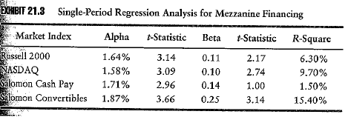
Objective 7.3
Private equity benchmarks: Mezzanine debt
In all cases, except Saloman Cash Pay the beta is statistically significant at the 1% level, but lower hence less sensitive than for venture capital or LBO, reflecting the hybrid nature of the security
In all cases alpha is statistically significant at the 1% level, and indicate a risk adjusted return in excess of the risk-free rate of between 6% to 7% pa, lower than for either venture capital or LBO, which is as expected
The R-Squares are all lower and indicative of the diversification potential of mezzanine debt

Slide 22
The return of Mezzanine debt is less influenced by the general movements in either the stock or bond market.

Slide 23
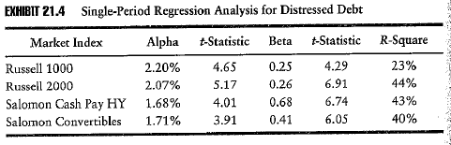
Objective 7.3
Private equity benchmarks: Distressed debt
In all cases the beta is statistically significant at the 1% level and higher than mezzanine debt fro both equity and debt benchmarks reflecting a stronger hybrid characteristic than for mezzanine debt
In all cases alpha is statistically significant at the 1% level, and indicate a risk adjusted return in excess of the risk-free rate of between 7% to 9% pa, higher than for mezzanine debt, which is as expected
The R-Squares are all higher than for mezzanine debt and similar both for equity and debt benchmarks reflecting again strong evidence of it hybrid characteristics

Slide 24
Objective 7.5
Testing for the effects of “stale” or “managed” pricing
The existence of “stale” or “managed” pricing mean that private equity returns may lag market returns
If so the simple one period regression equation will understate beta and overstate alpha
To solve this the simple one period regression model can be expanded to include multi-period pricing effects

Slide 25
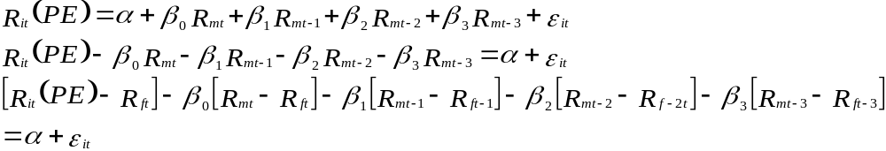
Objective 7.5
Testing for the effects of “stale” or “managed” pricing
The multiperiod regression model can be rearranged and restated as follows:
where
  R_{it} (PR) = return to private equity investment at time t
  R_{mt} = return to broad market or benchmark index at time t
  R_{ft} = risk free rate at time t
  ε_{it} = residual return
  α = the risk adjusted return due to the private equity manager’s skill

Slide 26
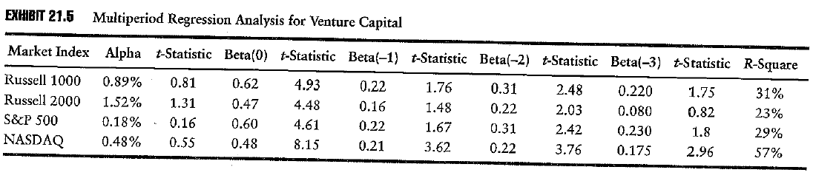
Objective 7.5
Private equity benchmarks: Venture capital
Beta is statistically significant at the 1% level for current and lagged prices, hence there is strong evidence of stale or managed pricing, and as summed is higher suggesting that when we allow for stale or managed pricing returns to venture capital it has a greater exposure to market returns
Alpha is significantly lower than in the single period model at little over 2% rather than 6% to 8.5% and in any event is not significant, hence residual returns are likely to be due to noisy data and any excess returns due to chance rather than skill
The R-Squares are all higher than for the single period model

Slide 27
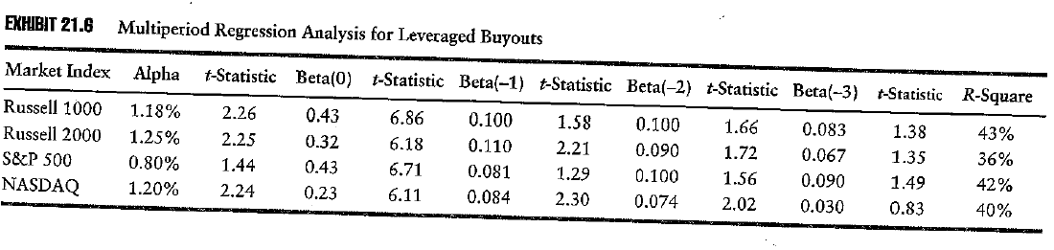
Objective 7.5
Private equity benchmarks: Leverage buyouts
Betas are statistically significant in the prior two quarters but the effect of stale or managed prices is less evident than for venture capital
In most cases alpha is statistically significant at the 1% level, though alpha is lower than in the single period model, however unlike venture capital the significant alphas indicate LBO managers add value of around 5% per annum
The R-Squares are all higher than for the single period model

Slide 28
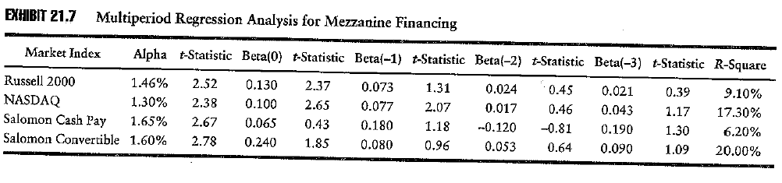
Objective 7.5
Private equity benchmarks: Mezzanine debt
Betas are statistically significant in the current quarter but the effect of stale or managed prices is less evident than for venture capital
In all cases alpha is statistically significant at the 1% level for both equity and debt, though alpha is lower than in the single period model, however unlike venture capital the significant alphas indicate mezzanine debt managers add over 5% pa
The R-Squares are all higher than for the single period model, though still mezzanine debt returns find less explanatory power in these benchmarks than do the other forms of private equity

Slide 29
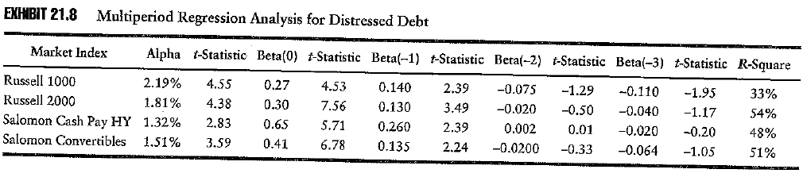
Objective 7.5
Private equity benchmarks: Distressed debt
Betas are statistically significant in the current and previous quarter but the effect of stale or managed prices is less evident than for venture capital
In all cases alpha is statistically significant at the 1% level for both equity and debt, though alpha is lower than in the single period model, however unlike venture capital the significant alphas indicate distressed debt managers add over 6% pa
The R-Squares are all higher than for the single period model, though still mezzanine debt returns find less explanatory power in these benchmarks than do the other forms of private equity

Slide 30
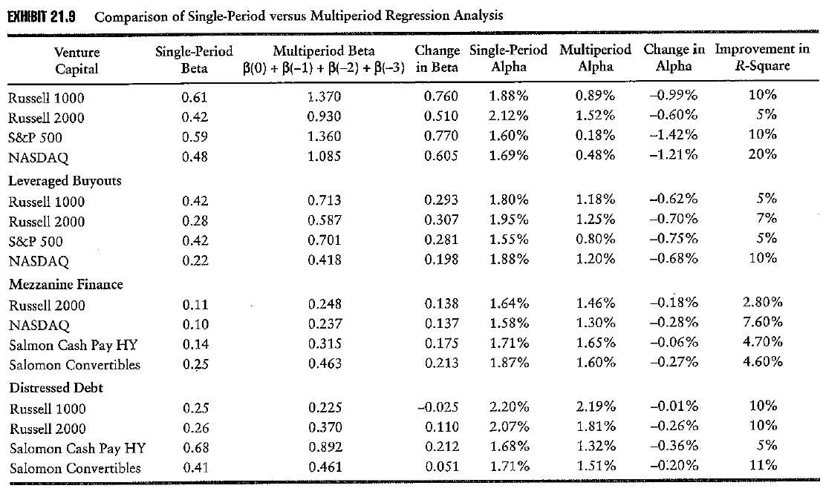
Objective 7.5
Private equity benchmarks

Slide 31
Objective 7.5
“Stale” or “managed” pricing
“Stale” pricing would show little difference in how private equity portfolios are marked in up versus down markets, hence the alphas and betas of the multiperiod regressions should be the same irrespective of whether the market was rising or falling. There should be no bias in the pricing of private equity whatever the direct of the market may be.

Slide 32
Objective 7.5
“Stale” or “managed” pricing
“Managed” pricing might cause the alphas and betas of the multiperiod regressions to be different depending on whether the market was rising or falling
  If the motivation is to maximize performance fees, managers would quickly mark up their portfolios in a rising market and slowly mark down their portfolios in a falling market, causing lagged returns to have less impact in a rising market and more impact in a falling market
  If the motivation is to be conservative, managers would slowly mark up their portfolios in a rising market and quickly mark down their portfolios in a falling market, causing lagged returns to have more impact in a rising market and less impact in a falling market

Slide 33
Objective 7.5
“Stale” or “managed” pricing
The multiperiod regression model can be rearranged and restated as follows to include a dummy variable to capture different market phases:
where
  R_{it} (PR) = return to private equity investment at time t
  R_{mt} = return to broad market or benchmark index at time t
  R_{ft} = risk free rate at time t
  ε_{it} = residual return
  α = the risk adjusted return due to the private equity manager’s skill
  D = the dummy variable

Slide 34
The regression is run twice, once when we set the dummy variable equal to 1 when the market rises and in the second when we set the dummy variable to 1 when the market falls
In each regression we calculate the size of the lagged betas.
If the private equity returns suffers from managed as against stale pricing we would expect to see asynchronous lagged betas

Slide 35
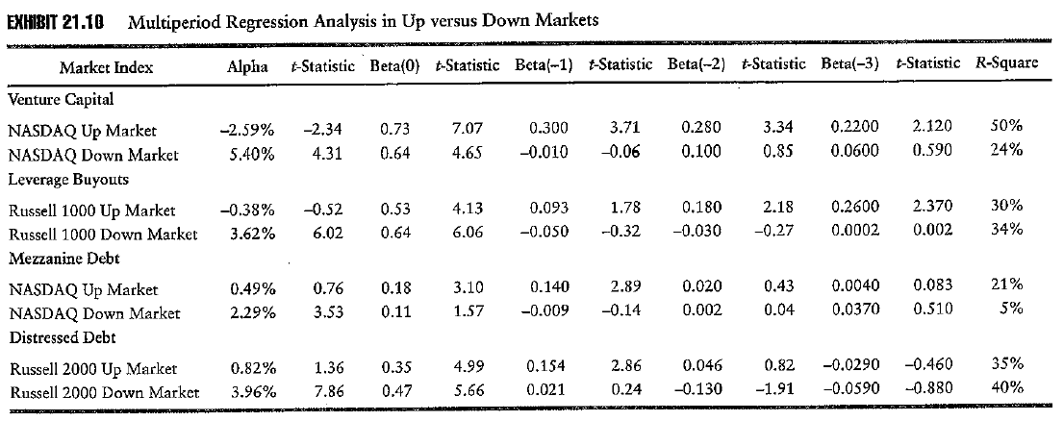
Objective 7.5
“Stale” or “managed” pricing
Pricing in private equity shows:
  Asynchronous lagged betas, large and significant betas for the up market and non significant betas for the down market,
  A high R-square for the up market and a low R-square for the down market
  Significant and negative alphas in the up market and significant and large positive alphas in the down market
  Funds are managing their pricing motivated by conservatism
Notes:
INSERT EXHIBIT 21.10

Slide 36
Considers only those benchmarks which returns the highest R-Square value for each form of private equity
They are slow to incorporate positive stock market returns into their portfolios, preferring to wait until they are assured of earning these returns. Conversely, when the stock market performs poorly, managers are quickly to incorporate these negative returns into their private equity portfolios.

Slide 37
Trends in private equity
Recent trends in the private equity market:
  LBOs has turned into an efficient, auction-driven asset class which has resulted in many secondary sales of private equity portfolios.
  Private equity has been brought to the retail market through Business development companies (BDC).
  Private equity firms have moved into the market for leveraged loans.
  Private equity firms use PIPE deals to spread their over abundance of capital around.

Slide 38
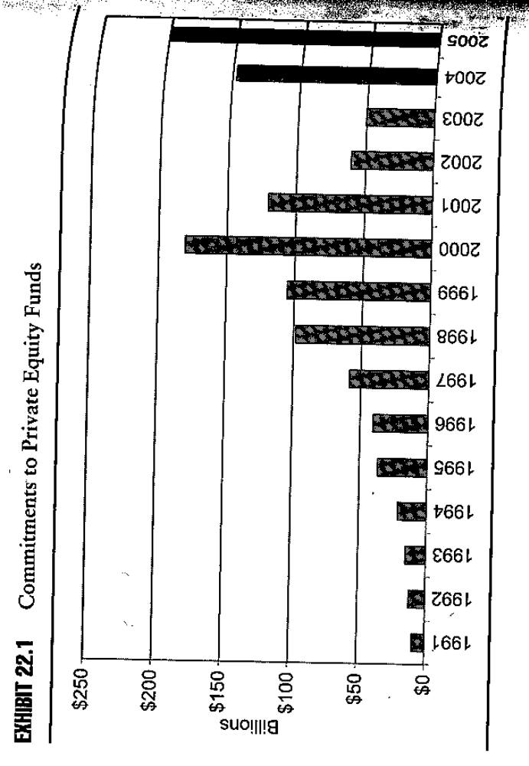

Slide 39
An auction market
The traditional model of private equity investment::
  A single private equity firm approached a standalone firm or its subsidiaries.
  The lone private equity firm would work with the executive management of this company to develop a financing plan for taking the firm public or private.
  This process might take months or years to bring a deal to fruition. The private equity firm also build its relationship with the senior management.

Slide 40
An auction market
The auction model of private equity investment::
  When a firm decides to sell in a LBO format, it almost always hires an investment banker to establish a bidding process among several private equity firms.
  Usually the highest bidder wins the auction. The private equity investor loses in the sense that there is less upside to extract from the deal.
  An auction market indicates an efficient market but more competition means less returns on invested capital.

Slide 41
An auction market
The disadvantages of the auction model relative to single-sourced deal:
  The private firm has less time to review the target company’s financial statements and operations.
  The shorter time frame associated with an auction means thate there is less time for a private equity firm to conduct a thorough due diligence.
  In an auction market, the private firm may meet with senior management only two or three times.

Slide 42
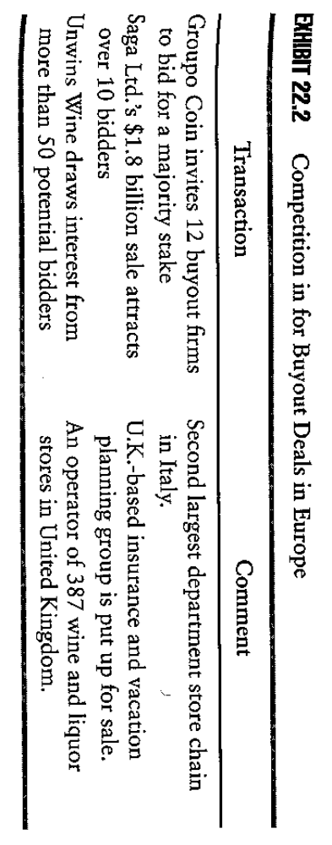

Slide 43
Club deals
The large inflow of capital into the private equity market has forced LBO firms to work together on “clubs”.
In a club deal, one or more LBO firms worked together to share costs, present a business plan, and contribute capital to the deal.
Unlike LBO firms, VC firms have worked together for years. Each stage of the start-up company was financed by different VCs.
VC firms long ago learned that bringing in different levels of expertise into a start-up venture can add value to the long-term prospects of the company.

Slide 44
Club deals
Advantage:
  Club deal can help the bidder get a more attractive price for the target.
  Club deal helps to spread the risk particularly for large private equity deals.
Disadvantage:
  It might reflect a lack of opportunities in the market for the amount of capital that the LBO firms have to put to work. That is “too much money chasing too few targets”.
  Too many cooks in the kitchen can spoil the dinner. For example, it is less clear who will take the lead, who will monitor the board, who will negotiate with the lenders.
  Club deals may reflect a private equity firm that has no real deal flow other than talking to other private equity firms.

Slide 45
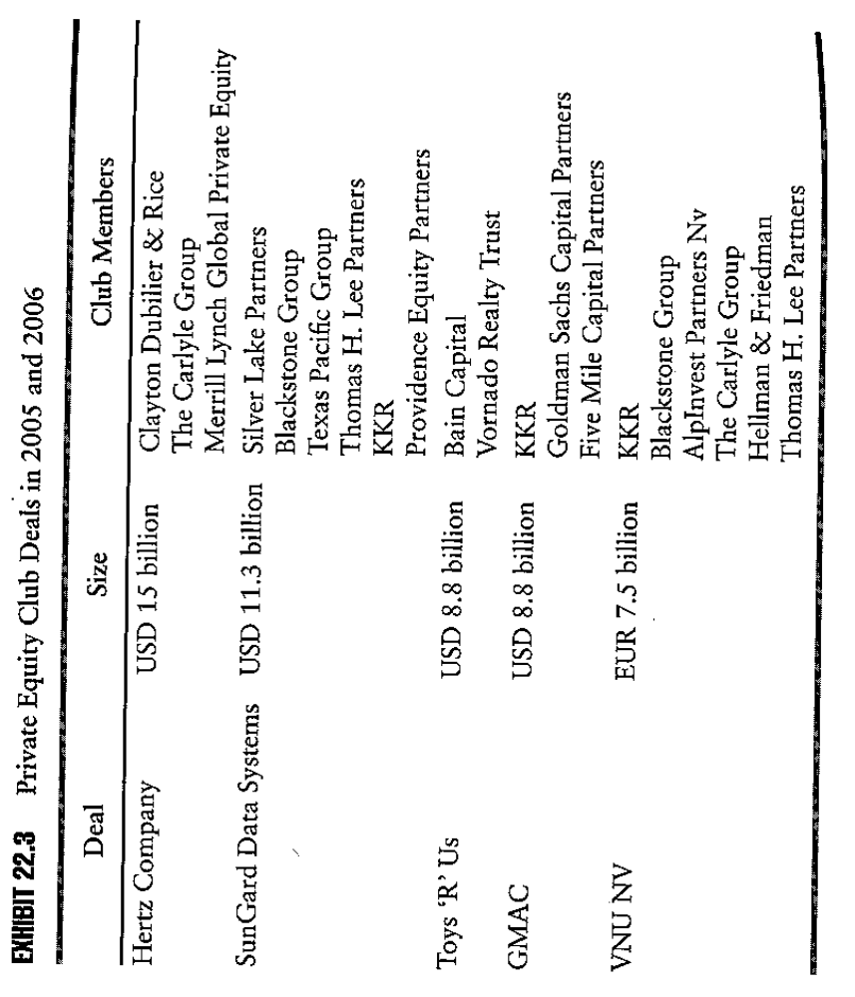

Slide 46
The secondary private equity market
Secondary buyouts
  The secondary buyout model also indicates the increased efficiency of the private equity market.
  Private equity firms are increasingly selling to one another as an exit strategy.
  Private equity firms are also looking at existing private deals.
  Initially, the private equity firms are reluctant to sell a portfolio company to another private firms in a buyout-buyout deal. There was a stigma of failure associated with not being able to take a company public or sell it to a strategic partner (a corporation in the same or related industry).
  Now the market for buyout-buyout deal is robust.
  One problem with the buyout-buyout deal is that each private-to-private equity sales incurs transaction costs in the form of incentive fees and this erodes the value of the operating company.

Slide 47
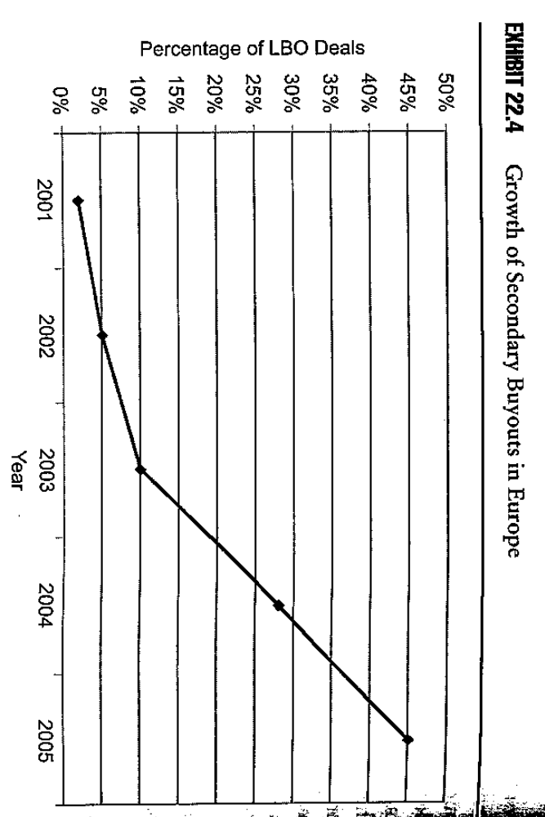

Slide 48
The secondary private equity market
The investor secondary market: The limited partners sell their partnerships in the secondary market. The reasons are:
  To raise cash for funding requirements.
  There may be strategic shifts in institutional portfolios.
  Institutional investors need to rebalance their portfolios from time to time.
Advantages to a secondary purchase:
  The investor gains exposure to a portfolio of companies with a vintage year that is different from his existing portfolio.
  Secondary interests may be closer to harvesting profits from the private portfolio than new private equity.
  The purchase of the secondary interest may be a way to gain access to further funds offered by the general partner.

Slide 49
The secondary private equity market
Primary secondaries: The secondary sales not to a limited partnership or other specialized secondary fund, but instead, directly to an institutional investor.
Two main goals for primary secondaries:
  To establish a relationship with the general partner so as to gain further access to investment vehicles offered by the general partner.
  The purchase of the secondary interests can reduce the J curve effect because the purchased interests are in the profit harvesting stage.

Slide 50
The secondary private equity market
There will be a discount price to the net asset value in order to entice the secondary buyer.
The closer the vintage year of the fund to the sale date the larger the discount because the shorter time period means that the private equity fund has had less time to generate profits for investors.

Slide 51
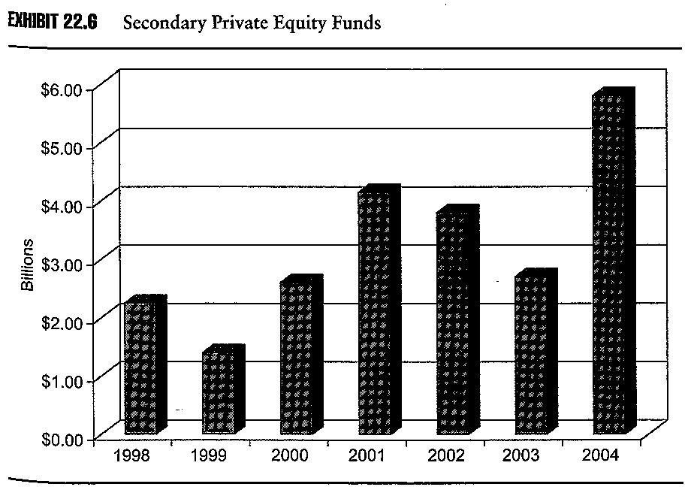

Slide 52
Business development companies
BDCs were created by the Small Business Investment Incentive Act of 1980. BDCs are a special type of closed end mutual funds that were established to encourage investments in small private businesses.
Closed end funds are retail investment funds where the investor cannot redeem her shares by selling them back to the mutual fund management company. Close end funds have their shares traded on a stock exchange.
BDCs were underutilized for may years. Private equity firms have recently started filing registration statements with the SEC to offer BDC funds.They all state that the BDC will invest in mezzanine debt.

Slide 53
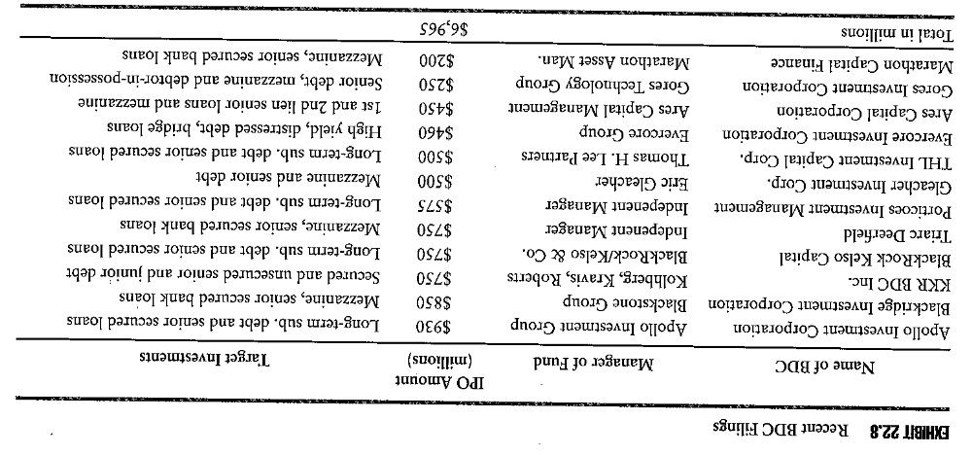

Slide 54
Business development companies
The benefits to the private equity firm include:
  A BDC provides the private equity firm with a permanent base of captured investment capital that will never be redeemed.
  The management fee can be collected before any real investment to be made.
  Unlike traditional private equity fund, the incentive fees can be collected before there is a return of investor capital and there are no clawbacks.
The benefits to the investor include:
  Gaining access to mezzanine debt market.
  Having liquidity in tradable shares.
  The ability to earn returns significantly in excess of traditional bonds.

Slide 55
Business development companies
The risks to the investors include:
  The BDC shares may trade at a discount to the initial public offering.
  The fee structure is expensive compared to other closed end mutual funds.
  The BDC may lack experience investing in mezzanine debt.

Slide 57
The growth of leveraged loans
A leveraged loan is a bank loan made to a corporate borrower that is not investment grade, often due to excess leverage on its balance sheet.
Generally, a loan is considered leveraged if:
  The company has outstanding debt that is rated below BBB-.
  The coupon is in excess of 150 basis points over LIBOR.
  The loan has a second lien interest after other senior secured loans.

Slide 58
The growth of leveraged loans
Institutional investors have an increased focus on active total return management, which leads to an increase in the secondary trading for leveraged loans.
With the entry of institutional investors into this market through private equity, leveraged loans have become accepted form of investing.
Moody began to assign credit ratings to bank loans in 1995.
A large portion of leveraged loans made by banks each year are sold in the secondary market to investors who are much better at assessing the investment risk of holding on to a leveraged loan for three to five years.

Slide 59
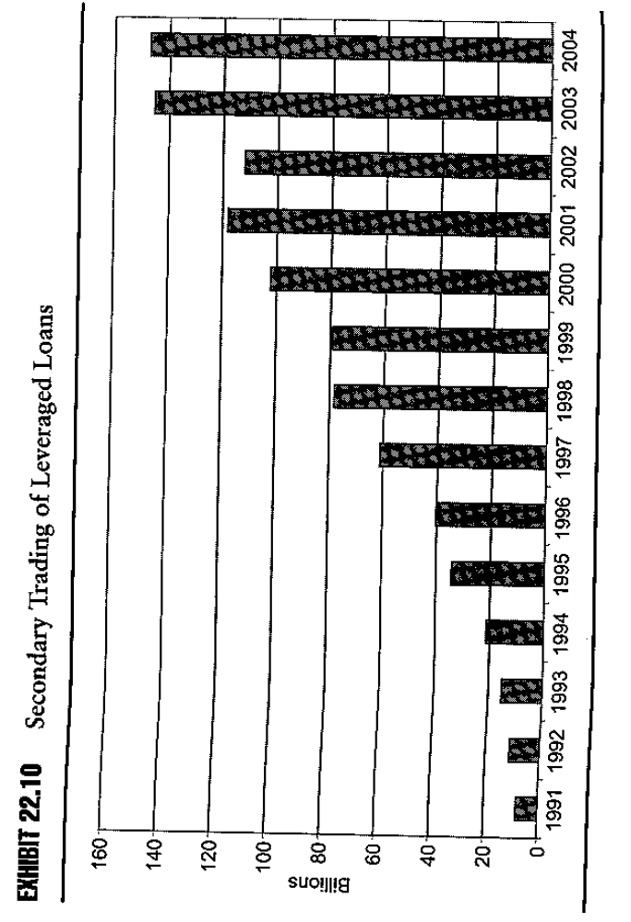

Slide 61
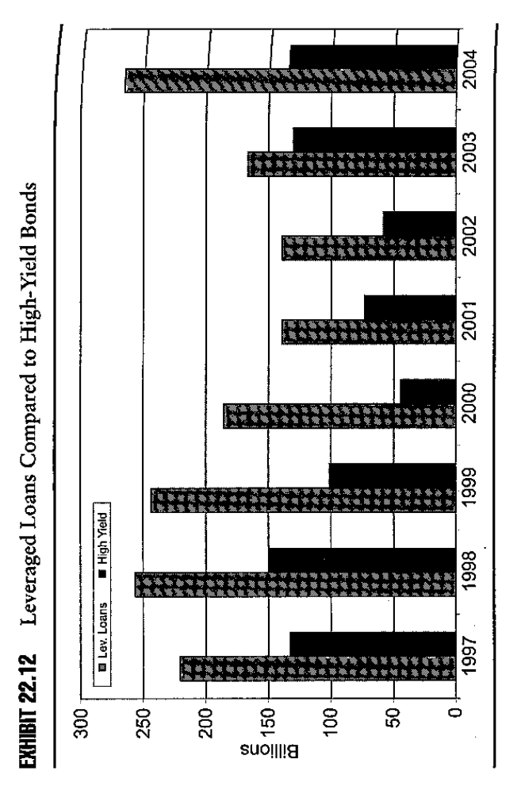

Slide 63
Private investment in public entities (PIPES)
PIPE are private issued equity or equity linked securities that done outside of a public offering. Typically, these securities are exempt from registration D of the Securities Act of 1933.
PIPE are undertaken by companies that already have common stock that is publicly traded. PIPE issuers can be anything from small companies listed in the OTC market to NYSE listed companies.
Most PIPE are designed for small capital infusions in the range of $10m to $50m. However, some PIPEs are over $200m. Smaller PIPE appeal to VC while the larger PIPE appeal to LBO firms.

Slide 64
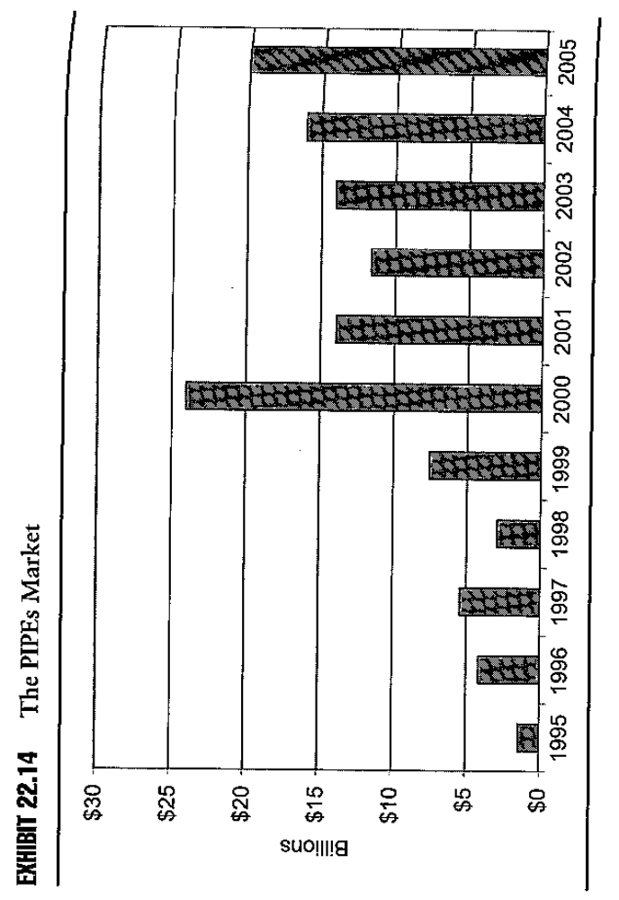

Slide 65
Private investment in public entities (PIPES)
Advantages for the issuers:
  The company can quickly raise capital without the need for a lengthy registration process. Larger companies view PIPEs as a quicker and cheaper process for raising capital.
  Management of the company does not need to be distracted with a prolonged “road show” that typically precedes every IPOs. Management can remain focused on the operations of the business while receiving an equity infusion that strengthens the balance sheet.
Advantages for the investors:
  It can acquire a block of stock are a discount to the public market price.
  The issuers usually commits to registering the equity with the SEC within the next six months. This is appealing for private equity firms because they can exit within six months through the market.

Slide 66
Private investment in public entities (PIPES)
Traditional PIPEs:
  They are straightforward private purchases of common equity and preferred stock with a fixed conversion into common shares. They have a single conversion price, fixed at a premium to the current market price, which is maintained throughout the life of the PIPE.
Structured PIPEs:
  They include more exotic investment such as floating rate convertible preferred stocks, convertible resets, and common stock resets. They have a floating conversion price which can change depending upon the price of the public traded stock. If the stock price of the issuer declines, the PIPE investor receives a greater number of shares to cover into, or the conversion price declines commensurately with the outstanding stock price. This type of convertibles is called” toxic convertibles” or “death spiral”.
  Almost all floating conversion rate PIPEs have a floor value beyond which the floating conversion rate is capped.

Slide 67
