Slide 1
Text-guided image editing
Paper:
* Nam, H., Kwon, G., Park, G. Y., & Ye, J. C. (2024). Contrastive denoising score for text-guided latent diffusion image editing.

Slide 2
Agenda
Introduction
Prerequisites
Paper contribution
Experiments
Conclusion

Slide 3
Introduction
Concept
Applications & Challenges
Project objective

Slide 4
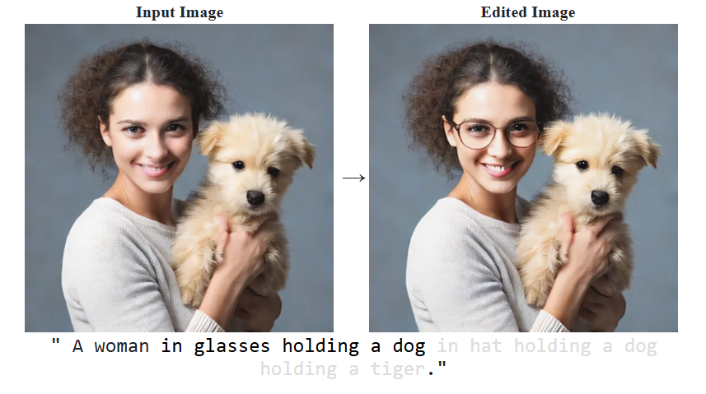
Concept
AI-powered image editing using text prompts instead of manual tools.
Example: “A woman in glasses holding a dog in hat holding a dog holding a tiger" → AI modifies the image accordingly.

Slide 5
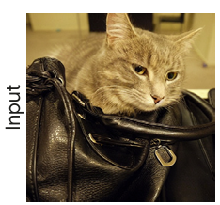
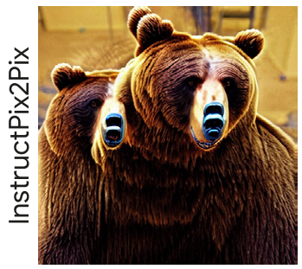
Applications & Challenges
🔹 Applications ✔ Change image styles ("Make it look like a painting") ✔ Add/remove objects ("Remove background") ✔ Modify attributes ("Turn this frown into a smile")
⚠ Challenges ❌ Lack of fine control → AI might misinterpret prompts. ❌ Artifacts & distortions → Unnatural or unwanted changes. ❌ Computational cost → Requires strong hardware.

Slide 6
Project objective
Problems:
❌ Full fine-tuning large models is time-consuming ❌ Standard diffusion models struggle with semantic consistency and fine details
Objectives:
✅ Explore the paper on Contrastive Denoising Score (CDS), which improves diffusion models by enhancing denoising through contrastive learning.

Slide 7
Prerequisites
Contrastive Unpaired Translation
Latent Diffusion Model
Score Distillation Sampling
Delta Denoising Score

Slide 8
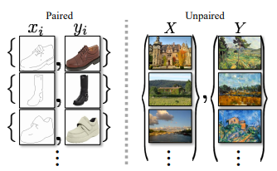
Contrastive Unpaired Translation (1)
Proposed in Contrastive learning for unpaired image-to-image translation by Park, T., Efros, A. A., Zhang, R., & Zhu, J. Y. (2020).
Deal with the problem of transforming images from Domain A to Domain B without paired examples.
Encouraging content preservation in unpaired image translation problems

Slide 9
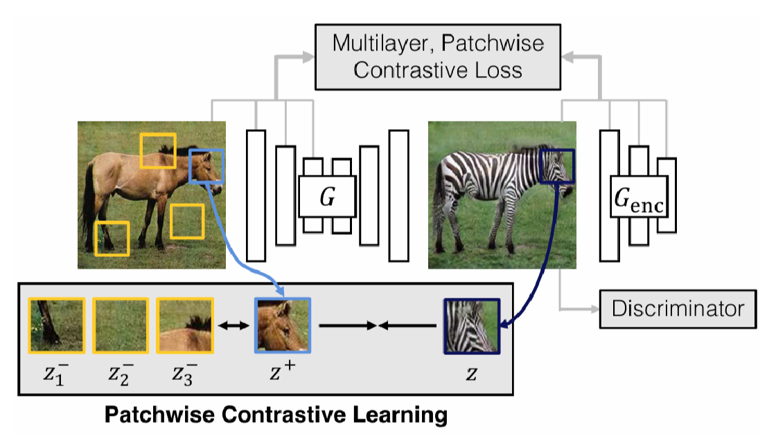
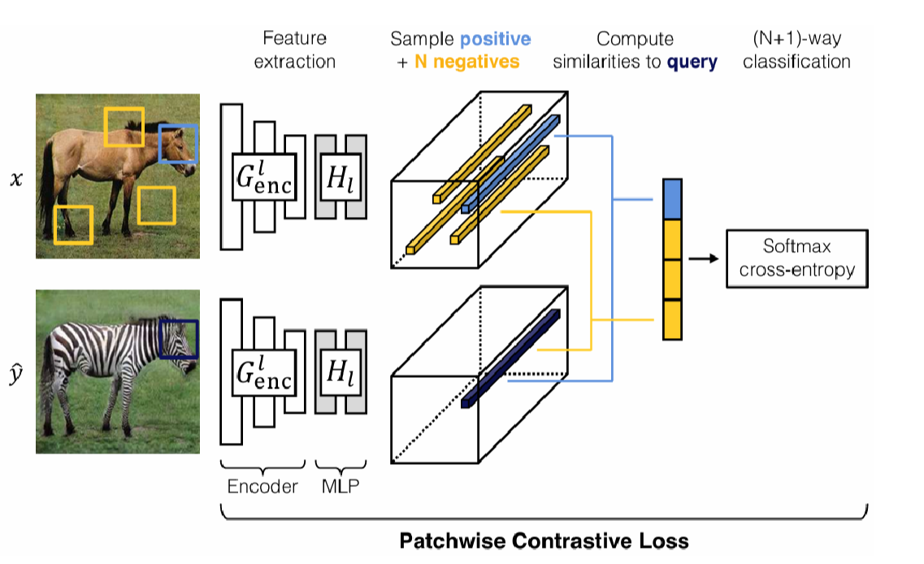
Contrastive Unpaired Translation (2)
Utilize patchwise contrastive loss to maximize mutual information between corresponding patches in input and output images.

Slide 10
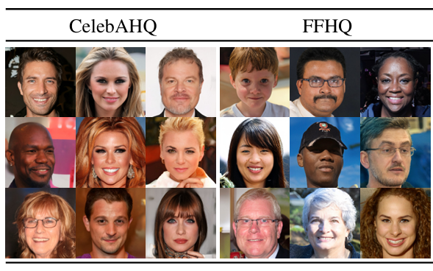
Latent Diffusion Model (1)
Proposed in High-resolution image synthesis with latent diffusion models by Rombach, R., Blattmann, A., Lorenz, D., Esser, P., & Ommer, B. (2022).
Instead of applying diffusion directly to high-dimensional pixel space, the model learns and denoises in a compressed latent space.
Introduce cross-attention layers that enable flexible control over image generation.

Slide 11
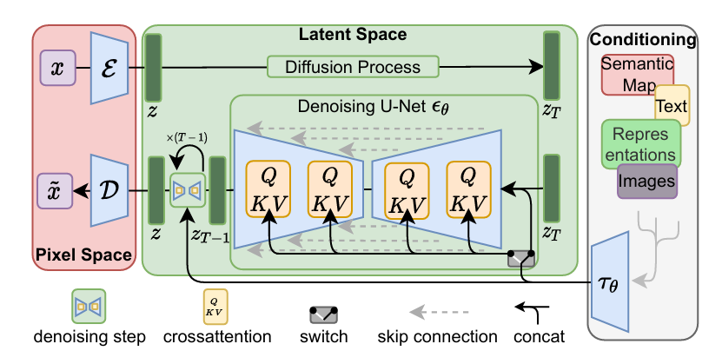
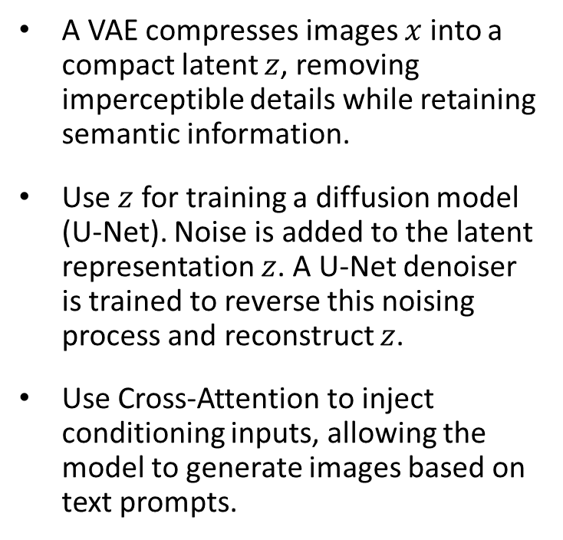
Latent Diffusion Model (2)
A VAE compresses images $x$ into a compact latent $z$, removing imperceptible details while retaining semantic information.
Use $z$ for training a diffusion model (U-Net). Noise is added to the latent representation $z$. A U-Net denoiser is trained to reverse this noising process and reconstruct $z$.
Use Cross-Attention to inject conditioning inputs, allowing the model to generate images based on text prompts.

Slide 12
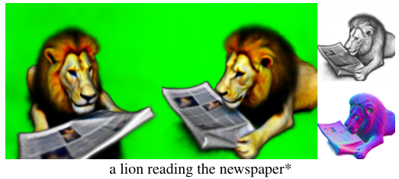
Score distillation sampling (1)
Proposed in Dreamfusion: Text-to-3d using 2d diffusion by Poole, B., Jain, A., Barron, J. T., & Mildenhall, B. (2022).
Deal with the problem of generating a 3D image from a text without training data.
Showed that pretrained 2D image-text models may be used for 3D synthesis, though 3D objects produced by this approach tend to lack realism and accuracy.

Slide 13
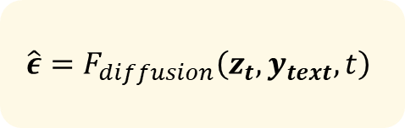


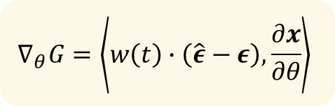
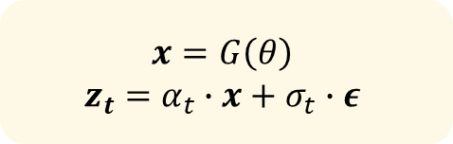
Score distillation sampling (2)
Loop N times
$$x=G\left(θ\right)$$
$$z_{t}=α_{t}∙x+σ_{t}∙ε$$
For each text prompt, we train a randomly initialized G from scratch.
Don’t need to fine-tune diffusion model.
Use diffusion model output as an additional loss
$$ε\sim 𝒩\left(0, I\right)$$
$$t\sim 𝒰\left(0,1\right)$$
$$\hat{ε}=F_{diffusion}\left(z_{t}, y_{text}, t\right)$$
$$θ=Update\left(θ\right)$$
$$∇_{θ}G=\left\langle w\left(t\right)∙\left(\hat{ε}−ε\right),\frac{∂x}{∂θ}\right\rangle$$

Slide 14
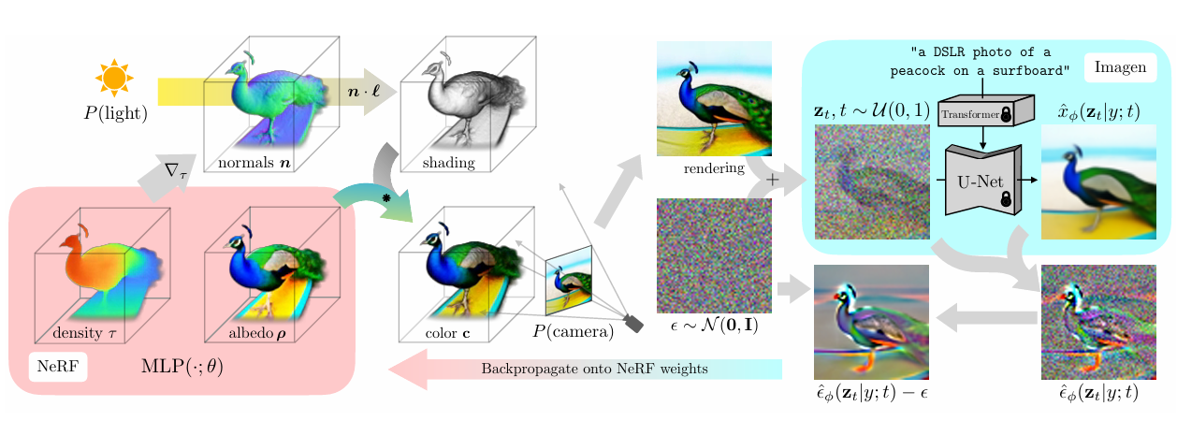
Score distillation sampling (3)

Slide 15
Delta denoising score
This is a powerful tool in public speaking. It involves varying pitch, tone, and volume to convey emotion, emphasize points, and maintain interest:
Pitch variation
Tone inflection
Volume control
Effective body language enhances your message, making it more impactful and memorable:
Meaningful eye contact
Purposeful gestures
Maintain good posture
Control your expressions

Slide 16
Paper contribution
Latent diffusion model and Stable diffusion
Score distillation sampling
Delta denoising score
Contrastive Unpaired Translation

Slide 17


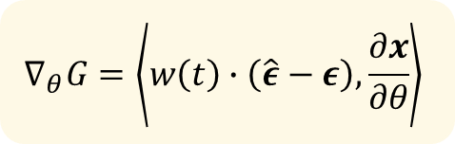
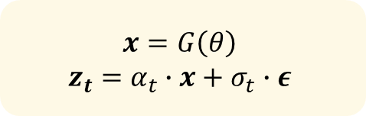
Contrastive Denoising Score
Loop N times
$$x=G\left(θ\right)$$
$$z_{t}=α_{t}∙x+σ_{t}∙ε$$
For each text prompt, we train a randomly initialized G from scratch.
Don’t need to fine-tune diffusion model.
Use diffusion model output as an additional loss
$$ε\sim 𝒩\left(0, I\right)$$
$$t\sim 𝒰\left(0,1\right)$$
$$\hat{ε}=F_{diffusion}\left(z_{t}, y_{text}, t\right)$$
$$θ=Update\left(θ\right)$$
$$∇_{θ}G=\left\langle w\left(t\right)∙\left(\hat{ε}−ε\right),\frac{∂x}{∂θ}\right\rangle$$

Slide 18
Experiments
Make eye contact with your audience to create a sense of intimacy and involvement
Weave relatable stories into your presentation using narratives that make your message memorable and impactful
Encourage questions and provide thoughtful responses to enhance audience participation
Use live polls or surveys to gather audience opinions, promoting engagement and making sure the audience feel involved

Slide 19
Conclusion
1. Key Observations
🔹 CDS improves denoising quality, leading to sharper and more coherent images. 🔹 The contrastive loss helps the model differentiate noise scales more effectively. 🔹 Trade-offs exist: Better quality but higher computational cost compared to standard diffusion.
2. Challenges & Limitations
⚠️ Tuning contrastive loss weight is crucial – too high can lead to overfitting, too low has minimal effect. ⚠️ Computationally expensive – additional contrastive loss increases training time. ⚠️ Limited benchmark studies – needs further testing on diverse datasets.
3. Future Directions
➡️ Optimize CDS to reduce computational overhead. ➡️ Experiment with different contrastive loss formulations. ➡️ Extend to other modalities beyond images (e.g., text, video).

Slide 20
Thank you
Dam Viet Anh
Dinh Thi Hoa
Nguyen Thanh Ha

