Slide 1
Text-guided image editing
Paper:
* Nam, H., Kwon, G., Park, G. Y., & Ye, J. C. (2024). Contrastive denoising score for text-guided latent diffusion image editing.

Slide 2
Agenda
Introduction
Prerequisites
Paper contribution
Experiments
Conclusion

Slide 3
Introduction
What is text-guided image editing?
Current limitation

Slide 4
What is text-guided image editing?
This is a powerful tool in public speaking. It involves varying pitch, tone, and volume to convey emotion, emphasize points, and maintain interest:
Pitch variation
Tone inflection
Volume control
Effective body language enhances your message, making it more impactful and memorable:
Meaningful eye contact
Purposeful gestures
Maintain good posture
Control your expressions

Slide 5
Current limitation
This is a powerful tool in public speaking. It involves varying pitch, tone, and volume to convey emotion, emphasize points, and maintain interest:
Pitch variation
Tone inflection
Volume control
Effective body language enhances your message, making it more impactful and memorable:
Meaningful eye contact
Purposeful gestures
Maintain good posture
Control your expressions

Slide 6
Prerequisites
Contrastive Unpaired Translation
Latent Diffusion Model
Score Distillation Sampling
Delta Denoising Score

Slide 7
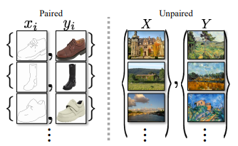
Contrastive Unpaired Translation (1)
Proposed in Contrastive learning for unpaired image-to-image translation by Park, T., Efros, A. A., Zhang, R., & Zhu, J. Y. (2020).
Deal with the problem of transforming images from Domain A to Domain B without paired examples.
Encouraging content preservation in unpaired image translation problems

Slide 8
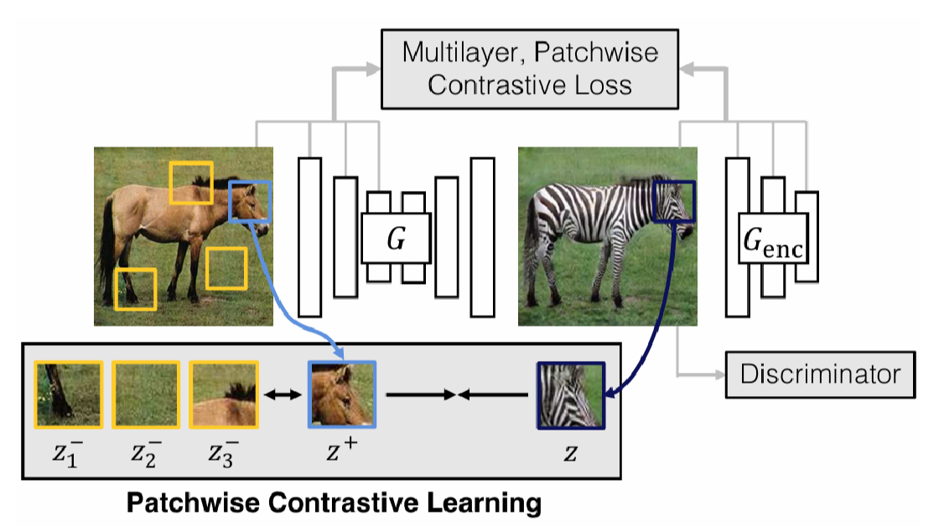
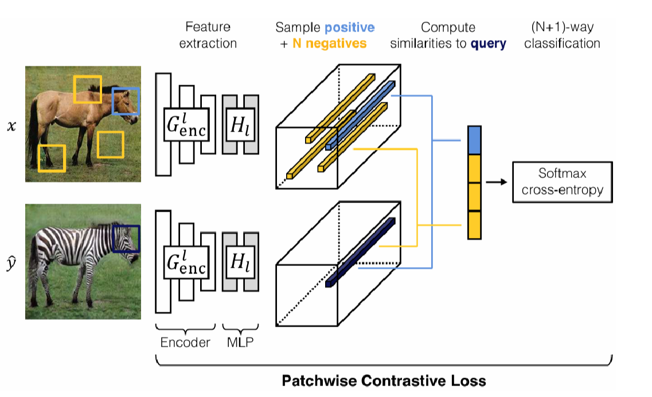
Contrastive Unpaired Translation (2)
Utilize patchwise contrastive loss to maximize mutual information between corresponding patches in input and output images.

Slide 9
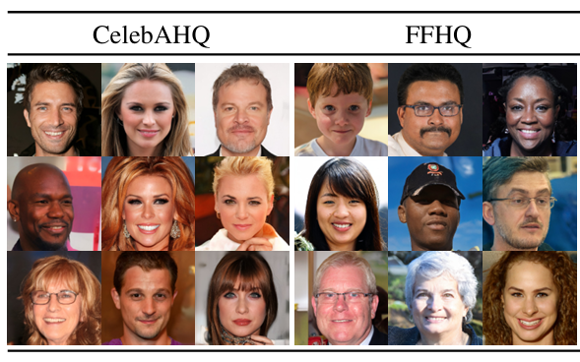
Latent Diffusion Model (1)
Proposed in High-resolution image synthesis with latent diffusion models by Rombach, R., Blattmann, A., Lorenz, D., Esser, P., & Ommer, B. (2022).
Instead of applying diffusion directly to high-dimensional pixel space, the model learns and denoises in a compressed latent space.
Introduce cross-attention layers that enable flexible control over image generation.

Slide 10
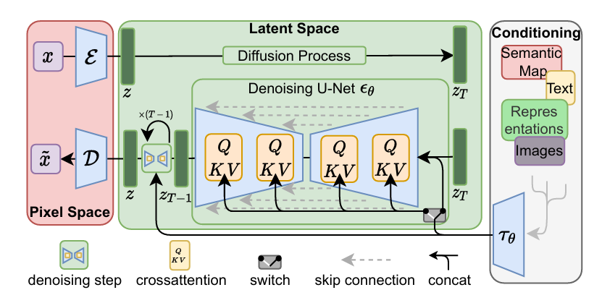
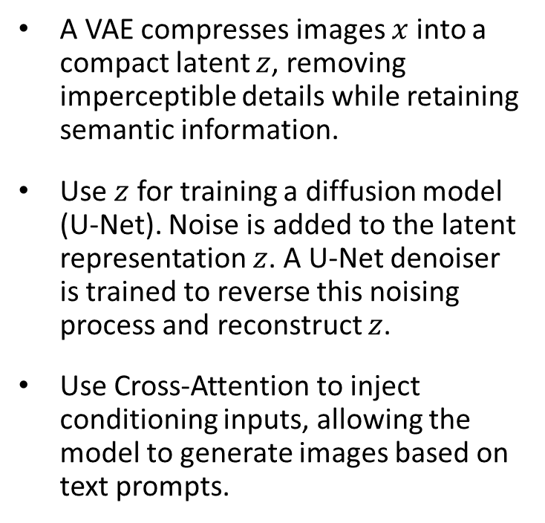
Latent Diffusion Model (2)
A VAE compresses images $x$ into a compact latent $z$, removing imperceptible details while retaining semantic information.
Use $z$ for training a diffusion model (U-Net). Noise is added to the latent representation $z$. A U-Net denoiser is trained to reverse this noising process and reconstruct $z$.
Use Cross-Attention to inject conditioning inputs, allowing the model to generate images based on text prompts.

Slide 11
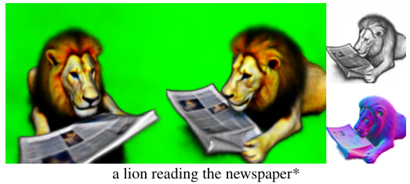
Score distillation sampling (1)
Proposed in Dreamfusion: Text-to-3d using 2d diffusion by Poole, B., Jain, A., Barron, J. T., & Mildenhall, B. (2022).
Deal with the problem of generating a 3D image from a text without training data.
Showed that pretrained 2D image-text models may be used for 3D synthesis, though 3D objects produced by this approach tend to lack realism and accuracy.

Slide 12
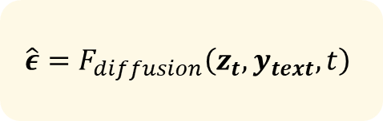


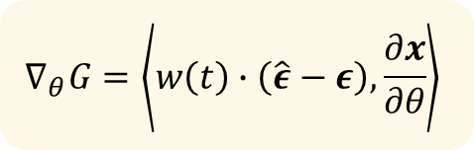
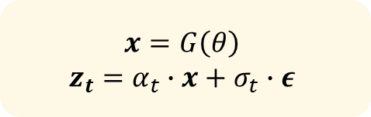
Score distillation sampling (2)
Loop N times
$$x=G\left(θ\right)$$
$$z_{t}=α_{t}∙x+σ_{t}∙ε$$
For each text prompt, we train a randomly initialized G from scratch.
Don’t need to fine-tune diffusion model.
Use diffusion model output as an additional loss
$$ε\sim 𝒩\left(0, I\right)$$
$$t\sim 𝒰\left(0,1\right)$$
$$\hat{ε}=F_{diffusion}\left(z_{t}, y_{text}, t\right)$$
$$θ=Update\left(θ\right)$$
$$∇_{θ}G=\left\langle w\left(t\right)∙\left(\hat{ε}−ε\right),\frac{∂x}{∂θ}\right\rangle$$

Slide 13
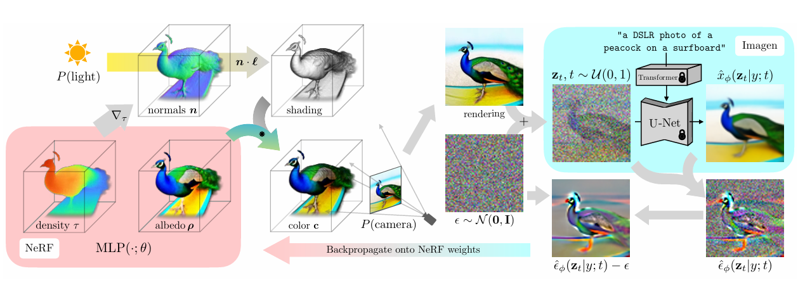
Score distillation sampling (3)

Slide 14
Delta denoising score
This is a powerful tool in public speaking. It involves varying pitch, tone, and volume to convey emotion, emphasize points, and maintain interest:
Pitch variation
Tone inflection
Volume control
Effective body language enhances your message, making it more impactful and memorable:
Meaningful eye contact
Purposeful gestures
Maintain good posture
Control your expressions

Slide 15
Paper contribution
Latent diffusion model and Stable diffusion
Score distillation sampling
Delta denoising score
Contrastive Unpaired Translation

Slide 16


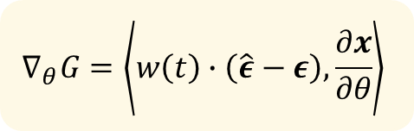
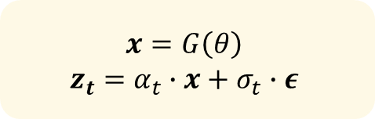
Contrastive Denoising Score
Loop N times
$$x=G\left(θ\right)$$
$$z_{t}=α_{t}∙x+σ_{t}∙ε$$
For each text prompt, we train a randomly initialized G from scratch.
Don’t need to fine-tune diffusion model.
Use diffusion model output as an additional loss
$$ε\sim 𝒩\left(0, I\right)$$
$$t\sim 𝒰\left(0,1\right)$$
$$\hat{ε}=F_{diffusion}\left(z_{t}, y_{text}, t\right)$$
$$θ=Update\left(θ\right)$$
$$∇_{θ}G=\left\langle w\left(t\right)∙\left(\hat{ε}−ε\right),\frac{∂x}{∂θ}\right\rangle$$

Slide 17
Experiments
Make eye contact with your audience to create a sense of intimacy and involvement
Weave relatable stories into your presentation using narratives that make your message memorable and impactful
Encourage questions and provide thoughtful responses to enhance audience participation
Use live polls or surveys to gather audience opinions, promoting engagement and making sure the audience feel involved

Slide 18
Conclusion
Make eye contact with your audience to create a sense of intimacy and involvement
Weave relatable stories into your presentation using narratives that make your message memorable and impactful
Encourage questions and provide thoughtful responses to enhance audience participation
Use live polls or surveys to gather audience opinions, promoting engagement and making sure the audience feel involved

Slide 19

Overcoming nervousness
Confidence-building strategies

Slide 20
Selecting visual aids
Enhancing your presentation

Slide 21
Effective delivery techniques
This is a powerful tool in public speaking. It involves varying pitch, tone, and volume to convey emotion, emphasize points, and maintain interest:
Pitch variation
Tone inflection
Volume control
Effective body language enhances your message, making it more impactful and memorable:
Meaningful eye contact
Purposeful gestures
Maintain good posture
Control your expressions

Slide 22
Navigating Q&A sessions
Know your material in advance
Anticipate common questions
Rehearse your responses
Maintaining composure during the Q&A session is essential for projecting confidence and authority. Consider the following tips for staying composed:
Stay calm
Actively listen
Pause and reflect
Maintain eye contact

Slide 23

Speaking impact
Your ability to communicate effectively will leave a lasting impact on your audience
Effectively communicating involves not only delivering a message but also resonating with the experiences, values, and emotions of those listening

Slide 24
Dynamic delivery
Learn to infuse energy into your delivery to leave a lasting impression.
One of the goals of effective communication is to motivate your audience.
Metric | Measurement | Target | Actual
Audience attendance | # of attendees | 150 | 120
Engagement duration | Minutes | 60 | 75
Q&A interaction | # of questions | 10 | 15
Positive feedback | Percentage (%) | 90 | 95
Rate of information retention | Percentage (%) | 80 | 85

Slide 25
Final tips & takeaways
Consistent rehearsal
Strengthen your familiarity
Refine delivery style
Pacing, tone, and emphasis
Timing and transitions
Aim for seamless, professional delivery
Practice audience
Enlist colleagues to listen & provide feedback
Seek feedback
Reflect on performance
Explore new techniques
Set personal goals
Iterate and adapt

Slide 26
Speaking engagement metrics
Impact factor | Measurement | Target | Achieved
Audience interaction | Percentage (%) | 85 | 88
Knowledge retention | Percentage (%) | 75 | 80
Post-presentation surveys | Average rating | 4.2 | 4.5
Referral rate | Percentage (%) | 10 | 12
Collaboration opportunities | # of opportunities | 8 | 10

Slide 27

Power of communication

Slide 28
Thank you
Dam Viet Anh
Dinh Thi Hoa
Nguyen Thanh Ha

