Slide 1
9. Unit tests

Slide 2
9.1. The Three Laws of TDD
TDD asks us to write unit tests before production code:
First Law You may not write production code until you have written a failing unit test.
Second Law You may not write more of a unit test than is sufficient to fail, and not compiling is failing.
Third Law You may not write more production code than is sufficient to pass the currently failing test.
Unit tests will cover virtually all of our production code.
The sheer bulk of those tests can present a daunting management problem.

Slide 3
9.2. Keeping Tests Clean
Test code is just as important as production code.
Unit tests that keep our code flexible, maintainable, and reusable
Without tests, you will be reluctant to make changes because of the fear that you will introduce undetected bugs!
If your tests are dirty, then your ability to change your code is hampered, then lose the ability to improve the structure of that code.
The dirtier your tests, the dirtier your code becomes.

Slide 4
9.3. Clean Tests
What makes a clean test?
Readability
Readability
Readability

Slide 5
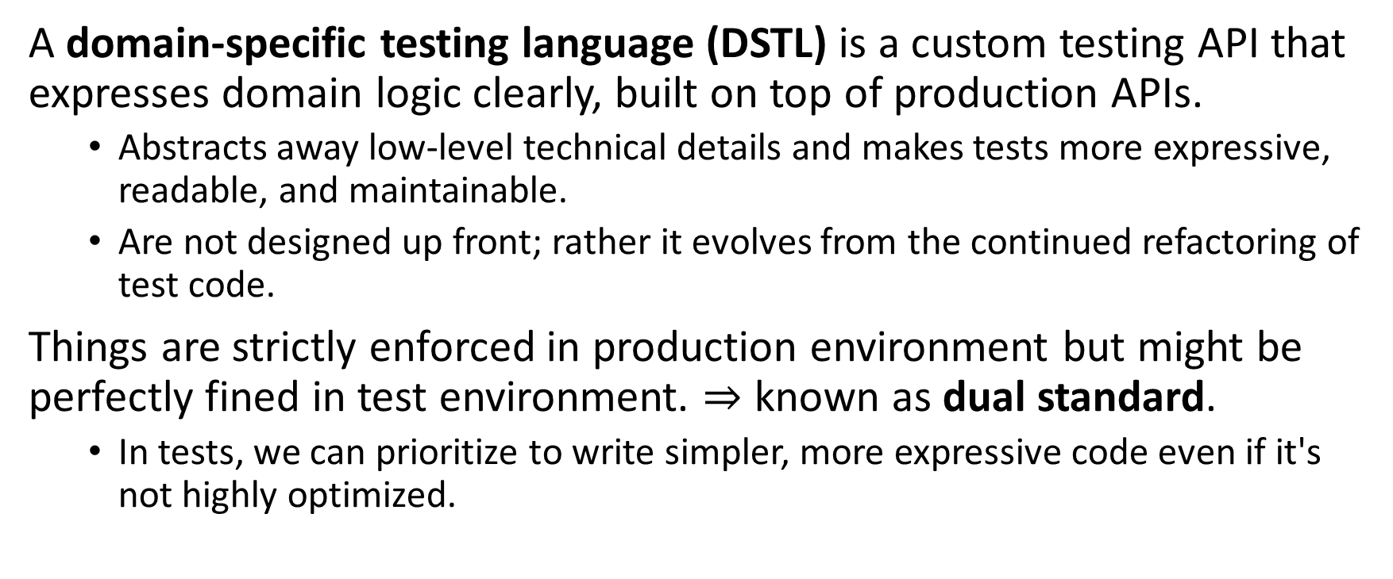
9.3. Clean Tests
A domain-specific testing language (DSTL) is a custom testing API that expresses domain logic clearly, built on top of production APIs.
Abstracts away low-level technical details and makes tests more expressive, readable, and maintainable.
Are not designed up front; rather it evolves from the continued refactoring of test code.
Things are strictly enforced in production environment but might be perfectly fined in test environment. $⇒$ known as dual standard.
In tests, we can prioritize to write simpler, more expressive code even if it's not highly optimized.

Slide 6
9.3. Clean Tests
public void testGetPageHieratchyAsXml() {
crawler.addPage(root, PathParser.parse("PageOne"));
crawler.addPage(root, PathParser.parse("PageTwo"));
request.setResource("root");
request.addInput("type", "pages");
Responder responder = new SerializedPageResponder();
SimpleResponse response = responder.makeResponse(root, request);
String xml = response.getContent();
assertEquals("text/xml", response.getContentType());
assertSubString("<name>PageOne</name>", xml);
assertSubString("<name>PageTwo</name>", xml);
}
☹
Without DSTL
public void testGetPageHierarchyAsXml() throws Exception {
makePages("PageOne", "PageTwo");
submitRequest("root", "type:pages");
assertResponseIsXML();
assertResponseContains("<name>PageOne</name>", "<name>PageTwo</name>");
}
☺
With DSTL

Slide 7
9.3. Clean Tests
public String getState() {
String state = "";
state += heater ? "H" : "h";
state += blower ? "B" : "b";
state += cooler ? "C" : "c";
state += hiTempAlarm ? "H" : "h";
state += loTempAlarm ? "L" : "l";
return state;
}
☺
Without
StringBuilder
public String getState() {
StringBuilder state = new StringBuilder(5);
state.append(heater ? 'H' : 'h');
state.append(blower ? 'B' : 'b');
state.append(cooler ? 'C' : 'c');
state.append(hiTempAlarm ? 'H' : 'h');
state.append(loTempAlarm ? 'L' : 'l');
return state.toString();
}
☺
With
StringBuilder

Slide 8
9.4. Single Concept per Test
public void testAddMonths() {
SerialDate d1 = SerialDate.createInstance(31, 5, 2004);
SerialDate d2 = SerialDate.addMonths(1, d1);
assertEquals(30, d2.getDayOfMonth());
assertEquals(6, d2.getMonth());
assertEquals(2004, d2.getYYYY());
SerialDate d3 = SerialDate.addMonths(2, d1);
assertEquals(31, d3.getDayOfMonth());
assertEquals(7, d3.getMonth());
assertEquals(2004, d3.getYYYY());
SerialDate d4 = SerialDate.addMonths(1, SerialDate.addMonths(1, d1));
assertEquals(30, d4.getDayOfMonth());
assertEquals(7, d4.getMonth());
assertEquals(2004, d4.getYYYY());
}
You should minimize the number of asserts per concept and test just one concept per test function.
Notes:
The three test functions probably ought to be like this:
• Given the last day of a month with 31 days (like May):
When you add one month, such that the last day of that month is the 30th (like June), then the date should be the 30th of that month, not the 31st.
When you add two months to that date, such that the final month has 31 days, then the date should be the 31st.
• Given the last day of a month with 30 days in it (like June):
When you add one month such that the last day of that month has 31 days, then the date should be the 30th, not the 31st.
When you increment the month, the date can be no greater than the last day of the month.
This implies that incrementing the month on February 28th should yield March 28th. That test is missing and would be a useful test to write.

Slide 9
9.5. F.I.R.S.T
Fast Tests should be fast. They should run quickly.
Independent Tests should not depend on each other. You should be able to run each test independently and in any order you like.
Repeatable Tests should be repeatable in any environment.
Self-Validating The tests should have a boolean output. Either they pass or fail.
Timely The tests need to be written in a timely fashion. Unit tests should be written justbefore the production code that makes them pass.
Notes:
- Fast When tests run slow, you won’t want to run them frequently. If you don’t run them frequently, you won’t find problems early enough to fix them easily. You won’t feel as free to clean up the code.
- Independent When tests depend on each other, then the first one to fail causes a cascade of downstream failures, making diagnosis difficult and hiding downstream defects.
- Repeatable You should be able to run the tests in the production environment, in the QA environment, and on your laptop while riding home on the train without a network. If your tests aren’t repeatable in any environment, then you’ll always have an excuse for why they fail. You’ll also find yourself unable to run the tests when the environment isn’t available.
- Self-Validating You should not have to read through a log file to tell whether the tests pass. You should not have to manually compare two different text files to see whether the tests pass. If the tests aren’t self-validating, then failure can become subjective and running the tests can require a long manual evaluation.
- Timely If you write tests after the production code, then you may find the production code to be hard to test. You may decide that some production code is too hard to test. You may not design the production code to be testable.

