Slide 1
Chapter 4: Threads

Slide 2
Chapter 4: Threads
Overview
Multithreading Models
Threading Issues
Pthreads
Windows XP Threads
Linux Threads
Java Threads

Slide 3

Single and Multithreaded Processes

Slide 4
Benefits
Responsiveness
Resource Sharing
Economy
Utilization of MP Architectures

Slide 5
User and Kernel Threads
User threads - Thread management done by user-level threads library.
Kernel threads - Threads directly supported by the kernel.

Slide 6
Kernel Threads
Examples
  Windows XP/2000
  Solaris
  Linux
  Tru64 UNIX
  Mac OS X

Slide 7
Multithreading Models
Mapping user threads to kernel threads:
Many-to-One
One-to-One
Many-to-Many

Slide 8
Many-to-One
Many user-level threads mapped to single kernel thread
Examples:
  Solaris Green Threads
  GNU Portable Threads

Slide 9

Many-to-One Model

Slide 10
One-to-One
Each user-level thread maps to kernel thread
Examples
  Windows NT/XP/2000
  Linux
  Solaris 9 and later

Slide 11

One-to-one Model

Slide 12
Many-to-Many Model
Allows many user level threads to be mapped to many kernel threads
Allows the operating system to create a sufficient number of kernel threads
Solaris prior to version 9
Windows NT/2000 with the ThreadFiber package

Slide 13

Many-to-Many Model

Slide 14
Two-level Model
Similar to M:M, except that it allows a user thread to be bound to kernel thread
Examples
  IRIX
  HP-UX
  Tru64 UNIX
  Solaris 8 and earlier

Slide 15

Two-level Model

Slide 16

Java Threads
Java threads are managed by the JVM
Java threads may be created by:
  Implementing the Runnable interface

Slide 17
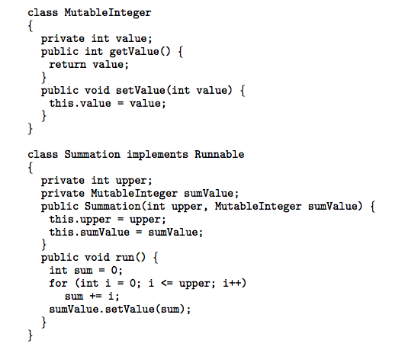
Java Threads - Example Program

Slide 18
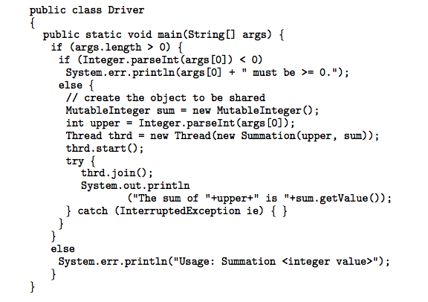
Java Threads - Example Program

Slide 19
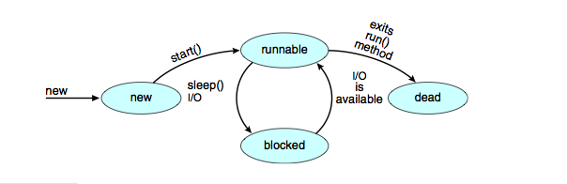
Java Thread States

Slide 20
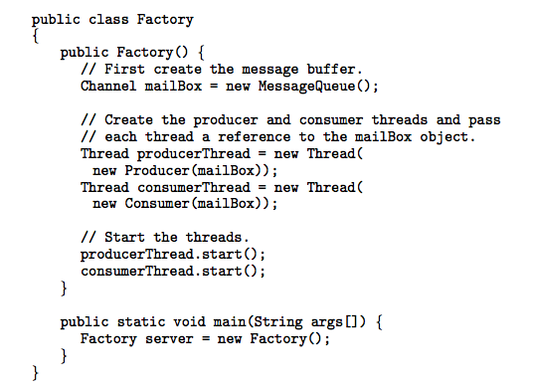
Java Threads - Producer-Consumer

Slide 21
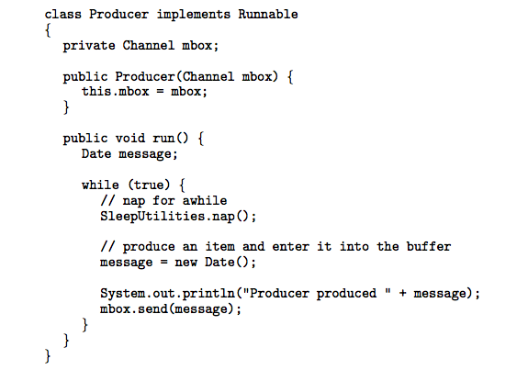
Java Threads - Producer-Consumer

Slide 22
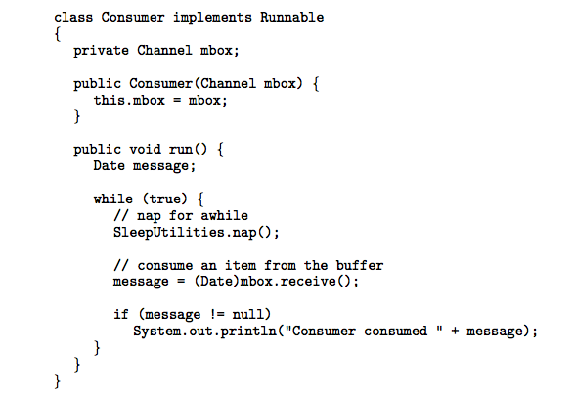
Java Threads - Producer-Consumer

Slide 23
Threading Issues
Semantics of fork() and exec() system calls
Thread cancellation
Signal handling
Thread pools
Thread specific data
Scheduler activations

Slide 24
Semantics of fork() and exec()
Does fork() duplicate only the calling thread or all threads?

Slide 25
Thread Cancellation
Terminating a thread before it has finished
Two general approaches:
  Asynchronous cancellation terminates the target thread immediately
  Deferred cancellation allows the target thread to periodically check if it should be cancelled

Slide 26

Thread Cancellation
Deferred cancellation in Java
Interrupting a thread

Slide 27
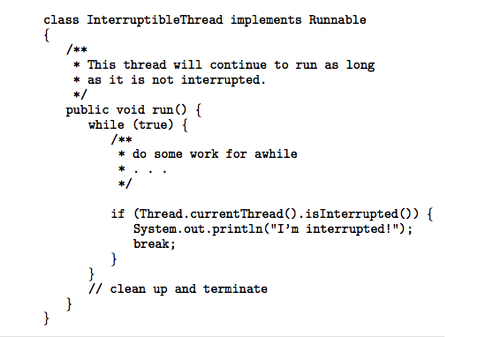
Thread Cancellation
Deferred cancellation in Java
Checking interruption status

Slide 28
Signal Handling
Signals are used in UNIX systems to notify a process that a particular event has occurred
A signal handler is used to process signals
  Signal is generated by particular event
  Signal is delivered to a process
  Signal is handled
Options:
  Deliver the signal to the thread to which the signal applies
  Deliver the signal to every thread in the process
  Deliver the signal to certain threads in the process
  Assign a specific threa to receive all signals for the process

Slide 29
Thread Pools
Create a number of threads in a pool where they await work
Advantages:
  Usually slightly faster to service a request with an existing thread than create a new thread
  Allows the number of threads in the application(s) to be bound to the size of the pool

Slide 30
Thread Pools
Java provides 3 thread pool architectures:
1. Single thread executor - pool of size 1.
2. Fixed thread executor - pool of fixed size.
3. Cached thread pool - pool of unbounded size

Slide 31
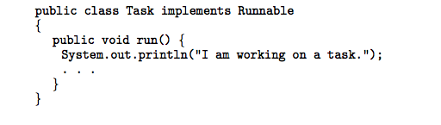
Thread Pools
A task to be serviced in a thread pool

Slide 32
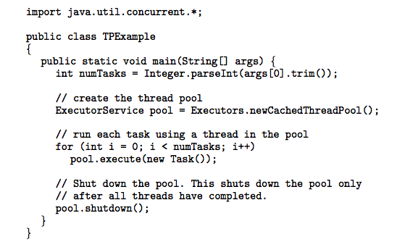
Thread Pools
Creating a thread pool in Java

Slide 33
Thread Specific Data
Allows each thread to have its own copy of data
Useful when you do not have control over the thread creation process (i.e., when using a thread pool)

Slide 34
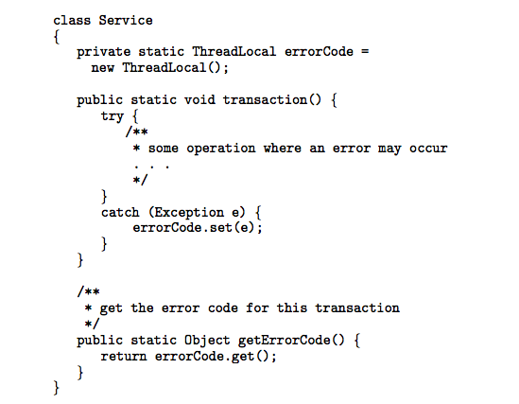
Thread Specific Data
Thread-specific data in Java.

Slide 35
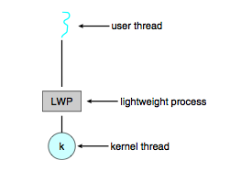
Scheduler Activations
Both M:M and Two-level models require communication to maintain the appropriate number of kernel threads allocated to the application
Scheduler activations provide upcalls - a communication mechanism from the kernel to the thread library
This communication allows an application to maintain the correct number kernel threads

Slide 36
Pthreads
A POSIX standard (IEEE 1003.1c) API for thread creation and synchronization
API specifies behavior of the thread library, implementation is up to development of the library
Common in UNIX operating systems (Solaris, Linux, Mac OS X)

Slide 37
Windows XP Threads
Implements the one-to-one mapping
Each thread contains
  A thread id
  Register set
  Separate user and kernel stacks
  Private data storage area
The register set, stacks, and private storage area are known as the context of the threads

Slide 38
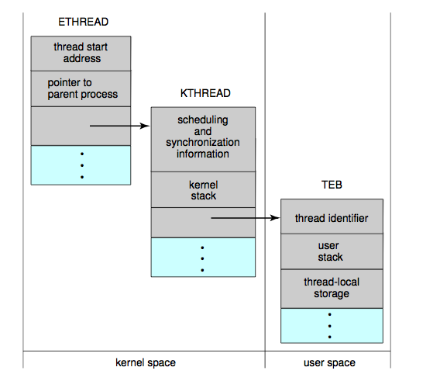
Windows XP Threads

Slide 39
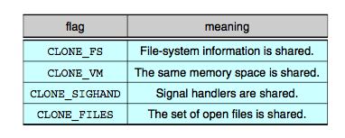
Linux Threads
Linux refers to them as tasks rather than threads
Thread creation is done through clone() system call
clone() allows a child task to share the address space of the parent task (process)

Slide 40
End of Chapter 4

