Slide 1
Chapter 15: Security

Slide 2
Chapter 15: Security
The Security Problem
Program Threats
System and Network Threats
Cryptography as a Security Tool
User Authentication
Implementing Security Defenses
Firewalling to Protect Systems and Networks
Computer-Security Classifications
An Example: Windows XP

Slide 3
Objectives
To discuss security threats and attacks
To explain the fundamentals of encryption, authentication, and hashing
To examine the uses of cryptography in computing
To describe the various countermeasures to security attacks

Slide 4
The Security Problem
Security must consider external environment of the system, and protect the system resources
Intruders (crackers) attempt to breach security
Threat is potential security violation
Attack is attempt to breach security
Attack can be accidental or malicious
Easier to protect against accidental than malicious misuse

Slide 5
Security Violations
Categories
  Breach of confidentiality
  Breach of integrity
  Breach of availability
  Theft of service
  Denial of service
Methods
  Masquerading (breach authentication)
  Replay attack
    Message modification
  Man-in-the-middle attack
  Session hijacking

Slide 6
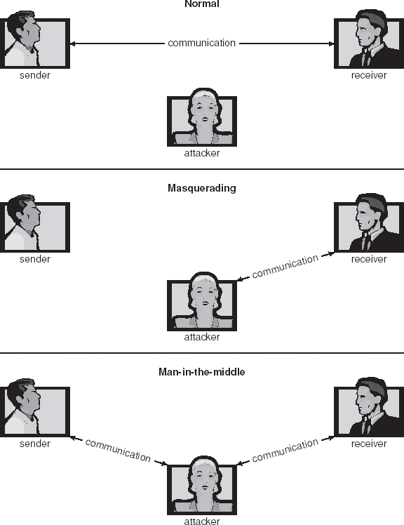
Standard Security Attacks

Slide 7
Security Measure Levels
Security must occur at four levels to be effective:
  Physical
  Human
    Avoid social engineering, phishing, dumpster diving
  Operating System
  Network
Security is as week as the weakest chain

Slide 8
Program Threats
Trojan Horse
  Code segment that misuses its environment
  Exploits mechanisms for allowing programs written by users to be executed by other users
  Spyware, pop-up browser windows, covert channels
Trap Door
  Specific user identifier or password that circumvents normal security procedures
  Could be included in a compiler
Logic Bomb
  Program that initiates a security incident under certain circumstances
Stack and Buffer Overflow
  Exploits a bug in a program (overflow either the stack or memory buffers)

Slide 9
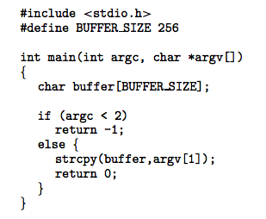
C Program with Buffer-overflow Condition

Slide 10
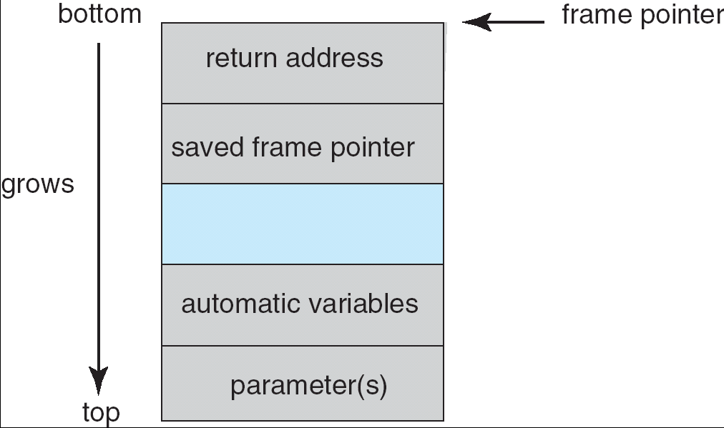
Layout of Typical Stack Frame

Slide 11
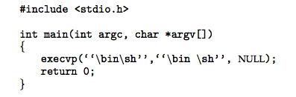
Modified Shell Code

Slide 12
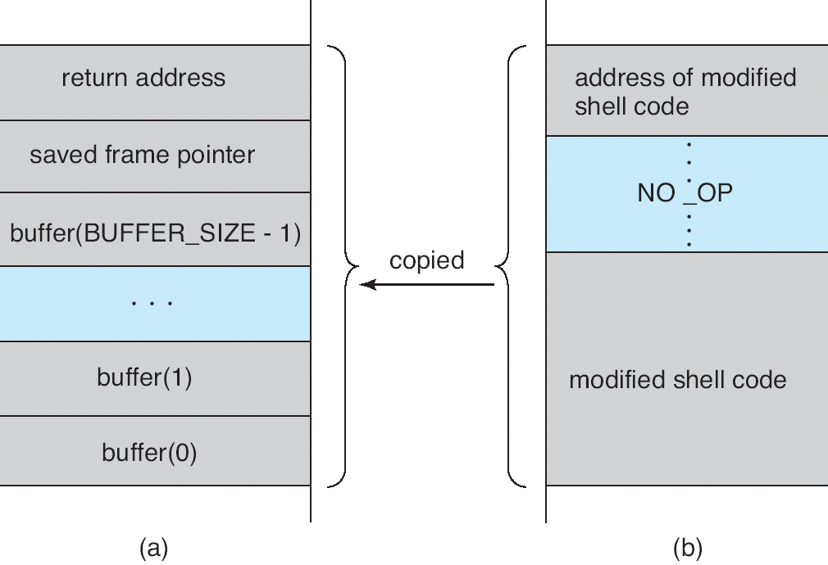
Hypothetical Stack Frame
Before attack
After attack

Slide 13
Program Threats (Cont.)
Viruses
  Code fragment embedded in legitimate program
  Very specific to CPU architecture, operating system, applications
  Usually borne via email or as a macro
    Visual Basic Macro to reformat hard drive
      Sub AutoOpen()
      Dim oFS
      Set oFS = CreateObject(’’Scripting.FileSystemObject’’)
      vs = Shell(’’c:command.com /k format c:’’,vbHide)
      End Sub

Slide 14
Program Threats (Cont.)
Virus dropper inserts virus onto the system
Many categories of viruses, literally many thousands of viruses
  File
  Boot
  Macro
  Source code
  Polymorphic
  Encrypted
  Stealth
  Tunneling
  Multipartite
  Armored

Slide 15
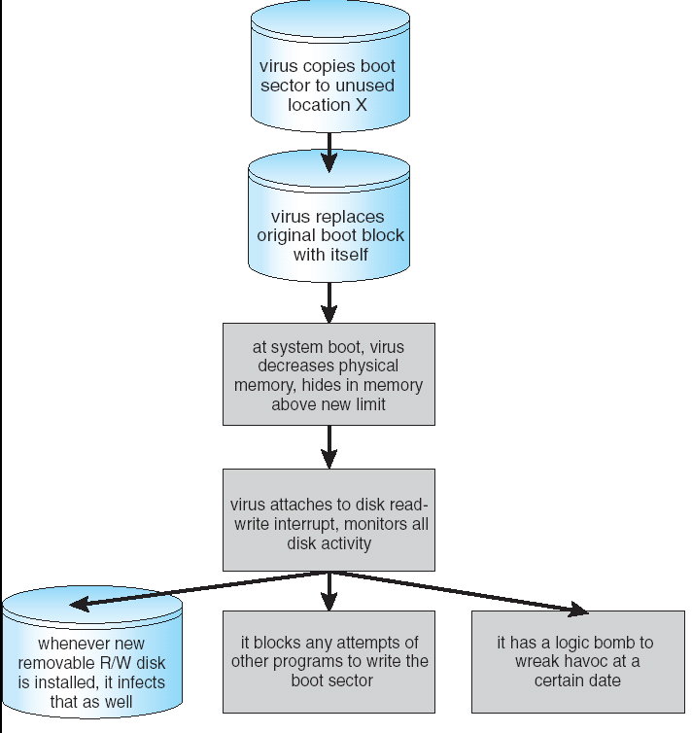
A Boot-sector Computer Virus

Slide 16
System and Network Threats
Worms – use spawn mechanism; standalone program
Internet worm
  Exploited UNIX networking features (remote access) and bugs in finger and sendmail programs
  Grappling hook program uploaded main worm program
Port scanning
  Automated attempt to connect to a range of ports on one or a range of IP addresses
Denial of Service
  Overload the targeted computer preventing it from doing any useful work
  Distributed denial-of-service (DDOS) come from multiple sites at once

Slide 17
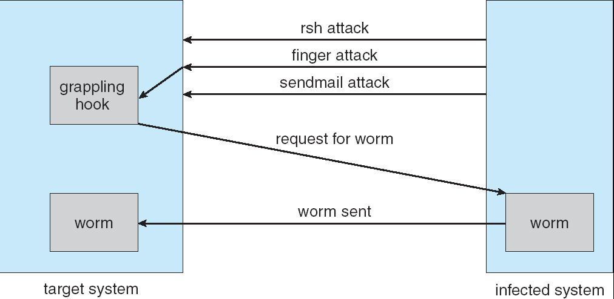
The Morris Internet Worm

Slide 18
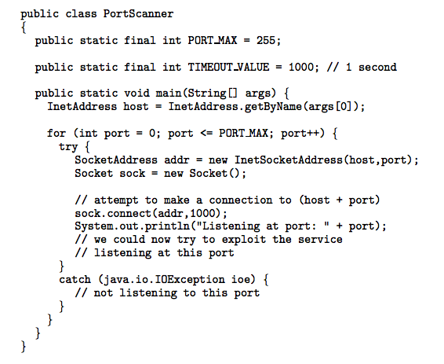
Port Scan in Java

Slide 19
Cryptography as a Security Tool
Broadest security tool available
  Source and destination of messages cannot be trusted without cryptography
  Means to constrain potential senders (sources) and / or receivers (destinations) of messages
Based on secrets (keys)

Slide 20
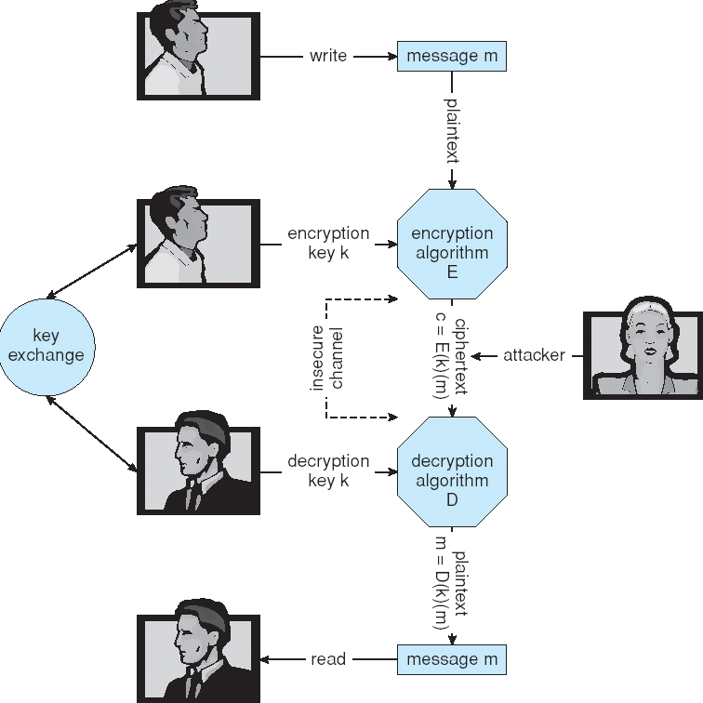
Secure Communication over Insecure Medium

Slide 21
Encryption
Encryption algorithm consists of
  Set of K keys
  Set of M Messages
  Set of C ciphertexts (encrypted messages)
  A function E : K → (M→C). That is, for each k ∈ K, E(k) is a function for generating ciphertexts from messages.
    Both E and E(k) for any k should be efficiently computable functions.
  A function D : K → (C → M). That is, for each k ∈ K, D(k) is a function for generating messages from ciphertexts.
    Both D and D(k) for any k should be efficiently computable functions.

Slide 22
Encryption (Cont.)
An encryption algorithm must provide this essential property: Given a ciphertext c ∈ C, a computer can compute m such that E(k)(m) = c only if it possesses D(k).
  Thus, a computer holding D(k) can decrypt ciphertexts to the plaintexts used to produce them, but a computer not holding D(k) cannot decrypt ciphertexts.
  Since ciphertexts are generally exposed (for example, sent on the network), it is important that it be infeasible to derive D(k) from the ciphertexts

Slide 23
Symmetric Encryption
Same key used to encrypt and decrypt
  E(k) can be derived from D(k), and vice versa
DES is most commonly used symmetric block-encryption algorithm (created by US Govt)
  Encrypts a block of data at a time
Triple-DES considered more secure
Advanced Encryption Standard (AES), twofish up and coming
RC4 is most common symmetric stream cipher, but known to have vulnerabilities
  Encrypts/decrypts a stream of bytes (i.e wireless transmission)
  Key is a input to psuedo-random-bit generator
    Generates an infinite keystream

Slide 24
Asymmetric Encryption
Public-key encryption based on each user having two keys:
  public key – published key used to encrypt data
  private key – key known only to individual user used to decrypt data
Must be an encryption scheme that can be made public without making it easy to figure out the decryption scheme
  Most common is RSA block cipher
  Efficient algorithm for testing whether or not a number is prime
  No efficient algorithm is know for finding the prime factors of a number

Slide 25
Asymmetric Encryption (Cont.)
Formally, it is computationally infeasible to derive D(k_{d} , N) from E(k_{e} , N), and so E(k_{e} , N) need not be kept secret and can be widely disseminated
  E(k_{e} , N) (or just k_{e}) is the public key
  D(k_{d} , N) (or just k_{d}) is the private key
  N is the product of two large, randomly chosen prime numbers p and q (for example, p and q are 512 bits each)
  Encryption algorithm is E(k_{e} , N)(m) = m^{ke} mod N, where k_{e} satisfies k_{e}k_{d} mod (p−1)(q −1) = 1
  The decryption algorithm is then D(k_{d} , N)(c) = c^{kd} mod N

Slide 26
Asymmetric Encryption Example
For example. make p = 7and q = 13
We then calculate N = 7∗13 = 91 and (p−1)(q−1) = 72
We next select k_{e} relatively prime to 72 and< 72, yielding 5
Finally,we calculate k_{d} such that k_{e}k_{d} mod 72 = 1, yielding 29
We how have our keys
  Public key, k_{e,} N = 5, 91
  Private key, k_{d} , N = 29, 91
Encrypting the message 69 with the public key results in the cyphertext 62
Cyphertext can be decoded with the private key
  Public key can be distributed in cleartext to anyone who wants to communicate with holder of public key

Slide 27
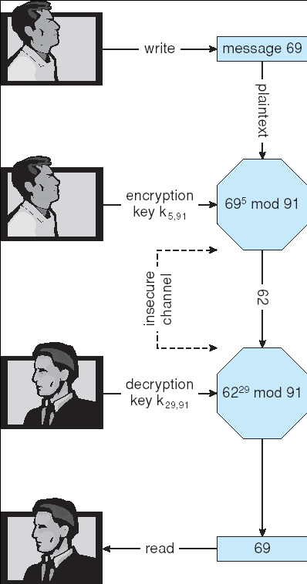
Encryption and Decryption using RSA Asymmetric Cryptography

Slide 28
Cryptography (Cont.)
Note symmetric cryptography based on transformations, asymmetric based on mathematical functions
  Asymmetric much more compute intensive
  Typically not used for bulk data encryption

Slide 29
Authentication
Constraining set of potential senders of a message
  Complementary and sometimes redundant to encryption
  Also can prove message unmodified
Algorithm components
  A set K of keys
  A set M of messages
  A set A of authenticators
  A function S : K → (M→ A)
    That is, for each k ∈ K, S(k) is a function for generating authenticators from messages
    Both S and S(k) for any k should be efficiently computable functions
  A function V : K → (M× A→ {true, false}). That is, for each k ∈ K, V(k) is a function for verifying authenticators on messages
    Both V and V(k) for any k should be efficiently computable functions

Slide 30
Authentication (Cont.)
For a message m, a computer can generate an authenticator a ∈ A such that V(k)(m, a) = true only if it possesses S(k)
Thus, computer holding S(k) can generate authenticators on messages so that any other computer possessing V(k) can verify them
Computer not holding S(k) cannot generate authenticators on messages that can be verified using V(k)
Since authenticators are generally exposed (for example, they are sent on the network with the messages themselves), it must not be feasible to derive S(k) from the authenticators

Slide 31
Authentication – Hash Functions
Basis of authentication
Creates small, fixed-size block of data (message digest, hash value) from m
Hash Function H must be collision resistant on m
  Must be infeasible to find an m’ ≠ m such that H(m) = H(m’)
If H(m) = H(m’), then m = m’
  The message has not been modified
Common message-digest functions include MD5, which produces a 128-bit hash, and SHA-1, which outputs a 160-bit hash

Slide 32
Authentication - MAC
Symmetric encryption used in message-authentication code (MAC) authentication algorithm
Simple example:
  MAC defines S(k)(m) = f (k, H(m))
    Where f is a function that is one-way on its first argument
      k cannot be derived from f (k, H(m))
    Because of the collision resistance in the hash function, reasonably assured no other message could create the same MAC
    A suitable verification algorithm is V(k)(m, a) ≡ ( f (k,m) = a)
    Note that k is needed to compute both S(k) and V(k), so anyone able to compute one can compute the other

Slide 33
Authentication – Digital Signature
Based on asymmetric keys and digital signature algorithm
Authenticators produced are digital signatures
In a digital-signature algorithm, computationally infeasible to derive S(k_{s} ) from V(k_{v})
  V is a one-way function
  Thus, k_{v} is the public key and k_{s} is the private key
Consider the RSA digital-signature algorithm
  Similar to the RSA encryption algorithm, but the key use is reversed
  Digital signature of message S(k_{s} )(m) = H(m)^{ks} mod N
  The key k_{s} again is a pair d, N, where N is the product of two large, randomly chosen prime numbers p and q
  Verification algorithm is V(k_{v})(m, a) ≡ (a^{kv} mod N = H(m))
    Where k_{v} satisfies k_{v}k_{s} mod (p − 1)(q − 1) = 1

Slide 34
Authentication (Cont.)
Why authentication if a subset of encryption?
  Fewer computations (except for RSA digital signatures)
  Authenticator usually shorter than message
  Sometimes want authentication but not confidentiality
    Signed patches et al
  Can be basis for non-repudiation

Slide 35
Key Distribution
Delivery of symmetric key is huge challenge
  Sometimes done out-of-band
Asymmetric keys can proliferate – stored on key ring
  Even asymmetric key distribution needs care – man-in-the-middle attack

Slide 36
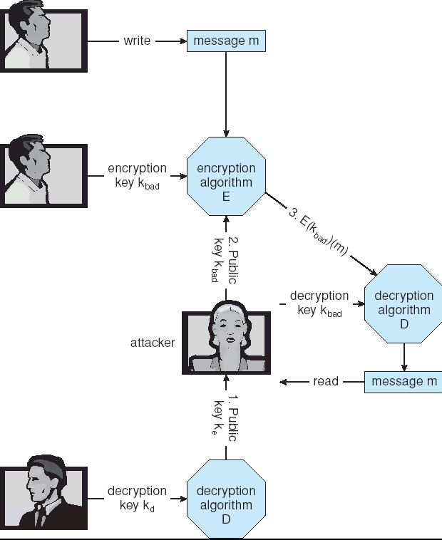
Man-in-the-middle Attack on Asymmetric Cryptography

Slide 37
Digital Certificates
Proof of who or what owns a public key
Public key digitally signed a trusted party
Trusted party receives proof of identification from entity and certifies that public key belongs to entity
Certificate authority are trusted party – their public keys included with web browser distributions
  They vouch for other authorities via digitally signing their keys, and so on

Slide 38
Encryption Example - SSL
Insertion of cryptography at one layer of the ISO network model (the transport layer)
SSL – Secure Socket Layer (also called TLS)
Cryptographic protocol that limits two computers to only exchange messages with each other
  Very complicated, with many variations
Used between web servers and browsers for secure communication (credit card numbers)
The server is verified with a certificate assuring client is talking to correct server
Asymmetric cryptography used to establish a secure session key (symmetric encryption) for bulk of communication during session
Communication between each computer theb uses symmetric key cryptography

Slide 39
User Authentication
Crucial to identify user correctly, as protection systems depend on user ID
User identity most often established through passwords, can be considered a special case of either keys or capabilities
  Also can include something user has and /or a user attribute
Passwords must be kept secret
  Frequent change of passwords
  Use of “non-guessable” passwords
  Log all invalid access attempts
Passwords may also either be encrypted or allowed to be used only once

Slide 40
Implementing Security Defenses
Defense in depth is most common security theory – multiple layers of security
Security policy describes what is being secured
Vulnerability assessment compares real state of system / network compared to security policy
Intrusion detection endeavors to detect attempted or successful intrusions
  Signature-based detection spots known bad patterns
  Anomaly detection spots differences from normal behavior
    Can detect zero-day attacks
  False-positives and false-negatives a problem
Virus protection
Auditing, accounting, and logging of all or specific system or network activities

Slide 41
Firewalling to Protect Systems and Networks
A network firewall is placed between trusted and untrusted hosts
  The firewall limits network access between these two security domains
Can be tunneled or spoofed
  Tunneling allows disallowed protocol to travel within allowed protocol (i.e. telnet inside of HTTP)
  Firewall rules typically based on host name or IP address which can be spoofed
Personal firewall is software layer on given host
  Can monitor / limit traffic to and from the host
Application proxy firewall understands application protocol and can control them (i.e. SMTP)
System-call firewall monitors all important system calls and apply rules to them (i.e. this program can execute that system call)

Slide 42
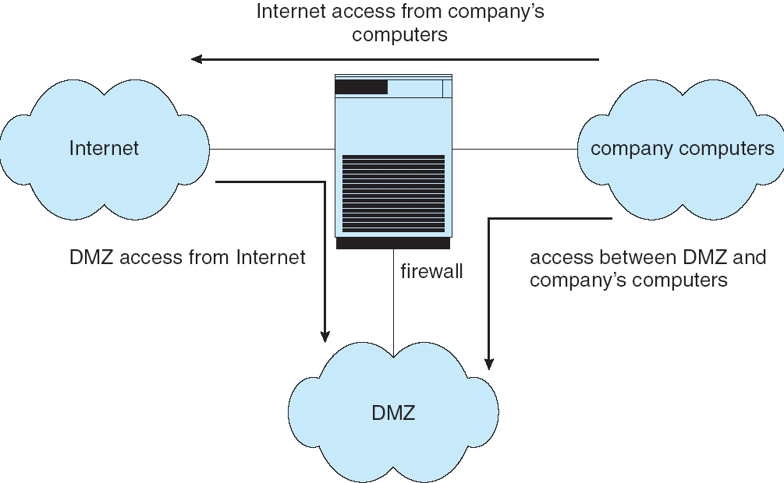
Network Security Through Domain Separation Via Firewall

Slide 43
Computer Security Classifications
U.S. Department of Defense outlines four divisions of computer security: A, B, C, and D.
D – Minimal security.
C – Provides discretionary protection through auditing. Divided into C1 and C2. C1 identifies cooperating users with the same level of protection. C2 allows user-level access control.
B – All the properties of C, however each object may have unique sensitivity labels. Divided into B1, B2, and B3.
A – Uses formal design and verification techniques to ensure security.

Slide 44
Example: Windows XP
Security is based on user accounts
  Each user has unique security ID
  Login to ID creates security access token
    Includes security ID for user, for user’s groups, and special privileges
    Every process gets copy of token
    System checks token to determine if access allowed or denied
Uses a subject model to ensure access security. A subject tracks and manages permissions for each program that a user runs
Each object in Windows XP has a security attribute defined by a security descriptor
  For example, a file has a security descriptor that indicates the access permissions for all users

Slide 45
End of Chapter 15

