Slide 1

Technology Trend
Le Duc Anh
27.07.2025

Slide 2



OUTLINE
Executive Summary
Introduction
Methodology
Results
Visualization – Charts
Dashboard

Slide 3

EXECUTIVE SUMMARY
Data contextual and data analyst goal
Methodology description
Data gathering
Data analysis
Data visualizations
Results supported with graphs

Slide 4

INTRODUCTION
The necessity of data-driven decision making
The need to adapts with trends in data technologies
Identify emerging and future skill requirements
Report for: company managers
Value: meaningful information regarding tech trend
Main research questions:
Which programming languages are most in demand?
Which database technologies are currently most sought after?

Slide 5

METHODOLOGY
Data collection methods
Downloading directedly
Colleting data & explore the contents
Python
Data wrangling
Handling duplicates
Identify and addressing missing values
Normalizing the data
Exploratory data analysis
Perform EDA
Data distribution
Handling outliers
Data visualization
Dashboard
Power BI
Source of data: Stack Overflow Developer Survey Dataset
https://survey.stackoverflow.co/datasets/stack-overflow-developer-survey-2025.zip

Slide 6
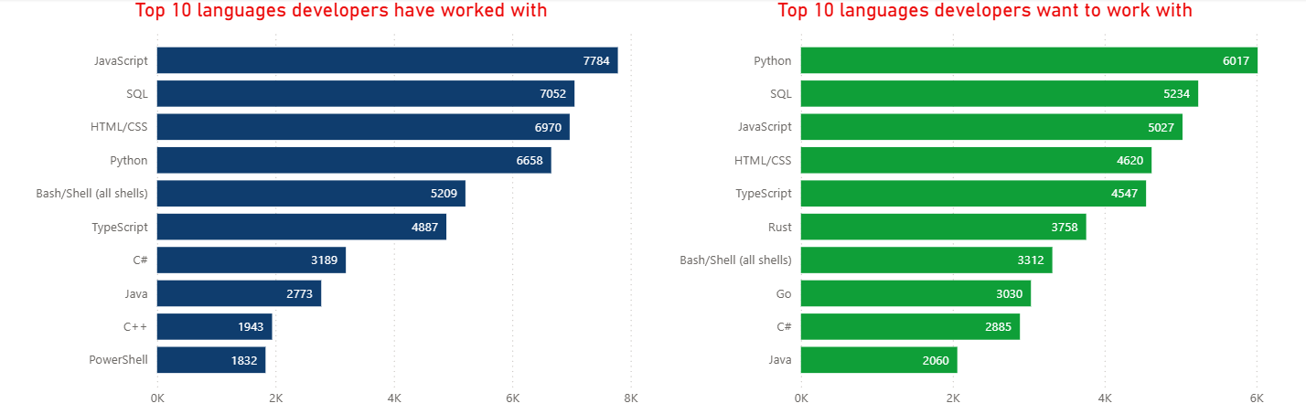
PROGRAMMING LANGUAGE TRENDS

Slide 7
PROGRAMMING LANGUAGE TRENDS - FINDINGS & IMPLICATIONS
Findings
Python is expected to take the leading position of JavaScript
SQL remains its 2nd position
HTML/CSS lose its 3rd to 4th position
Bash/Shell gets out of top 5, which is replaced by TypeScript
C++ disappears from top 10, while Rust shows up for the 1st time
Implications
Python will gain significant attention in the near future
SQL is still the most popular language
JavaScript is no more in desire
Pay more attention to the raising of Rust

Slide 8
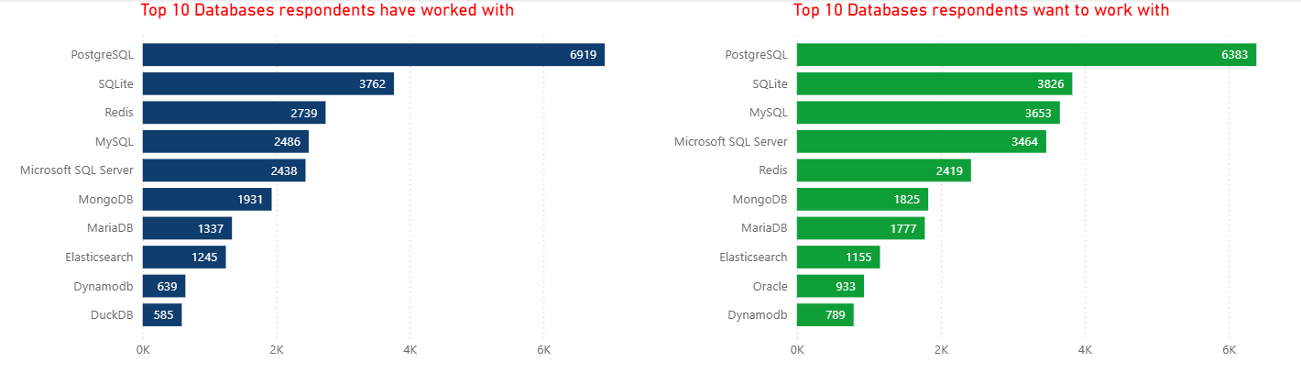
DATABASE TRENDS

Slide 9
DATABASE TRENDS - FINDINGS & IMPLICATIONS
Findings
PostgreSQL is the dominant database
Redis loses lot of interests, drop from 3rd to 5th position
Oracle appears in the top 10 for the 1st time, while DuckDB gone
Implications
PostgreSQL is still the most popular database
The next four databases: SQLite, myQSL, MicrosoftSQL Serve, Redis are being used quite similar among developers
Redis is claiming fast and need more attention

Slide 10
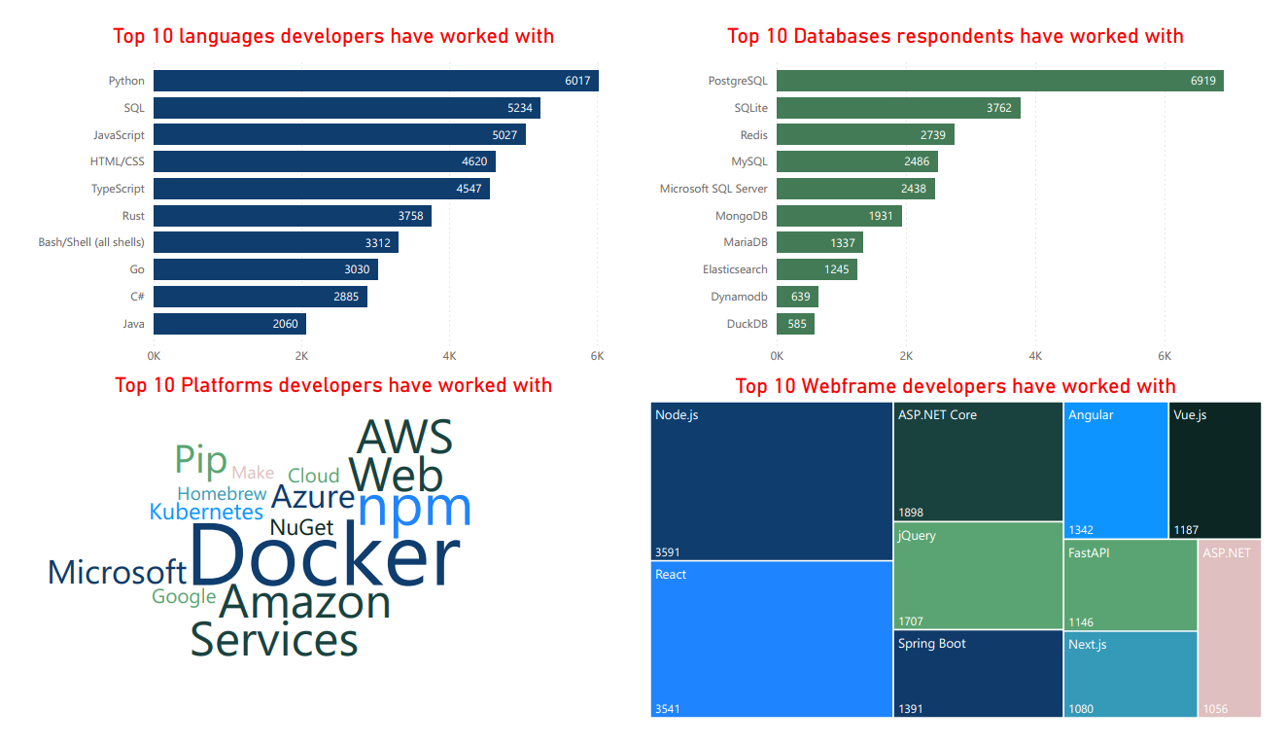

Slide 11
