Slide 1
Introduction C#
Mentor: Nguyen Manh Hung
Reported by HungNM
Updated 10/2020

Slide 2
Content
Basic
Advanced
Data types, classes, and variables
Switches and loops
Stream I/O
Generic
Collections
Delegates
LINQ
Task
Multi-threading
Reported by HungNM
Updated 10/2020

Slide 3
Document
https://docs.microsoft.com/en-us/dotnet/csharp/
https://www.w3schools.com/cs/default.asp
https://www.tutorialsteacher.com/csharp/csharp-tutorials
http://www.java2s.com/Tutorial/CSharp/CatalogCSharp.htm
https://www.guru99.com/c-sharp-tutorial.html
Reported by HungNM
Updated 10/2020

Slide 4
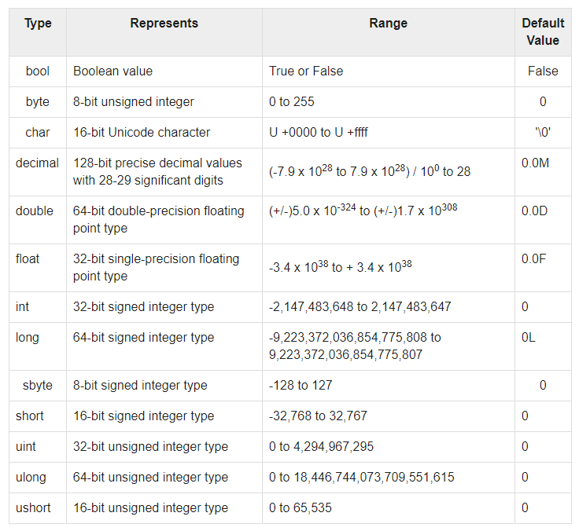
Data types
Reported by HungNM
Updated 10/2020

Slide 5
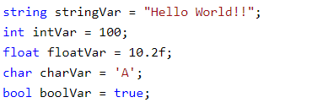
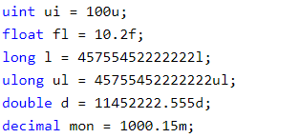


Example
Reported by HungNM
Updated 10/2020

Slide 6
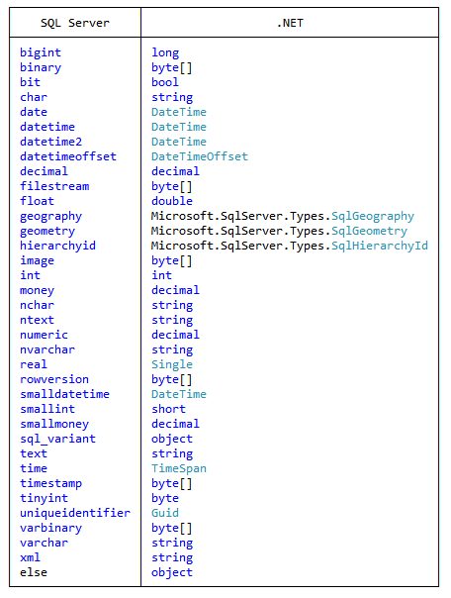
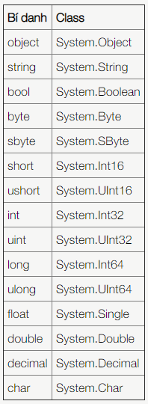
Note
Reported by HungNM
Updated 10/2020

Slide 7
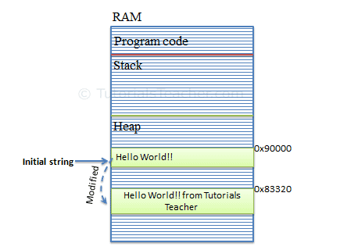
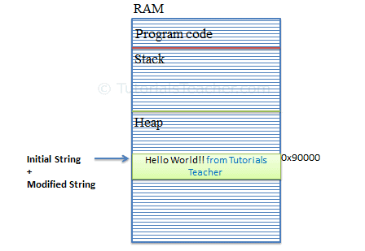
String vs StringBuilder
Reported by HungNM
Updated 10/2020

Slide 8

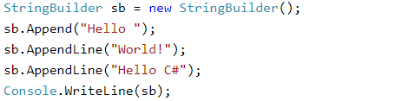
StringBuilder
Reported by HungNM
Updated 10/2020

Slide 9
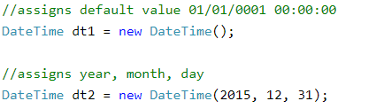
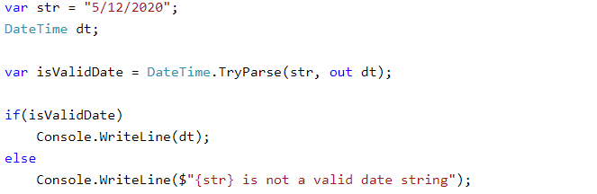
Datetime
Reported by HungNM
Updated 10/2020

Slide 10
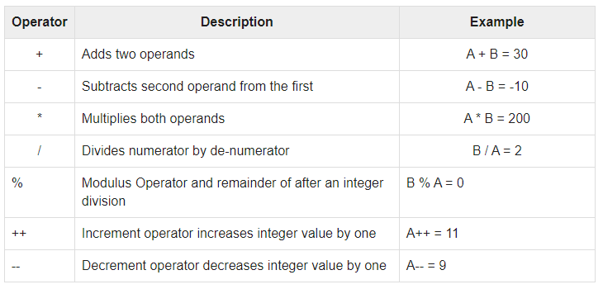
Operators
Reported by HungNM
Updated 10/2020

Slide 11

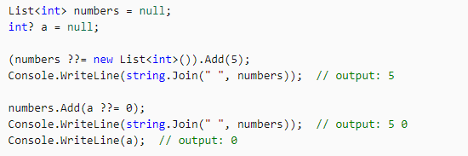
Note
condition ? statement 1 : statement 2 <=> if(condition) statement 1 else statement 2
?? (C# 7.3) <=> if(A is null) B = A1 else B = A <=> A == null? A1: A2
??= (C# 8.0) <=> if(A is null) A = A1 else A <=> A == null? A1: A
Reported by HungNM
Updated 10/2020

Slide 12
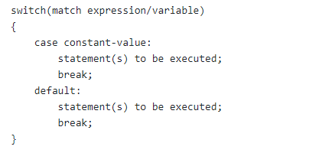
Switch
Reported by HungNM
Updated 10/2020

Slide 13
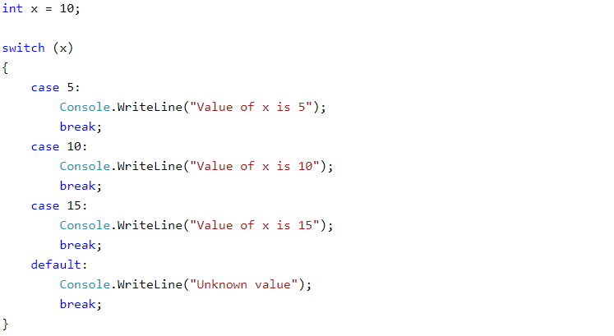
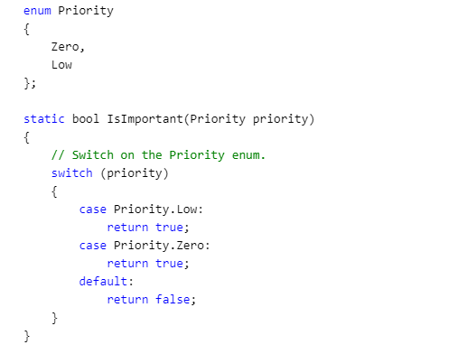
Example
Reported by HungNM
Updated 10/2020

Slide 14
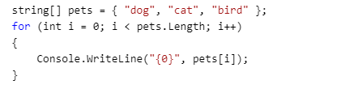
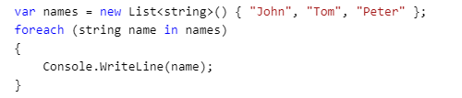
Loop
Array
Collections
Reported by HungNM
Updated 10/2020

Slide 15
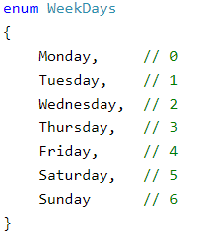
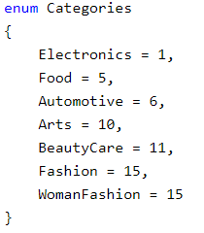
Enum
Reported by HungNM
Updated 10/2020

Slide 16
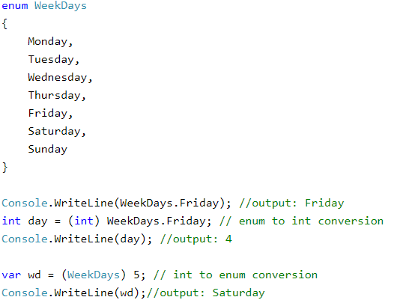
Example
Reported by HungNM
Updated 10/2020

Slide 17
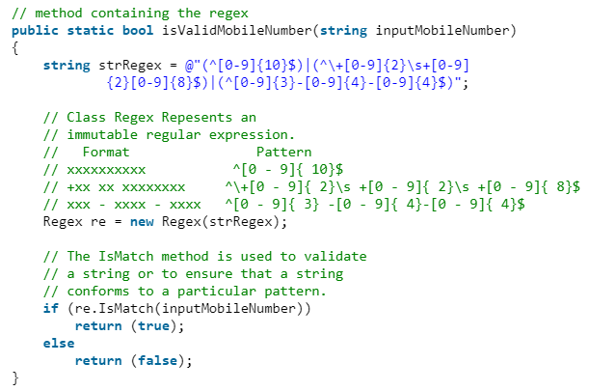

Regular Expressions (Regex)
Reported by HungNM
Updated 10/2020

Slide 18
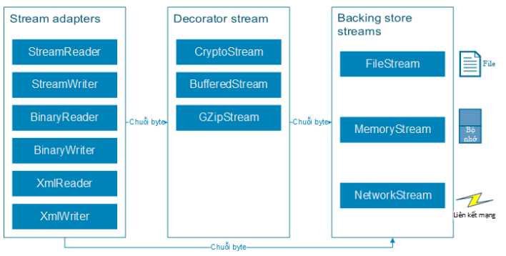
Stream I/O
Reported by HungNM
Updated 10/2020

Slide 19
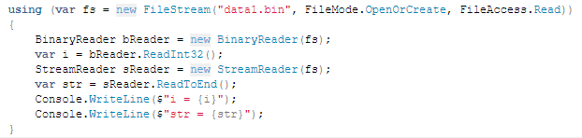
Stream I/O
Reported by HungNM
Updated 10/2020

Slide 20
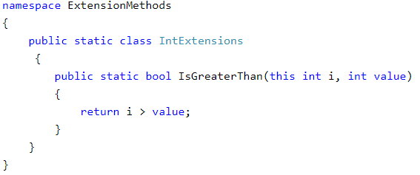
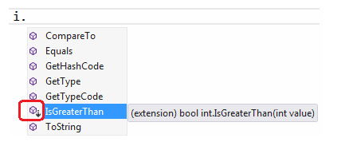
Extension Method
Reported by HungNM
Updated 10/2020

Slide 21
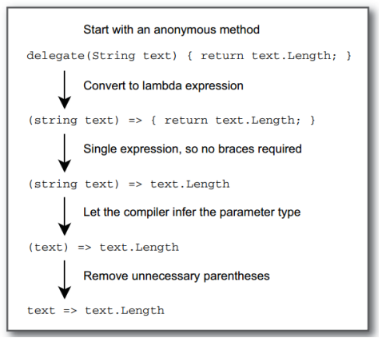
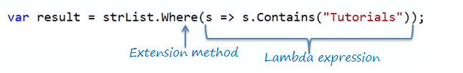
Lambda expression
Reported by HungNM
Updated 10/2020

Slide 22
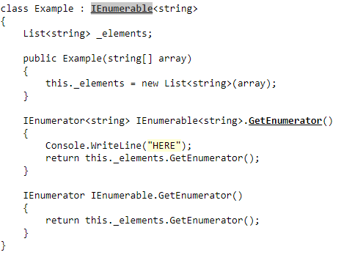
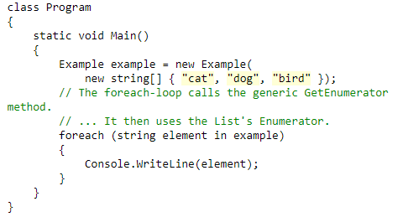
IEnumerable
Reported by HungNM
Updated 10/2020

Slide 23
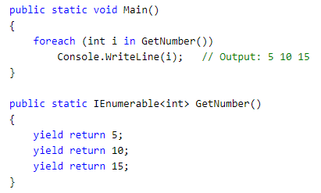
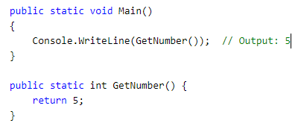
Yield
Reported by HungNM
Updated 10/2020

Slide 24
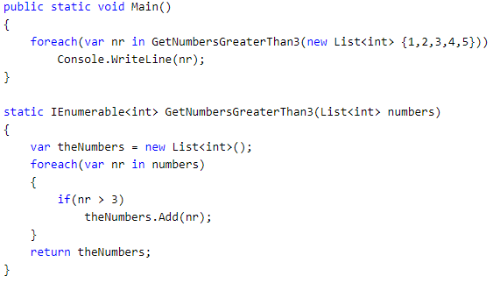
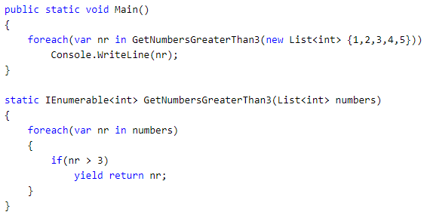
Example
Reported by HungNM
Updated 10/2020

Slide 25
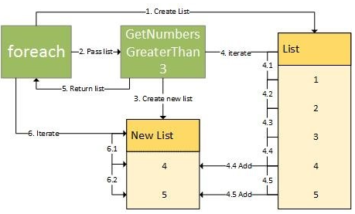
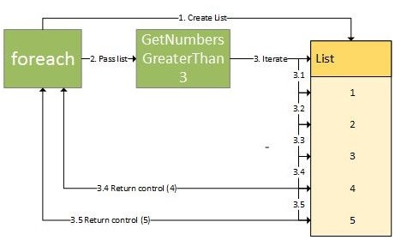
Example
Reported by HungNM
Updated 10/2020

Slide 26
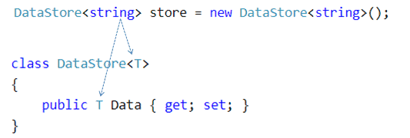

Generics
Reported by HungNM
Updated 10/2020

Slide 27
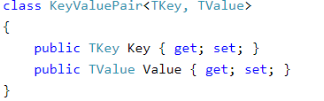
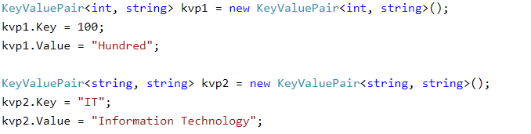
Example
Reported by HungNM
Updated 10/2020

Slide 28
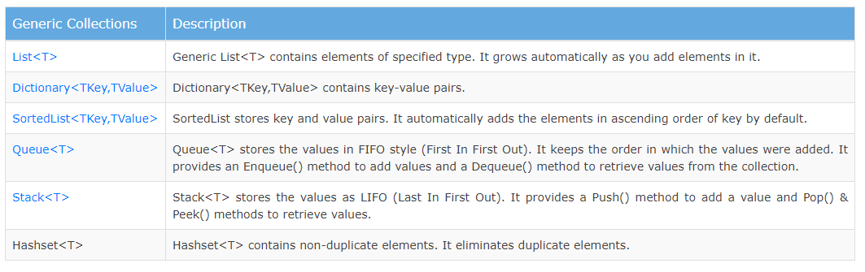
Generic Collections
Reported by HungNM
Updated 10/2020

Slide 29
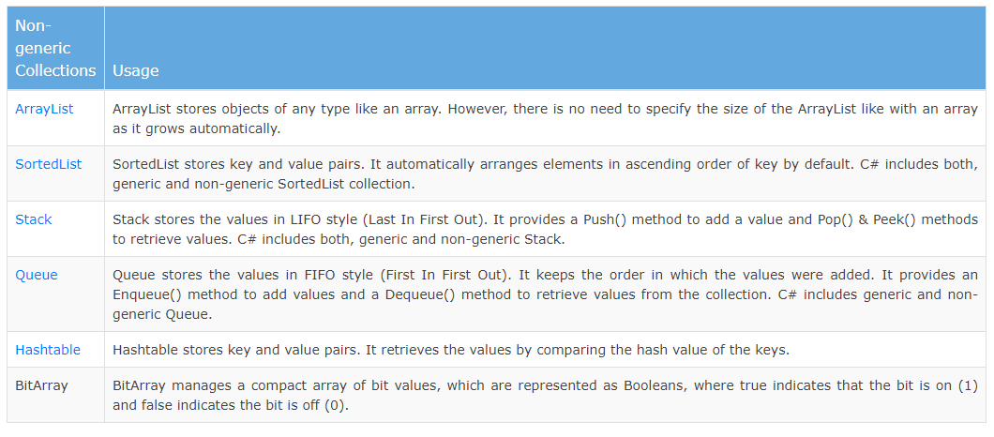
Non-Generic Collections
Reported by HungNM
Updated 10/2020

Slide 30
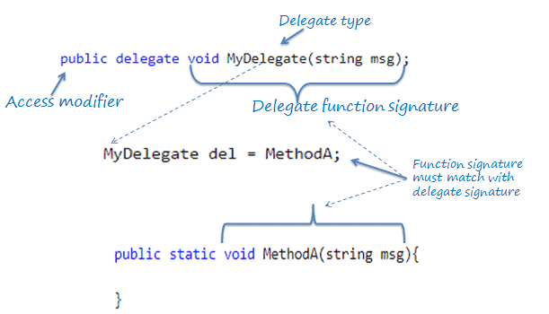
Delegates
Reported by HungNM
Updated 10/2020

Slide 31
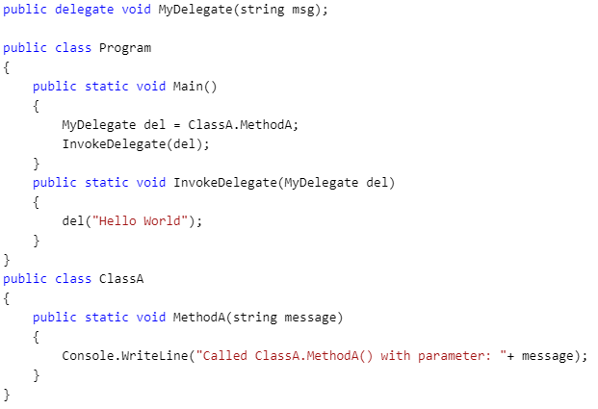
Example
Reported by HungNM
Updated 10/2020

Slide 32
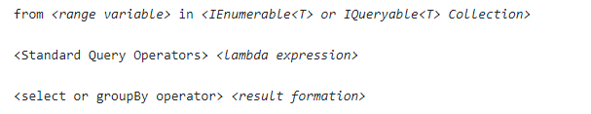
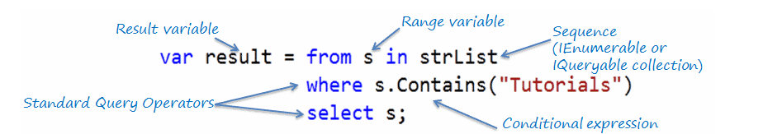
LINQ
Extension method.
Callback and Delegate (Func, Predicate).
Lamda Expression.
Generic.
IEnumrable and yield.
Reported by HungNM
Updated 10/2020

Slide 33
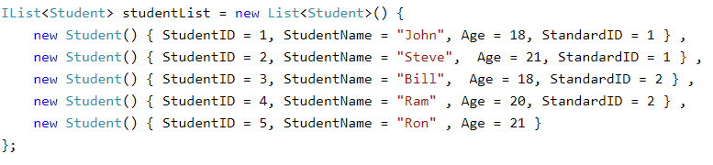

Example
Reported by HungNM
Updated 10/2020

Slide 34
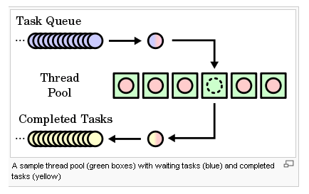
Tasks
Reported by HungNM
Updated 10/2020

Slide 35
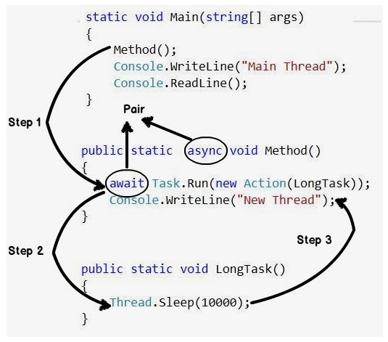
Example
Reported by HungNM
Updated 10/2020

Slide 36
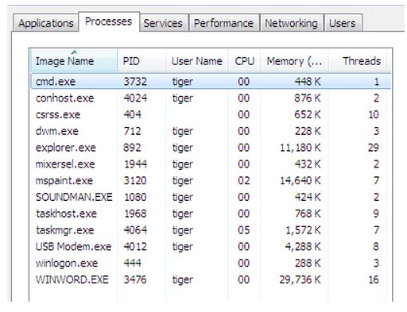
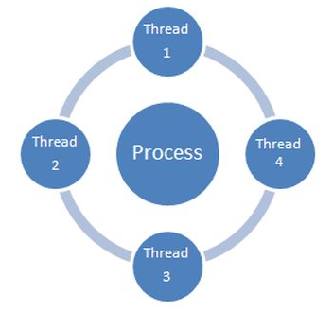
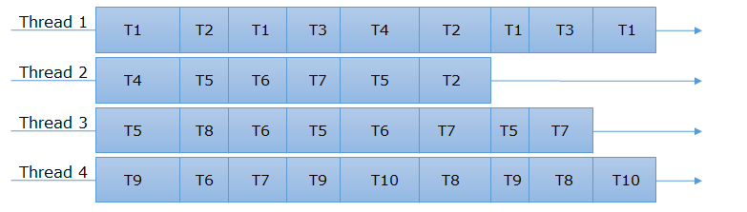
Multi-threading
Reported by HungNM
Updated 10/2020

Slide 37

Example
Reported by HungNM
Updated 10/2020

Slide 38

Thread pool
Reported by HungNM
Updated 10/2020

Slide 39


Lock
Reported by HungNM
Updated 10/2020

Slide 40

Deadlock
Reported by HungNM
Updated 10/2020

Slide 41


Multi-threading vs Asynchronous
Synchronous
Asynchronous
Reported by HungNM
Updated 10/2020

Slide 42
Thanks for watching!
Reported by HungNM
Updated 10/2020

