Slide 1
Advanced C#
Mentor: Nguyen Manh Hung
Reported by HungNM
Updated 10/2020

Slide 2
Content
Basic
Advanced
Data types, classes, and variables
Switches and loops
Stream I/O
Generic
Collections
Delegates
LINQ
Task
Multi-threading
Reported by HungNM
Updated 10/2020

Slide 3
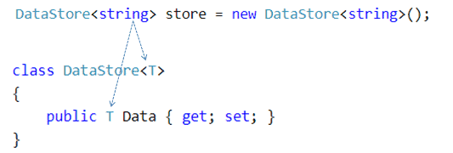

Generics
Reported by HungNM
Updated 10/2020

Slide 4
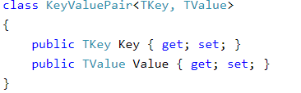
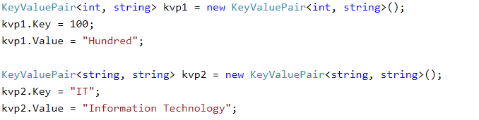
Example
Reported by HungNM
Updated 10/2020

Slide 5
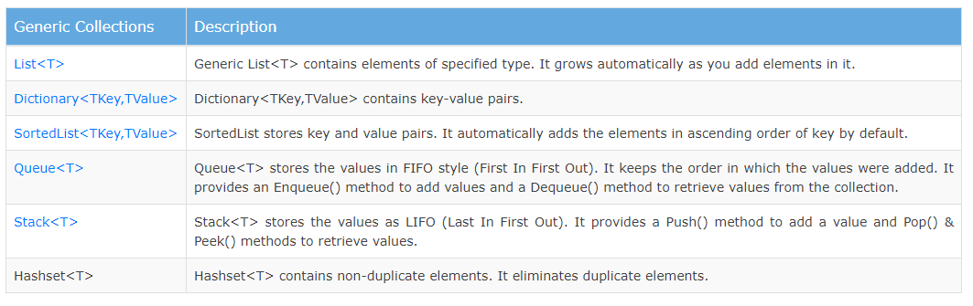
Generic Collections
Reported by HungNM
Updated 10/2020

Slide 6
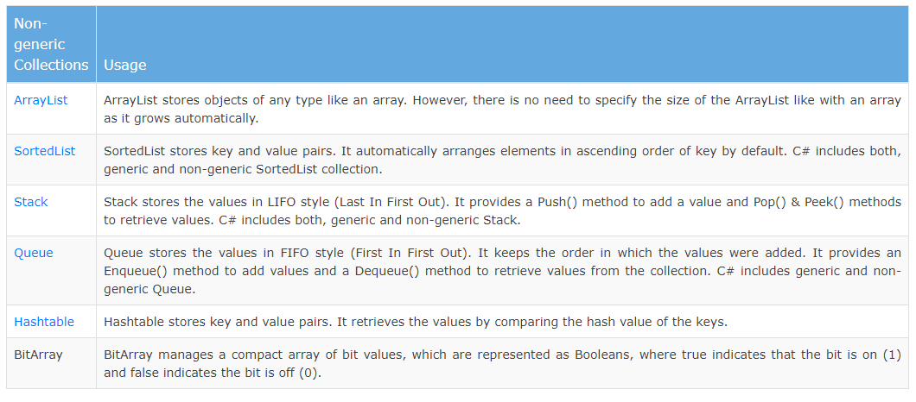
Non-Generic Collections
Reported by HungNM
Updated 10/2020

Slide 7
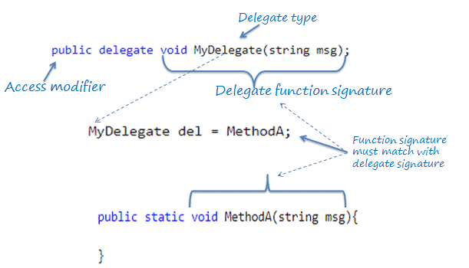
Delegates
Reported by HungNM
Updated 10/2020

Slide 8
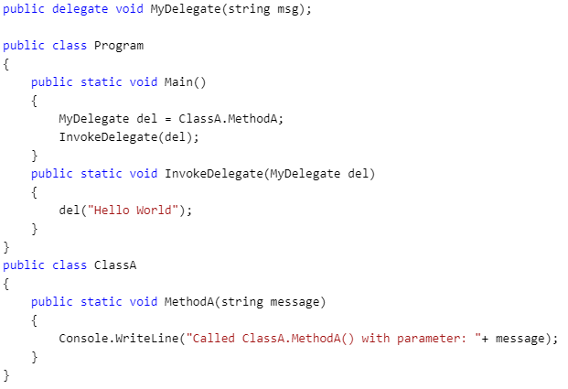
Example
Reported by HungNM
Updated 10/2020

Slide 9
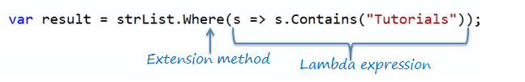
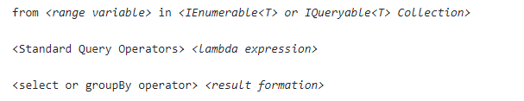
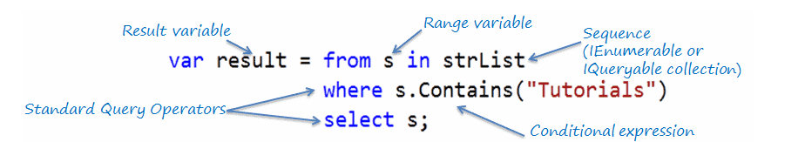
LINQ
Extension method.
Callback and Delegate (Func, Predicate).
Lamda Expression.
Generic.
IEnumrable and yield.
Reported by HungNM
Updated 10/2020

Slide 10
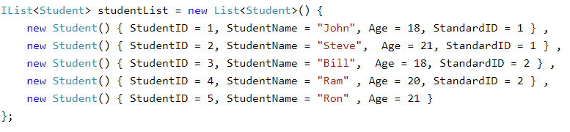

Example
Reported by HungNM
Updated 10/2020

Slide 11
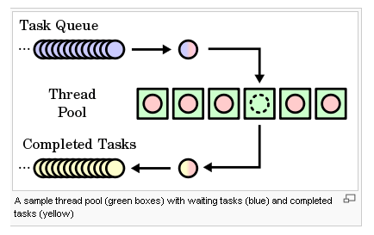
Tasks
Reported by HungNM
Updated 10/2020

Slide 12
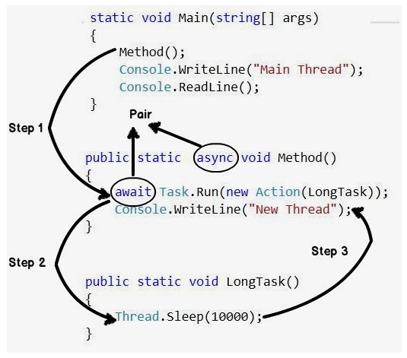
Example
Reported by HungNM
Updated 10/2020

Slide 13
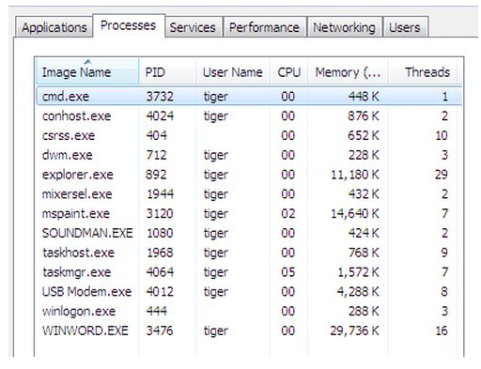
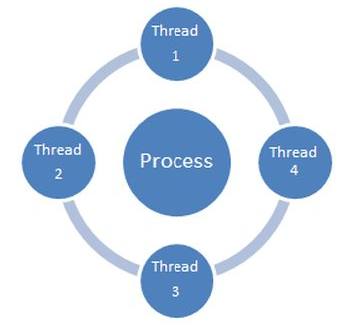
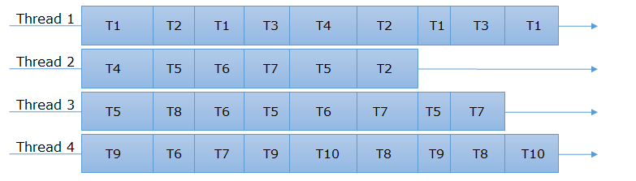
Multi-threading
Reported by HungNM
Updated 10/2020

Slide 14
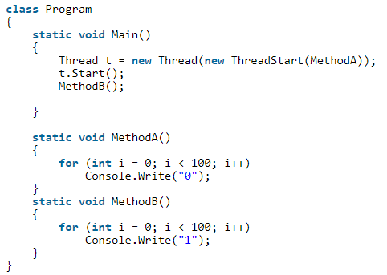
Example
Reported by HungNM
Updated 10/2020

Slide 15
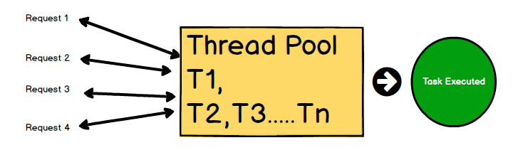
Thread pool
Reported by HungNM
Updated 10/2020

Slide 16
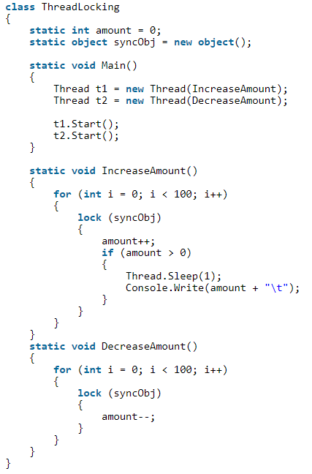
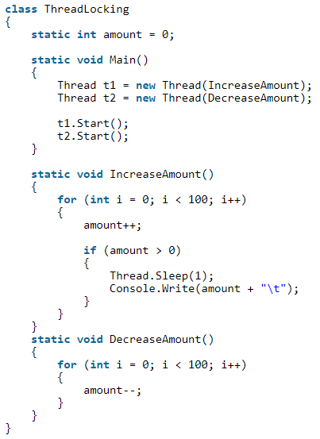
Lock
Reported by HungNM
Updated 10/2020

Slide 17
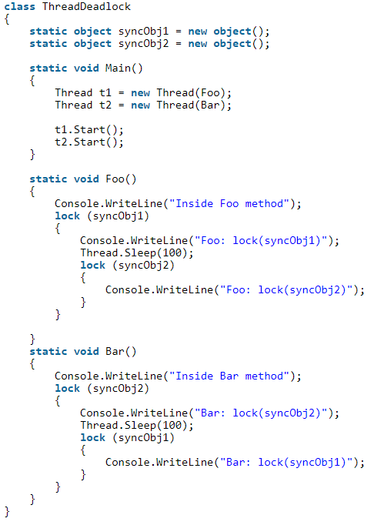
Deadlock
Reported by HungNM
Updated 10/2020

Slide 18
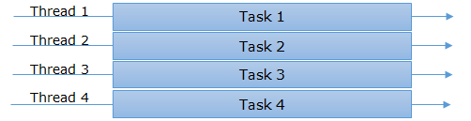

Multi-threading vs Asynchronous
Synchronous
Asynchronous
Reported by HungNM
Updated 10/2020

Slide 19
Thanks for watching!
Reported by HungNM
Updated 10/2020

