Slide 1
Applied Data Analytics

Slide 2
Session 1: Basic Concepts

Slide 3
Introduction
What is Statistics?
Science of gathering, analyzing, interpreting, and presenting data
Population Versus Sample
Population — the whole: a collection of persons, objects, or items under study
Sample — a portion of the whole: a subset of the population
Census — process of gathering data from the entire population for a measurement of interest.

Slide 4
Descriptive Statistics
Descriptive vs. Inferential Statistics
Descriptive Statistics — statistics gathered on a group to describe or reach conclusions about that same group only.
Inferential Statistics — statistics gathered on sample data to reach conclusions about the population from which the sample was taken.

Slide 5
Descriptive Statistics
Descriptive Statistics
Descriptive statistics are the tabular, graphical, and numerical methods used to summarize data.
Example:
The manager of Hudson Auto would like to have a better understanding of the cost of parts used in the engine tune-ups performed in the shop. She examines 50 customer invoices for tune-ups. The costs of parts, rounded to the nearest dollar, are listed below:

Slide 6
Descriptive Statistics

Slide 7
Descriptive Statistics
Tabular Summary
Parts Percent
Cost ($) Frequency Frequency
50-59 2 4
60-69 13 26
70-79 16 32
80-89 7 14
90-99 7 14
100-109 5 10
Total 50 100

Slide 8
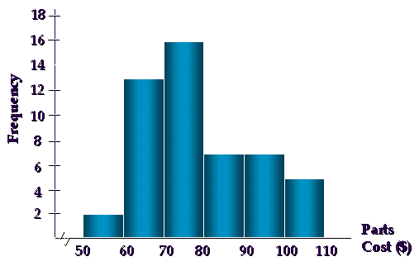
Descriptive Statistics
Graphical Summary (Histogram)

Slide 9
Descriptive Statistics
Numerical Descriptive Statistics
The most common numerical descriptive statistic is the average (or mean). Others: mode, median, variance, standard deviation, etc.

Slide 10
Statistical Inferences
Statistical Inference
The process of using data obtained from a small group of elements (the sample) to make estimates and test hypotheses about the characteristics of a larger group of elements (the population).
Parameter vs. Statistic
Parameter — descriptive measure of the population
Usually represented by Greek letters
Statistic — descriptive measure of a sample
Usually represented by Roman letters

Slide 11
Statistical Inferences
Population Parameters:
: denotes population mean (expected value)
: denotes population variance.
: denotes population standard deviation
Sample Parameters:
: denotes sample mean
: denotes sample variance.
: denotes sample standard deviation

Slide 12
Statistical Inferences
Process of Inferential Statistics

Slide 13
Data Measurement
Scales/Levels of Data Measurement
Nominal — Lowest level of measurement
Ordinal
Interval
Ratio — Highest level of measurement
The scale determines the amount of information contained in the data.
The scale indicates the data summarization and statistical analyses that are most appropriate.

Slide 14
Data Measurement
Nominal Level Data
Data are labels or names used to identify an attribute of the element.
A nonnumeric label or a numeric code may be used.
Numbers are used to classify or categorize

Slide 15
Data Measurement
Example:
Students of a university are classified by the school using a nonnumeric label: Business, Humanities, Education, and so on.
Alternatively, a numeric code could be used (e.g. 1 denotes Business, 2 denotes Humanities, 3 denotes Education, …).
Employment Classification: 1 for Educator; 2 for Construction Worker; 3 for Manufacturing Worker

Slide 16
Data Measurement
Ordinal Level Data
The data have the properties of nominal data and the order or rank of the data is meaningful.
A nonnumeric label or a numeric code may be used.
Numbers are used to indicate rank or order
Relative magnitude of numbers is meaningful
Differences between numbers are not comparable

Slide 17
Data Measurement
Examples:
Students are classified as Freshman, Sophomore, Junior, or Senior. Alternatively, a numeric code could be used (e.g. 1 denotes Freshman, 2 denotes Sophomore, and so on).
Position within an organization
1 for President 2 for Vice President
3 for Plant Manager 4 for Department Supervisor
5 for Employee
Likert scale in questionnaire:

Slide 18
Data Measurement
Interval Level Data
The data have the properties of ordinal data and the interval between observations is expressed in terms of a fixed unit of measure.
Interval data are always numeric.
Distances between consecutive integers are equal
Relative magnitude of numbers is meaningful
Differences between numbers are comparable
Location of origin, zero, is arbitrary and not mean the absence of the phenomenon
Vertical intercept of unit of measure transform function is not zero
Example: Fahrenheit Temperature (32+9/5*Centigrade)

Slide 19
Data Measurement
Ratio Level Data
The data have all the properties of interval data and the ratio of two values is meaningful.
Variables such as distance, height, weight, and time use the ratio scale.
This scale must contain a zero value that indicates that nothing exists for the variable at the zero point.

Slide 20
Data Measurement
Highest level of measurement
Relative magnitude of numbers is meaningful
Differences between numbers are comparable
Location of origin, zero, is absolute (natural)
Examples:
Height, Weight, and Volume
Example: Monetary Variables: Profit and Loss, Revenues, Expenses

Slide 21
Data Measurement
Data Level | Meaningful Operations | Statistical Method
Nominal Ordinal Interval Ratio | Classifying and Categorizing All of the above plus Ranking All of the above plus Addition, Subtraction, Multiplication All of the above and Division | Nonparametric Nonparametric Parametric (Nonparametric) Parametric (Nonparametric)

Slide 22
Data Measurement
Nonparametric statistics:
A class of statistical techniques that make few assumptions about the population
Used with nominal and ordinal level data
Parametric statistics:
A class of statistical techniques that contain assumptions about the population
Used only with interval & ratio level data

Slide 23
Ungrouped vs. Grouped Data
Ungrouped data
have not been summarized in any way
are also called raw data
Grouped data
have been organized into a frequency distribution

Slide 24
Ungrouped vs. Grouped Data
Example: Ages of a sample of managers
42 | 26 | 32 | 34 | 57
30 | 58 | 37 | 50 | 30
53 | 40 | 30 | 47 | 49
50 | 40 | 32 | 31 | 40
52 | 28 | 23** | 35 | 25
30 | 36 | 32 | 26 | 50
55 | 30 | 58 | 64 | 52
49 | 33 | 43 | 46 | 32
61 | 31 | 30 | 40 | 60
74* | 37 | 29 | 43 | 54

Slide 25
Ungrouped vs. Grouped Data
Frequency Distribution of Manager’s Ages:
Class Interval Frequency
20-under 30 6
30-under 40 18
40-under 50 11
50-under 60 11
60-under 70 3
70-under 80 1

Slide 26
Ungrouped vs. Grouped Data
Range and Class
Data Range: Range = Largest – Smallest
Ex: Range = 74 – 23 = 51
Number of Classes and Class Width
• The number of classes should be between 5 and 20.
Fewer than 5 classes cause excessive summarization.
More than 20 classes leave too much detail.

Slide 27
Ungrouped vs. Grouped Data
• Class Width
Divide the range by the number of classes for an approximate class width
Round up to a convenient number
Ex: Approximate Class Width = 51/6 = 8.5
Class Width = 10

Slide 28
Ungrouped vs. Grouped Data
Relative Frequency
Class Interval Frequency Relative Frequency
20-under 30 6 .12
30-under 40 18 .36
40-under 50 11 .22
50-under 60 11 .22
60-under 70 3 .06
70-under 80 1 .02
Total 50 1.00

Slide 29
Ungrouped vs. Grouped Data
Cumulative Frequency
Class Interval Frequency Cumulative Frequency
20-under 30 6 6
30-under 40 18 24
40-under 50 11 35
50-under 60 11 46
60-under 70 3 49
70-under 80 1 50
Total 50

Slide 30
Ungrouped vs. Grouped Data
Cumulative Relative Frequencies
Class Interval Frequency RF Cu. Frequency CRF
20-under 30 6 .12 6 .12
30-under 40 18 .36 24 .48
40-under 50 11 .22 35 .70
50-under 60 11 .22 46 .92
60-under 70 3 .06 49 .98
70-under 80 1 .02 50 1.00
Total 50 1.00

Slide 31
Measures of Central Tendency Ungrouped Data
Measures of central tendency yield information about “particular places or locations in a group of numbers.”
Common Measures of Location
Mode, Median, Mean, Percentiles, Quartiles

Slide 32
Measures of Central Tendency Ungrouped Data
Mode
The most frequently occurring value in a data set
Applicable to all levels of data measurement (nominal, ordinal, interval, and ratio)
Bimodal -- Data sets that have two modes
Multimodal -- Data sets that contain more than two modes

Slide 33
Measures of Central Tendency Ungrouped Data
Example:
35 37 37 39 40 40
41 41 43 43 43 43 Value 44 occurs 5 times
44 44 44 44 44 45 The mode is 44
45 46 46 46 46 48
• Mode is often used in determining sizes (garment industry): S, M, L, XL, XXL (modal sizes)

Slide 34
Measures of Central Tendency Ungrouped Data
Median
Middle value in an ordered array of numbers.
Applicable for ordinal, interval, and ratio data
Not applicable for nominal data
Unaffected by extremely large and extremely small values
Median is determined without using all information from the data set.

Slide 35
Measures of Central Tendency Ungrouped Data
Computational Procedure
Arrange the observations in an ordered array.
If there is an odd number of terms, the median is the middle term of the ordered array.
If there is an even number of terms, the median is the average of the middle two terms.

Slide 36
Measures of Central Tendency Ungrouped Data
Example:
Ordered Array: 3 4 5 7 8 9 11 14 15 16 16 17 19 19 20 21 22
- There are 17 terms in the ordered array.
- Position of median = (n+1)/2 = (17+1)/2 = 9
- The median is the 9th term, 15.
Ordered Array: 3 4 5 7 8 9 11 14 15 16 16 17 19 19 20 21
- There are 16 terms in the ordered array.
- Position of median = (n+1)/2 = (16+1)/2 = 8.5
- The median is between the 8th and 9th terms: 14.5.

Slide 37
Measures of Central Tendency Ungrouped Data
Arithmetic Mean
Commonly called ‘the mean’: the average of a group of numbers
Applicable only for interval and ratio data
Affected by each value in the data set, including extreme values
Computed by summing all values in the data set and dividing the sum by the number of values in the data set

Slide 38


Measures of Central Tendency Ungrouped Data
Population Mean
Sample Mean

Slide 39
Measures of Central Tendency Ungrouped Data
Percentiles
Measures of central tendency that divide a group of data into 100 parts.
Applicable for ordinal, interval, and ratio data
At least n% of the data lie below the nth percentile, and at most (100 - n)% of the data lie above the nth percentile
Example
90th percentile indicates that at least 90% of the data lie below it, and at most 10% of the data lie above it
The median is the 50th percentile.

Slide 40
Measures of Central Tendency Ungrouped Data
Computational Procedure
1. Organize the data into an ascending ordered array.
2. Calculate the percentile location:
3. Determine the percentile’s location and its value.
If i is a whole number, the percentile is the average of the values at the i and (i+1) positions.
If i is not a whole number, the percentile is at the ([i]+1) position in the ordered array.

Slide 41
Measures of Central Tendency Ungrouped Data
Example
Raw Data: 14, 12, 19, 23, 5, 13, 28, 17
Ordered Array: 5, 12, 13, 14, 17, 19, 23, 28
Location of 30th percentile:
The location index, i, is not a whole number; [i ]+1 = 2+1=3
The 30th percentile is at the 3rd location of the array: the 30th percentile is 13.

Slide 42
Measures of Central Tendency Ungrouped Data
Quartiles
Measures of central tendency that divide a group of data into four subgroups
Q₁ is equal to the 25th percentile
Q₂ is located at 50th percentile and equals the median
Q₃ is equal to the 75th percentile

Slide 43
Measures of Central Tendency Ungrouped Data
Example
Ordered array: 106, 109, 114, 116, 121, 122, 125, 129

Slide 44
Measures of Central Tendency Grouped Data
Mean of Grouped Data
• Weighted average of class midpoints
• Class frequencies are the weights
or

Slide 45
Measures of Central Tendency Grouped Data
Example
Class Interval Frequency Class Midpoint fM
20-under 30 6 25 150
30-under 40 18 35 630
40-under 50 11 45 495
50-under 60 11 55 605
60-under 70 3 65 195
70-under 80 1 75 75
Total 50 2150

Slide 46
Measures of Central Tendency Grouped Data
Median of Grouped Data
where:
L : the lower limit of the median class
cf_{p} : cumulative frequency of class preceding the median class
f_{med} : frequency of the median class
W : width of the median class
N : total of frequency

Slide 47
Measures of Central Tendency Grouped Data
Example
Class Interval Frequency Cu. Frequency
20-under 30 6 6
30-under 40 18 24
40-under 50 11 35
50-under 60 11 46
60-under 70 3 49
70-under 80 1 50
N = 50
Note that N/2 = 25, therefore the median is the average of the 25th and 26th values. So, the median class: 40-under 50.

Slide 48
Measures of Central Tendency Grouped Data
Mode of Grouped Data
• Midpoint of the modal class
• Modal class has the greatest frequency
Example (see the former slide)
The modal class is 30-under 40. So, Mode = 35.

Slide 49
Measures of Variability Ungrouped Data
Measures of variability describe the spread or the dispersion of a set of data.
Common Measures of Variability
Range
Interquartile Range
Mean Absolute Deviation
Variance
Standard Deviation
Z scores
Coefficient of Variation

Slide 50
Measures of Variability Ungrouped Data
Range
The difference between the largest and the smallest values in a set of data
Simple to compute
Ignores all data points except the two extremes

Slide 51
Measures of Variability Ungrouped Data
Interquartile Range
• Range of values between the first and third quartiles
• Range of the “middle half”
• Less influenced by extremes

Slide 52
Measures of Variability Ungrouped Data
Mean Absolute Deviation (MAD)
• Average of the absolute deviations from the mean
Example: Data set: 5, 9, 16, 17, 18
Mean = 13: Deviations from the mean: -8,-4,3,4,5

Slide 53
Measures of Variability Ungrouped Data
Variance and Standard Deviation
Population
Population Variance: Average of the squared deviations from the arithmetic mean
• Population Standard Deviation: Square root of the variance

Slide 54
Measures of Variability Ungrouped Data
Sample
• Sample Variance: Average of the squared deviations from the arithmetic mean
Sample Standard Deviation: Square root of the sample variance

Slide 55
Measures of Variability Ungrouped Data
z-Score
The z-score is often called the standardized value.
It denotes the number of standard deviations a data value x_{i} is from the mean, and hence, give a clearer information about the difference between x_{i} and the mean

Slide 56
Measures of Variability Ungrouped Data
Coefficient of Variation (CV)
Ratio of the standard deviation to the mean, expressed as a percentage.
Measurement of relative dispersion, and hence, provide clearer information about variability of the data set

Slide 57
Measures of Variability Grouped Data
Variance and Standard Deviation
Population Sample

Slide 58
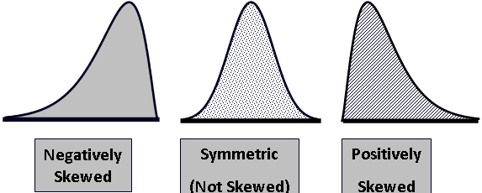
Measures of Shape
Skewness
Absence of symmetry
Extreme values in one side of a distribution
(Mean < Median < Mode) (Mean = Median = Mode) (Mode < Median < Mean)

Slide 59
Measures of Shape
Coefficient of Skewness
• If S < 0, the distribution is negatively skewed (skewed to the left).
• If S = 0, the distribution is symmetric (not skewed).
• If S > 0, the distribution is positively skewed (skewed to the right).

Slide 60
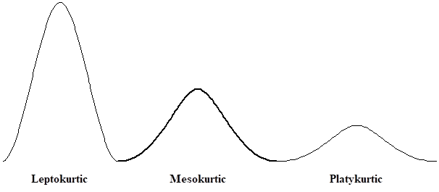
Measures of Shape
Kurtosis
Peakedness of a distribution
Leptokurtic: high and thin
Mesokurtic: normal in shape
Platykurtic: flat and spread out

Slide 61
Measures of Shape
Measure of Kurtosis
K > 3: Leptokurtic
K =3: Mesokurtic
K < 3: Plattykurtic

Slide 62
Measures of Shape
Box and Whisker Plot
Five specific values (five-number summary) are used to summarize the data:
Median, Q₂
First quartile, Q₁
Third quartile, Q₃
Minimum value in the data set
Maximum value in the data set

Slide 63
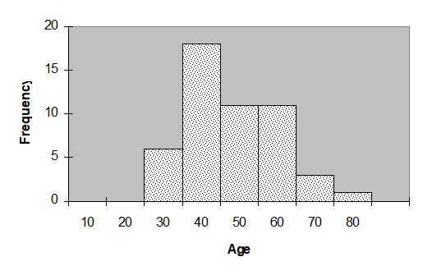
Common Statistical Graphs
Histogram -- vertical bar chart of frequencies

Slide 64
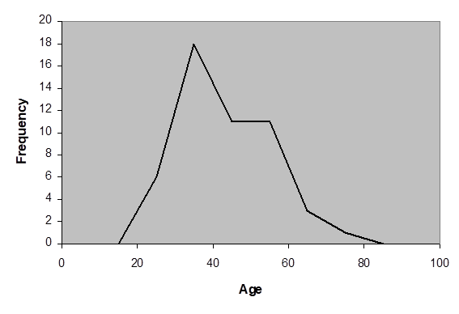
Common Statistical Graphs
Frequency Polygon -- line graph of frequencies
Relationship between Class Frequencies and Class Midpoints

Slide 65
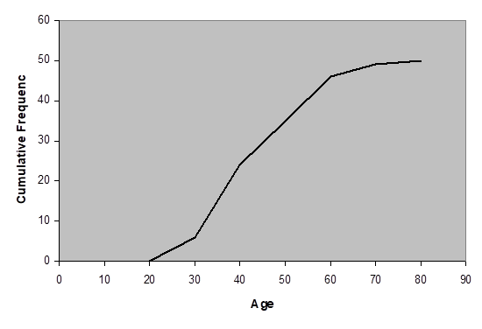
Common Statistical Graphs
Ogive -- line graph of cumulative frequencies
Relationship between Cumulative Class Frequencies and
Class Midpoints

Slide 66
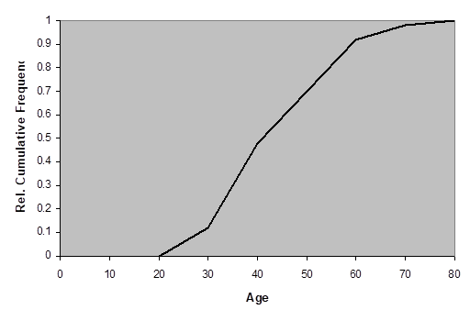
Common Statistical Graphs
Relative Frequency Ogive

Slide 67
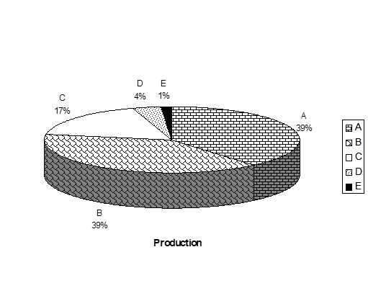
Common Statistical Graphs
Pie Chart
Ex: Consider the following data
Company | 2nd Quarter Truck Production | Percentage (%)
A B C D E | 357,411 354,936 160,997 34,099 12,747 | 39 39 17 4 1
Total | 920,190 | 100

Slide 68
Common Statistical Graphs
Scatter Diagram
A graphical presentation of the relationship between two quantitative variables.
One variable is shown on the horizontal axis and the other variable is shown on the vertical axis.
The general pattern of the plotted points suggests the overall relationship between the variables.

Slide 69
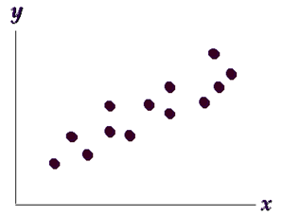
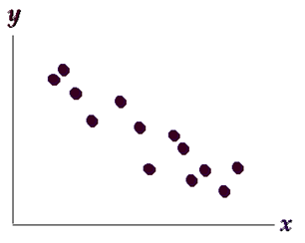
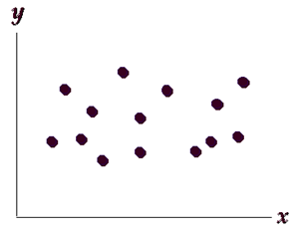
Common Statistical Graphs
Scatter Diagram
A Positive Relationship A Negative Relationship No Apparent Relationship

Slide 70
Determination of Outliers
Inner Fences
IQR = Q₃ - Q₁
Lower inner fence = Q₁ - 1.5 IQR
Upper inner fence = Q₃ + 1.5 IQR
Outer Fences
Lower outer fence = Q₁ - 3.0 IQR
Upper outer fence = Q₃ + 3.0 IQR

Slide 71
Determination of Outliers
It should be noted that
Values of the data set located outside the inner fences are considered as outliers.
An outlier located outside the outer fences is an extreme outlier, otherwise, it is a mild outlier.
If there exist a single extreme outlier or many mild outliers in the sample, statistical procedures may be unreliable.
When there exist outliers in the data set, the whiskers of the box plot will be extended to the non-outlier values only.

Slide 72
Determination of Outliers
Example
Consider the following data set:
5.3 8.2 13.8 74.1 85.3 88.0 90.2 91.5 92.4 92.9 93.6 94.3
94.8 94.9 95.5 95.8 95.9 96.6 96.7 98.1 99.0 101.4 103.7 106.0
and 113.5
The quartiles are: Q₁=90.2, Q₂=94.8, Q₃=96.7
The fences: LIF = 80.45 UIF = 106.45
LOF = 70.7 UOF = 116.2
There are 5 outliers: 5.3, 8.2, 13.8, 74.1, 113.5 in which the first three outliers are extreme outliers. The whiskers should be extended out to only 85.3 and 106.0

