Slide 1
Applied Data Analytics

Slide 2
Session 2: Statistical Inferences

Slide 3
Sampling Distribution
Why need sampling distribution?
• Proper analysis and interpretation of a sample statistic requires knowledge of its distribution.

Slide 4
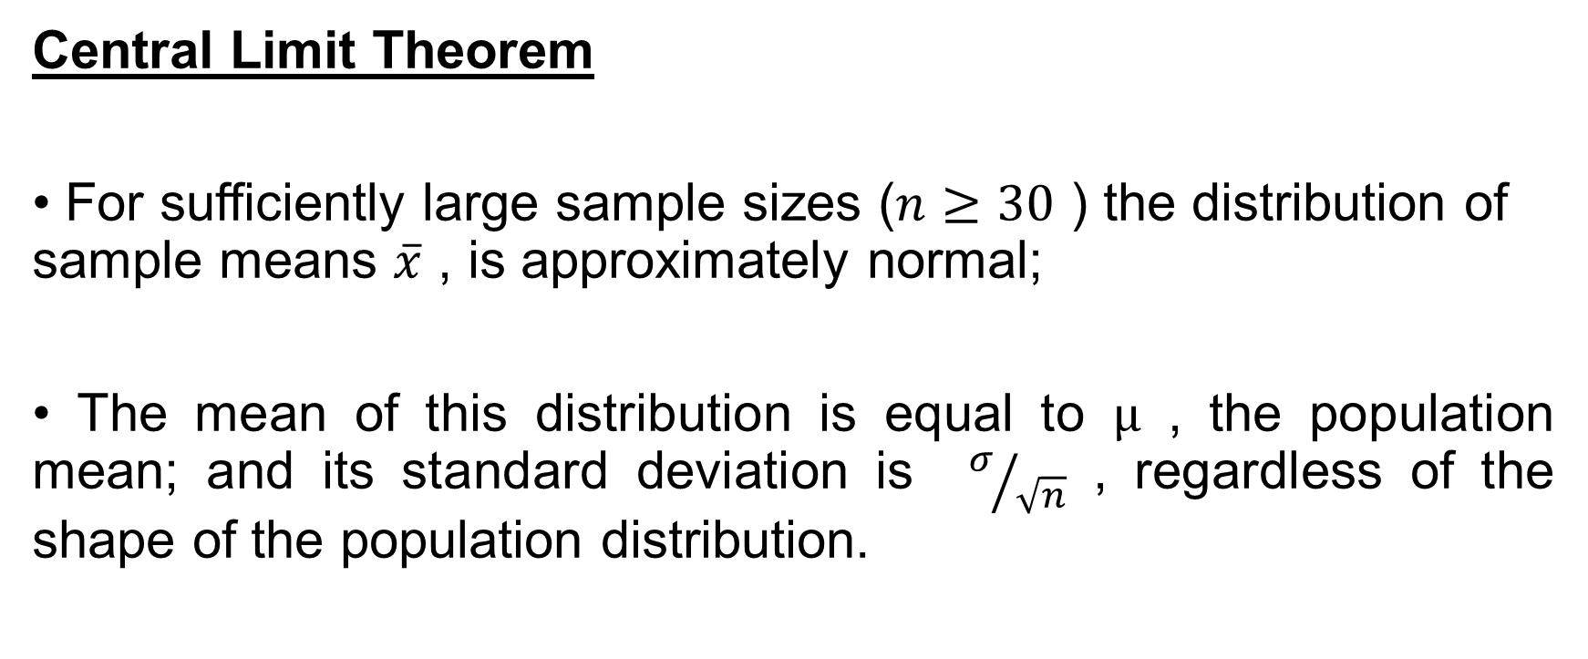
Sampling Distribution of Sample Average $\overline{x}$
Central Limit Theorem
• For sufficiently large sample sizes ($n≥30$ ) the distribution of sample means $\overline{x}$ , is approximately normal;
• The mean of this distribution is equal to $µ$ , the population mean; and its standard deviation is $σ/{\sqrt{n}}$ , regardless of the shape of the population distribution.

Slide 5
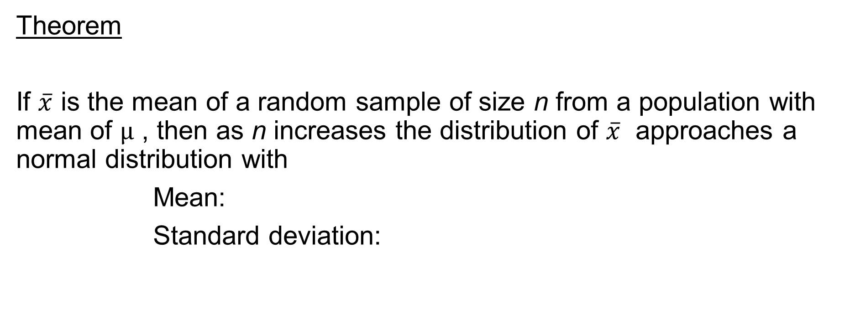
Sampling Distribution of Sample Average $\overline{x}$
Theorem
If $\overline{x}$ is the mean of a random sample of size n from a population with mean of $µ$ , then as n increases the distribution of $\overline{x}$ approaches a normal distribution with
Mean:
Standard deviation:

Slide 6
Sampling Distribution of Sample Average $\overline{x}$
Note that when population is finite:
: finite correction factors
Z Formula:
or
(infinite) (finite)

Slide 7
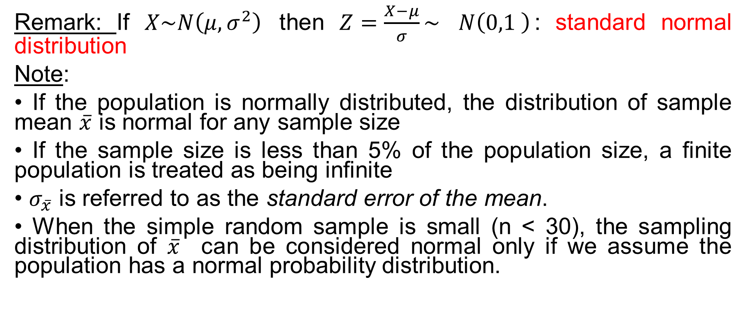
Sampling Distribution of Sample Average $\overline{x}$
Remark: If $X\sim N\left(μ,σ^{2}\right)$ then $Z=\frac{X−μ}{σ}\sim$ $N\left(0,1 \right)$: standard normal distribution
Note:
• If the population is normally distributed, the distribution of sample mean $\overline{x}$ is normal for any sample size
• If the sample size is less than 5% of the population size, a finite population is treated as being infinite
• $σ_{\overline{x}}$ is referred to as the standard error of the mean.
• When the simple random sample is small (n < 30), the sampling distribution of $\overline{x}$ can be considered normal only if we assume the population has a normal probability distribution.

Slide 8
Sampling Distribution of Sample Proportion $\hat{p}$
Sample Proportion
where: n: number of items in the sample
x: number of items in the sample that possess the characteristic

Slide 9
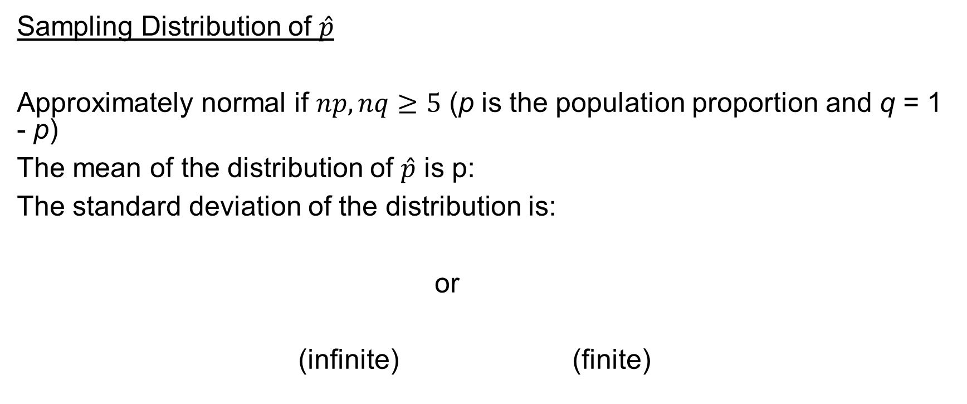
Sampling Distribution of Sample Proportion $\hat{p}$
Sampling Distribution of $\hat{p}$
Approximately normal if $np,nq≥5$ (p is the population proportion and q = 1 - p)
The mean of the distribution of $\hat{p}$ is p:
The standard deviation of the distribution is:
or
(infinite) (finite)

Slide 10

Sampling Distribution of Sample Proportion $\hat{p}$
Z Formula
or
• $σ_{\hat{p}}$ is referred to as the standard error of the proportion.

Slide 11
Sampling Distribution of Sample Proportion $\hat{p}$
Example
Suppose 60% of the electrical contractors in a region use a particular brand of wire. Find the probability of taking a random sample of size 120 from these electrical contractors and finding that at most 50% use that brand of wire?

Slide 12
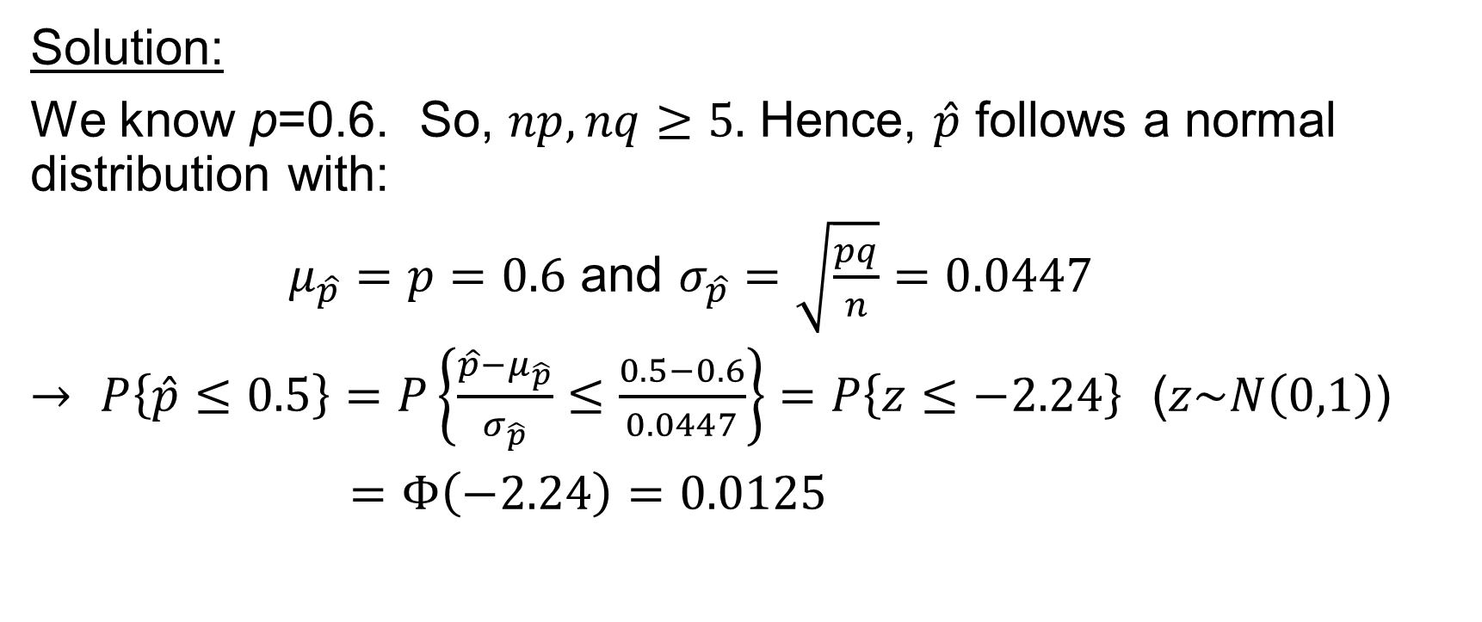
Sampling Distribution of Sample Proportion $\hat{p}$
Solution:
We know p=0.6. So, $np,nq≥5.$ Hence, $\hat{p}$ follows a normal distribution with:
$μ_{\hat{p}}=p=0.6$ and $σ_{\hat{p}}=\sqrt{\frac{pq}{n}}=0.0447$
$→$ $P\left\{\hat{p}≤0.5\right\}=P\left\{\frac{\hat{p}−μ_{\hat{p}}}{σ_{\hat{p}}}≤\frac{0.5−0.6}{0.0447}\right\}=P\left\{z≤−2.24\right\}$ ($z\sim N\left(0,1\right)$)
$=Φ\left(−2.24\right)=0.0125$

Slide 13
Statistical Estimation
• Point estimate -- the single value of a statistic calculated from a sample
• Interval Estimate -- a range of values determined from a sample statistic(s) and standardized statistics, such as the z-value, the t-value, etc.
How to construct an interval estimate?
1. Select the appropriate standardized statistic based on sampling
distribution.
2. Select the critical values of the standardized statistic based on the
desired level of confidence.
3. Construct the confidence interval with the sample statistic observed

Slide 14
Required Properties of Point Estimators
Before using a sample statistic as a point estimator, we should check to see whether the sample statistic has the following properties associated with good point estimators.
• Unbiasedness
• Efficiency
• Consistency

Slide 15
Required Properties of Point Estimators
Unbiasedness
The expected value of the sample statistic is equal to the population parameter being estimated: an unbiased estimator of the population parameter.
Efficiency
Given two unbiased estimators of the same population parameter, the point estimator with the smaller standard deviation is said to have greater relative efficiency than the other.
Consistency
A point estimator is consistent if the values of the point estimator tend to become closer to the population parameter as the sample size becomes larger.

Slide 16
Interval Estimation for Mean – Large Sample
Point estimate
Interval Estimate
or

Slide 17
Interval Estimation for Mean – Large Sample
Distribution of Sample Mean

Slide 18
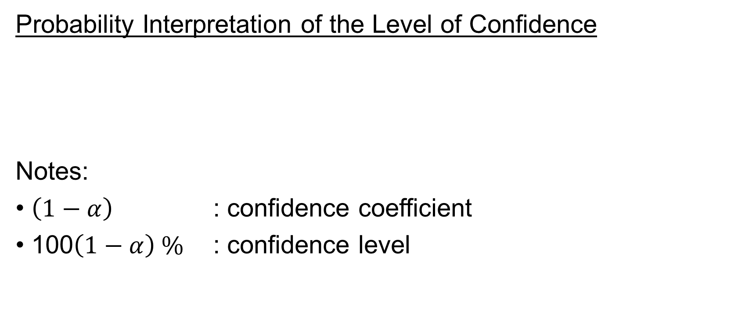
Interval Estimation for Mean – Large Sample
Probability Interpretation of the Level of Confidence
Notes:
• $\left(1−α\right)$ : confidence coefficient
• 100$\left(1−α\right) \%$ : confidence level

Slide 19

Interval Estimation for Mean – Large Sample
Example
Given $\overline{x}=4.26$ , $σ=1.1$ , $n=60$. Construct the 95% confidence interval for $μ$ .

Slide 20
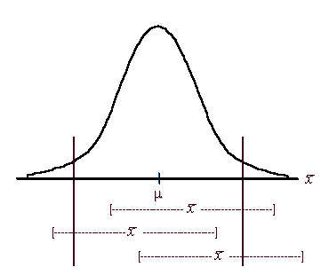
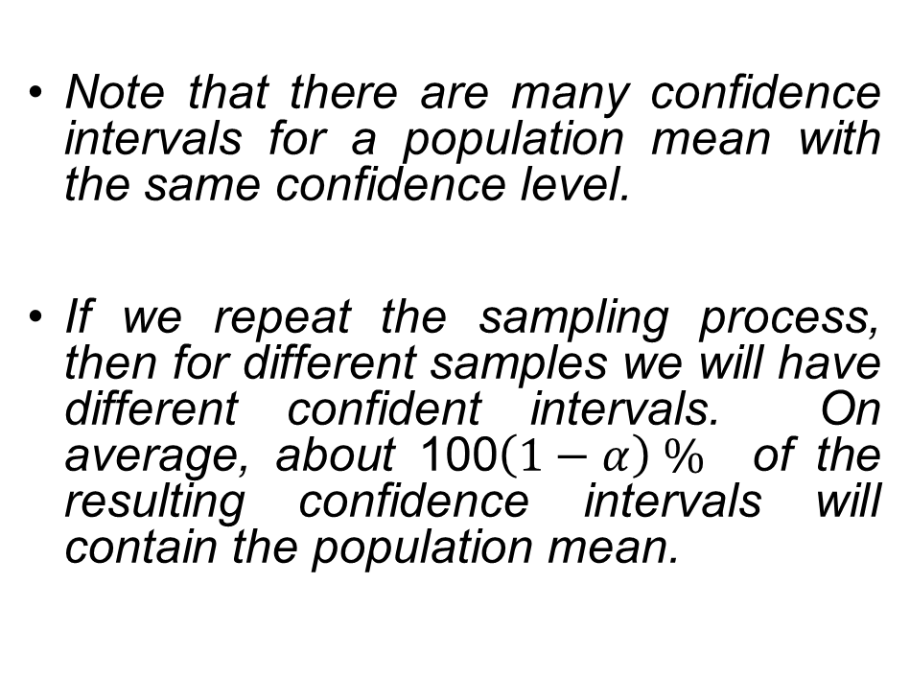
Interval Estimation for Mean – Large Sample
Note that there are many confidence intervals for a population mean with the same confidence level.
If we repeat the sampling process, then for different samples we will have different confident intervals. On average, about 100$\left(1−α\right) \%$ of the resulting confidence intervals will contain the population mean.

Slide 21

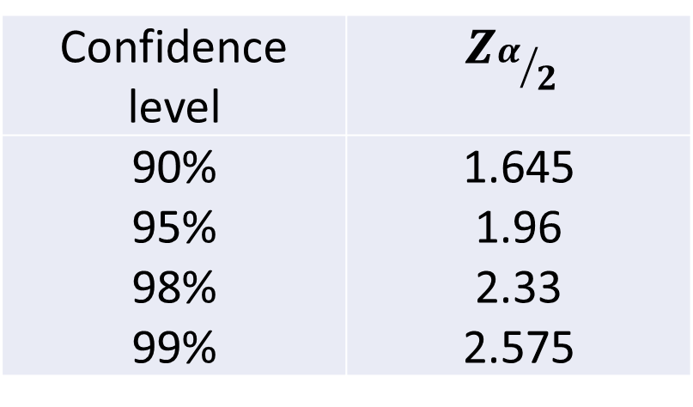
Interval Estimation for Mean – Large Sample
When $σ$ is unknown:
Z Values for Some of the Common Levels of Confidence:
Confidence level | $$Z_{α/2}$$
90% 95% 98% 99% | 1.645 1.96 2.33 2.575

Slide 22
Interval Estimation for Mean – Small Sample
Assumptions:
• The population has a normal distribution.
• The value of the population standard deviation is
unknown.
• The sample size is small, n < 30.
Sampling distribution:
• Normal distribution is not appropriate
• Student distribution (i.e., t distribution) should be used

Slide 23
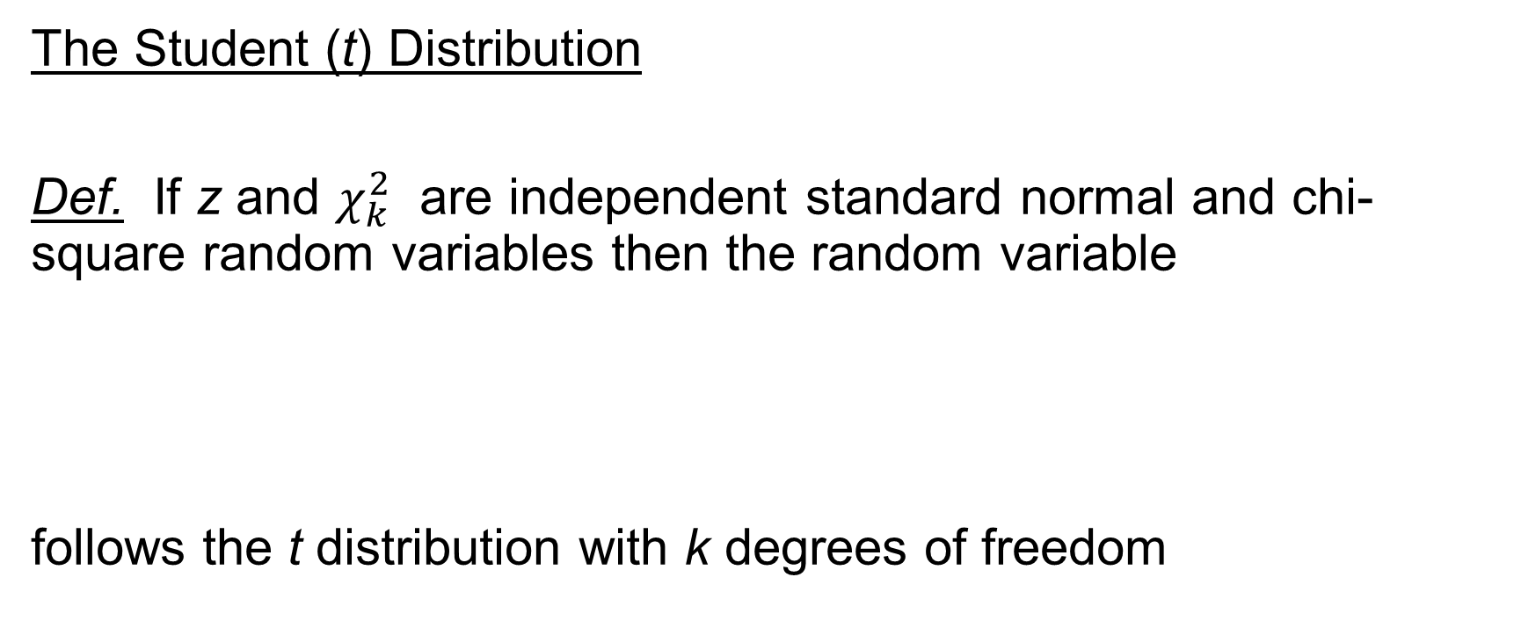
Interval Estimation for Mean – Small Sample
The Student (t) Distribution
Def. If z and $χ_{k}^{2}$ are independent standard normal and chi-square random variables then the random variable
follows the t distribution with k degrees of freedom

Slide 24
Interval Estimation for Mean – Small Sample
The t Distribution
• Developed by British statistician, William Gosset
• Symmetric, Unimodal, Mean = 0, flatter than a standard normal distribution (i.e., z- distribution)
• t formula:

Slide 25

Interval Estimation for Mean – Small Sample
Confidence Intervals for $μ$:

Slide 26
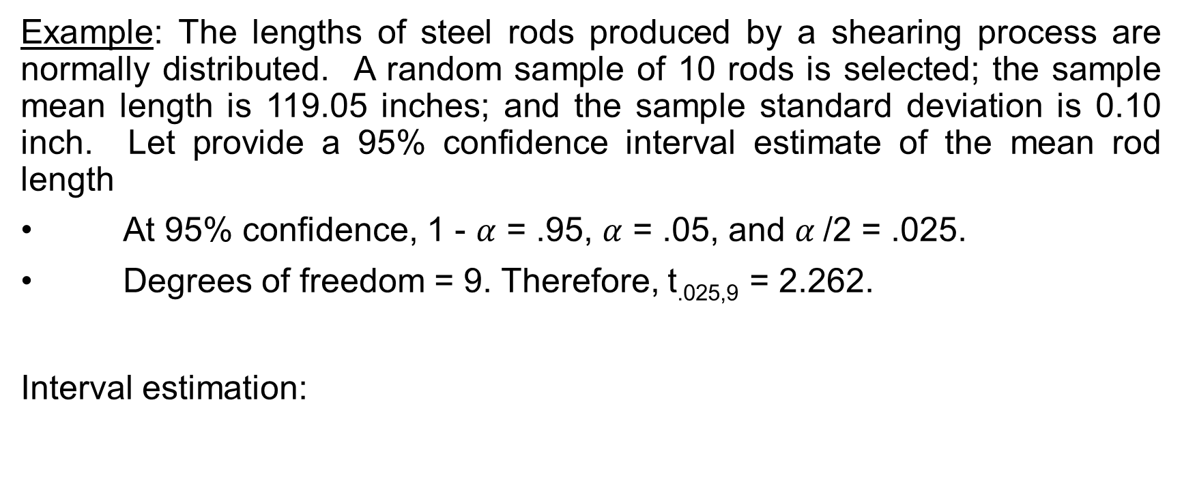
Interval Estimation for Mean – Small Sample
Example: The lengths of steel rods produced by a shearing process are normally distributed. A random sample of 10 rods is selected; the sample mean length is 119.05 inches; and the sample standard deviation is 0.10 inch. Let provide a 95% confidence interval estimate of the mean rod length
• At 95% confidence, 1 - $α$ = .95, $α$ = .05, and $α$/2 = .025.
• Degrees of freedom = 9. Therefore, t_{.025,9} = 2.262.
Interval estimation:

Slide 27

Interval Estimation for Population Proportion
where $\hat{p}$ : sample proportion
$\hat{q}$ : 1- $\hat{p}$
p: population proportion
n : sample size

Slide 28

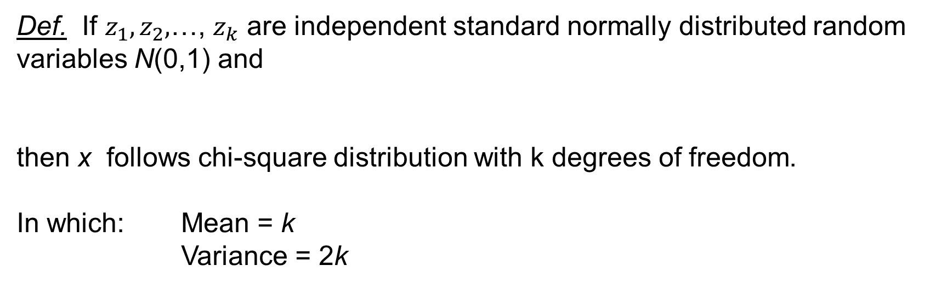
Interval Estimation for Population Variance
Chi-square ($χ^{2}$) distribution
Def. If $z_{1},z_{2},$…, $z_{k}$ are independent standard normally distributed random variables N(0,1) and
then x follows chi-square distribution with k degrees of freedom.
In which: Mean = k
Variance = 2k

Slide 29

Interval Estimation for Population Variance
Property:
If $y_{1},y_{2},$… $y_{n}$is a random sample from an $N(μ,σ^{2})$ then
(Why?)

Slide 30

Interval Estimation for Population Variance
Unbiassed Estimator of $σ^{2}$:
$χ^{2}$formula for Single Variance:
Confidence Interval for $σ^{2}$:

Slide 31

Interval Estimation for Population Variance
Example
Construct a 90% confidence interval for $σ^{2}$ given:
$$s^{2}=0.0022125, n=8$$
We have: df = 8-1=7;
$χ_{α/2}^{2}=$ $χ_{0.05}^{2}$=14.0671; $χ_{1−α/2}^{2}=$ $χ_{0.95}^{2}$=2.16735

Slide 32
Determine Sample Size when Estimating $μ$
Let E = the maximum sampling error mentioned in the precision statement.
E is the amount added to and subtracted from the point estimate to obtain an interval estimate and is often referred to as the margin of error.
Estimated Sample Size: if E is a required value then

Slide 33

Determine Sample Size when Estimating $μ$
How to estimated $σ?$
If the required width of the confidence interval is W, then

Slide 34
Determine Sample Size when Estimating $p$
Let E = the maximum sampling error mentioned in the precision statement
Estimated Sample Size: if E is a required value then
If the required width of the confidence interval is W , then
p may be assigned an appropriate value for calculation when there is no prior information (for example, p=0.5 → the sample size will be overestimated!).

