Slide 1
Applied Data Analytics

Slide 2
Session 4: Data Visualization

Slide 3
Introduction to Data Visualization
The best data is the data that we can see and understand
As data scientists, we should create and build the most comprehensive and understandable visualizations
To do this we need to find the data, read it, clean it, filter it, and then use the right tool to visualize it

Slide 4
Introduction to Data Visualization
Data visualization is the graphical representation of information and data. By using visual elements like charts, graphs, and maps, data visualization tools provide an accessible way to see and understand trends, outliers, and patterns in data.
In the world of Big Data, data visualization tools and technologies are essential to analyze massive amounts of information and make data-driven decisions.
It is noted that infographic refers to representations of information perceived as casual, funny, or frivolous, while visualization refers to designs perceived to be more serious, rigorous, or academic

Slide 5
Introduction to Data Visualization
Common types of data visualization
Charts
Tables
Graphs
Maps
Infographics
Dashboards

Slide 6
Introduction to Data Visualization
More specific methods to visualize data:
Area Chart
Bar Chart
Colum/Stacked Column Chart
Box-and-Whisker Plots
Distribution Plot
Gantt Chart
Heat Map
Histogram
Scatter/ Bubble Chart
Treemap
Matrix Visuals
…
And any combination in a dashboard!

Slide 7
Introduction to Data Visualization
Story Telling from Your Data
There are different ways to visualize data, each of which will provide a specific insight.
It’s important to select the appropriate way to help the readers understand the story you are trying to tell and the relationships you are focusing on.
Looking for patterns of interest to start your story such as
Trend: Sales vs. Time
Correlations: Sales of Coca-Cola vs. Temperature
Outliers: Unusual sales of a product in a specific region (e.g., rural area)

Slide 8
Introduction to Data Visualization
Data Types
Quantitative Data: all data values are numerical, the data can be counted or measured
Discrete: data can be counted. Example: number of a product solved in a specific year
Continuous: data cannot be counted and can receive any value in a range. Example: remaining time until expiry date of a product
Categorical Data: data can be classified in to groups or categories. Example: Types of products produced

Slide 9
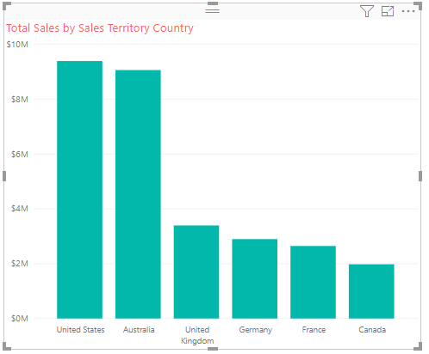
Basic Charts for Numerical Data and Categorical Data
Bar/Column Charts
Bar/Column charts is used to display categorical data
Bar charts present data horizontally while column charts depicts it vertically
Bar charts are best used for data with long category labels

Slide 10
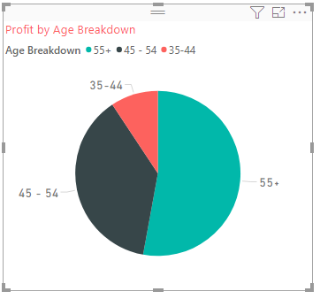
Basic Charts for Numerical Data and Categorical Data
Pie/Donut Charts
A pie chart is a circular statistical representation of data that is divided into slices to illustrate proportion or percentage
Donut chart is similar to pie chart but with circular section cut out in the middle
Pie/Donut charts are best used for making part-to-whole comparisons with discrete or continuous data.

Slide 11
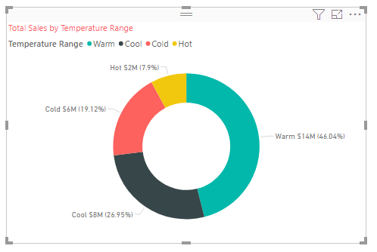
Basic Charts for Numerical Data and Categorical Data
Pie/Donut Charts

Slide 12
Basic Charts for Numerical Data and Categorical Data
Line Charts
Line charts are useful for time-based data
They are used to show time-series relationships with continuous data
They help show trend, acceleration, deceleration, and volatility

Slide 13
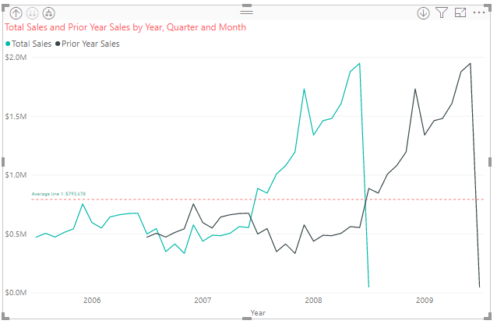
Basic Charts for Numerical Data and Categorical Data
Line Charts

Slide 14
Basic Charts for Numerical Data and Categorical Data
Area Charts
Area chart is also used to depict time-series relationship
Area chart is a type of line chart that is not only depict continuous change over a period of time but also reflect volume

Slide 15
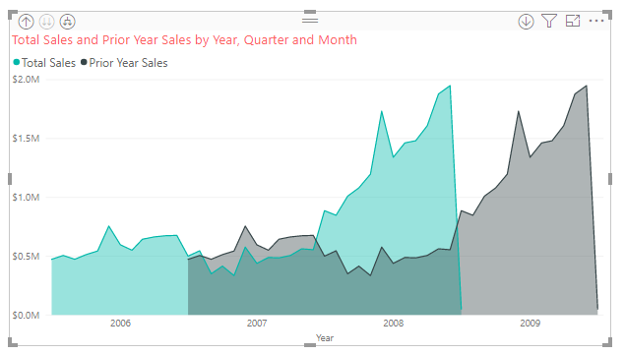
Basic Charts for Numerical Data and Categorical Data
Area Charts

Slide 16
Basic Charts for Numerical Data and Categorical Data
Scatter/Bubble Charts
This type of chart has a horizontal and a vertical axis to represent numerical values, enabling to show at least two sets of numbers as a series of XY coordinates (Ex.: Profit vs. Total Sales)
Bubble chart is a scatter chart with bubbles in which a third variable is used for the size of the bubbles (Ex.: Sales Quantity)

Slide 17
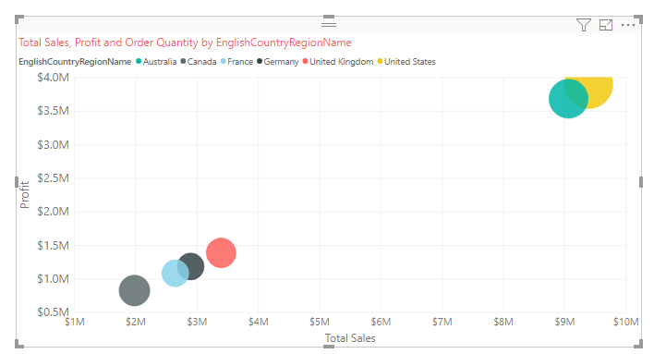
Basic Charts for Numerical Data and Categorical Data
Scatter/Bubble Charts

Slide 18
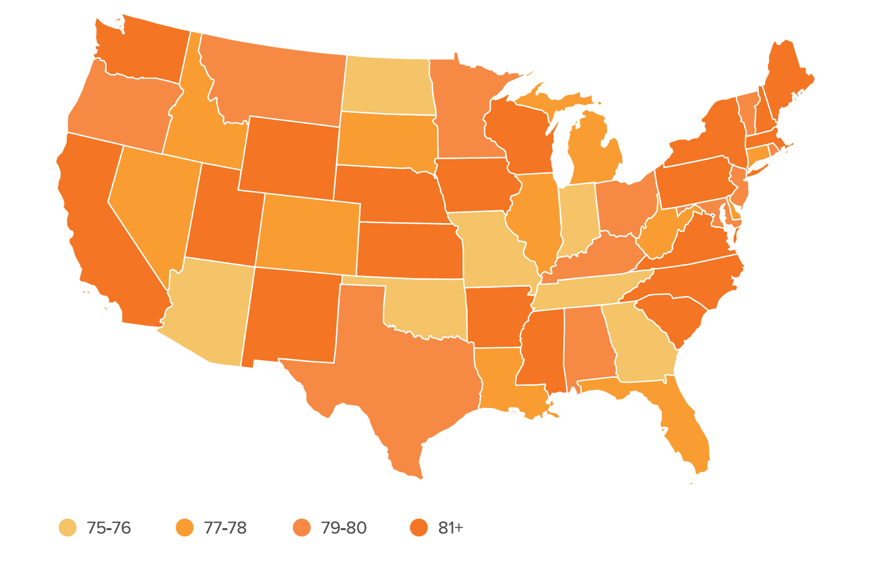
Basic Charts for Numerical Data and Categorical Data
Heat Map
Heat map displays categorical data, using intensity of color to represent values of geographical areas or data tables

Slide 19
Basic Charts for Numerical Data and Categorical Data
Table
This type of visual is best suited for numbers in tabular format representing certain grades of data group together
The table visual is perfect for looking at many values (measures) for a category

Slide 20
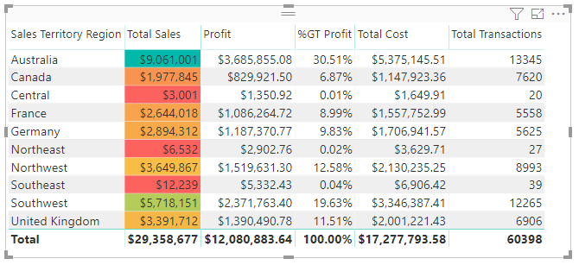
Basic Charts for Numerical Data and Categorical Data
Table

Slide 21
Basic Charts for Numerical Data and Categorical Data
Matrix
Matrix visual can deal with more than one category. It allows users to not only select a category for the rows, but we can also select a field to populate the columns as well
It allows detailed data at the cross sections for two categories to be seen.
The construction of matrix visual will be discussed in tutorial session (using Power BI)

Slide 22
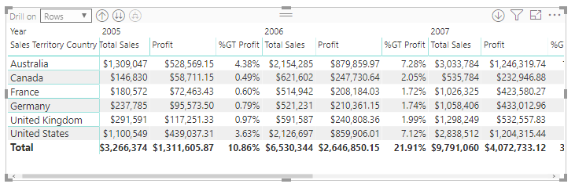
Basic Charts for Numerical Data and Categorical Data
Matrix

Slide 23
Distribution/Probability Plots
A distribution/probability plot is a graphical technique for comparing two data sets, either two sets of empirical observations, one empirical set against a theoretical set (commonly), or (more rarely) two theoretical sets against each other.
A probability plot can be constructed in two ways:
P–P plot, "Probability-Probability" or "Percent-Percent" plot;
Q–Q plot, "Quantile-Quantile" plot, which is more commonly used.
The most commonly used plot in practice is Normal probability plot, a Q–Q plot against the standard normal distribution

Slide 24
Distribution/Probability Plots
Normal Q-Q Plots
When running a statistical analysis under the assumption that a dependent variable follows a normal distribution, a Normal Q-Q plot can be used to check that assumption.
It is noted that the plot is subjective and just a visual check. Anyway, the plot allows us to see at-a-glance if the assumption is valid or not.
If the assumption is invalid, the plot can help to identify the outliers or the data points contribute to the violation.
The normal probability plot can be constructed using qqnorm and qqline commands in R (see tutorial session for details). The x-axis on the plot presents theoretical quantiles from the standard normal distribution (i.e., mean =0 & std =1) while the y-axis presents sample quantiles determined from the data set
Let look at the following graphs and check your understanding!

Slide 25
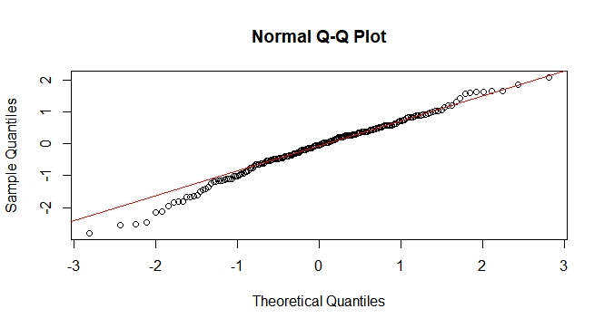
Distribution/Probability Plots
Data set: 200 values generated from a standard normal distribution
(Take a look at the position of the mean!)

Slide 26
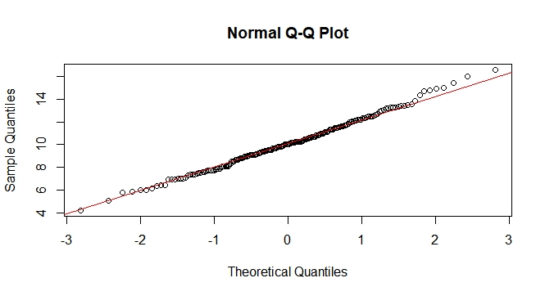
Distribution/Probability Plots
Data set: 200 values generated from a normal distribution with mean = 10, std = 2
(Take a look at the position of the mean!)

Slide 27
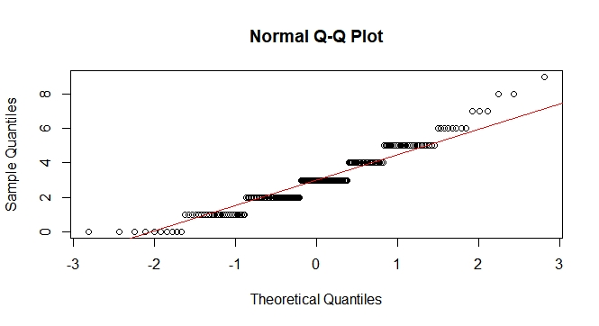
Distribution/Probability Plots
Data set: 200 values generated from a Poisson distribution with mean = 3
(Do not fit! Poisson distribution can be approximated by Normal distribution when the mean is large (~10))

Slide 28
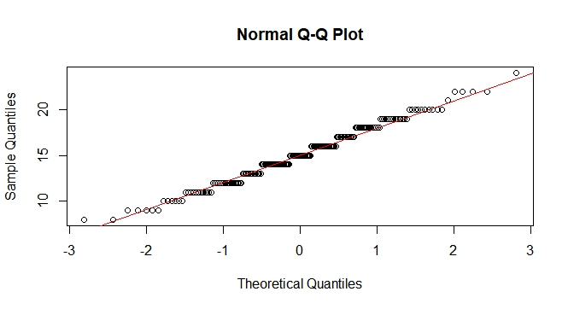
Distribution/Probability Plots
Data set: 200 values generated from a Binomial distribution with parameter n = 50, p=0.3
(Fitted! Reason: Binomial distribution can be approximated by Normal distribution)

Slide 29
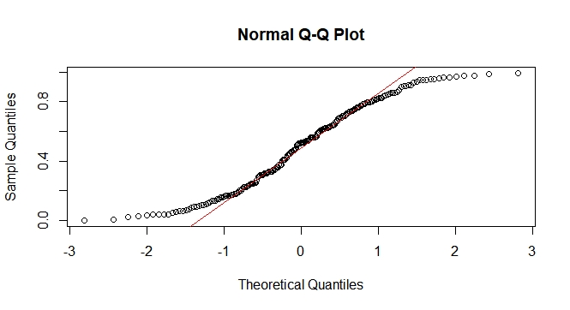
Distribution/Probability Plots
Data set: 200 values generated from a Uniform distribution over [0,1]
(Do not fit!)

Slide 30
Distribution/Probability Plots
Q-Q Plot of Other Distributions
Probability plots for distributions other than normal distribution can be constructed in exactly the same way as the normal probability plot.
There is a function in R called qqplot which allows to create quantile plots for comparing data with other standard probability distributions besides the normal distribution (see tutorial session for guidance).

Slide 31
Multivariate Charts
Combo/Combination Charts
The combination chart is a visualization that combines the features of the bar chart and the line chart.
The combination chart displays the data using a number of bars and/or lines, each of which represent a particular category.
A combination of bars and lines in the same visualization is useful when comparing values in different categories, since the combination gives a clear view of which category is higher or lower. An example of this can be seen when using the combination chart to compare the projected sales with the actual sales for different time periods.

Slide 32
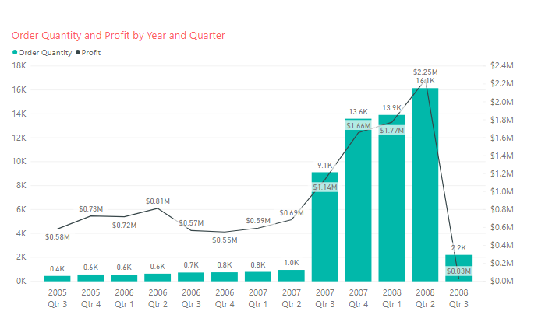
Multivariate Charts
Combo/Combination Charts
Line and Column Chart

Slide 33
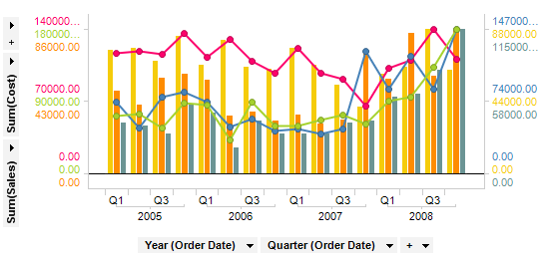
Multivariate Charts
Combo/Combination Charts
Multiple scales can also be used on the Y-axis when you want to compare several lines and bars with significantly different value ranges

Slide 34
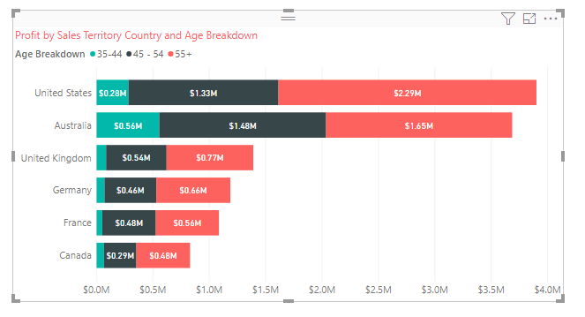
Multivariate Charts
Stacked Bar/Column Charts
This type of chart is useful if you need to know both the values of various subcategories of data as well as the total value

Slide 35
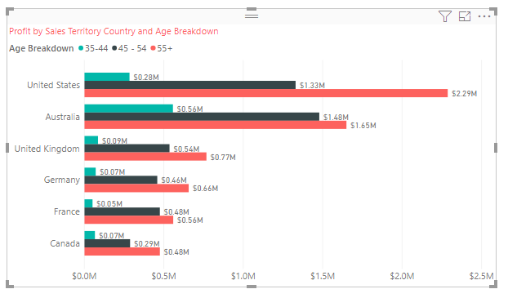
Multivariate Charts
Clustered Bar/Column Charts
This type of chart shows a comparison of all categories and subcategories as part of a whole

Slide 36
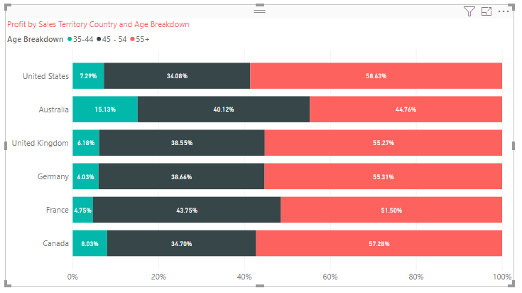
Multivariate Charts
100% Stacked Bar/Column Charts
This type of chart also combines various subcategories of data into a single bar/column. However, it is presented as a percentage

Slide 37
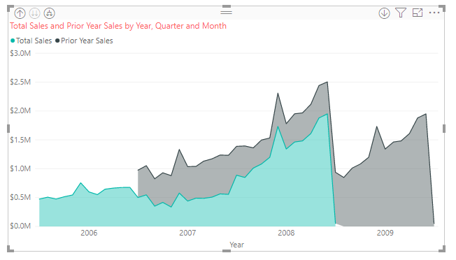
Multivariate Charts
Stacked Area Charts
Similar to the area charts but show the data in a stacked format

