Slide 1
Applied Data Analytics

Slide 2
Session 6: Regression Analysis

Slide 3
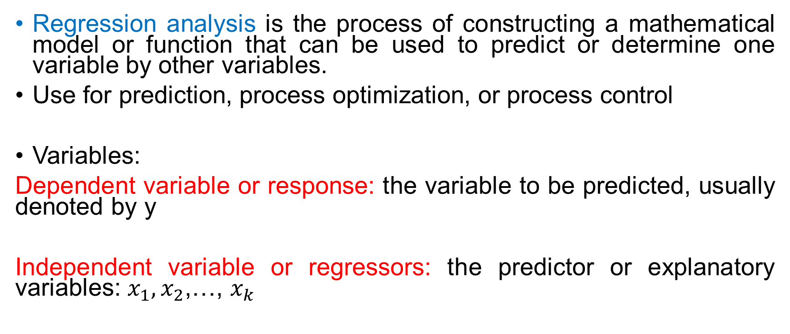
Introduction
Regression analysis is the process of constructing a mathematical model or function that can be used to predict or determine one variable by other variables.
Use for prediction, process optimization, or process control
Variables:
Dependent variable or response: the variable to be predicted, usually denoted by y
Independent variable or regressors: the predictor or explanatory variables: $x_{1},x_{2}$,…, $x_{k}$

Slide 4
LINEAR REGRESSION/MULTIPLE LINEAR REGRESSION MODELS
Linear Regression Model:
The normal form of a multiple linear regression model:

Slide 5
LINEAR REGRESSION/MULTIPLE LINEAR REGRESSION MODELS
Other forms:
(first-order model with interaction term)
(second-order response surface model)
Linear regression models: models that are linear in the parameters, regardless of the shape of the response surface that it generates.
Model Fitting: Estimate the parameters

Slide 6
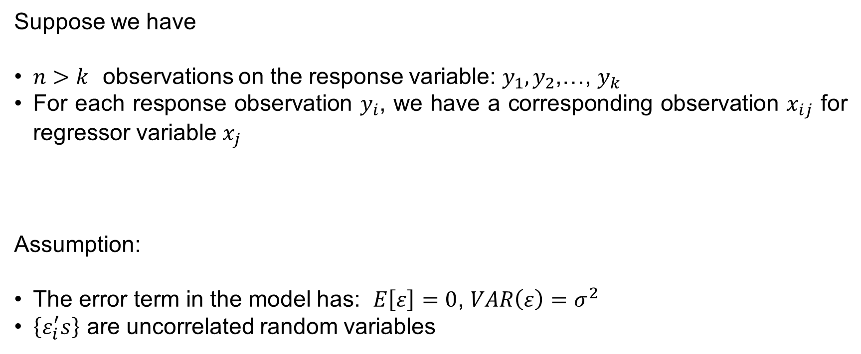
LEAST SQUARE METHOD
Suppose we have
$n>k$ observations on the response variable: $y_{1},y_{2}$,…, $y_{k}$
For each response observation $y_{i}$, we have a corresponding observation $x_{ij}$ for regressor variable $x_{j}$
Assumption:
The error term in the model has: $E\left[ε\right]=0$, $VAR\left(ε\right)=σ^{2}$
$\left\{ε_{i}^{′}s\right\}$ are uncorrelated random variables

Slide 7
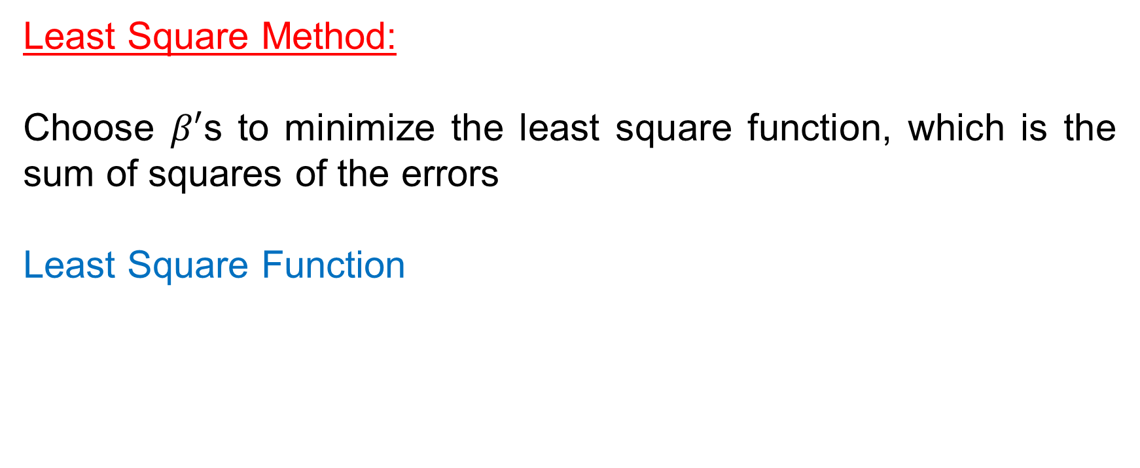
LEAST SQUARE METHOD
Least Square Method:
Choose $β′$s to minimize the least square function, which is the sum of squares of the errors
Least Square Function

Slide 8

LEAST SQUARE METHOD
$⇒$ Least Square Normal Equations: $p=k+1$ equations
The solution: least square estimators of the regression coefficients
${\hat{β}}_{1},{\hat{β}}_{2}$,…, ${\hat{β}}_{k}$

Slide 9

LEAST SQUARE METHOD
Matrix Form
Regression Model: $y=Xβ+ε$
where

Slide 10
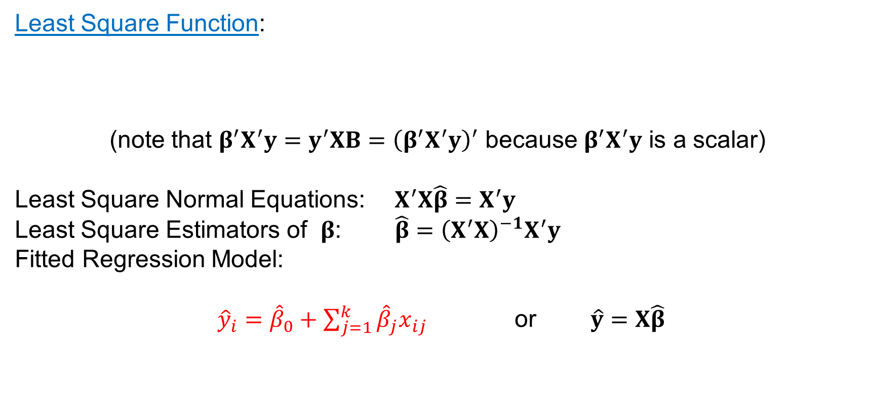
LEAST SQUARE METHOD
Least Square Function:
(note that $β^{′}X^{′}y=y^{′}XB={\left(β^{′}X^{′}y\right)}^{′}$ because $β^{′}X^{′}y$ is a scalar)
Least Square Normal Equations: $X^{′}X\hat{β}=X^{′}y$
Least Square Estimators of $β$: $\hat{β}={\left(X^{′}X\right)}^{−1}X^{′}y$
Fitted Regression Model:
${\hat{y}}_{i}={\hat{β}}_{0}+\sum_{j=1}^{k}{{\hat{β}}_{j}x_{ij}}$ or $\hat{y}=X\hat{β}$

Slide 11

RESIDUAL ANALYSIS
Residual:
$e_{i}=y_{i}−{\hat{y}}_{i}$ or $e=y−\hat{y}$
$⇒$Sum of Squares of the Residuals (error sum of squares):
(degrees of freedom = $n−p$)

Slide 12

RESIDUAL ANALYSIS
Estimate of $σ^{2}$:

Slide 13
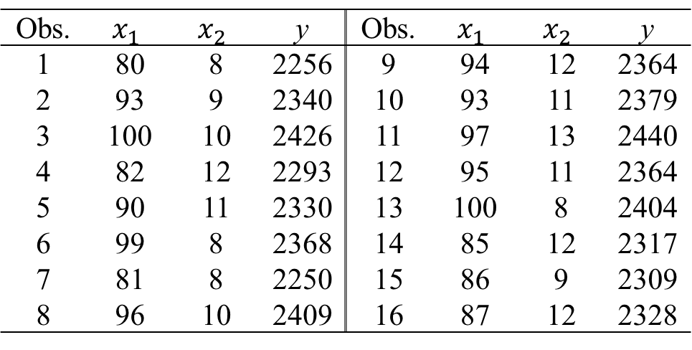

RESIDUAL ANALYSIS
Example: Investigate the effects of reaction temperature ($x_{1}$) and catalyst feed rate ($x_{2}$) on viscosity of a polymer ($y$)
Obs. | $$x_{1}$$ | $$x_{2}$$ | y | Obs. | $$x_{1}$$ | $$x_{2}$$ | y
1 2 3 4 5 6 7 8 | 80 93 100 82 90 99 81 96 | 8 9 10 12 11 8 8 10 | 2256 2340 2426 2293 2330 2368 2250 2409 | 9 10 11 12 13 14 15 16 | 94 93 97 95 100 85 86 87 | 12 11 13 11 8 12 9 12 | 2364 2379 2440 2364 2404 2317 2309 2328

Slide 14
RESIDUAL ANALYSIS
Least square estimators of parameters:

Slide 15
RESIDUAL ANALYSIS
Predicted values – Residuals – Other diagnostics

Slide 16
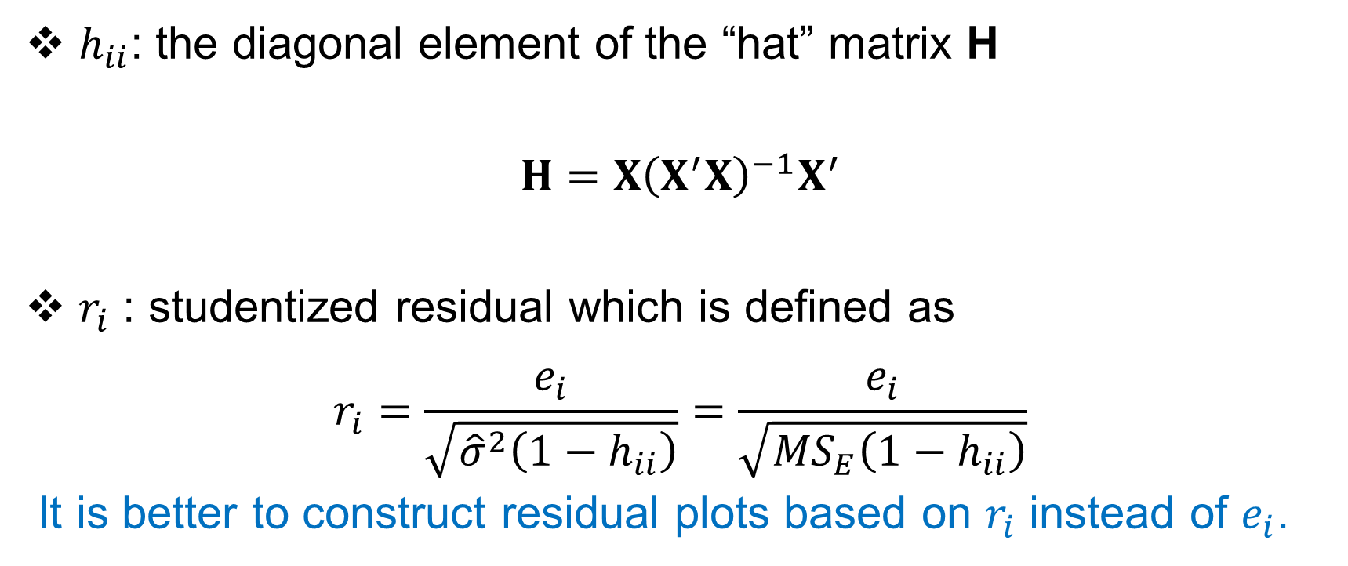
RESIDUAL ANALYSIS
$h_{ii}$: the diagonal element of the “hat” matrix H
$$H=X{\left(X^{′}X\right)}^{−1}X^{′}$$
$r_{i}$ : studentized residual which is defined as
$$r_{i}=\frac{e_{i}}{\sqrt{{\hat{σ}}^{2}\left(1−h_{ii}\right)}}=\frac{e_{i}}{\sqrt{{MS}_{E}\left(1−h_{ii}\right)}}$$
It is better to construct residual plots based on $r_{i}$ instead of $e_{i}$.

Slide 17
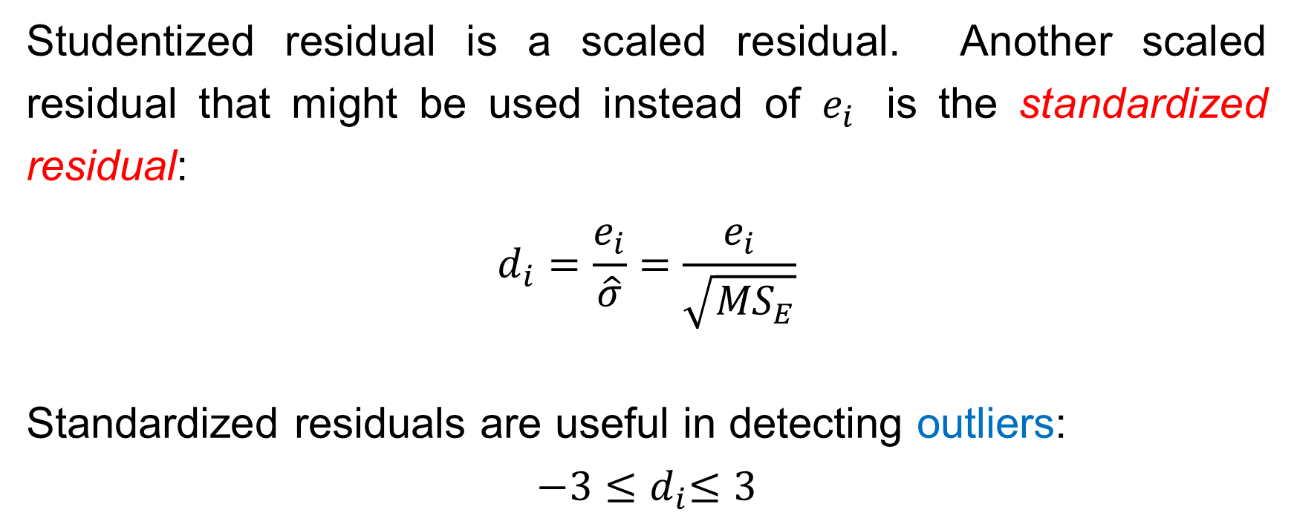
RESIDUAL ANALYSIS
Studentized residual is a scaled residual. Another scaled residual that might be used instead of $e_{i}$ is the standardized residual:
$$d_{i}=\frac{e_{i}}{\hat{σ}}=\frac{e_{i}}{\sqrt{{MS}_{E}}}$$
Standardized residuals are useful in detecting outliers:
$${−3≤d}_{i}≤3$$

Slide 18
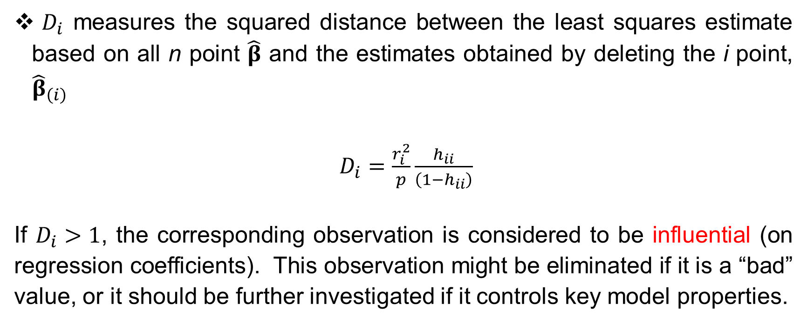
RESIDUAL ANALYSIS
$D_{i}$ measures the squared distance between the least squares estimate based on all n point $\hat{β}$ and the estimates obtained by deleting the i point, ${\hat{β}}_{\left(i\right)}$
$D_{i}=\frac{r_{i}^{2}}{p}\frac{h_{ii}}{\left(1−h_{ii}\right)}$
If $D_{i}>1$, the corresponding observation is considered to be influential (on regression coefficients). This observation might be eliminated if it is a “bad” value, or it should be further investigated if it controls key model properties.

Slide 19
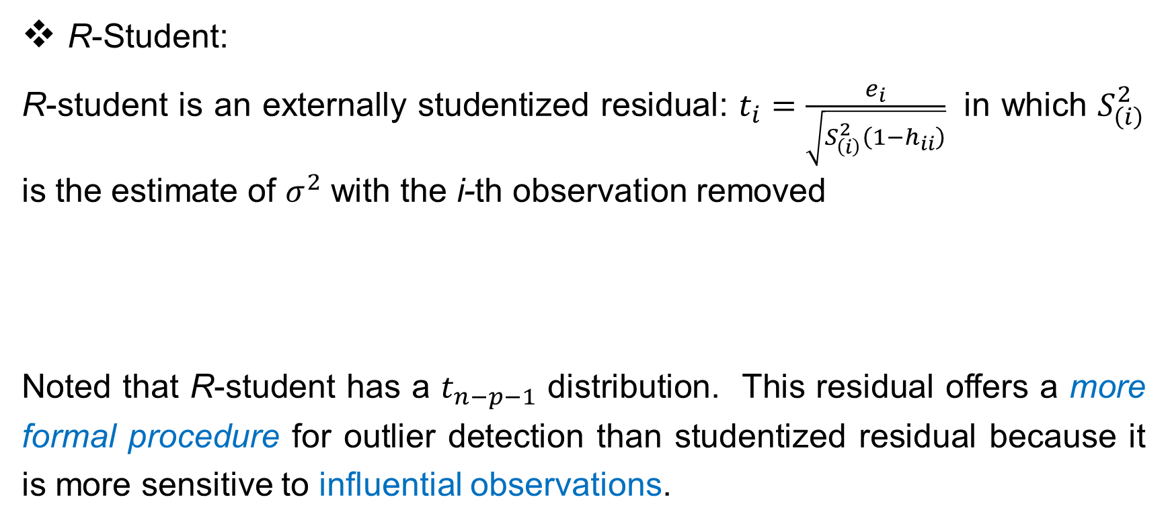
RESIDUAL ANALYSIS
R-Student:
R-student is an externally studentized residual: $t_{i}=\frac{e_{i}}{\sqrt{S_{\left(i\right)}^{2}\left(1−h_{ii}\right)}}$ in which $S_{\left(i\right)}^{2}$ is the estimate of $σ^{2}$ with the i-th observation removed
Noted that R-student has a $t_{n−p−1}$ distribution. This residual offers a more formal procedure for outlier detection than studentized residual because it is more sensitive to influential observations.

Slide 20
RESIDUAL ANALYSIS
PRESS Residuals
PRESS: Prediction Error Sum of Squares
PRESS residual: the ith PRESS residual is the prediction error for point i when its fitted value is determined from the regression model in which point i is removed

Slide 21
RESULTS
Call:
lm(formula = Viscosity ~ Reaction.Temperature + Catalyst.Feed.Rate, Notes:
data = ViscosityData) Total degree of freedom = 15
Degree of freedom of Regression =2
Residuals: Degree of freedom of Residual Error = 15-2 = 13
Min 1Q Median 3Q Max
-21.4972 -13.1978 -0.4736 10.5558 25.4299
Coefficients:
Estimate Std. Error t value Pr(>|t|)
(Intercept) 1566.0778 61.5918 25.43 1.80e-12 ***
Reaction.Temperature 7.6213 0.6184 12.32 1.52e-08 ***
Catalyst.Feed.Rate 8.5848 2.4387 3.52 0.00376 **
---
Signif. codes: 0 ‘***’ 0.001 ‘**’ 0.01 ‘*’ 0.05 ‘.’ 0.1 ‘ ’ 1
Residual standard error: 16.36 on 13 degrees of freedom
Multiple R-squared: 0.927, Adjusted R-squared: 0.9157
F-statistic: 82.5 on 2 and 13 DF, p-value: 4.1e-08

Slide 22
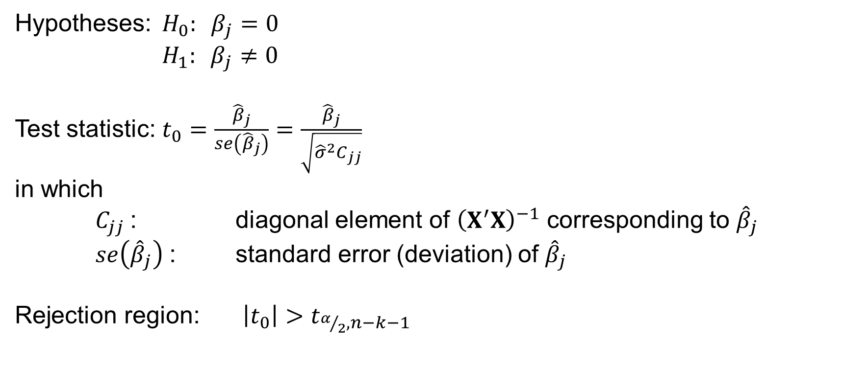
TEST ON INDIVIDUAL REGRESSION COEFFICIENTS
Hypotheses: $H_{0}: β_{j}=0$
$H_{1}: β_{j}≠0$
Test statistic: $t_{0}=\frac{{\hat{β}}_{j}}{se\left({\hat{β}}_{j}\right)}=\frac{{\hat{β}}_{j}}{\sqrt{{\hat{σ}}^{2}C_{jj}}}$
in which
$C_{jj}$: diagonal element of ${\left(X^{′}X\right)}^{−1}$ corresponding to ${\hat{β}}_{j}$
$se\left({\hat{β}}_{j}\right)$: standard error (deviation) of ${\hat{β}}_{j}$
Rejection region: $\left|t_{0}\right|>t_{α/2,n−k−1}$

Slide 23

TEST ON THE USEFULNESS OF THE MODEL
Hypotheses: $H_{0}: β_{1}{=β}_{2}=…=β_{k}=0$
$H_{1}: β_{j}≠0$ for at least one $j$
Test statistic: $F_{0}=\frac{{{SS}_{R}}/k}{{{SS}_{E}}/{\left(n−k−1\right)}}=\frac{{MS}_{R}}{{MS}_{E}}$
in which
Rejection region: $F_{0} >F_{α,k,n−k−1}$

Slide 24
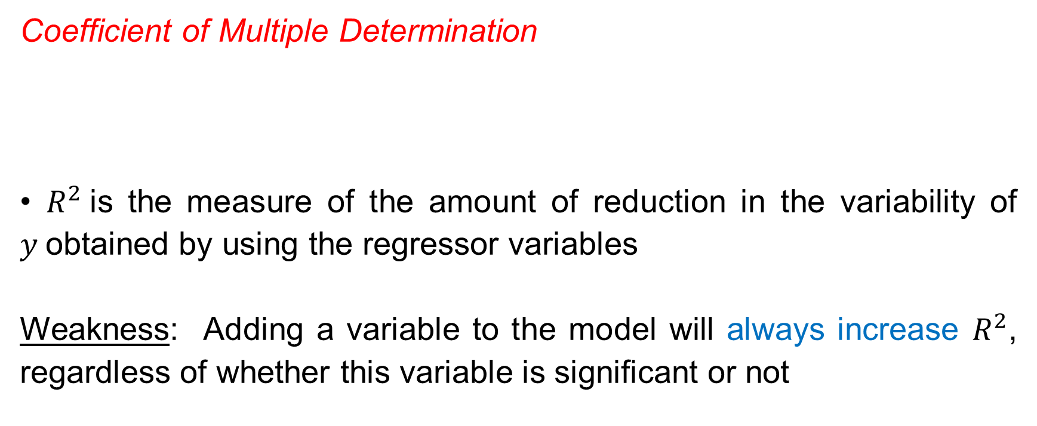
COEFFICIENT OF DETERMINATION
Coefficient of Multiple Determination
• $R^{2}$is the measure of the amount of reduction in the variability of $y$obtained by using the regressor variables
Weakness: Adding a variable to the model will always increase $R^{2}$, regardless of whether this variable is significant or not

Slide 25
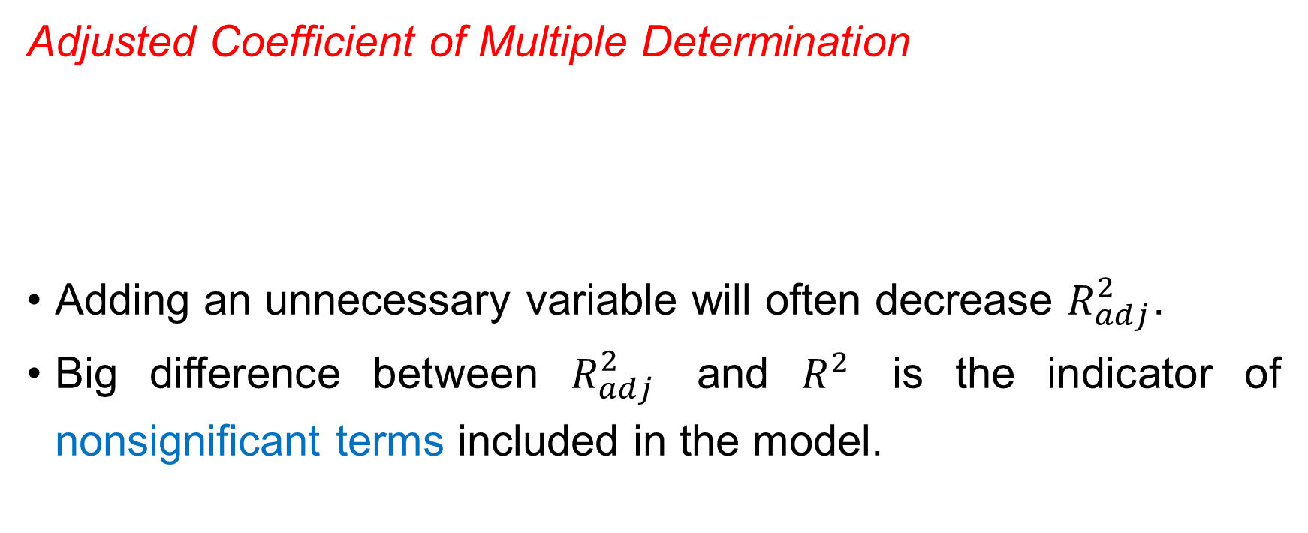
COEFFICIENT OF DETERMINATION
Adjusted Coefficient of Multiple Determination
Adding an unnecessary variable will often decrease $R_{adj}^{2}$.
Big difference between $R_{adj}^{2}$ and $R^{2}$ is the indicator of nonsignificant terms included in the model.

Slide 26
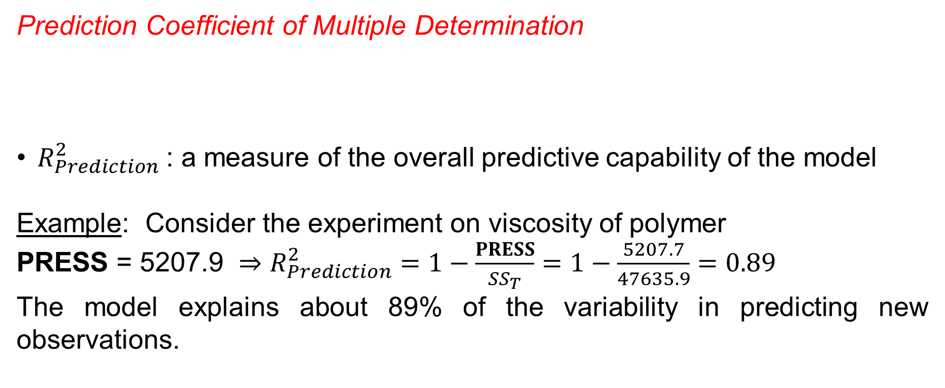
COEFFICIENT OF DETERMINATION
Prediction Coefficient of Multiple Determination
$R_{Prediction}^{2}$: a measure of the overall predictive capability of the model
Example: Consider the experiment on viscosity of polymer
PRESS = 5207.9 $⇒$ $R_{Prediction}^{2}=1−\frac{PRESS}{{SS}_{T}}=1−\frac{5207.7}{47635.9}=0.89$
The model explains about 89% of the variability in predicting new observations.

Slide 27
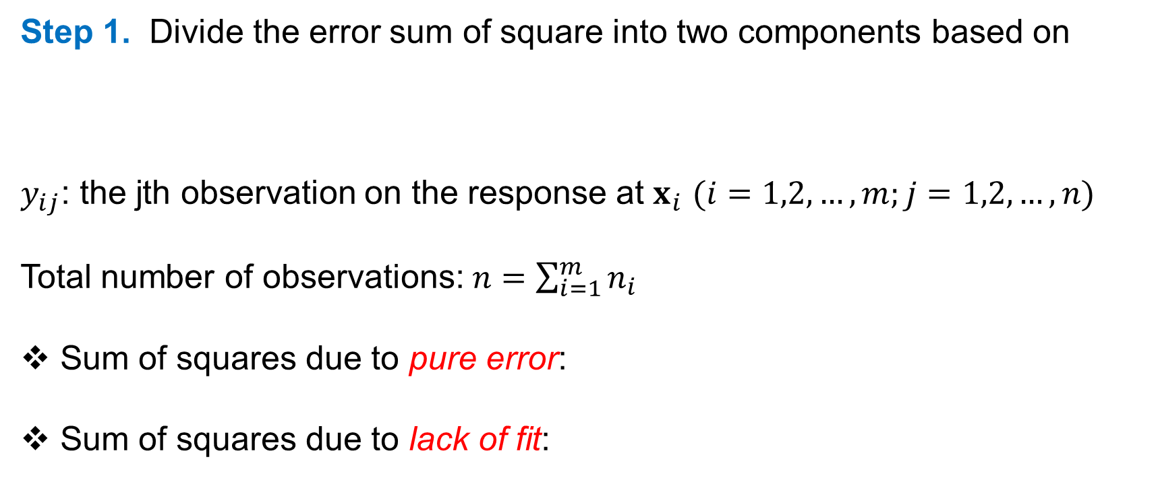
TESTING PROCEDURE FOR LACK OF FIT
Step 1. Divide the error sum of square into two components based on
$y_{ij}$: the jth observation on the response at $x_{i}$ $(i=1,2,…,m;j=1,2,…,n)$
Total number of observations: $n=\sum_{i=1}^{m}{n_{i}}$
Sum of squares due to pure error:
Sum of squares due to lack of fit:

Slide 28
TESTING PROCEDURE FOR LACK OF FIT
Step 2. Compute the test statistic
Step 3. There is a strong evidence of lack of fit, i.e., the regression function is not linear, if

