Slide 1
Applied Data Analytics

Slide 2
Session 8: Data Clustering

Slide 3
Introduction
Clustering refers to the grouping of records, observations, or cases into classes of similar objects.
A cluster is a collection of records that are similar to one another and dissimilar to records in other clusters.
Clustering differs from classification in that there is no target variable for clustering.
The clustering task does not try to classify, estimate, or predict the value of a target variable. Instead, it seeks to segment the entire data set into relatively homogeneous subgroups or clusters where the similarity of the records within the cluster is maximized, and the similarity to records outside this cluster is minimized.

Slide 4
Introduction
Clustering is often performed as a preliminary step in a data mining process
The resulting clusters will be used as further inputs into a different technique downstream, such as neural networks.
Owing to the enormous size of many databases, it is often helpful to apply clustering analysis first, to reduce the search space for the downstream algorithms.

Slide 5
Introduction
Cluster analysis encounters similar issues that we dealt with in classification.
How to measure similarity
How to recode categorical variables
How to standardize or normalize numerical variables
How many clusters we should use

Slide 6
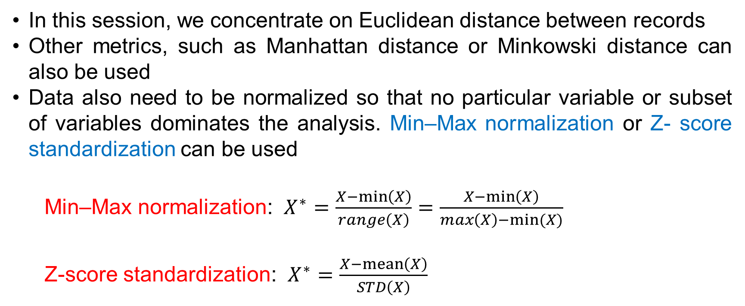
Introduction
In this session, we concentrate on Euclidean distance between records
Other metrics, such as Manhattan distance or Minkowski distance can also be used
Data also need to be normalized so that no particular variable or subset of variables dominates the analysis. Min–Max normalization or Z- score standardization can be used
Min–Max normalization: $X^{∗}=\frac{X−\min\left(X\right)}{range\left(X\right)}=\frac{X−\min\left(X\right)}{max\left(X\right)−min(X)}$
Z-score standardization: $X^{∗}=\frac{X−\operatorname{mean}\left(X\right)}{STD\left(X\right)}$

Slide 7
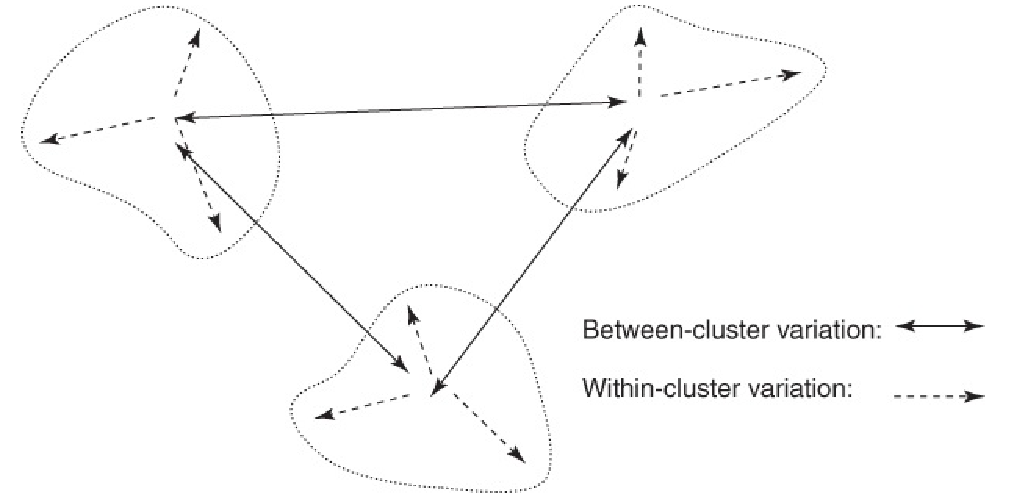
Introduction
Clusters should have small within-cluster variation compared to the between-cluster variation

Slide 8
Hierarchical Clustering Method
Clustering algorithms are either hierarchical or nonhierarchical.
In hierarchical clustering,
A treelike cluster structure (dendrogram) is created through recursive partitioning (divisive methods) or combining (agglomerative) of existing clusters.
Agglomerative clustering methods initialize each observation to be a tiny cluster of its own. Then, in succeeding steps, the two closest clusters are aggregated into a new combined cluster. until, all records are combined into a single huge cluster.
Divisive clustering methods begin with all the records in one big cluster. Then the most dissimilar records will be split off recursively into a separate cluster until each record represents its own cluster.

Slide 9
Hierarchical Clustering Method
In this session, we discuss only hierarchical clustering using agglomerative methods (the commonly used technique in most computer programs).
Several criteria have been used to help determined the distance between clusters of records, including
Single Linkage: the nearest-neighbor approach which is based on the minimum distance between any record in cluster A and any record in cluster B. Using this approach, cluster similarity is based on the similarity of the most similar members from each cluster.
Note: Single linkage tends to form long, slender clusters, which may sometimes lead to heterogeneous records being clustered together.

Slide 10
Hierarchical Clustering Method
Complete Linkage: the farthest-neighbor approach which is based on the maximum distance between any record in cluster A and any record in cluster B. Using this approach, cluster similarity is based on the similarity of the most dissimilar members from each cluster.
Note: Complete linkage tends to form more compact, sphere-like clusters.
Average Linkage: employed to reduce the dependence on extreme values, i.e., the most similar or dissimilar records. In average linkage, the criterion is the average distance of all the records in cluster A from all the records in cluster B.
Note: The resulting clusters tend to have approximately equal within-cluster variability.

Slide 11
Hierarchical Clustering Method
Single-Linkage Clustering
Example: consider the data set: 2, 5, 9, 15, 16, 18, 25, 33, 33, 45. The step-by-step procedure of applying single-linkage clustering method is illustrated in the figure

Slide 12
Hierarchical Clustering Method
Step 1: The two single-record clusters (33 and 33, distance of 0) are combined into one
Step 2: The two clusters containing values 15 and 16 (distance of 1) are combined into one
Step 3: The cluster {15,16} is combined with cluster {18}, because the distance between 16 and 18 (the closest records in each cluster) is 2, the minimum among remaining clusters.
Step 4: Clusters {2} and {5} are combined.
Step 5: Cluster {2,5} is combined with cluster {9}, because the distance between 5 and 9 (the closest records in each cluster) is 4, the minimum among remaining clusters.

Slide 13
Hierarchical Clustering Method
Step 6: Cluster {2,5,9} is combined with cluster {15,16,18}, because the distance between 9 and 15 is 6, the minimum among remaining clusters.
Step 7: Cluster {2,5,9,15,16,18} is combined with cluster {25}, because the distance between 18 and 25 is 7, the minimum among remaining clusters.
Step 8: Cluster {2,5,9,15,16,18,25} is combined with cluster {33,33}, because the distance between 25 and 33 is 8, the minimum among remaining clusters.
Step 9: Cluster {2,5,9,15,16,18,25,33,33} is combined with cluster {45}. This last cluster contains all the records in the data set.

Slide 14
Hierarchical Clustering Method
Complete-Linkage Clustering
Example: consider the data set: 2, 5, 9, 15, 16, 18, 25, 33, 33, 45. The step-by-step procedure of applying single-linkage clustering method is illustrated in the figure

Slide 15
Hierarchical Clustering Method
Step 1:. The two clusters each containing 33 are combined into one.
Step 2: The clusters containing values 15 and 16 are combined into one
Step 3: The farthest neighbors of the two clusters {15,16} and {18} are 15 and 18 with a distance of 3. The farthest neighbors of the two clusters {2} and {5} are 2 and 5 also with the same distance of 3. There exists a tie in this step, so, let combine the clusters {2} and {5} into a new cluster.
Step 4: Cluster {15,16} is combined with cluster {18}.
Step 5: Cluster {2,5} is combined with cluster {9}, because the complete-linkage distance is 7, the smallest among remaining clusters.

Slide 16
Hierarchical Clustering Method
Step 6: Cluster {25} is combined with cluster {33,33}, with a complete-linkage distance of 8.
Step 7: Cluster {2,5,9} is combined with cluster {15,16,18}, with a complete- linkage distance of 16.
Step 8: Cluster {25,33,33} is combined with cluster {45}, with a complete- linkage distance of 20.
Step 9: Cluster {2,5,9,15,16,18} is combined with cluster {25,33,33,45}. All records are now contained in only one large cluster.

Slide 17
k-Means Clustering
The k-means clustering algorithm is a straightforward and effective algorithm for finding clusters in data. The algorithm proceeds as follows:
Step 1: Ask the user how many clusters k the data set should be partitioned into.
Step 2: Randomly assign k records to be the initial cluster center locations.
Step 3: For each record, find the nearest cluster center and assign that record to the corresponding cluster
Step 4: For each of the k clusters, find the cluster centroid, and update the location of each cluster center to the new value of the centroid.

Slide 18
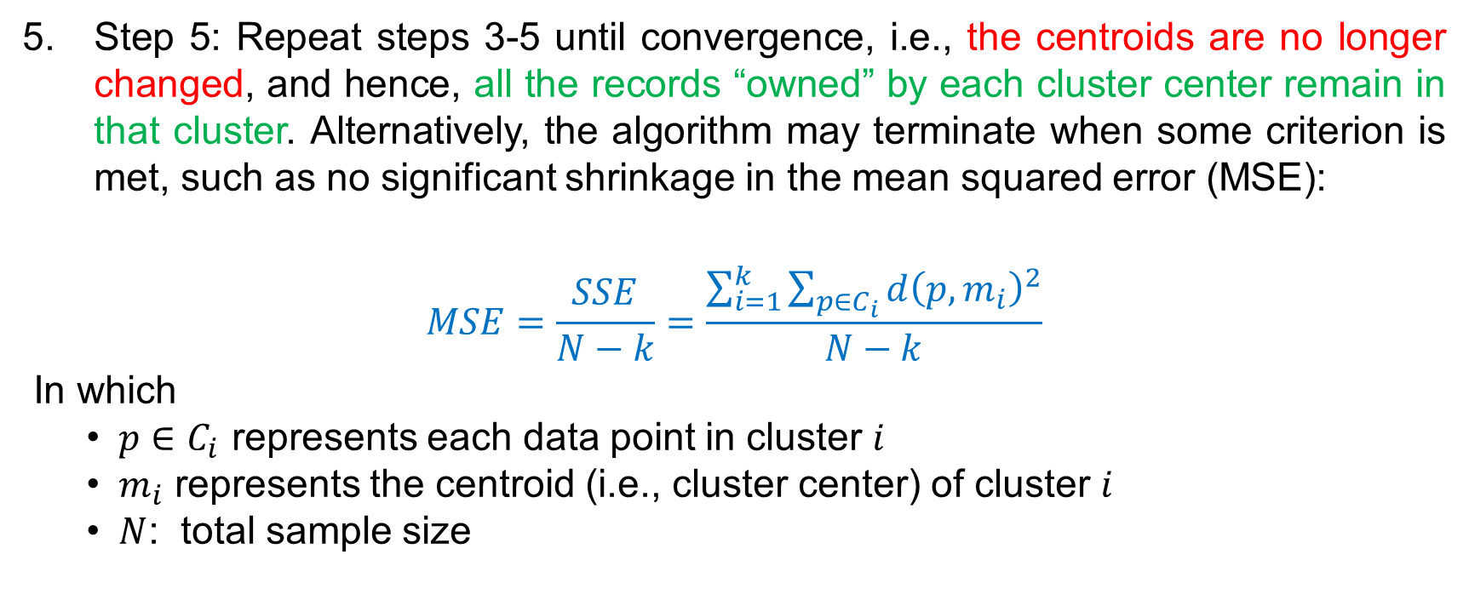
k-Means Clustering
Step 5: Repeat steps 3-5 until convergence, i.e., the centroids are no longer changed, and hence, all the records “owned” by each cluster center remain in that cluster. Alternatively, the algorithm may terminate when some criterion is met, such as no significant shrinkage in the mean squared error (MSE):
$$MSE=\frac{SSE}{N−k}=\frac{\sum_{i=1}^{k}{\sum_{p∈C_{i}}{d{\left(p,m_{i}\right)}^{2}}}}{N−k}$$
In which
$p∈C_{i}$ represents each data point in cluster $i$
$m_{i}$ represents the centroid (i.e., cluster center) of cluster $i$
$N$: total sample size

Slide 19
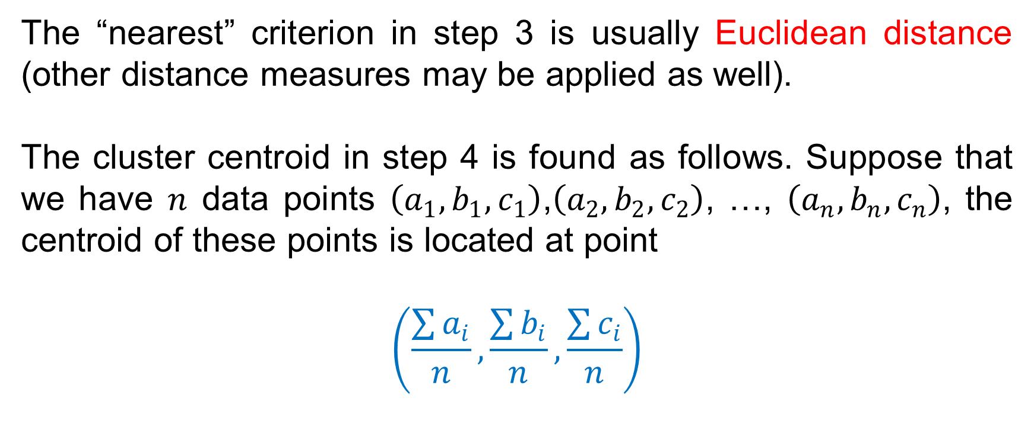
k-Means Clustering
The “nearest” criterion in step 3 is usually Euclidean distance (other distance measures may be applied as well).
The cluster centroid in step 4 is found as follows. Suppose that we have $n$ data points $\left(a_{1},b_{1},c_{1}\right)$,$\left(a_{2},b_{2},c_{2}\right)$, …, $\left(a_{n},b_{n},c_{n}\right)$, the centroid of these points is located at point
$$\left(\frac{\sum{a_{i}}}{n},\frac{\sum{b_{i}}}{n},\frac{\sum{c_{i}}}{n}\right)$$

Slide 20
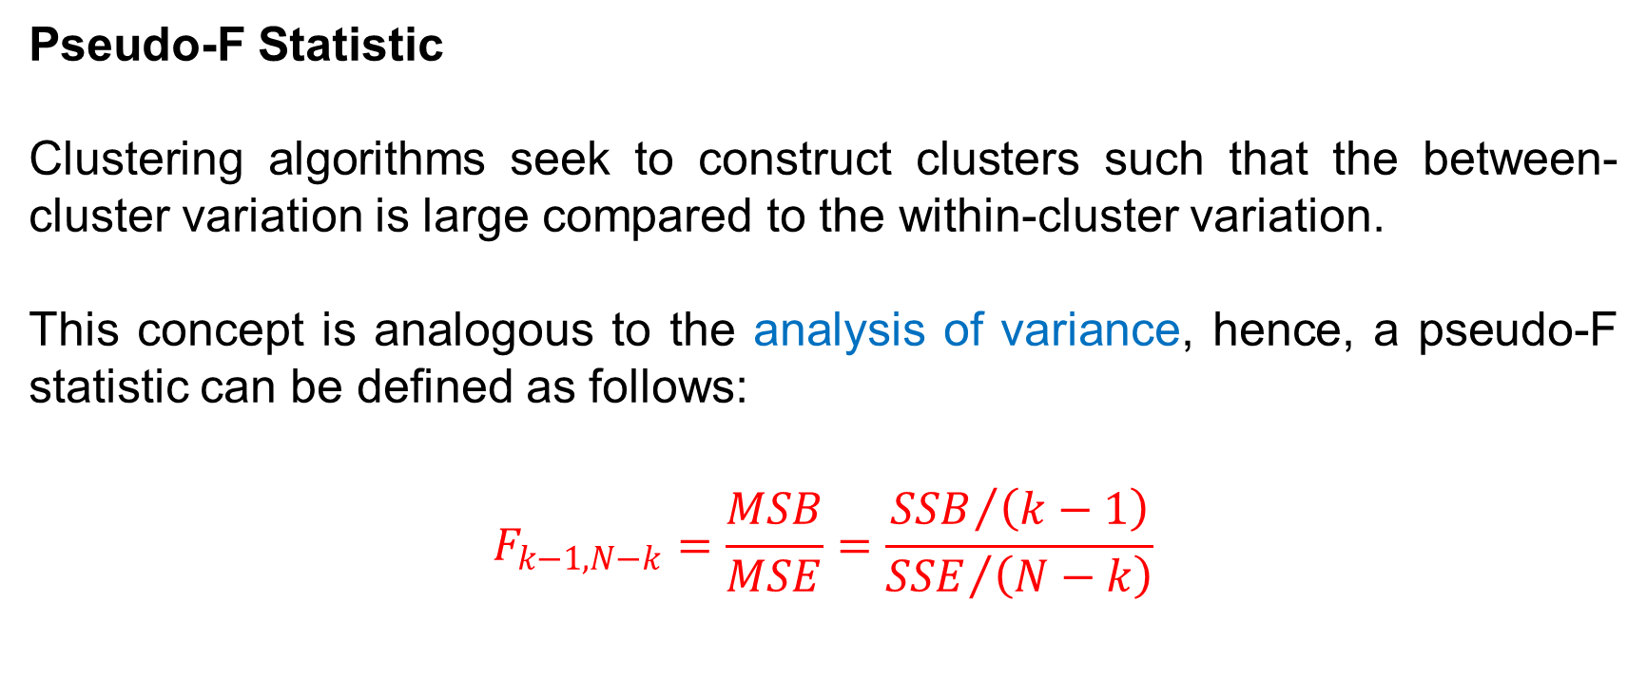
k-Means Clustering
Pseudo-F Statistic
Clustering algorithms seek to construct clusters such that the between-cluster variation is large compared to the within-cluster variation.
This concept is analogous to the analysis of variance, hence, a pseudo-F statistic can be defined as follows:
$$F_{k−1,N−k}=\frac{MSB}{MSE}=\frac{{SSB}/{\left(k−1\right)}}{{SSE}/{\left(N−k\right)}}$$

Slide 21
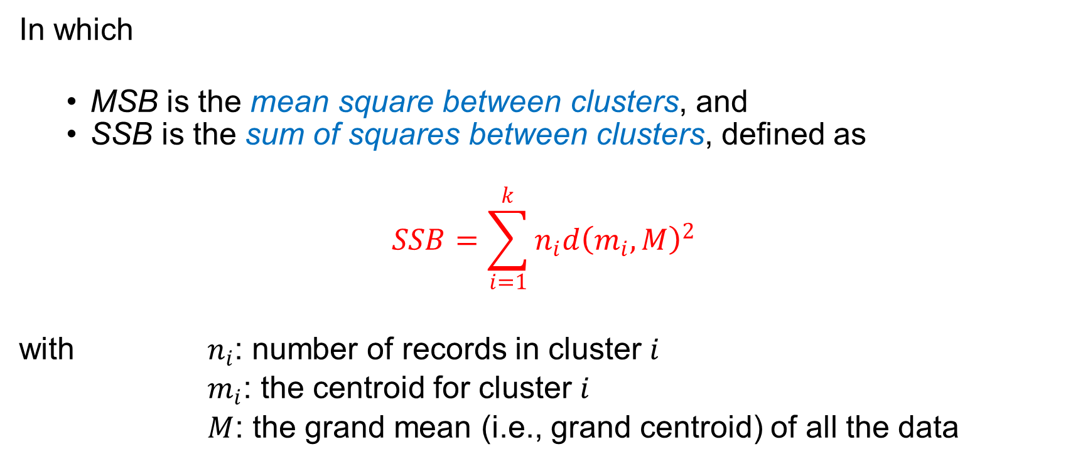
k-Means Clustering
In which
MSB is the mean square between clusters, and
SSB is the sum of squares between clusters, defined as
$$SSB=\sum_{i=1}^{k}{n_{i}{d\left(m_{i},M\right)}^{2}}$$
with $n_{i}$: number of records in cluster $i$
$m_{i}$: the centroid for cluster $i$
$M$: the grand mean (i.e., grand centroid) of all the data

Slide 22
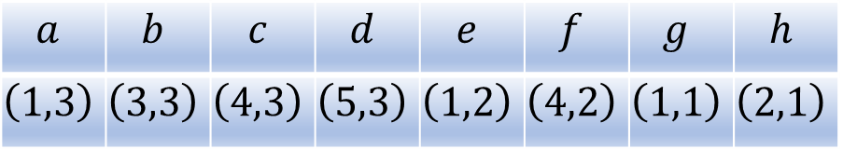
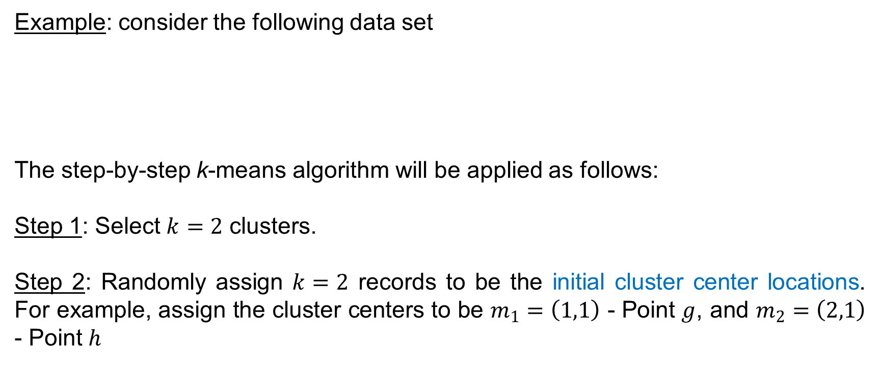
k-Means Clustering
Example: consider the following data set
The step-by-step k-means algorithm will be applied as follows:
Step 1: Select $k=2$ clusters.
Step 2: Randomly assign $k=2$ records to be the initial cluster center locations. For example, assign the cluster centers to be $m_{1}=\left(1,1\right)$ - Point $g$, and $m_{2}=\left(2,1\right)$ - Point $h$
$$a$$ | $$b$$ | $$c$$ | $$d$$ | $$e$$ | $$f$$ | $$g$$ | $$h$$
$$\left(1,3\right)$$ | $$\left(3,3\right)$$ | $$\left(4,3\right)$$ | $$\left(5,3\right)$$ | $$\left(1,2\right)$$ | $$\left(4,2\right)$$ | $$\left(1,1\right)$$ | $$\left(2,1\right)$$

Slide 23
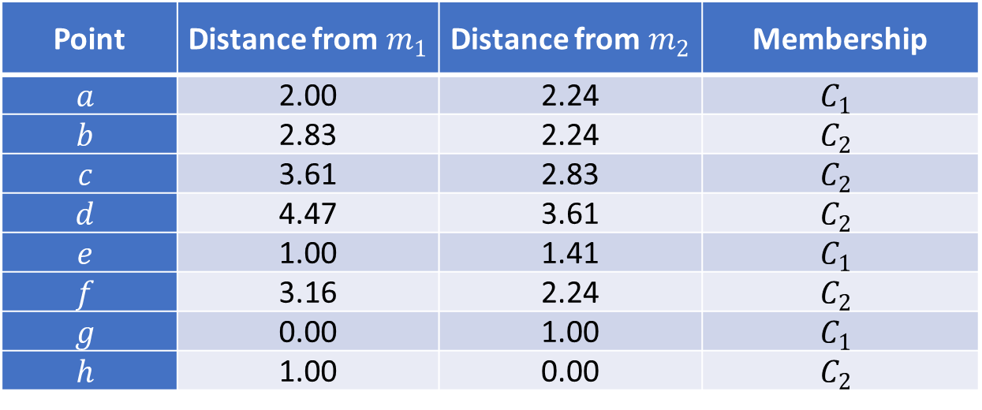

k-Means Clustering
First pass:
Step 3: For each record, find the nearest cluster center by finding the Euclidean distances between each point and each cluster center $m_{1}$ and $m_{2}$, and determining which cluster center the point is nearest to. The results are: cluster 1 contains points $\left\{a,e,g\right\}$ and cluster 2 contains points $\left\{b,c,d,f,h\right\}$.
Point | Distance from $m_{1}$ | Distance from $m_{2}$ | Membership
$$a$$ | 2.00 | 2.24 | $$C_{1}$$
$$b$$ | 2.83 | 2.24 | $$C_{2}$$
$$c$$ | 3.61 | 2.83 | $$C_{2}$$
$$d$$ | 4.47 | 3.61 | $$C_{2}$$
$$e$$ | 1.00 | 1.41 | $$C_{1}$$
$$f$$ | 3.16 | 2.24 | $$C_{2}$$
$$g$$ | 0.00 | 1.00 | $$C_{1}$$
$$h$$ | 1.00 | 0.00 | $$C_{2}$$

Slide 24
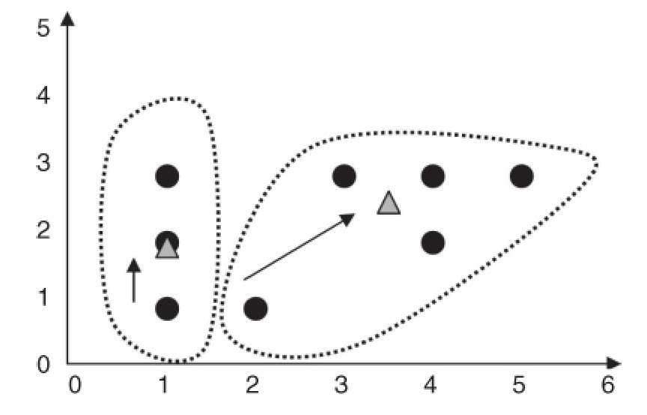

k-Means Clustering
Step 4: For each of the $k$ clusters find the cluster centroid and update the location of each cluster center to the new value of the centroid.
For instances,
The centroid for cluster 1 is $\left(\frac{1+1+1}{3},\frac{3+2+1}{3}\right)=\left(1.0,2.0\right)$
The centroid for cluster 2 is $\left(\frac{3+4+5+4+2}{5},\frac{3+3+3+2+1}{5}\right)=\left(3.6,2.4\right)$

Slide 25
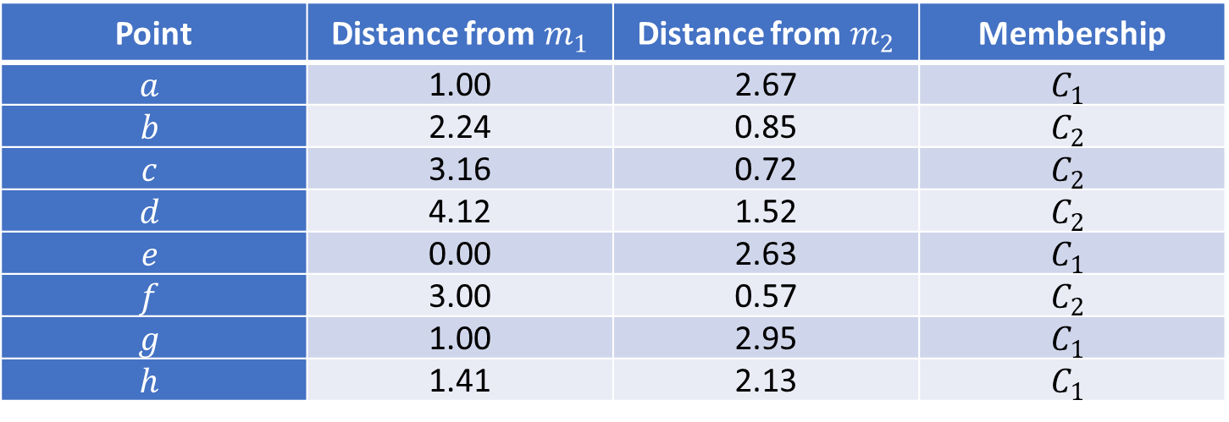

k-Means Clustering
Second pass:
Step 3: For each record, find the nearest cluster center by finding the Euclidean distances between each point and each revised cluster center $m_{1}=\left(1.0,2.0\right)$ and $m_{2}=\left(3.6,2.4\right)$, and determining resulting cluster membership. The results are: cluster 1 contains points $\left\{a,e,g,h\right\}$ and cluster 2 contains points $\left\{b,c,d,f\right\}$.
Point | Distance from $m_{1}$ | Distance from $m_{2}$ | Membership
$$a$$ | 1.00 | 2.67 | $$C_{1}$$
$$b$$ | 2.24 | 0.85 | $$C_{2}$$
$$c$$ | 3.16 | 0.72 | $$C_{2}$$
$$d$$ | 4.12 | 1.52 | $$C_{2}$$
$$e$$ | 0.00 | 2.63 | $$C_{1}$$
$$f$$ | 3.00 | 0.57 | $$C_{2}$$
$$g$$ | 1.00 | 2.95 | $$C_{1}$$
$$h$$ | 1.41 | 2.13 | $$C_{1}$$

Slide 26
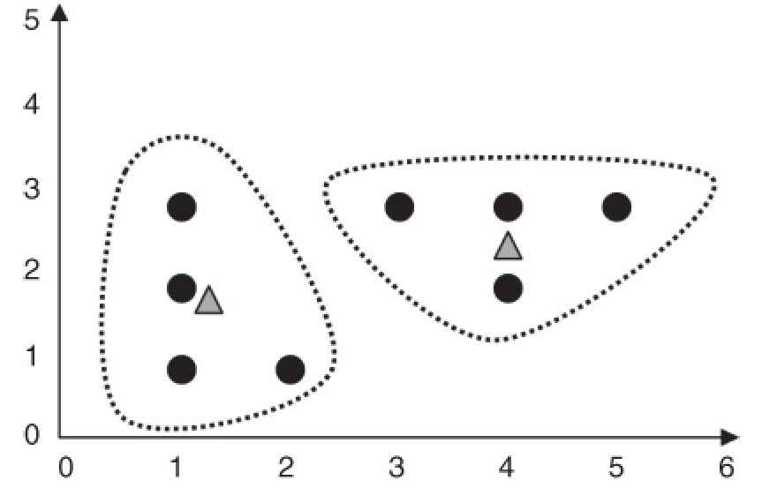

k-Means Clustering
Step 4: update the location of each cluster center.
The centroid for cluster 1 is $\left(\frac{1+1+1+2}{4},\frac{3+2+1+1}{4}\right)=\left(1.25,1.75\right)$
The centroid for cluster 2 is $\left(\frac{3+4+5+4}{4},\frac{3+3+3+2}{4}\right)=\left(4.0,2.75\right)$

Slide 27
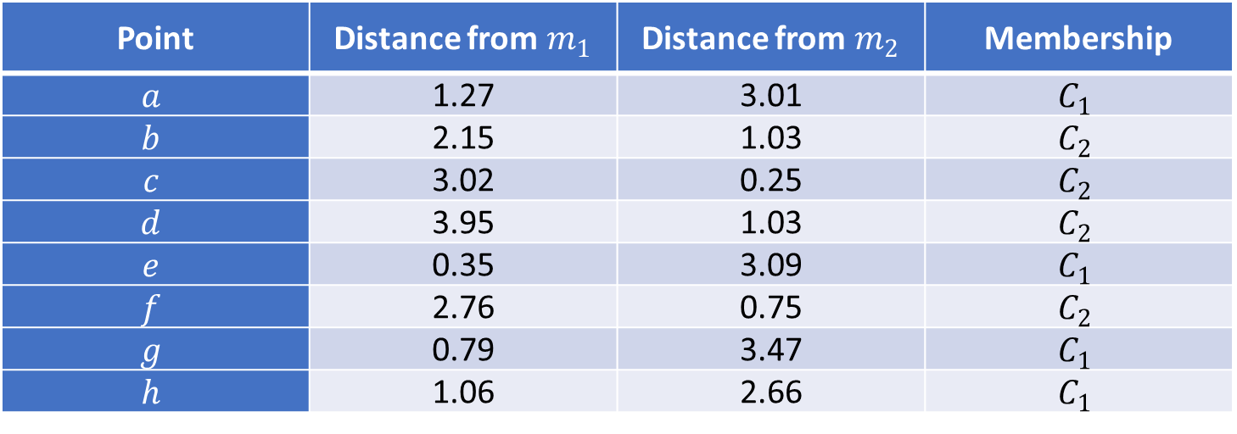

k-Means Clustering
Third pass:
Step 3: For each record, find the nearest cluster center by finding the Euclidean distances between each point and each revised cluster center $m_{1}=\left(1.25,1.75\right)$ and $m_{2}=\left(4.0,2.75\right)$, and determining resulting cluster membership. The result is: no records have shifted cluster membership
Point | Distance from $m_{1}$ | Distance from $m_{2}$ | Membership
$$a$$ | 1.27 | 3.01 | $$C_{1}$$
$$b$$ | 2.15 | 1.03 | $$C_{2}$$
$$c$$ | 3.02 | 0.25 | $$C_{2}$$
$$d$$ | 3.95 | 1.03 | $$C_{2}$$
$$e$$ | 0.35 | 3.09 | $$C_{1}$$
$$f$$ | 2.76 | 0.75 | $$C_{2}$$
$$g$$ | 0.79 | 3.47 | $$C_{1}$$
$$h$$ | 1.06 | 2.66 | $$C_{1}$$

Slide 28
k-Means Clustering
Step 4: update the location of each cluster center – no change!
The algorithm converges. STOP!

Slide 29
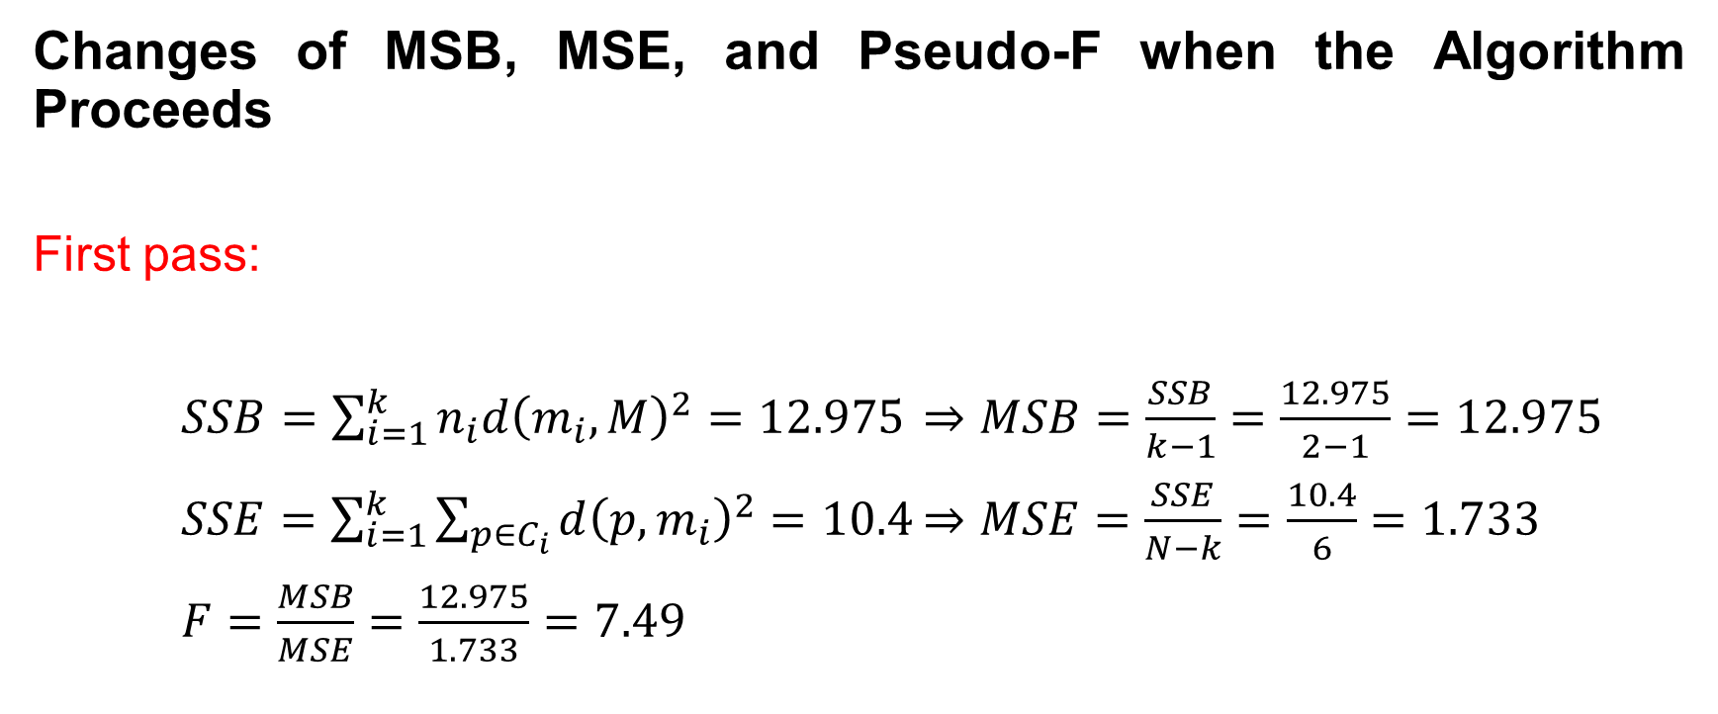
k-Means Clustering
Changes of MSB, MSE, and Pseudo-F when the Algorithm Proceeds
First pass:
$SSB=\sum_{i=1}^{k}{n_{i}d{\left(m_{i},M\right)}^{2}=12.975}$ $⇒MSB=\frac{SSB}{k−1}=\frac{12.975}{2−1}=12.975$
$SSE=\sum_{i=1}^{k}{\sum_{p∈C_{i}}{d{\left(p,m_{i}\right)}^{2}}=10.4}$ $⇒MSE=\frac{SSE}{N−k}=\frac{10.4}{6}=1.733$
$F=\frac{MSB}{MSE}=\frac{12.975}{1.733}=7.49$

Slide 30
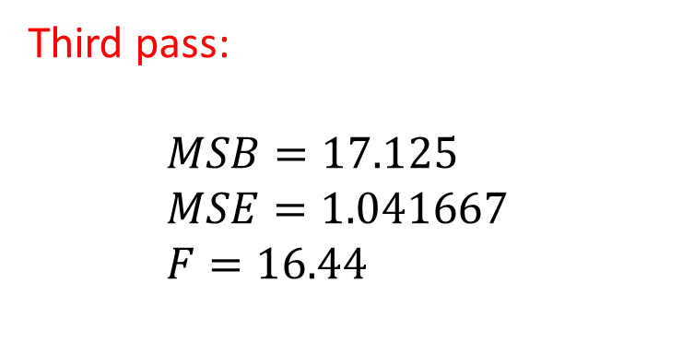
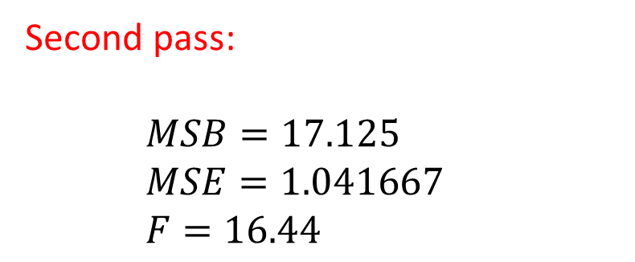
k-Means Clustering
Second pass:
$MSB=17.125$
$MSE=1.041667$
$F=16.44$
Third pass:
$MSB=17.125$
$MSE=1.041667$
$F=16.44$
Observation: As expected, MSB, which measures between-cluster variation, increases; MSE, which measures within-cluster variation, decreases; and hence, F increases.

Slide 31
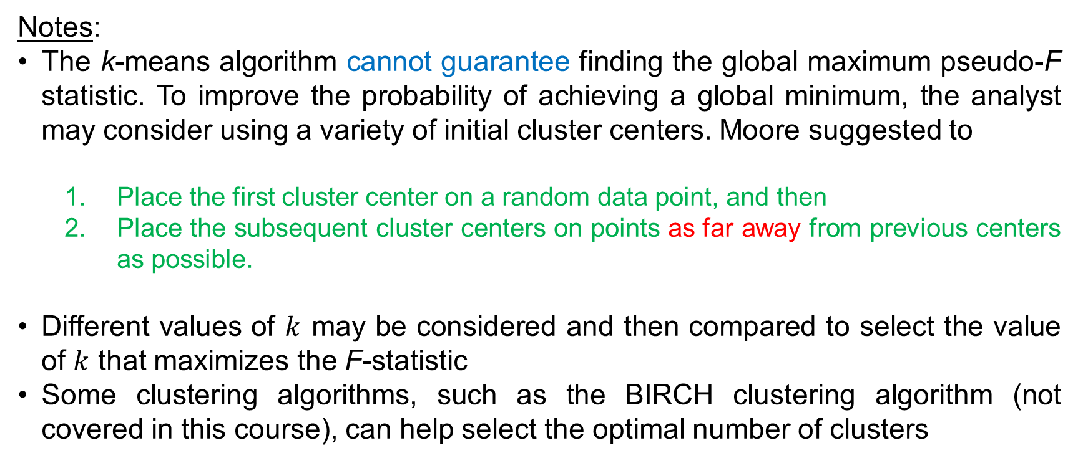
k-Means Clustering
Notes:
The k-means algorithm cannot guarantee finding the global maximum pseudo-F statistic. To improve the probability of achieving a global minimum, the analyst may consider using a variety of initial cluster centers. Moore suggested to
Place the first cluster center on a random data point, and then
Place the subsequent cluster centers on points as far away from previous centers as possible.
Different values of $k$ may be considered and then compared to select the value of $k$ that maximizes the F-statistic
Some clustering algorithms, such as the BIRCH clustering algorithm (not covered in this course), can help select the optimal number of clusters

Slide 32
Measuring Cluster Goodness
In this section, we examined two methods for measuring cluster goodness
The silhouette method
The pseudo- F statistic.
These techniques will help to evaluate and measure the goodness of cluster solutions.
Any measure of cluster goodness, or cluster quality, should address the concepts
Cluster separation: how distant the clusters are from each other?
Cluster cohesion: how tightly related the records within the individual clusters are.

Slide 33
Measuring Cluster Goodness
The sum of squares error (SSE) is a good measure of cluster quality. However, SSE accounts only for cluster cohesion. SSE is monotonically decreasing as the number of clusters increases, which is not a desired property of a valid measure of cluster goodness.

Slide 34
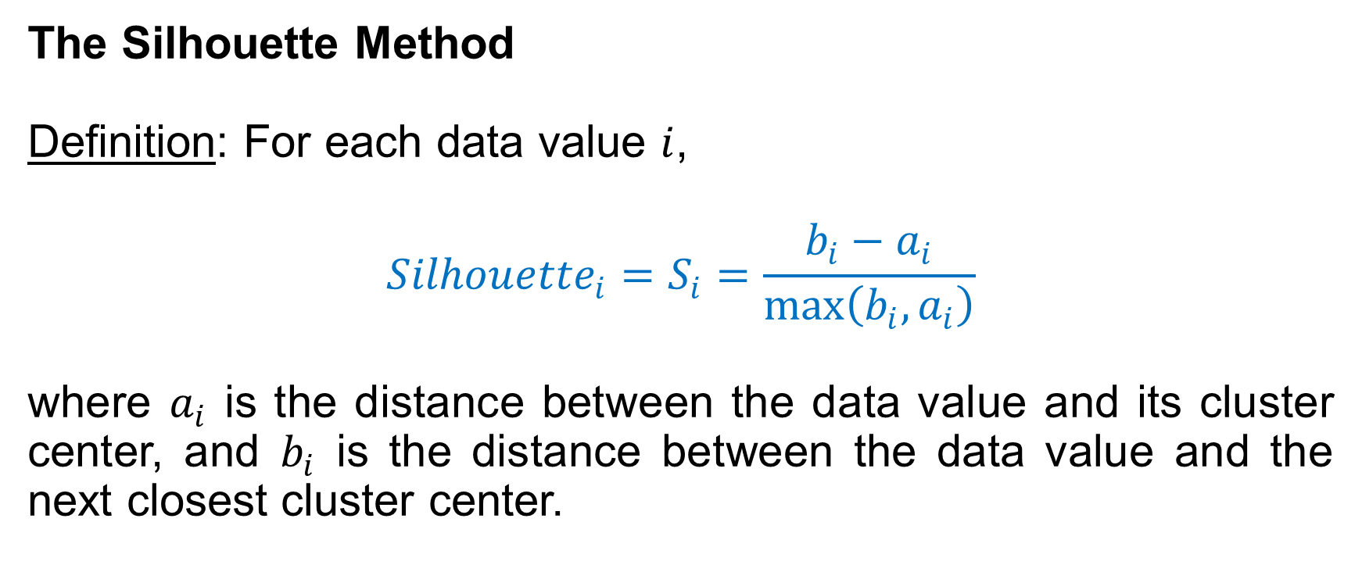
Measuring Cluster Goodness
The Silhouette Method
Definition: For each data value $i$,
$${Silhouette}_{i}=S_{i}=\frac{b_{i}−a_{i}}{max\left(b_{i},a_{i}\right)}$$
where $a_{i}$ is the distance between the data value and its cluster center, and $b_{i}$ is the distance between the data value and the next closest cluster center.

Slide 35
Measuring Cluster Goodness
Properties:
A positive value is “good”, and the higher the better
A value that is close to zero is considered a “weak assignment”
A negative value indicates “misclassification”, i.e., assignment to the next closest cluster would have been better

Slide 36
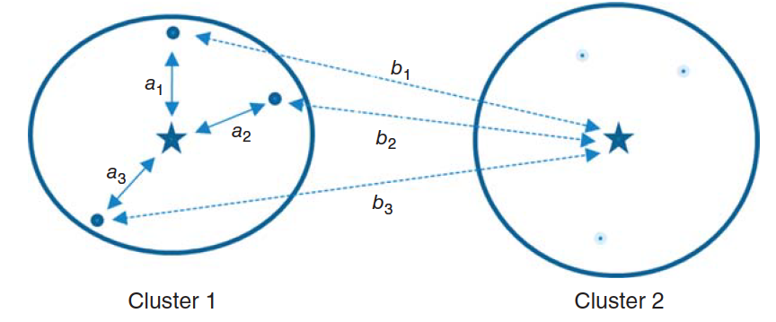

Measuring Cluster Goodness
Silhouette accounts for both separation and cohesion because
The value $a_{i}$ represents cohesion, as it measures the distance between the data value and its cluster center
The value $b_{i}$ represents separation, as it measures the distance between the data value and a different cluster.

Slide 37
Measuring Cluster Goodness
Taking the average silhouette value over all records yields a useful measure of how well the cluster solution fits the data. In case the expertise of the domain expert does not exists, the following interpretation of the average silhouette can be used:
0.5 or higher: Good evidence of the reality of the clusters in the data
0.25 - 0.5: Some evidence of the reality of the clusters in the data
Less than 0.25: Scant evidence of cluster reality

Slide 38
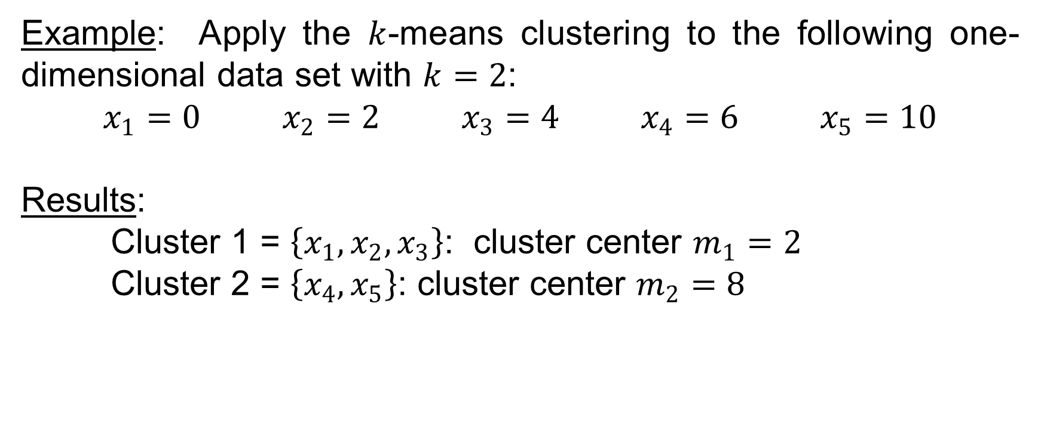
Measuring Cluster Goodness
Example: Apply the $k$-means clustering to the following one-dimensional data set with $k=2$:
$x_{1}=0$ $x_{2}=2$ $x_{3}=4$ $x_{4}=6$ $x_{5}=10$
Results:
Cluster 1 = $\left\{x_{1},x_{2},x_{3}\right\}$: cluster center $m_{1}=2$
Cluster 2 = $\left\{x_{4},x_{5}\right\}$: cluster center $m_{2}=8$

Slide 39
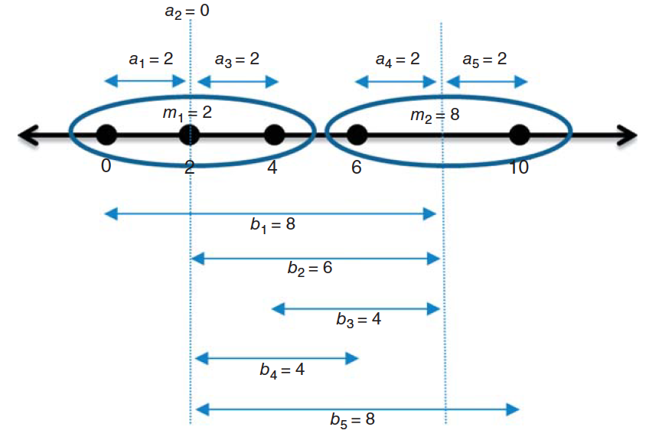
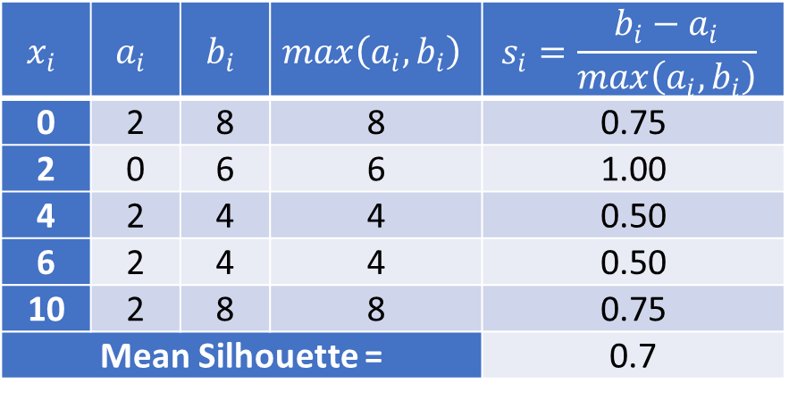
Measuring Cluster Goodness
Individual Data Value Silhouettes and Mean Silhouette
$$x_{i}$$ | $$a_{i}$$ | $$b_{i}$$ | $$max\left(a_{i},b_{i}\right)$$ | $$s_{i}=\frac{b_{i}−a_{i}}{max\left(a_{i},b_{i}\right)}$$
0 | 2 | 8 | 8 | 0.75
2 | 0 | 6 | 6 | 1.00
4 | 2 | 4 | 4 | 0.50
6 | 2 | 4 | 4 | 0.50
10 | 2 | 8 | 8 | 0.75
Mean Silhouette = |  |  |  | 0.7

Slide 40
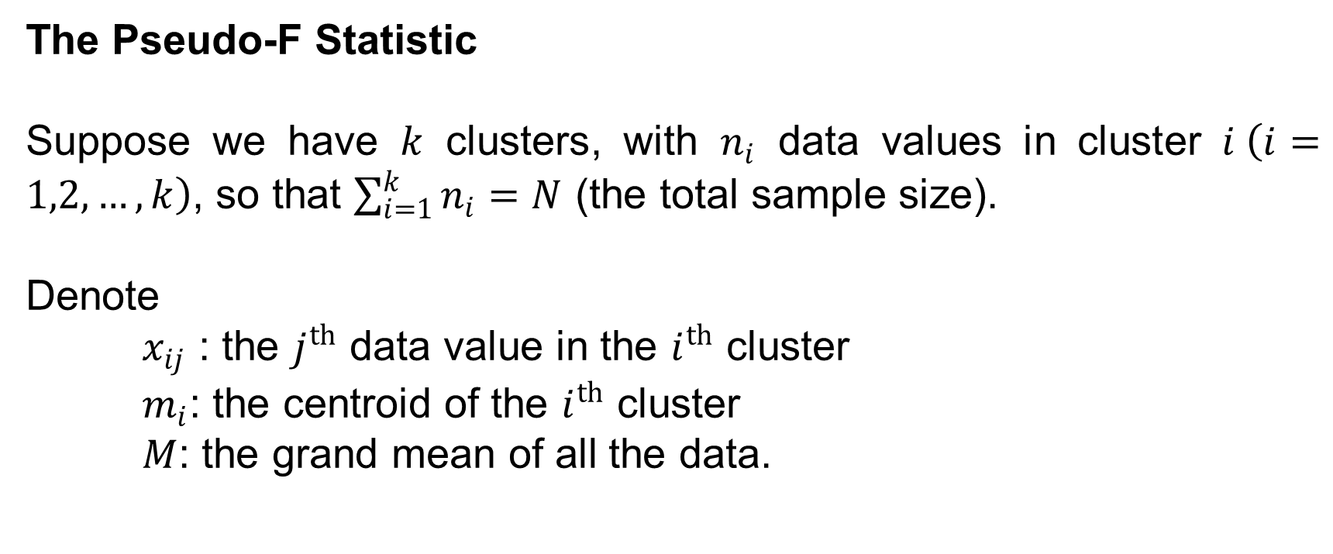
Measuring Cluster Goodness
The Pseudo-F Statistic
Suppose we have $k$ clusters, with $n_{i}$ data values in cluster $i \left(i=1,2,…,k\right)$, so that $\sum_{i=1}^{k}{n_{i}}=N$ (the total sample size).
Denote
$x_{ij}$ : the $j^{th}$ data value in the $i^{th}$ cluster
$m_{i}$: the centroid of the $i^{th}$ cluster
$M$: the grand mean of all the data.

Slide 41
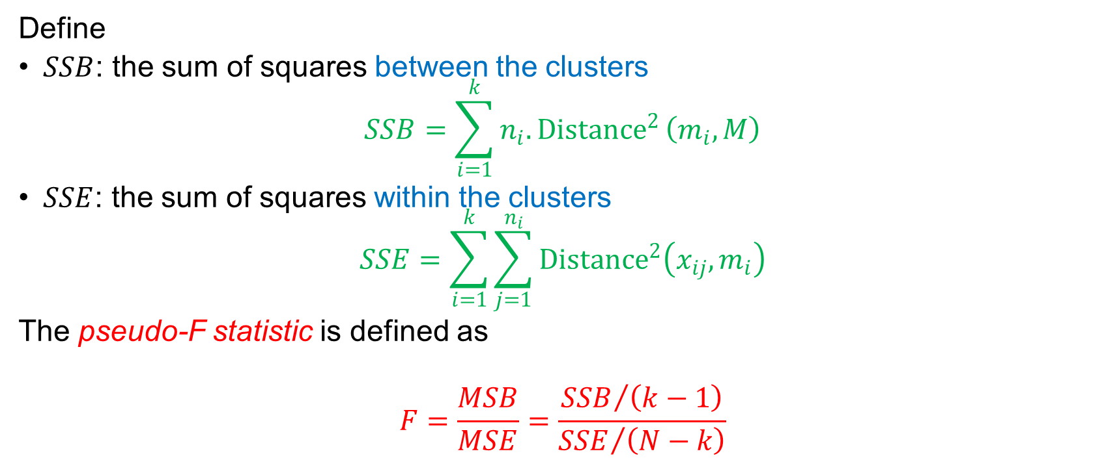
Measuring Cluster Goodness
Define
$SSB$: the sum of squares between the clusters
$$SSB=\sum_{i=1}^{k}{n_{i}{.Distance}^{2}\left(m_{i},M\right)}$$
$SSE$: the sum of squares within the clusters
$$SSE=\sum_{i=1}^{k}{\sum_{j=1}^{n_{i}}{{Distance}^{2}\left({x_{ij},m}_{i}\right)}}$$
The pseudo-F statistic is defined as
$$F=\frac{MSB}{MSE}=\frac{{SSB}/{\left(k−1\right)}}{{SSE}/{\left(N−k\right)}}$$

Slide 42
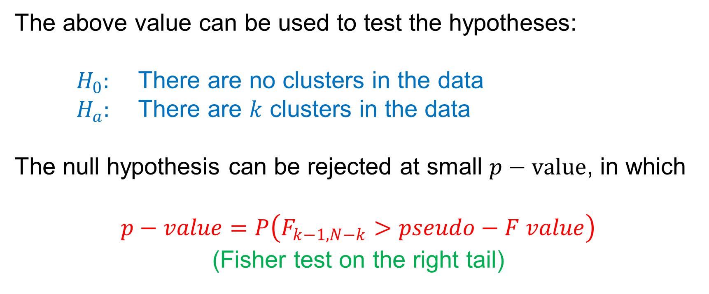
Measuring Cluster Goodness
The above value can be used to test the hypotheses:
$H_{0}:$ There are no clusters in the data
$H_{a}:$ There are $k$ clusters in the data
The null hypothesis can be rejected at small $p−value$, in which
$$p−value=P\left(F_{k−1,N−k}>pseudo−F value\right)$$
(Fisher test on the right tail)

Slide 43
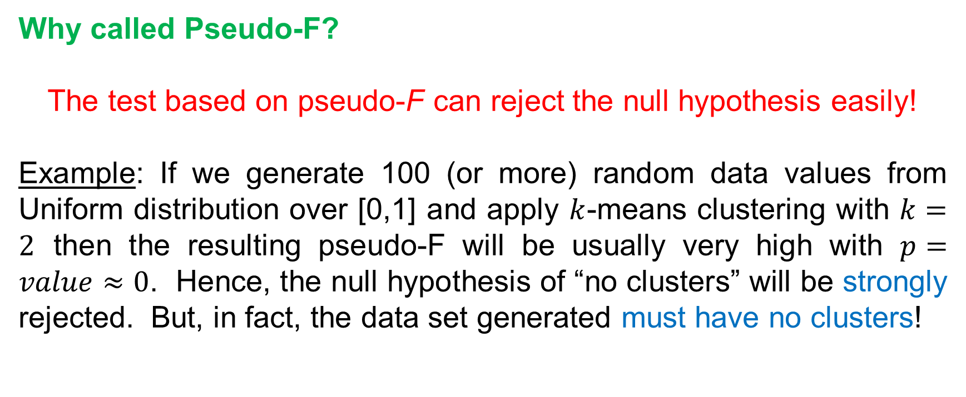
Measuring Cluster Goodness
Why called Pseudo-F?
The test based on pseudo-F can reject the null hypothesis easily!
Example: If we generate 100 (or more) random data values from Uniform distribution over [0,1] and apply $k$-means clustering with $k=2$ then the resulting pseudo-F will be usually very high with $p=value≈0$. Hence, the null hypothesis of “no clusters” will be strongly rejected. But, in fact, the data set generated must have no clusters!

Slide 44
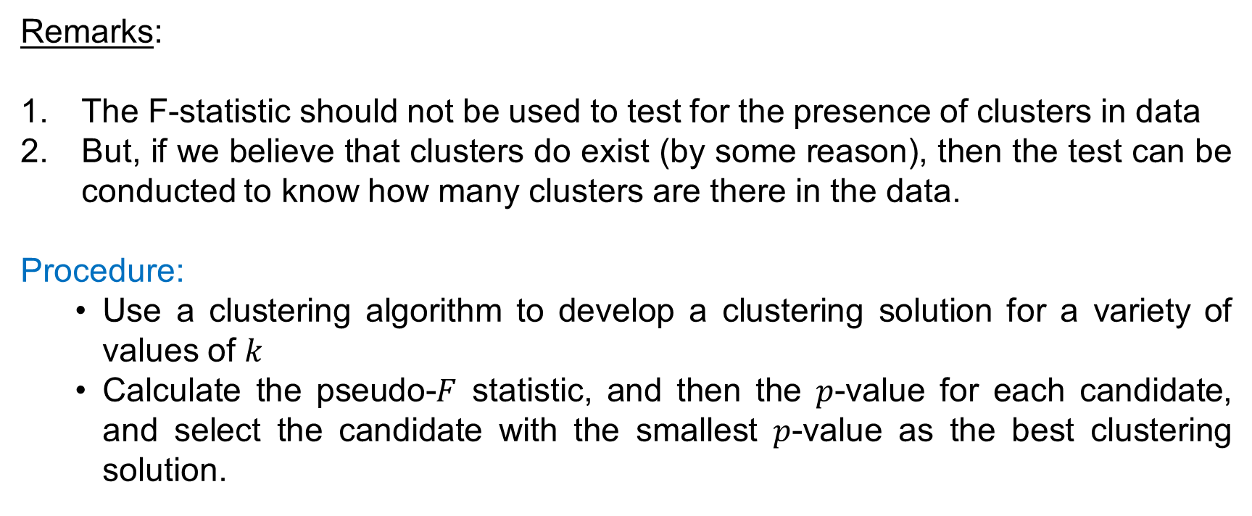
Measuring Cluster Goodness
Remarks:
The F-statistic should not be used to test for the presence of clusters in data
But, if we believe that clusters do exist (by some reason), then the test can be conducted to know how many clusters are there in the data.
Procedure:
Use a clustering algorithm to develop a clustering solution for a variety of values of $k$
Calculate the pseudo-$F$ statistic, and then the $p$-value for each candidate, and select the candidate with the smallest $p$-value as the best clustering solution.

Slide 45
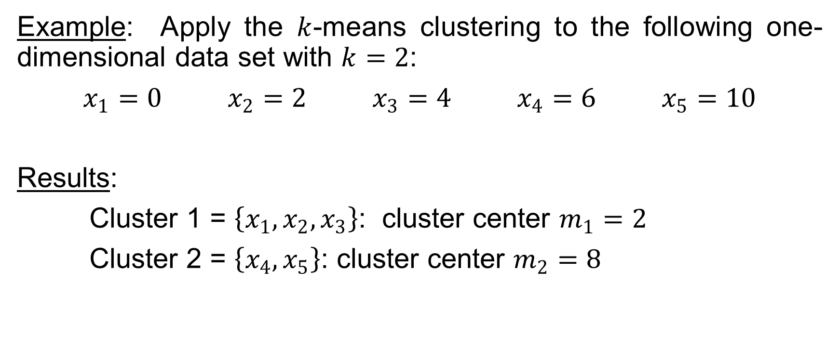
Measuring Cluster Goodness
Example: Apply the $k$-means clustering to the following one-dimensional data set with $k=2$:
$x_{1}=0$ $x_{2}=2$ $x_{3}=4$ $x_{4}=6$ $x_{5}=10$
Results:
Cluster 1 = $\left\{x_{1},x_{2},x_{3}\right\}$: cluster center $m_{1}=2$
Cluster 2 = $\left\{x_{4},x_{5}\right\}$: cluster center $m_{2}=8$

Slide 46
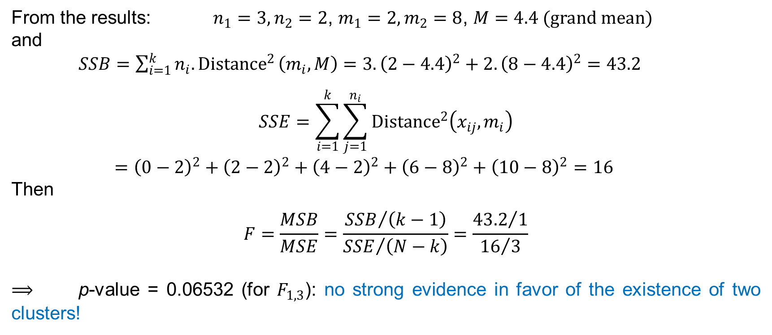
Measuring Cluster Goodness
From the results: $n_{1}=3, n_{2}=2$, $m_{1}=2, m_{2}=8$, $M=4.4 (grand mean)$
and
$SSB=\sum_{i=1}^{k}{n_{i}{.Distance}^{2}\left(m_{i},M\right)}=3.{\left(2−4.4\right)}^{2}+2.{\left(8−4.4\right)}^{2}=43.2$
$$SSE=\sum_{i=1}^{k}{\sum_{j=1}^{n_{i}}{{Distance}^{2}\left({x_{ij},m}_{i}\right)}}$$
$={\left(0−2\right)}^{2}+{\left(2−2\right)}^{2}+{\left(4−2\right)}^{2}+{\left(6−8\right)}^{2}+{\left(10−8\right)}^{2}=16$
Then
$$F=\frac{MSB}{MSE}=\frac{{SSB}/{\left(k−1\right)}}{{SSE}/{\left(N−k\right)}}=\frac{{43.2}/1}{{16}/3}$$
$⟹$ p-value = 0.06532 (for $F_{1,3}$): no strong evidence in favor of the existence of two clusters!

