Slide 1
Applied Data Analytics

Slide 2
Session 9: Association Rules

Slide 3
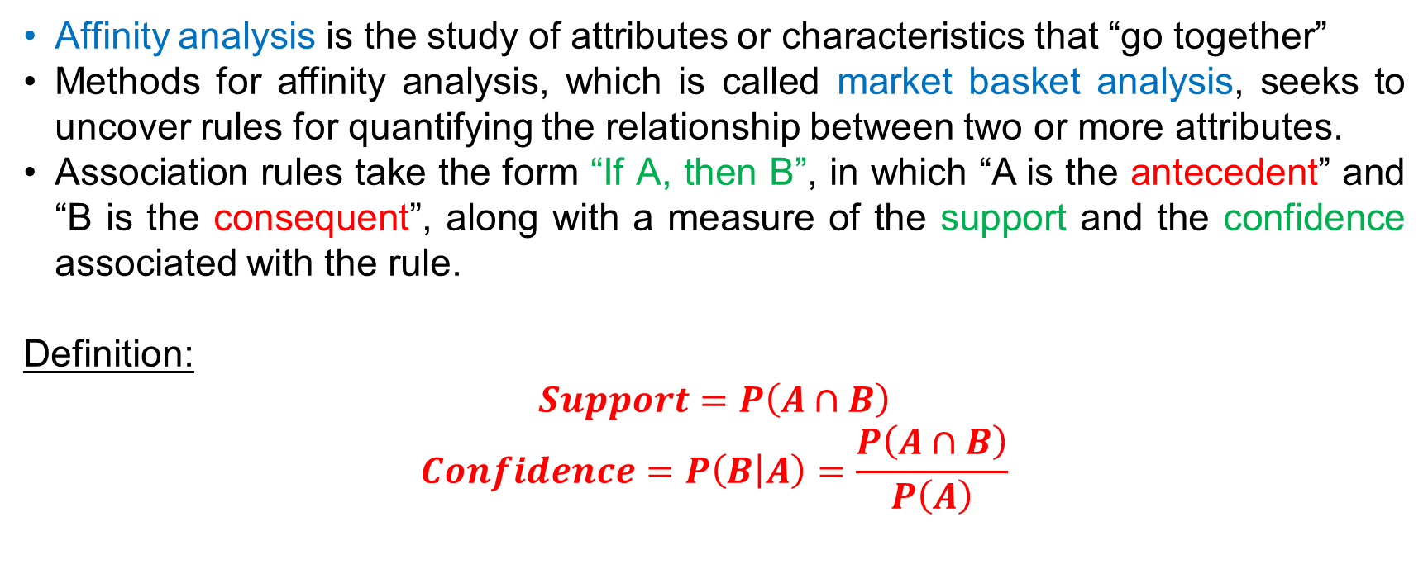
Affinity Analysis
Affinity analysis is the study of attributes or characteristics that “go together”
Methods for affinity analysis, which is called market basket analysis, seeks to uncover rules for quantifying the relationship between two or more attributes.
Association rules take the form “If A, then B”, in which “A is the antecedent” and “B is the consequent”, along with a measure of the support and the confidence associated with the rule.
Definition:
$Support=P\left(A∩B\right)$ $$Confidence=P\left(B | A\right)=\frac{P\left(A∩B\right)}{P\left(A\right)}$$

Slide 4
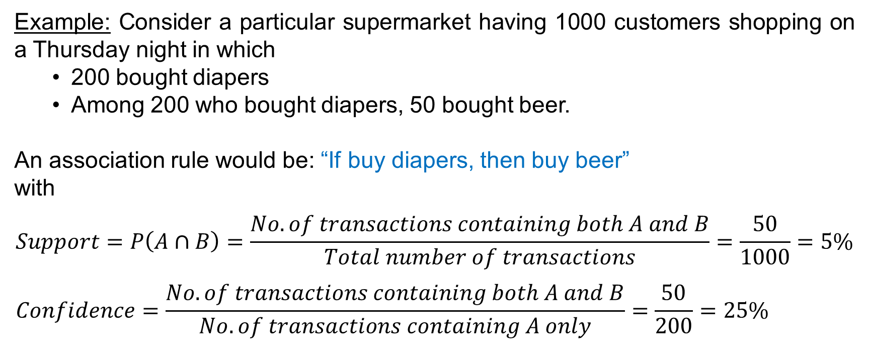
Affinity Analysis
Example: Consider a particular supermarket having 1000 customers shopping on a Thursday night in which
200 bought diapers
Among 200 who bought diapers, 50 bought beer.
An association rule would be: “If buy diapers, then buy beer”
with
$$Support=P\left(A∩B\right)=\frac{No.of transactions containing both A and B}{Total number of transactions}=\frac{50}{1000}=5\% \\ Confidence=\frac{No.of transactions containing both A and B}{No.of transactions containing A only}=\frac{50}{200}=25\%$$

Slide 5
Affinity Analysis
Examples of association tasks in business and research:
Investigating the proportion of subscribers to a cell phone plan that respond positively to an offer of a service upgrade;
Examining the proportion of children whose parents read to them who are themselves good readers;
Finding out which items in a supermarket are purchased together, and which items are never purchased together.

Slide 6
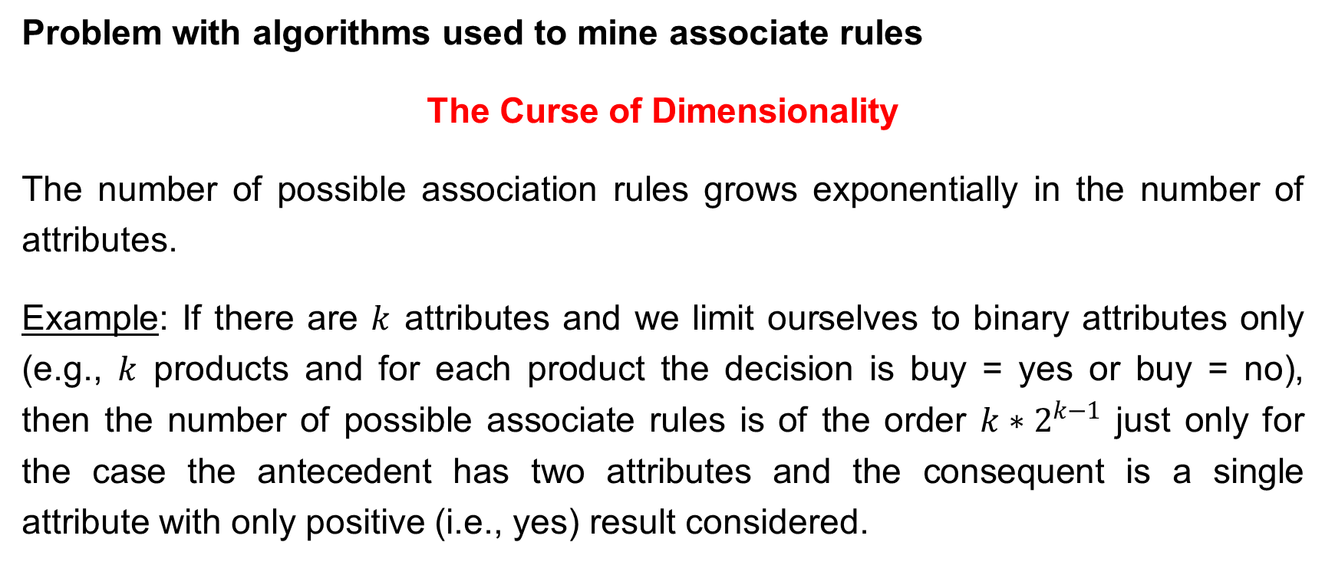
Affinity Analysis
Problem with algorithms used to mine associate rules
The Curse of Dimensionality
The number of possible association rules grows exponentially in the number of attributes.
Example: If there are $k$ attributes and we limit ourselves to binary attributes only (e.g., $k$ products and for each product the decision is buy = yes or buy = no), then the number of possible associate rules is of the order $k{∗2}^{k−1}$ just only for the case the antecedent has two attributes and the consequent is a single attribute with only positive (i.e., yes) result considered.

Slide 7
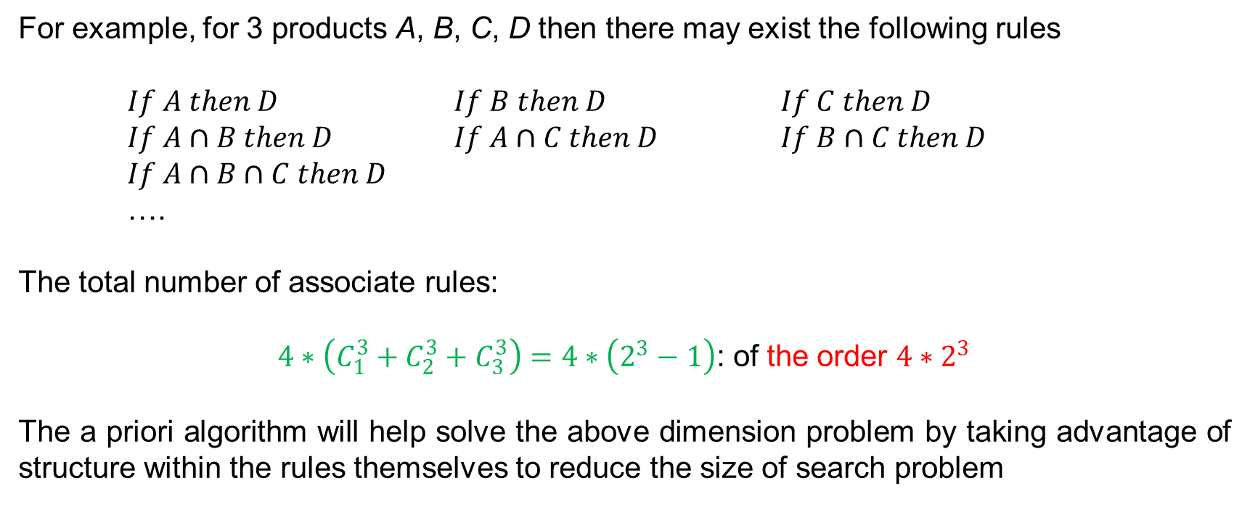
Affinity Analysis
For example, for 3 products A, B, C, D then there may exist the following rules
$If A then D$ $If B then D$ $If C then D$
$If A∩B then D$ $If A∩C then D$ $If B∩C then D$
$If A∩B∩C then D$
….
The total number of associate rules:
$4∗\left(C_{1}^{3}+C_{2}^{3}+C_{3}^{3}\right)=4∗\left(2^{3}−1\right)$: of the order $4∗2^{3}$
The a priori algorithm will help solve the above dimension problem by taking advantage of structure within the rules themselves to reduce the size of search problem

Slide 8
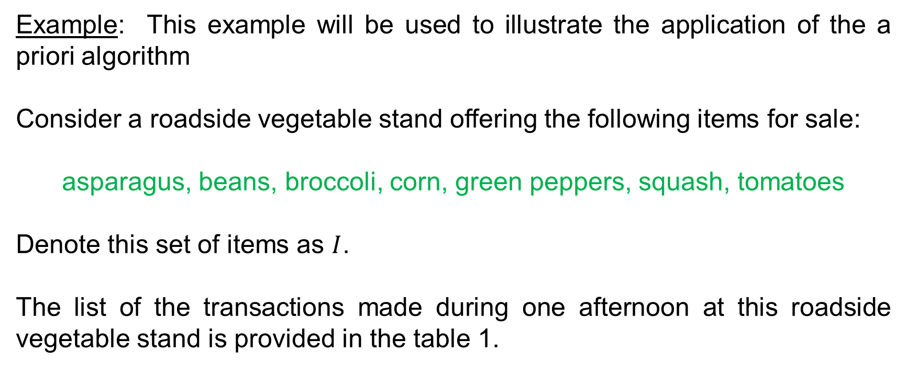
The a Priori Algorithm
Example: This example will be used to illustrate the application of the a priori algorithm
Consider a roadside vegetable stand offering the following items for sale:
asparagus, beans, broccoli, corn, green peppers, squash, tomatoes
Denote this set of items as $I$.
The list of the transactions made during one afternoon at this roadside vegetable stand is provided in the table 1.

Slide 9
The a Priori Algorithm
Table 1. Transactions made at the stand
Transaction | Items Purchased
1 | Broccoli, green peppers, corn
2 | Asparagus, squash, corn
3 | Corn, tomatoes, beans, squash
4 | Green peppers, corn, tomatoes, beans
5 | Beans, asparagus, broccoli
6 | Squash, asparagus, beans, tomatoes
7 | Tomatoes, corn
8 | Broccoli, tomatoes, green peppers
9 | Squash, asparagus, beans
10 | Beans, corn
11 | Green peppers, broccoli, beans, squash
12 | Asparagus, beans, squash
13 | Squash, corn, asparagus, beans
14 | Corn, green peppers, tomatoes, beans, broccoli

Slide 10
The a Priori Algorithm
The data can be expressed in the form of “transactional data format” or “tabular data format”
Table 2. Transactions data format
Transaction ID | Items
1 | Broccoli
1 | Green peppers
1 | Corn
2 | Asparagus
2 | Squash
2 | Corn
3 | Corn
3 | Tomatoes
… | ….

Slide 11
The a Priori Algorithm
Table 3. Tabular data format
(in alphabetical order!)
Transaction | Asparagus | Beans | Broccoli | Corn | Green Peppers | Squash | Tomatoes
1 | 0 | 0 | 1 | 1 | 1 | 0 | 0
2 | 1 | 0 | 0 | 1 | 0 | 1 | 0
3 | 0 | 1 | 0 | 1 | 0 | 1 | 1
4 | 0 | 1 | 0 | 1 | 1 | 0 | 1
5 | 1 | 1 | 1 | 0 | 0 | 0 | 0
6 | 1 | 1 | 0 | 0 | 0 | 1 | 1
7 | 0 | 0 | 0 | 1 | 0 | 0 | 1
8 | 0 | 0 | 1 | 0 | 1 | 0 | 1
9 | 1 | 1 | 0 | 0 | 0 | 1 | 0
10 | 0 | 1 | 0 | 1 | 0 | 0 | 0
11 | 0 | 1 | 1 | 0 | 1 | 1 | 0
12 | 1 | 1 | 0 | 0 | 0 | 1 | 0
13 | 1 | 1 | 0 | 1 | 0 | 1 | 0
14 | 0 | 1 | 1 | 1 | 1 | 0 | 1

Slide 12
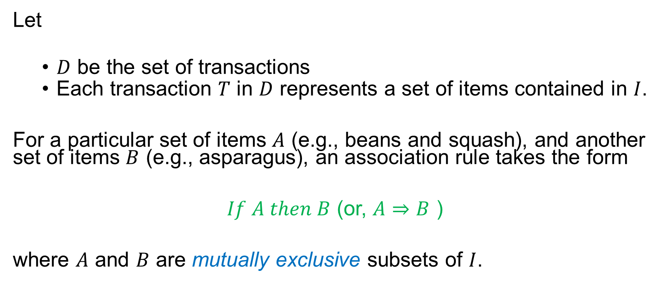
The a Priori Algorithm – Generating Frequent Itemsets
Let
$D$ be the set of transactions
Each transaction $T$ in $D$ represents a set of items contained in $I$.
For a particular set of items $A$ (e.g., beans and squash), and another set of items $B$ (e.g., asparagus), an association rule takes the form
$If A then B$ (or, $A⇒B$ )
where $A$ and $B$ are mutually exclusive subsets of $I$.

Slide 13
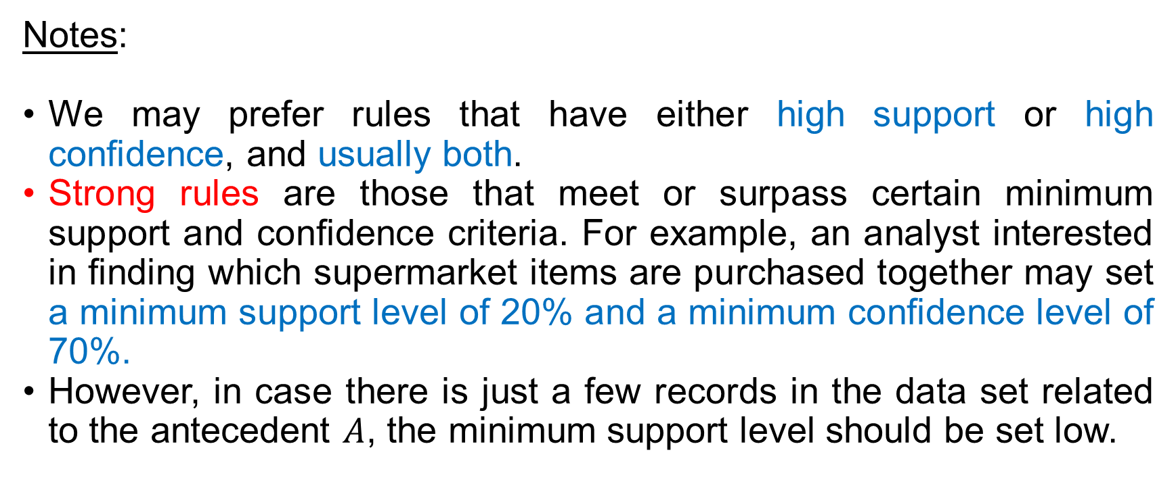
The a Priori Algorithm – Generating Frequent Itemsets
Notes:
We may prefer rules that have either high support or high confidence, and usually both.
Strong rules are those that meet or surpass certain minimum support and confidence criteria. For example, an analyst interested in finding which supermarket items are purchased together may set a minimum support level of 20% and a minimum confidence level of 70%.
However, in case there is just a few records in the data set related to the antecedent $A$, the minimum support level should be set low.

Slide 14
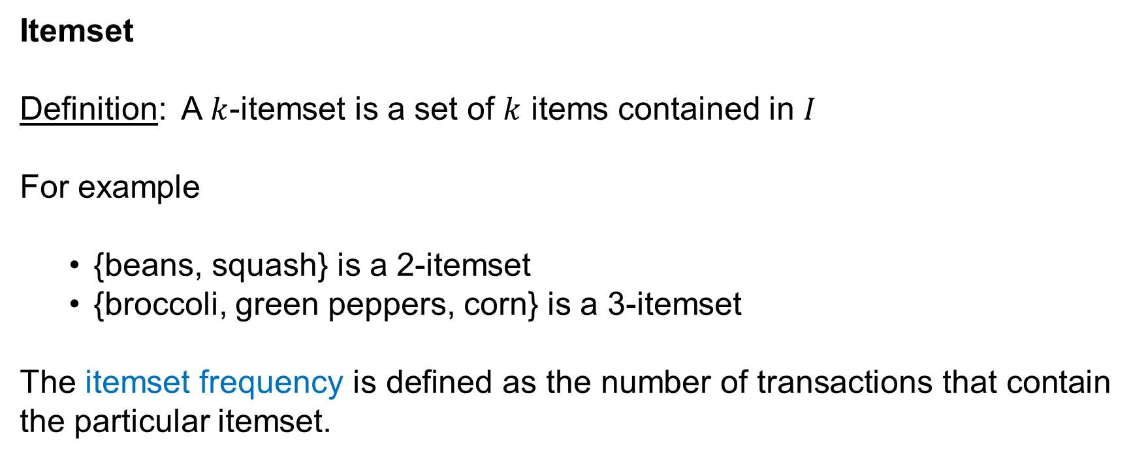
The a Priori Algorithm – Generating Frequent Itemsets
Itemset
Definition: A $k$-itemset is a set of $k$ items contained in $I$
For example
{beans, squash} is a 2-itemset
{broccoli, green peppers, corn} is a 3-itemset
The itemset frequency is defined as the number of transactions that contain the particular itemset.

Slide 15
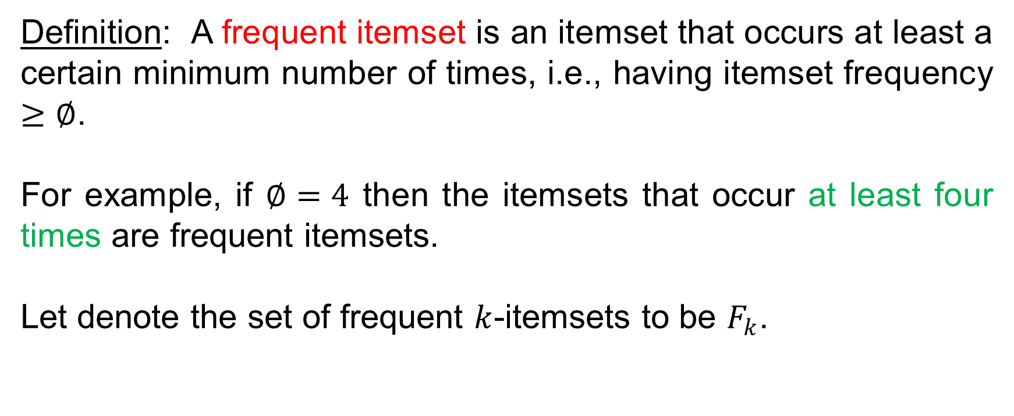
The a Priori Algorithm – Generating Frequent Itemsets
Definition: A frequent itemset is an itemset that occurs at least a certain minimum number of times, i.e., having itemset frequency $≥∅$.
For example, if $∅=4$ then the itemsets that occur at least four times are frequent itemsets.
Let denote the set of frequent $k$-itemsets to be $F_{k}$.

Slide 16
The a Priori Algorithm – Generating Frequent Itemsets
Procedure to mine associate rules
The mining of association rules from large databases is a two-step process:
Find all frequent itemsets
From the frequent itemsets, generate association rules satisfying the minimum support and confidence requirements.
In generation of frequent itemsets, the a priori algorithm will be applied to shrink the search space.

Slide 17

The a Priori Algorithm – Generating Frequent Itemsets
The a Priori Property
If an itemset $Z$ is not frequent, then for any item $A$,
$Z∩A$ will not be frequent

Slide 18
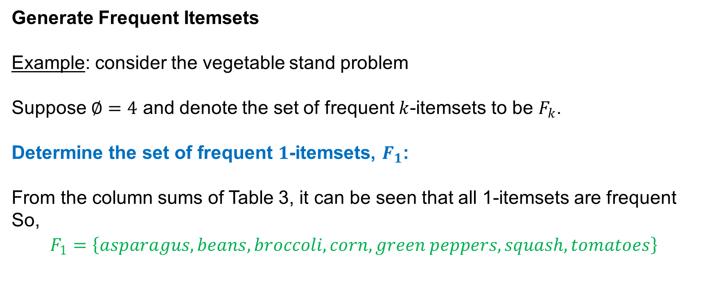
The a Priori Algorithm – Generating Frequent Itemsets
Generate Frequent Itemsets
Example: consider the vegetable stand problem
Suppose $∅=4$ and denote the set of frequent $k$-itemsets to be $F_{k}$.
Determine the set of frequent $1$-itemsets, $F_{1}$:
From the column sums of Table 3, it can be seen that all 1-itemsets are frequent
So,
$$F_{1}=\left\{asparagus, beans, broccoli, corn, green peppers, squash, tomatoes\right\}$$

Slide 19
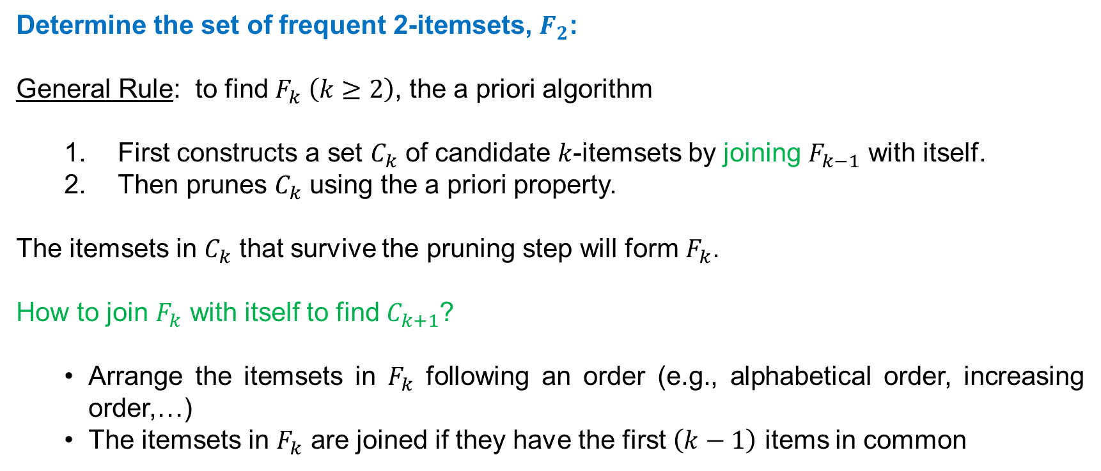
The a Priori Algorithm – Generating Frequent Itemsets
Determine the set of frequent 2-itemsets, $F_{2}$:
General Rule: to find $F_{k} \left(k≥2\right)$, the a priori algorithm
First constructs a set $C_{k}$ of candidate $k$-itemsets by joining $F_{k−1}$ with itself.
Then prunes $C_{k}$ using the a priori property.
The itemsets in $C_{k}$ that survive the pruning step will form $F_{k}$.
How to join $F_{k}$ with itself to find $C_{k+1}$?
Arrange the itemsets in $F_{k}$ following an order (e.g., alphabetical order, increasing order,…)
The itemsets in $F_{k}$ are joined if they have the first $\left(k−1\right)$ items in common

Slide 20
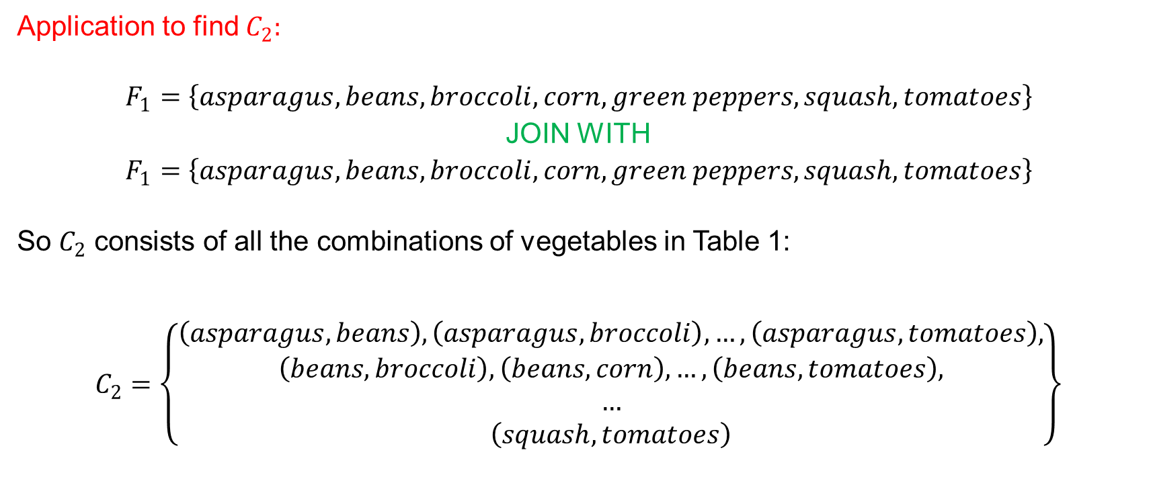
The a Priori Algorithm – Generating Frequent Itemsets
Application to find $C_{2}:$
$$F_{1}=\left\{asparagus, beans, broccoli, corn, green peppers, squash, tomatoes\right\}$$
JOIN WITH
$$F_{1}=\left\{asparagus, beans, broccoli, corn, green peppers, squash, tomatoes\right\}$$
So $C_{2}$ consists of all the combinations of vegetables in Table 1:
$$C_{2}=\left\{\begin{aligned}\left(asparagus, beans\right), \left(asparagus, broccoli\right),…, \left(asparagus, tomatoes\right), \\ \left(beans, broccoli\right),\left(beans, corn\right),…, \left(beans, tomatoes\right), \\ … \\ \left(squash, tomatoes\right)\end{aligned}\right\}$$

Slide 21
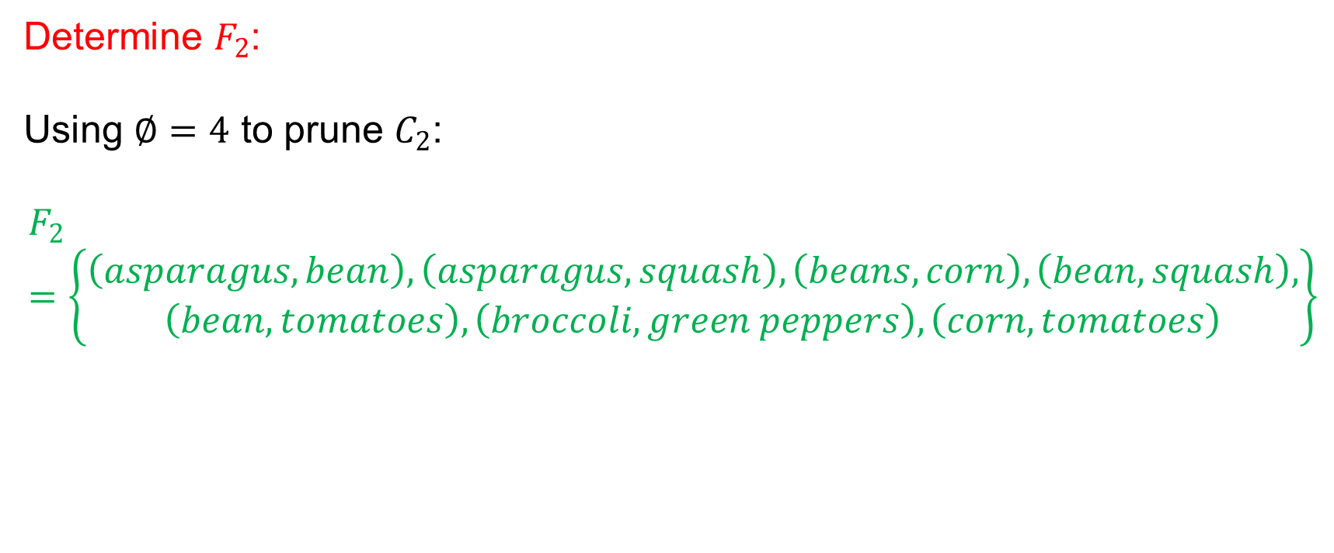
The a Priori Algorithm – Generating Frequent Itemsets
Determine $F_{2}$:
Using $∅=4$ to prune $C_{2}$:
$$F_{2}=\left\{\begin{aligned}\left(asparagus, bean\right), \left(asparagus, squash\right),\left(beans, corn\right),\left(bean,squash\right), \\ \left(bean, tomatoes\right), \left(broccoli, green peppers\right),\left(corn, tomatoes\right)\end{aligned}\right\}$$

Slide 22
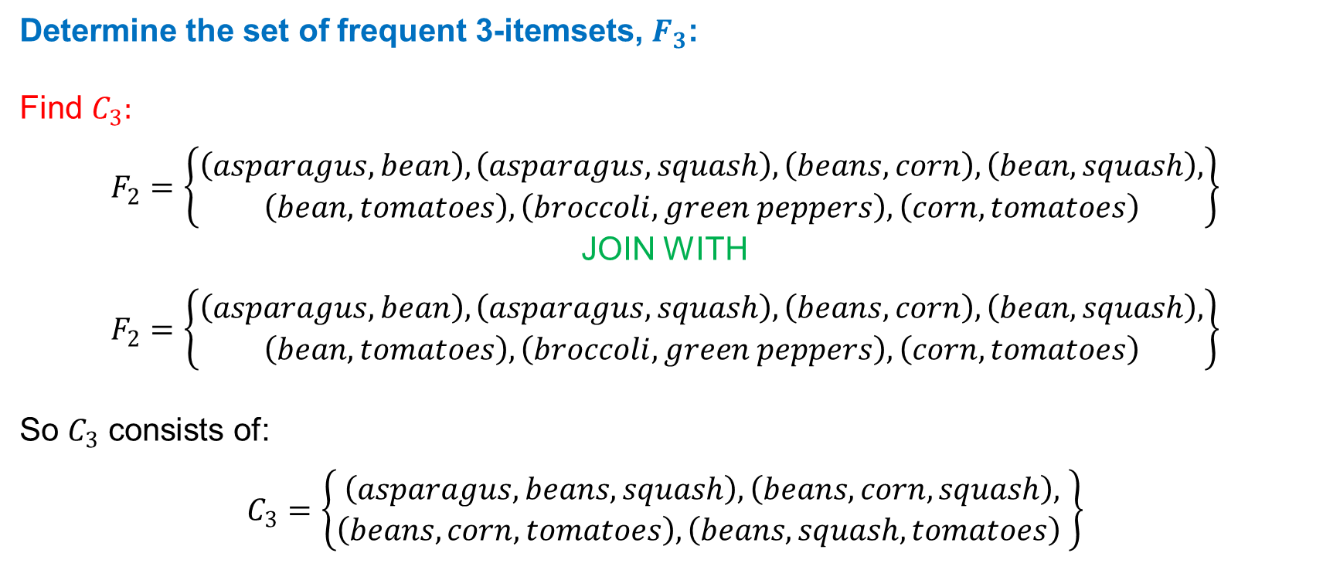
The a Priori Algorithm – Generating Frequent Itemsets
Determine the set of frequent 3-itemsets, $F_{3}$:
Find $C_{3}:$
$$F_{2}=\left\{\begin{aligned}\left(asparagus, bean\right), \left(asparagus, squash\right),\left(beans, corn\right),\left(bean,squash\right), \\ \left(bean, tomatoes\right), \left(broccoli, green peppers\right),\left(corn, tomatoes\right)\end{aligned}\right\}$$
JOIN WITH
$$F_{2}=\left\{\begin{aligned}\left(asparagus, bean\right), \left(asparagus, squash\right),\left(beans, corn\right),\left(bean,squash\right), \\ \left(bean, tomatoes\right), \left(broccoli, green peppers\right),\left(corn, tomatoes\right)\end{aligned}\right\}$$
So $C_{3}$ consists of:
$$C_{3}=\left\{\begin{aligned}\left(asparagus, beans,squash\right),\left(beans, corn, squash\right), \\ \left(beans, corn, tomatoes\right),\left(beans, squash,tomatoes\right) \end{aligned}\right\}$$

Slide 23
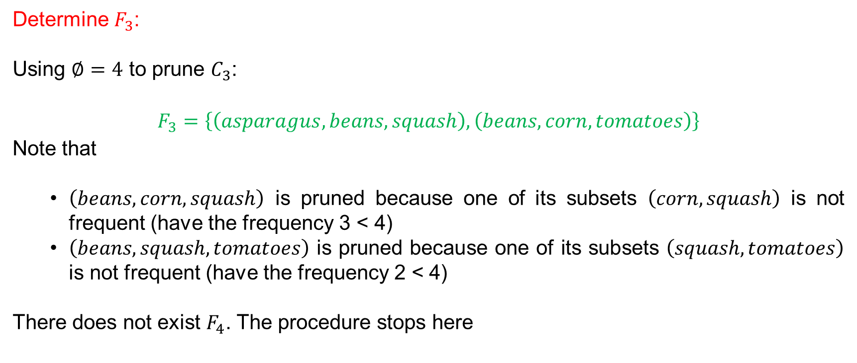
The a Priori Algorithm – Generating Frequent Itemsets
Determine $F_{3}$:
Using $∅=4$ to prune $C_{3}$:
$$F_{3}=\left\{\left(asparagus, beans,squash\right),\left(beans, corn, tomatoes\right)\right\}$$
Note that
$\left(beans, corn, squash\right)$ is pruned because one of its subsets $\left(corn, squash\right)$ is not frequent (have the frequency 3 < 4)
$\left(beans, squash,tomatoes\right)$ is pruned because one of its subsets $\left(squash,tomatoes\right)$ is not frequent (have the frequency 2 < 4)
There does not exist $F_{4}$. The procedure stops here

Slide 24
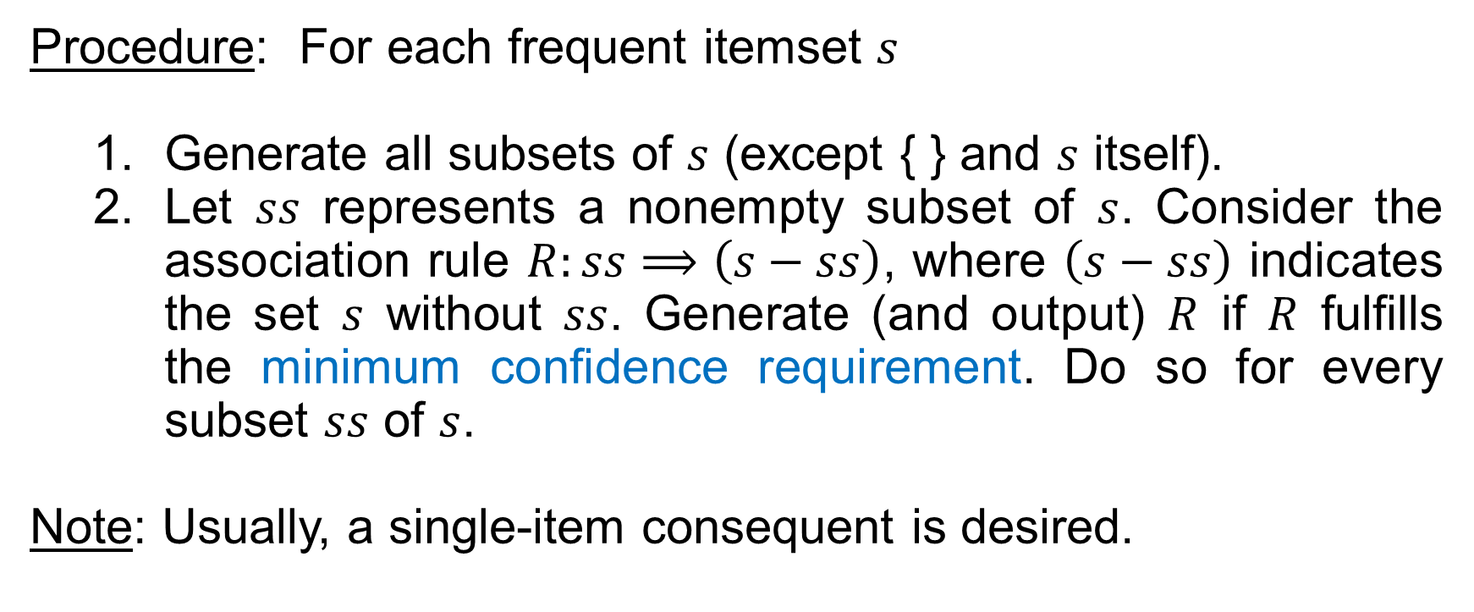
The a Priori Algorithm – Generating Association Rules
Procedure: For each frequent itemset $s$
Generate all subsets of $s$ (except { } and $s$ itself).
Let $ss$ represents a nonempty subset of $s$. Consider the association rule $R:ss⟹\left(s−ss\right)$, where $\left(s−ss\right)$ indicates the set $s$ without $ss$. Generate (and output) $R$ if $R$ fulfills the minimum confidence requirement. Do so for every subset $ss$ of $s$.
Note: Usually, a single-item consequent is desired.

Slide 25
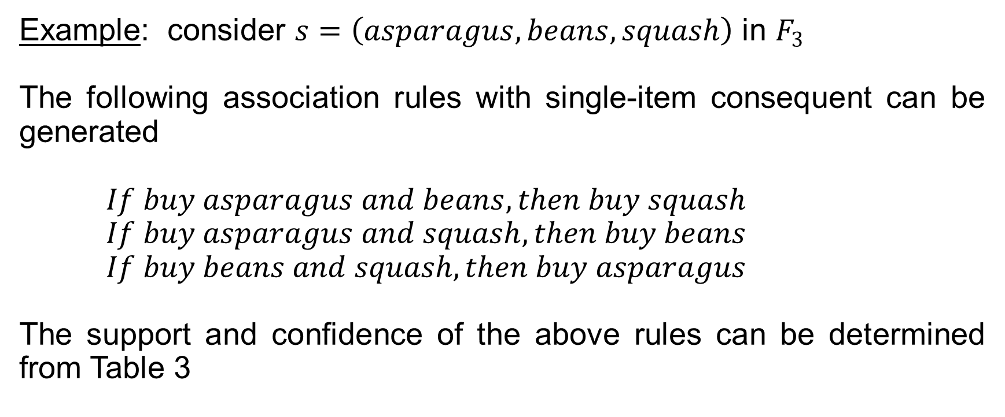
The a Priori Algorithm – Generating Association Rules
Example: consider $s=\left(asparagus, beans,squash\right)$ in $F_{3}$
The following association rules with single-item consequent can be generated
$If buy asparagus and beans, then buy squash$
$If buy asparagus and squash, then buy beans$
$If buy beans and squash, then buy asparagus$
The support and confidence of the above rules can be determined from Table 3

Slide 26
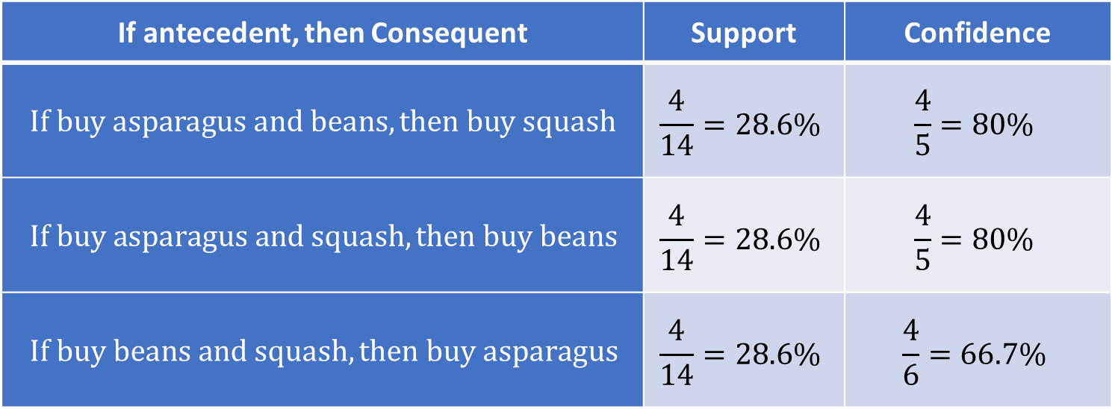

The a Priori Algorithm – Generating Association Rules
The same procedure can be applied for the remaining itemset in $F_{3}$
If antecedent, then Consequent | Support | Confidence
$$If buy asparagus and beans, then buy squash$$ | $$\frac{4}{14}=28.6\%$$ | $$\frac{4}{5}=80\%$$
$$If buy asparagus and squash, then buy beans$$ | $$\frac{4}{14}=28.6\%$$ | $$\frac{4}{5}=80\%$$
$$If buy beans and squash, then buy asparagus$$ | $$\frac{4}{14}=28.6\%$$ | $$\frac{4}{6}=66.7\%$$

Slide 27
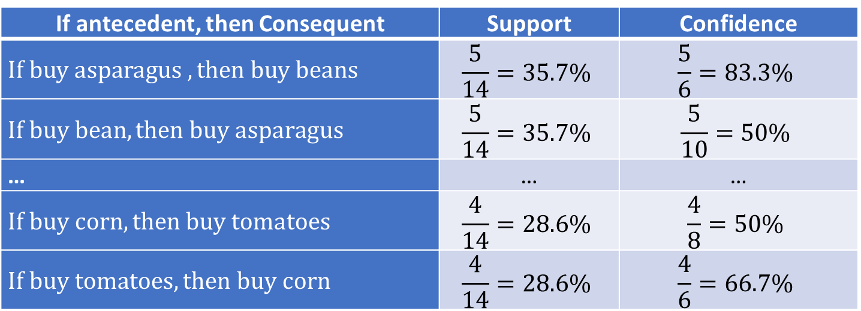

The a Priori Algorithm – Generating Association Rules
The single-antecedent/single-consequent rules can be generated from the itemsets in $F_{2}$
If antecedent, then Consequent | Support | Confidence
$$If buy asparagus , then buy beans$$ | $$\frac{5}{14}=35.7\%$$ | $$\frac{5}{6}=83.3\%$$
$$If buy bean, then buy asparagus$$ | $$\frac{5}{14}=35.7\%$$ | $$\frac{5}{10}=50\%$$
… | … | …
$$If buy corn, then buy tomatoes$$ | $$\frac{4}{14}=28.6\%$$ | $$\frac{4}{8}=50\%$$
$$If buy tomatoes, then buy corn$$ | $$\frac{4}{14}=28.6\%$$ | $$\frac{4}{6}=66.7\%$$

Slide 28
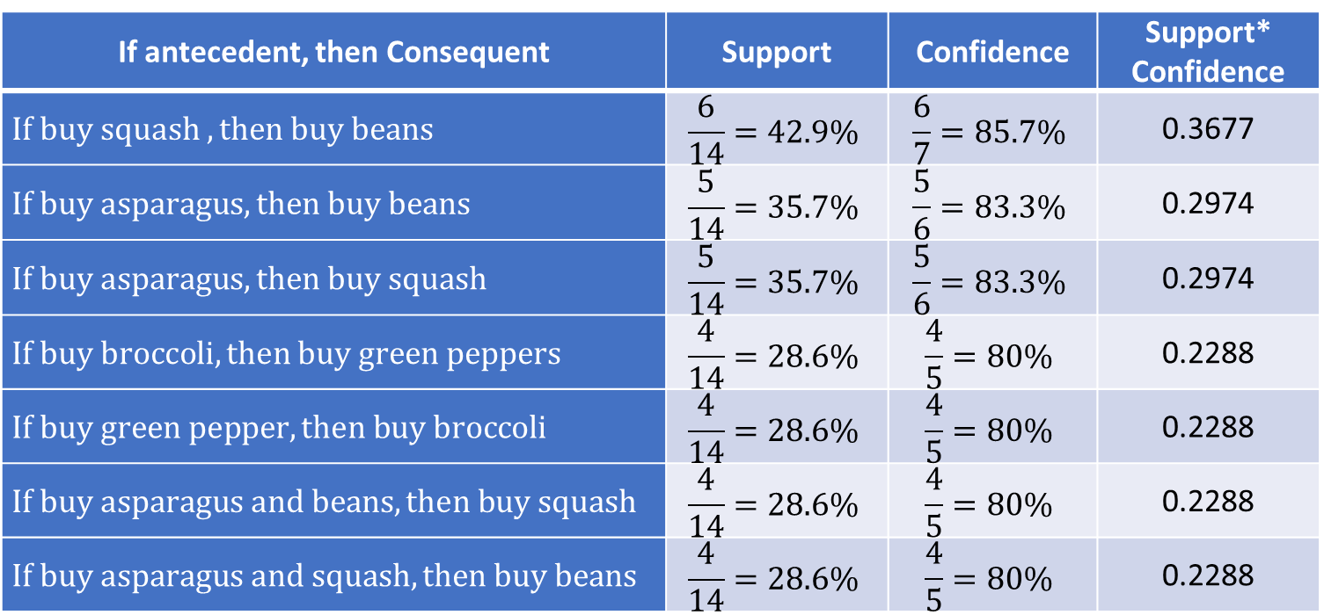
The a Priori Algorithm – Generating Association Rules
If a minimum 80% confidence is required, the following association rules will be remained:
If antecedent, then Consequent | Support | Confidence | Support* Confidence
$$If buy squash , then buy beans$$ | $$\frac{6}{14}=42.9\%$$ | $$\frac{6}{7}=85.7\%$$ | 0.3677
$$If buy asparagus, then buy beans$$ | $$\frac{5}{14}=35.7\%$$ | $$\frac{5}{6}=83.3\%$$ | 0.2974
$$If buy asparagus, then buy squash$$ | $$\frac{5}{14}=35.7\%$$ | $$\frac{5}{6}=83.3\%$$ | 0.2974
$$If buy broccoli, then buy green peppers$$ | $$\frac{4}{14}=28.6\%$$ | $$\frac{4}{5}=80\%$$ | 0.2288
$$If buy green pepper, then buy broccoli$$ | $$\frac{4}{14}=28.6\%$$ | $$\frac{4}{5}=80\%$$ | 0.2288
$$If buy asparagus and beans, then buy squash$$ | $$\frac{4}{14}=28.6\%$$ | $$\frac{4}{5}=80\%$$ | 0.2288
$$If buy asparagus and squash, then buy beans$$ | $$\frac{4}{14}=28.6\%$$ | $$\frac{4}{5}=80\%$$ | 0.2288

Slide 29
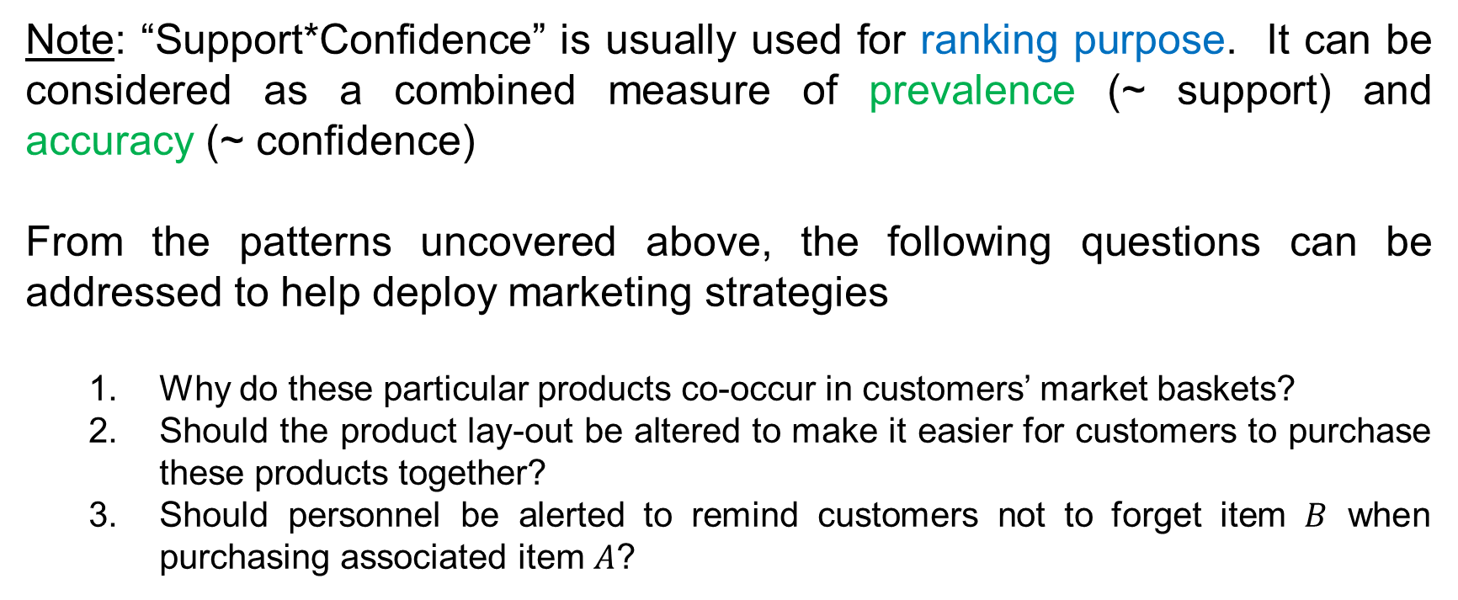
The a Priori Algorithm – Generating Association Rules
Note: “Support*Confidence” is usually used for ranking purpose. It can be considered as a combined measure of prevalence (~ support) and accuracy (~ confidence)
From the patterns uncovered above, the following questions can be addressed to help deploy marketing strategies
Why do these particular products co-occur in customers’ market baskets?
Should the product lay-out be altered to make it easier for customers to purchase these products together?
Should personnel be alerted to remind customers not to forget item $B$ when purchasing associated item $A$?

Slide 30
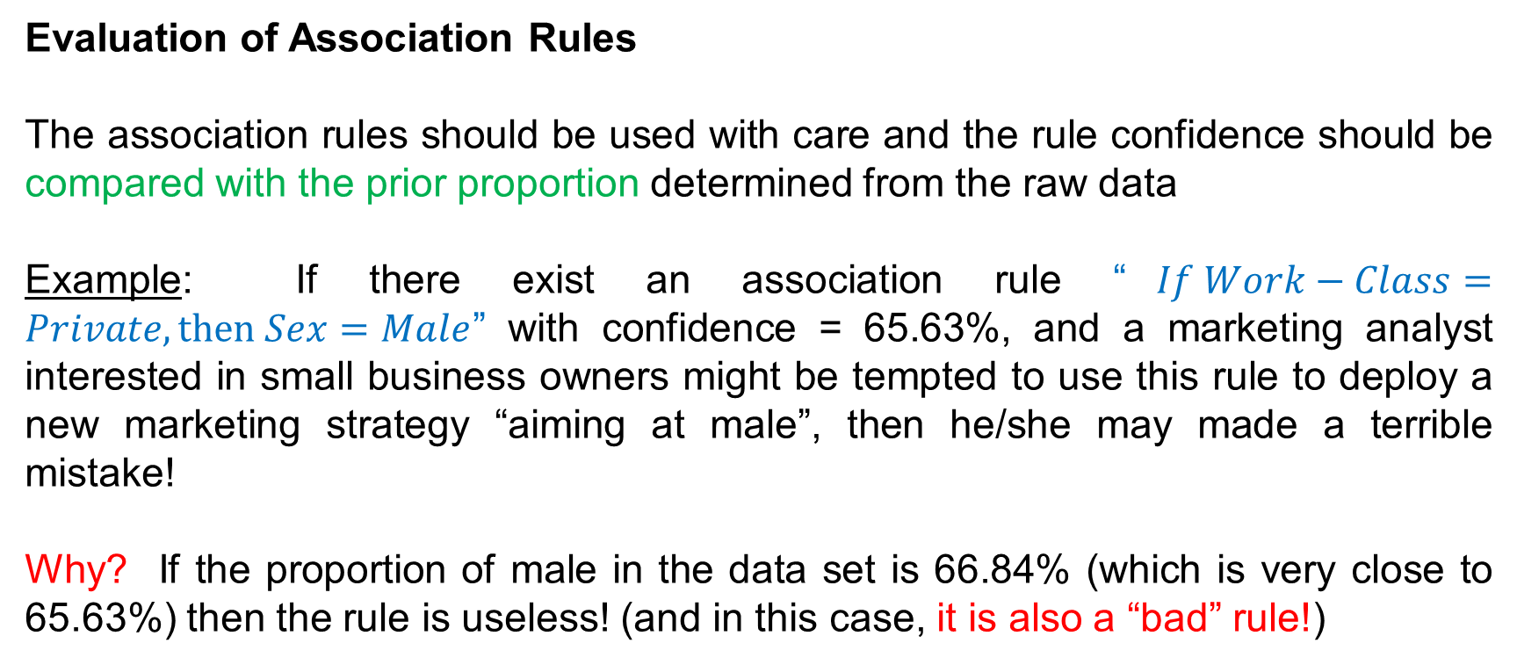
The a Priori Algorithm – Generating Association Rules
Evaluation of Association Rules
The association rules should be used with care and the rule confidence should be compared with the prior proportion determined from the raw data
Example: If there exist an association rule “$If Work−Class=Private, then Sex=Male$” with confidence = 65.63%, and a marketing analyst interested in small business owners might be tempted to use this rule to deploy a new marketing strategy “aiming at male”, then he/she may made a terrible mistake!
Why? If the proportion of male in the data set is 66.84% (which is very close to 65.63%) then the rule is useless! (and in this case, it is also a “bad” rule!)

Slide 31
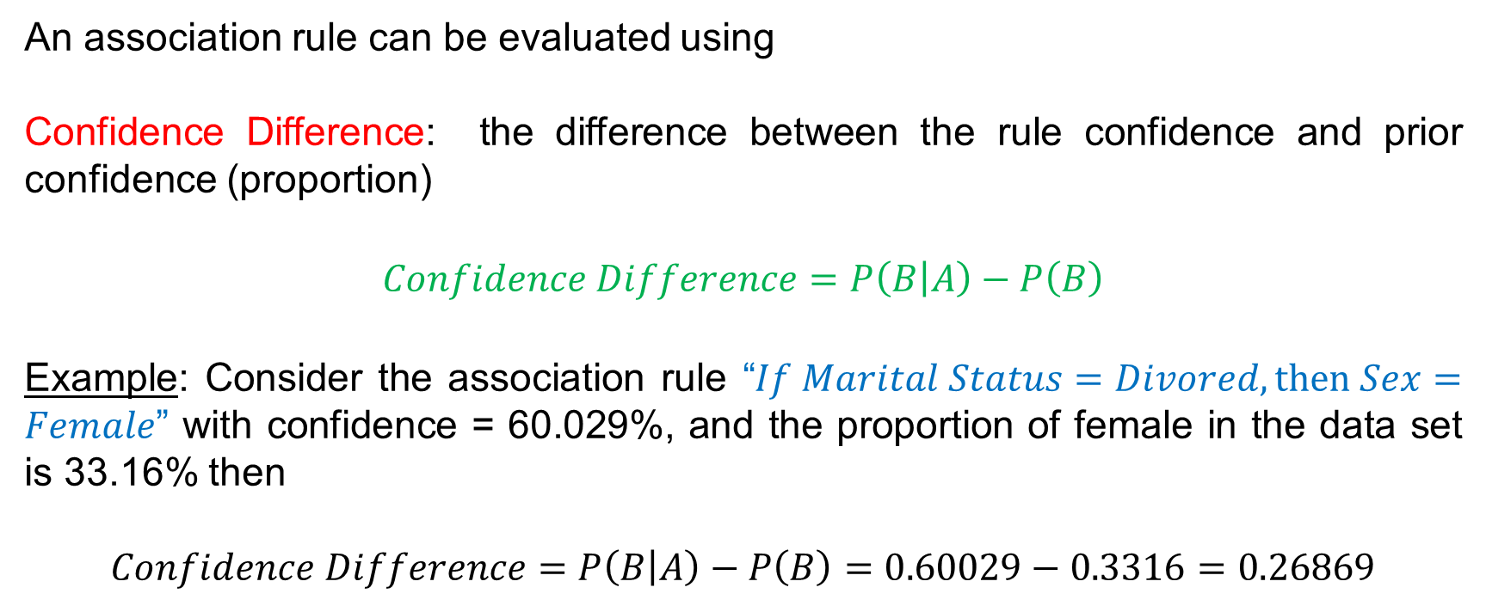
The a Priori Algorithm – Generating Association Rules
An association rule can be evaluated using
Confidence Difference: the difference between the rule confidence and prior confidence (proportion)
$$Confidence Difference=P\left(B | A\right)−P\left(B\right)$$
Example: Consider the association rule “$If Marital Status=Divored, then Sex=Female$” with confidence = 60.029%, and the proportion of female in the data set is 33.16% then
$$Confidence Difference=P\left(B | A\right)−P\left(B\right)=0.60029−0.3316=0.26869$$

Slide 32
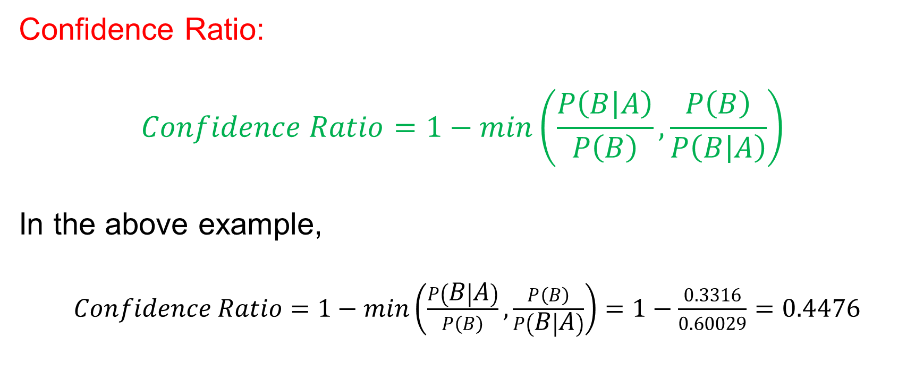
The a Priori Algorithm – Generating Association Rules
Confidence Ratio:
$$Confidence Ratio=1−min\left(\frac{P\left(B | A\right)}{P\left(B\right)},\frac{P\left(B\right)}{P\left(B | A\right)}\right)$$
In the above example,
$Confidence Ratio=1−min\left(\frac{P\left(B | A\right)}{P\left(B\right)},\frac{P\left(B\right)}{P\left(B | A\right)}\right)=1−\frac{0.3316}{0.60029}=0.4476$

Slide 33
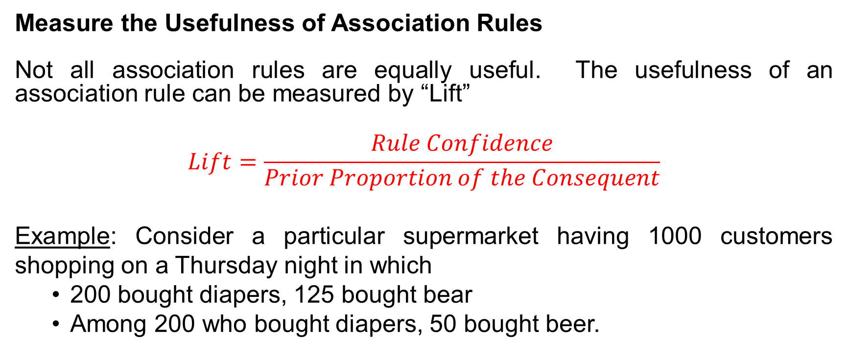
The a Priori Algorithm – Generating Association Rules
Measure the Usefulness of Association Rules
Not all association rules are equally useful. The usefulness of an association rule can be measured by “Lift”
$$Lift=\frac{Rule Confidence}{Prior Proportion of the Consequent}$$
Example: Consider a particular supermarket having 1000 customers shopping on a Thursday night in which
200 bought diapers, 125 bought bear
Among 200 who bought diapers, 50 bought beer.

Slide 34
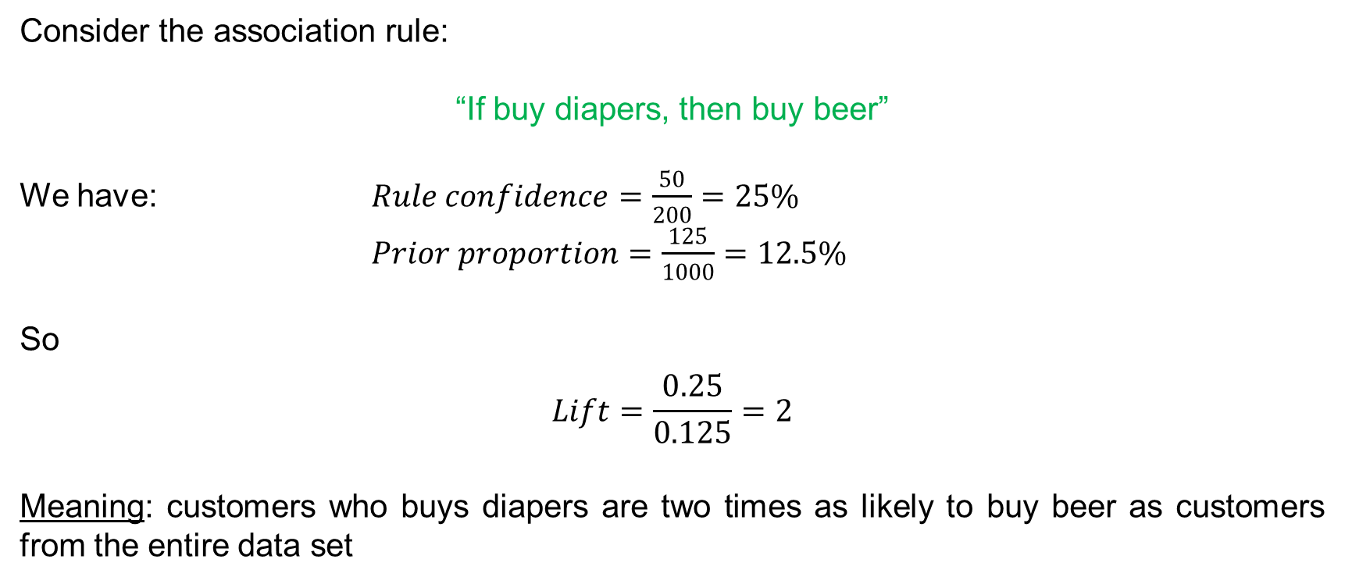
The a Priori Algorithm – Generating Association Rules
Consider the association rule:
“If buy diapers, then buy beer”
We have: $Rule confidence=\frac{50}{200}=25\%$
$Prior proportion=\frac{125}{1000}=12.5\%$
So
$$Lift=\frac{0.25}{0.125}=2$$
Meaning: customers who buys diapers are two times as likely to buy beer as customers from the entire data set

