Slide 1
India foreign trade

Slide 2
Contents
Introduction
Dataset Drescription
Methodology and Goals
Dashboard
Results overview and Recommendations

Slide 3

Introduction
INDIA trade from 2010-2018

Slide 4
Engaging the audience
This includes monitoring overall export/import trends, identifying top global trading partners, and understanding dominant commodity groups.
As an additional, focused task, the dashboard will also provide a detailed analysis of India's bilateral trade specifically with Vietnam during the same period.

Slide 5
Dataset description

Slide 6
Datasets
2010 – 2018_export (137024 rows)
2010 – 2018_import (76125 rows)
It contains information about HS code, commodity, value, country, year.
HS code: HS stands for Harmonized System
Commodity
Value
Country
Year

Slide 7
Methodology and goals
The general trends for India’s total export/ import and net trade 2010-2028.
Top partners
Commodity dominance
Methodology
Data cleaning
Exploratory Data Analysis
Visualization

Slide 8
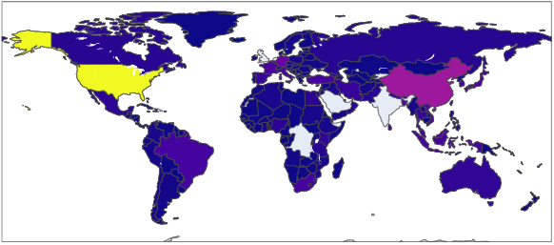
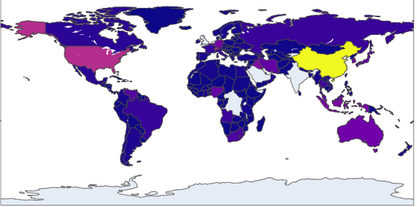
India Trade

Slide 9
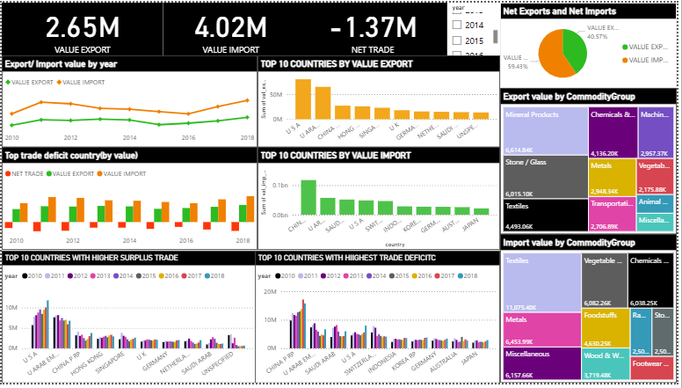
Dashboard India Trade

Slide 10
Results and overview
Growing trade volume
Shifting trade balance
Key export partner
USA dominant export partner
Key import partner
China – the leading import source

Slide 11

Recommendation
Boost exports
Diversify Import Sources
Strategic Engagement with Key Partners
Commodity-Specific Strategies

Slide 12
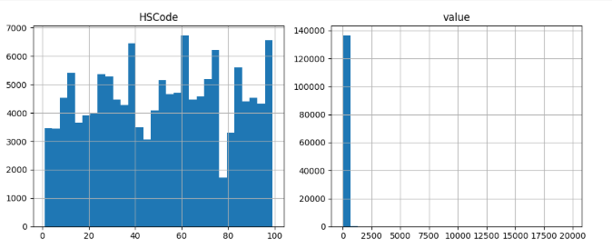
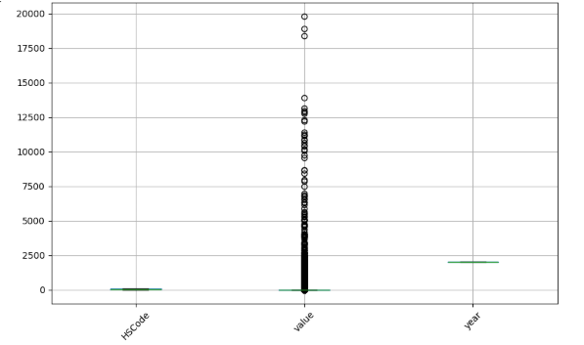
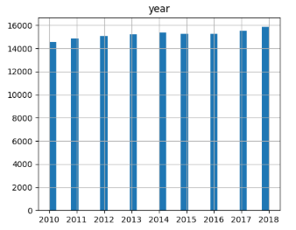
The matrix India export

Slide 13
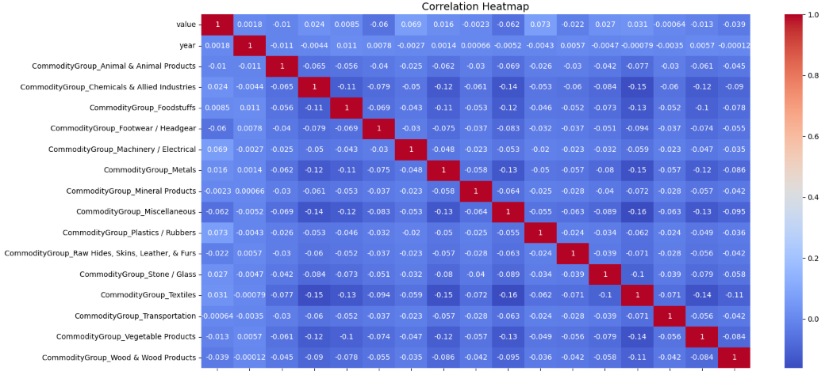
The matrix India export

Slide 14
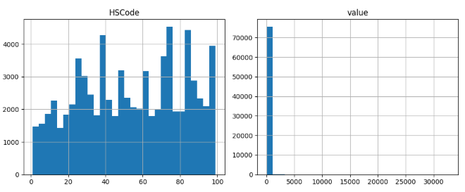
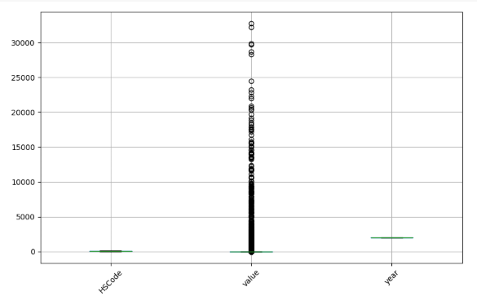
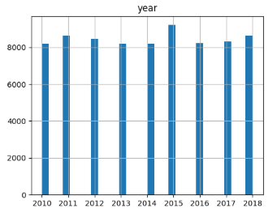
The matrix India import

Slide 15
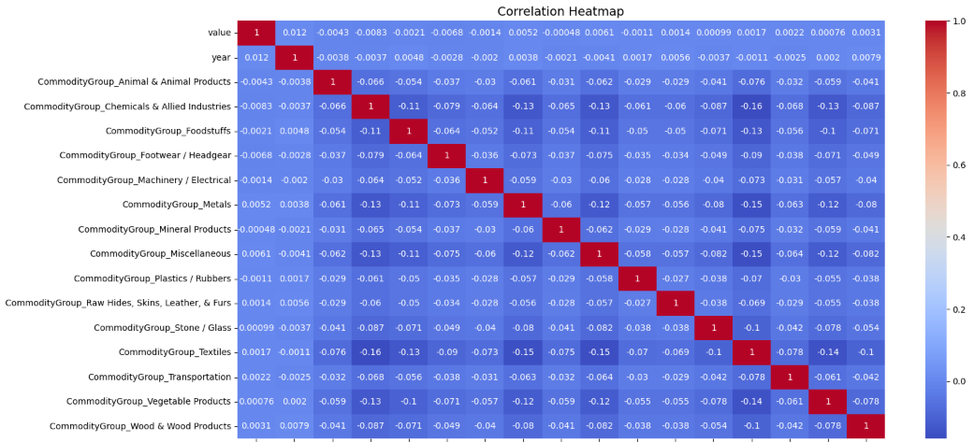
The matrix India import

Slide 16
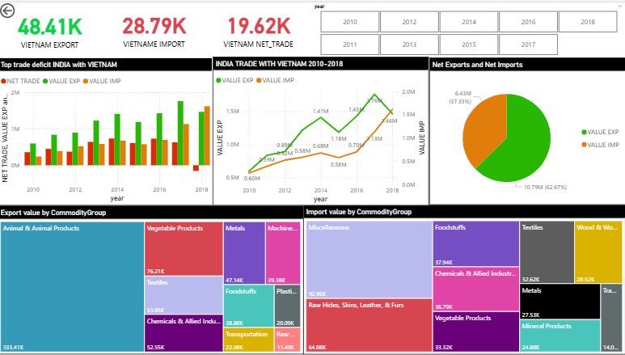
India-Vietnam Bilateral Trade

Slide 17
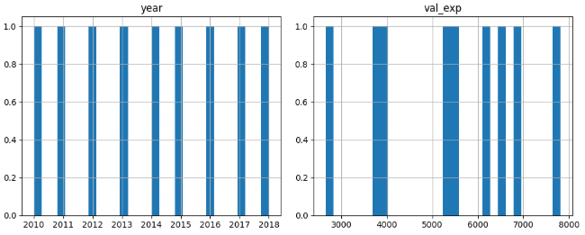
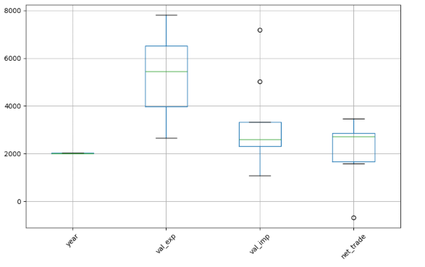
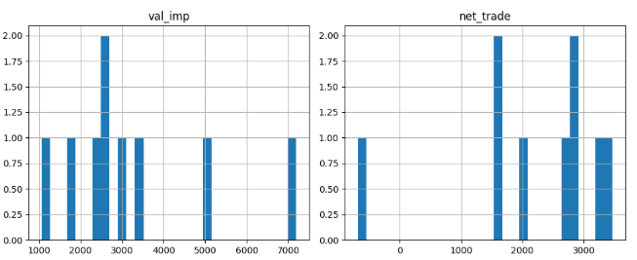
The matrix

Slide 18
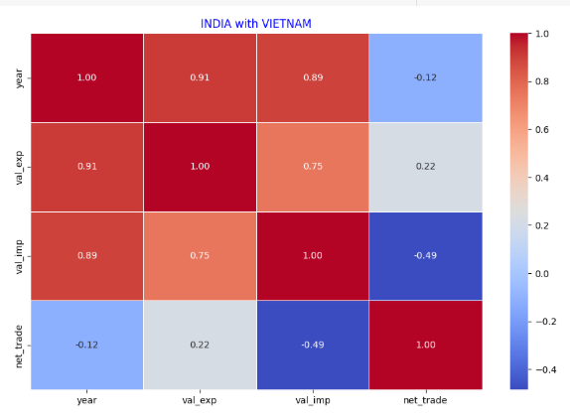
The matrix

Slide 19
Thank you
Duong Ngoc Anh
ngoc.anh.duong.24@gmail.com

