Slide 1
Linux Investigation

Slide 2
Table of contents
Linux
Introduction
Vi editor
Permissions and ownership
Wildcards
Finding files and directories
I/O redirection
Listing contents of directory
(cont)

Slide 3
Table of contents (cont)
Archiving file & directories
Job control
Processes
Other common command
Shell introduction
Shell and user variable
Reading User Input
Branch Condition (If)
Branch Condition (Switch)
Looping
Debugging scripts
(cont)

Slide 4
Table of contents (cont)
AWK
Using More Than One Field Separator
Sed
Sed format
Perl
Perl introduction
Scalar Value
Lists
(cont)

Slide 5
Table of contents (cont)
Opening a File
Reading from a file
Writing to a file
Branch condition
Looping

Slide 6
LINUX

Slide 7
Introduction
Unix
Designed to allow the staff share information
Obtained the source for free, for research into OS
Minux
Based on the first real version of Unix
First version of Linux created by Linus Torvalds

Slide 8
The vi editor
To edit files, scripts
2 mode: insert and input mode
Cmd: vi [filename]
Cmd switch to input mode: a, A, …
:wq, ZZ // save and quit
:q! //quit not save

Slide 9
The vi editor
Cmd delete, change
dd // delete line
x // delete character
u // undo
Copy, paste
p // paste to the right of cursor
yy // copy current line

Slide 10
The vi editor
Search
/findtext
n // repeat search in same direction
Movement
:0 //go to the beginning of file
G // go to the end of file

Slide 11
Permissions and ownership
To see permission use cmd ls –l
// “-” is a file, “d” is a directory, “l” is a link,
// ‘u’ user, ’ g ‘ group, ‘o’ other, ‘a’ all
// ‘+’ add, ‘-‘ remove, ‘=’ set permission
To change permission
Ex: chmod u=rwx filename

Slide 12
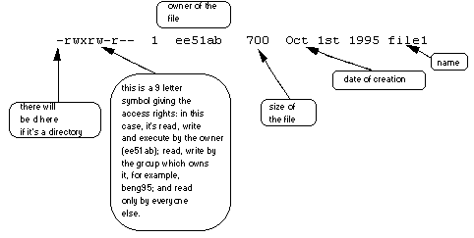
Permissions and ownership

Slide 13
Permissions and ownership
Setting ownership
chgrp –c <group> <files>
chown –c <user> <files>
chown –c <user>:<group> <files>

Slide 14
Finding files and directories
Finding file or directory
find <path> <options> -print
Ex: find / -name abc -print
Finding text in file
grep [option ] <find text> <path>
Ex: grep -c ‘abc’ ./

Slide 15
Wildcards
expanded by the shell before passed to the command
* // matches zero or more char
? // matches any one char
[chars] // any character in set
[!chars] // not any char in set
Ex: ls ![b-c]*

Slide 16
I/O redirection
command < file // redirect file as input
command > file // redirect file as output
command >> file // append to the end of file
command > file1 2 > file2 // write output //to file1, error to file2 only when it uses //stdout and stderr

Slide 17
Listing contents of directory
ls [option] // list file
-a // list all
-R // list all and every file in subdirectories
-l // detail

Slide 18
Archiving file & directories
To compress many files into one
Decompress file
Ex: tar –czvf name.tar * // compress current directories
Ex: tar –xzvf name.tar * // decompress tar file

Slide 19
Job control
Jobs ussually run in background
View jobs
jobs
cmd & // make process run in background
bg //
fg // make process run in foreground

Slide 20
Processes
ps // view processes
kill <pid> // kill process
top // view top consumers of memory and CPU timer

Slide 21
Other common command
pwd // print working directory
cd [option] // change directory
mkdir name // make empty dir
rmdir name // remove if empty
rm –r dir // remove dir and everything in it

Slide 22
Other commom command
cal // view calender
cat // show content of file
clear // clear screen
cp -rv file1 file2 // copy file1 any any files in file1 to file2
date // show date
df // view amount of free disk space
du // view used disk space for specified directory

Slide 23
Other commom command
echo // print text to screen
id // display user, group, other ID
less // show content of file
ln // create a link to a file or directory
mv // move file
netstat // display tcp/ip information
nslookup // query DNS

Slide 24
Other commom command
rm // remove file or dir
telnet // access remote system
ssh // access remote system securely
touch // update access & modified day of file
traceroute // network cmd
mount // mount device
unmount // unmount device
Whoami // show user name

Slide 25
Shell Introduction
The shell is a special program used as an interface between the user and operating system, a program called the kernel
The Bourne shell is the standard UNIX shell, and is used to administer the system.The default Bourne shell prompt is the dollar sign ($).
The C shell was developed at Berkeley and added a number of features, such as command line history, aliasing, built−in arithmetic, filename completion, and job control. The default C shell prompt is the percent sign (%).

Slide 26
Shell and user variable
common environmental variables: HOME, …
echo $name // display variable ‘s content
set variable = value // setting a variable

Slide 27
Reading User Input
The $< Variable. To make a script interactive, a special C shell variable is used to read standard input into a variable.

Slide 28
Branch Condition (If)
FORMAT
if ( expression ) then
command
command
else if ( expression ) then
command
command
else
command
endif

Slide 29
Branch Condition (Switch)
FORMAT
switch (variable)
case constant:
commands
breaksw
case constant:
commands
breaksw
endsw

Slide 30
Looping
FORMAT
while (expression)
command
. . .
command
end

Slide 31
Debugging scripts
The echo option is set and unset within the script. This enables you to debug certain sections of your script where you have run into a bottleneck, rather than echoing each line of the entire script.
echo Your home shell is $SHELL
unset echo
echo Good−bye $LOGNAME
−−> echo Your login shell is /bin/csh
−−> Your login shell is /bin/csh
−−> unset echo

Slide 32
AWK
Awk is a programming language used for manipulating data and generating reports.
Syntax awk 'pattern {action}' filename
Awk scans a file (or input) line by line, from the first to the last line, searching for lines that match a specified pattern and performing selected actions (enclosed in curly braces) on those lines

Slide 33
Using More Than One Field Separator
Used to separate fields when match character in square bracket
% awk –F'[ :\t]' '{print $1, $2, $3}' employees
// file seperators are space, tab and :

Slide 34
Sed
Is a streamlined, non-interactive editor. It allows you to perform the same kind of editing tasks used in the vi and ex editors.
Instead of working interactively with the editor, the sed program lets you type your editing commands at the command line, name the file, and then see the output of the editing command on the screen

Slide 35
Sed format
sed 'command' filename(s)
Sed commands tell sed how to process each line of input specified by an address. If an address is not given, sed processes every line of input

Slide 36
Perl Introduction
Perl is an acronym, short for Practical Extraction and Report Language. It was designed for writing programs in the UNIX environment. In short, Perl is as powerful as C but as convenient as awk, sed, and shell scripts.

Slide 37
Scalar Value
Basically, a scalar value is one unit of data. This unit of data can be either a number or a chunk of text.
Integer Scalar Values
Floating-Point Scalar Values
Character Strings

Slide 38
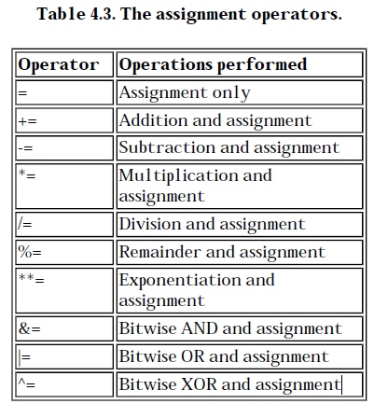

Slide 39
Lists
A list is a sequence of scalar values enclosed in parentheses. The following is a simple example of a list: (1, 5.3, "hello", 2)
Storing a list
@array = (1, 2, 3);
Retrieving the Length of a List
$scalar = @array;

Slide 40
Opening a File
Before you can read from or write to a file, you must first open the file. This operation tells the operating system that you are currently accessing the file and that no one else can change it while you are working with it.
open (filevar, filename);

Slide 41
Reading from a File
To read from a file, enclose the file variable associated with the file in angle brackets (< and >), as follows:
$line = <MYFILE>; // read a line

Slide 42
Writing to a File
the print statement sends output to the standard output file
open (OUTFILE, "outfile");
print OUTFILE ("Here is an output line.\n");

Slide 43
Branch Condition
if (expr_1) {
statement_block_1
} elsif (expr_2) {
statement_block_2
...
} else {
statement_block_n
}
unless (expr_1) {
statement_block_1
}

Slide 44
Looping
while (expr) {
statement_block
}
The while statement loops while its conditional expression is true.
until (expr) {
statement_block
}
The until statement loops until its conditional expression is true (as long as its conditional expression is false).)

Slide 45
The end
Thanks for listening

