Slide 1
iVCP1 Investigation
Renesas Design Vietnam Co., Ltd.
Tu Tran, VideoIP

Slide 2
Table of Contents
iVCP1
Overview
Features
Main Functions
Block Diagram
Interfaces
Input & Output
iVCP1 Operation
Reset Operation
iVCP1/TRF Module
Position
Block diagram
TRF SRAM list
TRF Sub-modules

Slide 3
Table of Contents
IPRC Sub-module
Function Interfaces
MB preparation
INTRA Prediction
RC operation (Reconstruct data)
T Sub-module
T horizontal processing
T vertical Processing
Q Sub-module
Q operation
iQ Sub-module

Slide 4
Table of Contents
IT Sub-module
IT horizontal processing
IT vertical processing
Internal Data ranges

Slide 5
iVCP1

Slide 6
Overview
Extremely-small-size H.264 encoder IP with low latency
Once iVCP1 starts, it can continue operating without the host CPU
Encode 1080p30 at 133 MHz low frequency without DRAM and frame memory

Slide 7
Features
Support for H.264/MPEG4 AVC encoding
Support for HDTV resolutions 1920 pixels × 1080 lines × 30 frames/second
Support 10bits depth of pixel and 4:2:2 raster order input from external camera
Rate control: Bit rate control for Constant Bit Rate(CBR) without host CPU
Low power consumption

Slide 8
Main Functions
Item | Description
Encoding standard supported | H.264/MPEG-4 AVC High10 Intra, High Profile, Progressive High Profile, Main Profile, Constrained Baseline Profile, Baseline Profile
Maximum throughput | 1920x1080p30 @ 133 MHz or more 1280x960p30 @ 74.25 MHz or more
Maximum bit rate | 100 Mbps @ CBR
Picture size supported in encoding | Minimum size: Horizontal 176 pixels x vertical144 lines (QCIF) Maximum size: Horizontal 1920 pixels x vertical 1088 lines
Input color format | YCbCr 4:2:2 format YUV None-Interleave: Y/UV or Y/VU YUV Interleave: UYVY, YUYV, VYUY, YVYU
Output color format | YCbCr 4:2:0 format
Input/Output bit depth | 8bit or 10bit
Bit stream format | NAL Unit, which is including SPS, PPS, AUD, Filter and VCL
Picture structure | Frame structure
External interface | Target: 32-bit AMBA3 APB 20-bits pallarel interface for camera input 32-bits SRAM like interface for stream output Restrictions: ・ Synchonization clocks between iVCP1 main clock and APB clock ・ Fixed frequency ratio clock between iVCP1 main clock and APB IP main clock(clk_m) : APB clock(clk_ap) = n:1 ( n = 1, 2, 3 or 4)

Slide 9
Block Diagram
Abbr. | Description | Abbr. | Description
PBC | Picture Buffer Control module | IME | Intra Mode Estimation module
TRF | Quantization, conversion, inverse quantization, inverse conversion and intra prediction | VLC | Variable Length Coding module
RATE | Rate control module | CTRL | Control module

Slide 10
Interfaces
One target port and two parallel interface ports.
The target port is connected to the 32-bit AMBA3 APB
Input parallel interface ports are connected to the 20-bit camera interface
Output parallel interface ports are connected to the 32-bit stream interface.

Slide 11
Input & Output
iVCP1 has following 6 YUV modes of image format which are specified by VP_CAM_SWITCH.INTL and VP_CAM_SWITCH.YUVTYPE.
No. | Format | Name | INTL | YUVTYPE
1 | None-Interleaved | Y/UV | 0 | 0
2 |  | Y/VU | 0 | 1
3 | Interleaved | UYVY | 1 | 0
4 |  | YUYV | 1 | 1
5 |  | VYUY | 1 | 2
6 |  | YVYU | 1 | 3
iVCP1 output stream format is “Byte stream format “ which is defined by H.264 standard.

Slide 12
iVCP1 Operation
Its operation is described by the flowchart

Slide 13
iVCP1 Operation
Initialization
CPU resets iVCP1 by software, set 0x00000F00 to VP_CMD register. After finish reset sequence in iVCP1, register value return to ”0” automatically
Set necessary parameter to parameter register
interrupt setting ： VP_IRQ_*
H.264 encoding parameter ： VP_PAR*
stream parameter ： VP_VLC_SWITCH
camera setting ： VP_CAM_SWITCH
rate control setting ： VP_RATE_CTRL*

Slide 14
iVCP1 Operation
CMD.START
The start bits set up and kick iVCP1
start to encode according to setting parameters
MS==1
When iVCP1 is running, VP_STATUS.MS register equal to ”1”.
CMD.STOP：
Set CMD.STOP register in order to terminate iVCP1 encoding.
Interrupt
After setting CMD.STOP register to “1”, iVCP1 finish encoding process in current picture, and then assert interrupt by setting VP_IRQ_ENB.CTE=1

Slide 15
Reset Operation
iVCP1 has a hardware reset controlled by input port and a software reset controlled by register setting
Software Reset
Set 00000F00h to VP_CMD register. (Set “1” to RATERST, PBCRST, CERST, and CTRLRST bit).
Hardware Reset (PowerOn Reset)
This reset initialize all status and register value in iVCP1

Slide 16
iVCP1/TRF Module

Slide 17
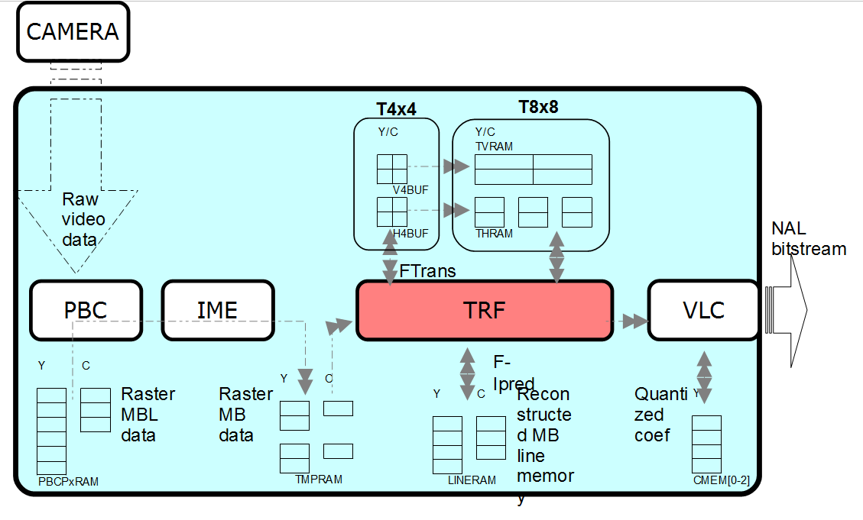
Position

Slide 18
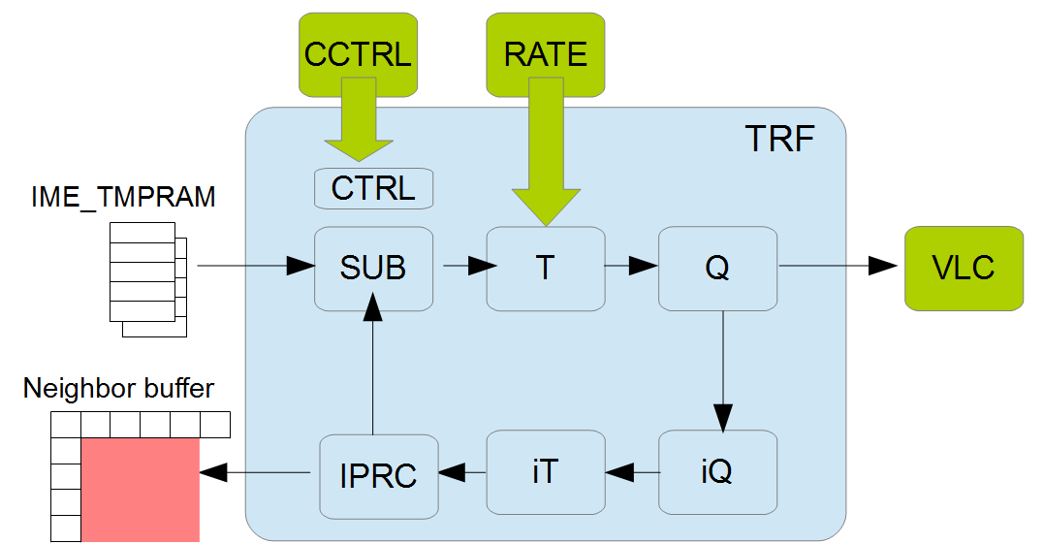
Block diagram

Slide 19
TRF Sub-modules
Module | Function | Description
TCTRL | Controller | Control whole TRF. Control pipelines in sub modules. Control the MB/picture parameter.
IPRC | Intra prediction Reconstruction Subtraction | Predict according to block parameter. Create reconstruct image and store for next MB IP enc Create residual image for transform
T | Transformation | Transform data from IPRC horizontally and vertically.
Q | Quantization | Quantize data in from T and output them to IQ and VLC
IQ | Inverse Quantization | Inverse quantize data from Q (ENC)
IT | Inverse Transformation | I-transform residual coef from iQ H/V to make reconstruct data for next MB prediction

Slide 20
TRF SRAM list
SRAM name | type | bit | word | quantity | R/W | description
TRF_PREDMEM | sp | 80 | 540 | 1 | RW | Y/C Line memory , Mbinfo for IME
TRF_THMEM{0-3} | sp | 32 | 16 | 4 | RW | HOR transpose ram for block 8x8
TRF_ITHMEM{0-3} | sp | 36 | 16 | 4 | RW | Invert HOR transpose ram for block 8x8
TRF_TVMEM{0-3} | 2p | 32 | 16 | 4 | RW | VER transpose ram for block 8x8
TRF_QMEM | 2p | 128 | 16 | 1 | RW | Store chroma Qcoeff . Coef size limitation to 16bit/coef

Slide 21
IPRC Sub-module Function
Receive prediction mode to do INTRA-prediction
Request YUV template data from IME to do SUB-operation to get residual data
(Residual data = YUV template data – YUV Predict data)
RC receive data from invert transform (IT) to do reconstruct operation and update to neighboring buffer
IPRC read MB parameters from IME_TEMPMEM to supply MB information for whole TRF

Slide 22
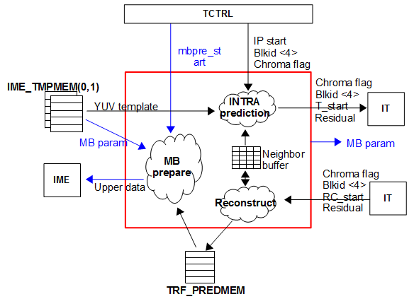
IPRC Sub-module Interfaces

Slide 23
MB preparation
MB preparation start by mbpre_start pulse from TCTRL
MB preparation running in 20 cycles
Output of MB preparation including:
mbp_posh : MB position horizontal
mbp_posv : MB position vertical
mbp_t_trans : MB trans-size (0: trans-size 4x4; 1: trans-size 8x8)
mbp_pic_bound : MB picture boundary
mbp_slice_bound : MB slice boundary
mbp_intra_mode[16] : INTRA luma prediction modes
mbp_intra_chroma_mode : INTRA chroma prediction mode
Upper reconstructed data : write to neighboring buffer and send to IME

Slide 24
INTRA Prediction
Input of Prediction processing including Intra Prediction modes and neighboring buffer
Output of Prediction processing is Predict data
Predict data be subtraction by Template data to create Residual data (will send to transform operation)
Residual data = Template data – Predict data
iVCP1/IP support below prediction modes

Slide 25
INTRA Prediction
Neighboring buffer mapping

Slide 26
RC operation (Reconstruct data)
Input of RC operation is Residual data (from IT) and Current Predict data (stored in neighboring buffer)
Reconstruct data updated back to neighboring buffer for next block INTRA Prediction processing
Last line reconstructed data of current MB stored to TRF-PREDMEM for next MB line referenced.
RC-IT interfaces present as below picture

Slide 27
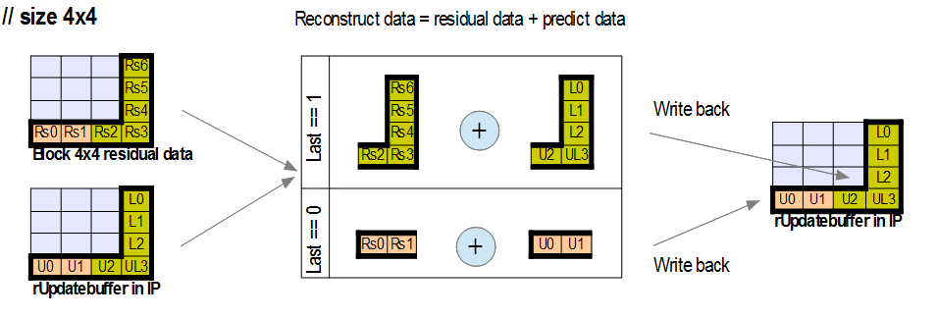
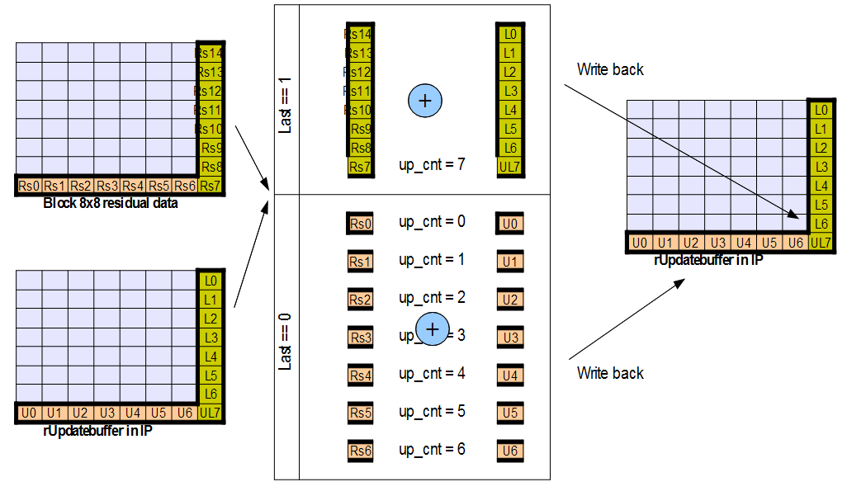
RC operation (Reconstruct data)

Slide 28
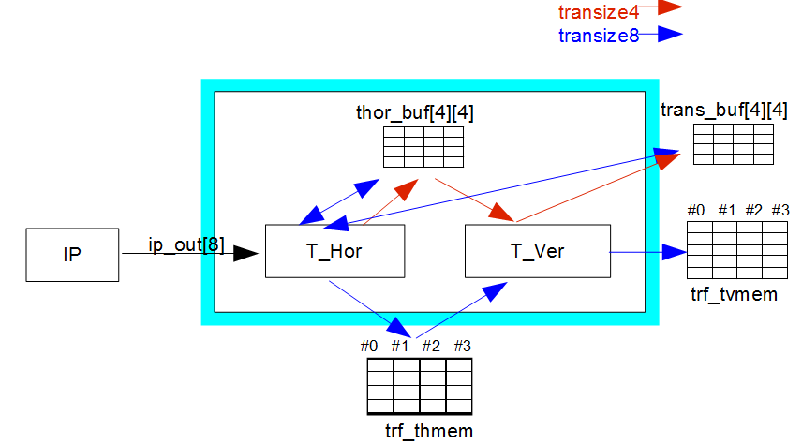
T Sub-module
Receive data output from IP module (residual data) .
Make DCT transform for Intra block 4x4, 8x8.
Output t_coef data to trans_buf[4][4] or TRF_TVMEM# (In case of I8x8)

Slide 29
T horizontal processing
Stage | Luma 4x4 or Chroma | Luma 8x8
0 | Empty | ip_out → mX
1 | ip_out → rA, Tr-Hor-stage 0 | mX → rA, Tr-Hor-stage 0
2 | Tr-Hor-stage 1 → write TH_buf | Tr-Hor-stage 1 → write TH(V)_buf
3 | Empty | Empty
4 | Empty | TH(V)_buf → TRF-THMEM

Slide 30
T vertical Processing
Stage | Luma 4x4 or Chroma | Luma 8x8
0 | Empty | Request TRF-THMEM
1 | Empty | Empty
2 | Empty | Read TRF-THMEM data
3 | Read TH_buf, Tr-Ver-stage 0 | Re-swap data THMEM → Tr-Ver-stage 0
4 | Tr-Ver-stage 1→ write TV_buf | Tr-Ver-stage 1→ write TRF-TVMEM

Slide 31
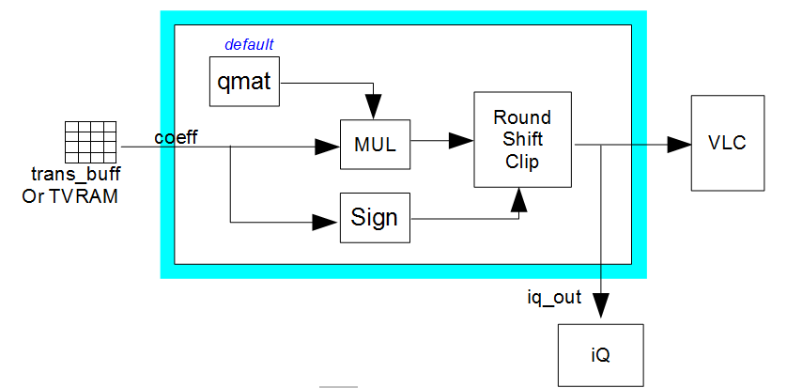
Q Sub-module
Receive coefficient from IT module.
Receive quantization parameter (qP) from TCTRL module.
Perform Quantization.
Output quantization coefficient to VLC and iQ module.

Slide 32
Q operation
Stage | Luma 4x4 or Chroma | Luma 8x8
0 | Empty | Request TRF-TVMEM
1 | Calculate qmat stage 0 | Calculate qmat stage 0
2 | Calculate qmat stage 1 | Calculate qmat stage 1 Read TRF-TVMEM
3 | Calculate rPrecoef | Calculate rPrecoef
4 | Round, Clip coef Send to VLC IF | Round, Clip coef Send to VLC IF

Slide 33
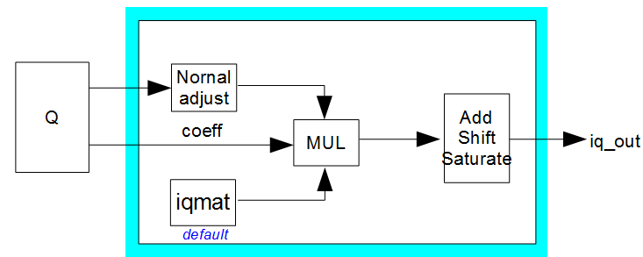
iQ Sub-module
Receive quantization coefficient (quan_coef) from Q module.
Receive quantization parameter (qP) from Q module.
Perform invert Quantization.
Select data and out to the iT (invert transform) module.

Slide 34
IQ Stages
Stage | Chroma | Luma
0 | Request QBUF | Empty
1 | Empty | Empty
2 | Calculate rMulret Read QBUF data | Calculate rMulret
3 | Calculate rPrecoef | Calculate rPrecoef
4 | Round, Clip coef | Round, Clip coef

Slide 35
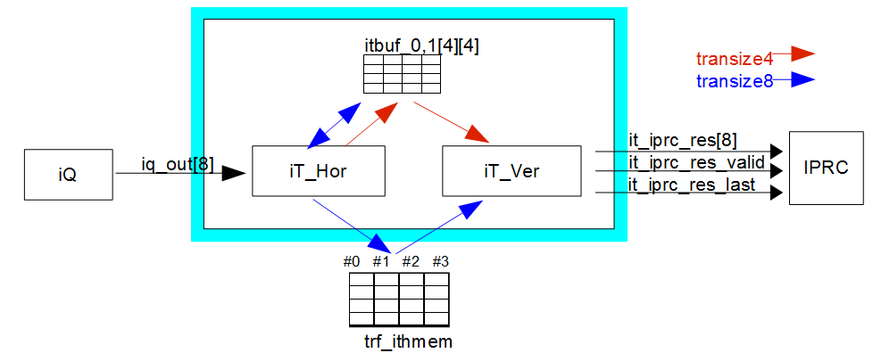
IT Sub-module
Receive data output from iQ module.
Make invert DCT transform for TU block 4x4, 8x8.
Output residual data to IPRC module.

Slide 36
IT horizontal processing
Stage | Luma 4x4 or Chroma | Luma 8x8
0 | Empty | iq_out → mX
1 | iq_out → rA, IT-Hor-stage 0 | mX → rA, IT-Hor-stage 0
2 | IT-Hor-stage 1 → Write ITH_buf | IT-Hor-stage 1 → write ITH(V)_buf
3 | Empty | Empty
4 | Empty | TH(V)_buf → TRF-ITHMEM

Slide 37
IT vertical processing
Stage | Luma 4x4 or Chroma | Luma 8x8
0 | Empty | Request TRF-ITHMEM
1 | Empty | Empty
2 | Empty | Read TRF-ITHMEM data
3 | Read ITH_buf, IT-Ver-stage 0 | Re-swap data ITHMEM → IT-Ver-stage 0
4 | IT-Ver-stage 1→ send res data | IT-Ver-stage 1→ send res data

Slide 38
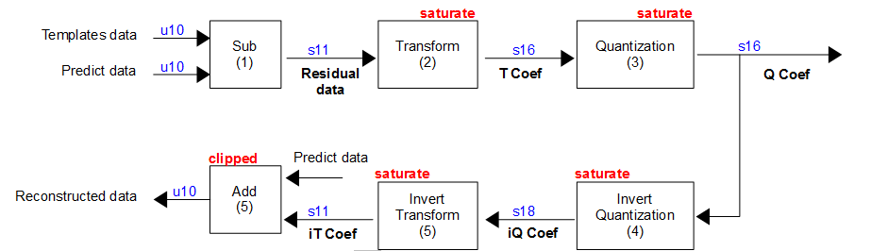
Internal Data ranges

Slide 39
The End Thanks for listening

Slide 40
Confirm the action items
AI#1: why do T sub-module and iT sub-module use different buffer
=>correct information: the T sub-module and iT sub-module use different buffer because the transform for 8x8 block uses 2 buffer.

