Slide 1
SystemC Investigation

Slide 2
Table of Contents
SystemC Definition
Verilog: always vs. SystemC: thread
SystemC: thread
Modules
Port and Data Type
Process
Method Process vs Thread Process
Sentivity List
Constructor
Operation

Slide 3
Table of Contents
Introduction to High-level design
System-level design
High-level design
Problem of RTL Design Flow
Solution with High-level Design Flow
Comparison between RTL and HLD
Aims of High-level Design
High-level Design Flow: Design step and EDA tool

Slide 4
SystemC Definition
SystemC is a set of C++ class that realize hardware description and simulation
SystemC follows the C++'s syntax.
We can run its simulation using general C++ compiler.
We can run its simulation together with Verilog design, using VCS/NC simulator

Slide 5
Verilog: always vs. SystemC: thread

Slide 6
SystemC: thread

Slide 7
Modules
A Module is the basic structural building block in SystemC. It is a container class in which processes and other modules are instantiated
Format
SC_MODULE( name ) {
sc_in input_port; // (1) Port and data type
sc_out output_port;
function() { // (2) Process, contrstructor and operation
task;
}
};

Slide 8
Port and Data Type
Port:
sc_in < data_type > input_nm;
sc_out < data_type > input_nm;
Data type:
<bool> : 1-bit
sc_uint<N> : N-bit unsigned
sc_int<N> : N-bit signed
sc_bigunit
sc_biginit

Slide 9
Process
Functions executed in parallel.
Purpose: to describe structure of a circuit
void func_name(void){
reset task
wait();
while(1){
normal task
wait();
}
}

Slide 10
Method Process vs Thread Process
Method | Thread
The entire body of the method process is executed. After completed, returns control to SystemC kernel. All local variables lose their value. Faster than thread processes | Executes until wait(). After executed wait(), process suspends and is saved its state. The process is resumed based upon its sensitivity list. Can be used to model: state machine, . . .

Slide 11
Sentivity List
Processes have sensitivity lists, i.e. a list of signals that cause the process to be invoked.
2 types:
Dynamic sensitivity list
Static sensitivity list

Slide 12
Constructor
A special function.
Purpose: to specify functions need to be treated as process.
SC_CTOR( name ) {
SC_CTHREAD( proc0 , clk.pos() );
reset_signal_is( reset , true );
}

Slide 13
Operation
A function to do specific operation.
Purpose: to describe operations.

Slide 14
Introduction to High-level design
Electronic machineries are getting more and more complicated, higher and higher performance and necessary to improve the design productivity.
Design methodology changed drastically in every ten years. Now, it's time to shift to system/behavior level

Slide 15
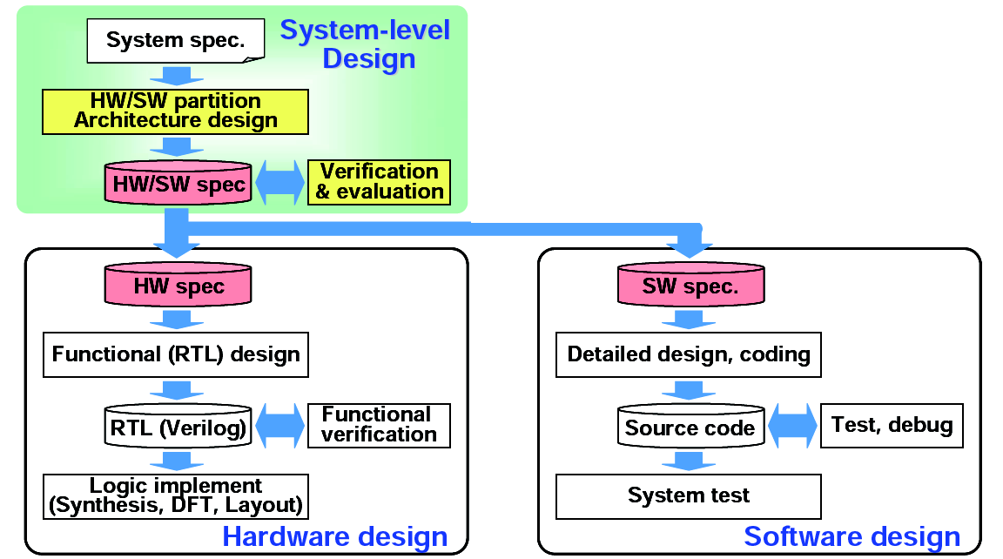
System-level design
Develop appropriate hardware and software specifications according to system specification
Purpose: Make HW/SW design very efficient and reduce total development period and cost

Slide 16
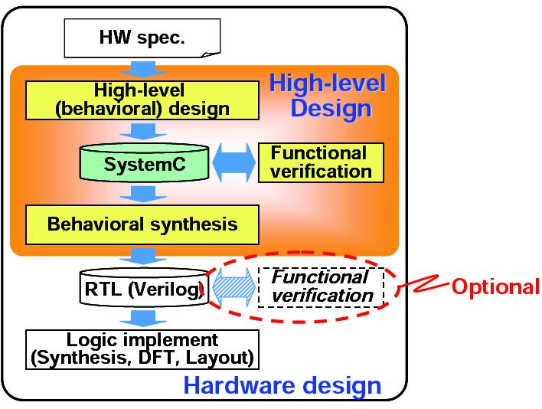
High-level design
Design HW at higher level (i.e behavioral) in SystemC. RTL description (Verilog HDL) is synthesized by a tool from the SystemC description
Purpose: Reduce HW design cost by designing at abstract level

Slide 17
Problem of RTL Design Flow
Number of lines of design description increases as LSIs get larger and more complicated
Simulation speed becomes slower
Difficult to verify, debug, modify or maintain the large design

Slide 18
Solution with High-level Design Flow
Design HW at a higher level of abstraction
Use SystemC as a high level design language and reduce number of lines of design description
Incorporate new behavioral synthesis technology and reduce man effort to design in detail

Slide 19
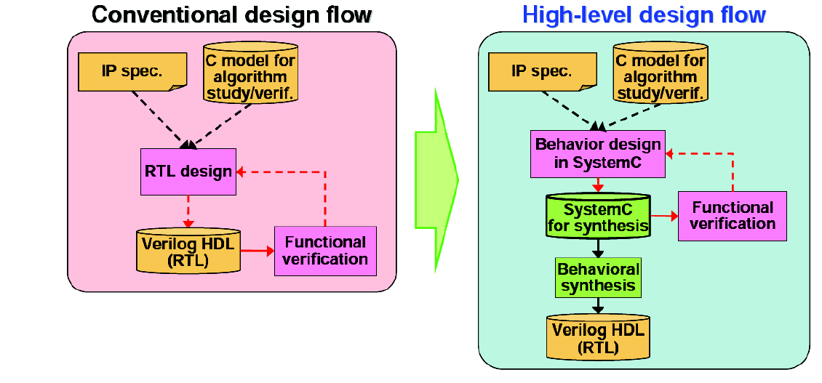
Comparison between RTL and HLD

Slide 20
Aims of High-level Design
Efficient design at a higher abstraction level
Design size (i.e. Number of lines of design description) can be reduced to one third of RTL (in Verilog)
=> Number of design errors is reduced
=> Easy to correct design errors
IPs become more flexible at an abstraction level so that they can be reused more efficiently
=> Reduce total design effort by using such proven designs
Optimize HW architecture in short period of time

Slide 21
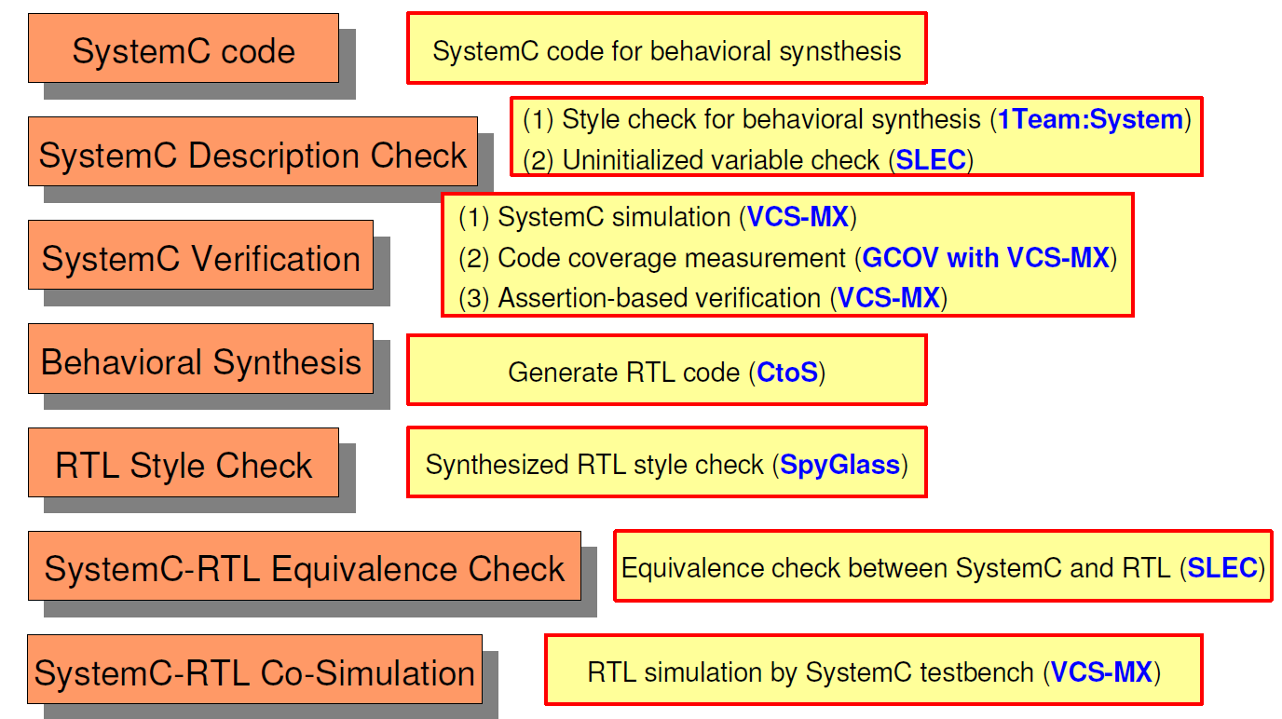
High-level Design Flow: Design step and EDA tool

Slide 22
The End Thanks for listening

