Slide 1
Video IP Investigation
Renesas Design Vietnam Co., Ltd.
Tu Tran, VideoIP

Slide 2
Table of Contents
Definitions
Capturing Video
Spatial Sampling
Temporal Sampling
Frames and Fields
Color Spaces
RBG
YCbCr (YUV)

Slide 3
Table of Contents
The Relation between RBG and YUV
YCbCr Sampling Formats
Video Coding Concepts
Video Codec
Video Encoder
Video Decoder
Temporal Model
Block-based Motion Estimation and Compensation
Macroblock & Block Size

Slide 4
Table of Contents
Spatial Model
Transform Coding
The Discrete Cosine Transform (DCT)
Quantisation
Reordering and Zero Encoding
Entropy Encoding
Predictive Coding
Variable-length Coding
Arithmetic Coding
Arithmetic Encoding Example
Arithmetic Decoding Example

Slide 5
Table of Contents
H.264/MPEG4 Part 10
Intra Prediction
4 × 4 Luma Prediction Modes
16 × 16 Luma Prediction Modes
8 × 8 Chroma Prediction Modes
Inter Prediction
Tree structured motion compensation
Motion Vectors & Motion Vector Prediction
Luma Interpolation Process (half-pel samples)
Luma Interpolation Process (quarter-pel samples)
Chroma Interpolation Process (eighth-sample positions)
Deblocking Filter

Slide 6
Definitions
Pixel is a picture element.
Resolution is the number of elements in a picture or frame. For example
TV: 640x480
HD: 1280x720
Full HD 1920x1080
Frame is picture that is formed by many pixels
Video is a sequence of frames and captured by using progressive or interlaced sampling .

Slide 7
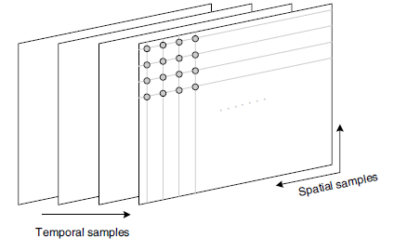
Capturing Video
Digital video is a representation of a natural (real-world) visual scene, sampled spatially and temporally
Each spatio-temporal sample (picture element or pixel) is represented as a number or set of numbers that describes the brightness (luminance) and color of the sample.

Slide 8
Spatial Sampling
The most common format for a sampled image is a rectangle with the sampling points positioned on a square or rectangular grid
Sampling occurs at each of the intersection points on the grid and the sampled image may be reconstructed by representing each sample as a square picture element (pixel).
The visual quality of the image is influenced by the number of sampling points.

Slide 9
Spatial Sampling

Slide 10
Temporal Sampling
A moving video image is captured by taking a picture at periodic time intervals
A higher temporal sampling rate (frame rate) gives apparently smoother motion in the video scene but requires more samples to be captured and stored.
A video signal may be sampled as a series of complete frames (progressive sampling) or as a sequence of interlaced fields (interlaced) sampling

Slide 11
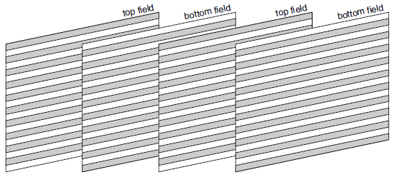
Frames and Fields
An interlaced video sequence contains a series of fields and half of the data in a frame (one field) is sampled at each temporal sampling interval.
A field consists of either the odd-numbered or even-numbered lines
Send twice as many fields per second as the number of frames

Slide 12
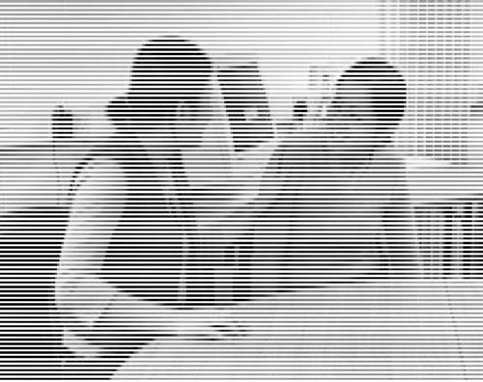
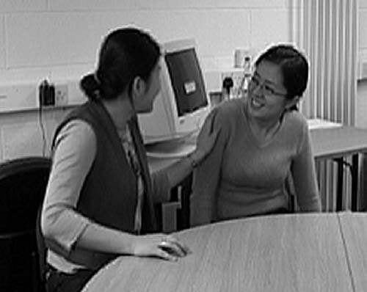
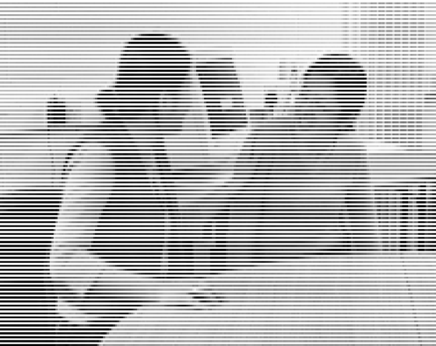
Frames and Fields
Top field
A frame
Bottom field

Slide 13
Color Spaces
Video needs a mechanism to capture and represent color information
Color images require at least three numbers per pixel position to represent color accurately.
The method chosen to represent brightness (luminance or luma) and color is described as a color space.
2 types: RBG, YCbCr

Slide 14
RBG
In the RGB colour space, a colour image sample is represented with three numbers Red, Green and Blue
Any colour can be created by combining red, green and blue in varying proportions
From a normal viewing distance, the separate components merge to give the appearance of ‘true’ colour.

Slide 15
YCbCr (YUV)
Because of the human visual system (HVS), represent a color image more efficiently by separating the luminance from the color information and representing luma with a higher resolution than color.
Y is the luminance component and Cb, Cr are color difference (chrominance or chroma) components of blue and red

Slide 16
The Relation between RBG and YUV

Slide 17
YCbCr Sampling Formats
4:4:4 sampling: chrominance components have same resolution as luminance component

Slide 18
YCbCr Sampling Formats
4:2:2 sampling (YUY2): chrominance components have half the horizontal resolution of luminance component

Slide 19
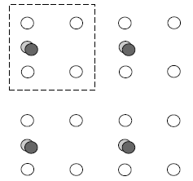
YCbCr Sampling Formats
4:2:0 sampling (YV12): chrominance components have half the horizontal and vertical resolution of luminance component

Slide 20
Video Coding Concepts
Video compression (video coding) is the process of compacting or condensing a video into a smaller number of bits.
Uncompressed video typically requires a large bitrate and compression is necessary for practical storage and transmission of digital video.
Compression involves a complementary pair of systems, a compressor (encoder) and a decompressor (decoder).

Slide 21
Video Coding Concepts
Data compression is achieved by removing redundancy, i.e. components that are not necessary
Methods: temporal and spatial redundancy

Slide 22
Video Codec
Encodes a source image or video sequence into a compressed form and decodes this to produce a copy (lossless) or approximation (lossy) of the source sequence
Consists of three main functional units: a temporal model, a spatial model and an entropy encoder.

Slide 23
Video Encoder

Slide 24
Video Decoder

Slide 25
Temporal Model
Purpose: reduce redundancy between transmitted frames
Input: uncompressed video (frames)
Output: residual frames and motion vectors
A practical and widely-used method is Block-based Motion Estimation and Compensation

Slide 26
Block-based Motion Estimation and Compensation
Compensate for movement of rectangular sections or ‘blocks’ of the current frame
Procedure:
Search an area in the reference frame to find the best match (motion estimation)
The chosen region is subtracted from the current block to form a residual M × N block (motion compensation)
The residual block and the offset between the current block and the position of the candidate region (motion vector) are encoded and transmitted

Slide 27
Macroblock & Block Size
The macroblock, corresponding to a 16×16-pixel region of a frame, is the basic unit for motion compensated prediction in a number of important visual coding standards
Block Size smaller motion compensation block sizes can produce better motion compensation results.
However, a smaller block size leads to increased complexity (more search operations must be carried out) and an increase in the number of motion vectors that need to be transmitted.

Slide 28
Spatial Model
Purpose: decorrelate image or residual data further and to convert it into a form that can be efficiently compressed using an entropy coder
Input: residual frames
Output: quantised transform coefficients
Three main components, transformation (decorrelates and compacts the data), quantisation (reduces the precision of the transformed data) and reordering (arranges the data to group together significant values).

Slide 29
Transform Coding
Convert image or motion-compensated residual data into another domain (the transform domain).
Popular transforms: Discrete Cosine Transform (DCT), Discrete Wavelet Transform (DWT or just ‘wavelet’) . . .

Slide 30
The Discrete Cosine Transform (DCT)
Y = AXA^{T}
Where X is a matrix of samples, Y is a matrix of coefficients and A is an N × N transform matrix. The elements of A are:
These coefficients can be considered as ‘weights’ of a set of standard basic patterns. Any image block may be reconstructed by combining all N × N basis patterns

Slide 31
Quantisation
A quantiser maps a signal with a range of values X to a quantised signal with a reduced range of values Y (reduce bit length).
Where QP is step size
Quantization is not reversible
If the step size is large, the range of quantised values is small and can therefore be highly compressed and and vice versa

Slide 32
Reordering and Zero Encoding
Scan
Raster scan
Z-scan

Slide 33
Reordering and Zero Encoding
Run-level encode
(run, level) pairs where run indicates the number of zeros preceding a nonzero coefficient and level indicates the magnitude of the nonzero coefficient.
Example:
Input array: 16,0,0,−3,5,6,0,0,0,0,−7, . . .
Output values: (0,16),(2,−3),(0,5),(0,6),(4,−7). . .

Slide 34
Entropy Encoding
Purpose: converts symbols into a compressed bitstream suitable for transmission or storage
Input: quantised transform coefficients, motion vectors, . . .
Output: bitstream
Encoding method: Predictive Coding, Variable-length Coding, Arithmetic Coding

Slide 35
Predictive Coding
Predicting elements of the current block or macroblock from previously-encoded data and encoding the difference between the prediction and the actual value
B
C
A
X
Motion vector X is predicted from Vectors A, B and C

Slide 36
Variable-length Coding
Maps input symbols to a series of codewords (variable length codes or VLCs).
Less common symbols are represented with long VLCs and vice versa
Method: Huffman Coding
D
1
p=1.0
0
0
C
Vector Probability(p) log2(1/p)‏
1
0
p=0.4
p=0.6
-2 0.1 3.32
-1 0.2 2.32
B
A
0 0.4 1.32
1
p=0.4
0
1
0
p=0.2
1 0.2 2.32
2 0.1 3.32
1
-1
2
-2
Codeword of vector 2: 001
p=0.2
p=0.2
p=0.1
p=0.1

Slide 37
Arithmetic Coding
Converts data symbols into a single fractional number
Optimize fractional number of bits required to represent each symbol
Ex:
Vector Probability(p) log2(1/p) sub-range
-2 0.1 3.32 0.0-0.1
-1 0.2 2.32 0.1-0.3
0 0.4 1.32 0.3-0.7
1 0.2 2.32 0.7-0.9
2 0.1 3.32 0.9-1.0

Slide 38
Arithmetic Encoding Example
Sequence data (0, -1, 0, 2)‏
0 0.1 0.3 0.7 0.9 1.0
(-2) (-1) (0) (1) (2)‏
0.3
0.34
0.42
0.7
(-1)
0.364
0.396
0.42
(0)
0.3928
0.396
Transmitted number is 0.394
(2)

Slide 39
Arithmetic Decoding Example
0 0.1 0.3 0.7 0.9 1.0
(-2) (-1) (0) (1) (2)‏
0.3
0.34
0.42
0.7
(-1)
==>The decoded data (0, -1, 0, 2)‏
0.34
0.364
0.396
0.42
(0)
0.364
0.3928
(-2) `

Slide 40
H.264/MPEG4 Part 10

Slide 41
Intra Prediction
a prediction block P is formed based on previously encoded and reconstructed blocks and is subtracted from the current block prior to encoding
form for each 4 × 4 block or for a 16 × 16 macroblock
9 optional prediction modes for each 4 × 4 luma block, 4 modes for a 16 × 16 luma block and 4 modes for the chroma components.
selects the prediction mode for each block that minimises the difference between P (prediction block) and the block to be encoded

Slide 42
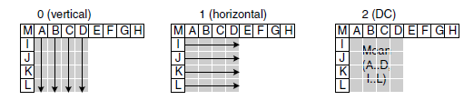
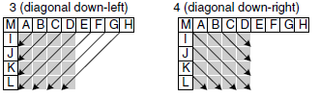
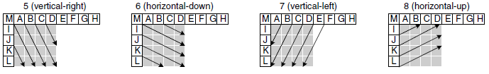
4 × 4 Luma Prediction Modes Intra Prediction

Slide 43
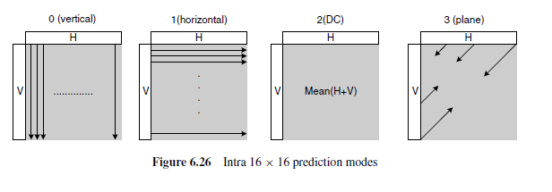
16 × 16 Luma Prediction Modes Intra Prediction
Mode 0 (vertical) Extrapolation from upper samples (H)
Mode 1 (horizontal) Extrapolation from left samples (V)
Mode 2 (DC) Mean of upper and left-hand samples (H + V).
Mode 4 (Plane) A linear ‘plane’ function is fitted to the upper and left-hand samples H and V

Slide 44
8 × 8 Chroma Prediction Modes Intra Prediction
are very similar to the 16×16 luma prediction modes
except that the numbering of the modes is different. The modes are DC(mode 0), horizontal (mode 1), vertical (mode 2) and plane (mode 3).

Slide 45
Inter Prediction
creates a prediction model from one or more previously encoded video frames or fields using block-based motion compensation
support for a range of block sizes (from 16 × 16 down to 4×4) and fine subsample motion vectors (quarter-sample resolution in the luma component)

Slide 46
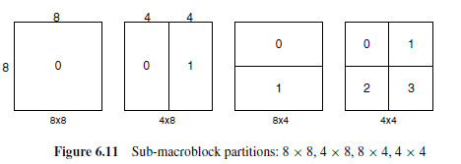
Tree structured motion compensation Inter Prediction
The luminance component of each macroblock (16×16 samples) may be split up in four ways
If the 8×8 mode is chosen, each of the four 8×8 sub-macroblocks within the macroblock may be split in a further 4 ways

Slide 47
Motion Vectors & Motion Vector Prediction Inter Prediction
Each partition or sub-macroblock partition in an inter-coded macroblock is predicted from an area of the same size in a reference picture
The offset between the two areas (the motion vector) has quarter-sample resolution for the luma component and one-eighth-sample resolution for the chroma components.
Encoding a motion vector can cost a significant number of bits, especially if small partition sizes are chosen
Motion vectors for neighbouring partitions are often highly correlated. A predicted vector, MVp, is formed based on previously calculated motion vectors

Slide 48
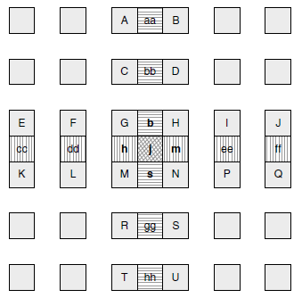
Luma Interpolation Process (half-pel samples)
Interpolated from integer-position samples using a six tap Finite Impulse Response (FIR) filter with weights (1/32,−5/32, 5/8, 5/8,−5/32, 1/32)
For example, half-pel sample b is calculated from the six horizontal integer samples E, F, G, H, I and J:
b = round((E − 5F + 20G + 20H − 5I + J) /32)
Interpolation of luma half-pel positions

Slide 49
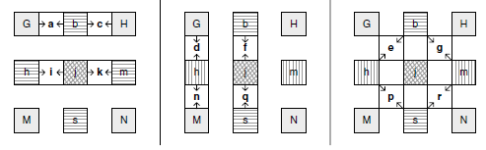
Luma Interpolation Process (quarter-pel samples)
Quarter-pel samples are produced after all the half-pel samples are available
Quarter-pel positions with two horizontally or vertically adjacent half- or integer-position samples are linearly interpolated between these adjacent samples, for example: a = round((G + b) / 2)
The remaining quarter-pel positions (e, g, p and r in the figure) are linearly interpolated between a pair of diagonally opposite half -pel samples. For example, e is interpolated between b and h.
Interpolation of luma quarter-pel positions

Slide 50
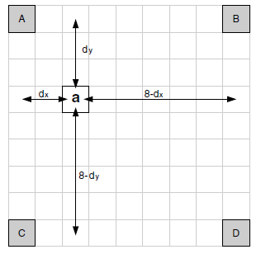
Chroma Interpolation Process (eighth-sample positions)
generated at eighth-sample intervals between integer samples in each chroma component using linear interpolation
Ex: a = round([(8 − dx ) · (8 − dy)A + dx · (8 − dy)B + (8 − dx ) · dyC + dx · dyD]/64)
Interpolation of chroma eighth-sample positions

Slide 51
Deblocking Filter
A filter is applied to each decoded macroblock to reduce blocking distortion
Applied after the inverse transform in the encoder and before reconstructing and displaying the macroblock in the decoder
The filter smooths block edges, improving the appearance of decoded frames

Slide 52
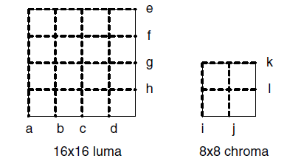
Deblocking Filter
Filtering is applied to vertical or horizontal edges of 4×4 blocks in a macroblock in the following order:
1. Filter 4 vertical boundaries of the luma component (in order a, b, c, d in Figure 6.29).
2. Filter 4 horizontal boundaries of the luma component (in order e, f, g, h, Figure 6.29).
3. Filter 2 vertical boundaries of each chroma component (i, j).
4. Filter 2 horizontal boundaries of each chroma component (k, l).

Slide 53
The End Thanks for listening

Slide 54
Confirm the action items
AI#1: fix slide 5 picture about pixels.
=> Correct information: slide 6
AI#2: slide 8 add, fix the example about field
=> Correct information: slide 9
AI#3: add investigation about prediction process (6.4.5 - 6.4.6)
=> Correct information: slide 41, 45
AI#4: add deblocking filter information (6.4.7)
=> Correct information: slide 51

