Slide 1
R visualization
Ho Thi Kim Cuong

Slide 2
Content
Import data
Reshape2 packages
do.call () and reduce
Basic plot and ggplot2
Compare: histogram - boxplot / barplot - histogram

Slide 3
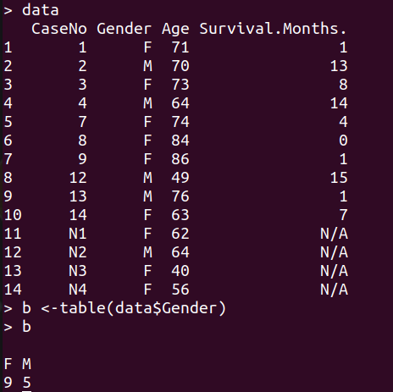
import data
read.csv(), read.table(), read.excel(), fread() (package data.table), load()
or choose.files(); load(files= )
data <- read.csv(
"/home/acer/Documents/DATA/DATA_VISUALIZATION/data/clinical.csv",
header=TRUE)

Slide 4
install.packages(“data.table”) library(data.table)
fread() function
It's simply works
Extremely fast
Improved read.table()
Example
data <- fread('/home/acer/Downloads/dowload/data.tsv', header=T)
https://www.youtube.com/watch?v=opai4Wmp6Zo

Slide 5
Reshape2
install.packages("reshape2")
library(reshape2)

Slide 6
FirstName <- c("Mary", "Mike", "Greg")
age <- c(44, 52, 46)
IQ <- c(160, 95, 110)
people <- data.frame(FirstName, age, IQ)
people
> library(reshape2)
> melted_people <- melt(people, id = "FirstName")
> melted_people
FirstName variable value
1 Mary age 44
2 Mike age 52
3 Greg age 46
4 Mary IQ 160
5 Mike IQ 95
6 Greg IQ 110
FirstName age IQ
1 Mary 44 160
2 Mike 52 95
3 Greg 46 110
> dim(people)
[1] 3 3
> dim(melted_people)
[1] 6 3

Slide 7
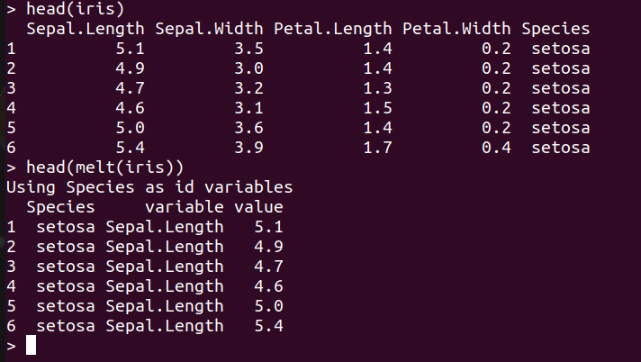
Syntax:
melt(data, na.rm = FALSE, value.name = “value”)
Parameters:
data: represents dataset that has to be reshaped
na.rm: if TRUE, removes NA values from dataset
value.name: represents name of variable used to store values
melt.data.frame for data.frames
melt.array for arrays, matrices and tables
melt.list for lists

Slide 8
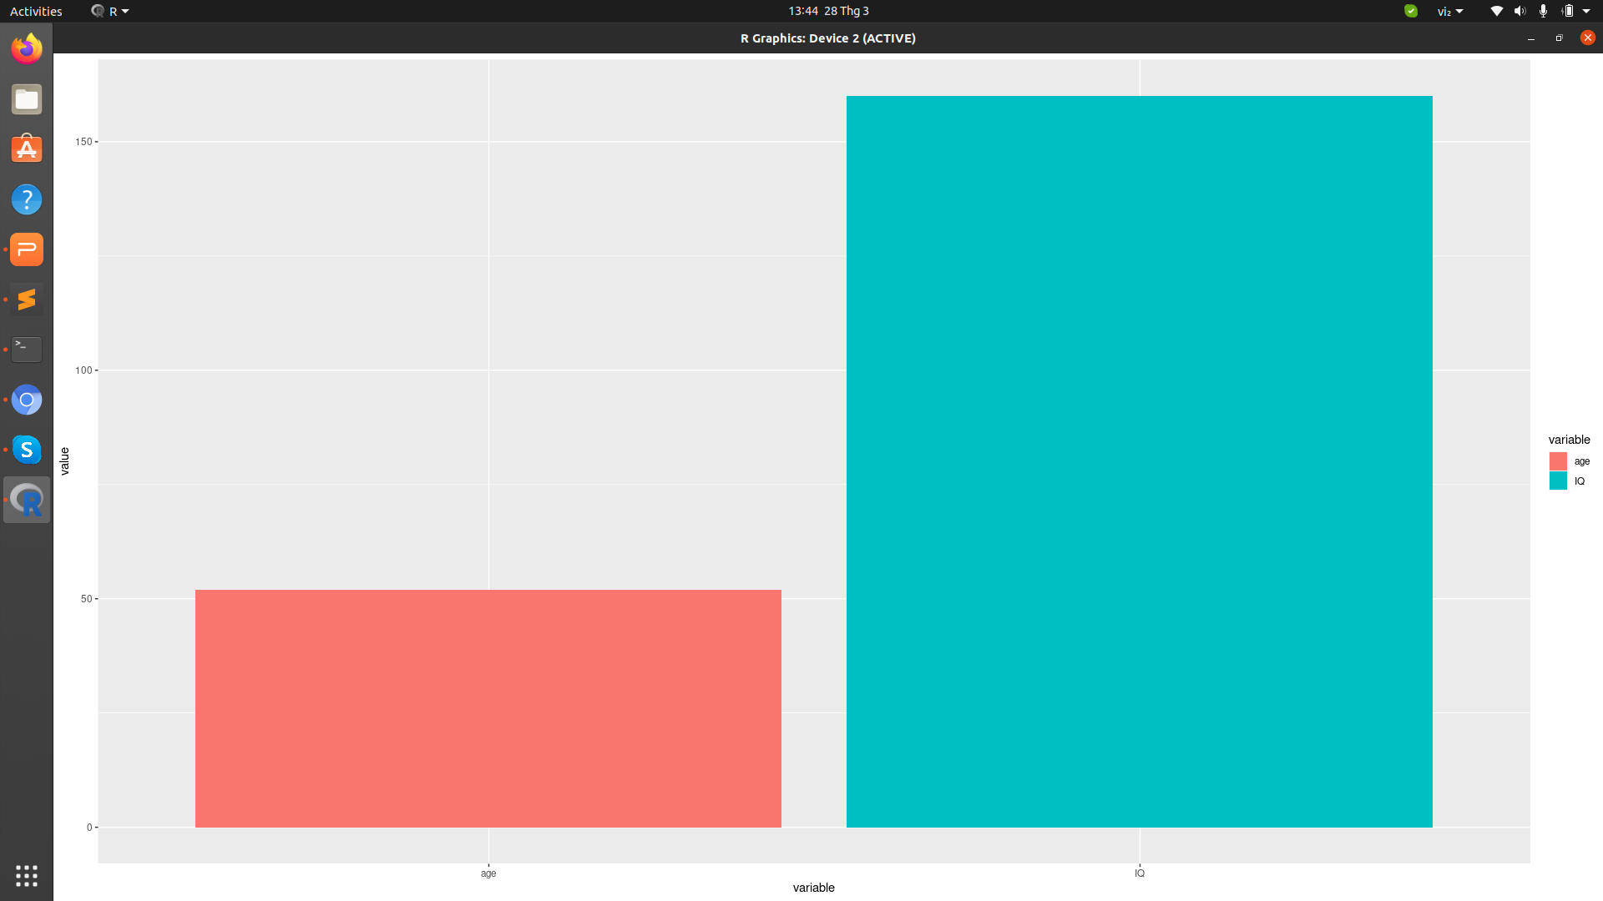
ggplot(data = melted_people , aes(x = variable, y = value, fill = variable)) + geom_col(position = 'dodge')
FirstName variable value
1 Mary age 44
2 Mike age 52
3 Greg age 46
4 Mary IQ 160
5 Mike IQ 95
6 Greg IQ 110

Slide 9

do.call ()
do.call ("any_function", arguments_list)
The do.call R function executes a function by its name and a list of corresponding arguments
This function allows you to call any R function, but instead of writing out the arguments one by one, you can use a list to hold the arguments of the function.
x1 <- 1:10
do.call(“sum”, list(x1))

Slide 10
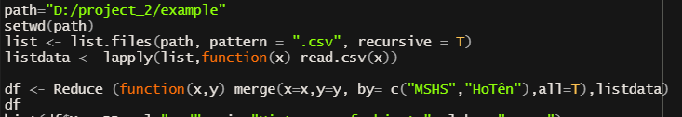
Reduce ()
path="/home/acer/Documents/DATA/project_2/example"
setwd(path)
# 5 files in list
list <- list.files(path, pattern = ".csv", recursive = T)
listdata <- lapply(list,function(x) read.csv(x))
#Reduce and apply function merge for 2 files for each
df <- Reduce (function(x,y) merge(x=x,y=y, by= c("MSHS","HoTên"),all=T),listdata)
df

Slide 11
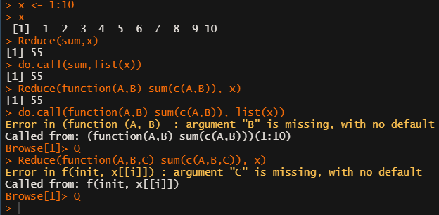
Reduce vs do.call
x <- 1:10
Reduce(sum,x)
do.call(sum,list(x))
Reduce(function(A,B) sum(c(A,B)), x)
do.call(function(A,B) sum(c(A,B)), list(x))
Reduce(function(A,B,C) sum(c(A,B,C)), x)
vd: list file input R
Do.call | Reduce
apply function for all elements in list | Take 2 elements to apply function for each (only 2 element)

Slide 12
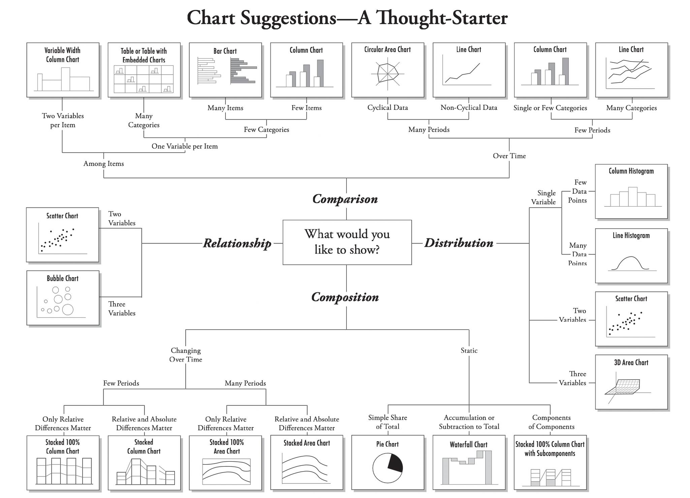
There are four basic presentation types that you can use to present your data:
Data Visualization Best Practices
Comparison
Composition
Distribution
Relationship

Slide 13
Basic plot and ggplot2
Univariate Graphs
Bivariate Graphs

Slide 14
Univariate Graphs
Univariate graphs plot the distribution of data from a single variable.
The variable can be:
Categorical (e.g., race, sex): bar chart, pie chart
Quantitative (e.g., age, weight): histogram, density, dot chart

Slide 15
Bivariate Graphs
Bivariate graphs display the relationship between two variables
Categorical vs. Categorical: Stacked bar chart, Grouped bar chart, Segmented bar chart
Quantitative vs. Quantitative: Scatterplot, Line plot
Categorical vs. Quantitative: barplot, boxplot, violin plot

Slide 16
Univariate Graphs
Bivariate Graphs
Univariate graphs plot the distribution of data from a single variable.
The variable can be:
Categorical (e.g., race, sex): bar chart, pie chart
Quantitative (e.g., age, weight): histogram, density, dot chart
Bivariate graphs display the relationship between two variables
Categorical vs. Categorical: Stacked bar chart, Grouped bar chart, Segmented bar chart
Quantitative vs. Quantitative: Scatterplot, Line plot
Categorical vs. Quantitative: barplot, boxplot, violin plot

Slide 17
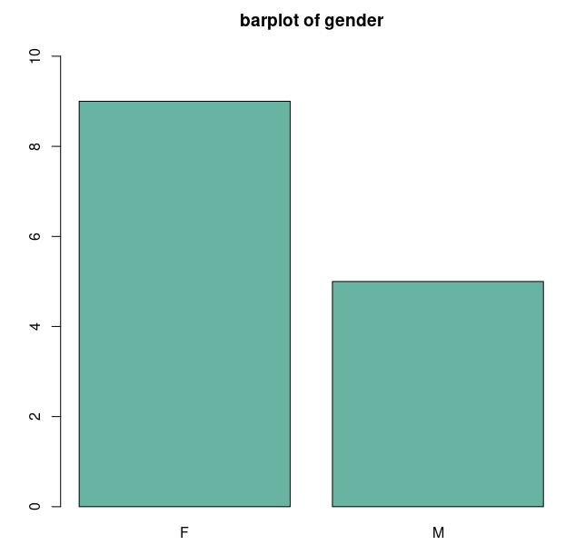
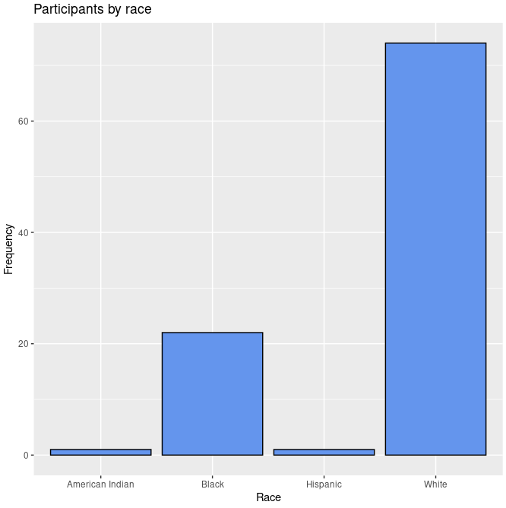
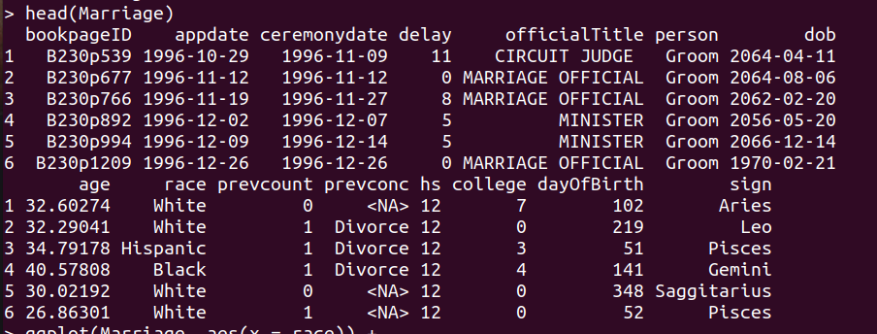
Univariate Graphs - Categorical
data <-read.csv("/home/acer/Documents/DATA/DATA_VISUALIZATION/data/clinical.csv",header=TRUE)
b <- table(data$Gender)
barplot(b,ylim=c(0,10),col="#69b3a2", main="barplot of gender")
library(mosaicData)
library(ggplot2)
head(Marriage)
ggplot(Marriage, aes(x = race)) +
geom_bar(fill = "cornflowerblue",
color="black") +
labs(x = "Race",
y = "Frequency",
title = "Participants by race")

Slide 18
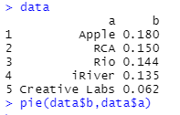
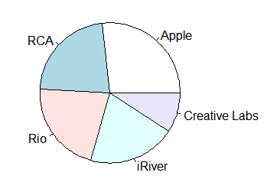
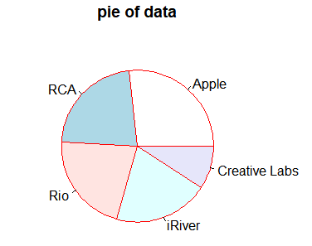
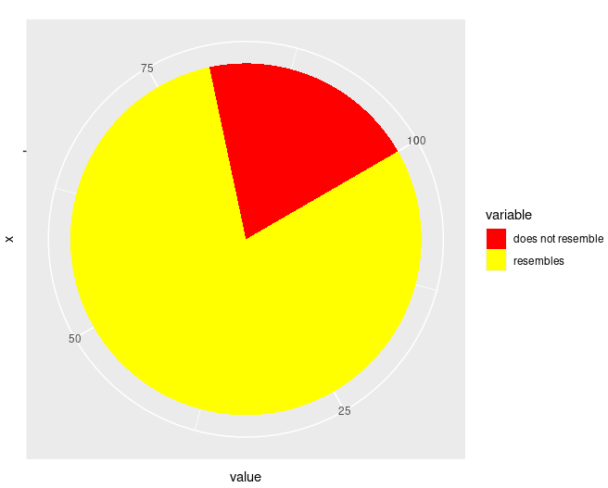
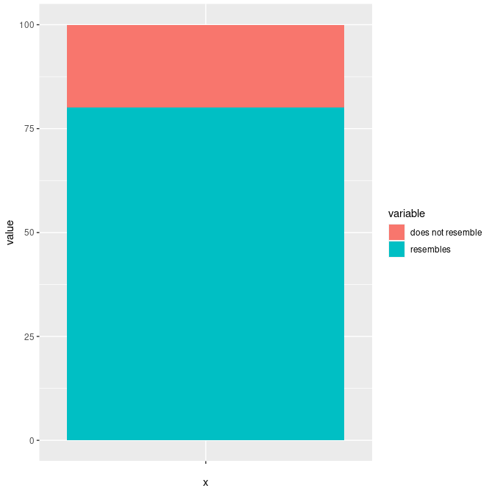
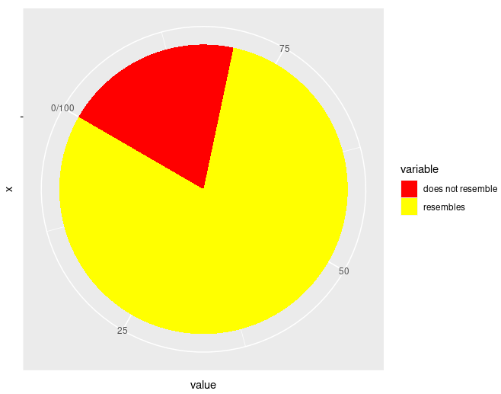
Univariate Graphs - Categorical
a <- c("Apple","RCA","Rio","iRiver","Creative Labs")
b <- c(0.18,0.15,0.144,0.135,0.062)
data <- data.frame(a,b)
data
pie(data$b, data$a)
pie(data$b, data$a, border ="red", main = "Pie of data")
A pie chart = stacked bar chart + polar coordinates
df <- data.frame(
variable = c("does not resemble", "resembles"),
value = c(20, 80))
ggplot(df, aes(x = "", y = value, fill = variable)) +
geom_col(width = 1) +
scale_fill_manual(values = c("red", "yellow")) +
coord_polar("y", start = pi / 3, direction=-1)
Notes:
Hệ tọa độ cực được sử dụng phổ biến nhất cho biểu đồ hình tròn, là một biểu đồ thanh xếp chồng lên nhau trong hệ tọa độ cực
direction=1 chieu kim dong ho (k se vao se hieu mac dinh)
muon chinh nguoc laij thi them direction= -1
direction: 1, clockwise; -1, anticlockwise

Slide 19
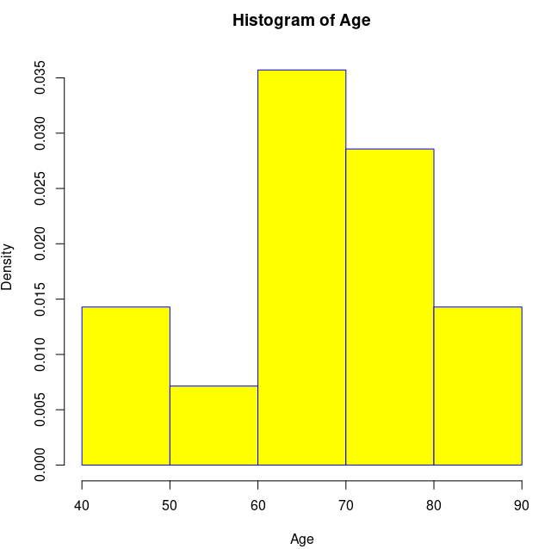
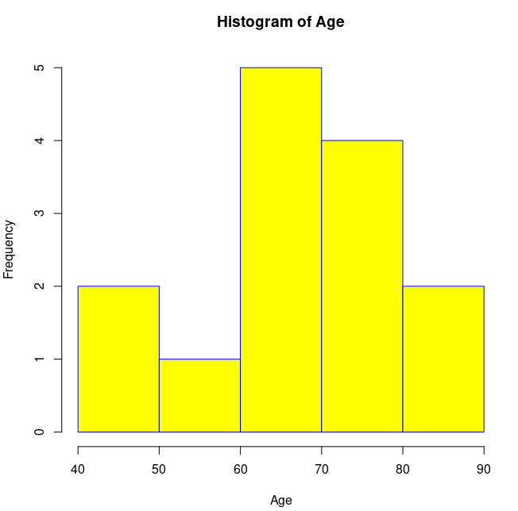
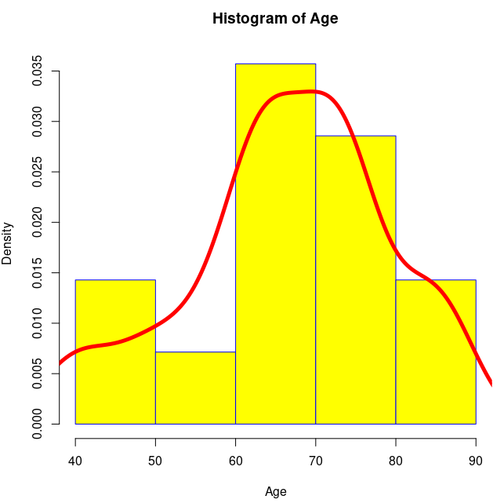
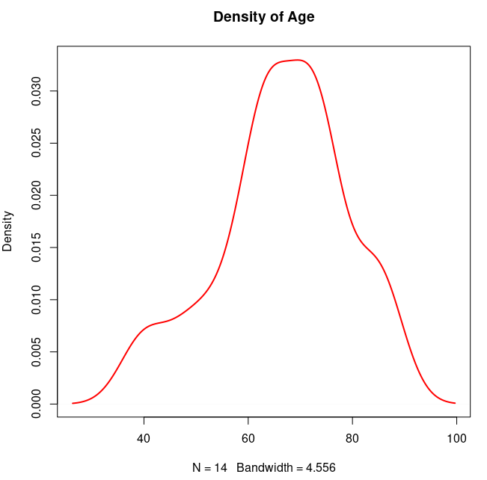
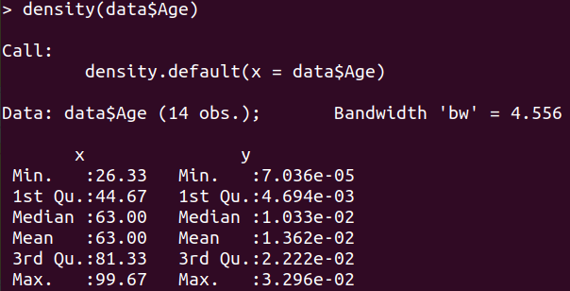
Univariate Graphs - Quantitative
Histogram basic
hist (var, xlab, ylab, main, xlim, ylim, col, border, prob)
lines (density(var), col, lwd)
hist(data$Age, col = "yellow", main= "Histogram of Age", xlab = "Age", border = "blue", probability = T)
lines(density(data$Age),col="red",lwd=5)
dx <- density(data$Age)
plot(dx, lwd=2, col = "red", main = "Density of Age")

Slide 20
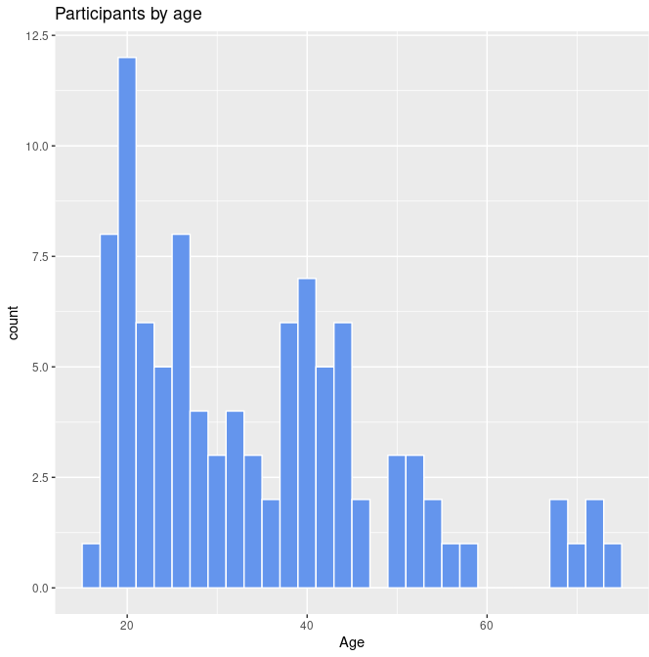
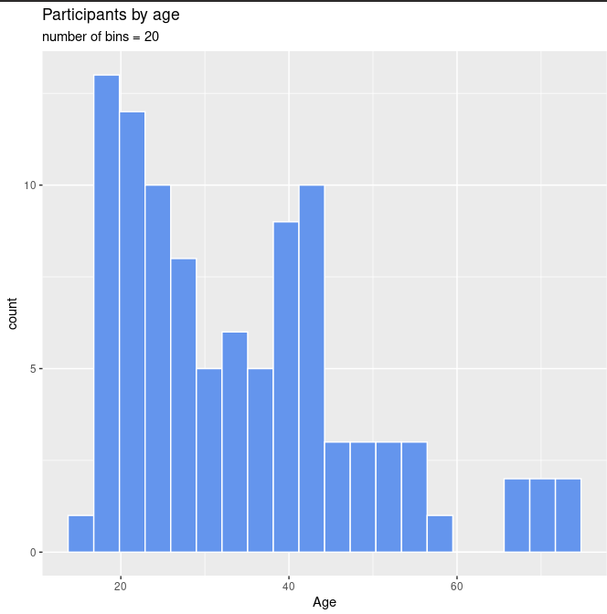
Histogram with specified fill and border colors
Univariate Graphs - Quantitative
Univariate Graphs - Categorical
ggplot(Marriage, aes(x = age)) +
geom_histogram(fill = "cornflowerblue",
color = "white") +
labs(title="Participants by age",
x = "Age")
Histogram with a specified number of bins
ggplot(Marriage, aes(x = age)) +
geom_histogram(fill = "cornflowerblue",
color = "white",
bins = 20) +
labs(title="Participants by age",
subtitle = "number of bins = 20",
x = "Age")

Slide 21
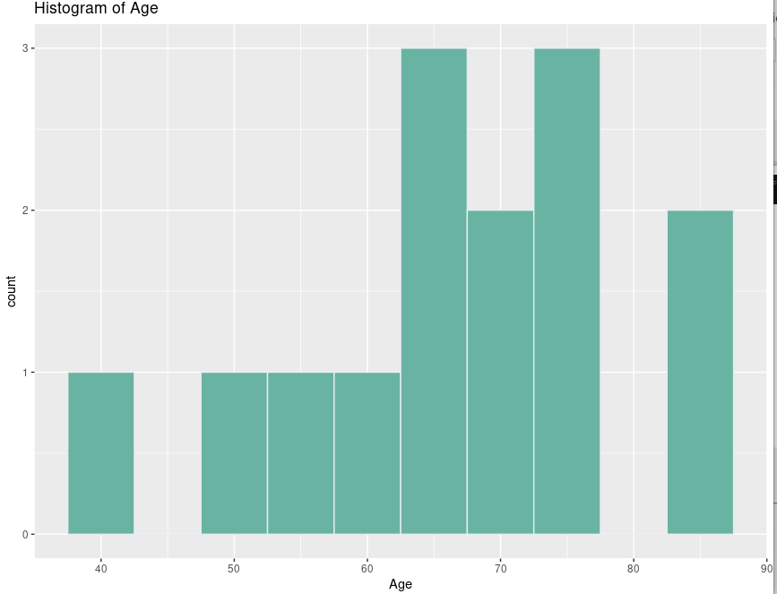
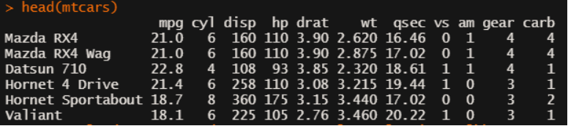
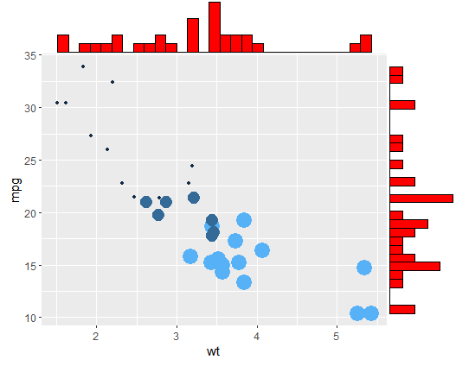
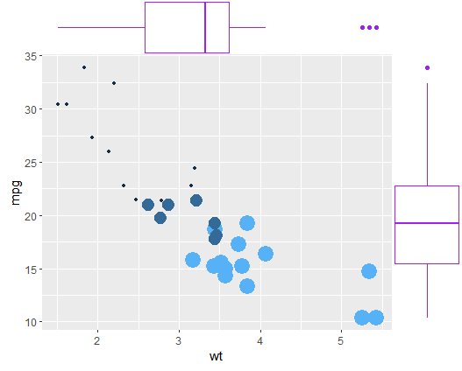
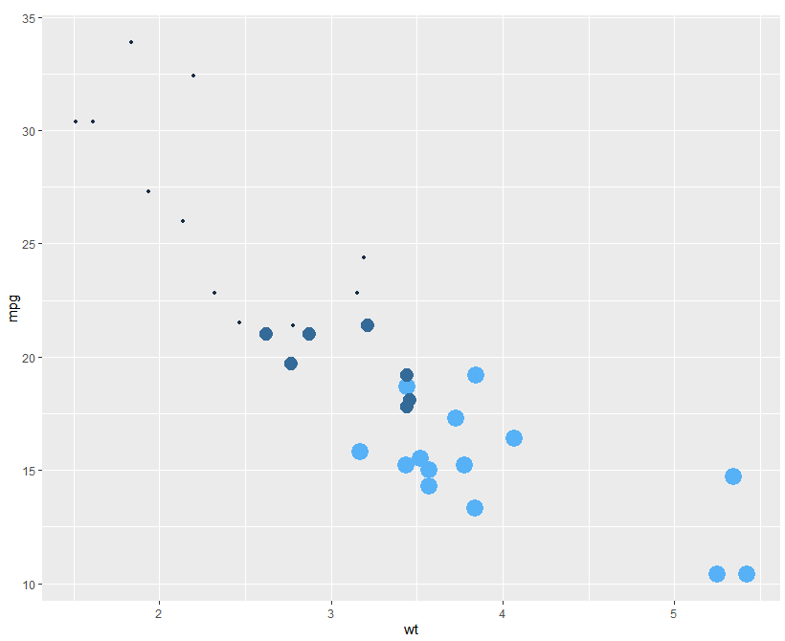
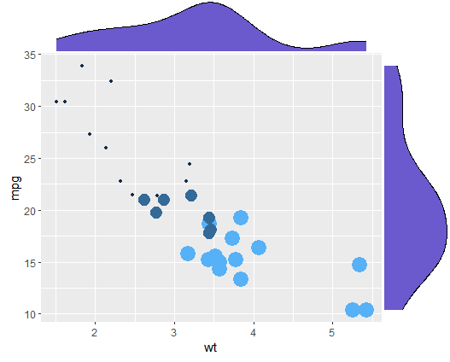
Univariate Graphs - Quantitative
Histogram
ggplot(data,aes(x=Age))+ geom_histogram(binwidth=5, fill="#69b3a2", color="#e9ecef") + ggtitle("Histogram of Age")
# Histogram + scatterplot
library(ggExtra)
p <- ggplot(mtcars, aes(x=wt, y=mpg, color= cyl, size = cyl)) + geom_point() + theme(legend.position = "none")
p1 <- ggMarginal(p, type="histogram", fill="red")
p2 <- ggMarginal(p, type="density", fill="slateblue")
p3 <- ggMarginal(p, type="boxplot", fill="purple")

Slide 22
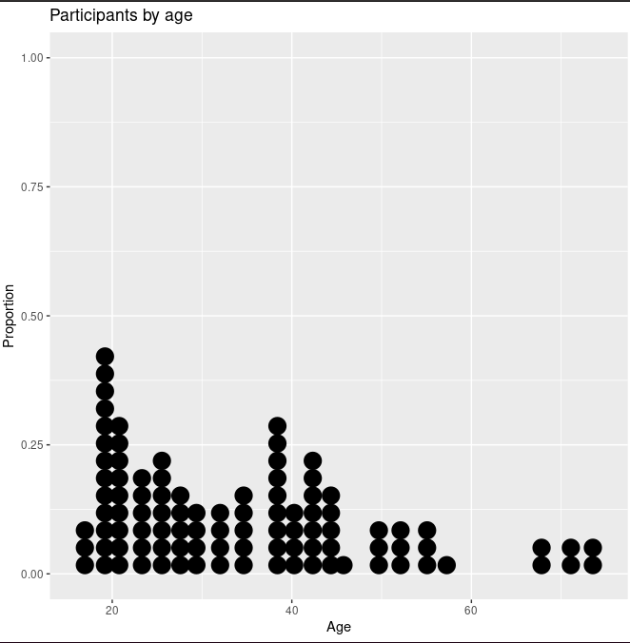
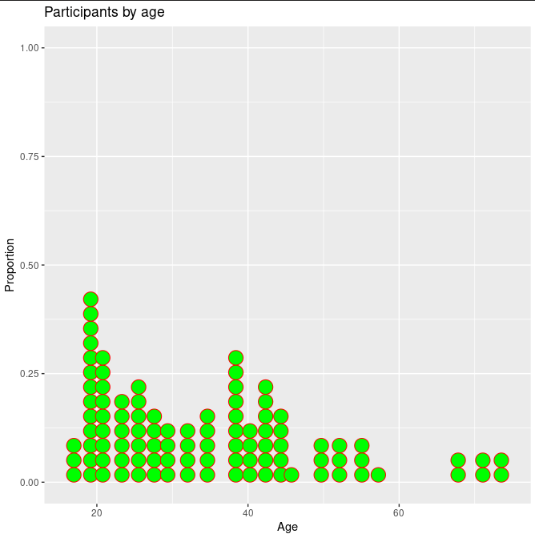
Dotplot
Univariate Graphs - Quantitative
Each observation is represented by a dot
By default, the width of a dot corresponds to the bin width, and dots are stacked, with each dot representing one observation.
Best when the number of observations is small
ggplot(Marriage, aes(x = age)) + geom_dotplot() + labs(title = "Participants by age", y = "Proportion", x = "Age")
#Dotplot with a specified color scheme
ggplot(Marriage, aes(x = age)) + geom_dotplot(fill="green",color="red") + labs(title = "Participants by age", y = "Proportion", x = "Age")

Slide 23
Bivariate Graphs
Bivariate graphs display the relationship between two variables
Categorical vs. Categorical: Stacked bar chart, Grouped bar chart, Segmented bar chart
Quantitative vs. Quantitative: Scatterplot, Line plot
Categorical vs. Quantitative: barplot, boxplot, violin plot

Slide 24
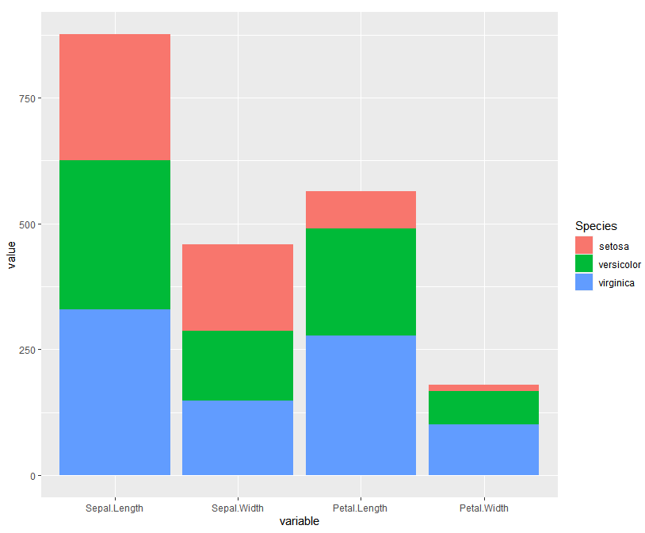
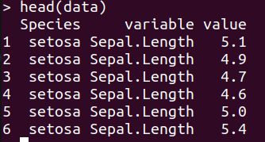
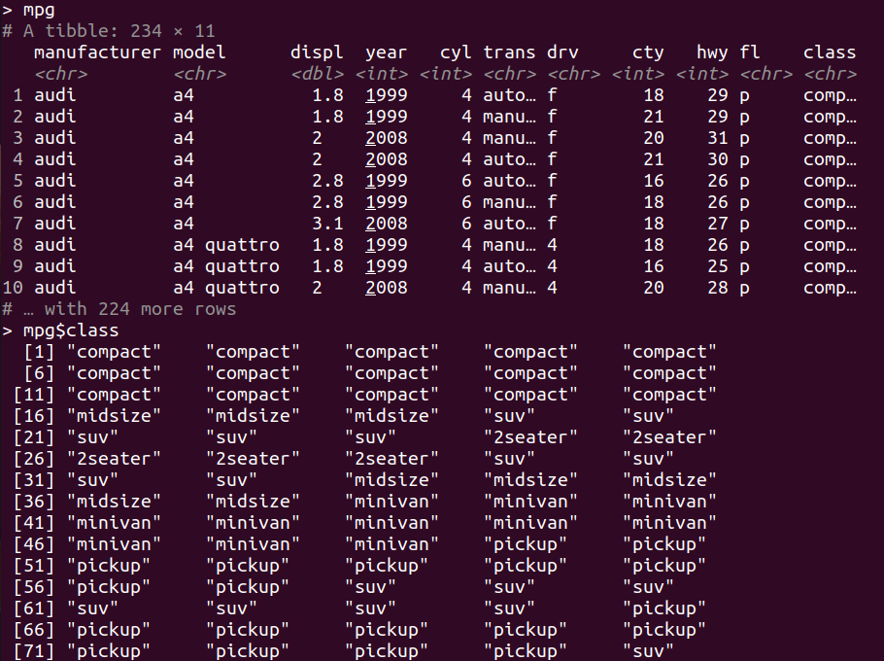
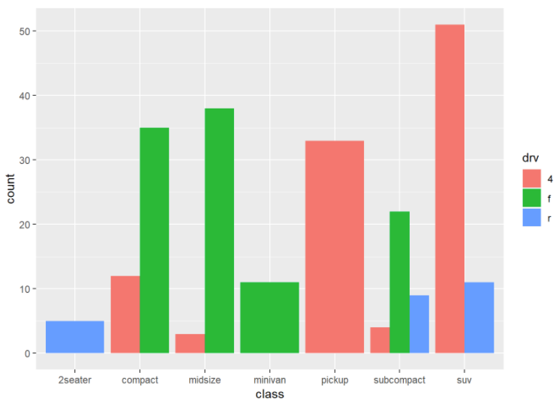
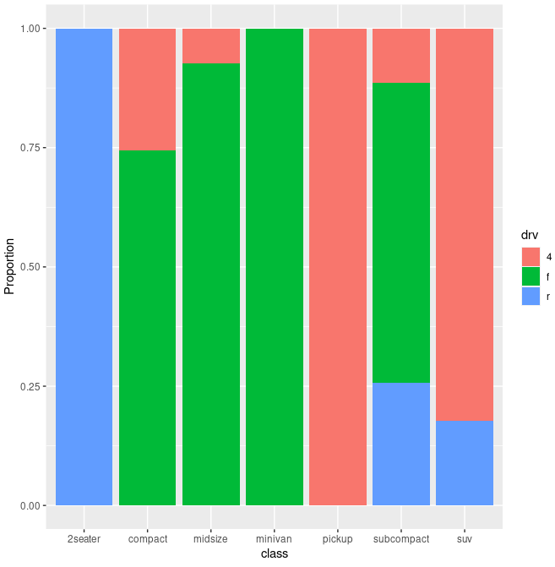
Segmented bar chart
Bivariate Graphs - Categorical vs. Categorical
data <- melt(iris)
head(data)
ggplot(data,aes(x=variable,y=value,fill=Species))+
geom_bar(stat="identity")
ggplot(mpg,
aes(x = class,
fill = drv)) +
geom_bar(position = "dodge")
Grouped bar chart
ggplot(mpg, aes(x = class, fill = drv)) +
geom_bar(position = "fill") +
labs(y = "Proportion")

Slide 25
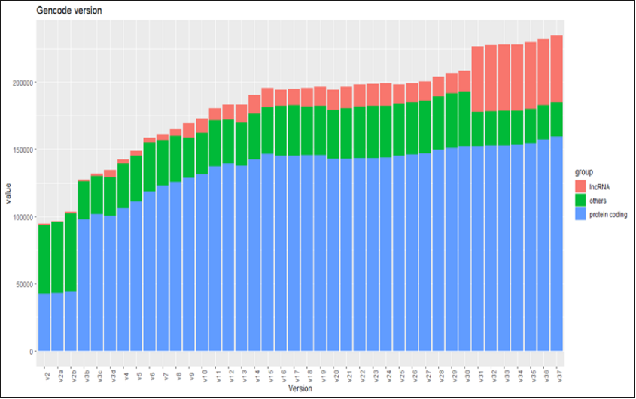
Stacked bar chart
Bivariate Graphs - Categorical vs. Categorical
#R
path="D:/gencode2"
setwd(path)
list.files(path)
list=list.files(path,pattern=".gz.txt",recursive=T)
listdata=lapply(list,function(x) read.table(x,sep="\t",header=T,col.names=c(x,"count")))
head(listdata)
#merge
df <- Reduce(function(x,y) merge(x=x, y=y, by="count",all=T), listdata)
#rename
names(df) <- gsub("gencode.", "" ,names(df))
names(df) <- gsub(".annotation.gtf.*", "" ,names(df))
library(ggplot2)
library(reshape2)
#
data<- melt(df)
library(tidyverse)
data= data %>% mutate(group=ifelse(count=="lncRNA"|count=="lincRNA" | count=="miRNA","lncRNA",ifelse(count=="protein_coding","protein coding","others")))
data$variable <- factor(data$variable, levels=c("v2","v2a","v2b","v3b","v3c","v3d","v4","v5","v6","v7","v8","v9","v10","v11","v12","v13","v14","v15","v16","v17","v18","v19","v20","v21","v22","v23","v24","v25","v26","v27","v28","v29","v30","v31","v32","v33","v34","v35","v36","v37","v38"))
ggplot(data,aes(x=variable,y=value,fill=group))+ geom_bar(position="stack",stat="identity") + xlab("Version")+ ylab("value")+ ggtitle("Gencode version") +theme(axis.text.x = element_text(angle = 90))
#Download
for i in `seq 1 38`
do
wget http://ftp.ebi.ac.uk/pub/databases/gencode/Gencode_human/release_${i}/gencode.v${i}.annotation.gtf.gz
echo ${i}
done
# edit
for i in `find *gtf.gz`
do
zcat $i | tr -d '";'| awk 'OFS="\t" {if ($3=="transcript") print $14}'|sort|uniq -c| awk 'OFS="\t" {print $1,$2}' > ${i}.txt
done

Slide 26
Univariate Graphs
Bivariate Graphs
Univariate graphs plot the distribution of data from a single variable.
The variable can be:
Categorical (e.g., race, sex): bar chart, pie chart
Quantitative (e.g., age, weight): histogram, density, dot chart
Bivariate graphs display the relationship between two variables
Categorical vs. Categorical: Stacked bar chart, Grouped bar chart, Segmented bar chart
Quantitative vs. Quantitative: Scatterplot, Line plot
Categorical vs. Quantitative: barplot, boxplot, violin plot

Slide 27
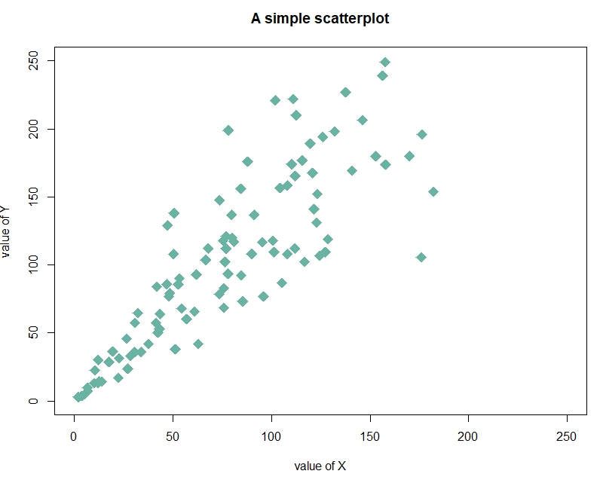
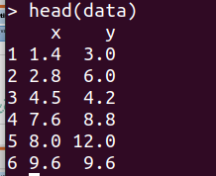
Bivariate Graphs - Quantitative vs. Quantitative
Scatter plot
plot (varX ~ varY, xlab, ylab,…)
data = data.frame(
x=seq(1:100) + 0.1*seq(1:100)*sample(c(1:10) , 100 , replace=T),
y=seq(1:100) + 0.2*seq(1:100)*sample(c(1:10) , 100 , replace=T)
)
# Basic scatterplot
plot(data$x, data$y,
xlim=c(0,250) , ylim=c(0,250),
pch=18,
cex=2,
col="#69b3a2",
xlab="value of X", ylab="value of Y",
main="A simple scatterplot"
)
Notes:
data in termimal?

Slide 28
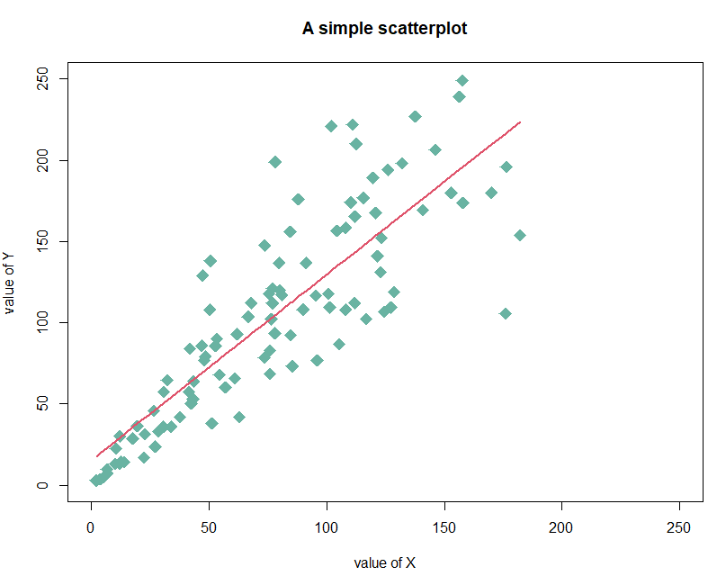
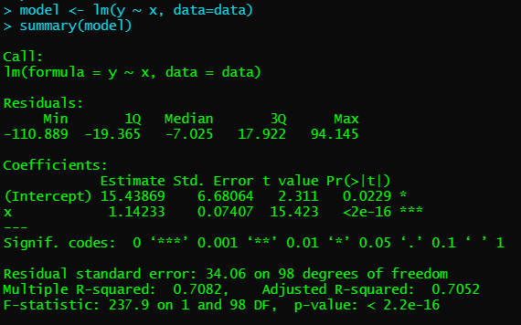
Bivariate Graphs - Quantitative vs. Quantitative
Scatter plot with trend line
plot (varX ~ varY, xlab, ylab,…)
model <- lm(y ~ x, data=data)
summary(model)
Y = 1.14x +15.4

Slide 29
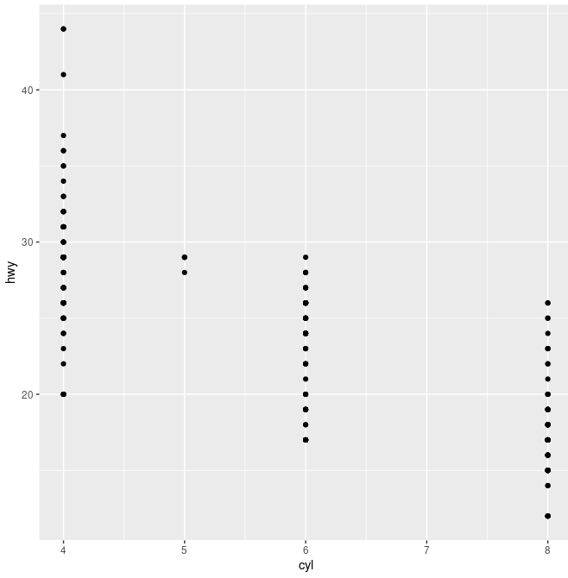
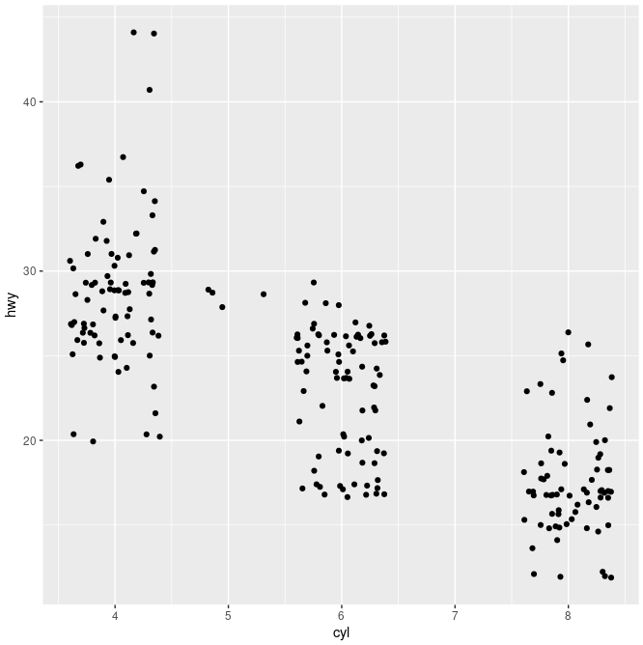
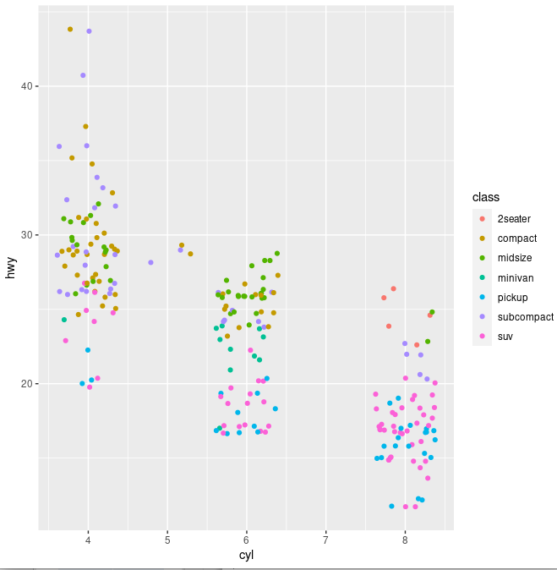
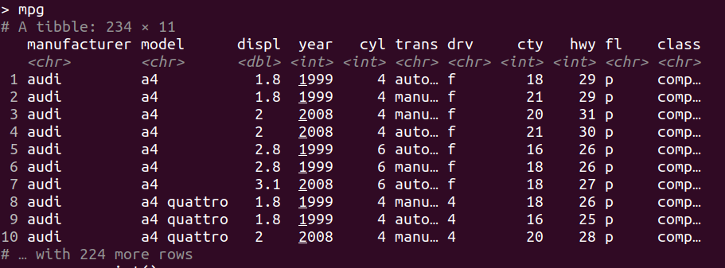
geom_point () - jitter
Typically a scatter plot is better when showing the relationship between two variables which was not important in this specific case. A jitter plot is better to show the distribution of data using a randomized x-axis to disperse the points.
data avaible: mpg in R
p <- ggplot(mpg, aes(cyl, hwy))
p + geom_point()
p + geom_jitter() [p + geom_point(position="jitter")]
p + geom_jitter(aes(colour = class))
Notes:
biểu đồ jitter theo cách này cho phép bạn tách các dấu hoặc chấm thành các cột khác nhau de nhin

Slide 30
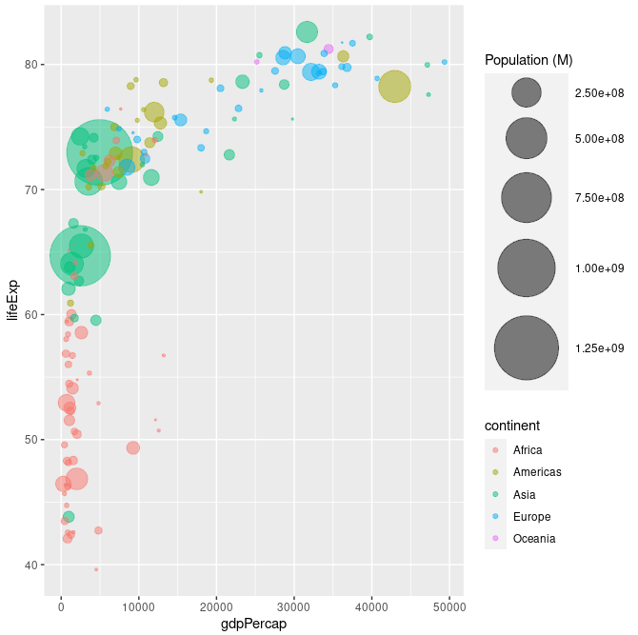
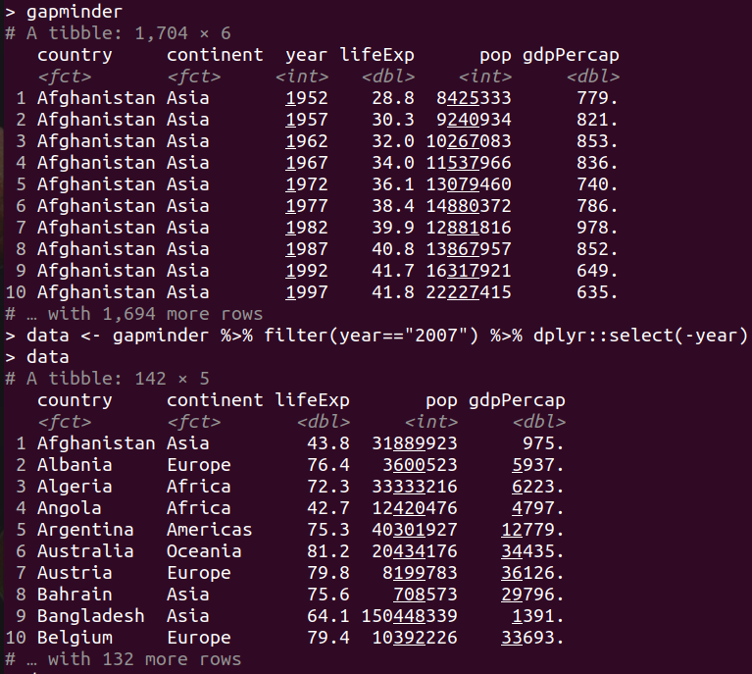
geom_point () - Bubble
library(ggplot2)
library(dplyr)
library(gapminder)
data <- gapminder %>% filter(year=="2007") %>% dplyr::select(-year)
data %>%
arrange(desc(pop)) %>%
mutate(country = factor(country, country)) %>%
ggplot(aes(x=gdpPercap, y=lifeExp, size=pop, color=continent)) +
geom_point(alpha=0.5) +
scale_size(range = c(.1, 24), name="Population (M)")
The first two dimensions for coordinates.
the thrid dimension is for color and the fourth as size.
Notes:
Biểu đồ bong bóng chủ yếu được sử dụng để hiển thị mối quan hệ giữa các biến số và nó có thể trực quan hóa (từ tọa độ, màu sắc và kích thước

Slide 31
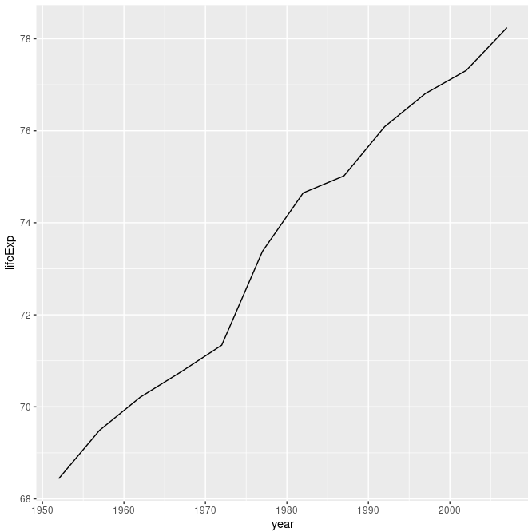
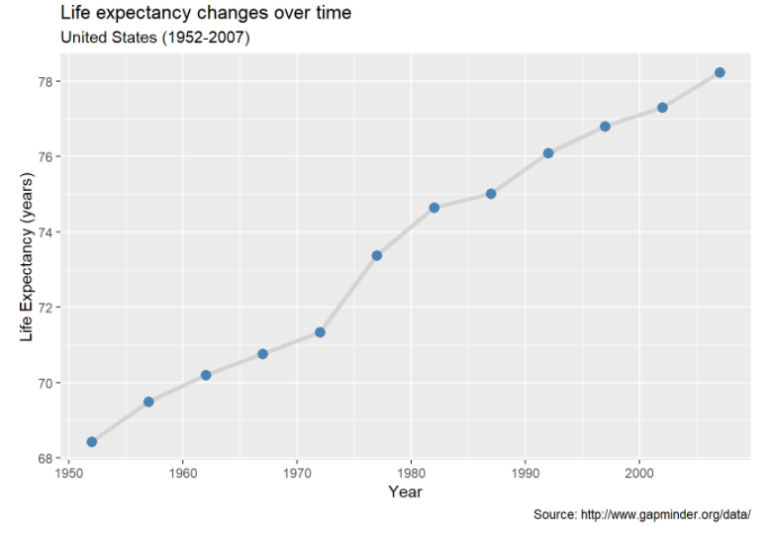
line plot
Bivariate Graphs - Quantitative vs. Quantitative
library(gapminder)
library(dplyr)
plotdata <- filter(gapminder,
country == "United States")
simple line plot
ggplot(plotdata,
aes(x = year,
y = lifeExp)) + geom_line()
line plot with points
ggplot(plotdata,
aes(x = year,
y = lifeExp)) +
geom_line(size = 1.5,
color = "lightgrey") +
geom_point(size = 3,
color = "steelblue") +
labs(y = "Life Expectancy (years)",
x = "Year",
title = "Life expectancy changes over time",
subtitle = "United States (1952-2007)",
caption = "Source: http://www.gapminder.org/data/")

Slide 32
Univariate Graphs
Bivariate Graphs
Univariate graphs plot the distribution of data from a single variable.
The variable can be:
Categorical (e.g., race, sex): bar chart, pie chart
Quantitative (e.g., age, weight): histogram, density, dot chart
Bivariate graphs display the relationship between two variables
Categorical vs. Categorical: Stacked bar chart, Grouped bar chart, Segmented bar chart
Quantitative vs. Quantitative: Scatterplot, Line plot
Categorical vs. Quantitative: barplot, boxplot, violin plot

Slide 33
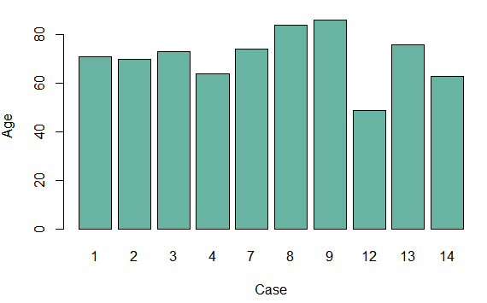
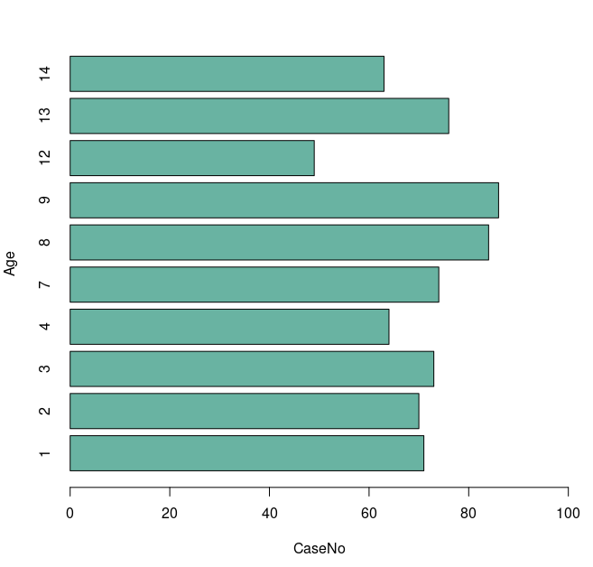


barplot
Bivariate Graphs - Categorical vs. Quantitative
data <-read.csv("/home/acer/Documents/DATA/DATA_VISUALIZATION/data/clinical.csv",header=TRUE)
b <- subset (data[1:10,])
barplot(height =b$Age, names = b$CaseNo,col="#69b3a2", xlab = "CaseNo", ylab = "Age")
barplot(height =b$Age, names = b$CaseNo,col="#69b3a2", xlab = "CaseNo", ylab = "Age",xlim=c(0,100),horiz=T)
data$class <- ifelse(data$CaseNo=="N1"|data$CaseNo=="N2"|data$CaseNo=="N3"|data$CaseNo=="N4","Control",”Tumor”)
data$CaseNo <- factor (data$CaseNo, levels=c(1,2,3,4,7,8,9,12,13,14,"N1","N2","N3","N4"))
ggplot(data,aes(y=Age,x=CaseNo,fill=class))+ geom_bar(stat="identity")

Slide 34


Bivariate Graphs - Categorical vs. Quantitative
Boxplot
Boxplot
Notes:
Tứ phân vị là đại lượng mô tả sự phân bố và sự phân tán của tập dữ liệu. Số phân tử có 3 giá trị, đó là số phân tử thứ nhất (Q1), thứ nhì (Q2) và thứ ba (Q3)

Slide 35



Bivariate Graphs - Categorical vs. Quantitative
boxplot (var, xlab, ylab, main, border, col, xlim, ylim, horizontal)
boxplot ( var ~ group, xlab, ylab,main, xlim, ylim, border, col, horizontal)
head(clinical)
boxplot(clinical$Age,col="green",xlab="Age")
boxplot(clinical$Age ~ clinical$Gender,col=c("green","red"),xlab = "Age", ylab = "Gender",horizontal = T)
Notes:
Có thể biết phân bố của 1 biến hoặc so sánh ban đầu

Slide 36




Bivariate Graphs - Categorical vs. Quantitative
Basic boxplot
ggplot(data,aes(y=Age, x=Gender,fill=Gender))+geom_boxplot()
Boxplot with individual data points
ggplot(data,aes(y=Age, x=Gender,fill=Gender))+geom_boxplot()+geom_jitter(size=1.95)
Basic Violint
ggplot(data,aes(y=Age, x=Gender,fill=Gender))+geom_violin()
Violint with jitter
ggplot(data,aes(y=Age, x=Gender,fill=Gender))+geom_violin()+geom_jitter(size=1.9)

Slide 37

HISTOGRAM AND BARPLOT
Histogram | Barplot
Show distributions of variables | Compare variables
Quantitative (numerical) data (continuous) | Categorical data
Not make sense to rearrange | The bars can be rearranged
No space between the columns | Have space between the columns

Slide 38


HISTOGRAM AND BOXPLOT
Histogram | Boxplot
probability distribution of a data | Comparing between several data sets. (distribution is symmetric or skewed)
Min, mean, max | Min, median, max and quartile
Although histograms are better in determining the underlying distribution of the data, box plots allow you to compare multiple data sets better than histograms as they are less detailed and take up less space.

