Slide 1
Math Animation and Image
Data Visulization
Phuc Loi Luu, PhD
luu.p.loi@googlemail.com
p.luu@garvan.org.au

Slide 2
Content
Math Animation with Anim
Understanding an image
Comparing classifiers and regressors

Slide 3
Installation Anim
Use directly the Anim online: https://joncomo.github.io/anim/
Download and run: https://github.com/JonComo/anim

Slide 4
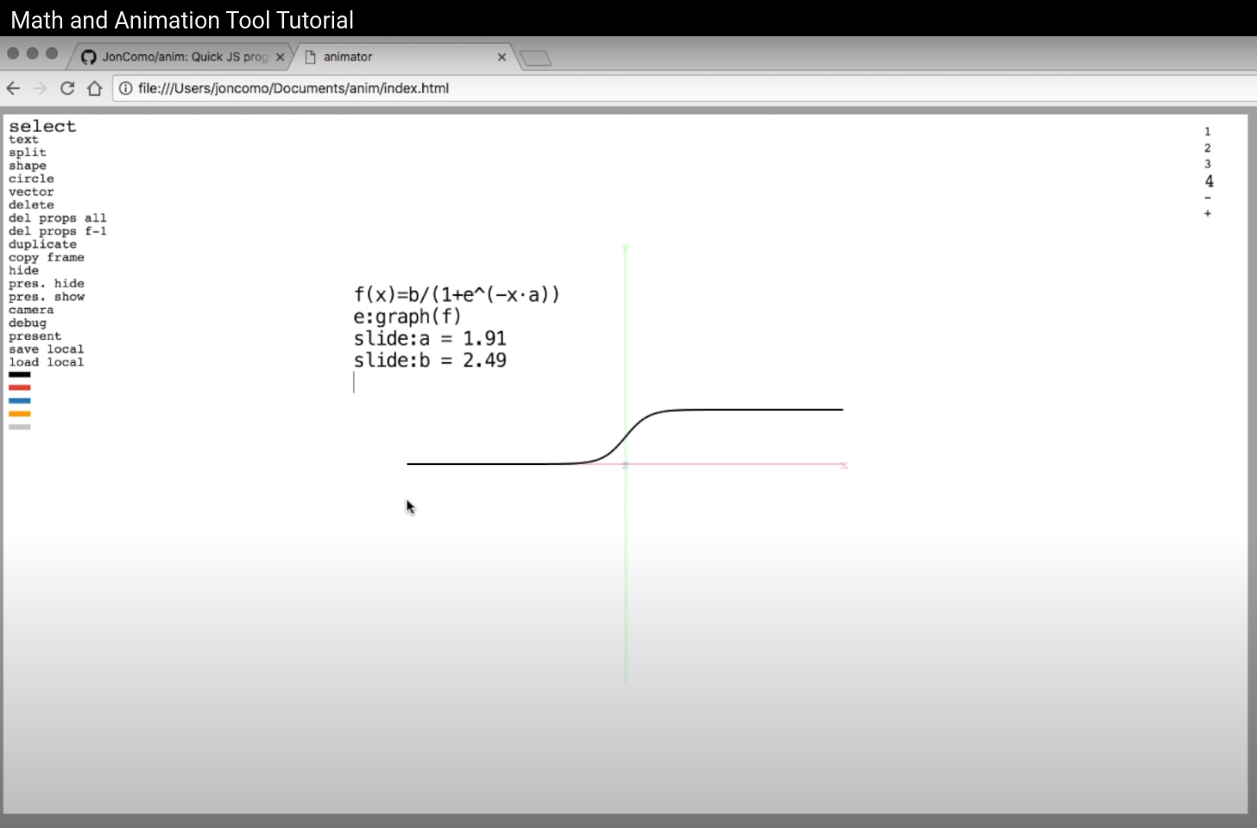
https://www.youtube.com/watch?v=PBTrvPewJ_s

Slide 5
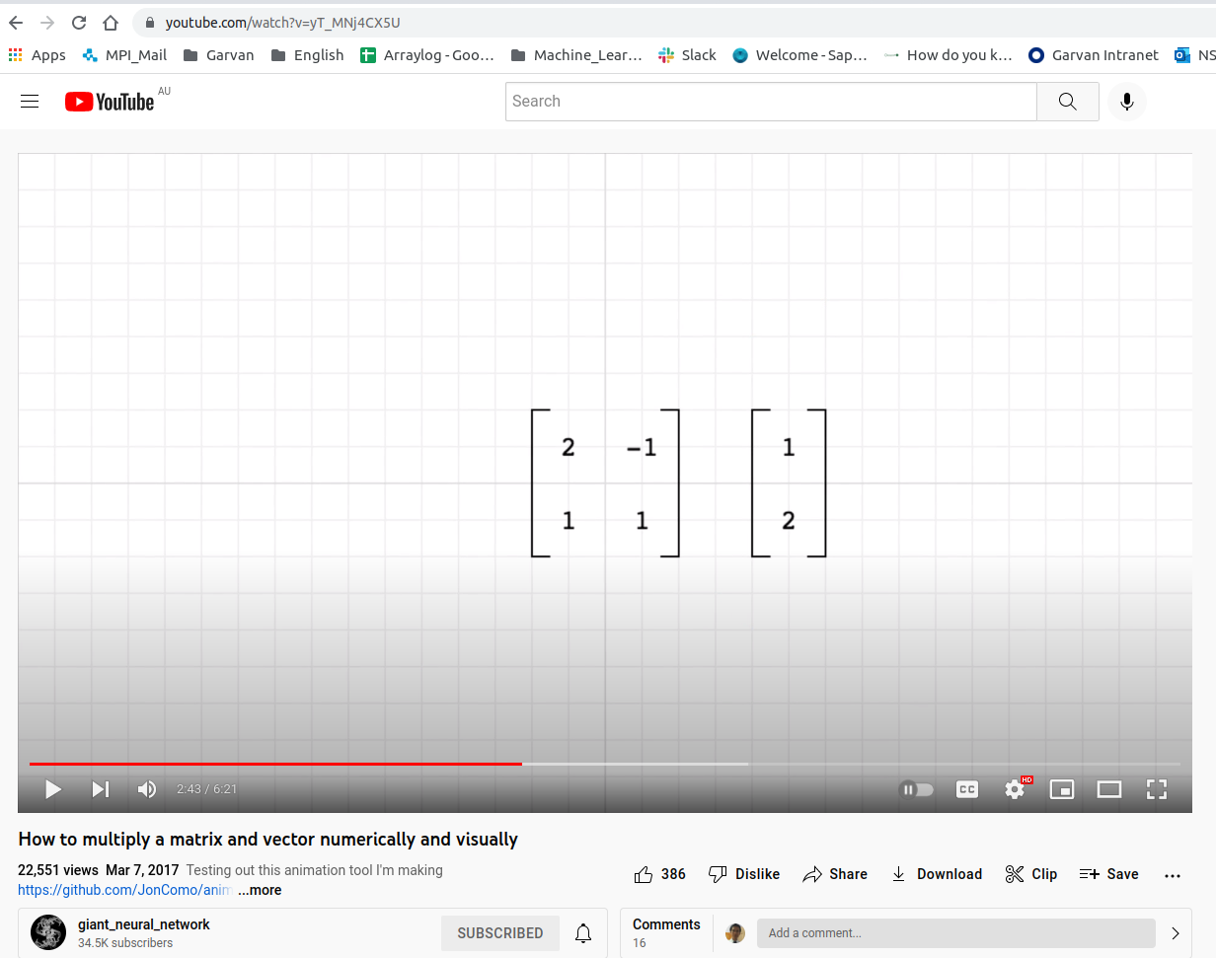
https://www.youtube.com/watch?v=yT_MNj4CX5U

Slide 6
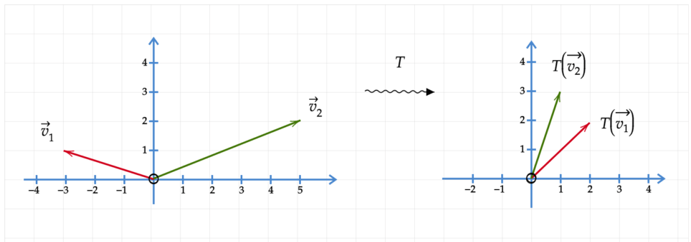
Class exercise: create a similar plot as below
https://yutsumura.com/linear-algebra/linear-transformation-from-rn-to-rm/

Slide 7
Class exercise: understanding w and b in linear function f(x) = wx+b 1. Ploting the function with w = 1 and b = 1 2. Change w from -100 to 100 with step = 1 and replot function 3. Change w from -1 to 1 with step = 0.001 and replot function 4. Change b from -100 to 100 with step = 1 and replot function 5. Change b from -1 to 1 with step = 0.001 and replot function 6. Change w and b from -1 to 1 with step = 0.001 and replot function

Slide 8
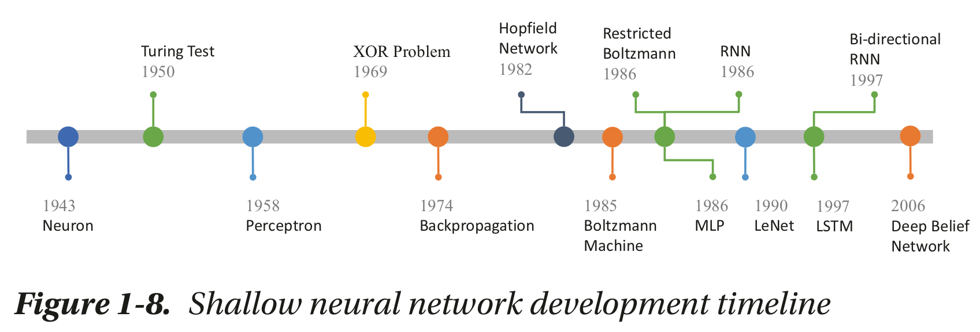
Neural Network
Beginning Deep Learning with TensorFlow Work with Keras

Slide 9
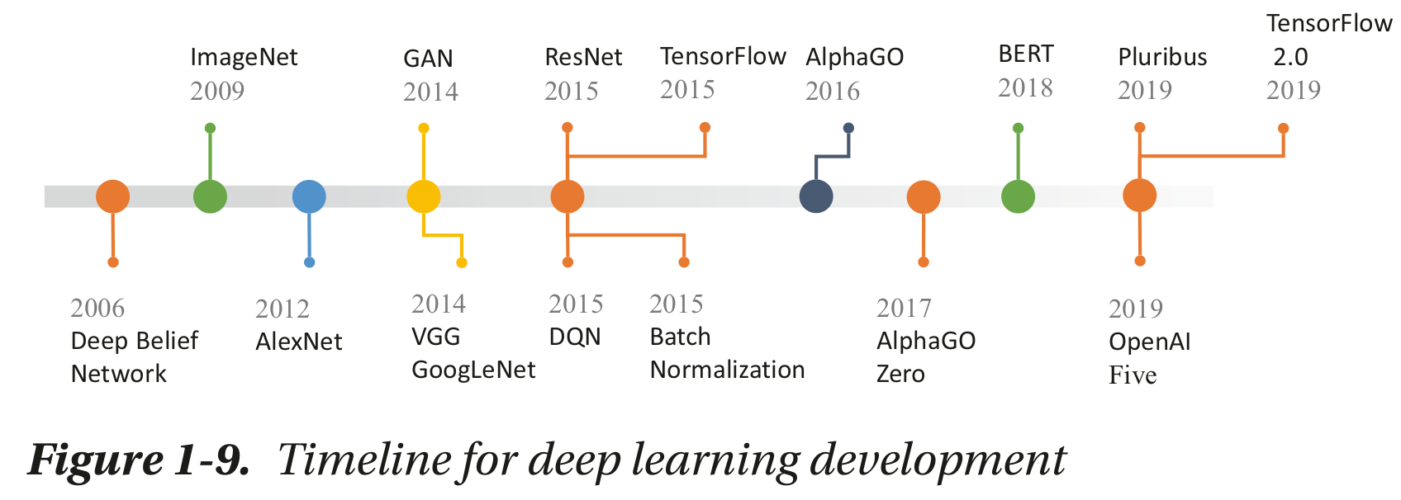
Deep Learning
Beginning Deep Learning with TensorFlow Work with Keras

Slide 10
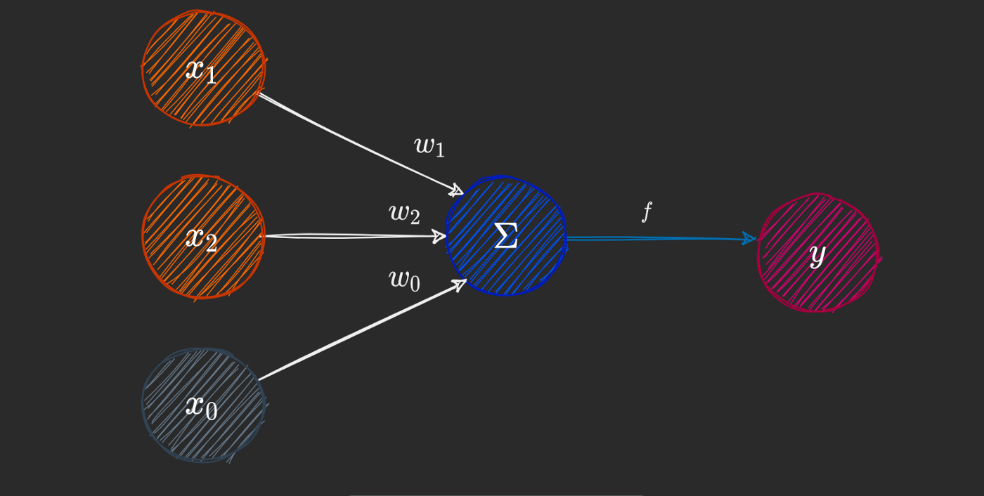
Class exercise: create a similar plot as below
https://towardsdatascience.com/how-neural-networks-solve-the-xor-problem-59763136bdd7

Slide 11
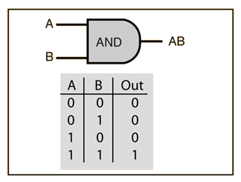
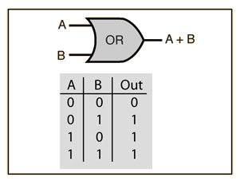
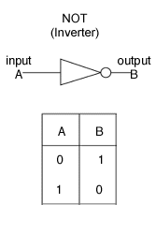
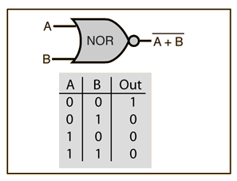
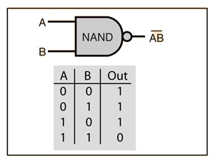
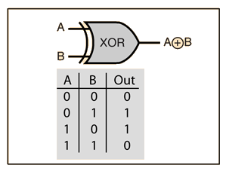
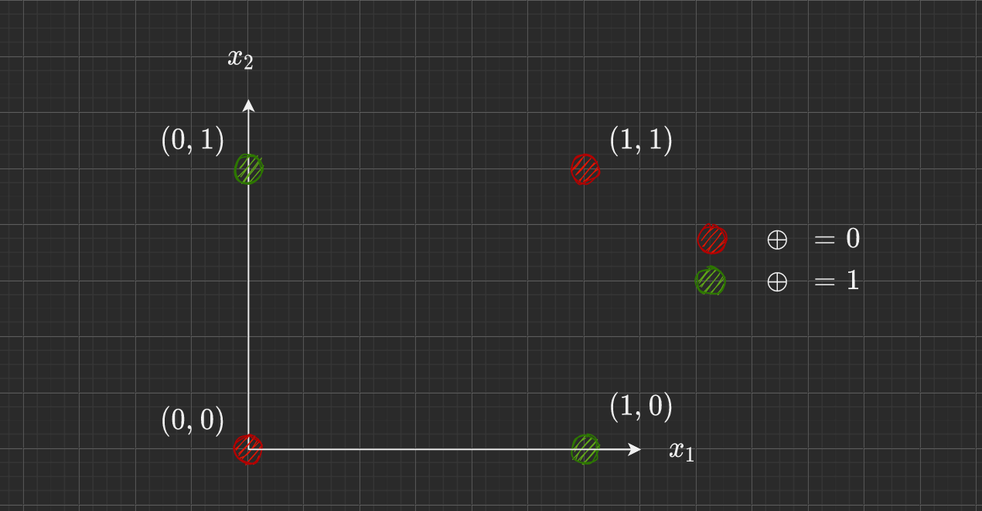
Class exercise: plot AND, OR, NOT, XOR problem
https://medium.com/@stanleydukor/neural-representation-of-and-or-not-xor-and-xnor-logic-gates-perceptron-algorithm-b0275375fea1

Slide 12
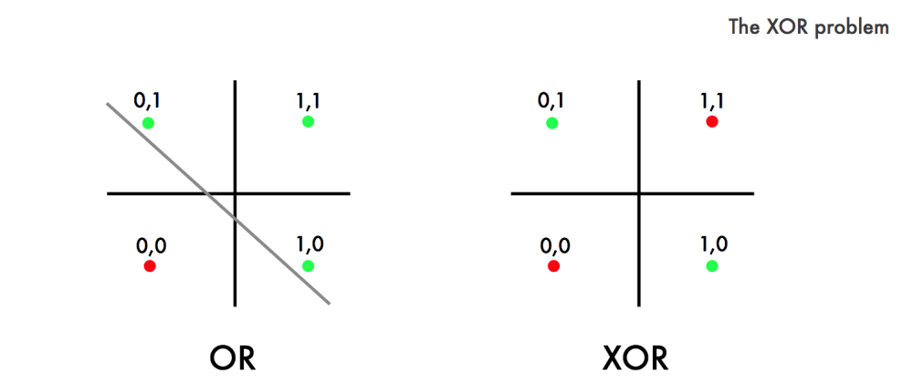
Class exercise: plot AND, OR, NOT, XOR problem
https://dev.to/jbahire/demystifying-the-xor-problem-1blk

Slide 13
Class exercise: understanding w and b in sigmoid function f(x) = 1/(1+e(-wx-b)) 1. Ploting the function with w = 1 and b = 1 2. Change w from -100 to 100 with step = 1 and replot function 3. Change w from -1 to 1 with step = 0.001 and replot function 4. Change b from -100 to 100 with step = 1 and replot function 5. Change b from -1 to 1 with step = 0.001 and replot function 6. Change w and b from -1 to 1 with step = 0.001 and replot function

Slide 14
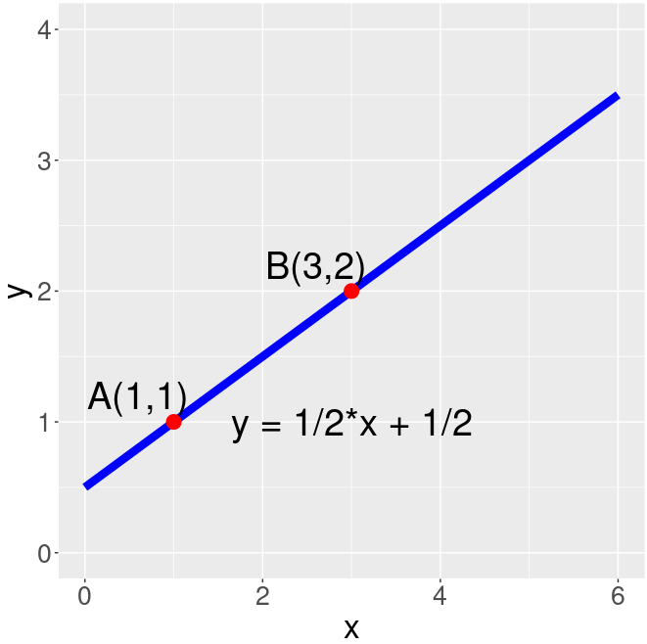
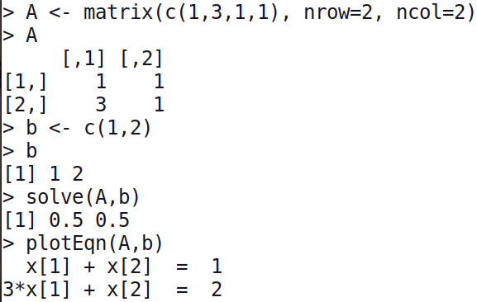
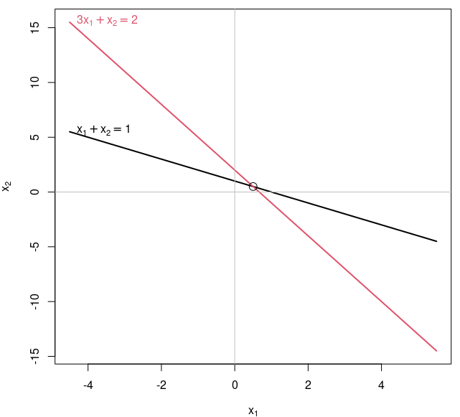
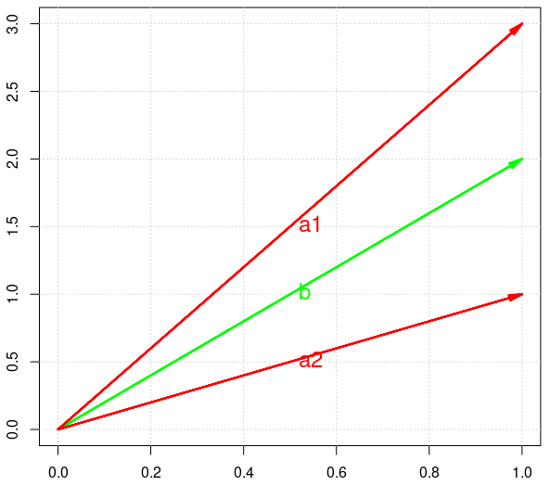
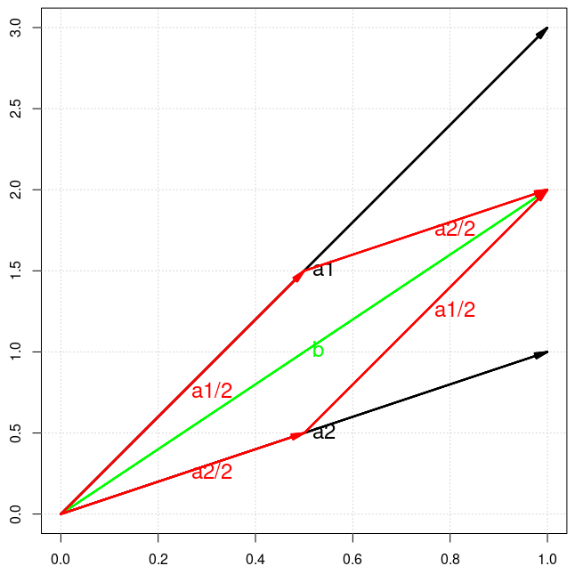

Class exercise: Fitting a line going through two points
 | x (Age) | y (Weight)
A | 1 | 1
B | 3 | 2
1 | 1
3 | 1
m
c
1
2
=
m=0.5
c=0.5
$$Ax=b$$
a1 a2 b
1
3
1
1
1
2
m + c =
m=0.5
c=0.5

Slide 15
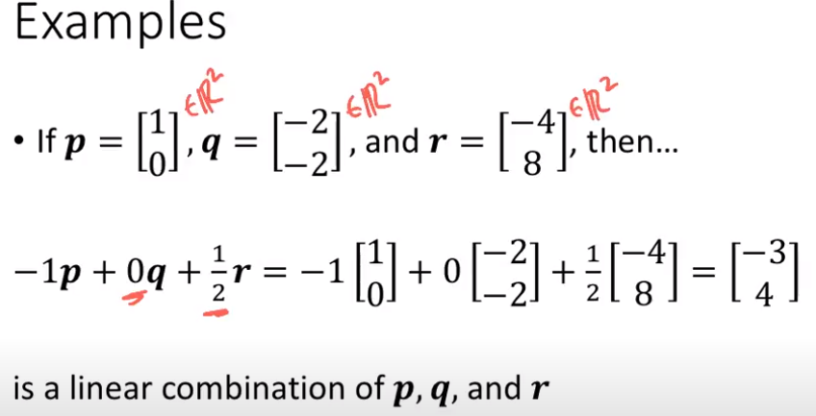
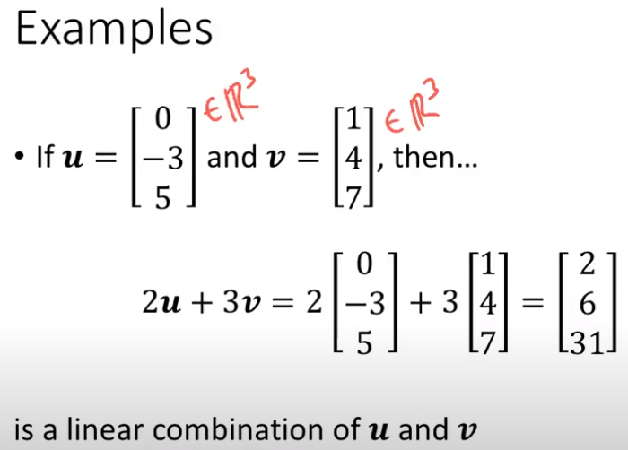
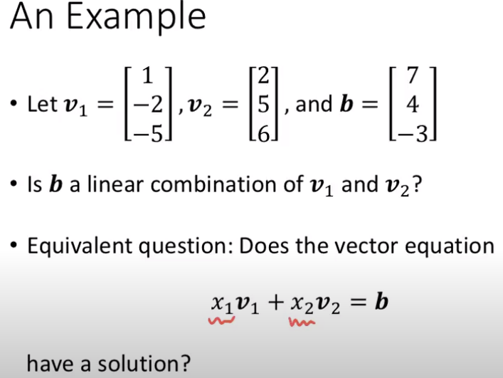
https://www.youtube.com/watch?v=rfdVVxFbklM&list=PLNr8B4XHL5kGDHOrU4IeI6QNuZHur4F86&index=8

Slide 16
Understanding an image (1)
install.packages("magick")
library(magick)
inp_img <- image_read("http://polytopes.net/Tora_color.png")
image_info(inp_img)
# format width height colorspace matte filesize density
# 1 PNG 77 133 sRGB TRUE 22377 28x28
plot(inp_img)
mod_img <- image_modulate(inp_img, brightness = 120, saturation = 20, hue = 20)
plot(mod_img)
https://towardsdatascience.com/guinea-pig-breed-classification-517fbb036ee6

Slide 17
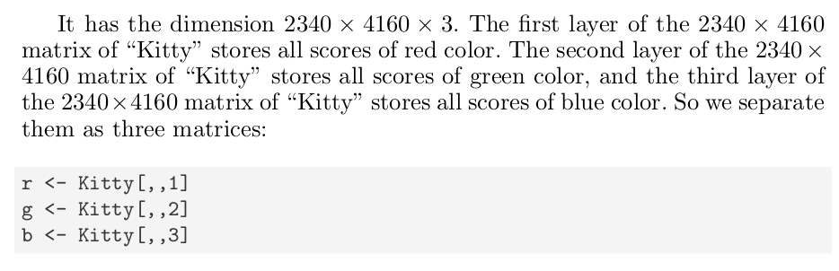
Understanding an image (2)
## library need to open a jpg file
library(jpeg)
## Download from the author’s website
myurl <- "http://polytopes.net/Tora_Sleeping.JPG"
z <- tempfile()
download.file(myurl, z, mode="wb")
Kitty <- readJPEG(z)
## dimension
d <- dim(Kitty)
d
[1] 2340 4160 3
r <- Kitty[,,1]
g <- Kitty[,,2]
b <- Kitty[,,3]

Slide 18
Compressing an image
# calculate the princile components
kitty.r.pca <- prcomp(r, center = FALSE)
kitty.g.pca <- prcomp(g, center = FALSE)
kitty.b.pca <- prcomp(b, center = FALSE)
kitty.rgb.pca <- list(kitty.r.pca, kitty.g.pca, kitty.b.pca)
# Create the compressed images using the set of eigen vectors with the first kth largest eigen values for k = 2, 50, 100, 1000, 2000
num <- c(2, 50, 100, 1000, 2000)
for (i in num){
print(i)
pca.img <- sapply(kitty.rgb.pca, function(j)
compressed.img <- j$x[,1:i] %*% t(j$rotation[,1:i]), simplify=‘array’)
writeJPEG(pca.img, paste(‘tora_compressed_’, round(i,0), ‘_components.jpg’, sep=’’))
}
https://rpubs.com/aaronsc32/image-compression-principal-component-analysis

Slide 19
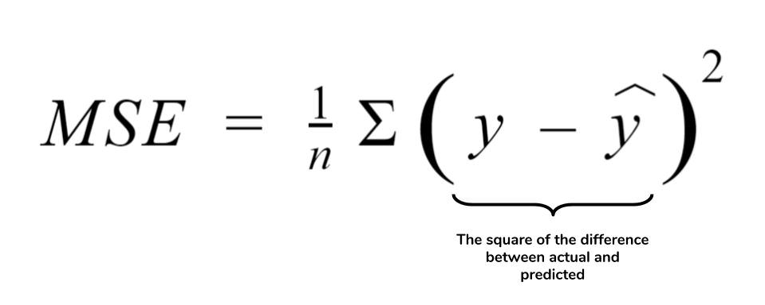
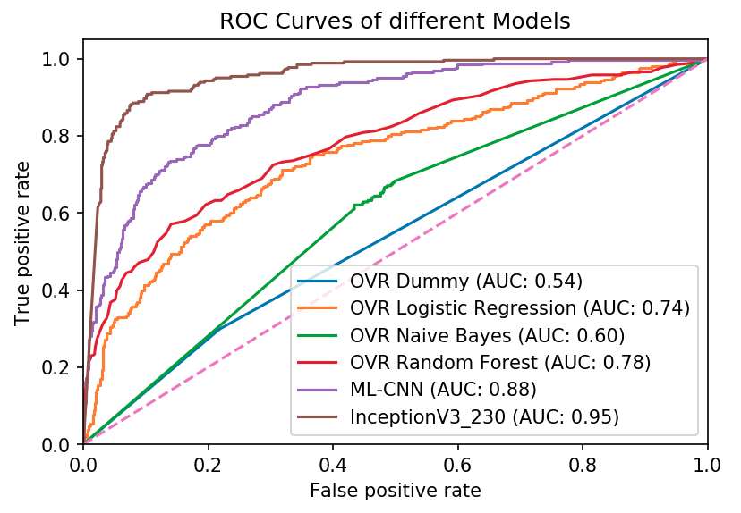
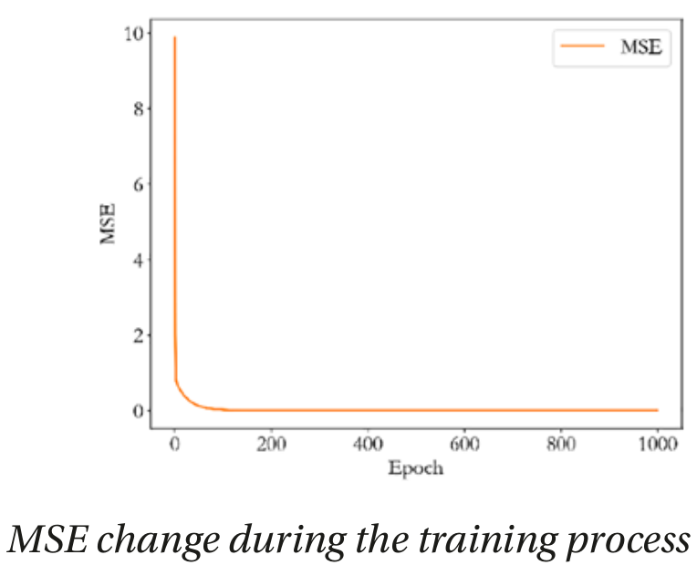
Comparing classifiers and regressors
https://people.duke.edu/~rnau/compare.htm

