Slide 1
Precision-Recall Curve/F1 is More Informative than ROC/Accuracy in Imbalanced Data
30.05.2022
Phuc Loi Luu, PhD
p.luu@garvan.org.au
luu.p.loi@googlemail.com

Slide 2
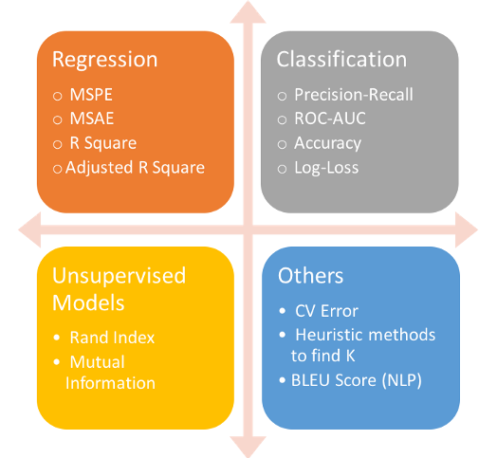
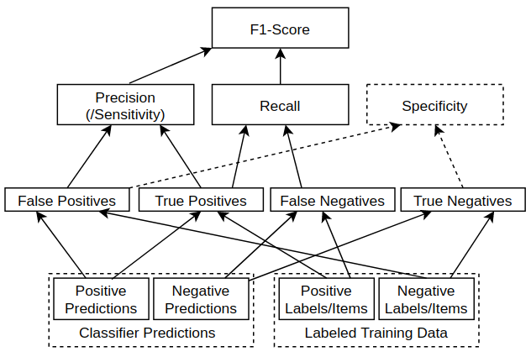
Metrics for evaluation of machine learning classifier
?
?
?
?
?
?
?

Slide 3
Metrics for evaluation of machine learning classifier
https://www.kdnuggets.com/2018/06/right-metric-evaluating-machine-learning-models-2.html
https://towardsdatascience.com/a-look-at-precision-recall-and-f1-score-36b5fd0dd3ec

Slide 4
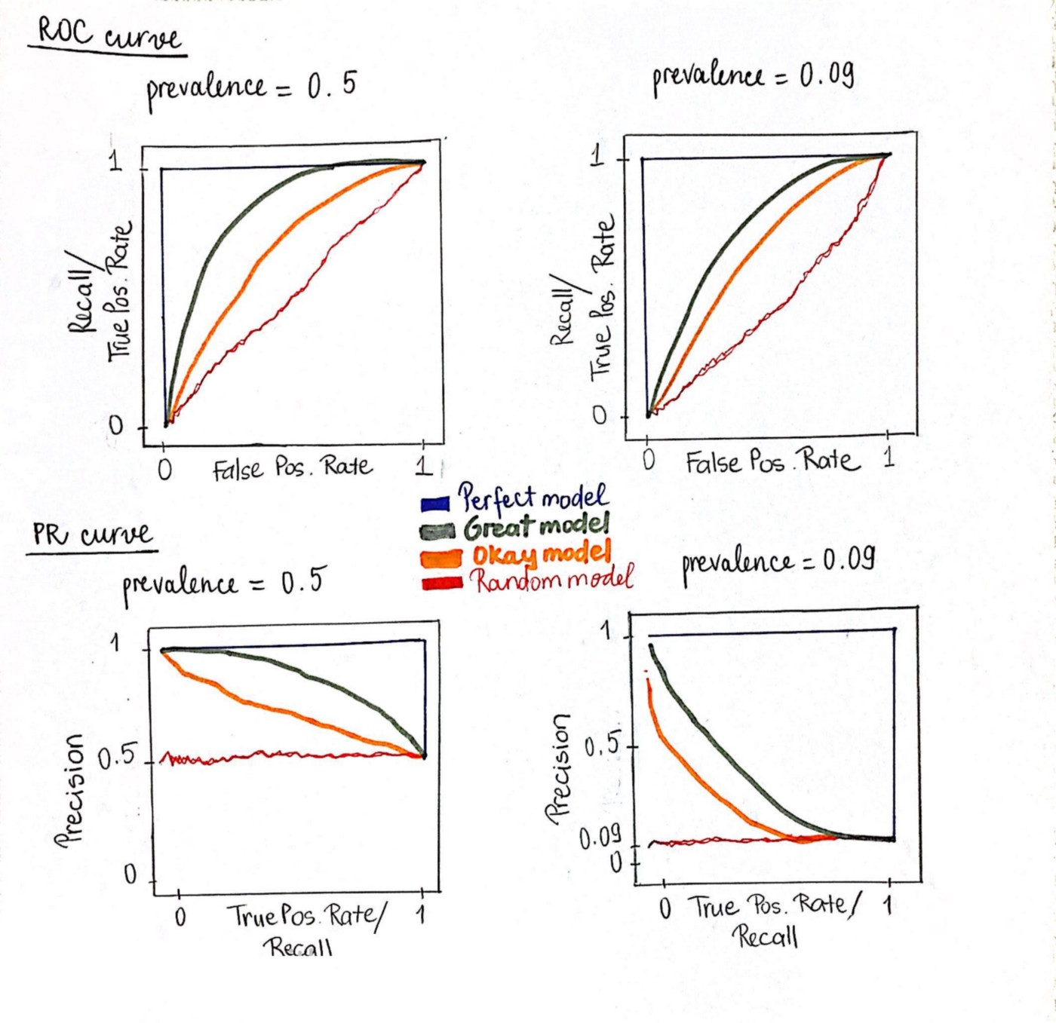
Label legend of the plot below
? Curve
? Curve
Black
Dark green
Orange
Red

Slide 5
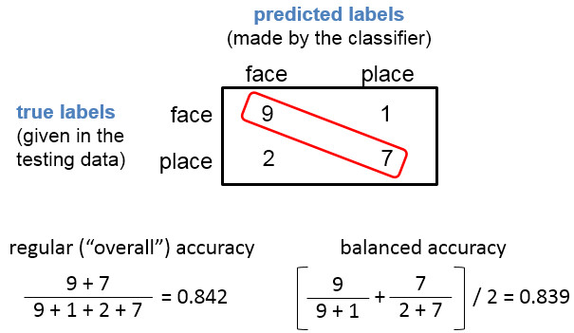
Accuracy is misleading

Slide 6
Accuracy is misleading
The failure of accuracy as a metric on imbalanced data is well-known.
Consider the case of a dataset with the ratio of 1 positive per 100 negatives.
On this task, a model that predicts all cases to be negative yields an accuracy of 99%.
This model, nevertheless, is a dummy classifier that always predicts the majority class.

Slide 7

F1-Score
F1-Score is a measure combining both precision and recall. It is generally described as the harmonic mean of the two. Harmonic mean is just another way to calculate an “average” of values, generally described as more suitable for ratios (such as precision and recall) than the traditional arithmetic mean. The formula used for F1-score in this case is:
The idea is to provide a single metric that weights the two ratios (precision and recall) in a balanced way, requiring both to have a higher value for the F1-score value to rise.
For example, a Precision of 0.01 and Recall of 1.0 would give :
An arithmetic mean of (0.01+1.0)/2=0.505,
F1-score score (formula above) of 2*(0.01*1.0)/(0.01+1.0)~0.02.
This is because the F1-score is much more sensitive to one of the two inputs having a low value (0.01 here). Which makes it great if you want to balance the two.

Slide 8
What is the advantages of F1-Score?

Slide 9
What is the advantages of F1-Score?
Very small precision or recall will result in lower overall score. Thus it helps balance the two metrics.
If you choose your positive class as the one with fewer samples, F1-score can help balance the metric across positive/negative samples.
As illustrated by the first figure in this article, it combines many of the other metrics into a single one, capturing many aspects at once.

Slide 10
F1-score vs Accuracy: show example and calulate
Accuracy is commonly described as a more intuitive metric, with F1-score better addressing a more imbalanced dataset.
So how does the F1-score (F1) vs Accuracy (ACC) compare across different types of data distributions (ratios of positive/negative):
Imbalance: Few Positive Cases
Balance 50/50 Positive and Negative cases
Imbalance: Few Negative Cases

Slide 11
F1-score
F1-score combines precision and recall, and works also for cases where the datasets are imbalanced as it requires both precision and recall to have a reasonable value.
Even if you have a small number of positive cases vs negative cases, the formula will weight the metric value down if the precision or recall of the positive class is low.

Slide 12
AUROC is overly optimistic

Slide 13
AUROC is overly optimistic
It is insensitive to class distribution
AUROC is threshold-invariant
The ROC can provide an overly optimistic measurement of a model’s performance. For example, consider the case of a dataset which has 10 positives and 100,000 negatives. We have 2 models:
Model A: predicts 900 positives, in which 9 of them are true positives
Model B: predicts 90 positives, in which 9 of them are true positives
Obviously, Model B has better performance. Although they both predict the same number of positives, Model B does not output as many false positives. In other words, Model B is more “precise”. However, consider the ROC analysis of the two models, which measures true positive rate (TPR) against false positive rate (FPR):
Model A: TPR = 9/10 = 0.9 and FPR = (900–9)/100,000 = 0.00891
Model B: TPR = 9/10 = 0.9 and FPR = (90–9)/100,000 = 0.00081
TPR is, as expected, exactly the same between both models. On the other hand, since the number of negatives largely dominates that of positives, the difference of FPR between both models (0.00891–0.00081 = 0.0081) is lost in the sense that it can be rounded to almost 0.

Slide 14
Precision-Recall curve is more informative

Slide 15
Precision-Recall curve is more informative
Because precision and recall don’t consider true negatives, the PR curve is not affected by the data imbalance. Back to the example above:
Model A: recall = TPR = 0.9 and precision = 9/900 = 0.01
Model B: recall = TPR = 0.9 and precision = 9/90 = 0.1
Clearly, PR analysis is more informative compared to the ROC analysis above.
Note that while the random baseline is fixed at 0.5 with ROC, the random baseline of the PR curve is determined by positive class prevalence, i.e. P / (P + N).
For instance, we have a baseline PR of 0.5 for a balanced class distribution, but a baseline PR of 0.09 for an imbalance class distribution in which for every positive there are 10 negatives. Since the random baseline of the PR curve shifts based on the prevalence rate of the positive class, it is crucial to compare the AUPRC to its corresponding baseline, rather than looking at its absolute value.
In addition, it’s a good practice to make sure that the test data reflects the class distribution of the true population as closely as possible (even though such distribution is usually unknown), given how sensitive the PR curve is to the prevalence rate.

Slide 16
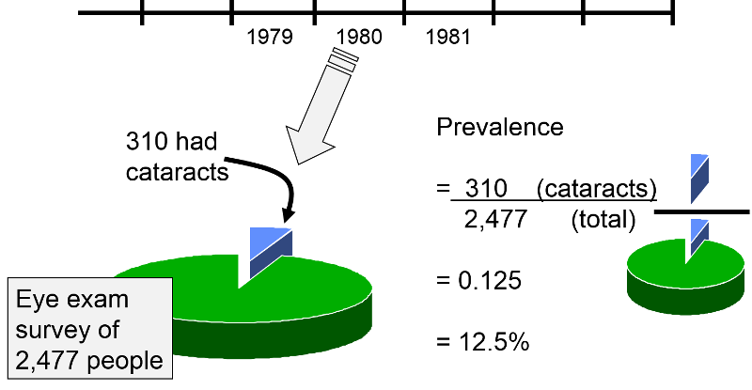
Precision-Recall curve vs ROC-curve
?
?
?
?

Slide 17
Precision-Recall curve vs ROC-curve

Slide 18
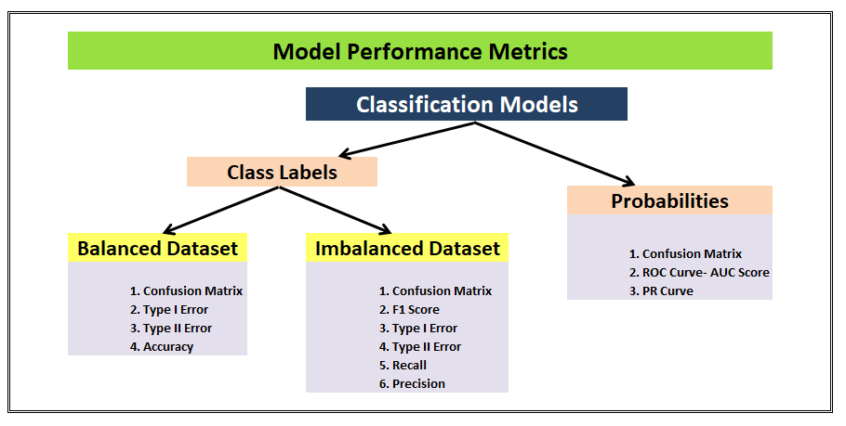
Please fill the question mark boxes
?
?
?
?
?

Slide 19
Please fill the question mark boxes

Slide 20
Conclusion
F1-score combines precision and recall, and works also for cases where the datasets are imbalanced as it requires both precision and recall to have a reasonable value.
When the negative class is more prevalent and there is low value in true-negative predictions, Precision-Recall curve is preferred over ROC
https://towardsdatascience.com/precision-recall-curve-is-more-informative-than-roc-in-imbalanced-data-4c95250242f6

Slide 21
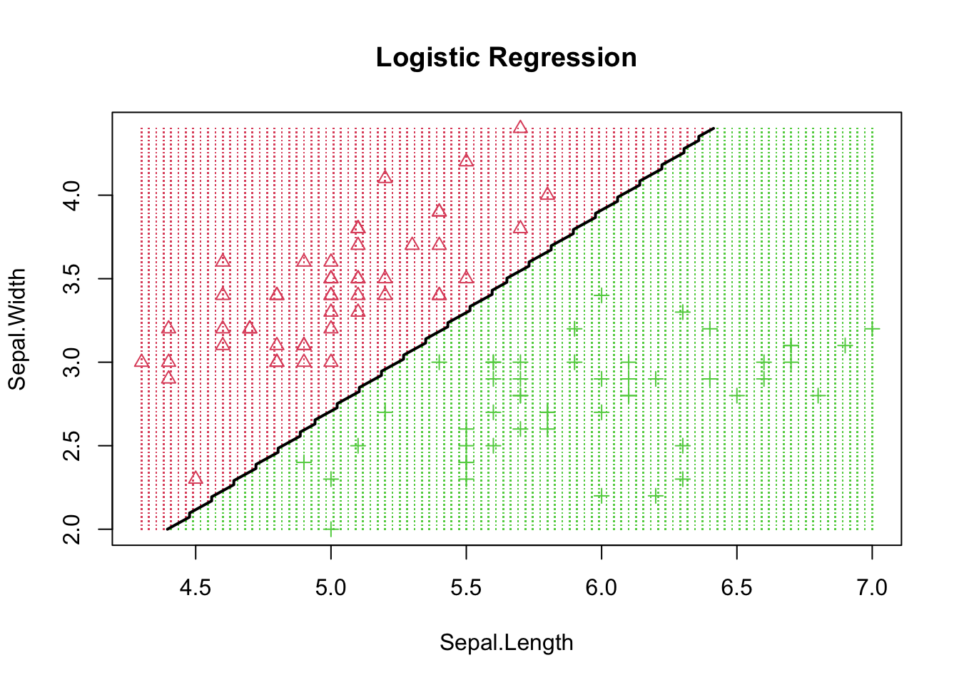
Plot Decision Boundary
How to plot decision boundary? List the steps of the idea
https://rpubs.com/ZheWangDataAnalytics/DecisionBoundary

Slide 22
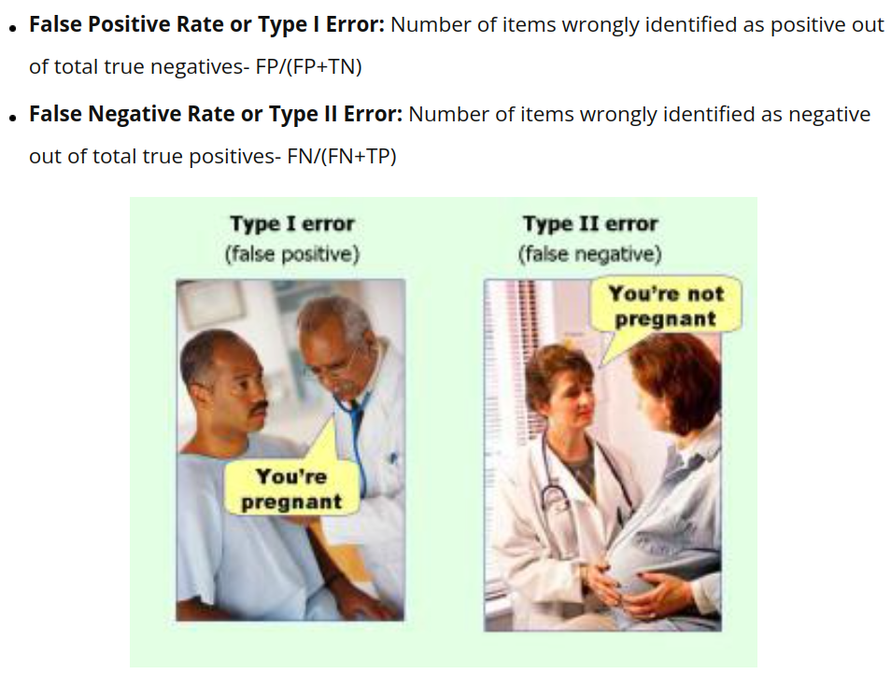
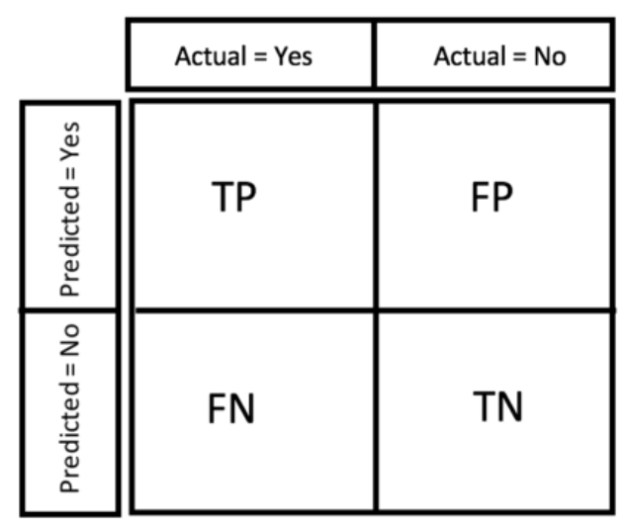
Type I and II Error
?
?

Slide 23
Type I and II Error

