Slide 1
Smoothing Spline Regression plot in R
27.06.2022
Phuc Loi Luu, PhD
p.luu@garvan.org.au
luu.p.loi@googlemail.com

Slide 2
Content
Motivation
Comparing smooth.spline vs ss
Parameters
Exercises

Slide 3
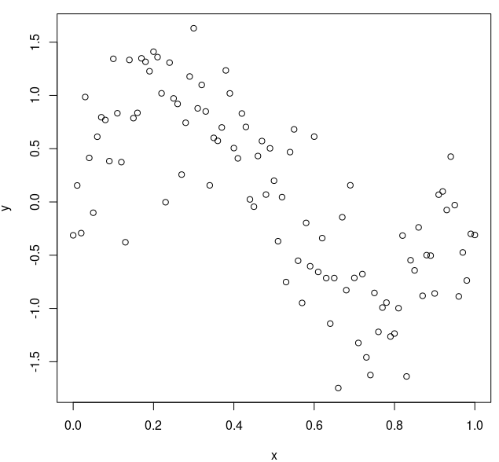
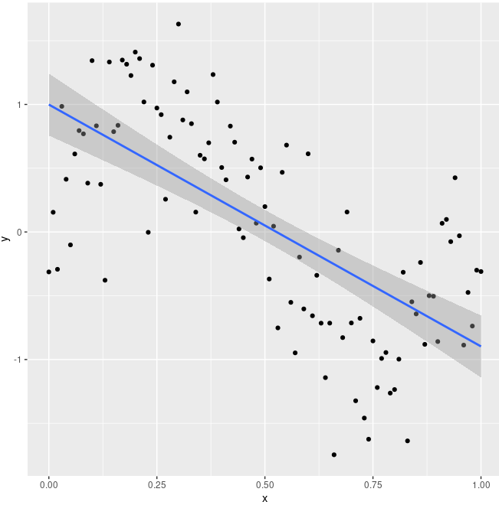
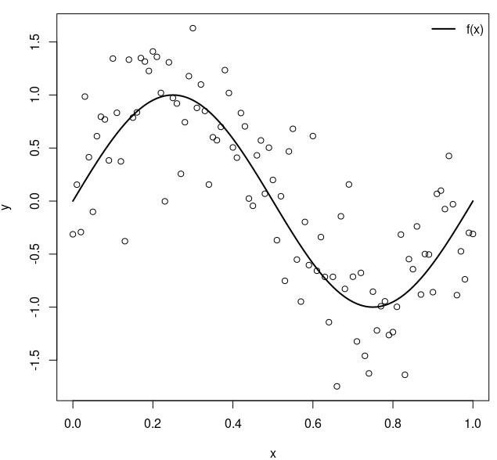
Motivation
# define function
n <- 101
x <- seq(0, 1, length.out = n)
fx <- sin(2 * pi * x)
# generate noisy data
set.seed(1)
y <- fx + rnorm(n, sd = 0.5)
# ggplot2
dt <- data.frame(x=x,y=y)
ggplot(dt, aes(x, y)) + geom_point() + geom_smooth(method = lm)
# plot data and f(x)
plot(x, y) # data
lines(x, fx, lwd = 2) # f(x)
legend("topright", legend = "f(x)", lty = 1, lwd = 2, bty = "n")

Slide 4
Comparing smooth.spline vs ss
# load 'npreg' package
# install.packages("npreg")
library(npreg)
# fit using ss
mod.ss <- ss(x, y, nknots = 10)
mod.ss
# fit using smooth.spline
mod.smsp <- smooth.spline(x, y, nknots = 10)
mod.smsp
# compare returned objects
names(mod.ss)
names(mod.smsp)
# rmse between solutions
sqrt(mean(( mod.ss$y - mod.smsp$y )^2))
# rmse between solutions and f(x)
sqrt(mean(( fx - mod.ss$y )^2))
sqrt(mean(( fx - mod.smsp$y )^2))

Slide 5
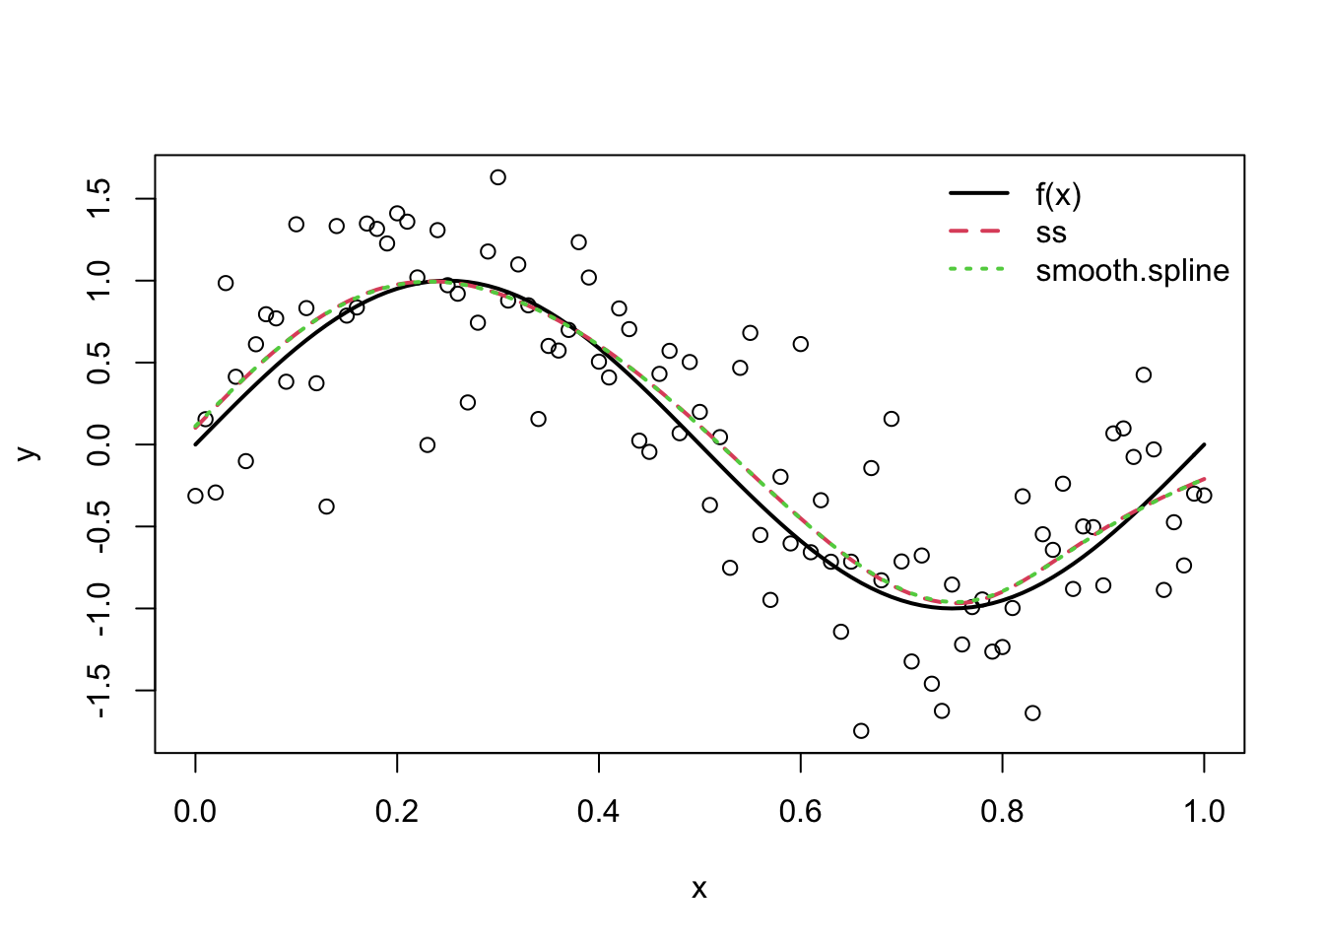
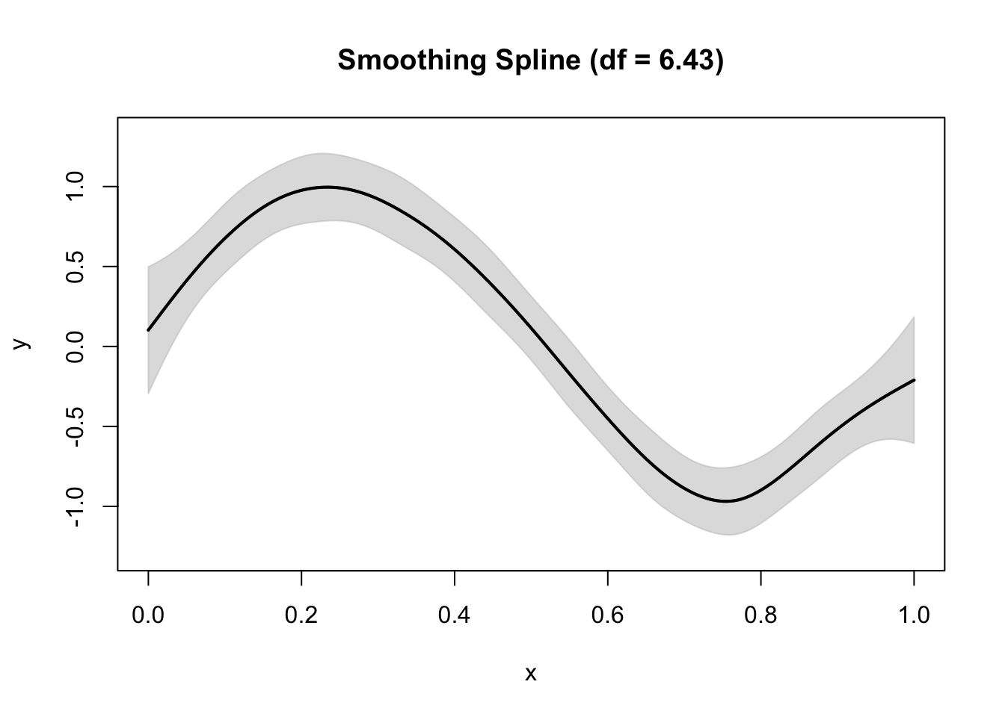
Plot the comparing
# plot results
plot(x, y)
lines(x, fx, lwd = 2)
lines(x, mod.ss$y, lty = 2, col = 2, lwd = 2)
lines(x, mod.smsp$y, lty = 3, col = 3, lwd = 2)
legend("topright",
legend = c("f(x)", "ss", "smooth.spline"),
lty = 1:3, col = 1:3, lwd = 2, bty = "n")
# plot method
plot(mod.ss)
# summary method
mod.sum <- summary(mod.ss)
mod.sum

Slide 6
Smoothing Parameter Influence
As λ→0 the penalty has less influence on the penalized least squares functional So, for very small values of λ, the function estimate f_{λ} essentially minimizes the residual sum of squares.
As λ→∞ the penalty has more influence the penalized least squares functional. So, for very large values of λ, the function estimate f_{λ} is essentially constrained to have a zero penalty, i.e., J_{m}(f_{λ})≈0.
As λ increases from 0 to ∞, the function estimate f_{λ} is forced to be smoother with respect to the penalty functional J_{m}(⋅). The goal is to find the λ that produces the “correct” degree of smoothness for the function estimate.

Slide 7
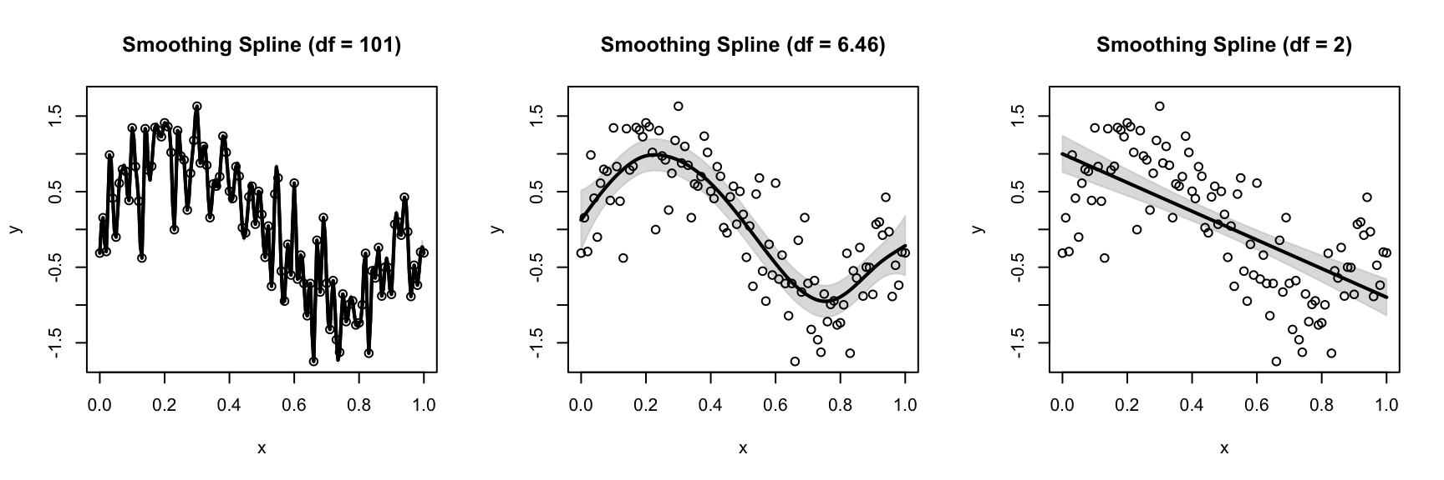
Smoothing Parameter Influence
# subplots (1 x 3)
par(mfrow = c(1,3))
# lambda = 1e-15 (df = n)
mod.ss0 <- ss(x, y, all.knots = TRUE, lambda = 1e-15)
plot(mod.ss0, ylim = c(-1.75, 1.75))
points(x, y)
# GCV selection
mod.ss <- ss(x, y, all.knots = TRUE)
plot(mod.ss, ylim = c(-1.75, 1.75))
points(x, y)
# lambda = 100 (df = m)
mod.ss10 <- ss(x, y, all.knots = TRUE, lambda = 100)
plot(mod.ss10, ylim = c(-1.75, 1.75))
points(x, y)

Slide 8
Penalty Order Influence
Setting m=2 produces a cubic smoothing spline, which penalizes the squared second derivative of the function. Cubic smoothing splines are the default in many software. Cubic smoothing splines estimate f(⋅) using piecewise cubic functions, which are connected at points known as “knots” (later defined). The function estimates have two continuous derivatives at the knots, ensuring a smooth estimate of the function and its derivatives.
Setting m=1 results in a linear smoothing spline (a piecewise linear function)
Setting m=3 produces a quintic smoothing spline (a piecewise quintic function).

Slide 9
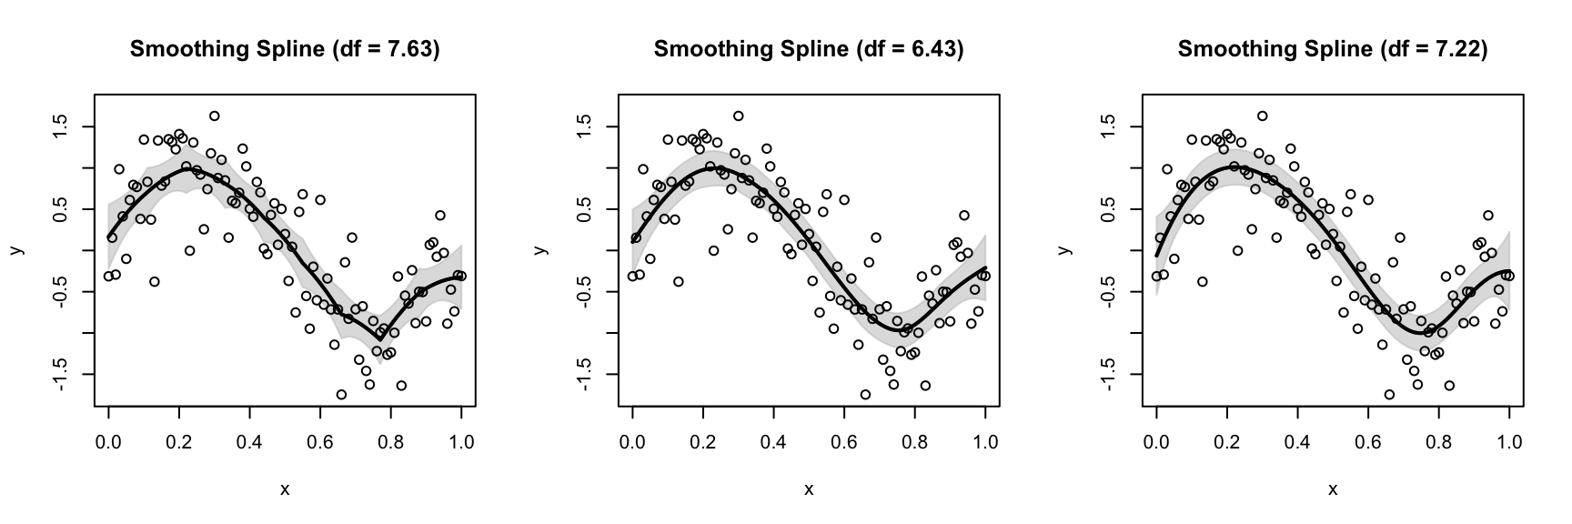
Penalty Order Influence
mod.lin <- ss(x, y, nknots = 10, m = 1)
mod.cub <- ss(x, y, nknots = 10)
mod.qui <- ss(x, y, nknots = 10, m = 3)
par(mfrow = c(1,3))
plot(mod.lin, ylim = c(-1.75, 1.75))
points(x, y)
plot(mod.cub, ylim = c(-1.75, 1.75))
points(x, y)
plot(mod.qui, ylim = c(-1.75, 1.75))
points(x, y)

Slide 10
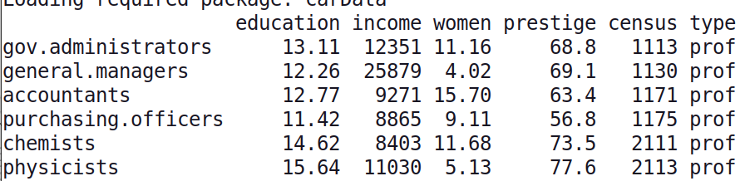
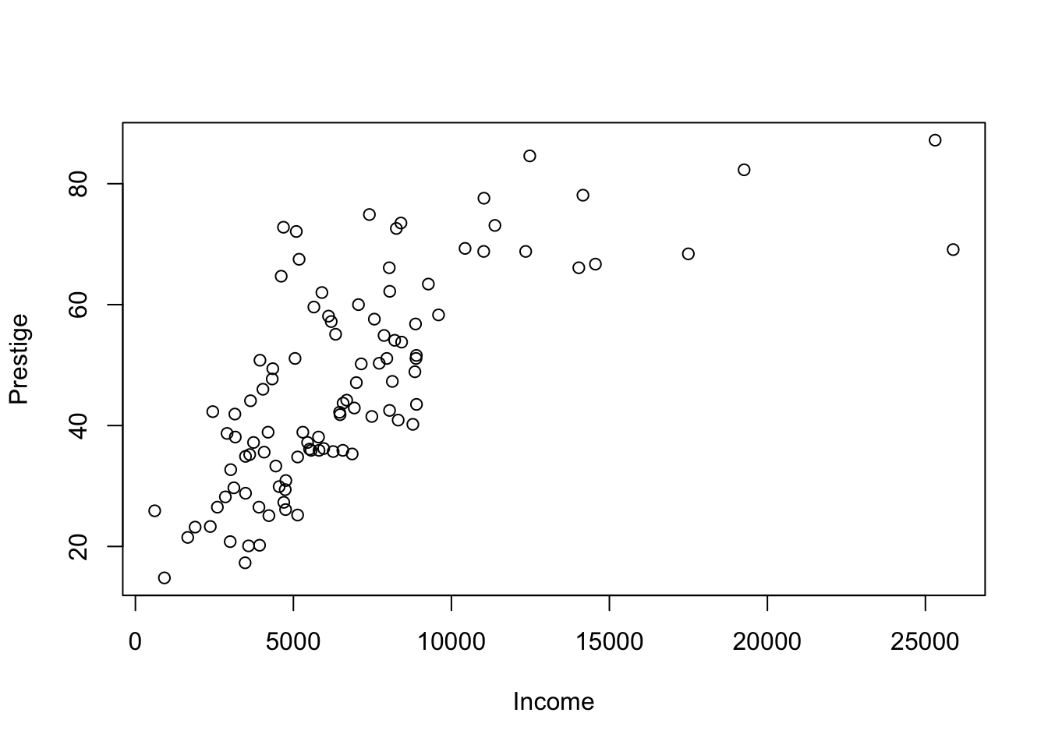
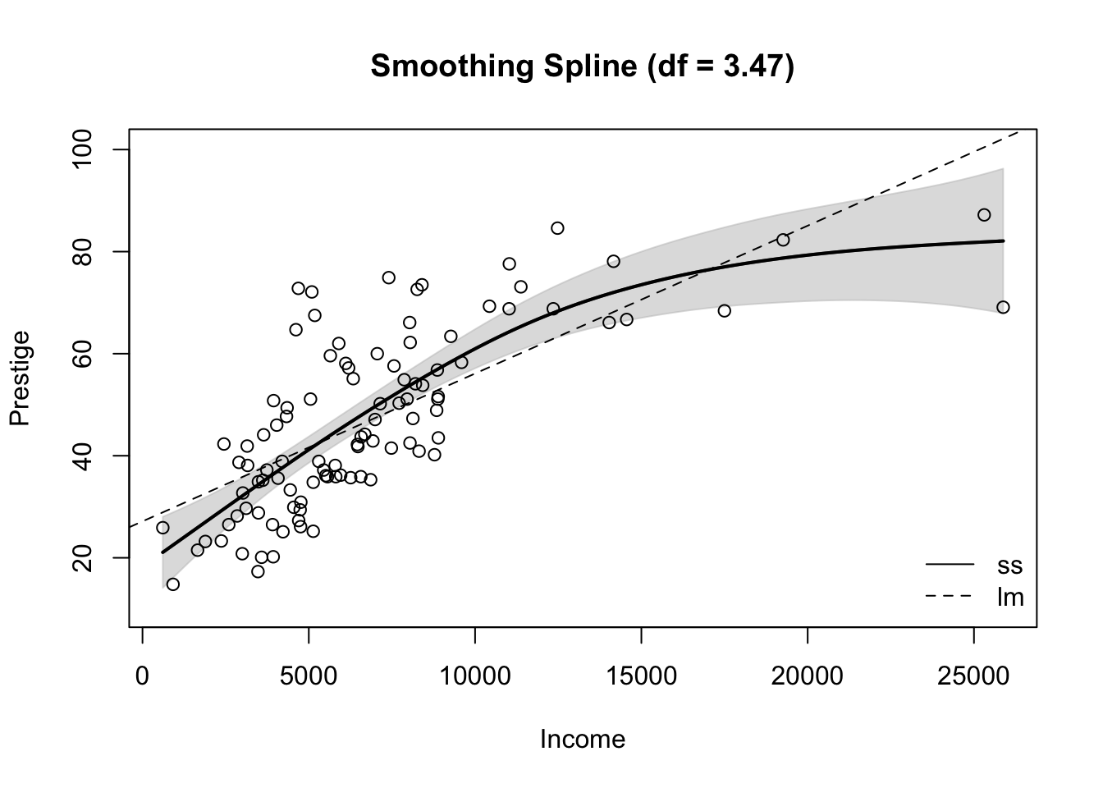
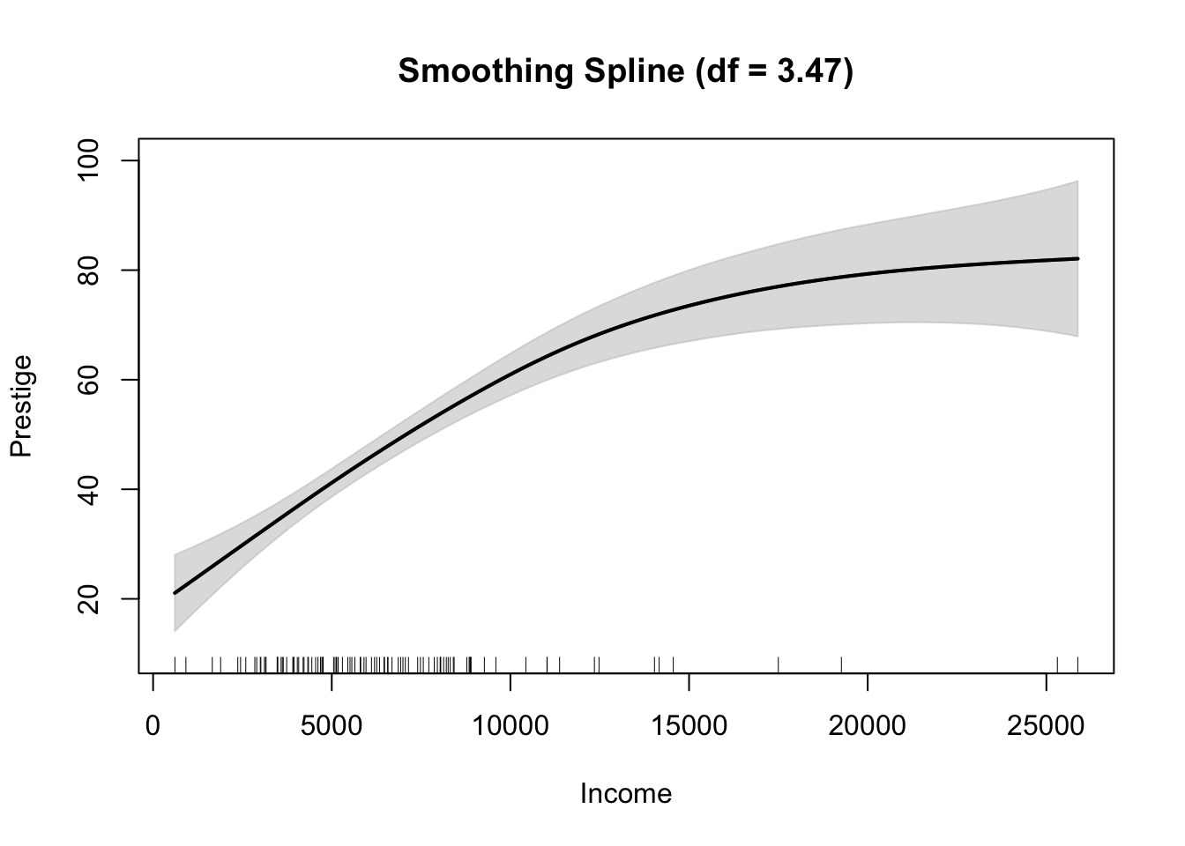
Exercise 1:
# load data
library(car)
data(Prestige)
head(Prestige)
# plot data
plot(Prestige$income, Prestige$prestige, xlab = "Income", ylab = "Prestige")

Slide 11
Exercise 1:
# load data
library(car)
data(Prestige)
head(Prestige)
# plot data
plot(Prestige$income, Prestige$prestige, xlab = "Income", ylab = "Prestige")
# fit model
mod.ss <- with(Prestige, ss(income, prestige))
mod.ss
# summarize fit
summary(mod.ss)
# plot fit
plot(mod.ss, xlab = "Income", ylab = "Prestige")
rug(Prestige$income) # add rug to plot
# plot ss fit
plot(mod.ss, xlab = "Income", ylab = "Prestige")
# add lm fit
abline(coef(lm(prestige ~ income, data = Prestige)), lty = 2)
# add data and legend
with(Prestige, points(income, prestige))
legend("bottomright", legend = c("ss", "lm"), lty = 1:2, bty = "n")

Slide 12
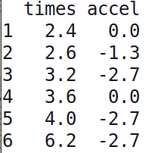
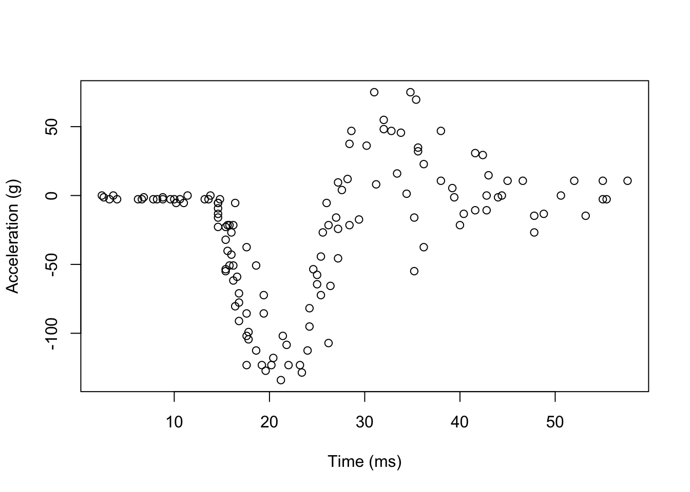
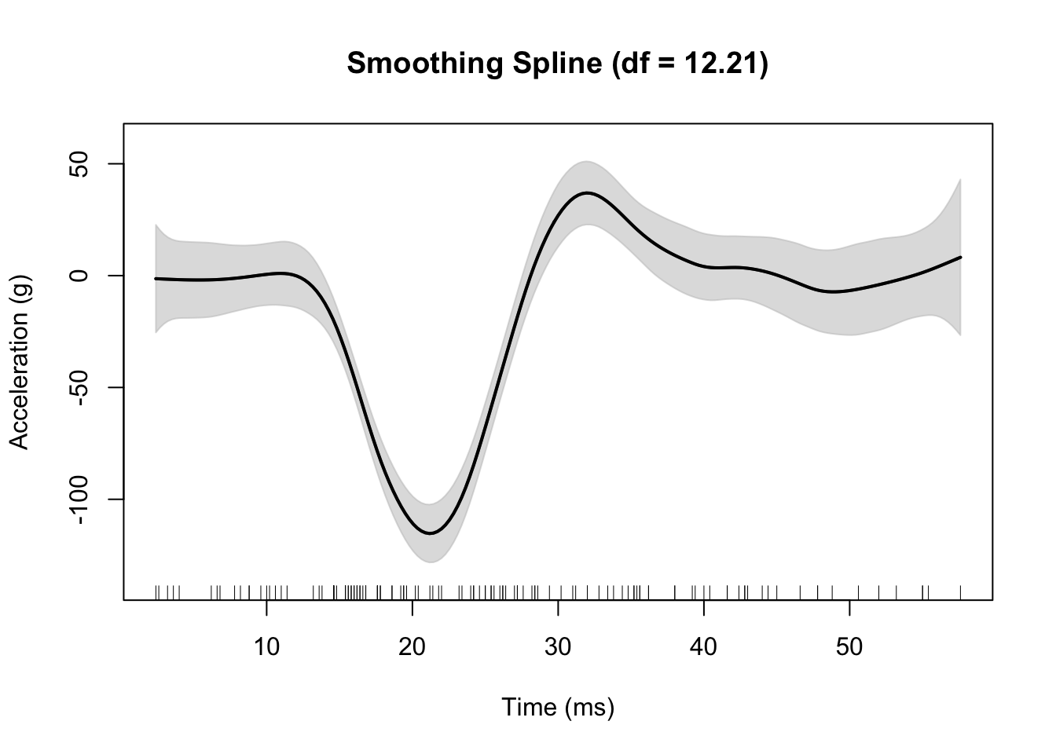
Exercise 2:
# load data
library(MASS)
data(mcycle)
head(mcycle)
# plot data
plot(mcycle$times, mcycle$accel, xlab = "Time (ms)", ylab = "Acceleration (g)")

Slide 13
Exercise 2:
# load data
library(MASS)
data(mcycle)
head(mcycle)
# plot data
plot(mcycle$times, mcycle$accel, xlab = "Time (ms)", ylab = "Acceleration (g)")
# fit model
mod.ss <- with(mcycle, ss(times, accel))
mod.ss
# summarize fit
summary(mod.ss)
# plot fit
plot(mod.ss, xlab = "Time (ms)", ylab = "Acceleration (g)")
rug(mcycle$times) # add rug to plot
http://users.stat.umn.edu/~helwig/notes/smooth-spline-notes.html

Slide 14
Exercise 3: plot using ggplot
# load data
library(MASS)
data(mcycle)
head(mcycle)
# plot data
plot(mcycle$times, mcycle$accel, xlab = "Time (ms)", ylab = "Acceleration (g)")
# ggplot
ggplot(mcycle, aes(x=times, y=accel)) + geom_point() + geom_smooth(method = lm)
# loess method: local regression fitting
ggplot(mcycle, aes(x=times, y=accel)) + geom_point() + geom_smooth(method = "loess")
# with function
ggplot(mcycle, aes(x=times, y=accel)) + geom_point() + geom_smooth(method = "lm", formula = y ~ poly(x, 3), se = FALSE)

Slide 15
Exercise 4: plot using ggplot
# load data
library(car)
data(Prestige)
head(Prestige)

