Slide 1
Handle Imbalanced Data For a Classification Problem
Phuc Loi Luu, PhD
p.luu@garvan.org.au
luu.p.loi@googlemail.com

Slide 2
Content
What is imbalanced data?
Problems with imbalanced data classification
Detecting imbalanced data classification
Correcting Dataset Imbalance

Slide 3
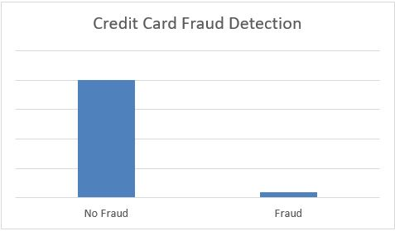
What is imbalanced data?
Let’s assume that XYZ is a bank that issues a credit card to its customers. Now the bank is concerned that some fraudulent transactions are going on and when the bank checks their data they found that for each 2000 transaction there are only 40 Nos of fraud recorded.
The number of fraud per 100 transactions is less than 2%, or we can say more than 98% transaction is “No Fraud” in nature.
The class “No Fraud” is called the majority class, and the much smaller in size “Fraud” class is called the minority class.

Slide 4
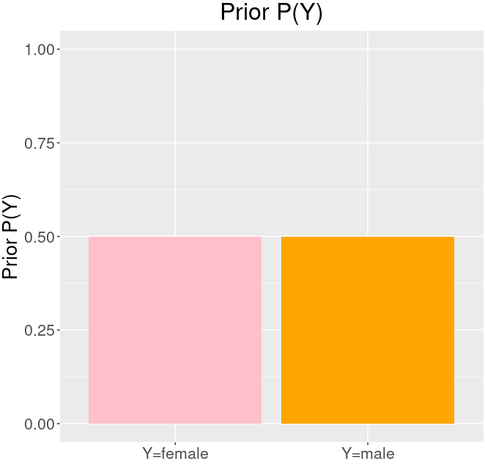
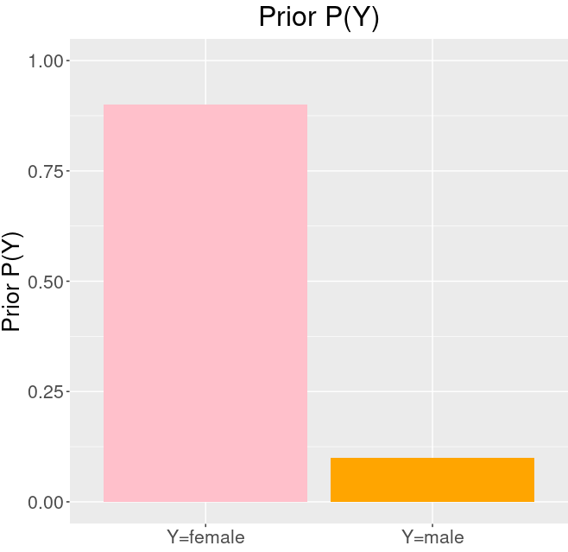
What is imbalanced data?
More such example of imbalanced data is
Disease diagnosis
Customer churn prediction
Fraud detection
Natural disaster
Class imbalanced is generally normal in classification problems. But, in some cases, this imbalance is quite acute where the majority class’s presence is much higher than the minority class.

Slide 5
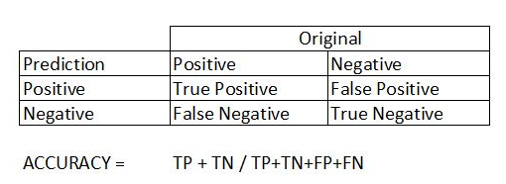
Problems with imbalanced data classification
Let’s assume we are going to predict disease from an existing dataset where for every 100 records only 5 patients are diagnosed with the disease.
So, the majority class is 95% with no disease and the minority class is only 5% with the disease.
Now, assume our model predicts that all 100 out of 100 patients have no disease.
What is the accuracy?
Compute the confusion matrix?

Slide 6
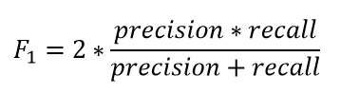
Detecting imbalanced data classification (1)
For an imbalanced class dataset F1 score is a more appropriate metric, rather than accuracy. It is the harmonic mean of precision and recall and the expression is
F1 score only increases if both the number and quality of prediction improves.
F1 score keeps the balance between precision and recall and improves the score only if the classifier identifies more of a certain class correctly.

Slide 7
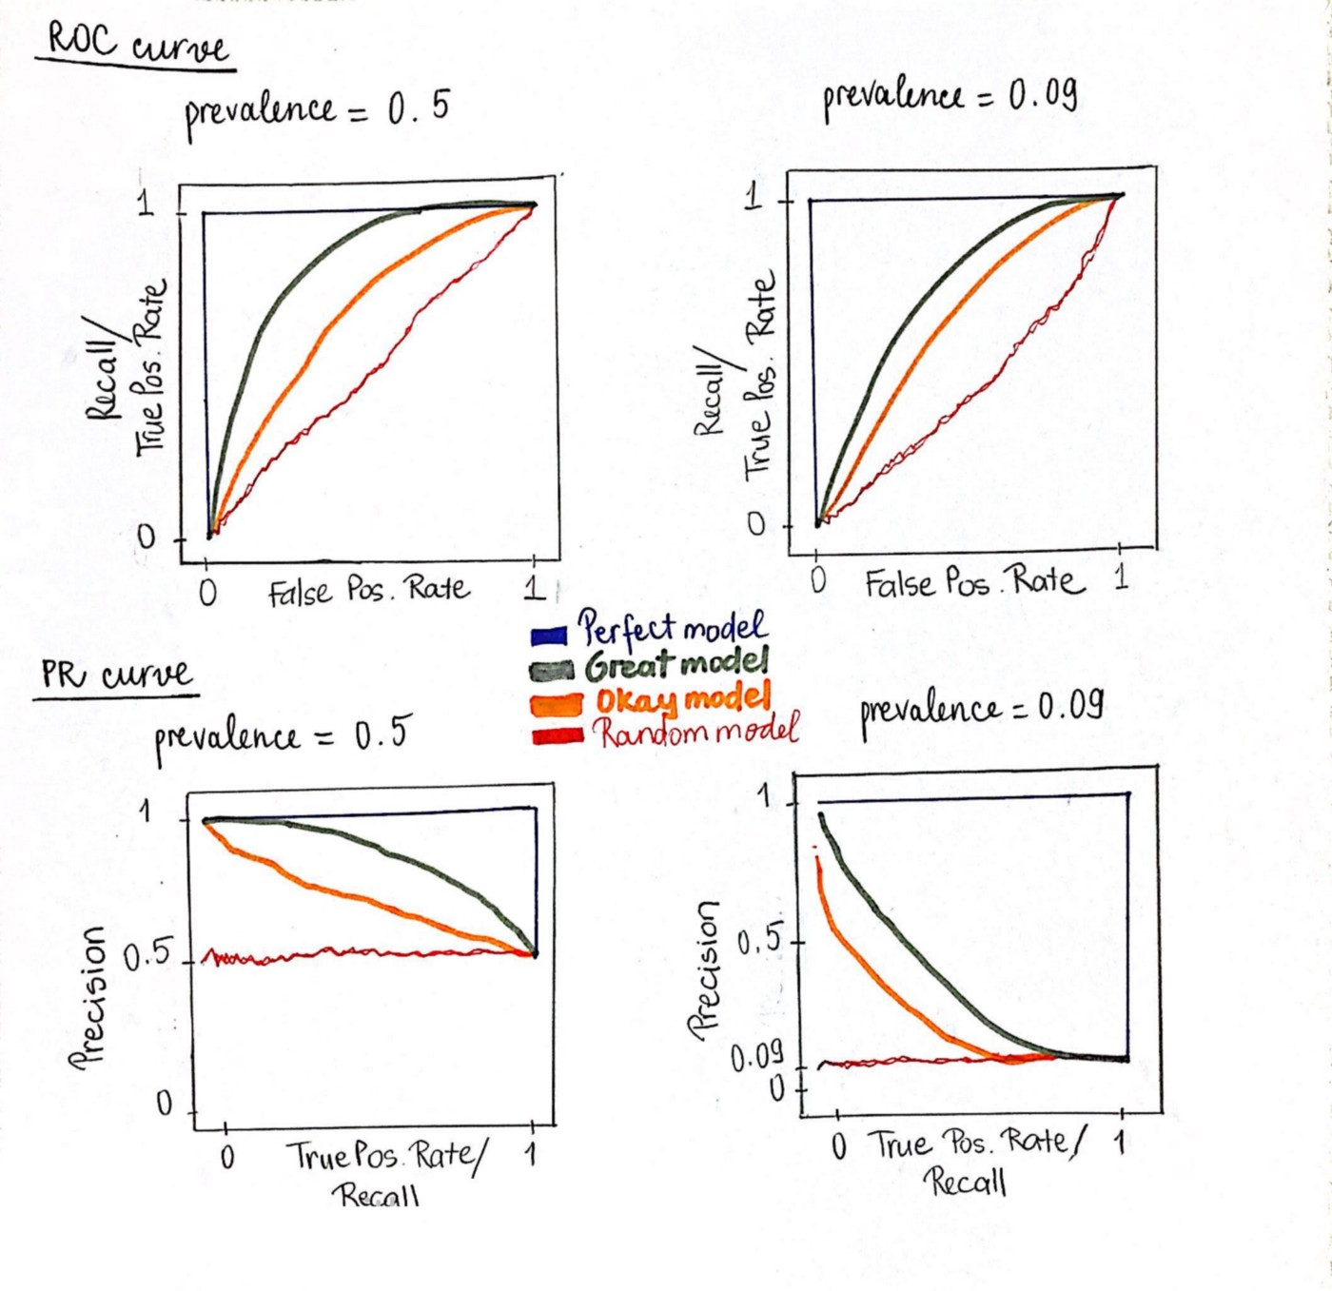
Detecting imbalanced data classification (2)
https://towardsdatascience.com/precision-recall-curve-is-more-informative-than-roc-in-imbalanced-data-4c95250242f6

Slide 8
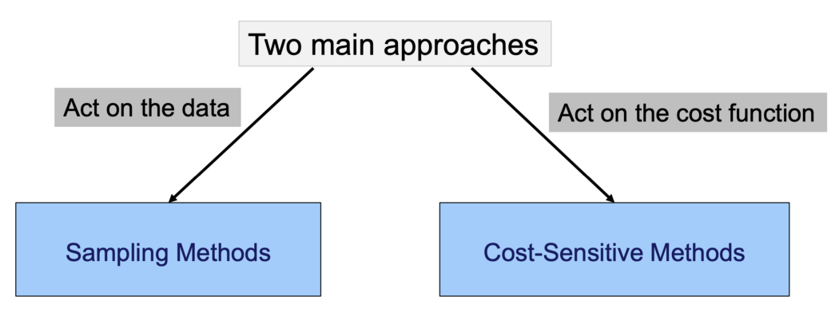
Correcting Dataset Imbalance
(Data approach)
(Algorithm approach)

Slide 9
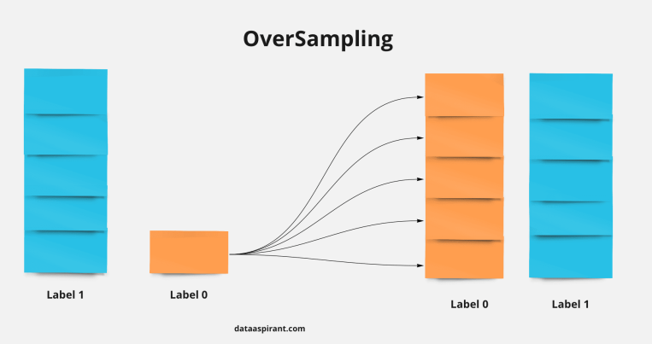
Data approach: Oversampling

Slide 10
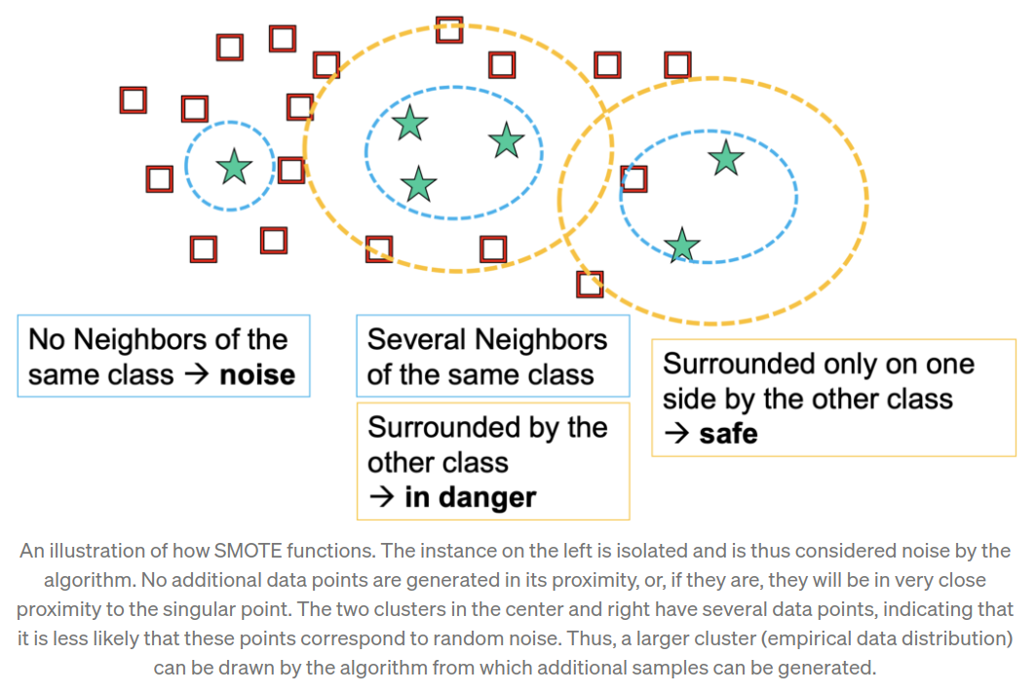
Data approach: SMOTE (Synthetic minority oversampling technique)
The algorithm for SMOTE is as follows. For each minority sample:
– Find its k-nearest minority neighbours
– Randomly select j of these neighbours
– Randomly generate synthetic samples along the lines joining the minority sample and its j selected neighbours (j depends on the amount of oversampling desired)

Slide 11
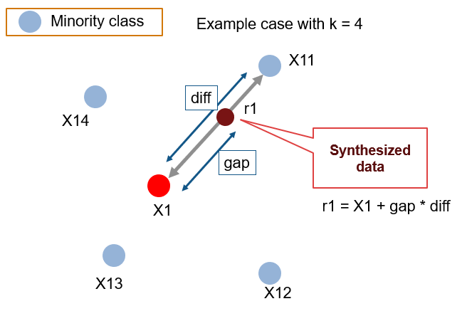
Data approach: SMOTE (Synthetic minority oversampling technique)
The algorithm for SMOTE is as follows. For each minority sample:
– Find its k-nearest minority neighbours
– Randomly select j of these neighbours
– Randomly generate synthetic samples along the lines joining the minority sample and its j selected neighbours (j depends on the amount of oversampling desired)

Slide 12
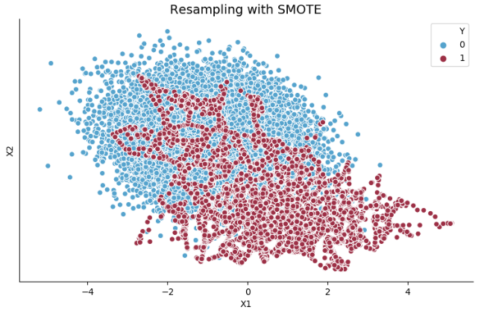
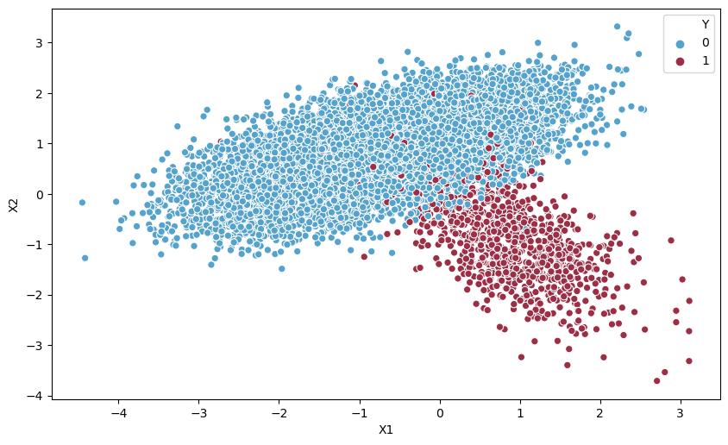
Data approach: SMOTE (Synthetic minority oversampling technique)

Slide 13
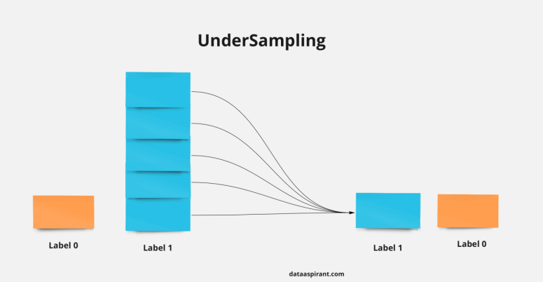
Data approach: Undersampling

Slide 14
Algorithm approach: weighted learners
We use Focal loss where we assign a higher weight to the minority class in our cost function which will penalize the model for misclassifying the minority class while at the same time reducing the weight of the majority class, causing the model to pay more attention to the underrepresented class.
Thus, boosting its importance during the learning process.
Upweighting. Upweighting is analogous to over-sampling and works by increasing the weight of one of the classes keeping the weight of the other class at one.
Down-weighting. Down-weighting is analogous to under-sampling and works by decreasing the weight of one of the classes keeping the weight of the other class at one.

Slide 15
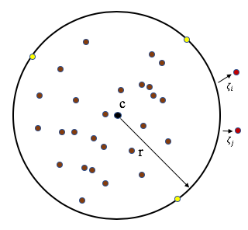
Algorithm approach: one-class learning or one-class classification (OCC)
OCC can be useful in imbalanced classification problems because it provides techniques for outlier and anomaly detection.
It does this by fitting the model on the majority class data (also known as positive examples) and predicting whether new data belong to the majority class or belong to the minority class (also known as negative examples) meaning it’s an outlier/anomaly.
https://en.wikipedia.org/wiki/One-class_classification

Slide 16
Algorithm approach: Threshold moving
In the case of our classifiers, many times classifiers actually predict the probability of class membership.
We assign those prediction’s probabilities to a certain class based on a threshold which is usually 0.5, i.e. if the probabilities < 0.5 it belongs to a certain class, and if not it belongs to the other class.
For imbalanced class problems, this default threshold may not work properly.
We need to change the threshold to the optimum value so that it can efficiently separate two classes.
We can use ROC Curves and Precision-Recall Curves to find the optimal threshold for the classifier.
We can also use a grid search method or search within a set of values to identify the optimal value.
https://www.analyticsvidhya.com/blog/2021/06/5-techniques-to-handle-imbalanced-data-for-a-classification-problem/

Slide 17
Practice
https://rpubs.com/abhaypadda/smote-for-imbalanced-data

