Slide 1
CONFOUNDER DETECTION AND REMOVAL ON IRIS DATA
April 20, 2022

Slide 2
Exercise
Is Species a confounder in iris data with threshold P value < 0.05 and R = 0.5?
If yes, please remove it from data

Slide 3
CONFOUNDER DETECTION

Slide 4

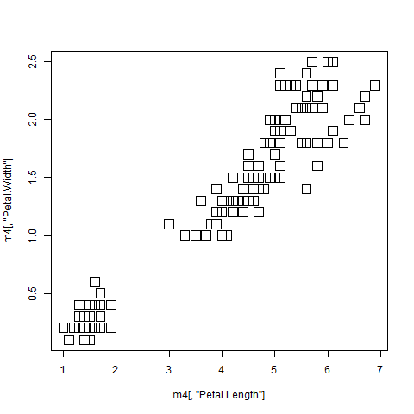
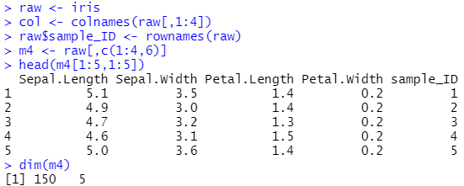
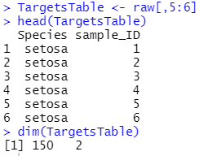

Slide 5





Slide 6
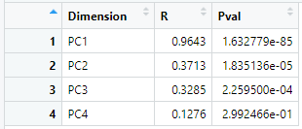


Slide 7
CONFOUNDER REMOVAL

Slide 8
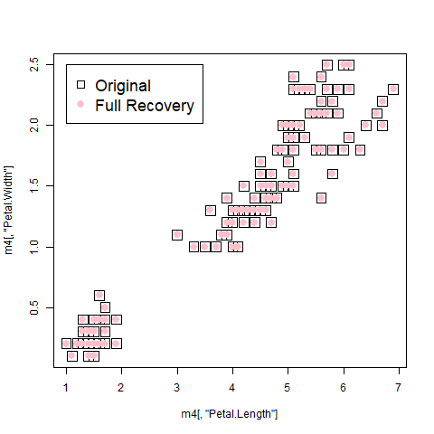

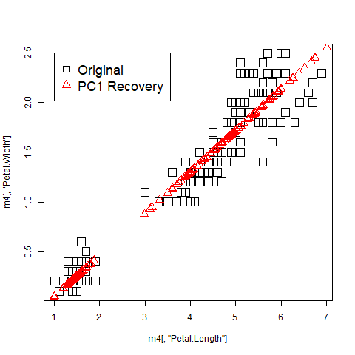


Slide 9
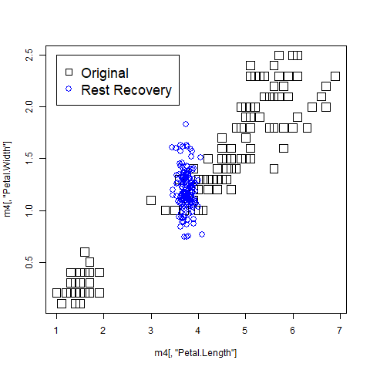

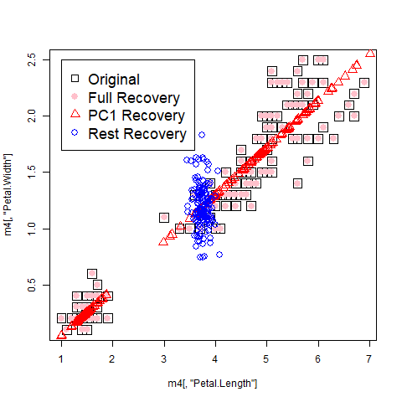


Slide 10
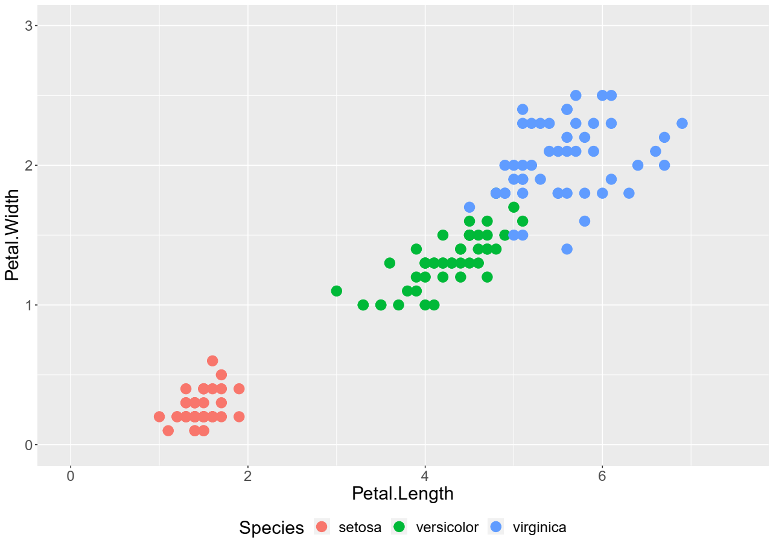
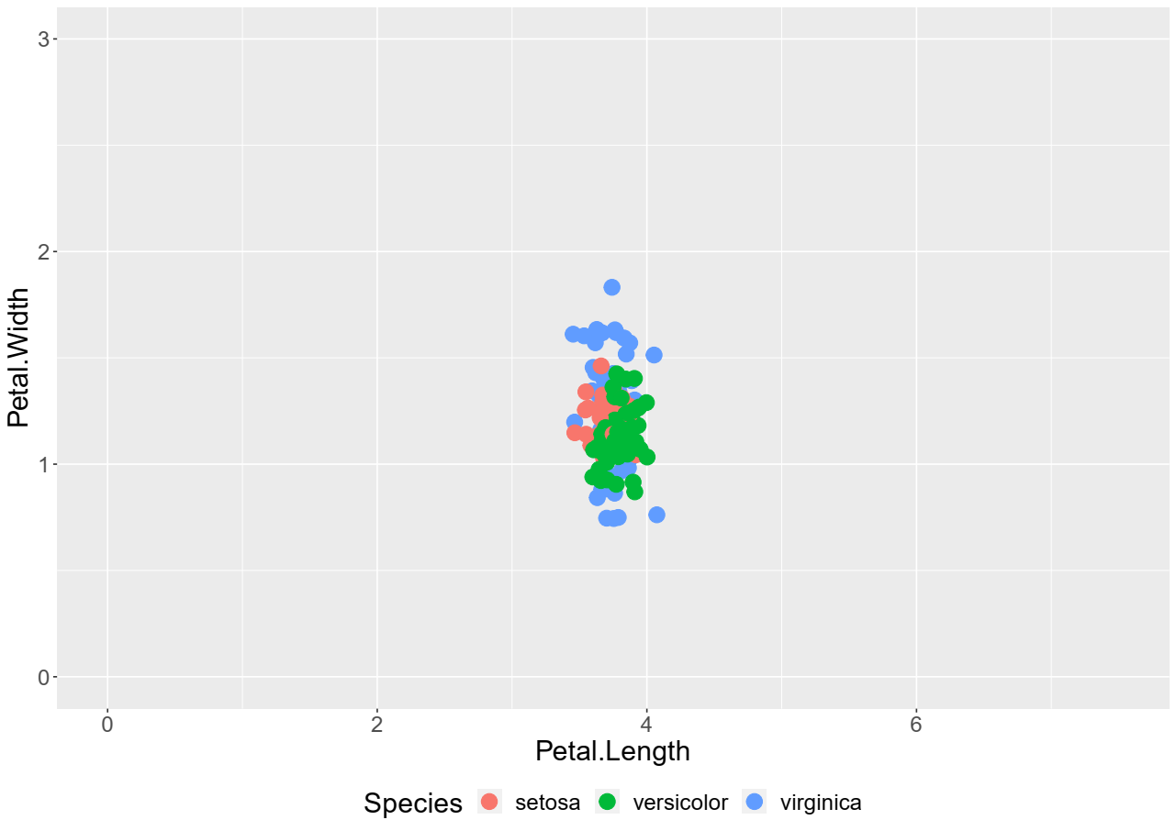
Feature space: Before and after confounder removal comparison
Before removal
After removal

Slide 11
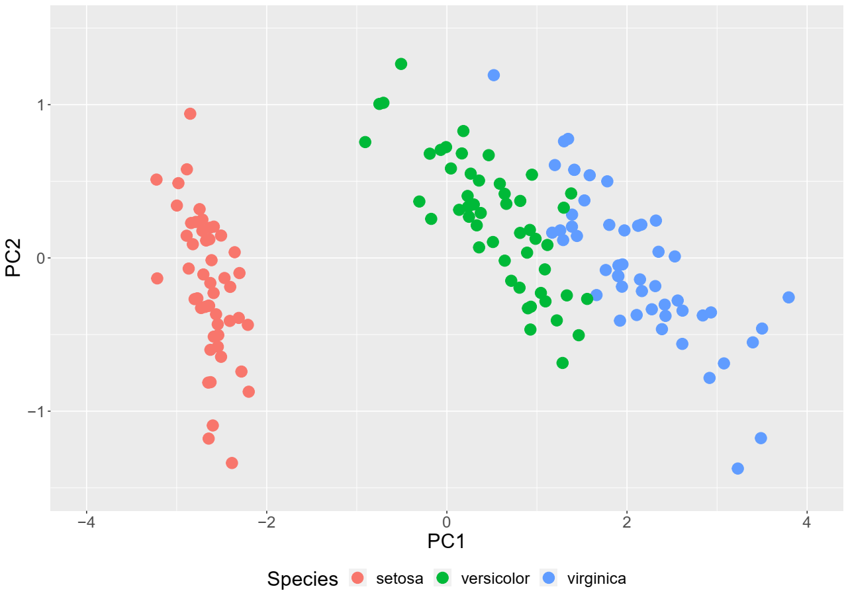
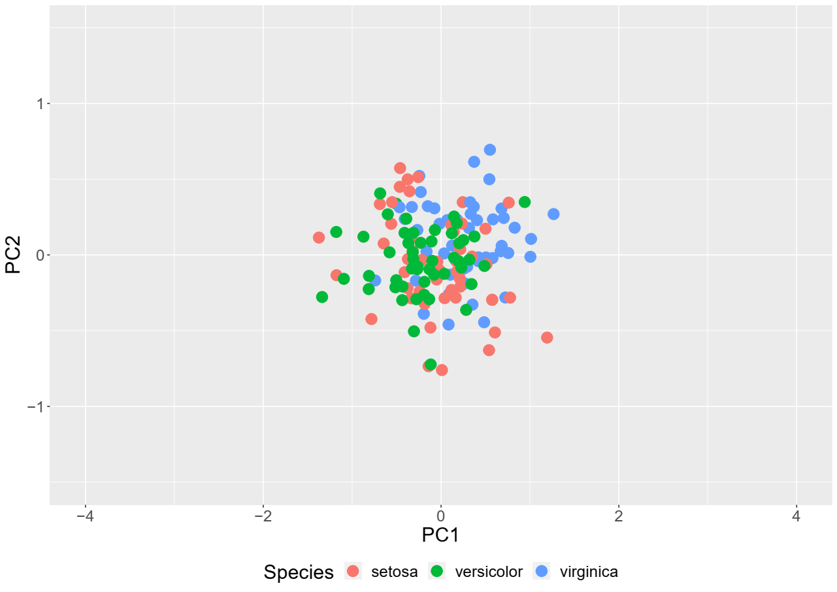
PCA space: Before and after confounder removal comparison
Before removal
After removal

