Slide 1
Neural Networks
Phuc Loi Luu, PhD
luu.p.loi@googlemail.com
p.luu@garvan.org.au

Slide 2
Content
Review Linear Regression and Logistic Regression
Decision Boundary
Introduction to Neural Network
Example 1: coding a perceptron
Example 2: calculate a perceptron
XOR Problem
Homework

Slide 3
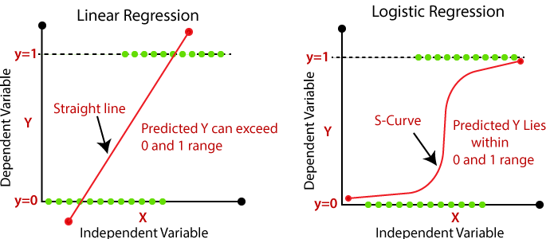
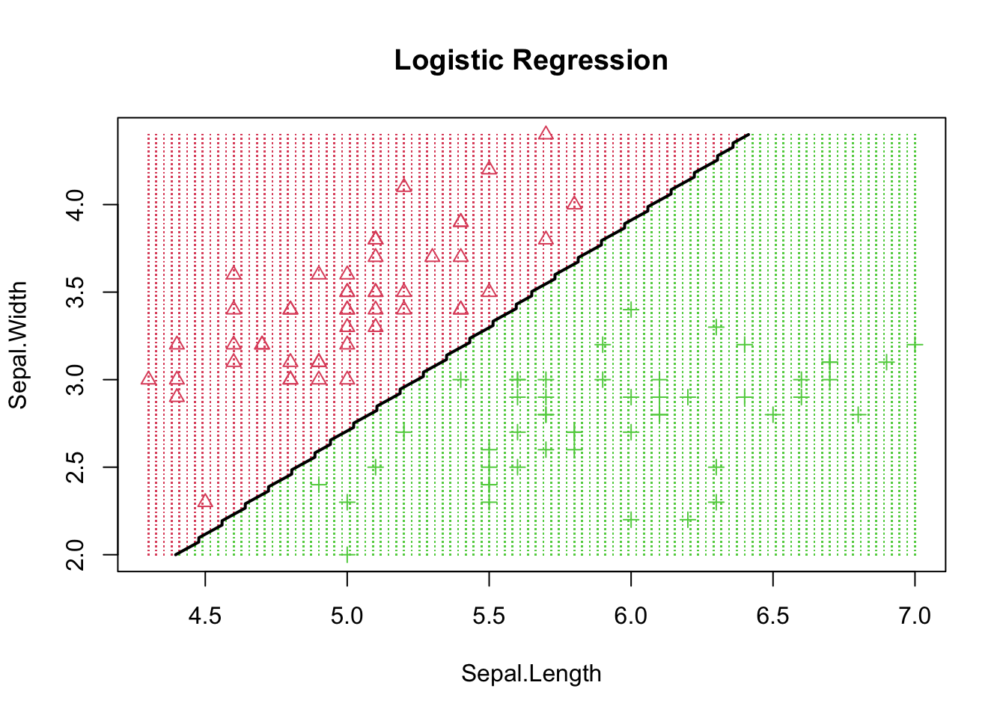
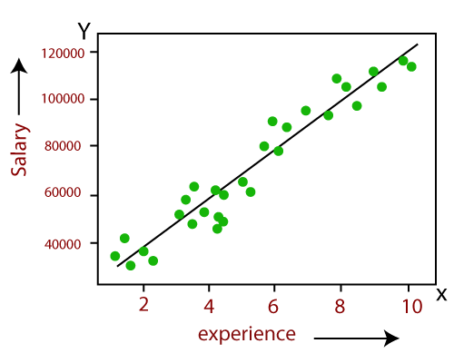
Review Linear Regression and Logistic Regression
 | Supervise Learning | Linear Regression (Regression) | Logistic Regression (Classification)
1 | Response/ Dependent variable | Continuous | Binary/Bernulli/Binominal
2 | Loss/Cost Function | L1, L2=Sum(y-yh)^2 | Cross entropy = ?
3 | Find Solution | 1. Gradient descent 2. Pseudo Inverse: Ax=b A^{T}Ax=A^{T}b x = (A^{T}A)⁻¹A^{T}b | 1. Gradient descent
https://www.javatpoint.com/linear-regression-vs-logistic-regression-in-machine-learning

Slide 4
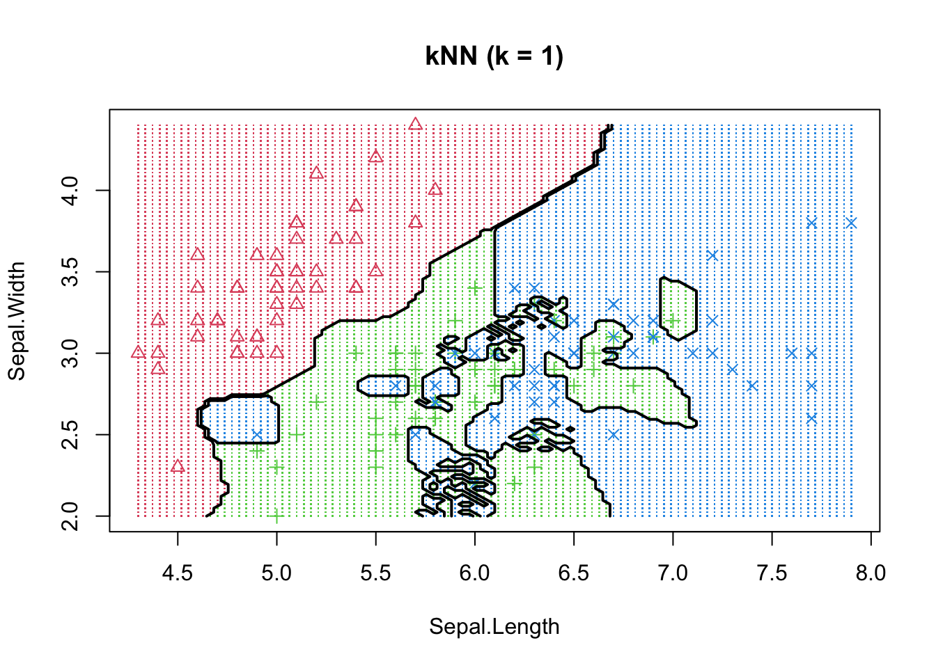
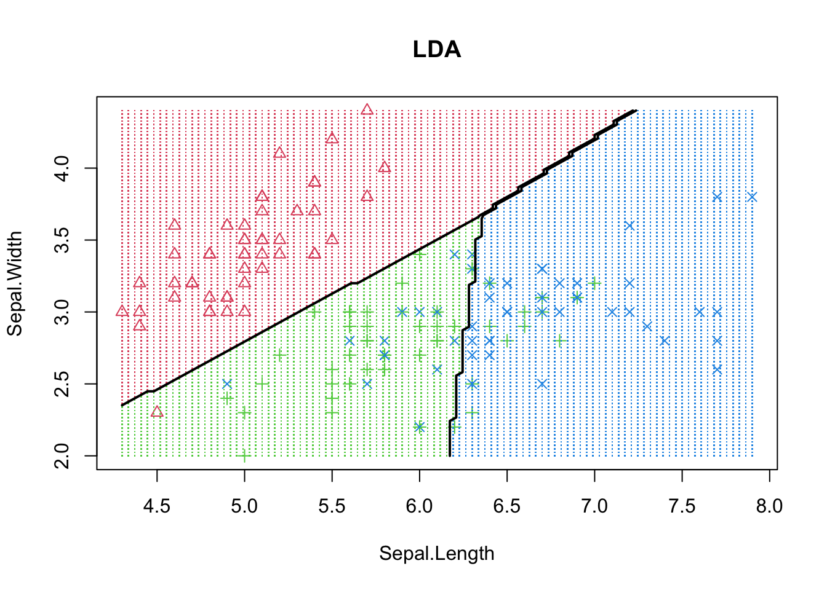
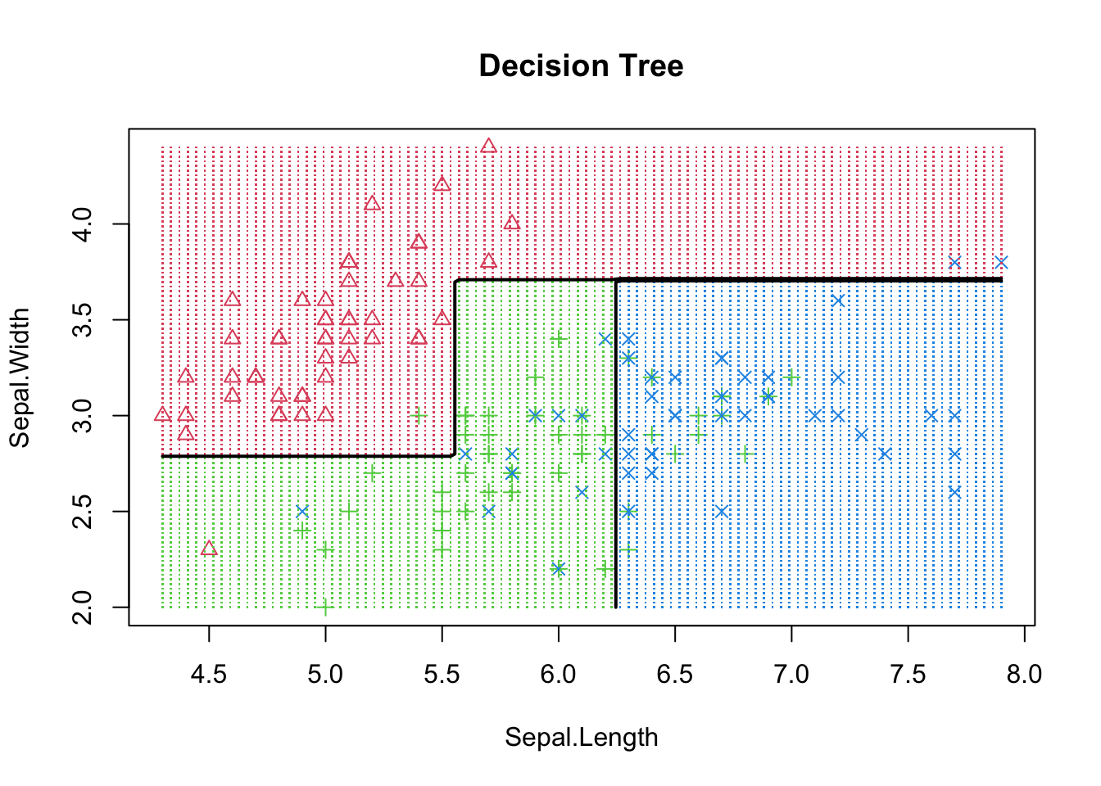
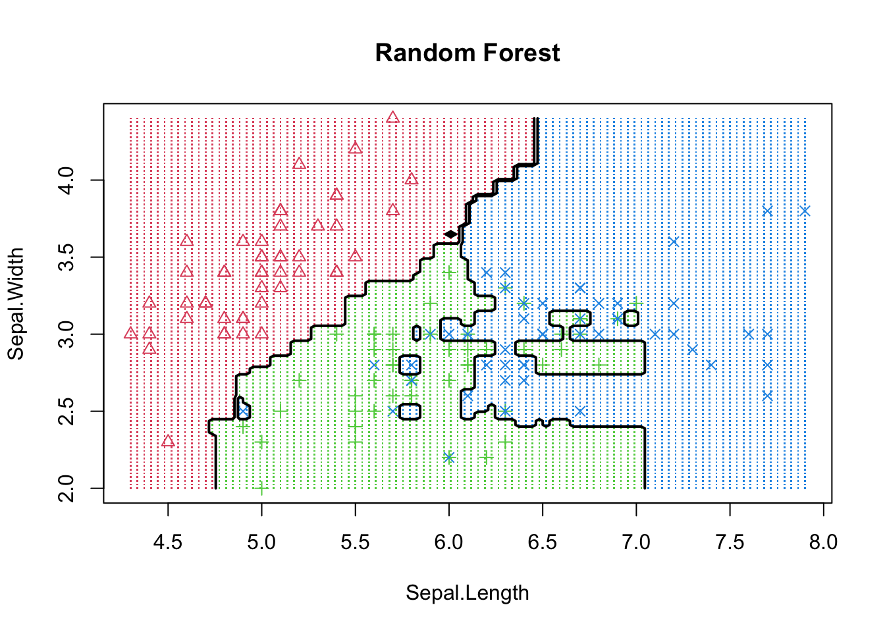
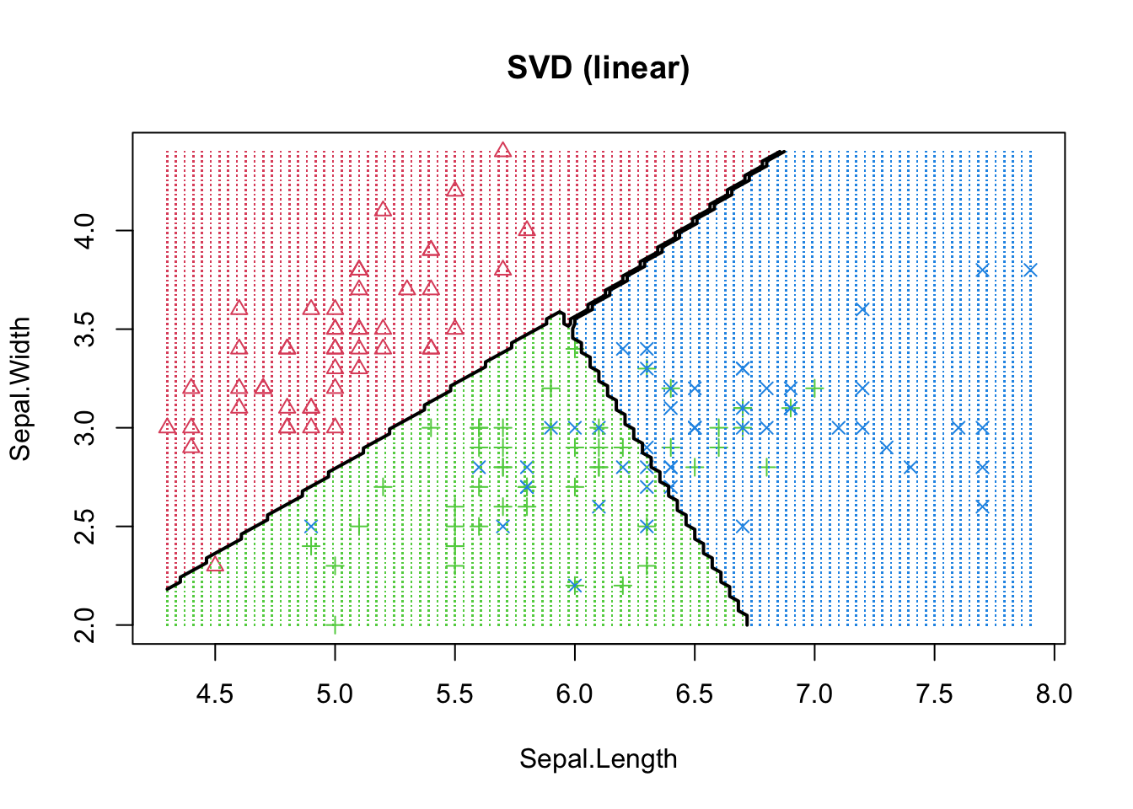
Decision Boundary
https://rpubs.com/ZheWangDataAnalytics/DecisionBoundary

Slide 5
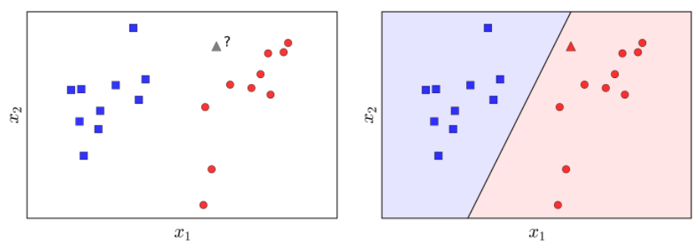
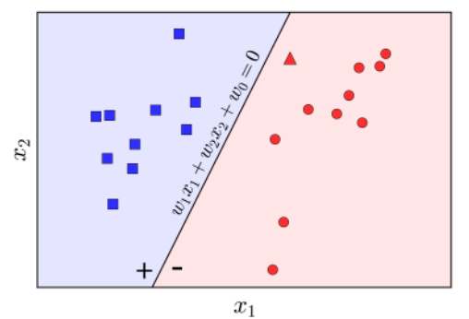
Introduction to Neural Network

Slide 6
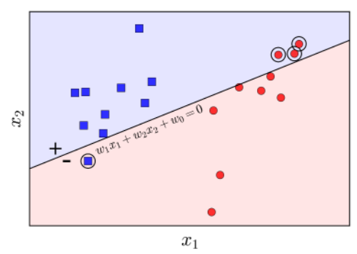
Introduction to Neural Network
https://machinelearningcoban.com/2017/01/21/perceptron/

Slide 7
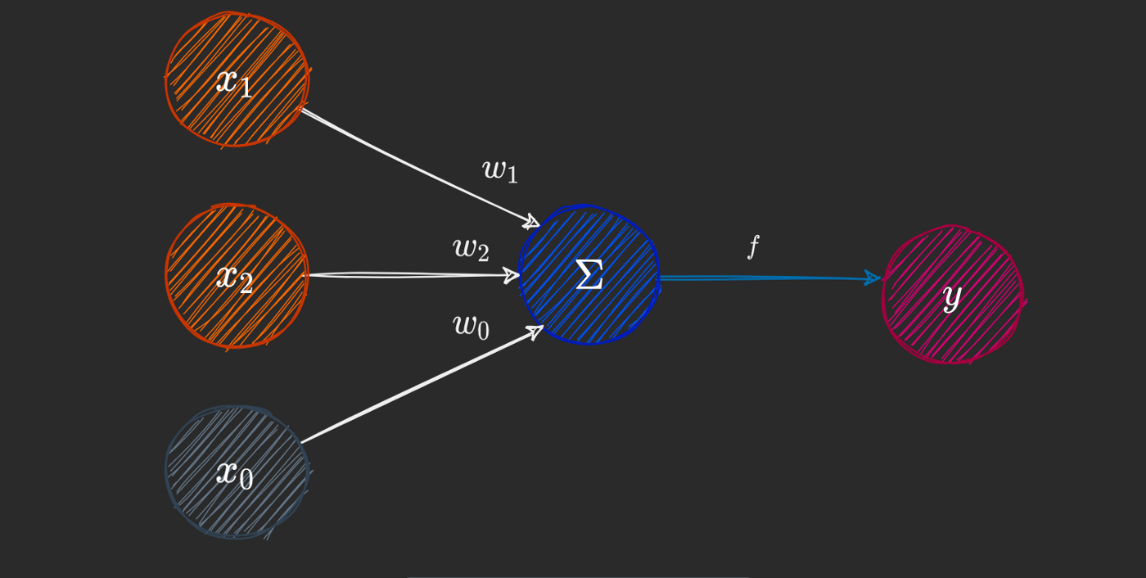
Perceptron
https://towardsdatascience.com/how-neural-networks-solve-the-xor-problem-59763136bdd7

Slide 8
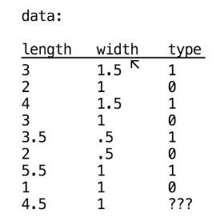
Example 1: coding a perceptron
https://www.youtube.com/watch?v=gQLKufQ35VE
Homework 1: create a neural network to solve this problem using R

Slide 9
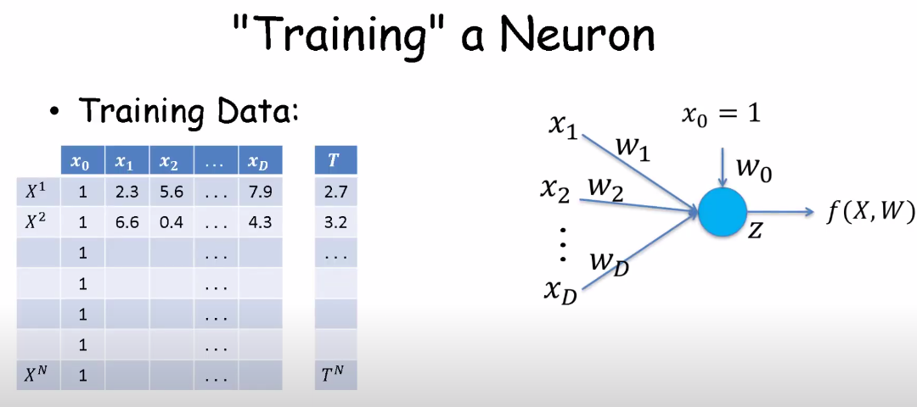
Example 2: calculate a perceptron
https://www.youtube.com/watch?v=LPBRVWTstEU
Homework 2: create a neural network (linear and sigmoid function) to solve this problem using R

Slide 10
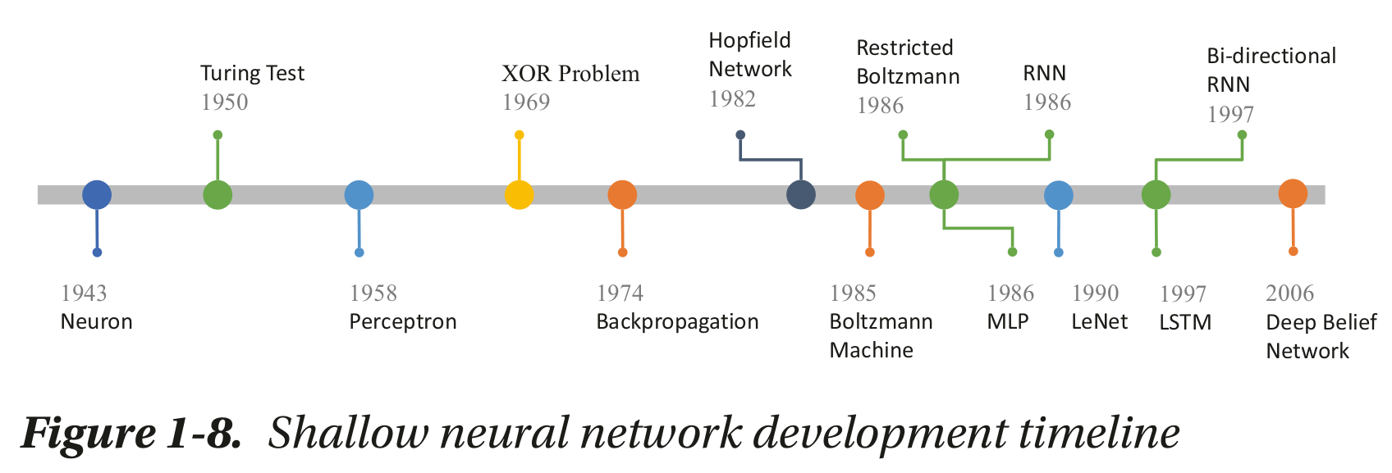
Neural Network
Beginning Deep Learning with TensorFlow Work with Keras

Slide 11
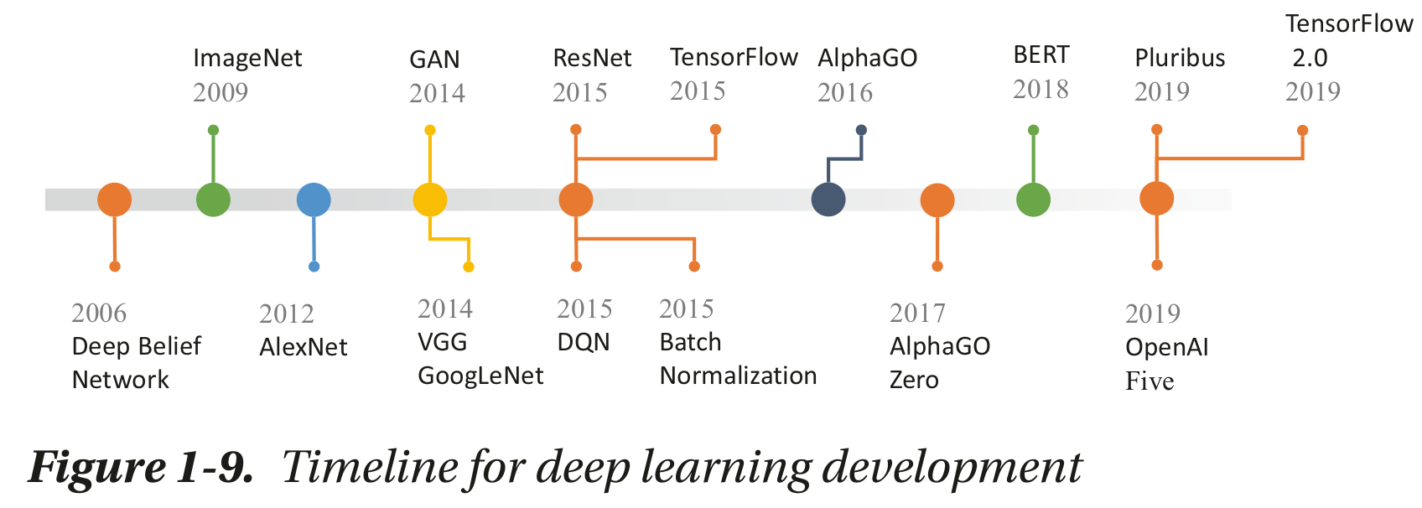
Deep Learning
Beginning Deep Learning with TensorFlow Work with Keras

Slide 12
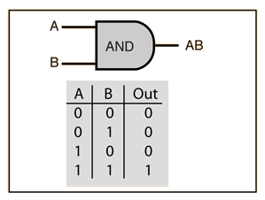
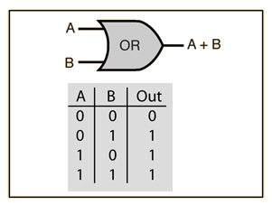
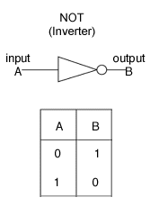
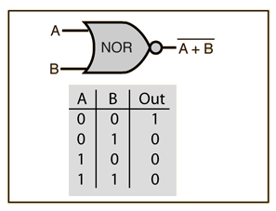
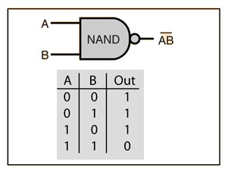
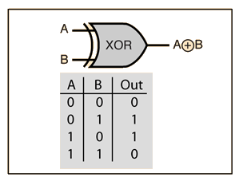
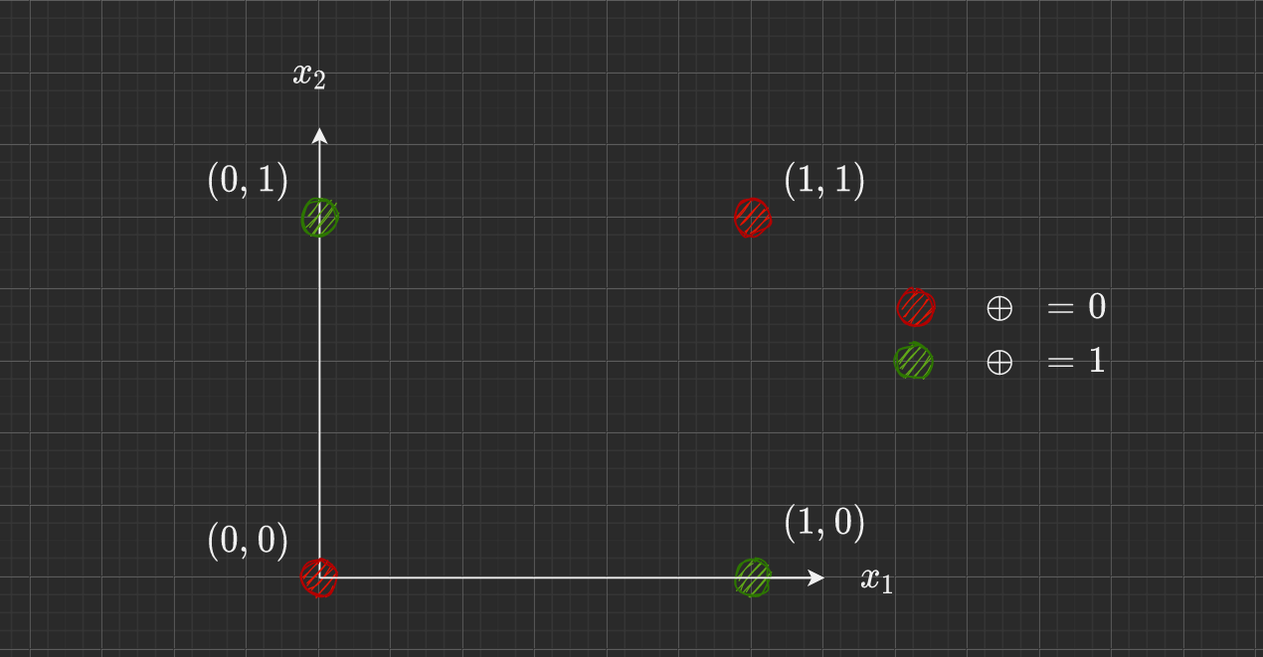
AND, OR, NOT and XOR problem
https://medium.com/@stanleydukor/neural-representation-of-and-or-not-xor-and-xnor-logic-gates-perceptron-algorithm-b0275375fea1

Slide 13
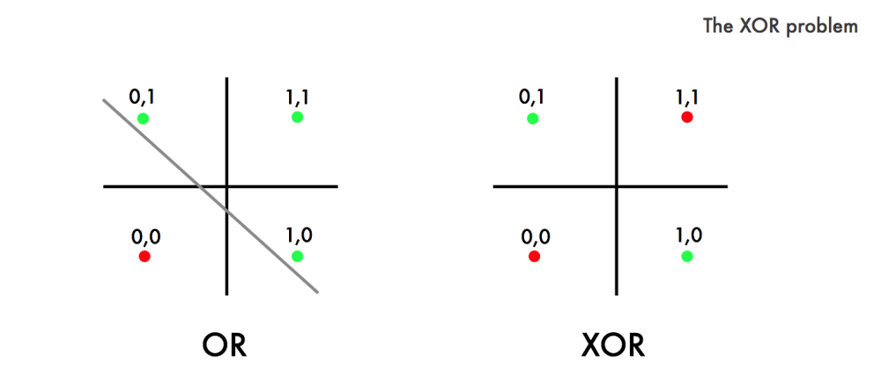
OR and XOR problem
https://dev.to/jbahire/demystifying-the-xor-problem-1blk

Slide 14
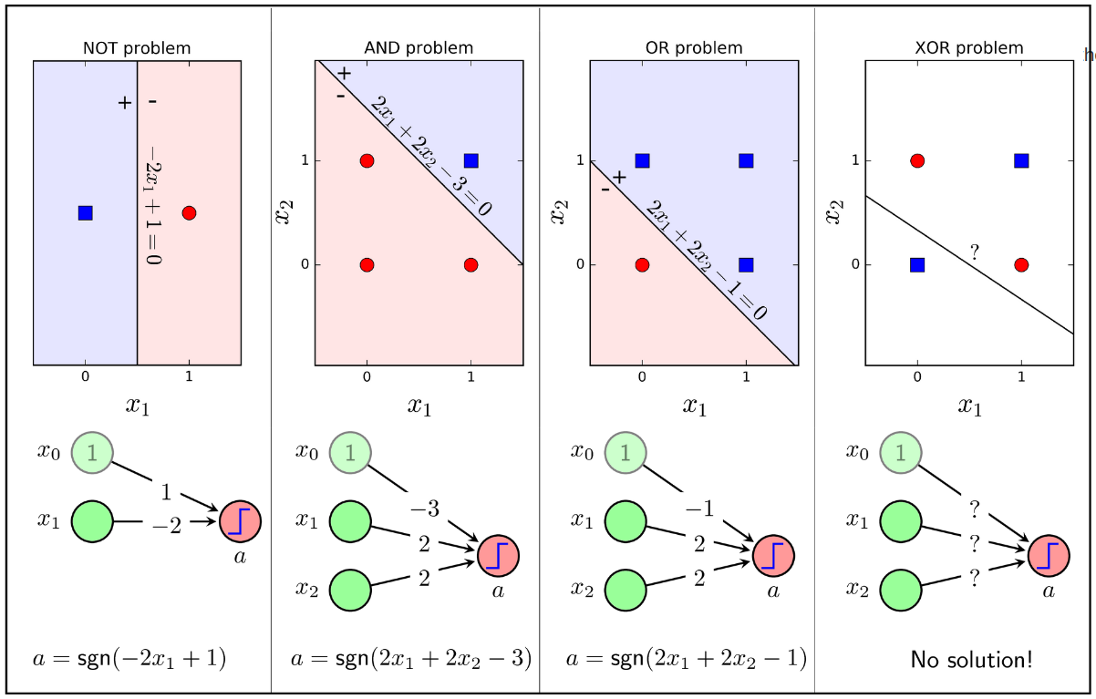
https://machinelearningcoban.com/2017/02/24/mlp/

Slide 15
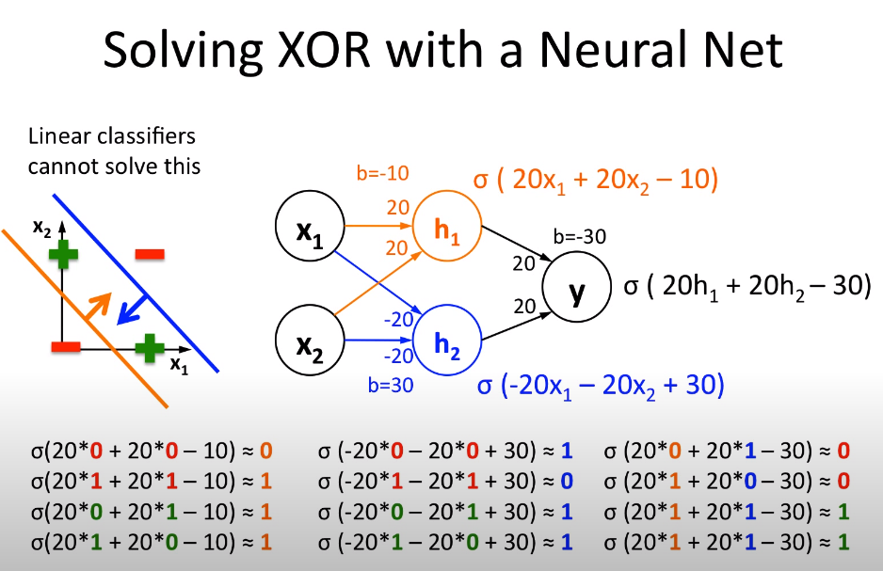
Homework 3: create a neural network for this example to solve the XOR problem using R
https://www.youtube.com/watch?v=kNPGXgzxoHw

Slide 16
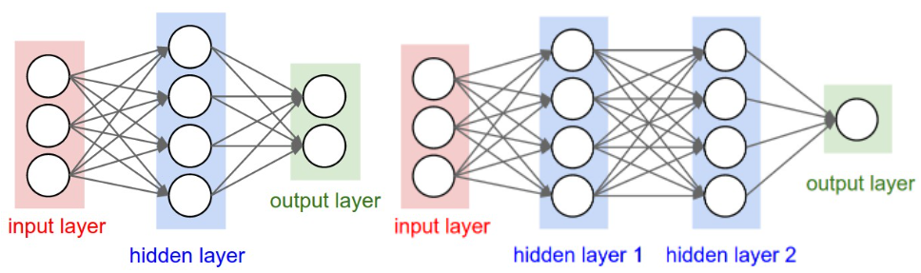
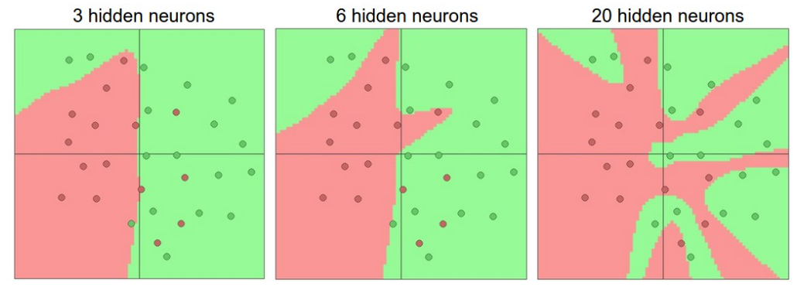
But too many hidden layers will lead to overfit
https://github.com/cs231n/cs231n.github.io/blob/master/neural-networks-1.md

Slide 17
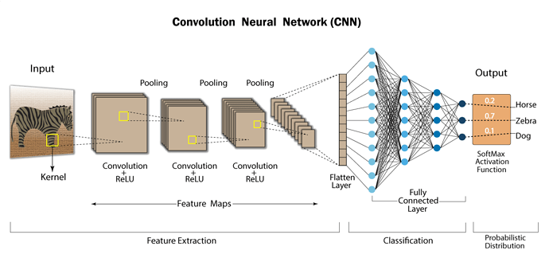
https://discuss.boardinfinity.com/t/what-do-you-mean-by-convolutional-neural-network/8533

Slide 18


Slide 19
Homework 4: Plot the decision boundary with number of hidden layer = 3, 5, 10 for the Iris data with the last 2 class (- Setosa)
Homework 5: Build the NN for homework 1 using cross entropy loss function and compare the results to homework 1

