Slide 1
Booostrap
Nguyen Minh Hoang

Slide 2
OUTLINE
1) Main idea of method
2) How it works
3) Booostrap for estimate standard errors (statistics)
4) Bootstrap aggregating for machine learning
6) Exercises

Slide 3
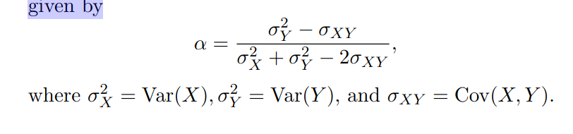
MAIN IDEA
A simple example
• Suppose that we wish to invest a fixed sum of money in two financial assets that yield returns of X and Y , respectively, where X and Y are random quantities.
• We will invest a fraction α of our money in X, and will invest the remaining 1 − α in Y .
• We wish to choose α to minimize the total risk, or variance, of our investment. In other words, we want to minimize Var(αX + (1 − α)Y ).
• One can show that the value that minimizes the risk is given by

Slide 4
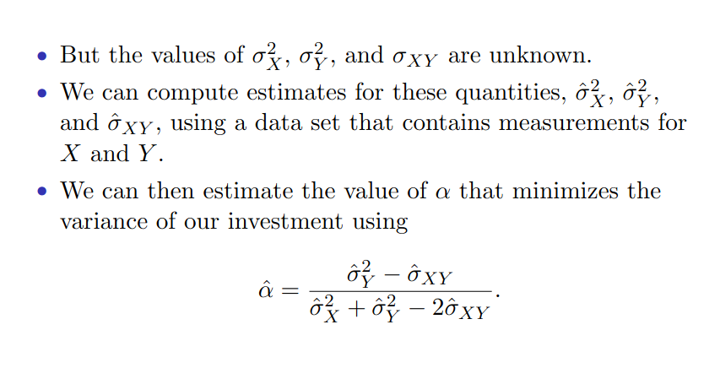
MAIN IDEA

Slide 5
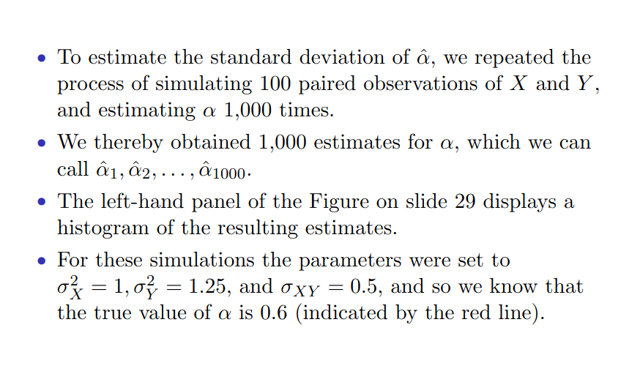
MAIN IDEA

Slide 6
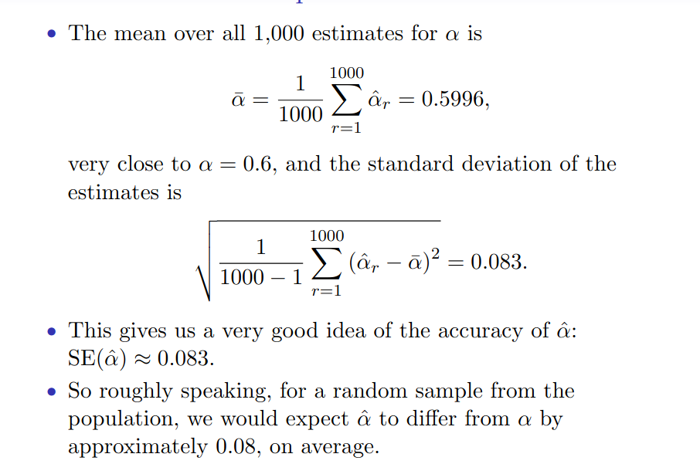
MAIN IDEA

Slide 7
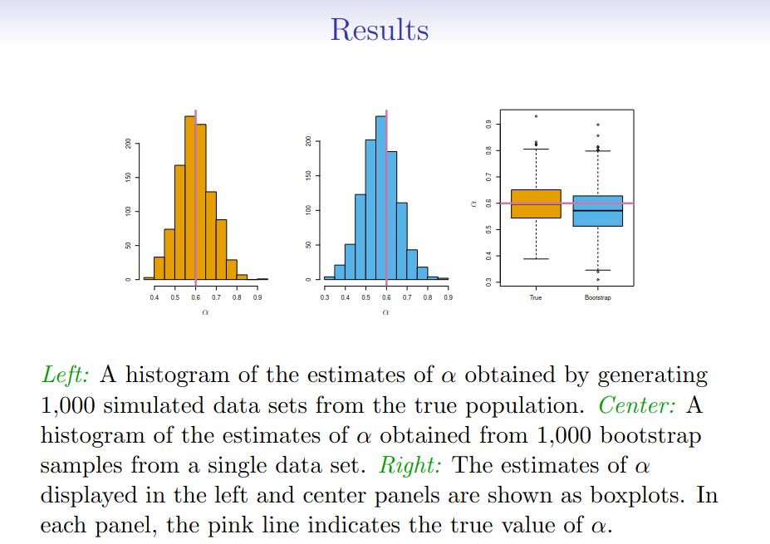
MAIN IDEA
Notes:
The procedure outlined above cannot be applied, because for real data we cannot generate new samples from the original population.
• However, the bootstrap approach allows us to use a computer to mimic the process of obtaining new data sets, so that we can estimate the variability of our estimate
without generating additional samples.
• Rather than repeatedly obtaining independent data sets from the population, we instead obtain distinct data sets by repeatedly sampling observations from the original data
set with replacement

Slide 8
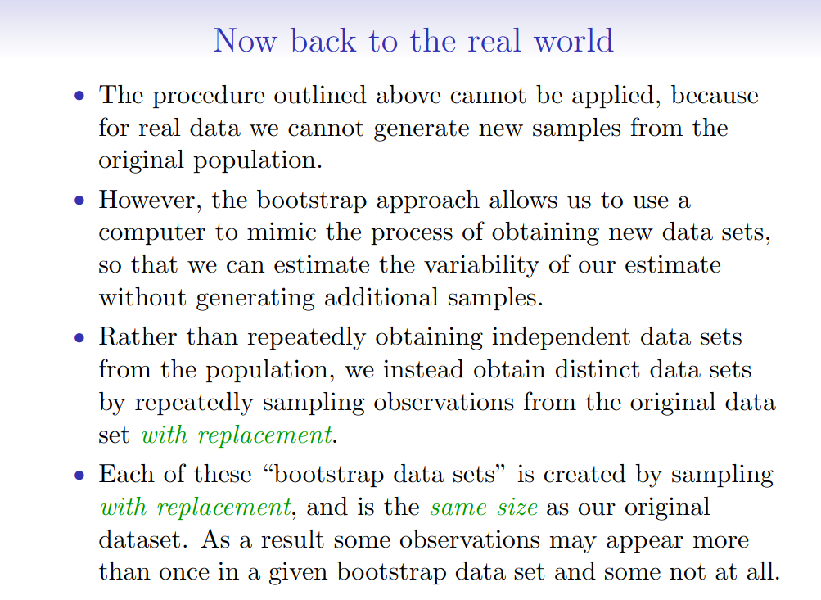
MAIN IDEA

Slide 9
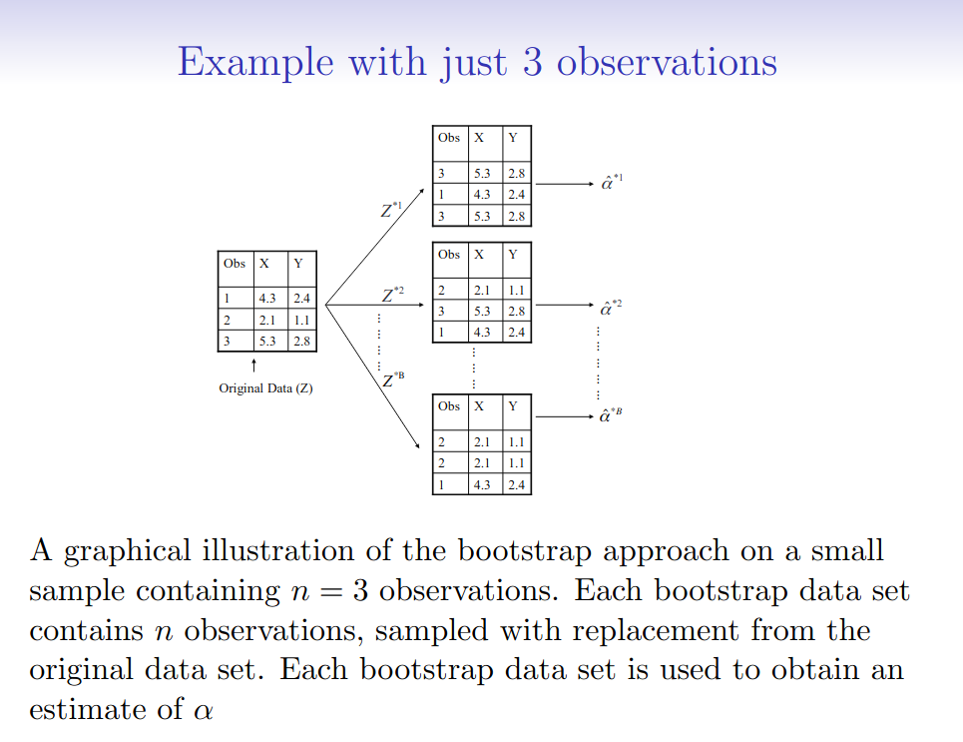
MAIN IDEA

Slide 10
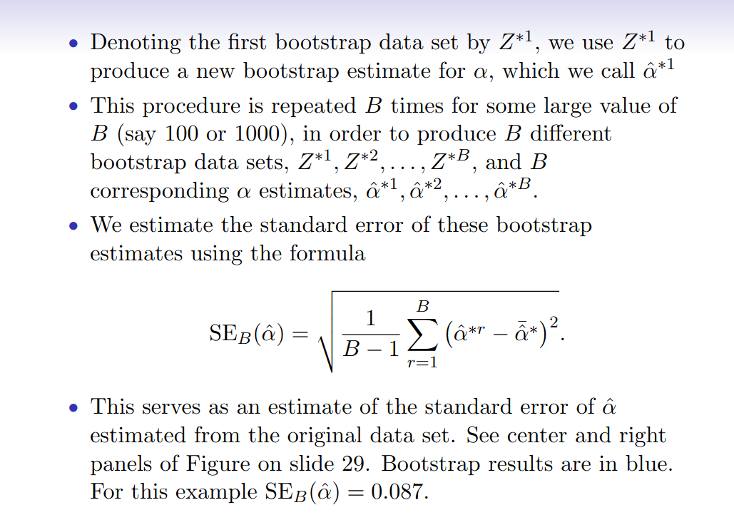
MAIN IDEA

Slide 11
MAIN IDEA
Notes:
The procedure outlined above cannot be applied, because for real data we cannot generate new samples from the original population.
• However, the bootstrap approach allows us to use a computer to mimic the process of obtaining new data sets, so that we can estimate the variability of our estimate
without generating additional samples.
• Rather than repeatedly obtaining independent data sets from the population, we instead obtain distinct data sets by repeatedly sampling observations from the original data
set with replacement

Slide 12
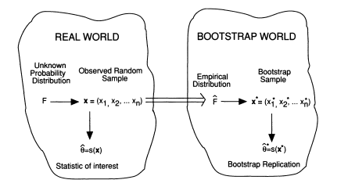
Boootstrap method = a method of inference
MAIN IDEA
Basic idea: to generate a lot of artifical datasets and to access the variability of a statistic from its variability over all the sets of afrtificial data.
Each of these “bootstrap data sets” is created by sampling with replacement, and is the same size as our original dataset. As a result some observations may appear more than once in a given bootstrap data set and some not at all.

Slide 13
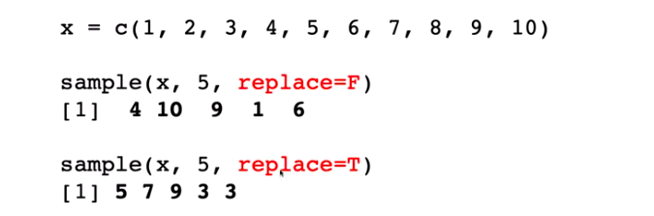
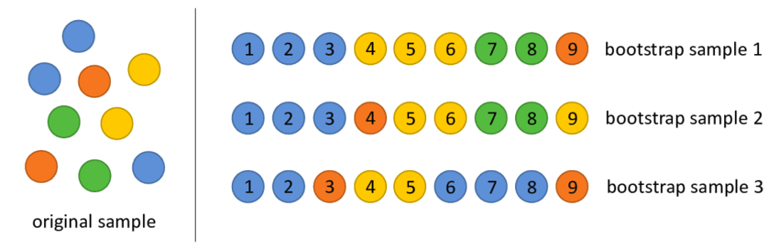
Sampling with Replacement
Sampling without replacement: each sample unit of the population has only one chance to be selected n the sample.
Sampling with replacement: a sample unit selected at random from the population is returned to the population, and then a second unit is selected at random

Slide 14
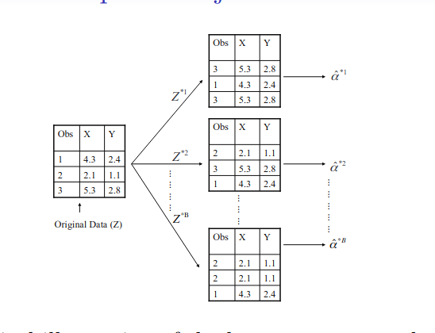
Sampling with Replacement
A graphical illustration of the bootstrap approach on a small sample containing n = 3 observations. Each bootstrap data set contains n observations, sampled with replacement from the original data set. Each bootstrap data set is used to obtain an estimate of α

Slide 15
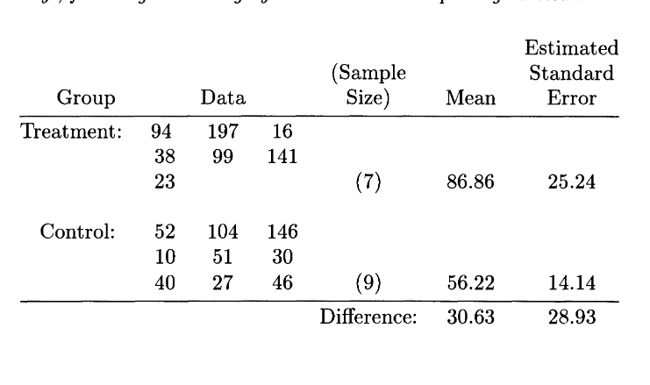
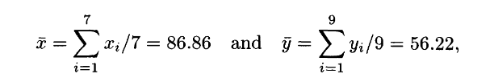



Booostrap for estimate standard errors.
Mean
Standard Error
Table: The mouse data. Sixteen mice were randomly assigned to a treatment group or a control group. Shown are their survival times, in days, following a test surgery. Did the treatment prolong survival?
We see that the observed difference 30.63 is only 30.63/28.93 = 1.05 estimated standard errors greater than zero.
Notes:
Unfortunately standard errors have a major disadvantage: for most statistical estimators other than the mean there is no formula like (2.2) to provide
estimated standard errors. In other words, it is hard to assess the accuracy of an estimate other than the mean.
The two medians are 94 for treatment and 46 for control, giving an estimated difference of 48, considerably more than the difference of the means. But how accurate are these medians?

Slide 16
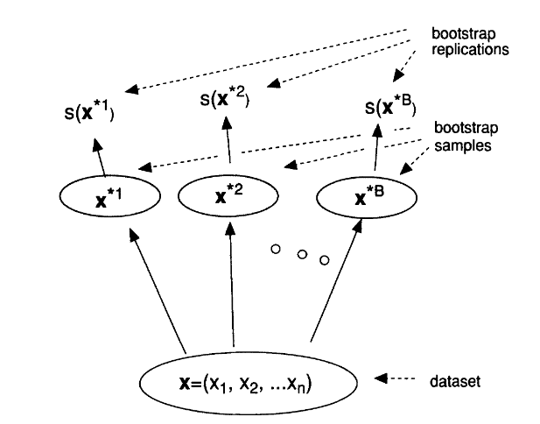


Booostrap for estimate standard errors.
Sampling with replacemen
The bootstrap algorithm
1. Generating a large number of independent bootstrap samples x* ¹ , x* ² , · • · , x* ^{B} , each of size n
2. Corresponding to each bootstrap sample is a bootstrap replication of s, namely s(x*^{b}), the value of the statistic s evaluated for x*^{b}.
3. The bootstrap estimate of standard error is the standard deviation of the bootstrap replications,
a schematic of the bootstrap process.

Slide 17
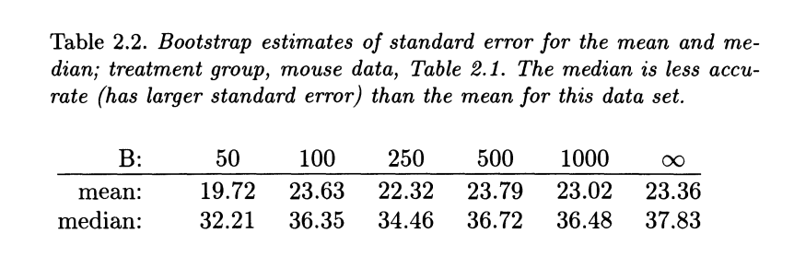
Booostrap for estimate standard errors.
The treatment group
We are now in a position to assess the precision of the difference in medians between the two groups.
The control group
A standard error of Median estimate of 11.54
The observed difference of 48 has an estimated standard error of √36.35 2 + 11.542 = 38.14, and
hence is 48/38.14 = 1.26.
This is larger than the observed difference in means, but is still insignificant.

Slide 18
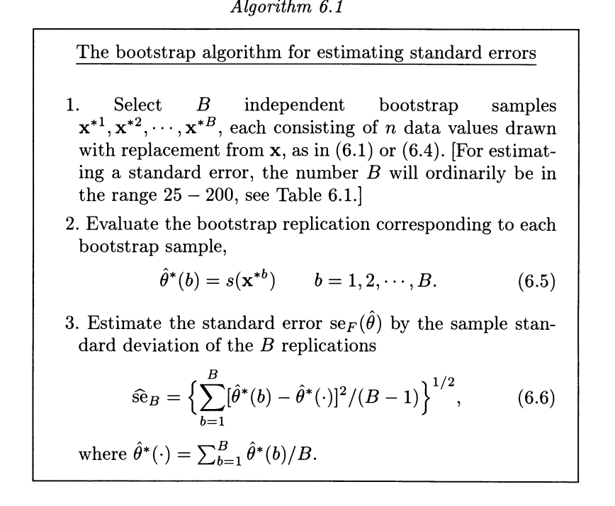
Booostrap for estimate standard errors.

Slide 19
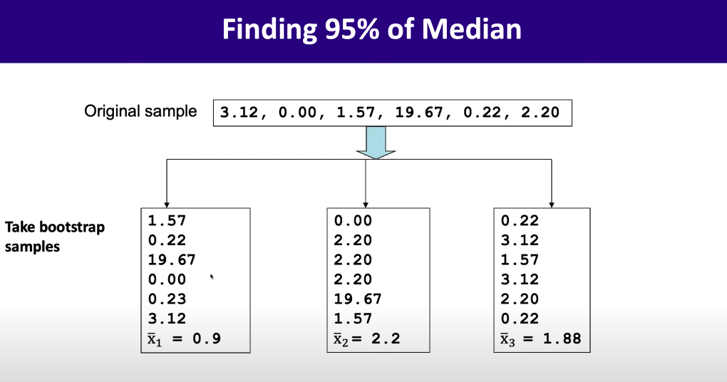
Booostrap for estimate Confident interval

Slide 20
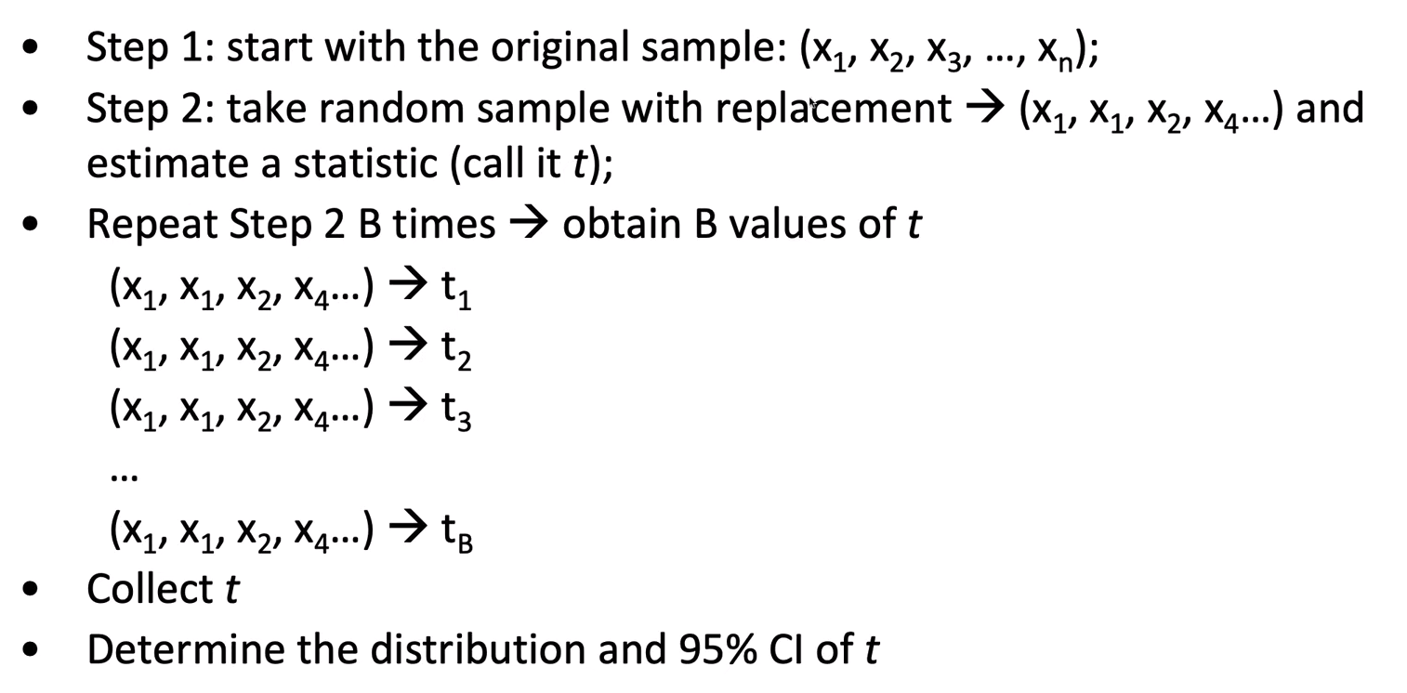
Booostrap for estimate Confident interval

Slide 21
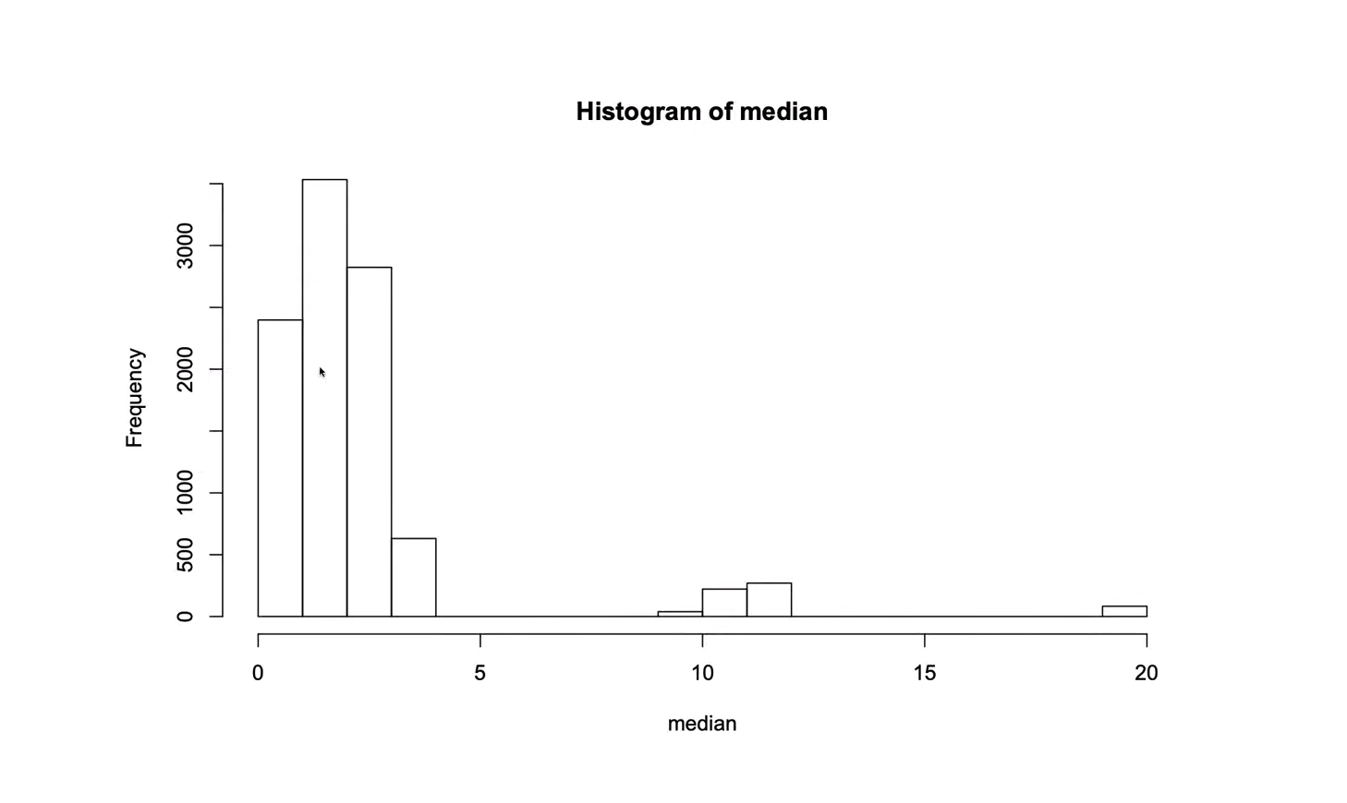
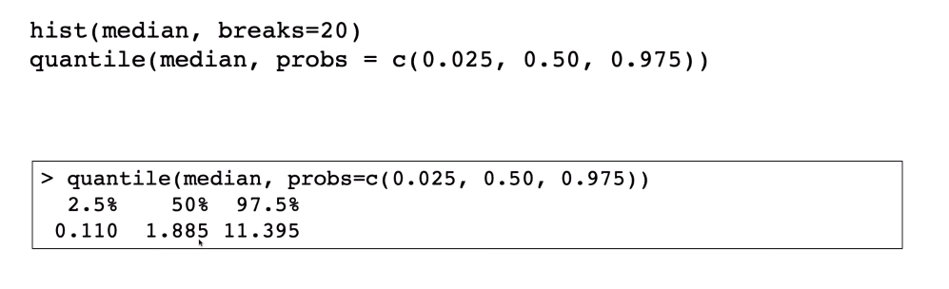
Booostrap for estimate Confident interval

Slide 22
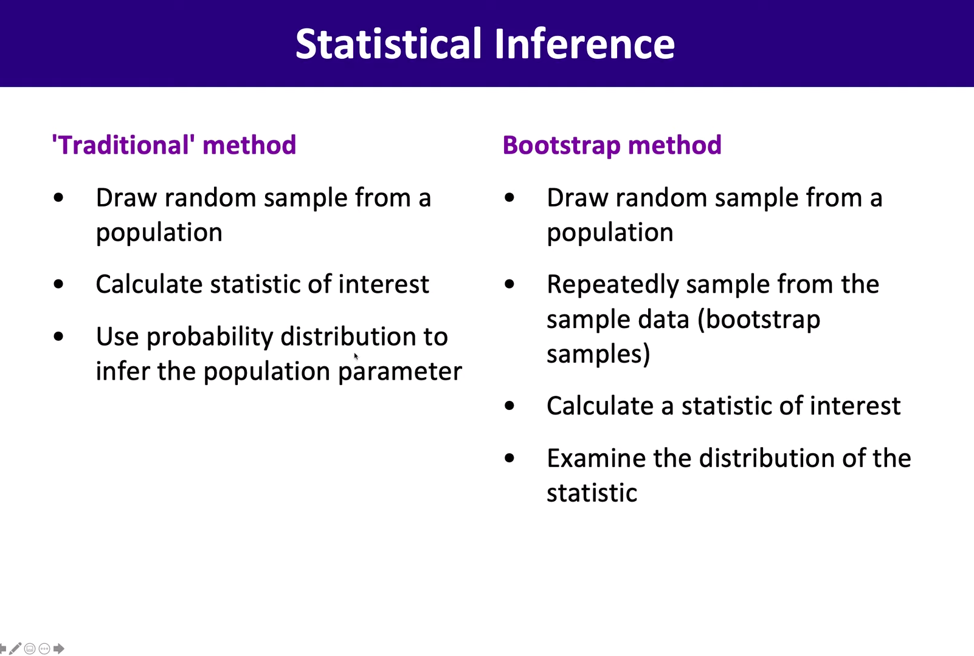
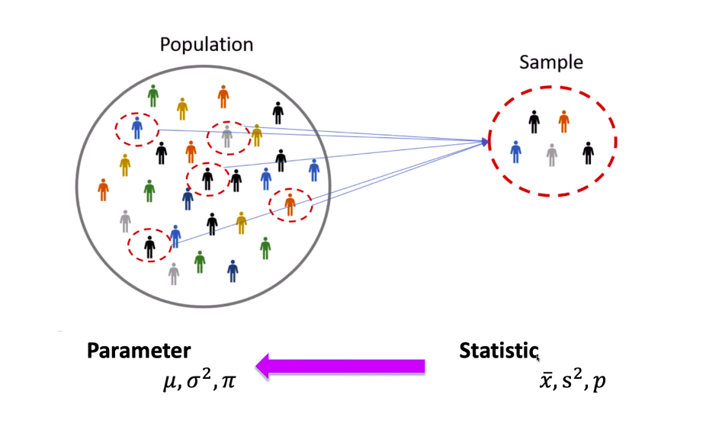
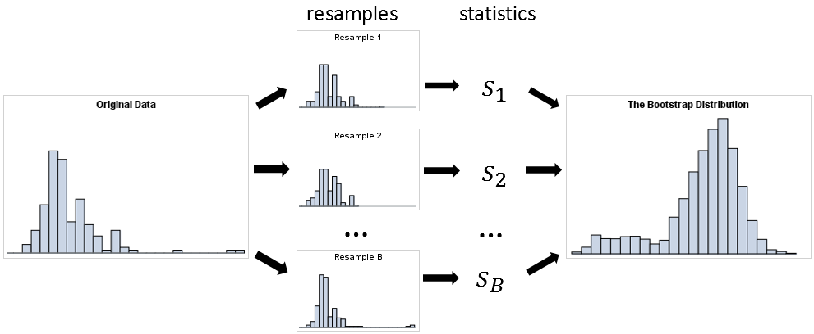
Summary
https://www.youtube.com/watch?v=o_uKEwqw7hY&t=576s

Slide 23
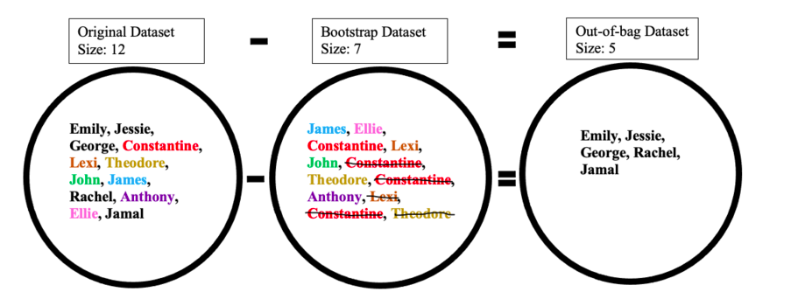
BOOOTSTRAPS IN MACHINE LEARNING
Creating the bootstrap dataset
Bootstrap sampling is used in a machine learning ensemble algorithm called bootstrap aggregating (also called bagging). It helps in avoiding overfitting and improves the stability of machine learning algorithms.
Creation of Decision Trees and Random forest
https://en.wikipedia.org/wiki/Bootstrap_aggregating
Notes:
Creating the bootstrap and out-of-bag datasets is crucial since it is used to test the accuracy of a random forest algorithm. For example, a model that produces 50 trees using the bootstrap/out-of-bag datasets will have a better accuracy than if it produced 10 trees. Since the algorithm generates multiple trees and therefore multiple datasets the chance that an object is left out of the bootstrap dataset is low. The next few sections talk about how the random forest algorithm works in more detail.

