Slide 1
Spectral Clustering
Tran Thi Hong Minh

Slide 2
Contents
Why spectral clustering?
Unnormalized spectral clustering algorithm
Graph Laplacians
What makes a good cut?
Other spectral clustering algorithms

Slide 3
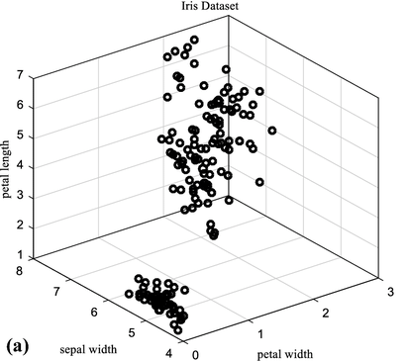
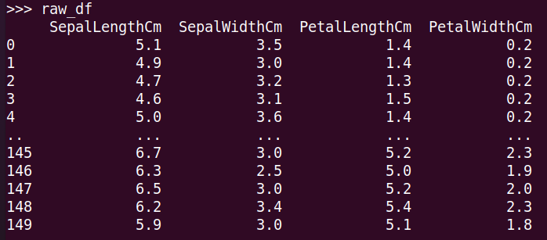
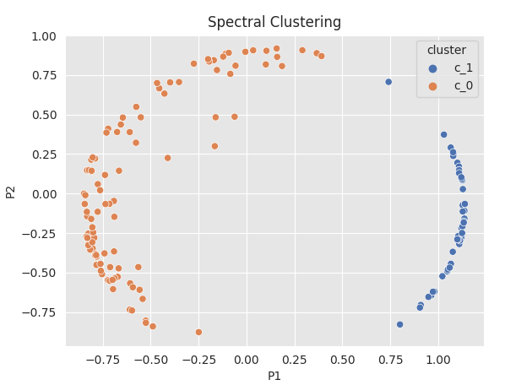

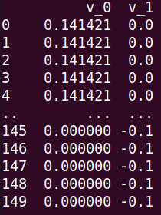
Why Spectral Clustering?
Spectral clustering
Obtain data representation in the low-dimensional space that can be easily clustered
Data of n objects and m features
nxk matrix (k<n)
Graph Laplacians
nxn weight matrix

Slide 4
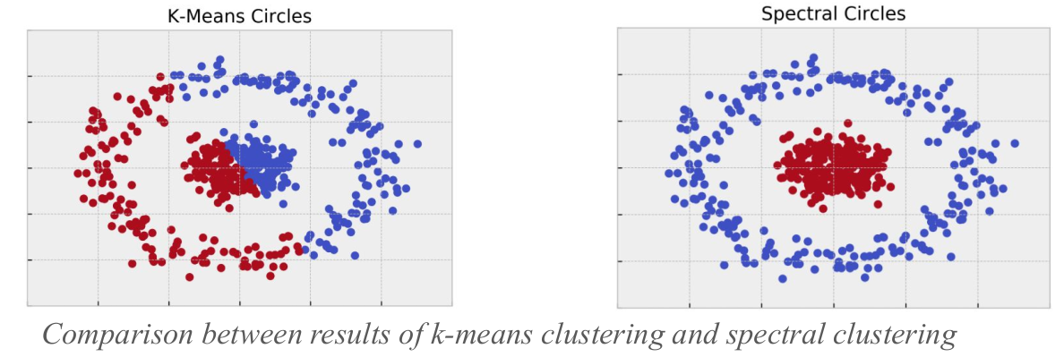
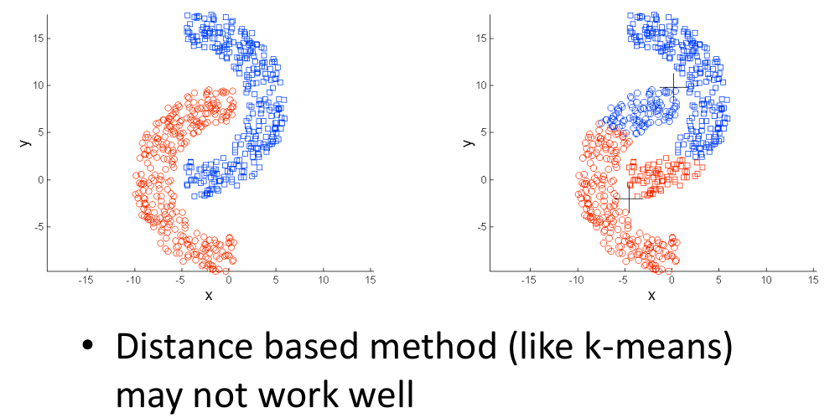
Make no assumptions on the shapes of clusters => solve complex scenarios, such as intertwined spirals
Spectral clustering
k-means

Slide 5
Unnormalized spectral clustering
Construct similarity graph (similarity matrix nxn S) → adjacency matrix A + degree matrix D
Build graph Laplacian
Get eigenvalues and eigenvectors of L
Form a n×k matrix U with eigenvectors (k<n) as columns
Treat each row of U as a data point, run some simple clustering algorithm such as K-means to cluster the points

Slide 6
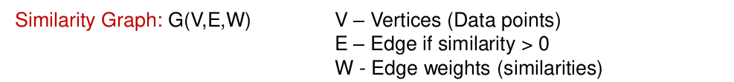
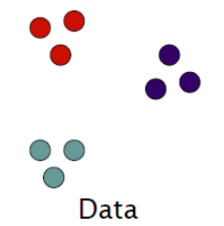
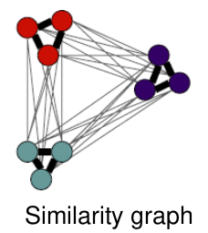
Similarity Graph and Adjacency matrix
Small weight
K-nearest neighbors
Large weight
Edges within a group have large weights and
Edges across groups have small weights

Slide 7
 | Gene 1 | Gene 2
Cell 1 | 3 | 0.3
Cell 2 | 2.8 | 0.3
Cell 3 | ... | ...
Cell 4 | ... | ...
Cell 5 | ... | ...
Cell 6 | ... | ...
Dist₁₂ = sqrt[(3-2.8)² + (0.3-0.3)²] = 0.2
Dist₁₃ = ...
 | 1 | 2 | 3 | 4 | 5
2 | 0.2
3 | 0.4 | 0.2
4 | 1 | 1 | 0.8
5 | 0.9 | 1 | 1 | 0.2
6 | 1 | 1 | 1 | 0.3 | 0.2
Similarity = 1 - dist/max(dist)
 | 1 | 2 | 3 | 4 | 5
2 | 0.8
3 | 0.6 | 0.8
4 | 0 | 0 | 0.2
5 | 0.1 | 0 | 0 | 0.8
6 | 0 | 0 | 0 | 0.7 | 0.8

Slide 8
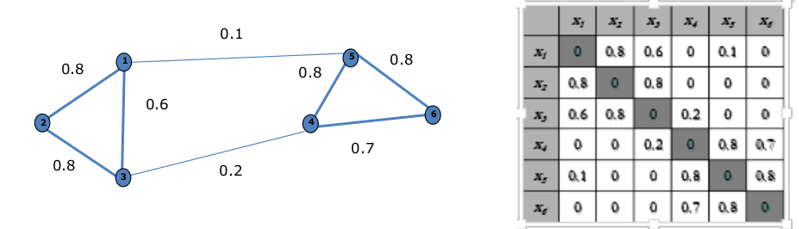
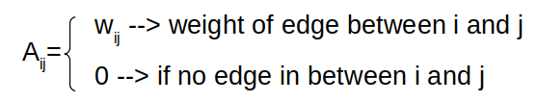
Similarity Graph and Adjacency matrix
Adjacency matrix (A)
Small weight
Large weight
 | 1 | 2 | 3 | 4 | 5
2 | 0.8
3 | 0.6 | 0.8
4 | 0 | 0 | 0.2
5 | 0.1 | 0 | 0 | 0.8
6 | 0 | 0 | 0 | 0.7 | 0.8
j
i

Slide 9
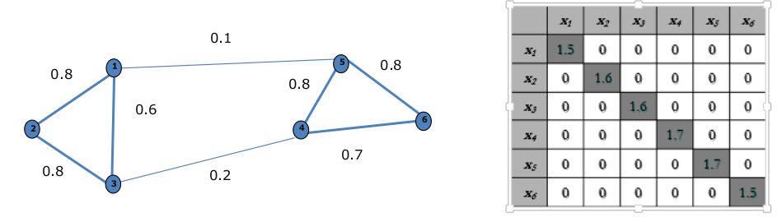
Degree matrix

Slide 10
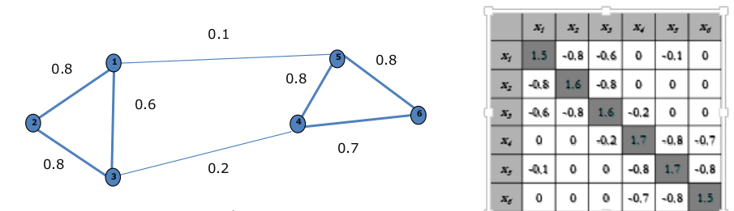
-
=

Slide 11
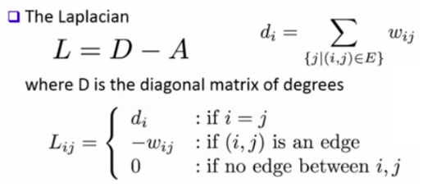
Un-normalized Laplacian
Un-normalized Laplacian

Slide 12
Unnormalized spectral clustering
0. Raw data (n rows/samples + m columns/features) → similarity matrix
Construct similarity graph (similarity matrix nxn S) → adjacency matrix A + degree matrix D
Build graph Laplacian (Laplacian matrix) L
Get eigenvalues and eigenvectors of L
Form a n×p matrix U with eigenvectors (p<n) as columns
Treat each row of U as a data point, run some simple clustering algorithm such as K-means to cluster the points
Find k cluster based on elbow rule

Slide 13
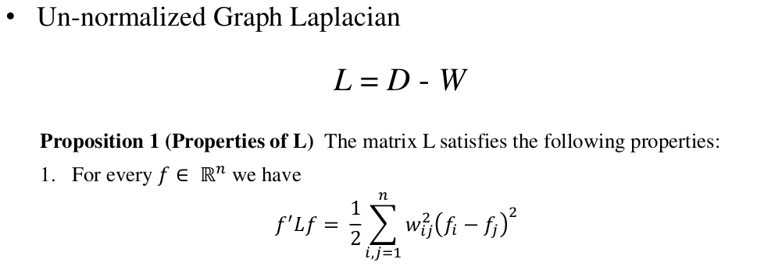
Graph Laplacians
Eigenvector f and Eigenvalue λ (Lf = λf)
f^{T}Lf ≥ 0
f^{T}Lf = f^{T}λf ≥ 0
f^{T}Lf = λf^{T}f = λ ≥ 0
The smallest λ = 0
What is the meaning of the smallest λ?
The null space of L: N(L)

Slide 14
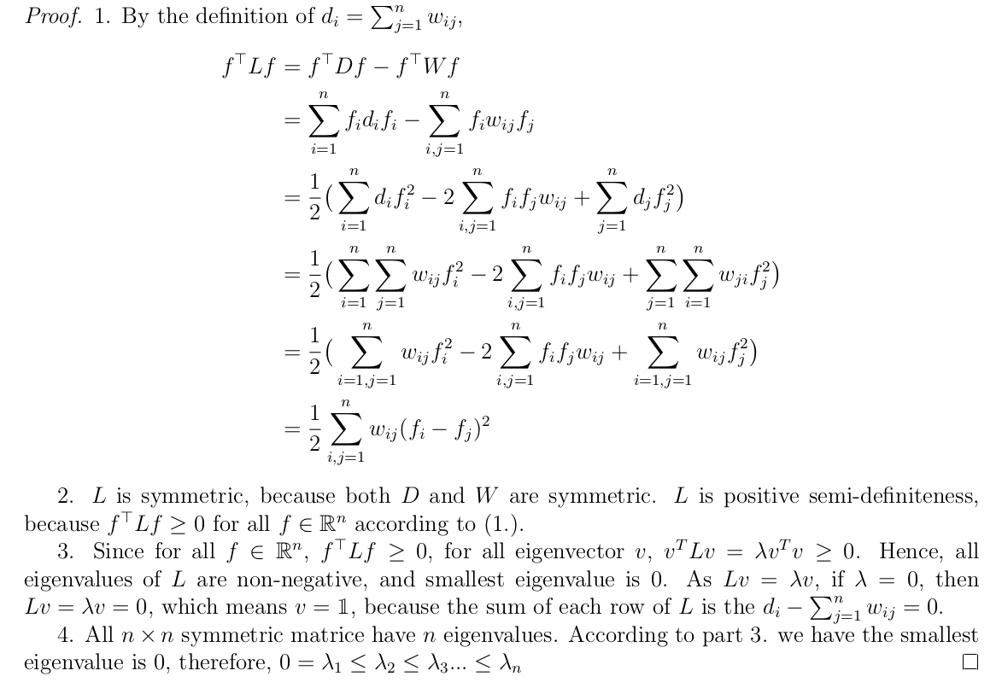
(đọc thêm)
i <= j

Slide 15
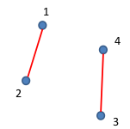
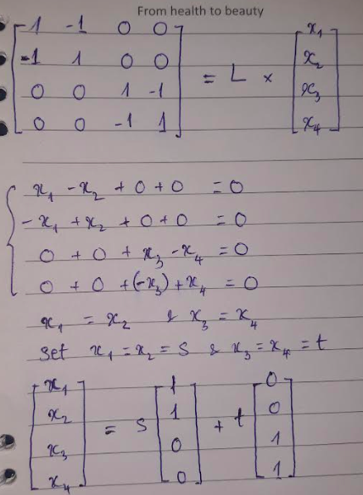
The meaning of zero eigenvalues
A basis for N(L) is given by
2 indicator vectors
Lx = 0
0
0
1
1
1
1
0
0
 | x1 | x2 | x3 | x4
x1 | 1 | -1 | 0 | 0
x2 | -1 | 1 | 0 | 0
x3 | 0 | 0 | 1 | -1
x4 | 0 | 0 | -1 | 1
s =
t =
N(L) = span(s,t)
s, t are linearly independent
dim(N(L)) = 2
=> 2 independent clusters

Slide 16
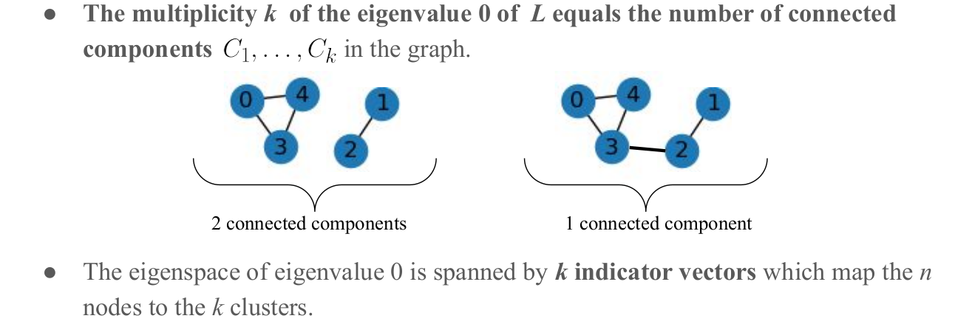
Zero eigenvalues and the connected components
Proposition 2: Let G be an undirected graph with non-negative weight matrix W. Then :
0 = λ₁ = λ₂
(k=2)
0 = λ₁
(k=1)

Slide 17
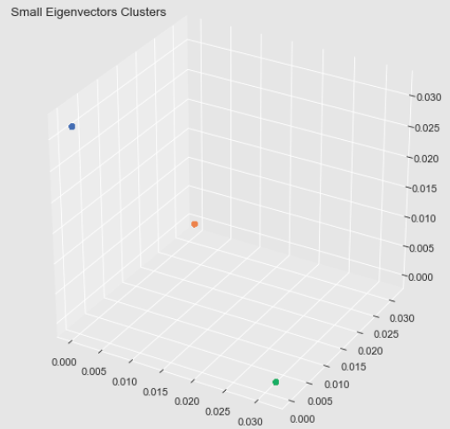
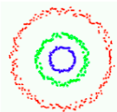
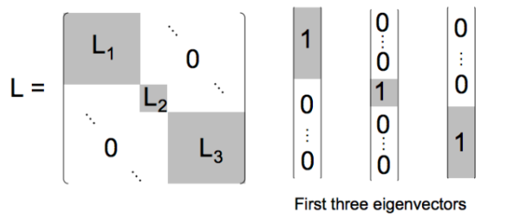
What happens if clusters are not independent ???
k = ?

Slide 18
What is the indicator vector?
1
1
1
1
1
1
C =
If k=1, does the graph has only 1 cluster?

Slide 19
Partition into k clusters
Construct similarity graph (similarity matrix nxn S) → adjacency matrix A + degree matrix D
Build graph Laplacian
Get eigenvalues and eigenvectors of L
Form a n×k matrix U with eigenvectors (k<n) as columns
Treat each row of U as a data point, run some simple clustering algorithm such as K-means to cluster the points

Slide 20
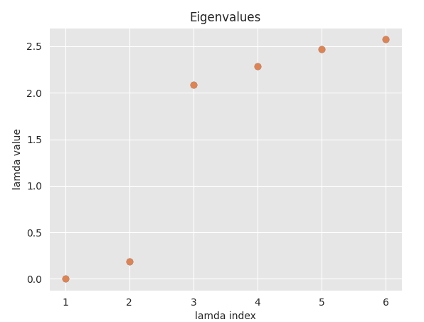
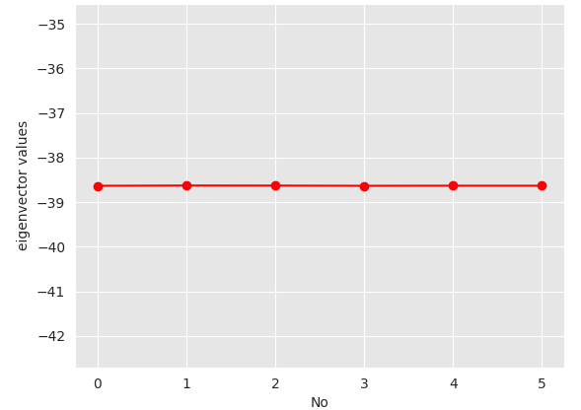
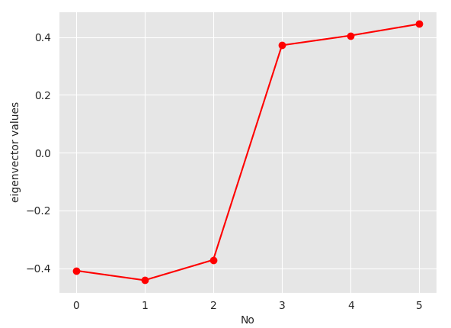
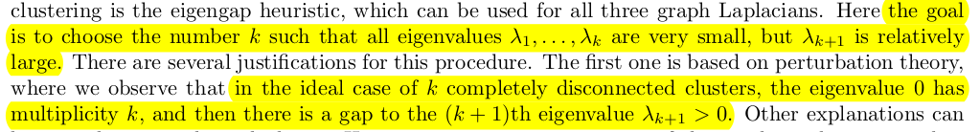
Choose p, case: fully connected graph
v_0
v_1
p=2 can divide the graph into clusters

Slide 21
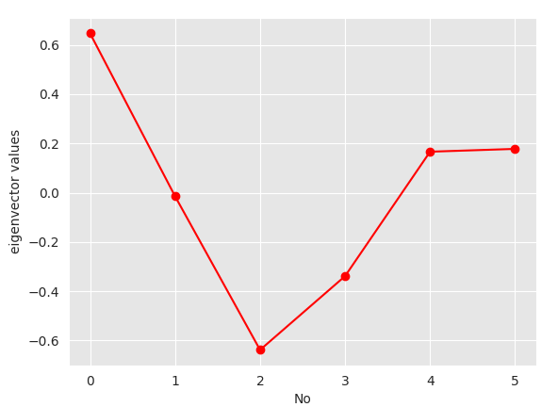
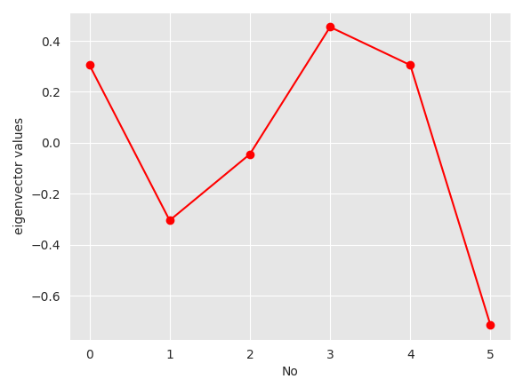
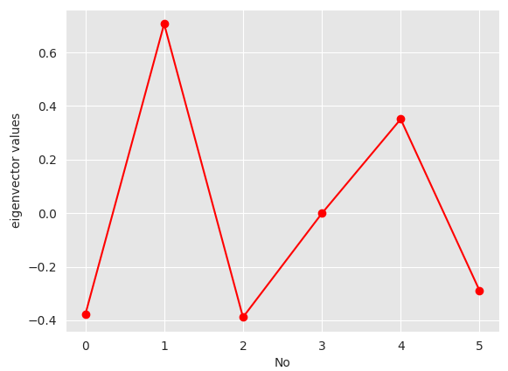
v_2
v_3
v_4
K = 2 is the best
v_1

Slide 22
Partition into k clusters
Construct similarity graph (similarity matrix nxn S) → adjacency matrix A + degree matrix D
Build graph Laplacian
Get eigenvalues and eigenvectors of L
Form a n×k matrix U with eigenvectors (k<n) as columns
Treat each row of U as a data point, run some simple clustering algorithm such as K-means to cluster the points

Slide 23
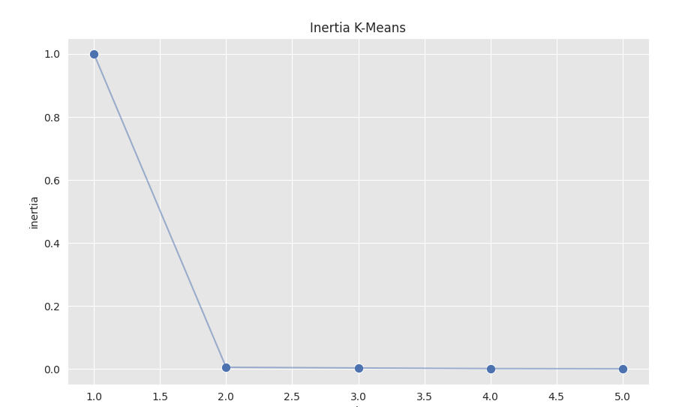
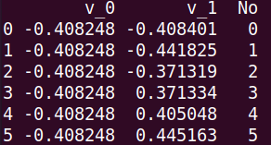
K-mean clustering
Matrix U (nxp, with p =2)
v_1
v_0

Slide 24
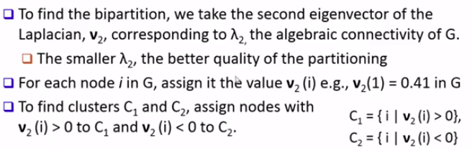
Graph Laplacians: second smallest eigenvalue - Bipartition (k=2)
λ2 = 0.189
 | v2
1 | -0.408
2 | -0.442
3 | -0.371
4 | 0.371
5 | 0.405
6 | 0.445
Laplacian

Slide 25
Graph Laplacians: second smallest eigenvalue
If 0 is the eigenvalue of L with k different eigenvectors, i.e., 0 = λ₁ = λ₂… = λ_{k}, then the graph G has k connected components
If the graph is connected, λ₂ > 0 and λ₂ is the algebraic connectivity of G
The greater λ₂ is, the more connected G is

Slide 26
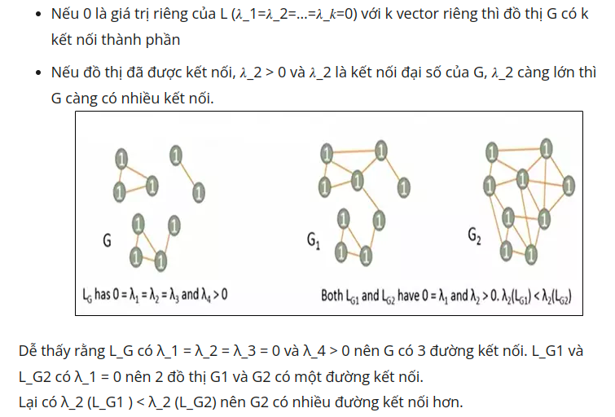
Graph Laplacians: second smallest eigenvalue

Slide 27
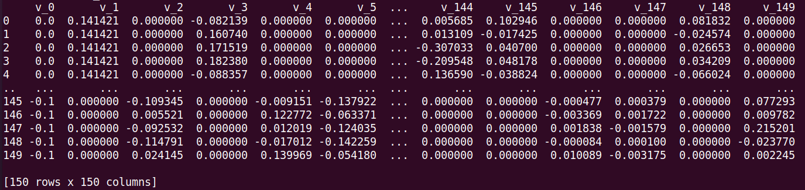
Independent clusters

Slide 28
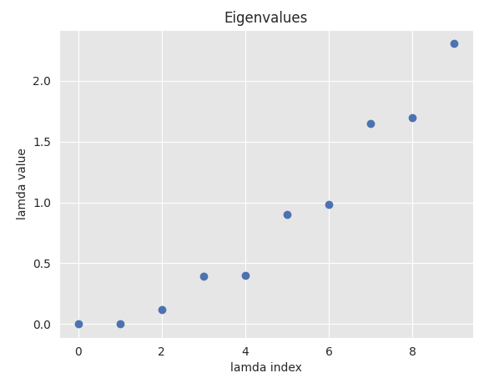
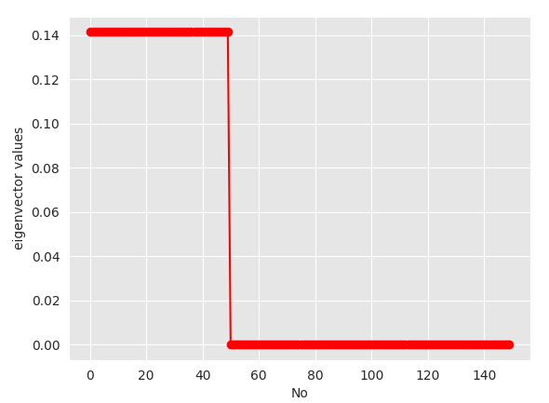

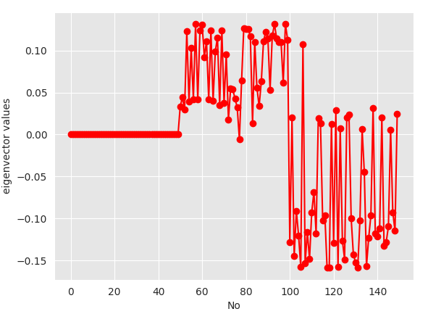
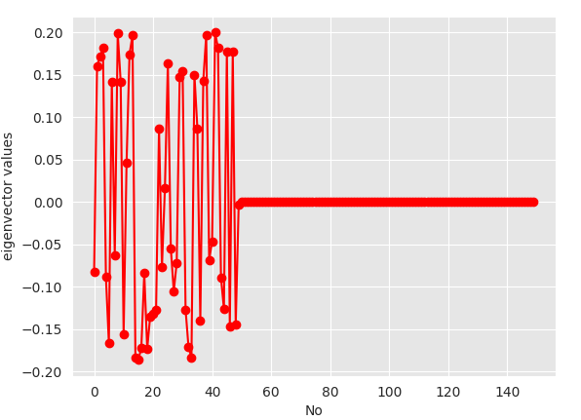
Case: Independent clusters
v_0
v_1
v_2
v_3
Choose k=2

Slide 29
Matrix U (nxp)
k-mean

Slide 30
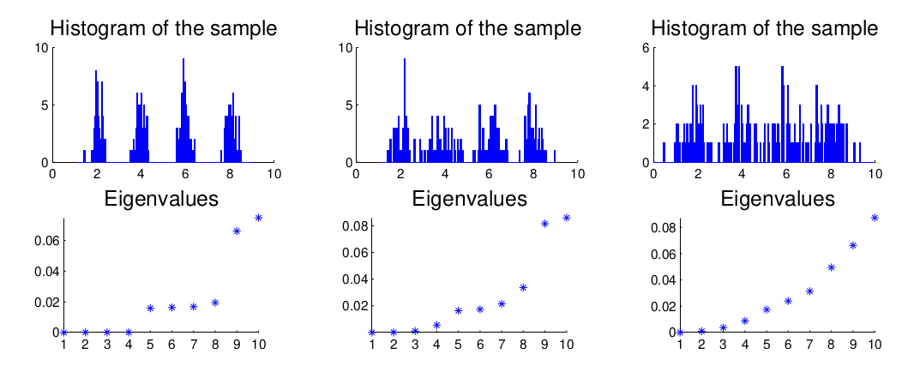
Disadvantage

Slide 31
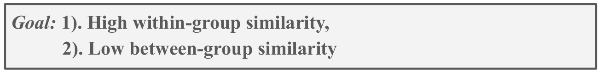
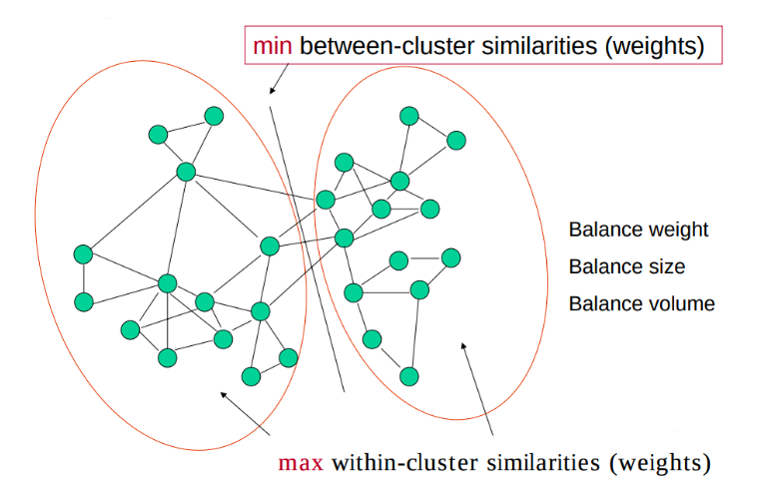
What makes a good graph cut?

Slide 32
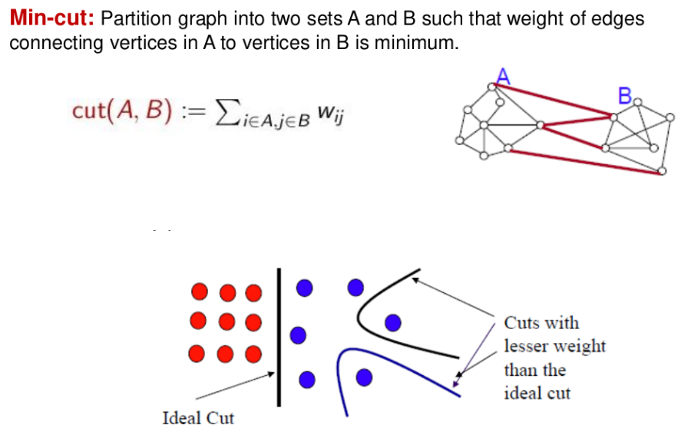
What makes a good graph cut?

Slide 33
A
B1
B2
Cluster B1-A vs B2-A
Cut(B1,A) = 4 > Cut(B2,A)= 2
=> B2-A is better than B1-A???

Slide 34
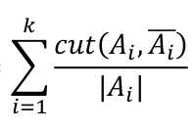
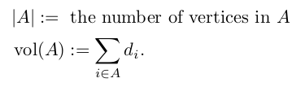
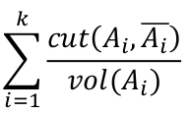
What makes a good cluster?
• RatioCut (Hagen and Kahng, 1992): unnormalized Laplacian
d_{i}: degree of a vertex (node)
RatioCut(A₁,…,A_{k}) =
• Ncut (Shi and Malik, 2000): normalized Laplacian
Ncut(A₁,…,A_{k}) =

Slide 35
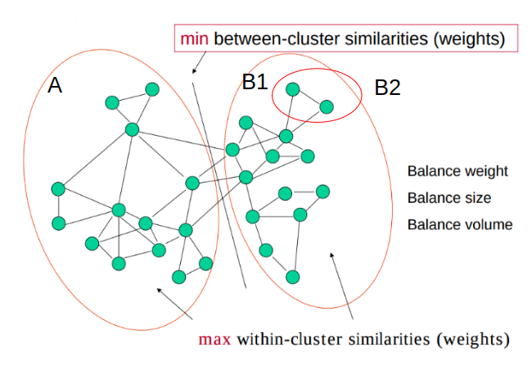
RatioCut(B1-A) = 4/14 = 0.28
RatioCut(B2-A) = 2/2 = 1
(B1-A) is better than (B2-A) 3.5 times

Slide 36
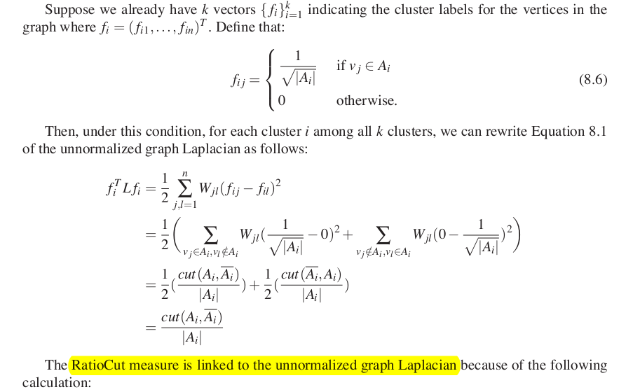

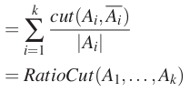
Graph Laplacians: second smallest eigenvalue
(đọc thêm)

Slide 37
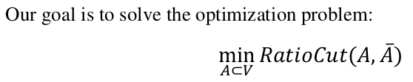


Graph Laplacians: second smallest eigenvalue
min
f is the eigenvector corresponding to the
second smallest eigenvalue of L

Slide 38
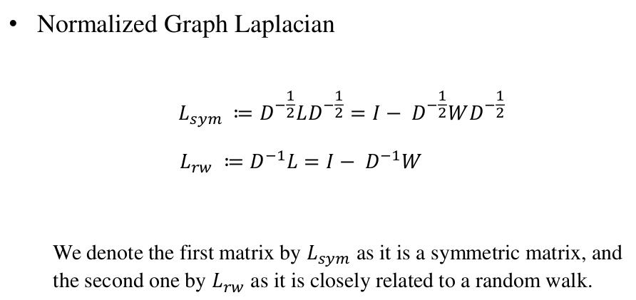
Other spectral clustering algorithms

Slide 39

Other spectral clustering algorithms
(đọc thêm)

Slide 40

Other spectral clustering algorithms

Slide 41
REFERENCES
Spectral Clustering. Chunpai Wang (2016)
Spectral Clustering. Jialu Liu, Jiawei Han.
A Tutorial on Spectral Clustering. Ulrike von Luxburg (2007)
https://www.youtube.com/watch?v=zLuVrqlYKyg&list=PLHXZdjnADb1Q6ol2UEuPMnXpQY-KzCmBy&index=1
https://www.youtube.com/watch?v=zkgm0i77jQ8

