Slide 1

Project Management
Team project
20 % of your grade

Slide 2
Team project
You will create a Project plan to develop a product
I will provide project ideas, and You will choose the project (product) to be planned
NO development of the actual product will take place, only planning
Team consists of 3-5 members (no exceptions)
You pick your own team

Slide 3
Team project
During the course you will do the planning step by step
For example: When we have covered Risk management in the course
You can update the document with The Risks, including Risk exposure (probability x impact)

Slide 4
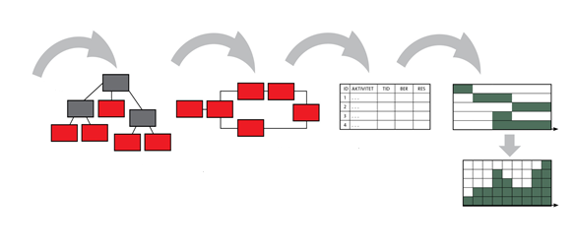
Project Planning flow
1
2
3
4
5
Time plan (GANTT)
Purpose + Goals +
Requirements
Network diagram Activities and Mile-Stones
Activity list Estimates Dependencies
WBS
Resource histogram

Slide 5
Document template
I have created 2 document templates
Project plan (word document)
Product and Sprint backlog (excel document)
You put all your information in these 2 documents.

Slide 6
Document content
The Word document: Project plan
Background & Purpose
Goal (S.M.A.R.T. and in one sentence)
Work Breakdown Structure (WBS)
Project schedule, overview (no details)
Risks, with Risk exposure (probability x impact)
Budget
Team organization & Roles
Communication plan

Slide 7
Document content:
The excel document: Product and Sprint backlog
Product backlog (Requirement list: user stories, prioritized & estimated)
Sprint backlog for Sprint 1
Burndown chart for sprint 1

Slide 8
Homepage for Project topics, with information about each project
www.nevonprojects.com
Your team shall pick one project out of the 10 projects I have provided on the next slide
First team choosing a Project gets it !!!

Slide 9
Team Projects
Android Blood Bank Project
Android Grocery Management App
E-Visa Processing & Follow Up System
Farming Assistant Web Service Php
Fitness Club Management System
Online Auction System using Python
Online Herbs Shopping Php
Online Private Tutors Finder System
Online Shoes Shopping Website
Organ Donation System using Python
Travel and Tourism Website using Python
https://nevonprojects.com/software-project-categories-2/

Slide 10
Team project: Presentation
Presentation will be done by the whole team at the last lecture in the course
Use PowerPoint
Prepare for presenting it in English
Hand in Paper copy of both documents

Slide 11


