Slide 1

Project Management
Team project
Lecturer: Jan Samuelsson
Email: jan452@gmail.com

Slide 2
Team project
Homework !!!

Slide 3
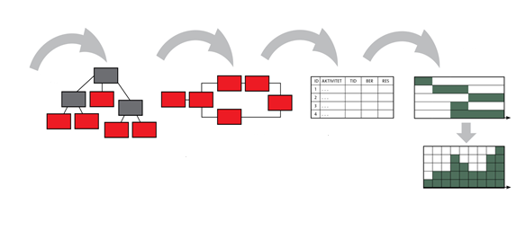
Project Plan flow
Time plan (GANTT)
Purpose + Goals +
Requirements
Network diagram Activities and Mile-Stones
Activity list Estimates Dependencies
WBS
Resource histogram

Slide 4
Document template
I have created 2 document templates
Project plan (word document)
Product and Sprint backlog (excel document)
You put all your information in these 2 documents.

Slide 5
Document content: First delivery
E-mail; Project documents (2), 26 November
Product overview
Background & Purpose
Project overview
Goal
(S.M.A.R.T. and in one sentence)
List of main features
Work Breakdown Structure (WBS)
Project schedule, overview (no details)
Product backlog (Requirement list: user stories, prioritized & estimated)
In excel document !
Email: jan452@gmail.com

Slide 6
Document content: Remaining
Team organization & Roles
Communication plan
Schedule
With features (estimated) for each sprint, but not more info than that
Budget
Risks, with Risk exposure (probability x impact)
Sprint backlog and burndown chart for sprint 1
Presentations: 21 December

