Slide 1
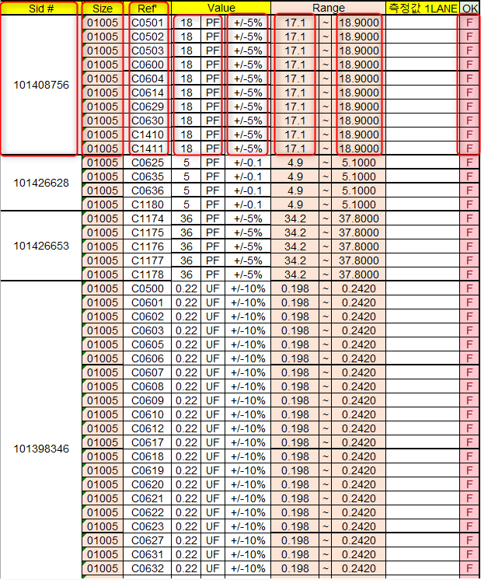
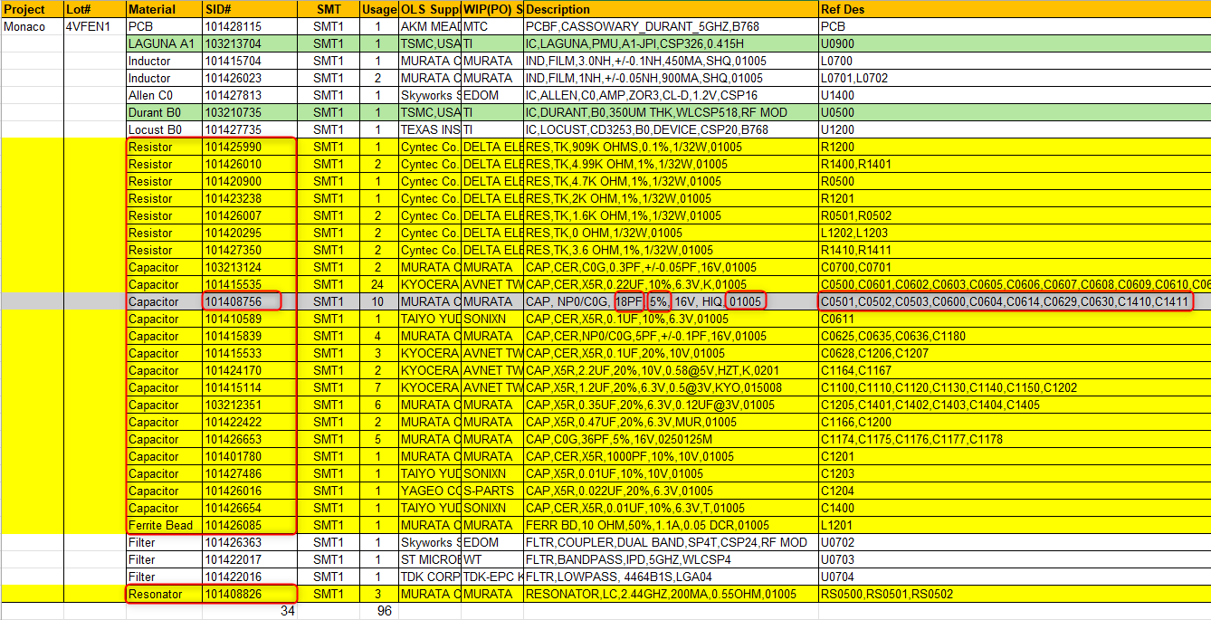
LCR – Logic Parsing
Sid# : Get SID# in Material including Resistor, Capacitor, Ferrite Bead and Resonator
Size : Last element in Description
Ref’ : Take each element in Ref Des
Value1,2 : If Material is Capacitor : Get element with PF, NF, UF
Else : Get element in Description with OHM, K OHM. Change OMH to Ω when converting. For ex: 2K OHM -> 2KΩ
Value3 : Get element in Description with +/- or %
If element is +/- convert to % as percentage
Range1:
Value1 – (Value1*Value3)
OK: Write function to check if 측정값 1LANE in range Range1 – Range3 then fill “P” (Pass). If not fill “F” (Fail)
Range3:
Value1 + (Value1*Value3)

