Slide 1
CNN-LSTM Based Spatiotemporal Flood Evolution Forecasting
With capsule-based severity classification and a post-hoc NeuroSymbolic reasoning layer
Anhad Mahajan (PRN: 24070126031) & Aman Sumeet Saxena (PRN: 24070126030)
DL Lab Project

Slide 2
The Problem
What we predict
Goal: using recent flood depth, rainfall, and land-shape data, predict what the flood will look like a few steps into the future, across the whole area, not just one point.
Not a water-level sensor: knowing the water height at one river gauge does not tell you which streets or fields nearby will actually go underwater.
Not a single photo check: looking at one satellite image and marking it "flooded" or "not flooded" does not show how the flood is spreading over time.
Why it matters
A map of the flood shows which areas are getting deeper, which are draining, and how fast the water's edge is moving, exactly what evacuation planning needs.
Physics simulation is slow: about 2 weeks for FloodCastBench's Pakistan event (2 days to 4 hours for the others). A trained surrogate is far quicker: a CNN-LSTM for Norfolk, VA cut 4 to 6 hours to 3.2 minutes per event.
Gap we address: the FloodCastBench paper reports only U-Net and FNO baselines and no trivial one; we add a patch-based CNN-LSTM result and a baseline ladder (not directly comparable to their whole-scene numbers).

Slide 3
Literature Review
Paper | Year | Method | Relevance to us
Shi et al. (ConvLSTM) arxiv.org/abs/1506.04214 | 2015 | Convolutional gates fuse CNN and LSTM in one cell | Closest architectural ancestor; we use a lighter CNN-then-LSTM variant
Ronneberger et al. (U-Net) doi.org/10.1007/978-3-319-24574-4_28 | 2015 | Encoder-decoder CNN with skip connections | FloodCastBench's own spatial-only baseline
Malik, Feng, Shao & Abduljabbar doi.org/10.1007/s12145-024-01354-y | 2024 | Time-distributed CNN-LSTM (TD-CNN-LSTM) | The design pattern we adopt
Wang et al. (Norfolk, VA) doi.org/10.1016/j.ejrh.2026.103234 | 2026 | CNN and LSTM fused at a bottleneck | Closest published analogue to our pipeline
Xu et al. (FloodCastBench) doi.org/10.1038/s41597-025-04725-2 | 2025 | FloodCastBench dataset and U-Net/FNO benchmark | Our dataset; the paper reports no CNN-LSTM baseline (the gap we address)
Sabour, Frosst & Hinton (Capsule Networks) arxiv.org/abs/1710.09829 | 2017 | Vector capsules with routing-by-agreement, preserving pose lost to CNN max-pooling | Basis for our severity-classification head

Slide 4
Gaps and Limitations
Established gaps in the literature
No CNN-LSTM/ConvLSTM baseline and no trivial baseline (copy the last frame) is reported for FloodCastBench; only U-Net and FNO/FNO+.
Most spatially explicit CNN-LSTM flood work is single-region. To our knowledge FloodCastBench's cross-regional transfer has not been tried with CNN-LSTM; we run the paper's two same-resolution transfers (Australia → UK at 60 m, Pakistan → Mozambique at 480 m) plus Australia → UK at 30 m, and, as an exploratory extra, the reverse directions.
Scope limits, not research gaps
No new hydrodynamic simulations; we rely entirely on FloodCastBench's already-simulated sequences.
Patch-based (128×128) forecasts at 30-minute steps, 2.5 h ahead; no whole-scene training and no claim of operational early-warning accuracy.
All four regions and three resolutions are used (30 m, 60 m, 480 m). The coarse depth grids are resampled, cropped copies of the 30 m grid; we recovered each crop offset from the data and checked the result against real maps. Severity is scored on Australia at 30 m only (elsewhere 84–100% of patches are "severe").
No new Indian dataset; no existing public source fits this exact task without out-of-scope data engineering.
Capsules have no precedent for dense regression, so they are scoped to severity classification. The motivation (routing-by-agreement may preserve spatial relationships that max-pooling discards) is a hypothesis we test, not assume; see Results.
NeuroSymbolic layer = deterministic rules (depth rate, rainfall, slope, drainage proximity) applied post hoc to the network's outputs; each severity output carries a stated reason.
Two explainability layers, by design: Grad-CAM (visual, post-hoc) for the depth branch; the Symbolic Rule Layer (logic-based) for the capsule's severity output. Neither changes the forward pass.

Slide 5
Methodology
1. Data
Depth, DEM, rainfall
2. Preprocess
128×128 patches, 30-min steps
3. Shared Encoder
Hidden map feeds depth + capsule heads
4. ConvLSTM
Full-resolution recurrence over 5 frames
5. Decoder
Last frame + learned change
7. Evaluate
Skill vs persistence + baseline ladder
8. Visualize
Georeferenced overlay
Grad-CAM
Post-hoc visual explainability, CNN encoder/decoder
Capsule Network
Severity classification, parallel to LSTM path
6. Symbolic Rule Layer
Rule-based severity reasoning (NeuroSymbolic)
CO1–CO5: Dense (CO1) · Classification head (CO2) · CNN enc/dec (CO3) · Dropout/LR (CO4) · LSTM enc-dec (CO5)

Slide 6
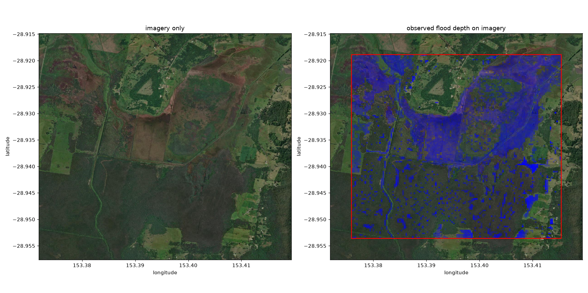
Visualization Pipeline
GeoTIFF
Predicted flood depth, real CRS + transform
rasterio
Applies real per-region CRS/transform at export time
Folium
Interactive overlay on real satellite imagery (Esri)
Real per-region georeferencing
Per-region CRS + pixel transform come from the archive's world files and are attached to the predicted depth grids at export time.
The world files describe the 30 m grid, so the coarse grids add the recovered offset (60 m / 480 m on top of it); the origin is a pixel centre, so the transform is shifted half a pixel.
Checked against real imagery and maps: Australia (satellite), Mozambique, Pakistan and the UK (OpenStreetMap): rivers, lakes and coast line up with the real ground.
Basemap is Esri World Imagery: folium's default OpenStreetMap tiles are blocked inside Colab.
Left: imagery only. Right: observed flood depth on the same imagery (red box = 128×128 patch, Australia).

Slide 7
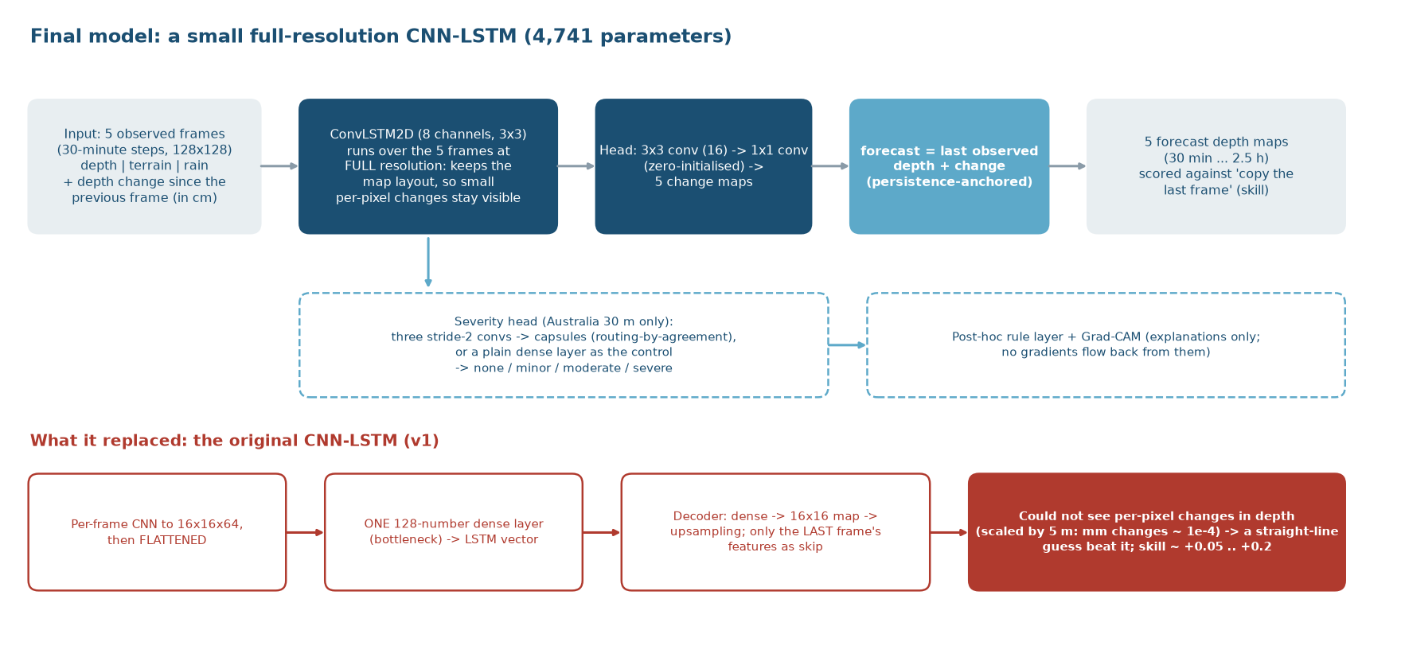
Architecture Diagram

Slide 8









Tech Stack
Python
Data loading, model code; local CPU runs and Colab GPU notebooks
TensorFlow / Keras
ConvLSTM, CNN, custom Capsule layers, margin loss
NumPy
Patch extraction, normalization, metrics (skill, RMSE, NSE, CSI)
Hugging Face Hub
Hosts our 26.9 GB dataset mirror, pulled into Colab
Matplotlib
Training curves, Grad-CAM heatmaps, evaluation plots
SciPy
Distance transform for the drainage-proximity rule
Grad-CAM
Direction-aware post-hoc explainability for the depth branch (custom implementation)
Folium
Interactive flood-depth overlay on Esri satellite imagery
rasterio
Reads/writes GeoTIFF; applies per-region CRS + transform (archive world files)

Slide 9
Experimental Setup
Data
All of FloodCastBench: 30 m (Australia, UK), 60 m (Australia, UK), 480 m (Pakistan, Mozambique). All 14,868 files were read and checked.
Task
128×128 patches. 5 past frames → next 5 at 30-minute steps (2.5 h ahead). Inputs: depth, terrain, rainfall in 3 settings: causal, hybrid (original), forced.
2 mm
Copying the last frame is that close at 5-minute steps (25-minute horizon). At our 30-minute steps (2.5 h) the copy error is 13.5 mm.
So a small error proves nothing. We report skill:
1 − (RMSE model ÷ RMSE copy)²
0 = no better than copying; above 0 = better.
Training
3 spatial tile folds per experiment (every tile held out once); 300 windows, 30 epochs; protocol written down before the final runs. Depth only except severity.
Baselines
Copy the last frame (skill 0), straight-line trend, a two-number lookup table, a per-pixel MLP. Every result sits next to these.
Severity label
Derived from max depth in the patch: none < 0.3 m, minor < 1 m, moderate < 2 m, severe > 2 m. Scored for Australia at 30 m only; elsewhere it is degenerate.
Checks
Rain timing verified physically; maps checked against real rivers; a separate agent re-derived the raw-data numbers, baselines and splits from the raw files (networks not re-run); another reviewed the code.
Notes:
Numbers: PROJECT_LOG.md, 'Pre-flight before Colab' (persistence table) and 'First real-scale run'. 46/16 patches and 400/240 windows are the Colab defaults (seed 42).

Slide 10
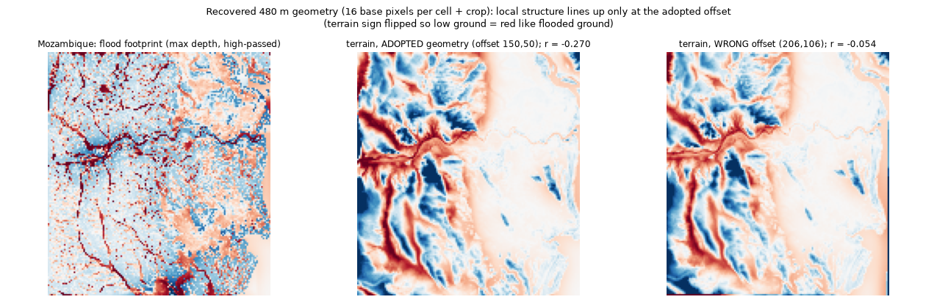
Completing the Dataset
Half the dataset was unused
The pipeline had read 13.5 of 26.9 GB. All four regions and the 60 m data are now used; every one of the 14,868 files was read: no NaN, no negative depth, even spacing.
Recovered, not assumed
A probe validated on known cases (Australia r = −0.28, UK r = −0.41) recovered Mozambique (r = −0.27, shown above) and Pakistan; the 60 m grids are 2×2 cells.
Honest limits
Pakistan's evidence is weaker (r = −0.09), but its lakes, desert and the Indus line up on a real map. A water-surface probe failed validation (not used). Rain timing is confirmed physically.
Notes:
Sources: PROJECT_LOG.md 'Completing the dataset'; verification_outputs/multires/alignment_evidence.png; audit_full_dataset.py; probe_alignment_terrain.py (validated on Australia 30 m and UK 30 m before use).

Slide 11
What the Audit Found
Rain came from the future
Rainfall file j is the rain that falls during the 30 minutes AFTER time 1800·j (checked in all four regions: correlation 1.00, depth gain = 0.5 × the mm/h value). Our input gave the last frame the rain of the half-hour it sits in: up to 30 minutes that had not yet fallen. Three settings are now tested: causal, hybrid (the original), forced.
The original model was weak
A straight-line guess for each pixel scored about twice what the original CNN-LSTM did. Its design squeezed every frame through one 128-number layer and could not see small changes in depth.
So an earlier finding was an artefact
"Rainfall drives the forecast and the history is not used" described the weak model, not floods. The final models depend on the depth history (freezing or scrambling it destroys their skill) and hardly on rain.
The paper's benchmark is easy to match
Its "RMSE" is a relative error, not metres. On its own measures, copying the initial frame matches or beats its best model (Mozambique NSE 0.9995 vs 0.955; CSI at 1 mm 0.98 vs 0.93). The paper reports no such baseline.
A separate agent re-computed from the raw files the rain timing, the copy-the-last-frame errors of every never-seen window, the window pools, the splits and the lookup-table baseline (all matched; it could not re-run the neural models). An adversarial code review found no critical error and five major issues, all fixed.
Notes:
Sources: PROJECT_LOG.md 'Completion, round 2'; completion/a_rain_lag.py; completion/f_paper_protocol.py; completion/review/*.md.

Slide 12
Results: The Baseline Ladder
A 2-number table gets most of it
Lookup on current depth × last change: +0.79 (UK 60 m), +0.74 (Mozambique), roughly 90% of the best score.
Neighbours don't help
Kernel 1 / 5 / 11 (per pixel / 5×5 / 11×11): +0.85 / +0.84 / +0.84 on the UK, +0.82 / +0.81 / +0.79 on Mozambique.
Recurrence: nothing measurable
Under the 30-epoch recipe the ConvLSTM is ahead by +0.025 on the UK at 60 m. Trained equally long (90 epochs) the two are level: +0.004 (UK), -0.014 (Mozambique).
Hybrid setting, mean of 3 tile folds. Intervals (95%, block bootstrap) are in the log; each region is one flood event.
Notes:
Numbers: completion/results/report.json (REPORT.md). Original CNN-LSTM row, if present, is batch C under the same folds and recipe.

Slide 13
Results: What the Models Use
History is what they use
Freezing the depth history takes the skill to about 0; putting it in the wrong order makes it strongly negative (−2.6 / −2.9).
Rain barely matters
Removing it, or feeding only rain that has already fallen, costs about 0.01 to 0.02 (0.01 to 0.025 if only strictly past rain is fed). The original model's 'rainfall drives it' was an artefact.
Terrain: nothing
Removing the terrain changes the skill by less than 0.01.
Test-time removal shows what a trained model relies on. A local CNN TRAINED without the depth history scores +0.17 (UK 60 m) and +0.09 (Mozambique), against +0.84 and +0.81 with it. One further ablation (rain moved by whole cells) is partly a no-op because of edge clipping and is not used.
Notes:
Numbers: mean over 3 folds of ablation_test in completion/results/runs/*.json (hybrid regime).

Slide 14
Results: Rain Settings and Recurrence
The rain leak was small
Going from strictly past rain to the original input adds about +0.02 for the local CNN. Future rain helps a little more (forced). None of it changes the picture.
Recurrence, tested fairly
30 epochs (frozen recipe): ConvLSTM − local CNN = UK +0.025 [+0.004, +0.043], Mozambique +0.004 [-0.011, +0.019]. Both trained 90 epochs: UK +0.004 [-0.021, +0.027], Mozambique -0.014 [-0.029, +0.006]: equivalent.
Rain as side channels
Giving the ConvLSTM the future rain as side channels lifts it from +0.85 to +0.88 (UK) and +0.77 to +0.82 (Mozambique): the dip was the input layout.
Vertical axis starts at 0.5. Hypotheses were written down before the runs; verdicts (H1–H6) are in the log, including the ones that failed.
Notes:
Numbers: completion/results/report.json. H4 verdicts from g_report.py (paired block bootstrap).

Slide 15
Results: Robustness and Extra Checks
Seeds
Five seeds per fold: the never-seen skill moves by about 0.01 between seeds, so differences below 0.02 cannot be told apart from noise.
Training length
90 instead of 30 epochs: the plain CNN gains +0.021 (UK) and +0.024 (Mozambique); the ConvLSTM gains +0.000 / +0.007. A 150x larger ConvLSTM scores no better (+0.84 UK, +0.80 Mozambique).
Data and recipe
Per-pixel model: +0.80 to +0.83 with only 25 training windows. The plain CNN gains from more windows only because it then trains longer (equal steps: within 0.01). Batch 8 / lr 3e-3: about 0.01 lower on unseen floods, but steadier on Pakistan tiles.
A hidden flood onset
Hide a time block as well as tiles and the plain CNN fails on Pakistan (−5.7 to −9.1, every seed, both recipes), almost all of it in the first windows of the flood (6 of 480 windows carry 98% of the error; +0.84 without them). A model never shown a flood's start cannot be trusted on one.
The other direction
Train on the small UK flood, test on Australia: the plain CNN scores +0.74 (60 m) and +0.66 (30 m). Mozambique → Pakistan fails for plain networks (−0.88); the lookup table (+0.55) and the ConvLSTM (+0.44) hold up better.
Our own safety net misfired
A check that aborts 'dead' networks fired 8 times; the 7 I re-ran without it all trained normally (the original model +0.19, a side-channel run +0.885). It looked at the earliest, near-static windows; now fixed and disclosed.
Exploratory checks added after the main matrix; each is labelled in the log. Numbers: completion/results/report.json.
Notes:
Sections 8.7-8.15 of the round-2 log; REPORT.md tables 'seed repeats', 'training length', 'learning curve', 'strict split on Pakistan', 'reverse-direction transfers', 'Runs aborted by the dead-network guard'.

Slide 16
Results: Severity, Rules and Grad-CAM
Symbolic rule layer
68% → 63%
accuracy after the rules; they changed 161 answers, fixed 25 and broke 109. With the new encoder they now lower accuracy instead of leaving it unchanged.
Its reasons are computed post hoc from the model's predicted depth trend; they were not reviewed by a flood expert.
Grad-CAM, redesigned test
Deleting the top-10% heat pixels changes the depth forecast more than both control masks in 88% of windows (severity map: 55%). Wet cells are hotter than dry in 79% of windows.
Capsules vs the trivial rule
The capsule head is right 68% of the time; a plain dense head 60%; thresholding the last observed frame 97%. With augmentation both reach 80% / 80%: the capsule advantage disappears. The label is almost fixed by the last frame, so neither head comes close to that rule.
Notes:
Numbers: completion/results/severity/SEV_*.json (hybrid regime, 3 folds pooled); tables in SEVERITY_REPORT.md. Australia 30 m only: the label is degenerate elsewhere.

Slide 17
The Paper's Own Protocol
Region | Copy: relative error | Copy: NSE | Copy: CSI (1 mm) | FNO+: relative error | FNO+: NSE | FNO+: CSI (1 mm)
Mozambique, 480 m | 0.0210 | 0.9995 | 0.983 | 0.0786 | 0.9555 | 0.934
UK, 60 m | 0.0243 | 0.9993 | 0.980 | 0.0248 | 0.9989 | 0.860
UK, 30 m | 0.0247 | 0.9993 | 0.975 | 0.0252 | 0.9990 | 0.811
What the paper does
Whole domain, 19 steps of 5 minutes from the true depth at t = 1 (FNO+ also gets terrain and the rain series). Its "RMSE" is a relative error, not metres.
What copying scores
Plain persistence (predict the frame at t = 1) matches or beats the best paper model on most of its own measures. The paper reports no such baseline. Which samples it used for transfer is not stated; on the last 20% of each event copying is even better.
How to read this
Not a criticism of FNO+ as a surrogate: it shows the benchmark's metrics reward "the water is mostly already there". Our task (5 → 5 frames, 128-px patches) differs, so our numbers are not comparable with the paper's tables.
Notes:
Persistence: completion/f_paper_protocol.py, whole event, paper metrics. FNO+ numbers: Xu et al. 2025, Table 5 (Europe PMC PMC11903882).

Slide 18
What We Learned
Compare with the simple thing first
We only compared with 'copy the last frame' and missed, until our second audit, that a straight-line guess beat our model.
Check inputs as hard as outputs
Up to 30 minutes of future rain sat in the input; it was found only by testing the files against the simulation itself.
A weak model can produce a false finding
'Rainfall drives the forecast' described our weak model, not floods.
Most of the skill is simple
A table of two numbers per pixel gets about 90% of the best skill; neighbours and recurrence add nothing measurable once the models are trained equally long.
The fancy extras did not pay off
Capsules equal a plain head once augmented and lose to a one-line threshold; the rulebook lowers accuracy; only Grad-CAM for the depth forecast passes a fair test.
Say how much evidence you have
Each never-seen region is one flood: two independent train → test pairs, not sixteen results. Intervals are block bootstraps.
Next: more storms and regions; a task where spatial structure matters (longer horizons, whole scenes); expert review of the rule reasons. These are development-stage numbers from one pre-registered study, not a deployment claim.
Notes:
See PROJECT_LOG.md 'Completion, round 2' for the full list of mistakes and corrections.

Slide 19
Thank You

