Slide 1
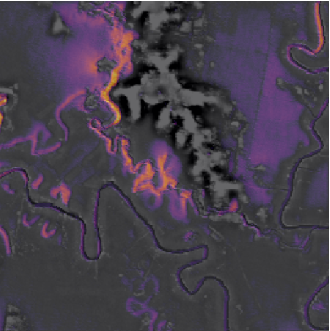
Deep Learning · CA3 Project
CNN-LSTM Based Spatiotemporal Flood Evolution Forecasting
Does a neural network forecast floods better than very simple rules?
Anhad Mahajan · PRN 24070126031
Aman Sumeet Saxena · PRN 24070126030
AIML A2 · October 2026
A picture from our model on the Australia flood. The bright lines are the river channels it pays most attention to.
Notes:
We built a neural network that looks at the last few flood maps and predicts the next one. Then we checked honestly whether it is really better than very simple rules, because that is what decides if it is worth using. The picture on the right is a real output of our model on the Australia flood. The bright lines are the river channels that the model pays most attention to.

Slide 2



The problem
Why we want to forecast floods with a neural network
Floods are fast
Simulators are slow
A network is fast
Floods damage homes, crops and roads every year. People can protect much more if they are warned early.
A physics simulator draws very detailed flood maps, but one large flood can take days to simulate on a powerful GPU.
Once it is trained, a neural network gives a forecast in seconds, so it could take the place of the simulator.
So our question is simple: is the neural network really better than very simple forecasts?
Notes:
Floods do a lot of damage every year, and the damage depends on how early people are warned. A physics simulator can draw very detailed flood maps, but the authors of our dataset report that one large flood can take days to simulate on a powerful GPU. A trained neural network gives an answer in seconds, so it could stand in for the simulator. Our question is whether it is really better than very simple forecasts, because that decides if it is worth using.

Slide 3
The task
What we ask the model to do
Neural
network
3 steps ago
2 steps ago
1 step ago
Now
The map 30 minutes later
The last four depth maps, 30 minutes apart, plus the rain that has already fallen and the height of the ground.
The catch
In 30 minutes the water in most places hardly changes. So just copying the last map is already a very good forecast. A neural network is only useful if it does better than simple forecasts like this one.
Part 1 (Colab notebook): one map, 30 minutes ahead. Part 2 (laptop study): five maps in a row, up to 2.5 hours ahead.
Notes:
We give the model the last four flood maps, taken 30 minutes apart, so the oldest one is an hour and a half old. Each map shows how deep the water is in every square of a grid. We also give it the rain that has already fallen and the height of the ground. The model has to draw the map for 30 minutes later. The catch is in the orange box. In 30 minutes the water in most places hardly changes, so just copying the last map is already a very good forecast. A neural network is only useful if it does better than simple forecasts like that. In Part 2 of our work the model predicts five maps in a row instead of one, which reaches 2.5 hours ahead.

Slide 4
The data
The data: four floods made by a simulator
Australia
UK
Pakistan
Mozambique
20 Feb to 2 Mar 2022
1073 × 1073 squares
each square 30 m wide
10 days, 481 maps
4 to 7 Dec 2015
170 × 275 squares
each square 30 m wide
3 days, 145 maps
18 to 31 Aug 2022
810 × 441 squares
each square 480 m wide
14 days, 673 maps
14 to 20 Mar 2019
151 × 138 squares
each square 480 m wide
6 days, 289 maps
Used for training
Kept for testing
Used for training
Kept for testing
These maps are not photographs. A physics simulator made them from real ground heights, a real land-cover map and real satellite rain. The dataset is called FloodCastBench (Xu et al., 2025).
Notes:
Our data is called FloodCastBench. It has four floods, in Australia, the UK, Pakistan and Mozambique. The maps are not photographs. The dataset's authors made them with a physics simulator that was given real ground heights, a real land-cover map and real satellite rain. Each map is a grid of squares, and the squares are 30 metres wide in Australia and the UK and 480 metres wide in Pakistan and Mozambique. We keep one map every 30 minutes. We train on Australia and Pakistan, and we keep the UK and Mozambique for testing, so the model never sees them while it learns.

Slide 5
Part 1: the Colab notebook
How we test the model
Trained on Australia
Tested on UK
30 m model
Train: first 70% of the flood
Stop
Test
A different flood it has never seen
The last 15% of the same flood
Trained on Pakistan
Tested on Mozambique
480 m model
Train: first 70% of the flood
Stop
Test
A different flood it has never seen
The last 15% of the same flood
We test every model twice: on the last part of the flood it learned from, and on a whole new flood. The “Stop” part (15%) is only used to decide when to stop training. We use a separate model for each map size, because a 30 m square and a 480 m square behave very differently.
Notes:
We train one model on the first 70 percent of a flood. The next 15 percent is only used to decide when to stop training. Then we test the model twice. First on the last 15 percent of the same flood, which it has not seen. Second on a completely different flood from another country, which is the harder test. The 30 metre model learns from Australia and is tested on the UK. The 480 metre model learns from Pakistan and is tested on Mozambique. We never mix the two map sizes, because a 30 metre square and a 480 metre square behave very differently. Part 1 is the Colab notebook, which Aman built. Part 2 is the larger laptop study. They use different set-ups, so we keep their results apart.

Slide 6
The system
Our whole system on one page
Last 4 depth maps,
rain, ground height
Forecaster
(CNN + ConvLSTM)
Depth map
30 minutes ahead
Water-balance
rule
Grad-CAM
heat maps
Capsule network
(rates the severity)
Three written
rules
Final rating and
the reason for it
The forecaster predicts the next map, and the water-balance rule checks the total water against the rain. The capsule network rates how serious the flood is, and three written rules check that rating.
NeuroSymbolic AI: a neural network checked by rules people can read. The written rules are our NeuroSymbolic part.
Explainable AI: showing why a model gave its answer. The dashed arrows are Grad-CAM, our way of doing that.
Notes:
This is everything we built. On the top row is the forecaster. It is a convolutional neural network followed by a ConvLSTM, and it reads the last four maps, with the rain and the ground height, and predicts the map 30 minutes ahead. A water-balance rule then checks the total amount of water in that forecast against the rain. On the bottom row, a capsule network reads the forecaster's memory and rates how serious the flooding is: none, minor, moderate or severe. Three written rules check that rating and give a reason for every decision. A neural network that is checked by rules people can read is called NeuroSymbolic AI, so the written rules are the NeuroSymbolic part of our project. Grad-CAM, shown with the dashed arrows, colours the parts of the input that mattered most, for both the forecaster and the capsule network. Showing why a model gave its answer is called explainable AI, and Grad-CAM is our way of doing it.

Slide 7
The model
The forecaster: how it reads the maps
Input
4 maps, each with
3 layers
2 CNN layers
3 × 3, 16 filters
ConvLSTM
3 × 3, 32 filters
Conv layer
3 × 3, 16 filters
Last layer
1 × 1, starts at zero
depth, rain, ground height
look at each map on its own
remembers how the water moved
turns the memory into a picture
predicts the change in depth
The CNN (convolutional neural network) layers look at each map on its own and pick out useful shapes, such as water edges, slopes and patches of rain.
62,833
The ConvLSTM layer then reads the four maps in order and keeps a memory of how the water has been moving.
parameters, the numbers the model learns while it trains
The model predicts how much the depth will change, not the whole map. This is easier, because most of the map hardly changes in 30 minutes.
Notes:
Here is what happens inside the forecaster. First, two small CNN layers, which stands for convolutional neural network, look at each of the four maps on its own. They pick out useful shapes such as water edges, slopes and patches of rain. Then the ConvLSTM layer reads the four maps in order, and it keeps a memory of how the water has been moving. Finally a small layer turns that memory into a prediction. The model does not draw the whole map from nothing. It predicts how much the depth will change, which is easier because most of the map hardly changes in 30 minutes. The whole model has 62,833 parameters, which are the numbers it learns during training.

Slide 8
The score
How we score a forecast
skill = 1 − (error of the forecast ÷ error of copying the last map)
below 0
0
1
worse than copying
same as copying
a perfect forecast
Copy the last map
The trend forecast
The forecast is simply the last map we have, so its skill is 0 by definition.
Take the last map and add a fraction of the change seen in the last 30 minutes. It uses one number found from the training data, and no neural network.
Notes:
To score a forecast we compare it with the simplest forecast there is, which is copying the last map. We call the score skill. A skill of 0 means the forecast is no better than copying. A skill of 1 means it is perfect, and a negative skill means it is worse than copying. For example, a skill of 0.9 means the forecast removes 90 percent of the error of copying. We use two simple forecasts to compare with. The first is copying the last map. The second is the trend forecast: take the last map and add a fraction of the change that happened in the last 30 minutes. That fraction is one number that we find from the training data, and there is no neural network in it. Every model in the project is compared with these two.

Slide 9
The model
Two versions of the model
Model A
Model B
starts from the last map
starts from the trend forecast
next depth = last depth + the change the model predicts
(and never below zero)
trend = last map + β × (last map − the map before it)
next depth = trend + a small correction from the model
This was our first version. It beat copying the last map in three of the four tests, so it looked successful. But in the last part of the Australia flood its skill was −1.449, which is worse than copying.
The network only has to learn a small correction. β is one number found from the training data: 0.921 for the 30 m floods and 0.948 for the 480 m floods.
In the Colab notebook, Model A is called the first version and Model B is called version 2.
Notes:
We built two versions of the network. Model A is the first one we made. It adds its predicted change to the last depth map. Model B starts from the trend forecast instead. The trend forecast takes the last map and adds a fraction of the last 30-minute change. The fraction is one number found on the training data: 0.921 for the 30 metre floods and 0.948 for the 480 metre floods. Model B then only learns a small correction on top of the trend. In the Colab notebook these two are called the first version and version 2.

Slide 10
Part 1: the Colab notebook, forecasting 30 minutes ahead
The simple trend forecast beats our first model
−1.449
This is Model A in the last part of the Australia flood. It is worse than just copying the last map.
0.001
Model B stays within this of the trend forecast in every test. It matches the trend, but it does not beat it.
Higher is better. “Last 15%” is the end of the flood the model learned from. “New flood” was never seen in training. All results are single runs.
Notes:
This is the main result of Part 1. Each group of bars is one test. The grey bar is the trend forecast, which has no neural network. The red bar is Model A, and the teal bar is Model B. Model A beat copying in three of the four tests, but the trend forecast scored between 0.91 and 0.99, while Model A scored only 0.15 to 0.35. In the last part of Australia, Model A scored minus 1.449, which is worse than copying. Model B starts from the trend and matches it in every test, to within 0.001, but it does not beat it. All of these are single runs.

Slide 11
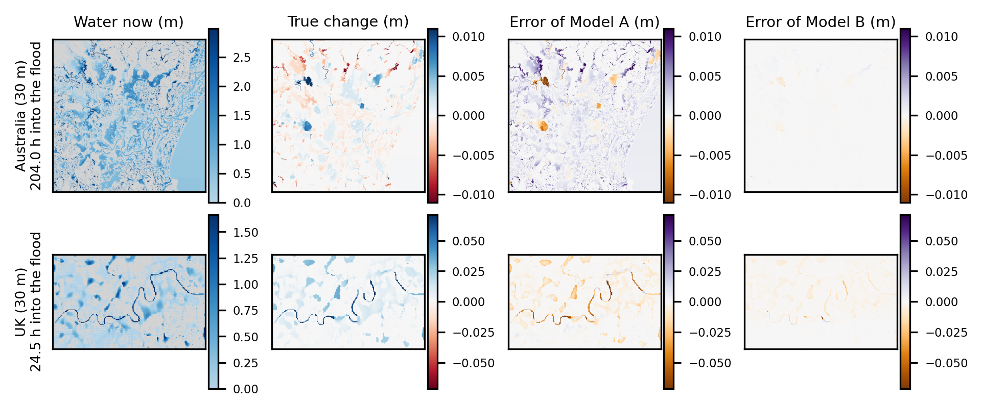
Part 1: the Colab notebook, where the models go wrong
On the map, Model B's mistakes almost disappear
Australia (top) and the UK (bottom). Purple means too much water was forecast, and orange means too little. The three maps on the right use the same colour scale.
Notes:
These pictures show where each model is wrong. From left to right: the water now, how the water really changed in the next 30 minutes, the mistakes of Model A, and the mistakes of Model B. Purple means the model forecast too much water, and orange means too little. The change and both mistake maps use the same colour scale, so they can be compared. Model A makes mistakes along the rivers and at the places with heavy rain. Model B's map is almost blank. The next slide shows the same pictures for the two 480 metre floods.

Slide 12
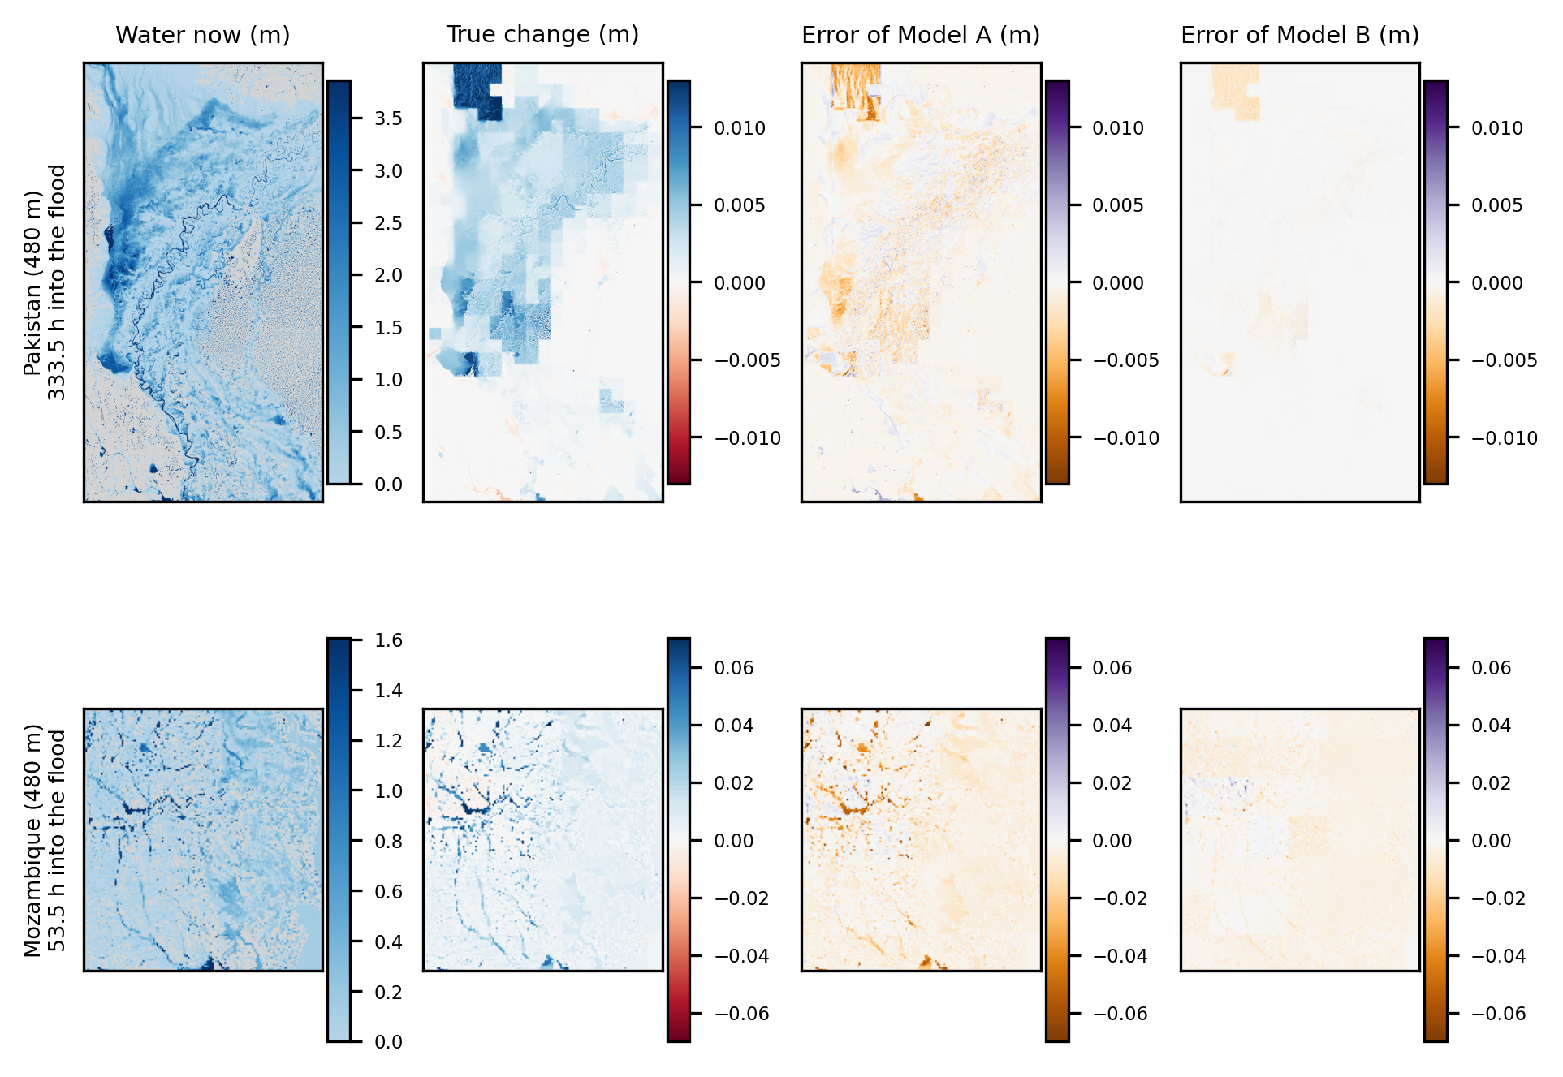
Part 1: the Colab notebook, where the models go wrong
The same maps for the two 480 m floods
Pakistan (top) and Mozambique (bottom). Purple means too much water was forecast, and orange means too little. Model B's map is almost blank again.
Notes:
These are the same pictures for Pakistan and Mozambique, where each square is 480 metres wide. Again, Model A makes visible mistakes and Model B's map is almost blank.

Slide 13
Part 1: the Colab notebook, what it means
At 30 minutes there is very little left to improve
1%
5%
9%
6%
Australia
UK
Pakistan
Mozambique
This is how much of the error of copying the last map is still left, after the trend forecast has done its job. Only this much is left for any model to remove.
So Model B matches the trend because there is almost nothing left to add. A fair test of the LSTM's memory needs a longer forecast, 6 to 24 hours ahead, where a simple trend should get worse. That is the next step we want to take.
Notes:
At 30 minutes ahead, the trend forecast already removes 91 to 99 percent of the squared error of copying. That leaves only about 1, 5, 9 and 6 percent of that error for any model to remove, in the four tests. So Model B can match the trend, but there is almost nothing left for it to add. A fair test of the LSTM's memory needs a longer forecast, 6 to 24 hours ahead, where a simple trend should get worse. That is the next step we want to take.

Slide 14
Part 2: the laptop study
Part 2: a bigger study on a laptop
310
training runs in total
Models we compared
Number of parameters
3
Original CNN-LSTM
about 4.5 million
experiments: Australia to UK at 60 m (E60) and 30 m (E30), and Pakistan to Mozambique at 480 m (E480)
Local CNN
4,101
3
splits of the data (folds) and 3 rain settings: past rain only, the original input, and future rain as well
Small ConvLSTM
4,741
Heavy ConvLSTM
652,918
6
predictions (hypotheses) written down before the final runs
Simple baselines: linear model, lookup table, per-pixel network
very few
Part 1 and Part 2 use different set-ups, so we do not compare their numbers with each other.
Notes:
The second part is a larger study that we ran on a laptop. Before the final runs we wrote down six predictions, called hypotheses, so that we could not quietly change what we were testing. There are three experiments: Australia to UK at 60 metres, Australia to UK at 30 metres, and Pakistan to Mozambique at 480 metres. We call them E60, E30 and E480. Each one uses three different splits of the data, which are called folds, and three rain settings. In this part each model forecasts five maps in a row, up to 2.5 hours ahead, on small pieces of the maps. This set-up is different from Part 1, so we do not compare the numbers of the two parts with each other. The table on the right lists the models, with the number of parameters of each.

Slide 15
Part 2: the laptop study, skill on a flood the model never saw
A very simple linear model already gets most of the way
0.79 to 0.82
is the skill of a very simple linear model (a straight-line formula) that only uses the recent depths of each square.
+0.01 to +0.05
is all that the local CNN and the small ConvLSTM add on top of it.
Lookup table: a table that only uses the current depth and the last change of each square. Per-pixel network: a small network that works on one square at a time. The original CNN-LSTM scored lowest because it ignores how the depth has been changing.
Notes:
Each group of bars is one kind of model, and the three bars are the three experiments. The original CNN-LSTM scored lowest, only 0.06 to 0.19, because it ignores how the depth has been changing. A lookup table that only uses the current depth and the last change of each square already reaches 0.74 to 0.79. A very simple linear model of the recent depths reaches 0.79 to 0.82. The local CNN and the small ConvLSTM reach 0.81 to 0.87, so they add only about 0.01 to 0.05 on top of the linear model. Looking at neighbouring squares did not help, and a network 140 times bigger did not help either.

Slide 16
Part 2: the laptop study
Does the LSTM's memory help?
When both models are trained for the same length (90 passes through the training data), they score the same. The difference is +0.004 on the UK and −0.014 on Mozambique, inside the ±0.03 band we set in advance to mean “the same”. A model 140 times bigger did not do better either.
The ConvLSTM does lose less skill as the forecast reaches further ahead. At 30 minutes the plain CNN is slightly better, and at 2.5 hours the ConvLSTM is better. It also stayed stable when we hid the start of a flood from training.
We did not test whether the memory is the reason for these two differences.
The chart shows Australia to UK at 60 m, with the planned 30-pass training. The other two experiments show the same pattern.
Notes:
This is the question behind the whole project. With the planned 30 passes through the training data, the ConvLSTM was ahead of the plain CNN on the UK at 60 metres by 0.025, but the plain CNN was slightly undertrained. When we trained both for 90 passes, the difference was 0.004 on the UK and minus 0.014 on Mozambique. Both are inside the plus or minus 0.03 band that we fixed in advance as our meaning of the same. So when training is equal, they score the same, and a ConvLSTM about 140 times bigger scored no better. The chart shows one real difference: the ConvLSTM loses less skill as the forecast reaches further ahead. It also stayed stable when we hid the start of a flood from training. We did not test whether the memory is the reason for these two differences.

Slide 17
Part 2: the laptop study
The models mostly use the recent depths
≈ 0
If we freeze the depth history, so the model cannot see any change over time, its skill drops to about zero.
0.01 to 0.02
Taking the rain away costs only about this much. Taking the ground height away costs 0.006 or less.
0.84 → 0.17
When we train the local CNN without the depth history, its skill falls from 0.84 to 0.17.
The bars show the local CNN on the UK flood (60 m). Only our original CNN-LSTM relied on the rain instead of the depth history.
Notes:
In these tests we change one input of a trained model and see how much the score drops. Taking the rain away costs only about 0.01 to 0.02, and taking the ground height away costs almost nothing. Freezing the depth history, so the model cannot see any change over time, takes the skill to about zero. A network that is trained without the depth history falls from about 0.84 to 0.17. Only our original CNN-LSTM relied on the rain instead of the depth history, so our early idea that rainfall drives the forecast is true only for that model.

Slide 18
Part 2: the laptop study
What we changed while tuning, and what helped
−0.008 to −0.026
A bigger batch with a higher learning rate made the score a little lower.
+0.008 to +0.024
Training for longer helped a little.
0.006 to 0.010
This is how much the score moves just from changing the random seed. So differences below about 0.02 are too small to trust.
E60, E30 and E480 are the three experiments. We only tested the Adam optimiser and a few learning rates, and we did not test other optimisers.
Notes:
We changed the training settings of the local CNN one at a time. A bigger batch with a higher learning rate did not help, and it lowered the score by 0.008 to 0.026. Training longer, 90 passes instead of 30, helped by 0.008 to 0.024. Doubling the number of training samples also helped, but mostly because it gave the model twice as many update steps. When we trained with five different random seeds, the score moved by 0.006 to 0.010 just from the seed, so differences smaller than about 0.02 are too small to trust. We only tested the Adam optimiser and a few learning rates. We did not test other optimisers, and the report says so.

Slide 19
Part 2: the laptop study
Six predictions we wrote down before the final runs
1
The local CNN and the small ConvLSTM beat copying the last map
2
They also beat the best linear model
Held in 13 of 16 test cases
Held in 15 of 16 cases, but only 8 by a clear margin
3
The recent depth history matters
4
The LSTM's memory matters
Held in all three experiments
Mixed: the same score at equal training
5
More rain information helps
6
A stricter test gives a similar score
Held for the local CNN, not the ConvLSTM
Held in only 2 of 5 cases
Green means it held. Orange means it held only in part, or the answer was mixed. Red means it held in only 2 of 5 cases.
Notes:
Before the final runs we wrote down six predictions, so that we could not quietly change what we were testing. The first said that the local CNN and the small ConvLSTM beat copying the last map. That held in 13 of 16 test cases. The second said that they beat the best linear model. That held in 15 of 16 cases by our planned test, but the gain was 0.02 or more in only 8 cases, it was within noise in 7, and in one case the ConvLSTM with future rain on E480 was worse by 0.046. The third said that the depth history matters, and it held in all three experiments. The fourth said that the LSTM's memory matters, and the answer was mixed. The fifth said that more rain information helps, which held for the local CNN but not for the ConvLSTM. The sixth said that a stricter test gives a similar score, and that held in only 2 of 5 cases.

Slide 20
NeuroSymbolic AI: the capsule network and the written rules
Rating how serious the flood is
The capsule network beat a plain output layer on Australia at first (67.8% against 60.2%). With rotated and flipped copies of the data added, they were almost the same (80.3% against 79.8%).
Three written rules check the rating and always give a reason. A neural network checked by rules people can read is called NeuroSymbolic AI. The rules raised the accuracy in all four floods.
In Pakistan, 698 of the 1,000 test tiles are “severe”. So always answering “severe” would already be right 69.8% of the time.
Tiles are small pieces of the map, 1,000 per flood. The rating read from the forecast map is right about 99% of the time, because the rating 30 minutes ahead is almost the same as the rating now.
Notes:
Besides the forecast, the system also rates how serious the flooding will be in 30 minutes: none, minor, moderate or severe. The capsule network does the rating. Putting written rules around a neural network is what we mean by NeuroSymbolic AI. On Australia, it beat a plain output layer at first, 67.8 percent against 60.2 percent. But once we added rotated and flipped copies of the data, the two were almost the same, 80.3 against 79.8. So we cannot say the capsule network is better. Three written rules check the rating and always give a reason, and they raised the accuracy in all four floods. The class of the forecast map alone is right about 99 percent of the time, because the rating in 30 minutes is almost the same as the rating now. In Pakistan, 698 of the 1,000 test tiles are severe, so always answering severe would already be right 69.8 percent of the time.

Slide 21
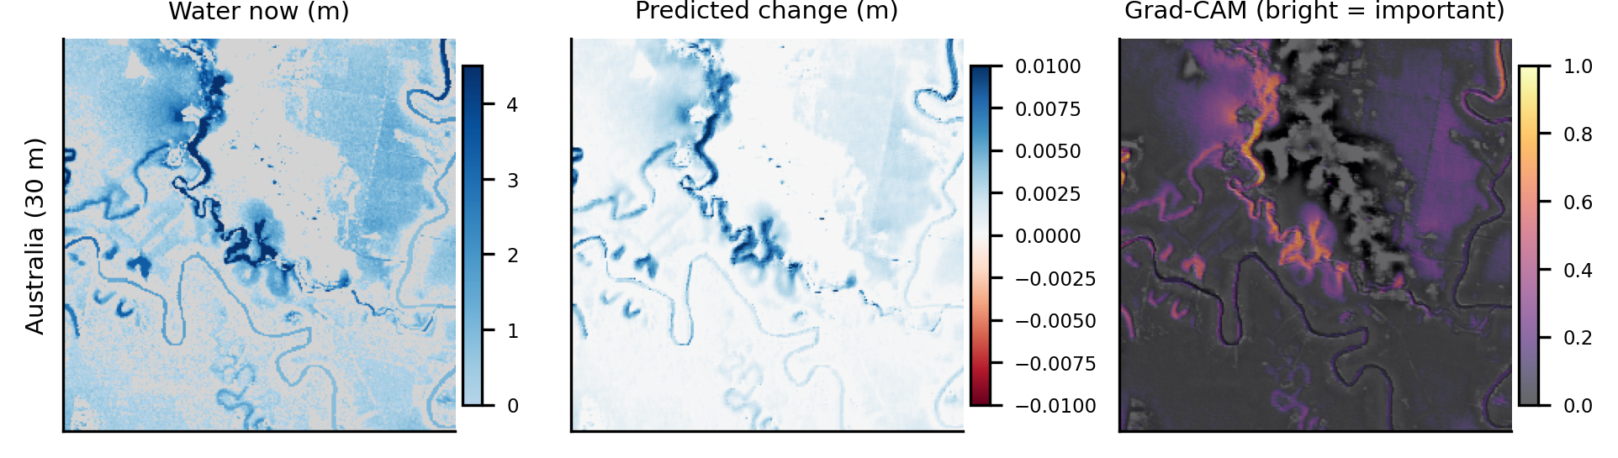
Explainable AI with Grad-CAM
Where does the forecaster look?
Explainable AI means showing why a model gave its answer. Grad-CAM is our way of doing that: it colours the parts of the input that mattered most, and bright means more important.
For the forecaster
For the capsule network
The bright areas follow the river channels and flood edges, where the water is changing. When we deleted the top 10% of the heat map, the forecast changed more than when we deleted random cells, in 84% to 92% of the test samples.
The heat maps were weak. Maps from two training runs agreed only a little (rank correlation 0.17). So we show them as pictures, not as proof.
Notes:
Explainable AI means showing why a model gave its answer. Grad-CAM is our way of doing that. It colours the parts of the input that mattered most for a prediction. Bright means more important. These pictures are for Australia: the water now, the change the model predicts, and the Grad-CAM map drawn on top of the ground height. The bright areas follow the river channels and flood edges, which are the places where the water is changing, so that makes sense. In the laptop study, when we deleted the top 10 percent of the heat map, the forecast changed more than when we deleted random cells, in 84 to 92 percent of the test samples. So the heat maps of the forecaster pass that test. For the capsule network the heat maps were weak and changed from one training run to another, so we show them as pictures and not as proof.

Slide 22
Where the model fails, and the limits of our study
What this study cannot tell us
The limits of this study
We have only one flood per region, so there are only two truly independent train-and-test pairs.
The floods are simulated, so the models learn to copy a simulator, not real floods.
The Colab results come from single runs.
In a harder test we hid a block of time from training. The plain CNN then failed badly on Pakistan, because six of 480 test windows, all at the very start of the flood, caused 98% of its error. The ConvLSTM and the lookup table coped.
The capsule network and Grad-CAM were built on Model A, not on Model B.
Notes:
We also tried a harder test, where a block of time is hidden from training. Then the plain CNN failed badly on Pakistan, and its skill fell from 0.430 to minus 6.56. Six of 480 test windows, all at the very start of the flood, caused 98 percent of its error. The ConvLSTM stayed at 0.742 and the lookup table at 0.66, while the per-pixel network also failed, at minus 2.65. The lesson is that a model that has never seen the start of a flood should not be trusted on one. On the right are the honest limits of the study. We have only one flood per region, so only two truly independent train and test pairs. The floods are simulations. The Colab results are single runs. And the capsule network and Grad-CAM were built on Model A and not rebuilt on Model B.

Slide 23
Live demo
The Colab notebook
1
Load the four floods and cut them into small training pieces
Nothing is retrained
2
Colab is Google's online notebook, and it gives us a GPU. The notebook loads the models we already saved on Google Drive. We ran it, and every number matched our report.
Load Model A and test it on whole maps
3
Fit the trend forecast and load Model B
4
Run the capsule network, Grad-CAM and the written rules
5
It takes about 20 to 30 minutes to run.
Print one summary table
Notes:
If we are asked for a live demo, we run this notebook. Colab is Google's online notebook, and it gives us a GPU. The notebook loads the models that we already saved on Google Drive, so nothing is retrained, and it prints the same tables as the report. We ran it on Colab and every number matched the report. That includes the trend numbers 0.921 and 0.948, the skill table, the water-balance ratios, the severity accuracies and the rule counts. It takes about 20 to 30 minutes to run.

Slide 24
Conclusion
What we learned
1
At 30 minutes ahead, a simple trend forecast with one fitted number does most of the work. Our second model matches it, but it does not beat it.
2
Up to 2.5 hours ahead, a very simple linear model of the recent depths already scores 0.79 to 0.82. The best networks score 0.81 to 0.87, and the LSTM's memory did not help when the training length was equal.
3
Always compare a model with simple forecasts. Our first model looked good until we did.
What we want to do next: forecast 6 to 24 hours ahead, where a simple trend should get worse and the LSTM's memory could really matter. We also want to rebuild the capsule network and Grad-CAM on Model B, and repeat the Colab runs with several random seeds.
Notes:
We learned three things. First, at 30 minutes ahead a simple trend forecast with one fitted number does most of the work, and our second model matches it but does not beat it. Second, up to 2.5 hours ahead a very simple linear model of the recent depths already scores 0.79 to 0.82, and the best networks score 0.81 to 0.87. The LSTM's memory did not help when the training length was equal. Third, and most important, always compare a model with simple forecasts. Our first model looked good until we did that. Next we want to forecast 6 to 24 hours ahead, where a simple trend should get worse and the LSTM's memory could really matter.

Slide 25
The main works we built on
References
Q. Xu, Y. Shi, J. Zhao and X. X. Zhu, FloodCastBench: a large-scale dataset and foundation models for flood modeling and forecasting, Scientific Data, 2025.
X. Shi et al., Convolutional LSTM network: a machine learning approach for precipitation nowcasting, NIPS 2015.
S. Sabour, N. Frosst and G. E. Hinton, Dynamic routing between capsules, NIPS 2017.
R. R. Selvaraju et al., Grad-CAM: visual explanations from deep networks via gradient-based localization, ICCV 2017.
S. Makridakis, E. Spiliotis and V. Assimakopoulos, Statistical and machine learning forecasting methods: concerns and ways forward, PLOS ONE, 2018.
A. Zeng, M. Chen, L. Zhang and Q. Xu, Are transformers effective for time series forecasting? AAAI 2023.
D. P. Kingma and J. Ba, Adam: a method for stochastic optimization, ICLR 2015.
The full list of 22 references, with DOIs, is in the report.
Notes:
These are the main works we built on. The full list of 22 references is in the report.

Slide 26
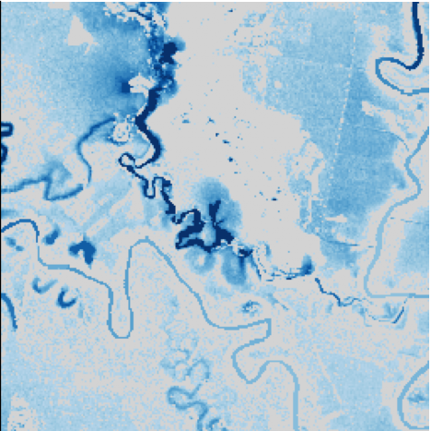
Thank you
Anhad Mahajan · PRN 24070126031
Aman Sumeet Saxena · PRN 24070126030
AIML A2
The water depth in the Australia flood, one step before the forecast.
Notes:
To finish, the three things to remember. At 30 minutes a simple trend forecast is already very strong. Up to 2.5 hours a very simple linear model of the recent depths gets most of the way. And every model should be compared with simple forecasts before we trust it. The Colab notebook is ready if we are asked for a live demo.

