Slide 1
CNN-LSTM Based Spatiotemporal Flood Evolution Forecasting
With capsule-based classification and physics-informed constraints
Anhad Mahajan (PRN: 24070126031) & Aman Sumeet Saxena (PRN: 24070126030)
DL Lab Project

Slide 2
The Problem
What we predict
Goal: using recent flood depth, rainfall, and land-shape data, predict what the flood will look like a few steps into the future, across the whole area, not just one point.
Not a water-level sensor: knowing the water height at one river gauge does not tell you which streets or fields nearby will actually go underwater.
Not a single photo check: looking at one satellite image and marking it "flooded" or "not flooded" does not show how the flood is spreading over time.
Why it matters
A map of the flood shows which areas are getting deeper, which are draining, and how fast the water's edge is moving, exactly what evacuation planning needs.
Running a full physics simulation took about 2 weeks for a 14-day event; a trained model gives a forecast in seconds (Norfolk, VA: cut from 4 to 6 hours down to under 3.2 minutes).
Gap we bridge: no one has tested a CNN-LSTM model on this exact benchmark yet; we are the first to add that result.

Slide 3
Literature Review
Paper | Year | Method | Relevance to us
Shi et al. (ConvLSTM) arxiv.org/abs/1506.04214 | 2015 | Convolutional gates fuse CNN and LSTM in one cell | Closest architectural ancestor; we use a lighter CNN-then-LSTM variant
Ronneberger et al. (U-Net) doi.org/10.1007/978-3-319-24574-4_28 | 2015 | Encoder-decoder CNN with skip connections | FloodCastBench's own spatial-only baseline
Malik, Feng, Shao & Abduljabbar doi.org/10.1007/s12145-024-01354-y | 2024 | Time-distributed CNN-LSTM (TD-CNN-LSTM) | The design pattern we adopt
Wang et al. (Norfolk, VA) doi.org/10.1016/j.ejrh.2026.103234 | 2026 | CNN and LSTM fused at a bottleneck | Closest published analogue to our pipeline
Xu et al. (FloodCastBench) doi.org/10.1038/s41597-025-04725-2 | 2025 | FloodCastBench dataset and U-Net/FNO benchmark | Our dataset; no CNN-LSTM baseline exists (the gap we fill)
Sabour, Frosst & Hinton (Capsule Networks) arxiv.org/abs/1710.09829 | 2017 | Vector capsules with routing-by-agreement, preserving pose lost to CNN max-pooling | Basis for our severity-classification head

Slide 4
Gaps and Limitations
Established gaps in the literature
No CNN-LSTM/ConvLSTM baseline exists for FloodCastBench; only U-Net and FNO/FNO+ are reported.
Most spatially explicit CNN-LSTM flood work is single-region; FloodCastBench's cross-regional transfer test has never been attempted with CNN-LSTM.
Scope limits, not research gaps
No new hydrodynamic simulations; we rely entirely on FloodCastBench's already-simulated sequences.
No full-resolution whole-scene training on all four events, and no claim of operational early-warning accuracy.
No new Indian dataset; no existing public source currently fits this exact task without out-of-scope data engineering.
Capsules have no precedent for dense regression; scoped to severity classification only. Chosen because routing-by-agreement preserves spatial relationships between inundated regions and terrain contours that max-pooling discards, information needed to judge severity, not just depth.
NeuroSymbolic AI = a rule-based logic layer (depth rate, rainfall, slope, drainage proximity) applied on the network outputs; each severity output comes with a stated reason, not a black-box score.
Two explainability layers, by design: Grad-CAM (visual, post-hoc) explains the CNN encoder/decoder's depth predictions; the Symbolic Rule Layer (logic-based) explains the capsule network's severity classifications.

Slide 5
Methodology
1. Data
Depth, DEM, rainfall
2. Preprocess
Patch extraction, normalize
3. CNN Encoder
Feeds LSTM path (depth) + Capsule path (severity)
4. LSTM Enc-Dec
Temporal context, horizon
5. CNN Decoder
Depth map prediction
7. Evaluate
RMSE, NSE, r, CSI vs baselines
8. Visualize
Georeferenced overlay
Grad-CAM
Post-hoc visual explainability, CNN encoder/decoder
Capsule Network
Severity classification, parallel to LSTM path
6. Symbolic Rule Layer
Rule-based severity reasoning (NeuroSymbolic)
CO1–CO5: Dense (CO1) · Classification head (CO2) · CNN enc/dec (CO3) · Dropout/LR (CO4) · LSTM enc-dec (CO5)

Slide 6
Visualization Pipeline
GeoTIFF
Predicted flood depth, real CRS + transform
rasterio
Applies real per-region CRS/transform at export time
Folium / Plotly
Interactive overlay on a real satellite/street basemap
FloodCastBench provides real per-region georeferencing
Per-region CRS and pixel transform (from the archive's own world files) are attached to predicted depth grids at export time, since resolution and origin are fixed per region — enabling real basemap overlay.

Slide 7
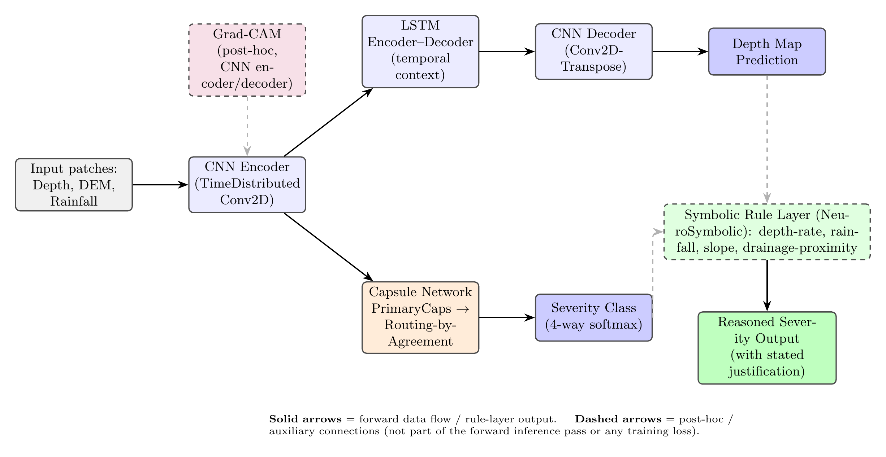

Architecture Diagram

Slide 8









Tech Stack
Python
Data loading, model code, demo backend
TensorFlow / Keras
CNN, LSTM, Dense, Capsule Network, softmax layers
NumPy
Patch extraction, normalization, metrics
Pandas
Train/val/test index, per-epoch logging
Matplotlib / Plotly
Training curves, heatmap rendering
scikit-learn
Splitting, scaling, standard metrics
Grad-CAM
Post-hoc visual explainability (CNN encoder/decoder)
Folium / Plotly (Mapbox)
Georeferenced flood-depth overlay on real basemap
rasterio
Applies real per-region CRS/transform (archive world files)

Slide 9
Thank You

