Slide 1


Project 6 ProducTion Planning

Slide 2



Hello!
WE ARE GROUP 10
Nguyễn Văn Toàn – 20194457
Bùi Anh Đức – 20194426
Tạ Việt Cường - 20194422

Slide 3


Introduction
Problem formulation
Methods -Greedy
- Branch and bound
Experiments
Conclusion

Slide 4

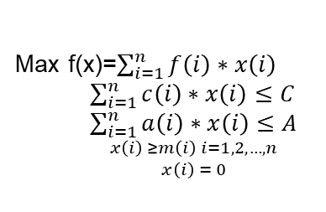
Problem description
There are N products: 1,2,3, …, N that need to be produced
The cost to produce 1 unit of product i is c (i)
The area to produce 1 unit of product i is a (i).
The profit earned from producing 1 unit of product i is f (i).
m (i) is the minimum number of product units i produced
when deciding to produce that product.
The total area of field is A.
Planning the production so that the total profit is maximum and total cost is less than or equal to C.
Max f(x)=$\sum_{i=1}^{n}{f\left(i\right)∗x\left(i\right) }$
$\sum_{i=1}^{n}{c\left(i\right)∗x\left(i\right)≤C}$
$\sum_{i=1}^{n}{a\left(i\right)∗x\left(i\right)≤A}$
${x\left(i\right) ≥m\left(i\right) i=1,2,…,n \atop x\left(i\right) = 0}$

Slide 5

GREEDy idea
At general solving:
Select the best product for the field (The total area of product and the total cost of product is the closet to all).
The number of production units of the product is greater than its minimum number of units m(i)
If remain cost and remain area enough for the next product , do the same as the previous product.

Slide 6
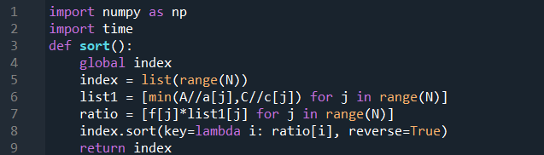

- Firstly, apply the sort function. + Use all cost (C) and area(A) for a product to sort product in decreasing order of profit. We have list index.

Slide 7
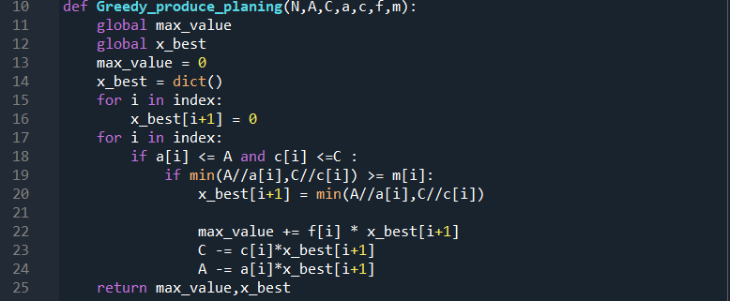
- Secondly, apply greedy produce planning function. + Using list index to take product from left to right .If number of product greater than m(i) , append this number in xbest , max_value is added this profit of product i + If remain cost and remain area enough for the next product , do the same as the previous product. - Finally, we have the max_value and x_best
7

Slide 8

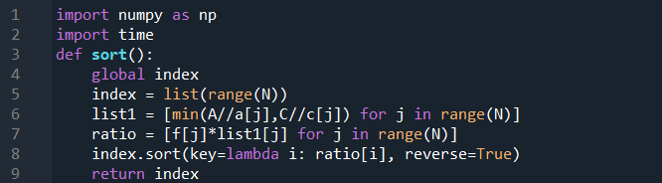

Branch and bound
- Firstly, apply the sort function. + Use all cost (C) and area(A) for a product to sort product in decreasing order of profit. We have list index.

Slide 9
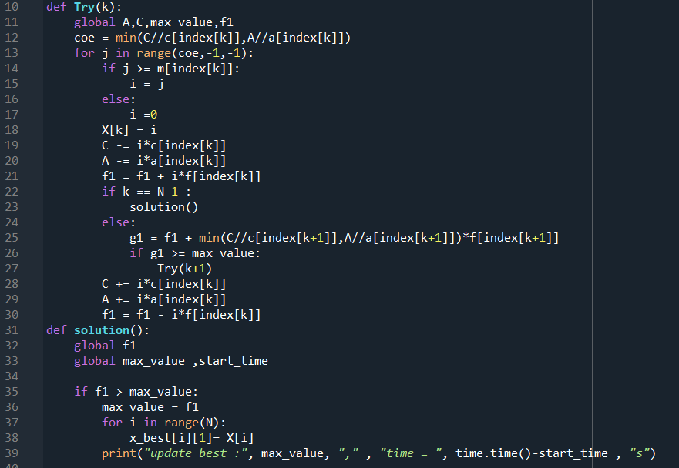
Branch and bound
Secondly, apply the Try function.
+ Using product from list index (from left to right)
to calculating coe ( number that we use all cost (C) and area(A) for a product ) , then we use loop for i in range(coe.-1.-1),each time of loop we calculate remain C , remain A and f1 ( profit ) . ( i < m(i) ->i=0 )
C = C - i*c[index[k]]
A = C - i*a[index[k]]
f1 = f1 + i*f[index[k]]
+ We calculate the upper bound to elimate situations that do not have optimal solution.
g1= f1 + coe of next product with remain C and remain A * profit of it.
if g1 greater than max_value , we use recursion with next product. When calculate final product,we have solution function : if f1 greater than max_value so we update max_value equal to f1 ,update x_best.

Slide 10

Branch and Bound IDEA
Max_Value = 0
Select product in index(left to right). k = 0
coe1= min(C//c(index[k]),A//a(index[k])
coe1 : f1= coe1 * f(i)
C = C – coe1 * c(i)
A = A – coe1 * a(i)
g = f1 + min(C//c(index[k+1]),A//a(index[k+1]) * f(index[k+1])
coe1-1:
coe1-2 :
0
…..
coe2= min(C//c(index[k+1]),A//a(index[k+1])
Second product
coe2
0
Sencond product
…
N-th product
If g < max_value : eliminate
N-th product
If g > max_value
Update max_value= f1 , x_best
If g > max_value
Update max_value= f1 , x_best
If g < max_value : elimimate
10

Slide 11

EXperiments
DATA | HEURISTRIC | BRAND AND BOUNCH
N= 4 | 0,00 | 0,00009
N= 6 | 0,00 | 0,00023
N= 8 | 0,00066 | 0,00080
N= 10 | 0,00078 | 0.00097

Slide 12
ConCLUSion
Result
We can’t find optimal solution. But Heuristric is better in time than BAB
03
Methods
There are many methods to solve this problem. And we do by Heuristric and Branch and bound
01
02
Opinion
We can find good solutions in a reasonable time with very large instances but the time doesn’t depend on data

Slide 13
Thanks!
Special thanks to all the people who listen and see my project.
- Greedy by Nguyễn Văn Toàn and Tạ Việt Cường
- Branch and Bound by Bùi Anh Đức

