Slide 1




Hello ! We are group 13
Bùi Anh Đức-20194426
Tạ Việt Cường-20194422
Nguyễn Văn Toàn-20194457
Lê Thành Thắng-201944

Slide 2
Problem Description
Method
-Uniform-cost search
- A* search
III. Time Table
IV. Conclusion

Slide 3
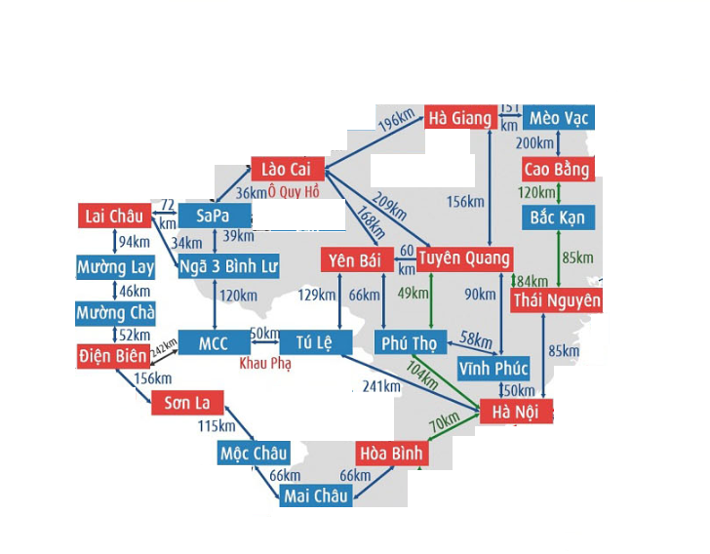
Problem Description
There are 23 cities
Road distance between cities. There are some locations that do not have a road connection.
- Within T (h), Starting from one place to the other. Find the cheapest route to that place.

Slide 4
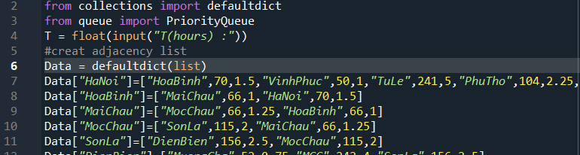
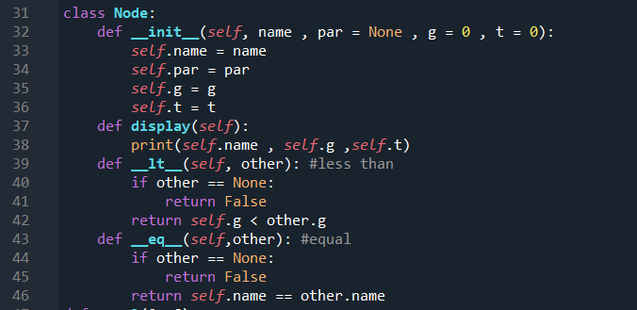
Uniform-cost search
Firstly, Using defaultdict library and PriorityQueue.
Input T by keyboard
Data in picture, it has distance and time between 2 cities.
We have :
g(n) = cost so far to reach n
t(n) = time so far to reach n
Secondly, Using class Node to define some function .
+ Because the queue.PriorityQueue class needs to maintain the order of its elements, a sorting mechanism is required every time a new element is enqueued by using a binary heap.So need to redefine equal function and less than function by cost (g)

Slide 5
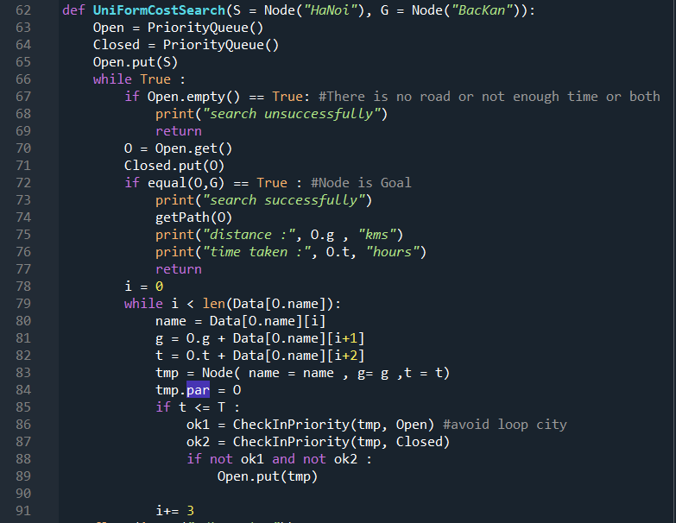
*UniformcostSeatch function:
1, Put starting Node in Open.
2, If Open empty , print “ Search unsuccessfully” and end searching.
3, Take first Node in Open and call it “O” put in Closed.
4, If O is Goal Node , print” Search successfully “ and end searching.
5, Find SubNode of O that are not part Open and Closed and calculate g and t. If t less than T, put this SubNode in Open with order of g
6, Again step 2

Slide 6
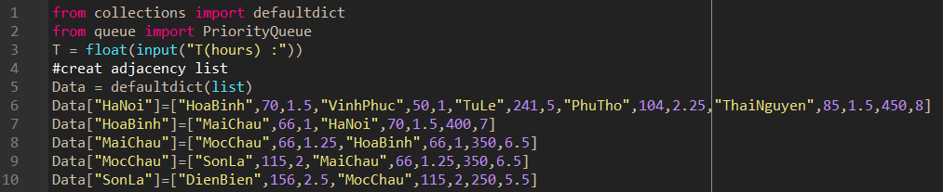
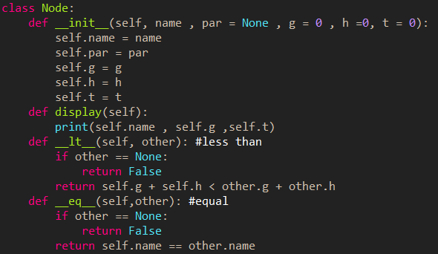
A* Search
Firstly, Using defaultdict library and PriorityQueue.
InPut T by keyboard
Data in picture, it has distance and time between 2 cities. In end data (eg Data”HaNoi” Cost of HaNoi to LaiChau is 450 and time is 8 )
we have :
g(n) = cost so far to reach n
h(n) = estimated cost from n to goal
f(n) = estimated total cost of path
through n to goal
t(n) = time so far to reach n
Secondly, Using class Node to define some function( the same with Uniform cost search). But less than function (compare nodes with g + h)

Slide 7
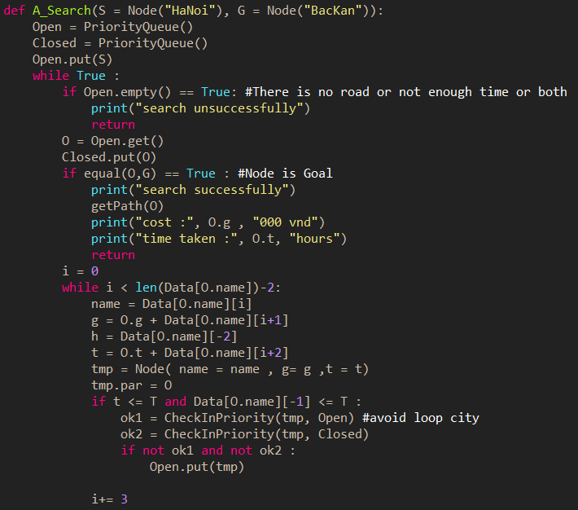
*A*_Search function :
1, Put starting Node in Open.
2, If Open empty , print “ Search unsuccessfully” and end searching.
3, Take first Node in Open and call it “O” put in Closee.
4, If O is Goal Node , print” Search successfully “ and end searching.
5, Find SubNode of O that are not part Open and Closed and calculate g and t. If t less than T, put this SubNode in Open with order of f(x) = g(x)+h(x)
6, Again step 2

Slide 8
TIME TABLE
DATA | Unifrom-Cost Search | A* Search
Data 1 | 0.0019 | 0.00099
Data 2 | 0.00099 | 0.00098
Data 3 | 0.001 | 0.0099
Data 4 | 0.0013 | 0.001

Slide 9
Conclusion
Both Uniform Cost Search and A* Search complete, have optimal solution, The first solution found is also the one has the lowest cost.

Slide 10
THANKS!

