Slide 1
2026 SMU Cox NAPE Energy Innovation Case Competition
Strategic Response to
Dissident Investor Activism
JV/PPA with AWS | Nuclear-Powered Data Center Strategy
TEAM MEMBERS
Anh Bui
Cuong Nguyen
Minh Nguyen
February 18, 2026 | Finals Presentation
Notes:
Welcome. We're presenting our strategic recommendation for an IPP facing a 9% dissident investor. Our recommendation: Execute a JV/PPA with AWS, modeled on Talen Energy's transformative partnership.

Slide 2
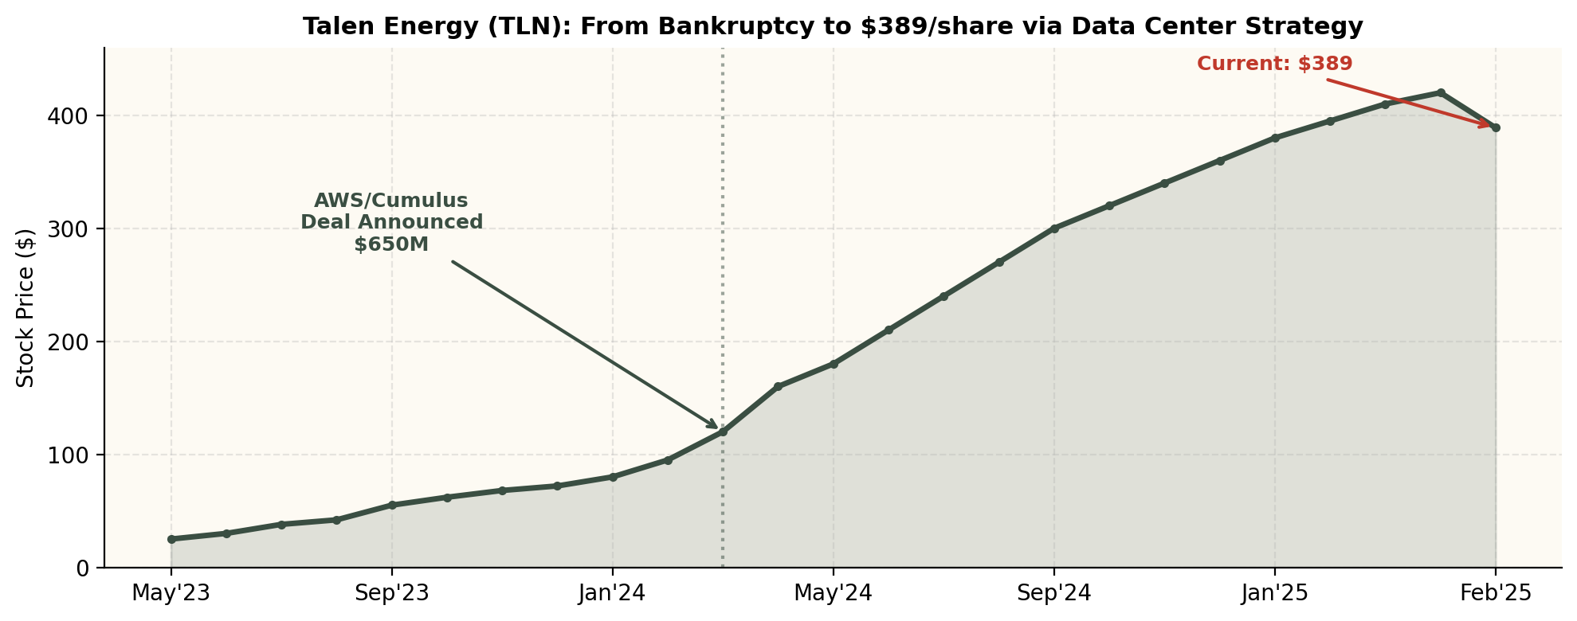
Company Background & Real-World Precedent
OUR COMPANY
REAL CASE: TALEN ENERGY (TLN)
• 13,000 MW total capacity (Nuclear + Gas + Coal)
• 13,100 MW capacity — nearly identical fleet
• 2,200 MW nuclear plant — PJM RTO
• 2,500 MW Susquehanna nuclear — PJM RTO
• $20B market cap | 45M shares | $444/share
• Sold Cumulus DC to AWS for $650M (Mar 2024)
• 30x EV/EBITDA | BB credit rating
• 20-year nuclear PPA with AWS through 2042+
• 9% dissident investor → 10% = special meeting
• Stock: $60 → $389 — 6.5x appreciation
• Target: 30% Adj FCF/share growth
• Market cap: $3B → $17.6B post-deal
Notes:
Our company is a $20B IPP with 13,000 MW in PJM — virtually identical to Talen Energy. Talen sold its Cumulus data center campus to AWS for $650M, signed a 20-year nuclear PPA, and stock went from $60 to $389. The parallels are striking: same market, same fuel mix, same scale.

Slide 3
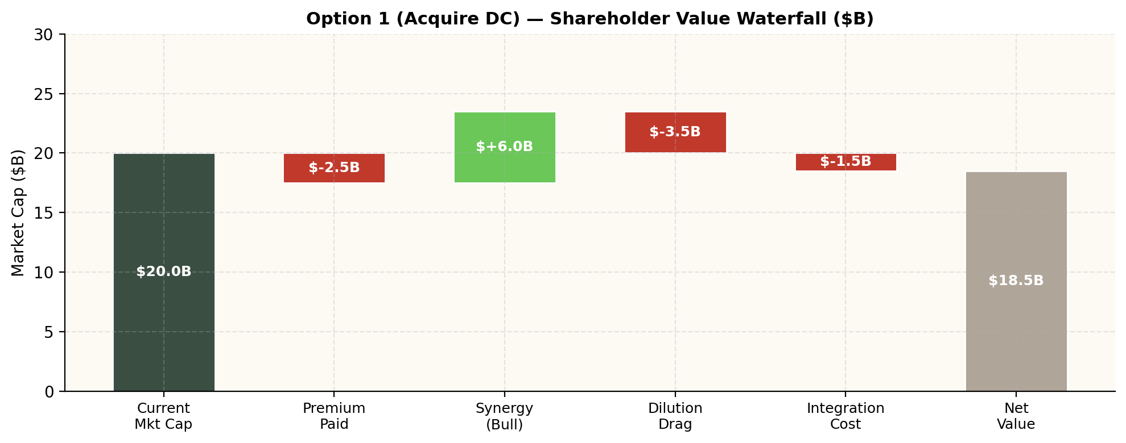
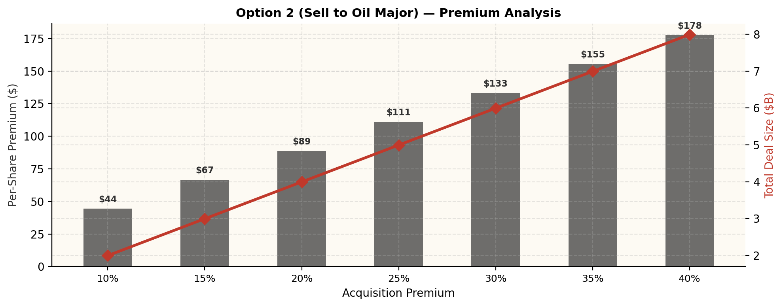
Market & Financial — Options 1 & 2
WHY WE PASSED
Option 1: Acquire Data Center ($4–6B)
Option 2: Sell to Shell/ExxonMobil
✓ PROS | ✗ CONS
Full value chain control | $4–6B cost → massive debt/dilution
Multiple expansion potential | Dilutive to FCF/share Years 1–2
Direct AI/DC exposure | No IPP has done this successfully
Revenue diversification | Integration risk (power ≠ DCs)
Strategic optionality | BB rating at risk of downgrade
✓ PROS | ✗ CONS
Immediate 20–30% premium | Company ceases to exist
Satisfies dissident with exit | 0% FCF growth — no upside
Certain value realization | ESG funds divest (oil major)
De-risks shareholders | Hyperscalers may cancel PPAs
No execution risk | NRC transfer: 12–18 months
VERDICT: Option 1 too expensive ($4–6B) and dilutive. Option 2 destroys long-term value. Neither unlocks the AI premium.
Notes:
Option 1: $4–6B acquisition is prohibitively expensive. Dilutive for Years 1–2, threatens BB credit rating.
Option 2: Shareholders get 20–30% premium but company dies. Zero future upside, ESG backlash, hyperscalers may cancel PPAs.
Neither option captures the AI premium our nuclear assets command.

Slide 4
Option 3: JV/PPA with AWS — Our Recommendation
RECOMMENDED
Deal Structure (Talen Playbook)
Why Pros Outweigh Cons
PPA Partner: Amazon Web Services (AWS)
✓ PROS (11) | ✗ CONS (6)
+65% FCF growth (vs 30% target) | Concentrated on single partner
$200M cost vs $4–6B (Option 1) | PPA locks in price (upside cap)
Proven by Talen: 6.5x stock | FERC scrutiny on BTM arrangement
Zero equity dilution | Nuclear ops risk during transition
Preserves independence | DC campus construction timeline
Satisfies dissident immediately | DC acquisition integration risk
Capacity: 1,500–2,000 MW nuclear
Price: $90–100/MWh (vs $51 merchant) → +86%
Duration: 20 years (2026–2046)
Investment: $200–400M (from cash — ZERO dilution)
DC Campus: 100–200 MW IT → sale to AWS $750–900M
Year 1 FCF
+65%
$10.20 → $16.87/sh
Revenue
+$513M/yr
PPA incremental
Market Cap
$32B
from $20B
Share Price
$711/sh
from $444
Notes:
Option 3 — JV/PPA with AWS. Modeled on Talen's March 2024 deal.
PPA at $90-100/MWh (vs $51 merchant). +$513M/yr incremental revenue. FCF goes from $10.20 to $16.87/share (+65%).
Only $200-400M investment, funded from cash. Zero dilution. Preserves independence.
Pros clearly outweigh cons: the downside risks are manageable (FERC has Talen precedent, single-partner risk mitigated by competitive bidding). The upside is transformative.

Slide 5
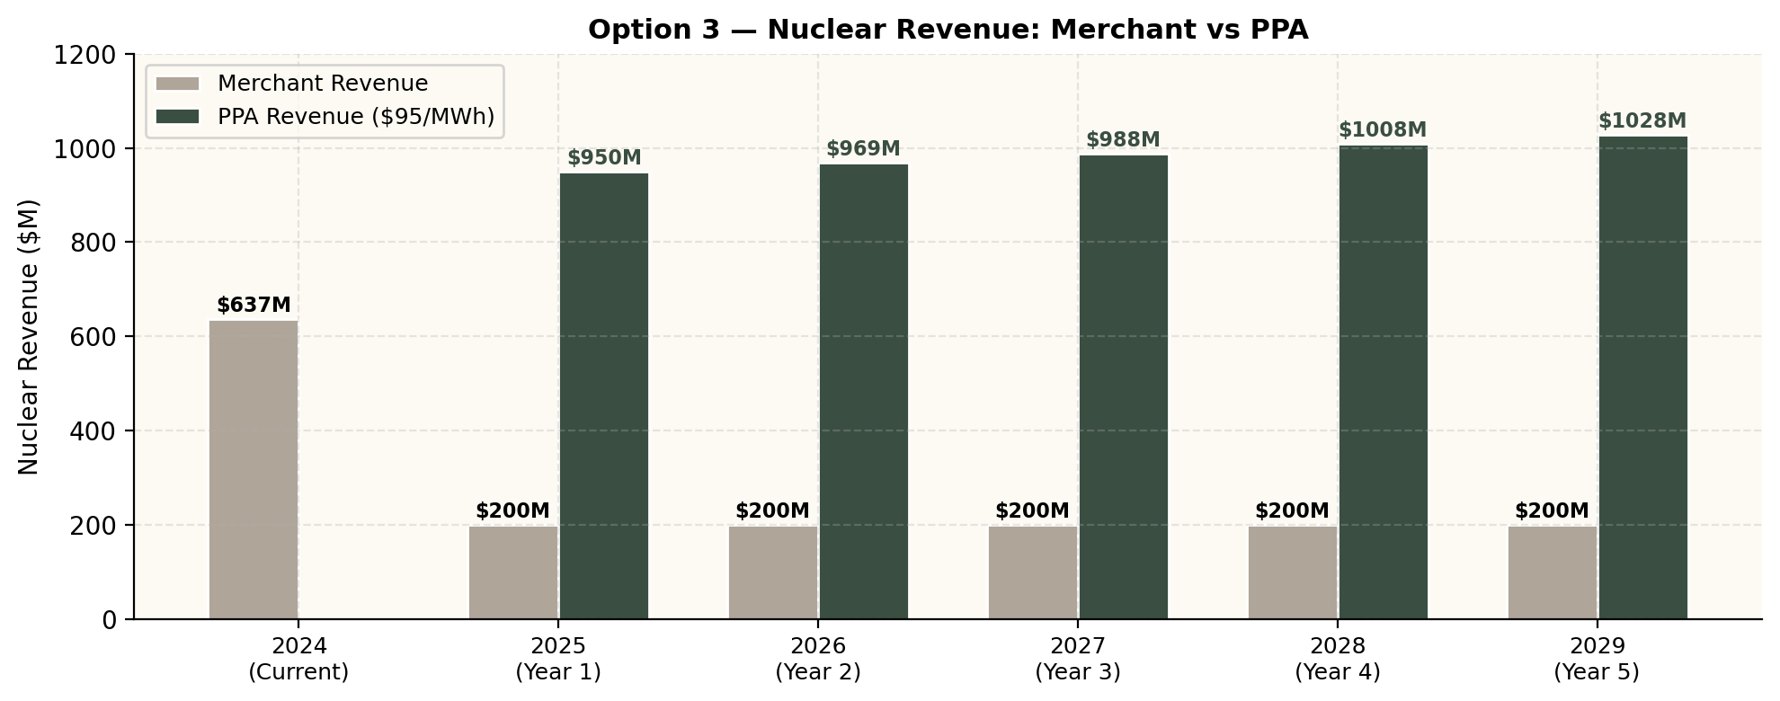
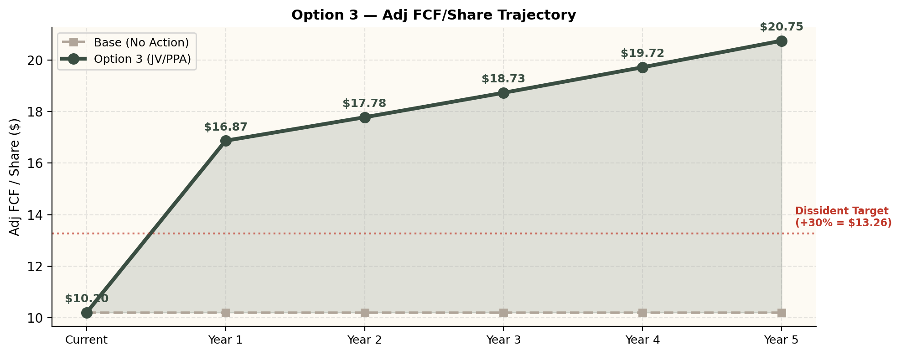
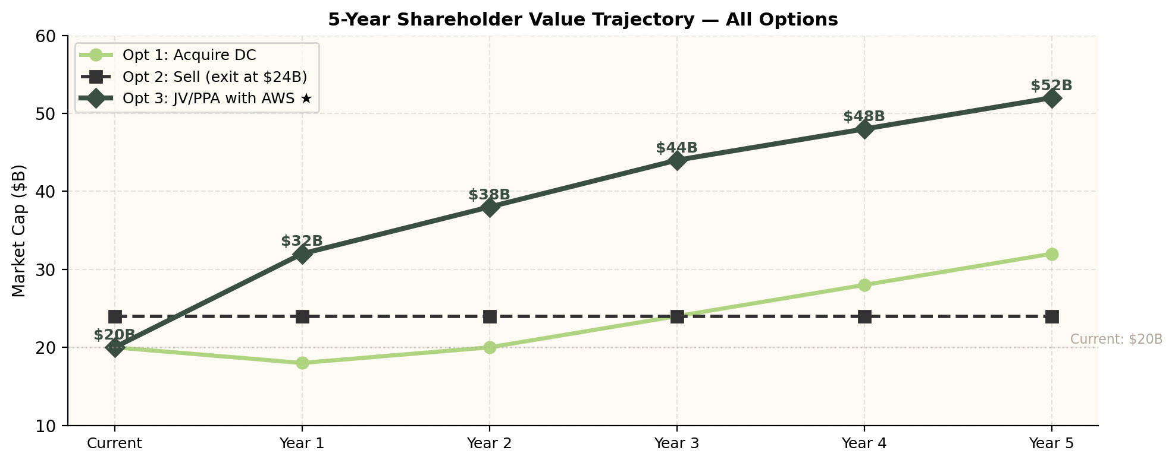
Option 3 — Revenue & FCF Impact
Notes:
Left: Nuclear revenue jumps from $637M (merchant at $51/MWh) to $1,150M (PPA at $95/MWh).
Right: FCF/share goes from $10.20 to $16.87 in Year 1 — 65% growth, far exceeding the dissident's 30% target.
Bottom: 5-year shareholder value trajectory shows Option 3 reaching $52B market cap by Year 5 vs $32B for Option 1 and flat $24B for Option 2.

Slide 6
Talen Energy — Financial Transformation
REAL-WORLD DATA
[ TEAMMATE'S CHART — Talen Financial Time Series
Insert: Stock price trajectory, Revenue/EBITDA growth,
Market cap expansion ($3B → $17.6B) ]
Notes:
Teammate inserts Talen Energy time series analysis: stock trajectory ($60→$389), revenue/EBITDA growth post-AWS deal, market cap expansion ($3B→$17.6B), and our company's projected overlay.

Slide 7
Operational & Execution — Options 1 & 2
RESOURCES & SUPPLY CHAIN
Option 1: Acquire DC — Execution
Option 2: Sale — Execution Risks
Challenge | Severity | Detail
Integration complexity | HIGH | Power gen ≠ DC operations
Capital deployment | HIGH | $4–6B — 18–24 month fundraise
Talent gap | MEDIUM | Need DC engineers, not plant ops
Regulatory | MEDIUM | FERC, PUC, antitrust: 6–12 months
Challenge | Severity | Detail
NRC license transfer | HIGH | 12–18 months, $10–20M legal
ESG backlash | HIGH | Oil major → ESG funds divest
PPA termination | HIGH | AWS/MSFT may exit nuclear PPAs
Culture clash | MEDIUM | Oil major parent disruption
Option 1: 18–24 months | Option 2: 12–18 months | Option 3: 1–3 months to close
Option 1
18–24 months — Fundraise → Acquire → Integrate
Option 2
12–18 months — NRC Review → FERC → Antitrust → Close
Option 3
1–3 months — Negotiate PPA → Sign → Revenue Starts
Notes:
Option 1: Integration complexity is extreme — power gen and data centers are different businesses. $4–6B fundraising takes 18–24 months.
Option 2: NRC license transfer alone takes 12–18 months and costs $10–20M. ESG funds would divest.
Option 3 closes in 1–3 months — it's a bilateral PPA contract.

Slide 8
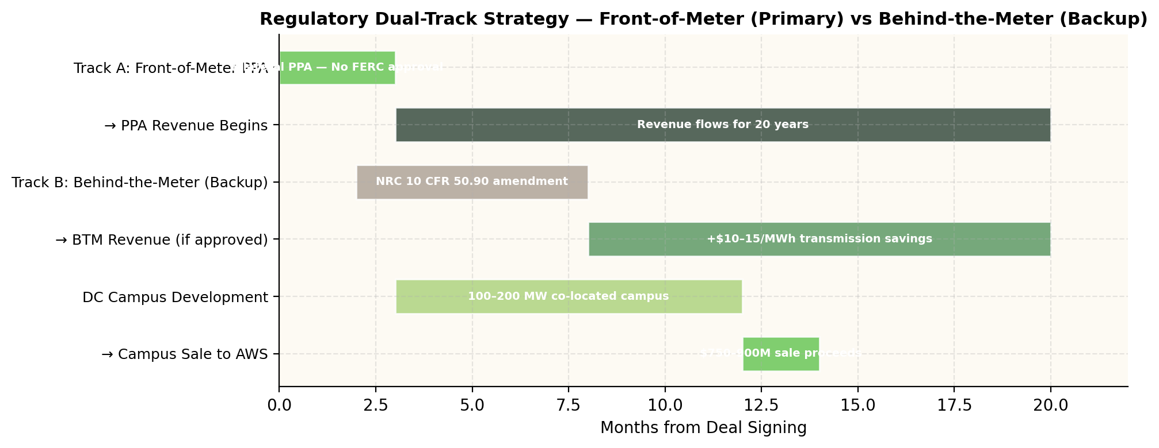
Option 3 — Execution Roadmap
Phase | Timeline | Action | Cost | Value Created
Phase 1 | Month 0–3 | Negotiate & Sign AWS PPA | $0 | +$513M/yr revenue
Phase 2 | Month 3–12 | Develop DC Campus | $200–400M | 100–200 MW IT capacity
Phase 3 | Month 12–18 | Campus Sale to AWS | +$750–900M | Net cash +$350–500M
Phase 4 | Year 2–5 | Expansion Rights | +$500M–1B | 300–500 MW additional
Phase 5 | Year 3–7 | DC Acquisitions (Talen) | $250–530M | $750M–1.6B value
Notes:
5-phase execution roadmap:
Phase 1 (Months 0–3): Bilateral PPA with AWS. No regulatory approval needed for front-of-meter. Revenue starts.
Phase 2 (Months 3–12): DC campus development. $200–400M, AWS funds majority.
Phase 3 (Months 12–18): Campus sale to AWS for $750–900M. Talen got $650M for smaller campus.
Phase 4 (Years 2–5): Exercise expansion rights. Add 300–500 MW.
Phase 5 (Years 3–7): Acquire DCs near power plants, following Talen's Cumulus Growth playbook.

Slide 9
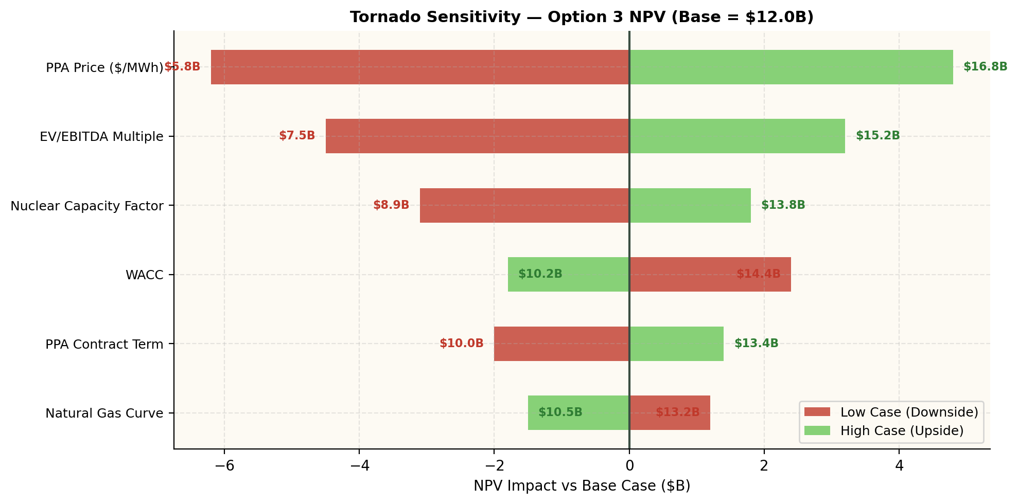
Sensitivity Analysis — What Drives Value
Key Takeaways
PPA Price = #1 Driver
$11B NPV swing. Run competitive bidding among AWS, MSFT, Google.
Multiple Re-Rating
$7.7B swing. Talen 28x is our floor; 40x achievable.
Nuclear CF Stable
92%+ CF industry-proven. Lowest-risk input.
Even Low Case Wins
$75/MWh → +$290M/yr vs merchant. $5.8B NPV.
Notes:
PPA Price is the #1 value driver — $11B NPV swing between $75 and $110/MWh. This is why we run competitive bidding.
Multiple re-rating is #2 — Talen trades at 28x, which is our floor.
Even in the worst case ($75/MWh), Option 3 still generates $5.8B NPV.

Slide 10
Talen Energy — Execution Timeline
REAL-WORLD DATA
[ TEAMMATE'S CHART — Talen Execution Timeline
Insert: Deal timeline (negotiation → close → expansion),
Cumulus campus milestones, post-deal DC acquisitions ]
Notes:
Teammate inserts Talen execution timeline: deal negotiation through close, Cumulus campus development, post-deal DC acquisitions through Cumulus Growth subsidiary.

Slide 11
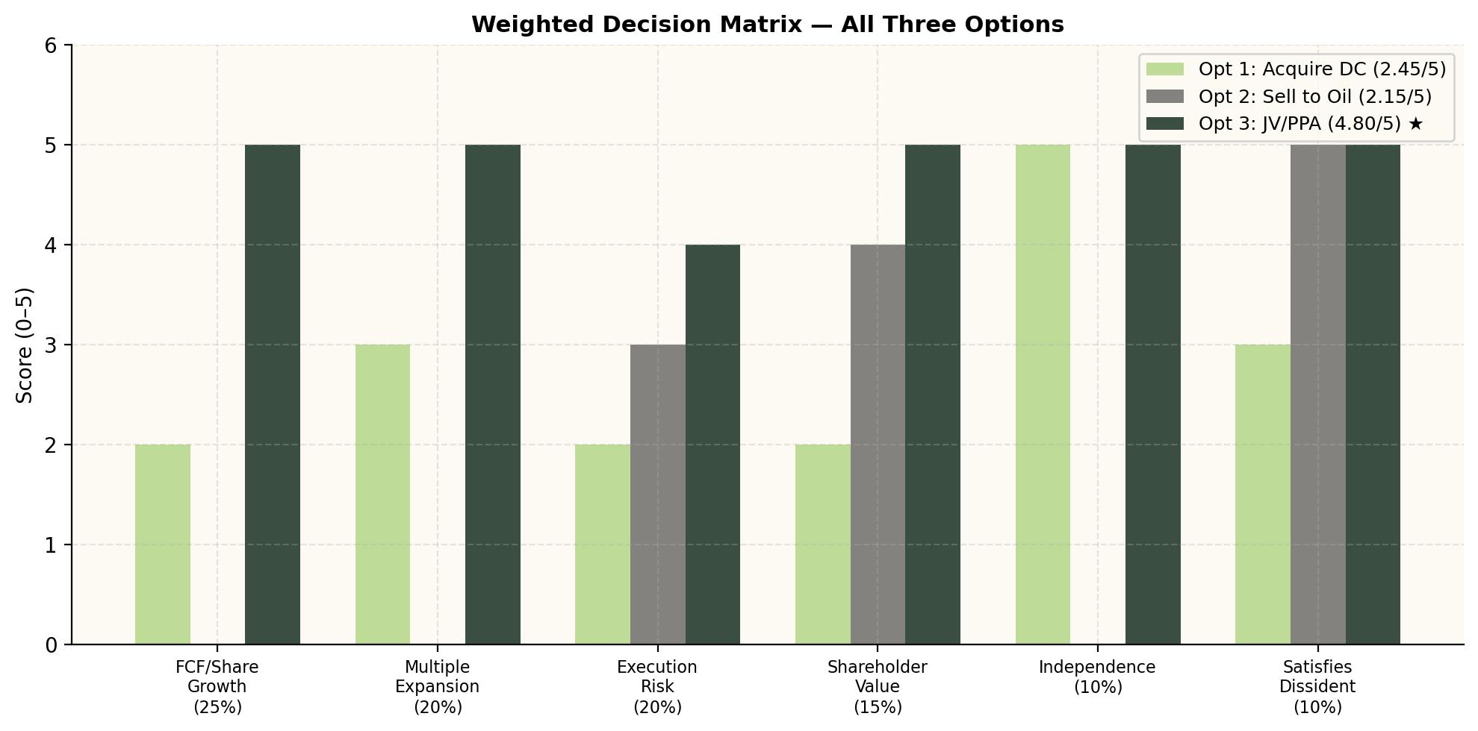
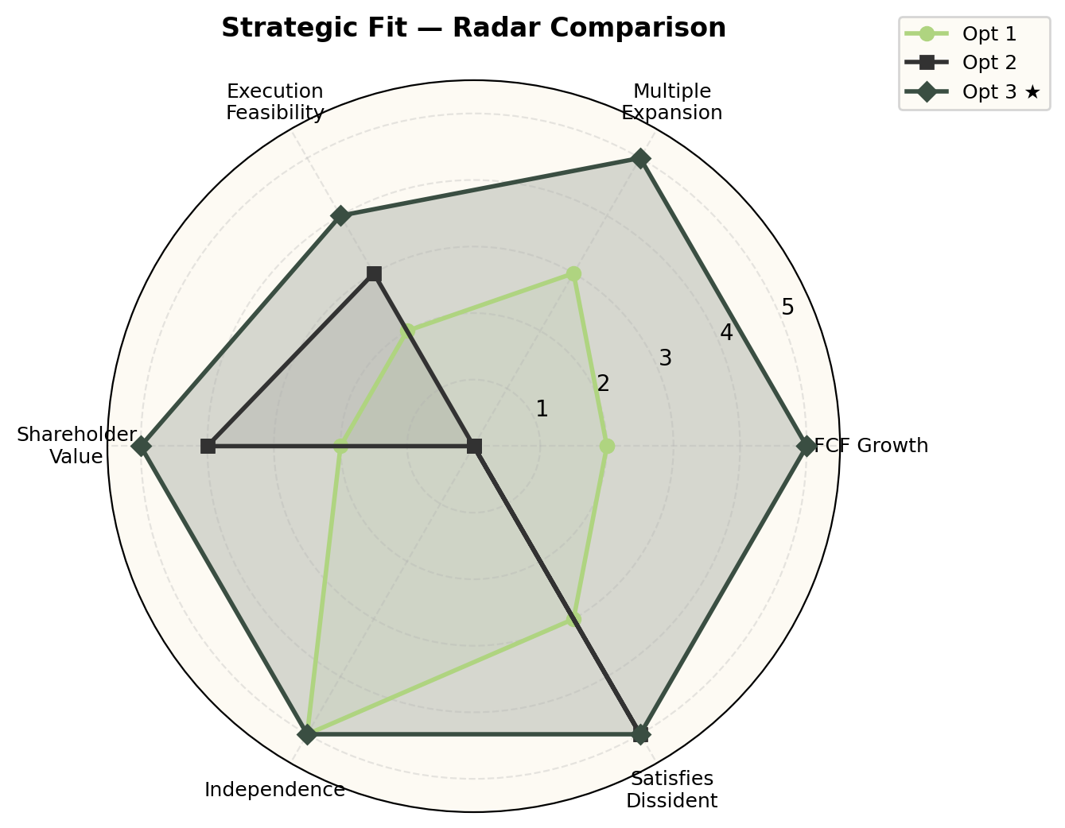
Comparative Analysis — All Three Options
WINNER: Option 3 — JV/PPA with AWS | Score: 4.80/5 | Only option delivering +65% FCF growth + independence + proven precedent
Notes:
Weighted decision matrix: Option 1 scores 2.45/5, Option 2 scores 2.15/5, Option 3 scores 4.80/5.
Option 3 dominates every criterion: FCF growth (5/5), multiple expansion (5/5), execution feasibility (4/5), shareholder value (5/5), independence (5/5), satisfies dissident (5/5).
The radar chart visually shows Option 3's complete dominance across all dimensions.

Slide 12
Risk Assessment & Mitigation
Risk | Probability | Impact | Mitigation
PPA negotiation fails | Low (20%) | High | Competitive bid: AWS, MSFT, Google, Meta all want nuclear
FERC blocks BTM | Med (30%) | Medium | Front-of-meter PPA primary (no FERC needed); BTM is backup only
Nuclear plant outage | Low (10%) | High | 92%+ CF; dual-unit redundancy; force majeure clauses
PPA price below target | Med (25%) | Low | Even $75/MWh = +$290M/yr vs merchant
Dissident escalates first | Med (35%) | Medium | Board seat offer; announce framework early
DC construction delay | Med (30%) | Low | PPA revenue starts Day 1 regardless of campus
Even worst-case ($75/MWh): +$290M/yr revenue, $5.8B NPV | Talen faced greater risks (bankruptcy) and succeeded
Notes:
Key risks and mitigations. Most important: PPA negotiation failure (20% prob) — mitigated by competitive bidding among 4 hyperscalers.
FERC risk mitigated by using front-of-meter PPA as primary track (no approval needed).
Even in worst case, Option 3 generates +$290M/yr and $5.8B NPV. Talen faced far greater risks (bankruptcy, OTC listing) and still succeeded.

Slide 13
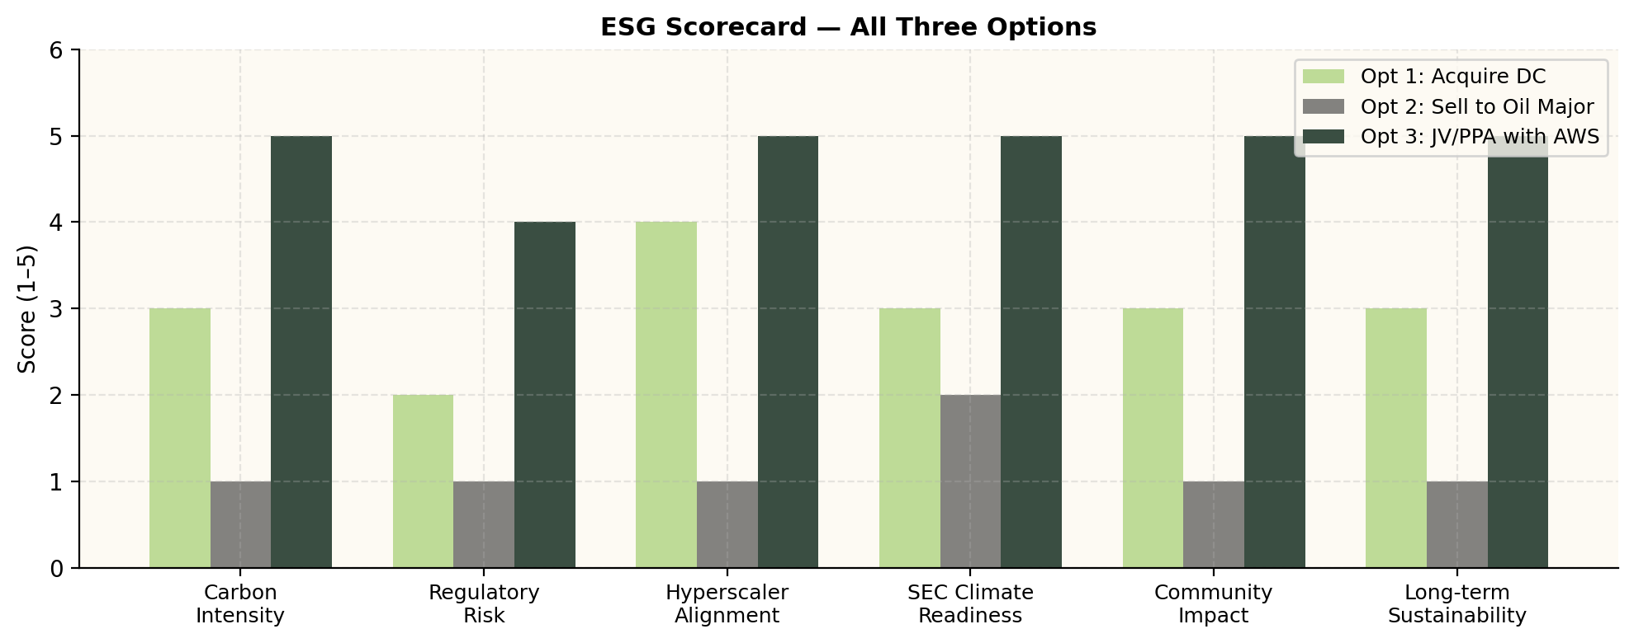
ESG & Sustainability
Hyperscaler Sustainability Mandates — Why Nuclear Wins
AWS: Net-zero by 2040 | 35+ GW needed
Microsoft: Carbon-negative by 2030 | 30+ GW needed
Google: 24/7 carbon-free by 2030 | 25+ GW needed
ESG Value: $2–4B Over 5 Years
+1–2x EV/EBITDA from ESG premium | Green bond savings $15–25M/yr | 45Q credits $85–350M/yr
Option 2 DESTROYS ESG value (oil major ownership → ESG funds divest)
Notes:
Nuclear = 0g CO2/MWh. Option 3 aligns perfectly with hyperscaler sustainability mandates.
AWS, Microsoft, Google all have aggressive carbon-free targets and need 100+ GW of clean power.
ESG value: $2–4B over 5 years from multiple premium, green bonds, 45Q credits.
Option 2 destroys ESG value — oil major ownership causes ESG fund divestment.

Slide 14
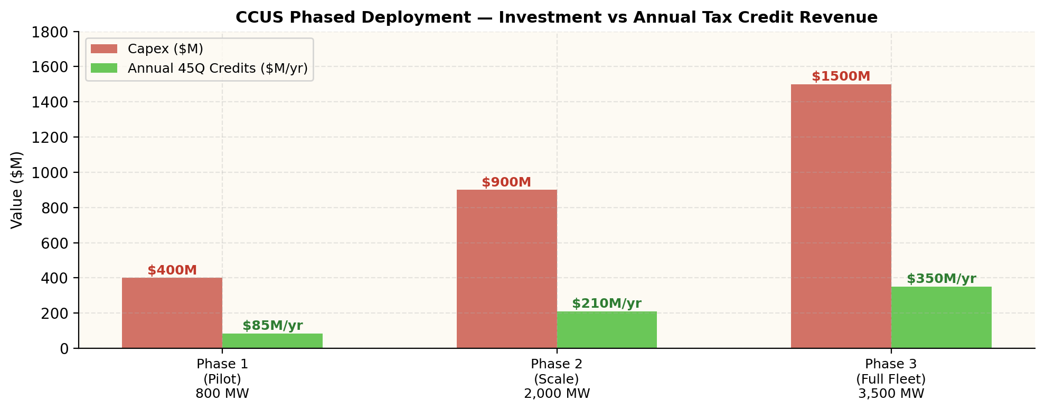
CCUS Integration — Gas Fleet Value Unlock
Phase | Capacity | 45Q Credits/yr | Capex | Timeline
1: Pilot | 800 MW | $85M | $400M | 2027–29
2: Scale | 2,000 MW | $210M | $900M | 2029–31
3: Full Fleet | 3,500 MW | $350M | $1.5B | 2031–34
Total | 6,300 MW | $350M/yr | $2.8B | 2027–34
Nuclear (0g CO₂) + CCUS Gas (~72 lb/MWh) = Only IPP offering 24/7 near-zero carbon in PJM
Notes:
CCUS adds $28/MWh to gas generation through 45Q credits, carbon cost avoidance, and premium PPA pricing.
3-phase deployment: pilot (800 MW), scale (2,000 MW), full fleet (3,500 MW). Total: $2.8B capex, $350M/yr in credits.
Combined nuclear + CCUS gas = only IPP in PJM offering true 24/7 near-zero carbon energy.

Slide 15
Nuclear Regulatory & Risk Management
Body | Concern | Risk | Our Solution
NRC | License amendment for DC | Low–Med | No change for FoM PPA; BTM has Talen precedent
FERC | BTM reduces grid capacity | Medium | FoM PPA primary (no approval); Talen survived FERC
State PUC | DC siting permits | Low | Nuclear sites have industrial zoning already
PJM RTO | Capacity obligation | Medium | Maintain FoM to preserve capacity revenue
Key Advantages vs Options 1 & 2
✓ No NRC Transfer: Opt 2 needs 12–18 months. We retain ownership.
✓ No Antitrust Review: Opt 1's $4–6B triggers HSR Act. PPA doesn't.
✓ FERC De-Risked: FoM PPA is standard bilateral trade.
✓ 1–3 Month Close: Revenue starts immediately.
Notes:
Dual-track regulatory strategy:
Track A (Primary): Front-of-meter PPA — standard bilateral trade, no regulatory approval needed.
Track B (Backup): Behind-the-meter — higher value but requires NRC amendment. Talen precedent exists.
Key advantage: Option 3 avoids the 12–18 month NRC license transfer (Option 2) and the antitrust review (Option 1). Closes in 1–3 months.

