Slide 1
Diversity
In
Silicon valley

Slide 2
Background
Silicon Diversity
The Silicon Valley data set tells a story about the diversity of employees in companies located in Silicon-Valley based on Race, Gender and Profession
Definition
Diversity means different
NB: Diversity is based on silicon valley population of 2 Million

Slide 3
Questions
1. What is the most preferred company to work for or the one with the highest employees?
2. Which company has the least employees working for it?
3. What is the balance between male and female relation in silicon-valley diversity group
4. What is the most and least preferred job to take on as a career, what do people mostly aspire to be?
5. In each company, what is the diversity of race and profession?
6. What is the relationship between race, gender and profession?

Slide 4
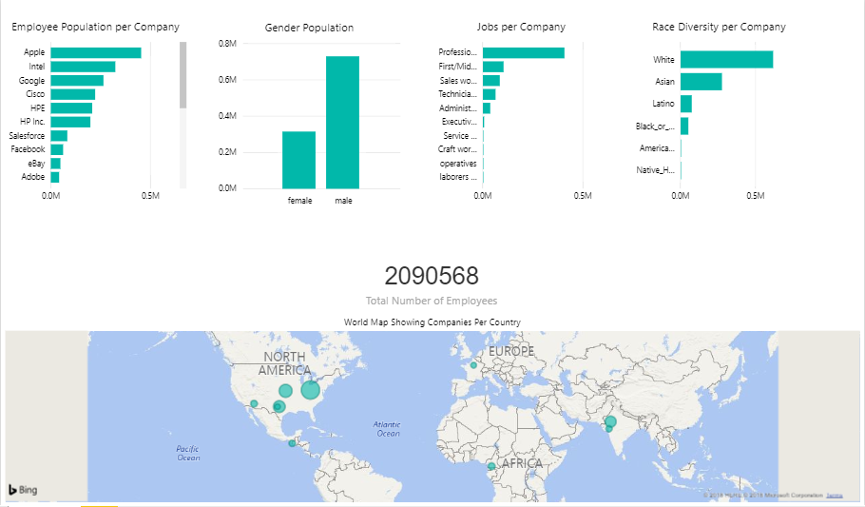
Silicon Valley diversity

Slide 5



Conclusion
1. Apple is the most preferred company to work for.
2. Adobe is the least worked for.
3. There are more males than females
4. They aspire to be professionals
5. The diversity of race and profession is unbalanced
6. White males have more jobs and attain highest professions

