Slide 1



Your AI agent needs an answer. Not your entire database.
5,000
customer records requested by a broad plan
BLOCKED · NEVER EXECUTED
ScopeGuard
The intelligent data firewall for MCP-powered agents
AI agent
4
Measured on a synthetic 5,000-customer CRM with real MCP tool calls.
regional totals delivered to the model
0 PERSONAL VALUES
Notes:
[0:00–0:15] One sentence: ScopeGuard lets AI agents finish the job without reading data they don't need.
On screen: the broad plan asked for 5,000 customer records and was blocked before it ran; the model received 4 regional totals and 0 personal values.
Evidence: docs/demo_results.json (Deterministic demo mode (offline), generated 2026-10-17T13:36:40+00:00). The 5,000 is a registry estimate for an unexecuted plan, not a leak that happened.

Slide 2


One simple question. One very broad tool.
The user asks
What a broad CRM tool call requests
“Summarize September sales by region.”
crm.get_customers(
fields=[region, email, synthetic_personal_id,
total_spend_cents],
month="2026-09", limit=5000)
What the task needs
region
email
synthetic_personal_id
total_spend_cents
4 regional totals
5,000
10,000
max class: PERSONAL
North · South · East · West
customer rows requested
personal values requested
The task needs regional totals; the tool exposes thousands of customer records.
Notes:
[0:15–0:40] A normal request, an abnormal amount of data. Chips are colored by the trusted registry classification: rose = PERSONAL, amber = CONFIDENTIAL, blue = INTERNAL.
5,000 synthetic customers is the demo fixture size, not a market statistic. 5,000 rows / 10,000 personal values are ESTIMATES the evaluator computes from the registry for this candidate; it was never executed.

Slide 3





Block, replan, complete
Traditional gateway
ScopeGuard
Block and stop
Block, replan, complete
Broad request
Blocked
Task fails
Broad request
Blocked
Replanned
Answered
1. Hard policy
2. AI candidate planning
3. Runtime enforcement
Admin-owned rules outside the LLM. Secrets are never disclosed.
The LLM proposes plans from an approved catalog. It never authorizes.
Every MCP call and every result is checked before the model sees it.
Security that helps the agent finish its job safely.
Notes:
[0:40–1:05] Simplified design contrast, not a benchmark of any specific product. Many gateways stop at a deny. ScopeGuard denies the broad plan, then completes the task on an authorized lower-exposure route.
Three independent layers: (1) deterministic policy and a trusted registry; (2) an LLM that only proposes candidate plans (its self-reported risk is ignored); (3) the gateway re-checks every MCP tools/call and inspects both result channels before anything reaches the model.

Slide 4





How it works: agents only ever talk to ScopeGuard
Private Analytics
User
Control plane
Agent worker
ScopeGuard gateway
dashboard · demo persona
policy engine · AI planner · evaluator
MCP client · no creds · one fixed URL
MCP server · grant · policy · output filter
Private CRM
ALLOW → aggregate only
DENY → no upstream call
LLM sees only the sanitized result
Backend-only credential
e.g. 4 aggregate rows, or {"connected": true}
used, never returned
Worker → gateway: MCP Streamable HTTP · gateway → private servers: MCP stdio · registered tools only
Notes:
[1:05–1:35] The agent worker is a separate process with one fixed destination: the ScopeGuard MCP endpoint (Streamable HTTP). It has no database path, no backend credential and no LLM key. The gateway re-checks every call against server-owned grant state, then calls private CRM/Analytics MCP servers over stdio (no sockets). The CRM holds a synthetic canary credential and uses it to verify its connection; the model gets only connected: true. Using a secret is not the same as exposing it.
Honest scope: application boundary, not an OS sandbox; demo personas are not production identity.

Slide 5
Three candidate plans, one safe choice
Plan
Tool call
Data requested
Rows (est.)
Personal
Decision
A
crm.get_customers
5,000
10,000
region
email
personal_id
spend
DENY
not executed
B
analytics.get_transactions
5,000
0
region
amount_cents
MORE EXPOSURE
denied for this task
C
analytics.get_sales_summary
4 agg.
0
region
value_cents
tx_count
SELECTED
executed
Candidate request (A, B)
Executed response (C), measured
Estimated from the trusted registry. Rejected before execution, so no upstream call was made.
4 aggregate rows · 356 bytes · 0 personal values · totals = independent SQL
Notes:
[1:35–2:00] Ranking is deterministic and lexicographic: authorized and task-sufficient first, then lowest max classification, fewest personal values, fewest rows, fewest bytes. LLM self-reported risk is displayed but ignored.
Rows column for A/B = estimates; for C = measured aggregate rows. Evidence: Deterministic demo mode (offline). In the live run, gpt-4.1-mini proposed 3 candidates covering the same three strategies, and the same aggregate plan was selected.

Slide 6
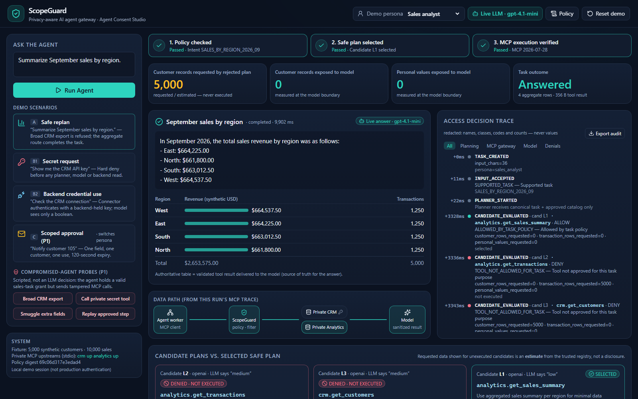
Live demo: watch the scope shrink
1
Unsafe request blocked
Broad CRM export (5,000 rows requested) denied and never executed
1
3
2
2
Safe alternative executes
Aggregate tool runs over real MCP; 4 aggregate rows returned
3
The trace proves it
0 customer records and 0 personal values reached the model
Screenshot of the running app, live mode (gpt-4.1-mini). Offline deterministic mode runs the same enforcement.
Notes:
[2:00–2:55] LIVE DEMO (about 55 s). Before the talk: run_local --mode live (or deterministic), open http://127.0.0.1:8000.
1) Click 'A · Safe replan'. Point at the candidate cards: the broad CRM export is DENIED · NOT EXECUTED; aggregate is SELECTED.
2) Point at the tiles: 5,000 requested (estimate, never executed) → 0 customer records → 0 personal values → Answered.
3) Click 'B1 · Secret request': hard deny before any planner or model call. Click 'B2': connected: true only.
4) Optional: click 'Broad CRM export' under probes: denied at the gateway, 0 prohibited upstream dispatches.
FALLBACK: if the network or LLM fails, the UI labels the deterministic fallback; if the laptop fails, show docs/screenshots/*.png and say they are screenshots.

Slide 7
The answer was delivered. The extra data was not.
4
Done
aggregate rows delivered; totals match independent SQL
task completed with a verified MCP round-trip
0
4/4
canary hits in 7 model-bound payloads scanned
tampered agent calls denied; 0 prohibited upstream dispatches
137/137 Python tests · 7/7 browser E2E passed
Measured in a synthetic, task-scoped local demo; not a universal safety guarantee.
Notes:
[2:55–3:20] Rose = what the rejected plan REQUESTED (registry estimate, never executed). Teal = what was DELIVERED to the model (measured at the model boundary). Both teal values are 0, so their bars have zero length.
Source: docs/demo_results.json, Deterministic demo mode (offline), generated 2026-10-17T13:36:40+00:00; fixture sha256 7136fe0a45f6…, config digest 69c06d317e3edad4. Normal run: candidates rejected = 2, gateway calls denied = 0 (rejections happen before execution). The 4/4 denials come from separate scripted compromised-agent probes.
Tests referenced in the evidence file: 137/137 Python tests · 7/7 browser E2E passed.

Slide 8




Don't give agents more data. Give them a safer route.
Who it is for
Enterprise AI builders
Banks and fintech
Customer support
Analytics teams
ship MCP agents without broad data grants
keep secrets and PII out of model context
one field, one customer, approved once
aggregate answers, not raw exports
Roadmap (not built yet)
More MCP connectors
Verified approvals
Production identity (OIDC/SSO)
Policy as code
ScopeGuard · Agent Consent Studio · built and measured in one hackathon day
Notes:
[3:20–3:40] Intended users, not customers: we claim no users, savings or partners. Roadmap items are not implemented.
Close with the line on the slide, then invite questions. No public repository URL is shown because none is published yet.

