Slide 1
AI Product Listing Upgrader
By Aniesh Das

Slide 2
Vision
Empower small sellers to create high-converting product content instantly using AI

Slide 3
Problem
Sellers lack good visuals, copywriting, and design skills
High cost of content creation

Slide 4
Solution
AI-powered tool that removes background, generates hooks, and creates ad-ready visuals

Slide 5
MVP Features
Image upload
Background removal
AI hook generation
Style selection
AI-generated backgrounds
Download output

Slide 6
User Persona
Small e-commerce seller
Limited budget
Needs fast content
Wants higher conversions

Slide 7
User Story
As a seller, I want to upload a product image and instantly get a premium listing so I can sell more
As a freelancer I want to get into product design and marketing but I don’t know how to start

Slide 8
TAM SAM SOM
TAM: Global e-commerce sellers
SAM: Small/medium sellers using online marketplaces
SOM: Early adopters in D2C and Instagram sellers

Slide 9
Market Reach
Target Shopify, Amazon, Instagram sellers
Focus on India + global SMBs

Slide 10
User Flow
Paste image URL
Click Upgrade
Select style
View results
Generate AI version
Download

Slide 11
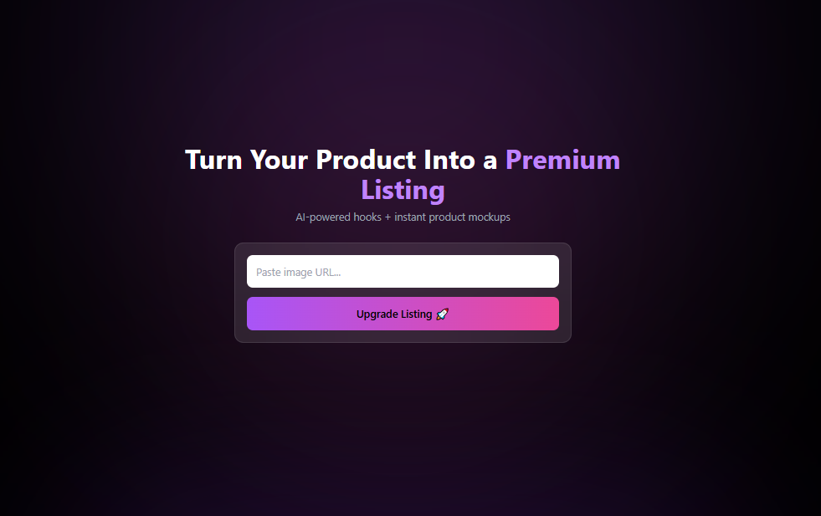
UI Wireframe
Single input box
CTA button
Result section with slider, styles, preview
Download button

Slide 12
Roadmap
Short-term: Better personalization
Mid-term: Marketplace integrations
Long-term: Full AI ad generation suite

Slide 13
Future Scope
AI-generated outputs even more personalized — based on product category or target audience.
Allow direct integrations with platforms like Shopify or Amazon.
Turn the styling system into actual rendered outputs instead of just visual previews — so users get production-ready creatives

