Slide 1

TransportX
A Transport Company Computerization Software

Slide 2
Good Evening!
We are a strong team of 3
Abhay Kumar Keshari | 20CS10001
Aniket Kumar | 20CS10083
Tanmay Mohanty | 20CS10089
Notes:
.

Slide 3
The purpose of Software Engineering is to control Complexity,
Not to Create it..
~ Pamela Zave

Slide 4
Problem Statement
1
It’s Clear Definition and Breakdown

Slide 5
PROBLEM STATEMENT
Software to handle bookkeeping activities of transportation companies
Consignment to be sent between offices, and revenue to be calculated based on volumes
Trucks allotment and dispatch is also managed
Let’s deep dive into individual components

Slide 6
PROBLEM STATEMENT
Consignment Handling
The consignment arrives at an office, it’s volume, sender and receiver details are provided.
Billing is based on volume and office charges.
Truck Allotment
If the sum of consignment volumes is greater than 500, to a particular office, a truck is allotted and dispatched

Slide 7
PROBLEM STATEMENT
Manager Functions
To be able to buy new trucks, if needed
To be able to ask about any consignment.
Manager Tools
To be able to view truck usage and status
Viewing Average Waiting periods and Idle times
Employee Functions
Book a consignment from a customer
See and tell customer about the consignment details

Slide 8

PROCESS OF THE ENTIRE PROBLEM STATEMENT
Customer comes to office, and employee enters all the consignment details to book the delivery
When sum of volumes of consignments to an office is greater than 500, a truck is allotted and dispatched
Customer
Truck
At any point of time, a manager can view statistics of consignments and trucks and take decisions
On arrival of the truck, the receiver is given the consignment.
Manager
Receiver

Slide 9
THE IMPORTANCE OF OUR PROJECT
Transport industry largely works on informal methods and is highly disorganised. The number of consignments can also increase to large number, making it very difficult to track using non-computerised methods
TransportX aims to standardise this informal sector, and have computerised records of all the transactions. This also helps the managers to make data-driven decisions and know the statistics related to the company.

Slide 10
Salient Points
2
Of SRS and Design Document

Slide 11
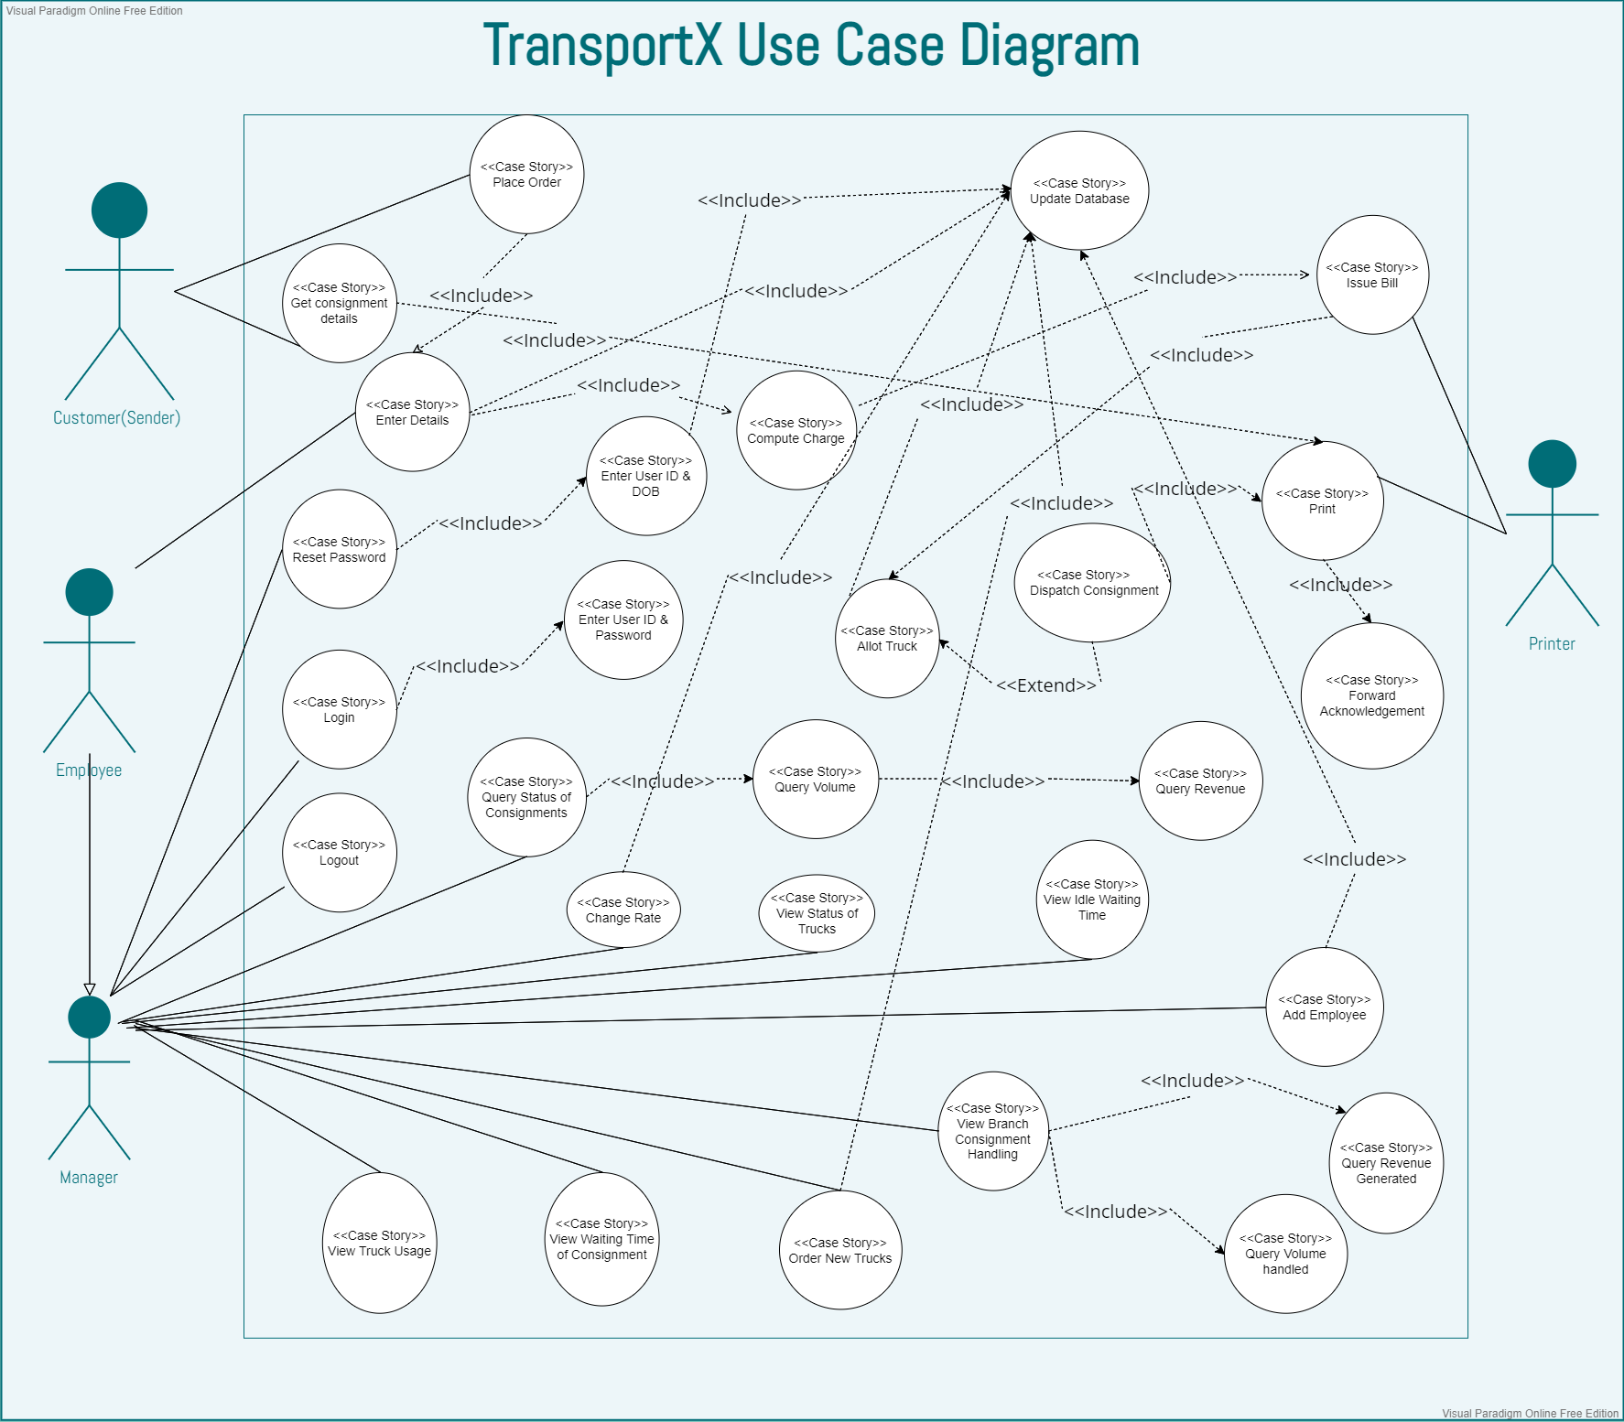
OUR USE CASE DIAGRAM & THE FUNCTIONALITIES

Slide 12
FOCUS POINTS OF SRS AND DESIGN DOCUMENT
Manager Can
View many statistics related to office and trucks
Order new trucks and change the office charge
Add employees and see consignment and truck details
Employee Can
Register new customers, on sender and receiver end
Book consignments between offices
Track the delivery status of consignments
Additional Functionalities
Users are given auto-generated IDs, which act as their usernames.
Forgot password is also functioning properly
Errors and warnings are displayed at all required places and actions

Slide 13
Challenges
3
And why we chose our language and other frameworks

Slide 14
THE CHALLENGES WE FACED
Connecting with Database
Setting up the connection with MySQL database was difficult.
The binding address and ports were creating some issues.
UI Layout issues
Some of the functionalities were hard to solve, which include UI flow and design problems.
Linking various panels in conjunction was also tricky.
Truck allotment
The algorithmic design for truck allotment and availability was initially giving errors.

Slide 15
OUR DECISIONS AND WHY?
Java
Object-Oriented
Platform-Independent
Just-in-Time Compilation
Multi-threaded
Huge Community Support
Java Swing
Platform-independent components.
Components which are lightweight and powerful.
Pluggable look and feel.
Swing follows MVC.
MySQL
MySQL is a relational database management system based on the Structured Query Language, which is the most commonly used language for accessing and managing database entries.
It is fast, flexible, scalable and easy to use.

Slide 16
Challenging Use Cases
4
Let’s see some of the test cases

Slide 17
SOME TRICKY AND CHALLENGING USE CASES
If rate is changed after some consignments are booked
The consignment cost and revenue are calculated considering the rate at that point of time. Further changes in rates do not affect the old calculations.
If a Truck is bought after the consignments are stored
The truck if booked late by the manager, is dispatched as soon as the volume is greater than 500 cub.m. or on the next consignment booking.
This allows smooth transitions between program class functions.
Statistics might be displayed as 0.0 Days
This is a testing period problem. Since we do the testing at time-stamps in a single day only, the statistics when derived are rounded off to 0. But the formulas for their calculation are correct and will shown results if the software is used over a larger period.

Slide 18
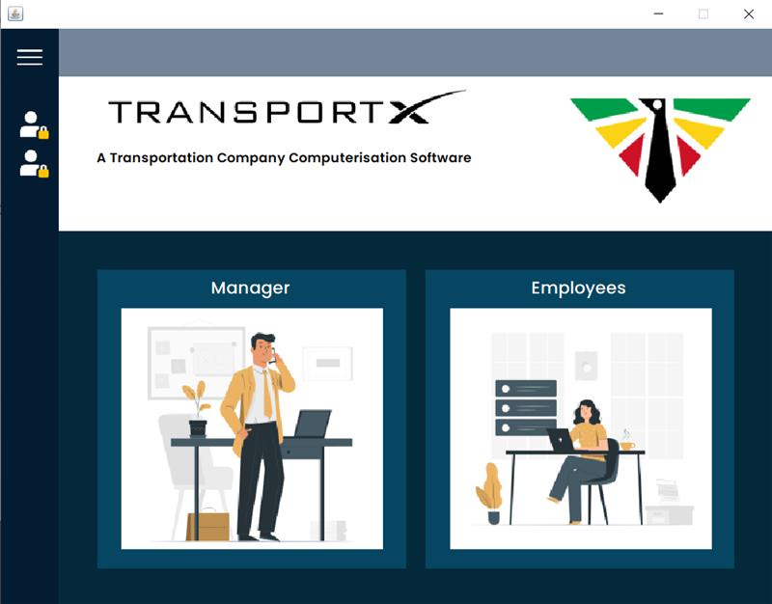
Let’s Look at The UI !
Click on the following.

Slide 19
Future Improvements
5

Slide 20
FUTURE IMPROVEMENTS
Geological Tagging
The locations of offices can be stored as their latitudinal and longitudinal coordinates and inter-office distance can be calculated.
Consignment Barcode
When a consignment is registered, we can generate a barcode to be pasted on it, containing its ID, and details can be easily derived out of it.
Better Scalability
The database is locally updated as of now, due to budget constraints. When scale is to be increased, we would switch to online database services.

Slide 21
THANK YOU
For giving this opportunity and helping us learn Software Engineering

