Slide 1

Solar Industries India Limited, Nagpur
Solar Industries India Limited is a leading Indian multinational company.
Established in 1995, headquartered in Nagpur, Maharashtra.
The company is a global manufacturer of industrial explosives and explosive-initiating systems.
It serves sectors like mining, infrastructure, defense, and construction.
Solar Industries operates multiple manufacturing plants in India and abroad.
Known for its focus on safety, innovation, and digital transformation.

Slide 2




Safety Training & Protocols
The company strictly follows a Zero Accident Safety Policy.
General Safety
Fire Safety
Awareness of plant rules and safety signage
Proper use of Personal Protective Equipment (PPE)
Safe movement inside plant and restricted zones
Identification of fire hazards
Use of fire extinguishers
Emergency evacuation procedures and assembly points
Permits and SOPs
Decontamination
Importance of work permits for hazardous activities
Following Standard Operating Procedures (SOPs)
Ensuring safe and authorized work execution
Procedures to remove hazardous substances
Personal and equipment decontamination practices
Maintaining hygiene and preventing contamination spread

Slide 3
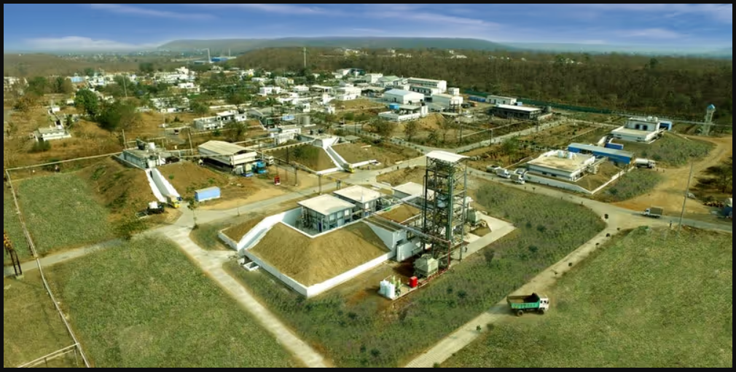
Chakdoh IIoT Platform: Real-time Monitoring & Industry 4.0
Real-time Monitoring
Asset Tracking
Predictive Maintenance
Live tracking of plant machinery, production metrics, and TPM integration for comprehensive operational visibility.
Digital monitoring of sensitive inventory and explosive distribution with e-detonator tracking for enhanced security and accountability.
AI-driven sensors predict equipment failure before it happens, reducing unplanned downtime and maintenance costs.
Data Analytics & Optimization
Management dashboards optimize energy consumption, raw material flow, and production efficiency across all operations.
This intricate network of sensors and analytics within the Chakdoh IIoT platform provides immediate operational overview, enabling proactive decision-making and preventing potential issues while driving Industry 4.0 transformation.

Slide 4








Chakhdoh IIoT Platform: Real-time Critical Parameter Monitoring
Temperature Control
Pressure Regulation
Precise monitoring of temperature across all critical processing units, preventing anomalies.
Continuous tracking of pressure levels to ensure optimal and safe operating conditions.
Environmental Factors
Chemical Composition
Monitoring humidity and other environmental parameters crucial for material integrity and safety.
Real-time analysis of chemical blends for consistent quality and adherence to specifications.
This intricate network of sensors and analytics within Chakhdoh provides an immediate overview, enabling proactive decision-making and preventing potential issues.

Slide 5

Production Monitoring & Optimisation through Chakhdoh
Efficiency Tracking
1
Monitor production line speeds, throughput, and downtime in real-time to identify bottlenecks.
Quality Assurance
2
Automated checks and data logging ensure consistent product quality and traceability.
Predictive Maintenance
3
Leverage AI-driven insights to predict equipment failures, reducing unplanned outages and costs.
Resource Management
4
Optimise energy consumption and raw material usage, leading to significant cost savings and environmental benefits.

Slide 6
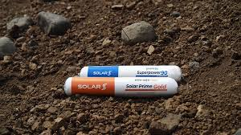
Products of Solar Industries (Chakdoh Plant)
The Chakdoh plant, spreading over 550 acres near Nagpur, is the heart of Solar Industries India Limited's operations. Our manufacturing facilities are equipped with state-of-the-art technology, adhering to international quality and safety standards. We specialise in a diverse range of products essential for various industries.
Industrial Explosives
Initiating Systems
Packaged Explosives (Slurry and Emulsion-based) for mining and construction. Bulk Explosives loaded directly at mine sites via pump trucks.
Electronic and Non-electric Detonators, Detonating Cords, and Cast Boosters for controlled blasting operations.
Defence Portfolio
High Energy Materials (HMX, RDX, TNT), Modern Weaponry including Pinaka Rockets, Nagastra-1 Loitering Munition, and 30mm Ammunition.
All products are manufactured under strict safety, quality, and regulatory standards.

Slide 7



Providing Diverse Industry Needs
Mining & Quarrying
Construction & Infrastructure
Defence & Space
Providing bulk and packaged explosives for efficient extraction of minerals and aggregates.
Developing advanced energetic materials for defence, aerospace, and space exploration.
Supporting large-scale civil engineering projects with reliable blasting solutions.

Slide 8
Thank You

