Slide 1
GRAFT
Grounding Region Annotations into Fine-Tuned Transformers
TTIC 31280 — Models for Representing Images & Videos
Siddharth Raj · Aniket Agrawal
University of Chicago | Spring 2026

Slide 2
Outline
1
Motivation & Setup
~5 min
The problem, architecture, data, evaluation
2
Main Findings
~5 min
Representation mismatches, variance, ablations
3
Results & Surprises
~4 min
Qualitative results, staircase training, auto-labels
4
Future Work
~1 min
Next steps and open questions

Slide 3
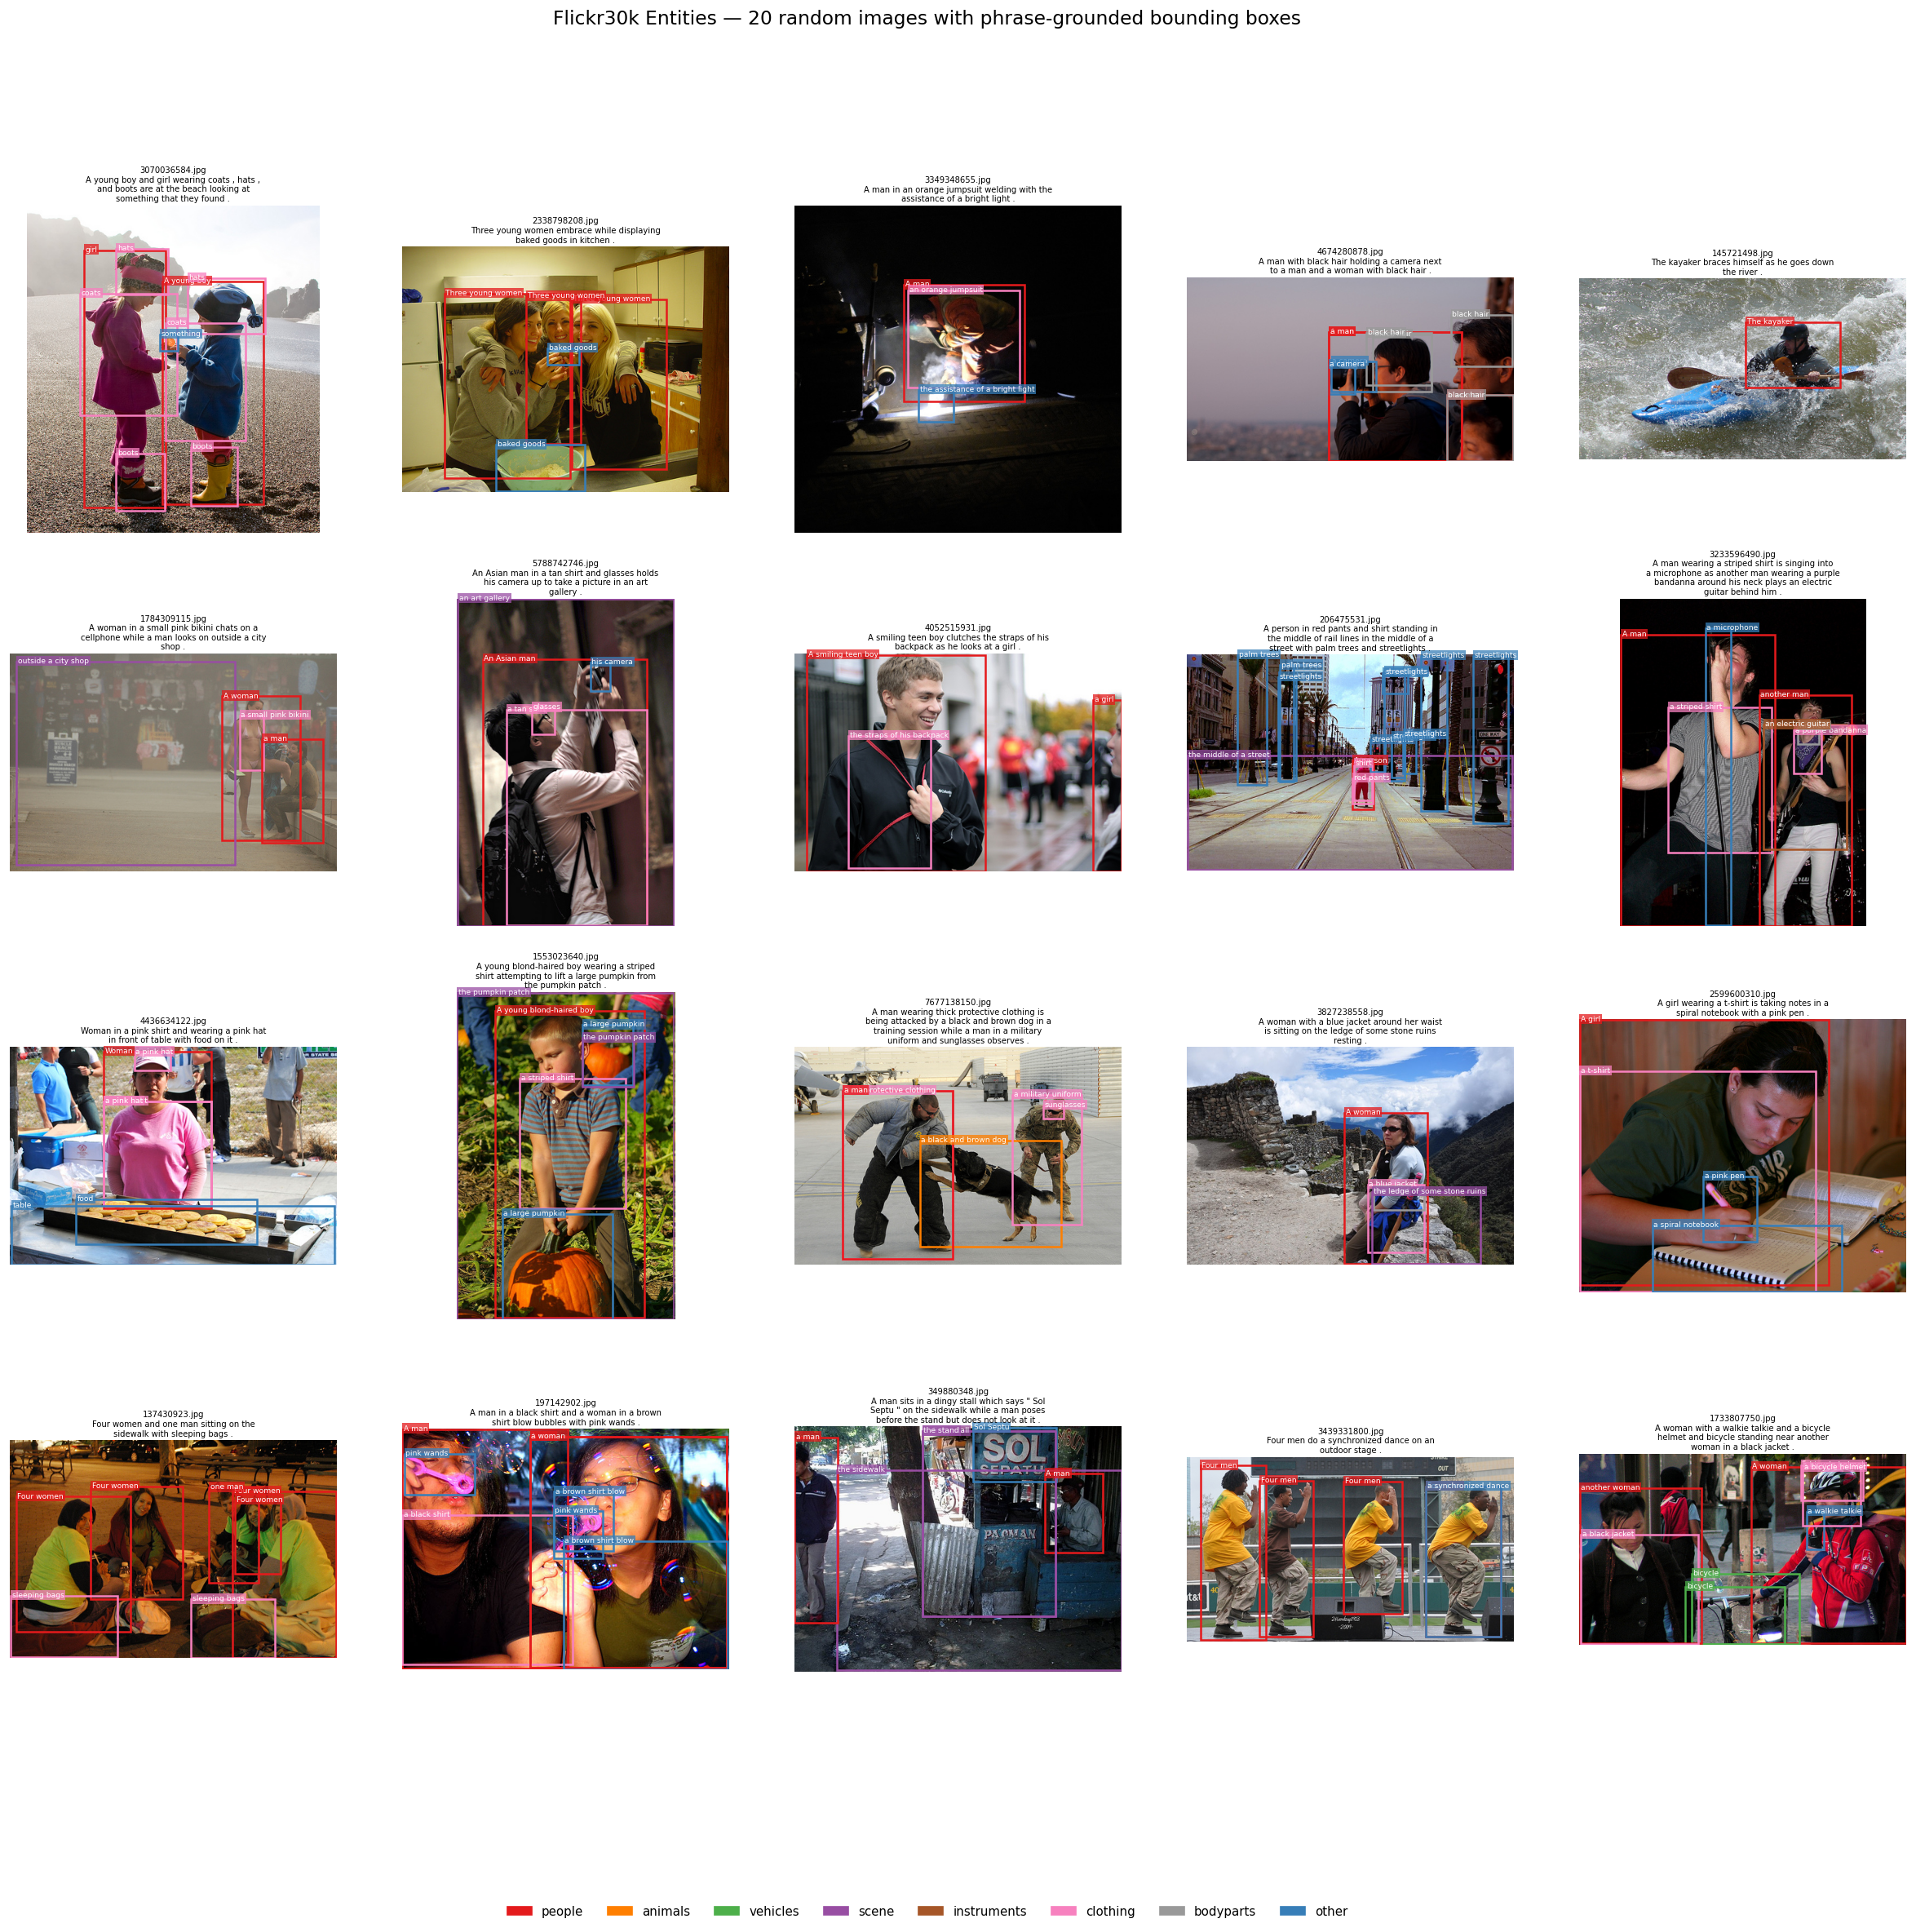
The Problem: Spatial Blindness in VLMs
▸ CLIP / SigLIP train with global image–text contrastive objectives
▸ Patch features are spatially coherent, but phrase-to-patch alignment is weak
▸ This limits: referring expression comprehension, dense captioning, spatial QA
Why SigLIP?
▸ Sigmoid loss — no batch denominator → stronger image-text matching
▸ Less spatial bias than CLIP — a harder, more honest test case
▸ Success here implies generalisation to other contrastive VLMs
Flickr30k Entities — phrase → bounding box annotations

Slide 4
Can a Generalist VLM Replace Human Spatial Annotations?
Human annotations are expensive and domain-specific. Can a large generalist VLM generate them instead?
The Problem with Human Annotations
Florence-2 as Annotation Oracle
▸ Expensive to collect at scale
▸ Fixed vocabulary — tied to dataset phrases
▸ Hard to extend to new domains
▸ Flickr30k Entities took years of annotation effort to build
▸ Generalist VLM — trained on 5B annotations (FLD-5B)
▸ Generates phrase → bbox pairs automatically on any image
▸ No human labellers — scales to CC3M, CC12M and beyond
▸ The question: does annotation quality match human-drawn boxes?
Key design choice: which Florence-2 annotation task to use — explored in detail in Results.

Slide 5
GRAFT: What We Built
Freeze SigLIP + LoRA adapters + Region loss → ℒ = ℒ_global + 0.5 · ℒ_region
Architecture
Training Losses
▸ LoRA on q-proj, v-proj (both encoders)
▸ Rank 4, α=16 → 295K trainable params (0.14% of backbone)
▸ MaskCLIP bypass installed before training — same path as eval
▸ Best-PG snapshot: checkpoint LoRA weights every 200 steps (~1 MB)
▸ ℒ_global: sigmoid-SigLIP on MHAP pooler ↔ EOS caption embedding
▸ ℒ_region: FILIP-style EOS phrase ↔ patch max-pool over in-bbox patches
▸ λ = 0.5: region weight — higher destabilises training
▸ Optimiser: AdamW, lr=2e-4, cosine decay, bf16 autocast

Slide 6
Data & Evaluation
Training Data
Evaluation Metrics
▸ Flickr30k-Entities (29K train images)
▸ Human-annotated phrase → bbox pairs (~5.7 phrases/image)
▸ Also tested: Florence-2 auto-annotations (two modes)
▸ 15 experiments total iterating to the locked recipe
▸ Pointing Game (PG): argmax patch centre inside GT bbox?
▸ Recall@1: tight box over top-k patches overlaps GT at IoU≥0.5
▸ Val: 200 images, 2,124 phrase-bbox pairs (fixed)
▸ Test: 2,900 held-out images, 28,467 pairs (SE≈0.24 pp)
Frozen Baseline (B0) — no fine-tuning
PG = 14.74% | R@1 top-25 = 7.91% | R@1 halfmax = 7.58%

Slide 7
The Journey: 15 Experiments
B0 Baseline
Exp 03 MaskCLIP Bypass ★
Exp 06 Seed Control
Exp 11 EOS Fix ★
Exp 13 5 Epochs ★
14.74%
22.08%
18.68 ±2.57%
20.76 ±0.41%
24.44%
→
→
→
→
+7.34 pp (largest gain)
True mean +3.94 pp
6× variance↓ +2.08 pp mean
Best result +9.70 pp
★ = major fix | Ablations between ★s all returned to the same mean (~18–21%)

Slide 8
MAIN FINDINGS
Core Insight: Representation Alignment > Loss Design
The two biggest gains come from fixing train/eval mismatches — not from changing the loss or the model.
Fix #1 — Image Path: MaskCLIP Bypass
Fix #2 — Text Path: EOS Token Alignment
Training used full self-attention; evaluation read bypass features → gradients sharpened the wrong representation
Region loss used mean(hidden_states); evaluation read only the EOS token → two different vectors
bypass(h) = W_O · W_V · h
e_phrase = last_hidden_state[:, -1, :]
▸ One-line fix: install bypass before training begins
▸ Result: +7.34 pp PG — the largest single gain in the project
▸ Shape change: broad weak activation → single sharp spike inside bbox
▸ Result: +2.08 pp mean PG across 3 seeds
▸ Variance: σ 2.57% → 0.41% (6× reduction)
▸ Together: v5 → v10 from 18.68% to 20.76% mean
Ablations varying loss weight, LoRA targets, and aggregation all returned to the same mean once both fixes were in place.

Slide 9
Text-Path Fix: Variance Collapse
Recipe | Seed 0 | Seed 1 | Seed 2 | Mean ± Std | Δ vs B0
v5 (mean tokens) | 19.26% | 15.87% | 20.90% | 18.68 ± 2.57% | +3.94 pp
v10 (EOS fix) | 20.57% | 20.48% | 21.23% | 20.76 ± 0.41% | +6.02 pp
σ: 2.57% ──────────────────────→ 0.41% (6× reduction)
▸ Every v10 seed lands in [20.48, 21.23] — a 0.75 pp spread vs. v5's 5.03 pp spread
▸ Best-PG snapshot: peak PG = final PG on every seed — late-training drift eliminated
▸ Mechanistic reading: EOS fix raised the peak by aligning training with evaluation. Snapshot locked it in.
▸ R@1 halfmax: 7.30 ± 0.00% across all seeds — the model learns a stable broad signal; variance is in which patch wins argmax

Slide 10
What Didn't Work: Ablations
↑ Region Loss Weight
↑ LoRA Capacity
Top-K Mean Loss
λ: 0.5 → 1.0
q+v → q+k+v (+50% params)
max-pool → mean of top-3 patches
▸ PG dropped −3.72 pp
▸ R@1 improved — broader, not sharper response
▸ Global loss provides structural regularisation
▸ At λ=1.0: collapse to PG < B0 at step 400
▸ Highest peak ever: 22.69% at step 400
▸ Drifted to 17.80% by end of epoch
▸ More capacity = more freedom to walk away
▸ Peak improved; final result did not
▸ 19.35% vs 19.96% — within noise
▸ R@1 halfmax: 7.30% identical on every variant
▸ Aggregation is not the lever
▸ Representation alignment is
Takeaway: The bottleneck is representation consistency — not loss formulation or model capacity.

Slide 11
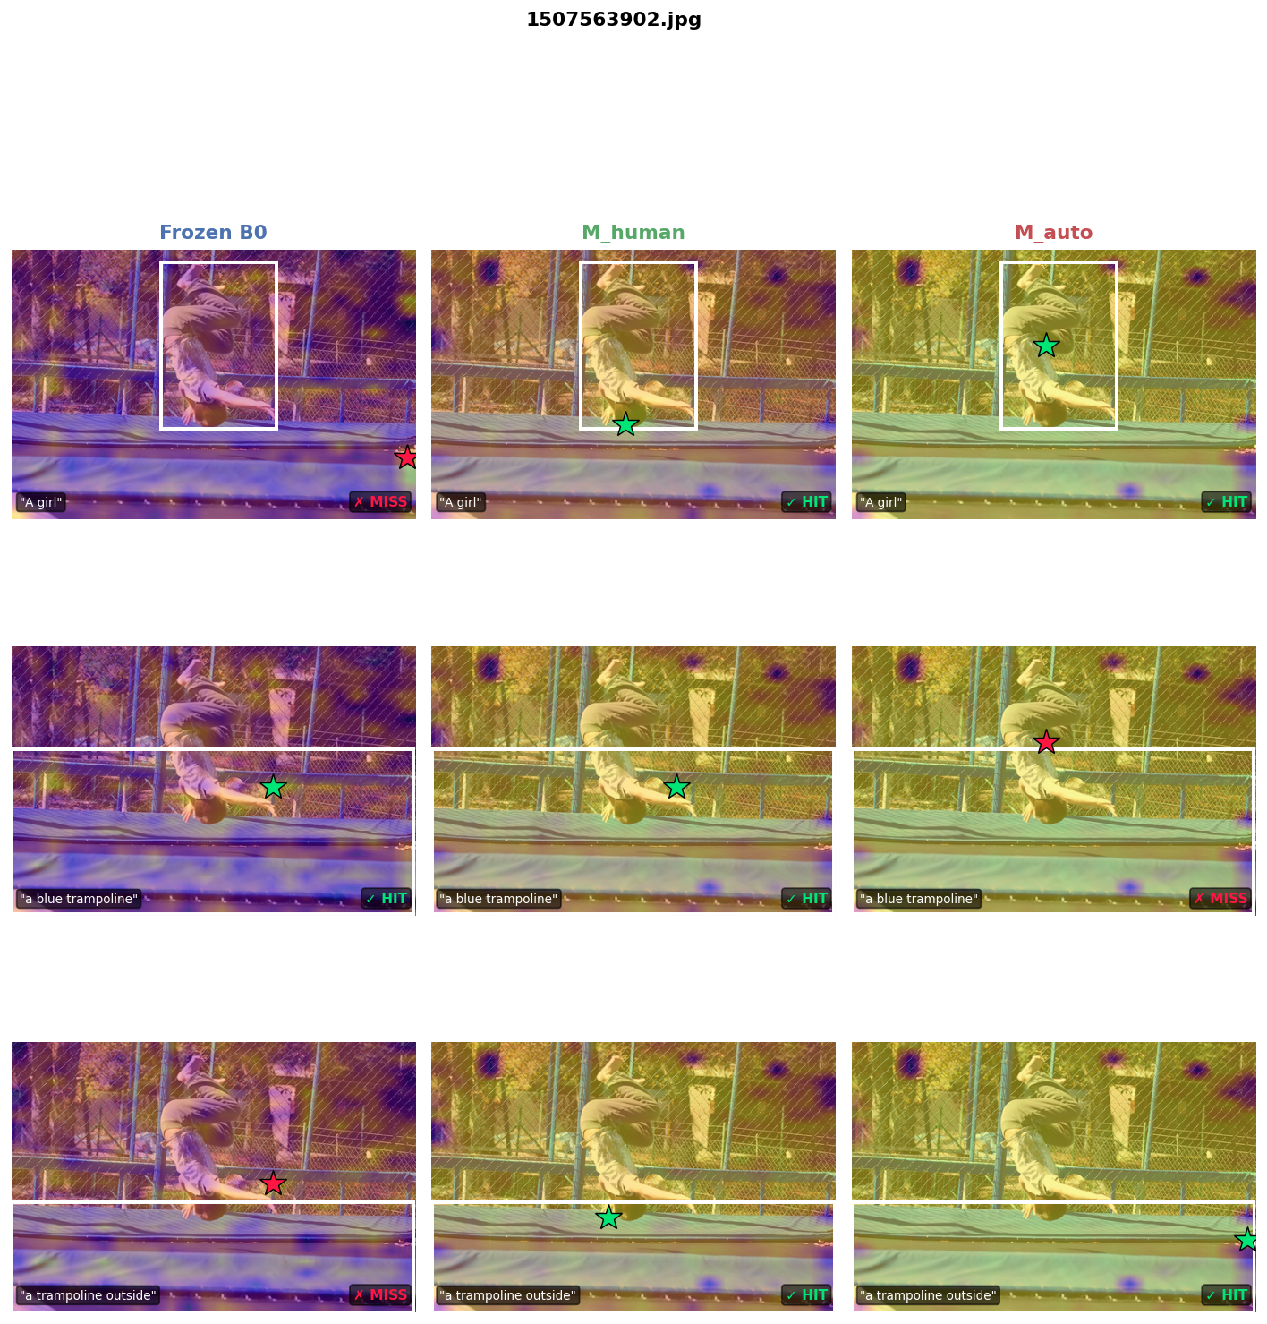
QUALITATIVE RESULTS
Most Dramatic Case — Image 1507563902 (n=3 phrases, each row = one phrase)
Per-Model Pointing Game (3 phrases)
Frozen B0:
33% ✓✗✗
M_human:
100% ✓✓✓
M_auto:
67% ✓✓✗
B0 misses 2 of 3 phrases. M_human hits all 3.
Plasma heatmap = cosine similarity of each patch to the query phrase ★ = argmax patch (green=HIT / red=MISS) ■ = ground-truth bbox
Columns: Frozen B0 | M_human | M_auto

Slide 12
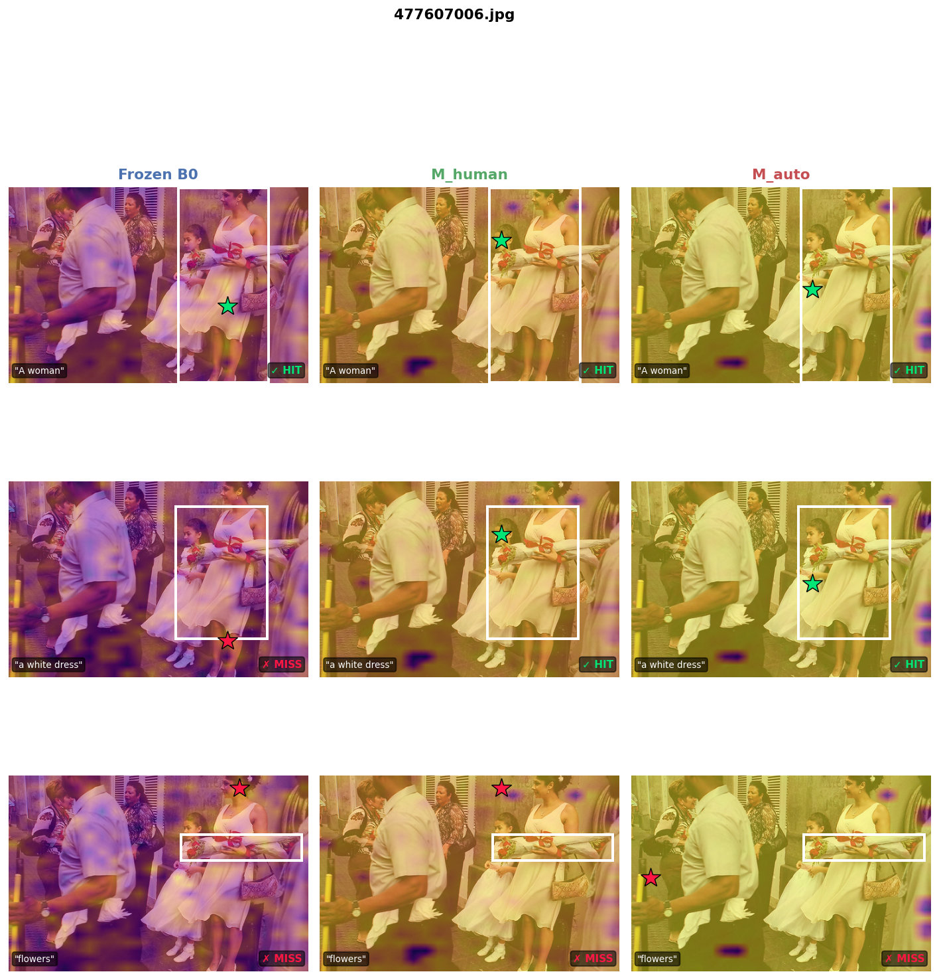
QUALITATIVE RESULTS
M_auto Outperforms M_human — Image 477607006 (n=3 phrases shown)
Per-Model Pointing Game (3 phrases shown)
Frozen B0:
25% ✓✗✗✗
M_human:
62% ✓✓✗✗
M_auto:
88% ✓✓✓✗
Auto-annotations can match or exceed human labels when vocabulary is correctly aligned.
Columns: Frozen B0 | M_human | M_auto

Slide 13
Longer Training: Staircase Improvement
Step | Ep | Val PG | Test PG | Behaviour
800 | 1 | 19.68% | 19.92% | Matches 1-ep result
1600 | 2 | 19.40% | 20.74% | Flat, oscillating
2400 | 3 | 19.21% | 21.41% | Still flat
3000 | 4 | 23.59% | 24.59% | STEP CHANGE +3 pp
3400 ★ | 5 | 24.44% | 25.26% | Best-PG snapshot
4000 | 5 | 24.11% | 26.03% | Late epoch 5
Best Result (seed 1)
Val PG = 24.44%
+9.70 pp over B0
Test PG = 26.16%
+11.42 pp over B0 (~48σ signal)
R@1 top-25 = 8.29%
First model to beat B0's 7.91%
Per-epoch cosine restarts kick the optimizer out of the epoch-1 basin. Epochs 1–3 reproduce the 1-epoch result; a step change occurs in epoch 4 (+3–5 pp). When ablations all fail, more training may be more productive than further hyperparameter search.

Slide 14
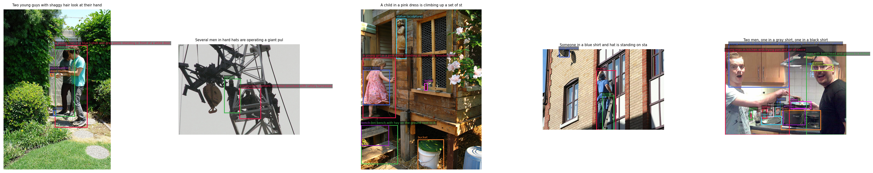
Auto-Annotations: Vocabulary Controls Everything
Florence-2 CAPTION_TO_PHRASE_GROUNDING — short noun-phrase → bbox annotations on Flickr30k images
M_auto: Dense Region Captions ✗
M_cpg: Caption-to-Phrase Grounding ✓
▸ Labels: "a woman in a blue top standing near a fence"
▸ PG ≈ 15.1% — barely above B0 (14.74%)
▸ Root cause: training vocabulary ≠ evaluation phrases
▸ Labels: "woman", "blue top", "fence"
▸ PG = 23.35% — +8.25 pp over M_auto
▸ Nearly matches M_human: 23.35% vs 24.44%
Same Florence-2 model · Same images · Same recipe · Only the labels differ

Slide 15
Main Results
Model | Config | Val PG | Test PG | R@1 top-25 | R@1 halfmax
B0 (frozen) | — | 14.74% | — | 7.91% | 7.58%
M_human v5 | FILIP, 1 ep | 18.68 ± 2.57% | — | 7.12 ± 0.12% | 7.30 ± 0.00%
M_human v10 | EOS+snap, 1 ep | 20.76 ± 0.41% | 20.07 ± 1.67% | — | 7.28%
M_human v11 | EOS+snap, 5 ep | 24.44% | 26.16% | 8.29% | 7.30%
M_auto | Dense cap., 1 ep | ~15.1% | — | — | —
M_cpg | Phrase gnd., 5 ep | 23.35% | 23.15% | — | —
Best single-seed: M_human v11 — 24.44% val / 26.16% test (+9.70 / +11.42 pp over B0)
M_cpg nearly matches M_human (23.35% vs 24.44%) using only Florence-2 phrase labels — no human bboxes needed
† Single seed; 3-seed mean ± std pending for v11 and M_cpg

Slide 16
Key Takeaways
1
Fix mismatches first. Train/eval alignment matters more than loss design. Two one-line fixes account for the bulk of improvement.
2
Measure variance before claiming improvement. The first single-seed result (22.08%) was +1.3σ noise. 3-seed verification is mandatory.
3
Longer training with restarts finds better basins. Flat for 3 epochs, then a step change at epoch 4. When ablations fail — train longer.
4
For auto-labels, vocabulary is everything. Accurate bboxes + wrong phrase distribution = no improvement. M_cpg nearly matches M_human.
5
295K params, 40 min on an L4. Enough to teach SigLIP where phrases are — and composable with any existing SigLIP pipeline.

Slide 17
Thank You!
Questions?
github.com/Ani0202/region-grounded
Siddharth Raj · Aniket Agrawal
University of Chicago

