Slide 1
Compositional Temporal
Audio Grounding
Finding when a sound happens — when the question depends on another sound
Anirudh Rangavajhala · M.Tech, IIIT Dharwad
Phase 1 and Phase 2 review · 12 September 2026

Slide 2
THE TASK
A timestamp question that needs two sounds
Audio LLMs are now asked when something happens, not just what.
Today that means one sound at a time: “find the dog barking.”
Real questions are compositional — the answer depends on a second event, on order, or on overlap.
“the car horn after the siren”
“the second bark”
“the dog barking while music plays”
“the bark not followed by a door slam”
“the next bark after 4.0 s”
The answer is a set of intervals, and it can legitimately be empty — which is itself a thing to get right.
2

Slide 3
RELATED WORK · 1 OF 2
Temporal grounding in audio LLMs
Work | Contribution | Query form
TimeAudio (2511.11039) | Temporal markers, time-aware encoding, segment-level token merging | single event
SpotSound (2604.13023) | Suppresses hallucinated timestamps for absent events; SpotSound-Bench | single event
Audio-Side Time Prompt (2604.13715) | TimePro-RL: timestamps embedded in the audio features, SFT then RL | single event
TEMPO (2608.29999) | Multi-task post-training, SFT + RL across speech, music and audio | single event
Auto-AEG (2607.04383) | Synthesised clips + multi-model pseudo-labels, RL; introduces AEGBench | list all intervals of X
AudioMap (2608.09559) | Cloze-and-choice RL for time-aware dense audio captioning | dense captions
Listening with Time (2604.22245) | Global-to-local iterative reasoning over long-form audio | single event
Encode Once, Decode Never (2602.10230) | Reuses audio-LM internals to localise; 50x faster than decoding | single event
LA-RAG (2602.14612) | Event-grounded QA over long audio via structured retrieval | retrieval
SpectCount (2606.06907) | Counting via synthetic spectrotemporal signals | counts
TAG-Bench (2609.01542) | 1,750 query–recording pairs, 149.5 h, eight subsets, 7 s to 20 min | benchmark
DCASE 2026 Task 6 | Audio Moment Retrieval from Long Audio | one moment
Every one of these localises one sound named on its own. None takes a query whose answer depends on a second event.
3

Slide 4
RELATED WORK · 2 OF 2
Compositional and relational queries
Work | Contribution | What it does not do
DAQA — Fayek & Johnson, TASLP 2020 (1911.09655) | Programmatic before / after / ordinal / count questions; MALiMo model | Answers are event names, yes/no or counts — never intervals
Sridhar et al., NAACL 2025 Industry, Qualcomm (2409.06223) | GPT-4 temporal QA from AudioSet-SL; curriculum fine-tune of LTU | Free-text QA; no interval output, no IoU
TREA — Interspeech 2025 (2505.13115) | Composed ESC-50, as here; duration / ordering / counting, 600 items | Concatenation only, so no concurrency; MCQ, not intervals
Oncescu et al., ACM MM 2024 (2409.00851) | Temporal ordering in text-to-audio retrieval; TempTest sets | Retrieval, not localisation
PolyBench — Interspeech 2026 (2603.05128) | Counting, classification, detection, concurrency, duration on polyphonic audio | Multiple choice; no conditional interval sets
CompA-order — ICLR 2024 (2310.08753) | 400 audio–caption matching instances probing event order | Matching, not grounding
STAR-Bench (2510.24693), MMAU (2410.19168) | Segment reordering, spatial localisation; 27 tasks, 10k clips | Multiple choice; no grounding
CoMET-Bench (2606.15320) — video | Conditional multi-event grounding, 4 temporal + 3 spatial conditions, Rejection-F1, CoMET-Agent | Video only; no superposition-based “while”
CompSTVG (2608.30584) — video | Scene-graph synthetic curriculum plus curriculum RL | Video only
MUSEG (2505.20715), One-to-Many TG (2606.06294) — video | Multi-segment grounding; RL with completeness rewards | Video only
TREA is the closest neighbour: same ESC-50 composition. It concatenates, so concurrency cannot arise, and its answers are multiple choice.
4

Slide 5
POSITIONING
The gap the two halves leave open
 | Interval-set output | Condition on a second event | Audio
Audio grounding work (TAG-Bench, TEMPO, Auto-AEG, …) | yes | no | yes
Audio relational QA (DAQA, Sridhar et al., PolyBench) | no | yes | yes
Video compositional grounding (CoMET-Bench, CompSTVG) | yes | yes | no
This project | yes | yes | yes
Each half of the task has a neighbour; the intersection is empty in audio. The video precedent (CoMET-Bench, 2026) shows the task shape is real and worth doing.
Cited, not claimed: DAQA and Sridhar et al. are the query-generation precedents — the question templates are not new. The framing is a port of CoMET-Bench from video, and reviewers will say so.
The defence: mixing-made while conditions (impossible in video), rejection queries, the ceiling diagnostic, and the miss/false-alarm asymmetry.
5

Slide 6
METHOD
What was built
A benchmark generator. Sounds are composed onto a known timeline, so ground truth is exact — no annotation, no label noise.
Eight query types, including rejection queries whose correct answer is “no such event”.
Metrics beyond f1: union-IoU, Hungarian matching, count accuracy, under-report rate, centre error, duration ratio.
Five arms from one codebase, 40 passing tests.
Type | Query | n (test)
PLAIN | the dog bark | 96
ORDINAL | the second bark | 96
BEFORE / AFTER | the bark after the siren | 89 / 89
NEXT_AFTER | the next bark after 4.0 s | 89
WHILE | the bark while music plays | 96
NOT_FOLLOWED | a bark not followed by a slam | 96
ABSENT | (rejection queries) | 48
4404 queries over 300 composed ESC-50 clips.
6

Slide 7
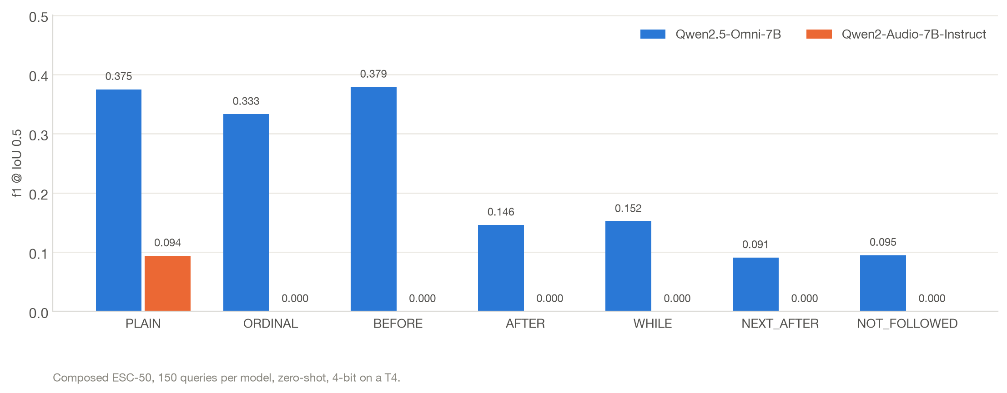
PHASE 1
Only one of the two candidate backbones can ground at all
Qwen2-Audio scores 0.094 on plain grounding and exactly 0.000 on every conditional type — it emits well-formed intervals that land nowhere near the event. SpotSound (2604.13023, §4.1) reports the same failure mode: “syntactically complete time windows … resulting in zero overlap with the ground truth.”
Qwen2.5-Omni is the backbone. It finds the sound, then drops the qualifier attached to it.
7

Slide 8
PHASE 1
The hard part is not “conditions” — it is relating two events
 | Handled | Collapses
Qwen2.5-Omni, f1@0.5 | BEFORE 0.379 ORDINAL 0.333 | WHILE 0.152 AFTER 0.146 NOT_FOLLOWED 0.095 NEXT_AFTER 0.091
ORDINAL needs only counting inside one event type. BEFORE needs one comparison against a single reference.
The four that collapse all require relating the target to a second event and then selecting among the matches. That is the specific capability that is missing.
Supporting signal: on NOT_FOLLOWED the model under-reports on 69% of queries — the highest of any type — consistent with collapsing a set of matches down to one.
8

Slide 9
THE DIAGNOSTIC
Is the model bad at conditions, or bad at hearing?
Answer the condition for the model: ground each sound separately, then apply the condition with the same predicates that define the ground truth. Then degrade the grounder on purpose.
Grounding quality given to the composer | f1@0.5, all 4404 queries
Perfect | 1.000
Boundaries jittered ±0.5 s | 0.925
25% of events missed | 0.650
25% spurious detections | 0.937
Degraded until PLAIN matches Qwen2.5-Omni | 0.263
Qwen2.5-Omni answering directly | 0.243
Perfect events give 1.000 on every condition type.
So the conditions are trivial.
Grounding quality is the binding constraint — essentially the whole gap from 1.000 to 0.26.
9

Slide 10
THE DIAGNOSTIC
Which produced a falsifiable prediction
At the model's real grounding quality the two approaches tie overall — 0.263 against 0.243 — but the per-type split is not a tie, and that is testable:
Predicted: decomposition wins | Predicted: direct prompting wins
AFTER, NEXT_AFTER, WHILE, NOT_FOLLOWED — the four needing a second event | ORDINAL, BEFORE — the two the model already handles, where decomposition pays to ground a reference it does not need
This prediction was made on CPU, from simulation only, before any of it was run on a GPU. The next slide is the test.
10

Slide 11
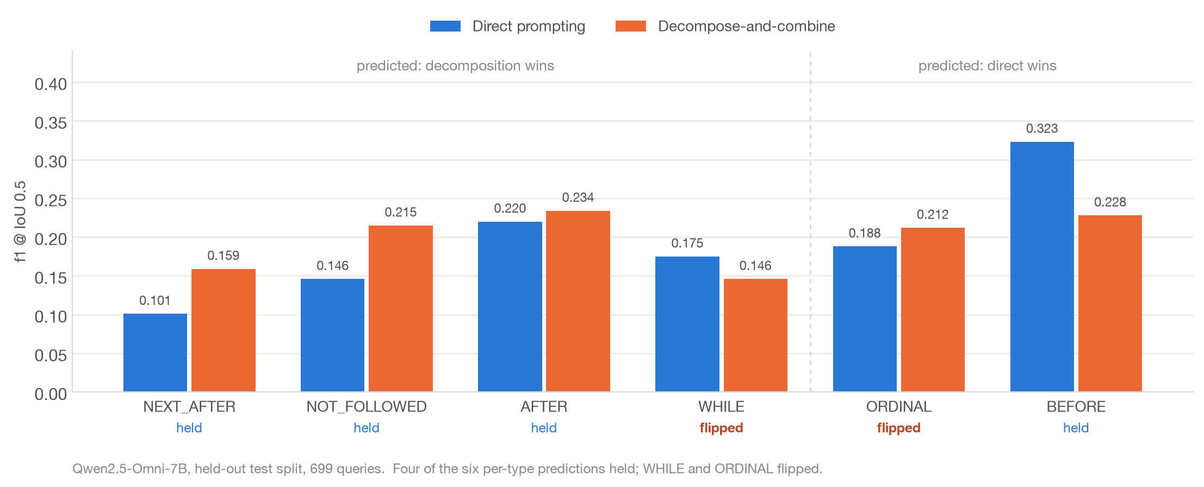
RESULT — 11 SEPTEMBER 2026, HELD-OUT TEST SPLIT
Tested on the real model: four of six predictions held
Decomposition rescues the relational types as predicted — NEXT_AFTER +57%, NOT_FOLLOWED +47% — and loses BEFORE as predicted. WHILE and ORDINAL went the other way.
Overall the arms nearly cancel (0.207 vs 0.218). The per-type structure, not the average, is the finding — and it is what a per-type hybrid should exploit.
11

Slide 12
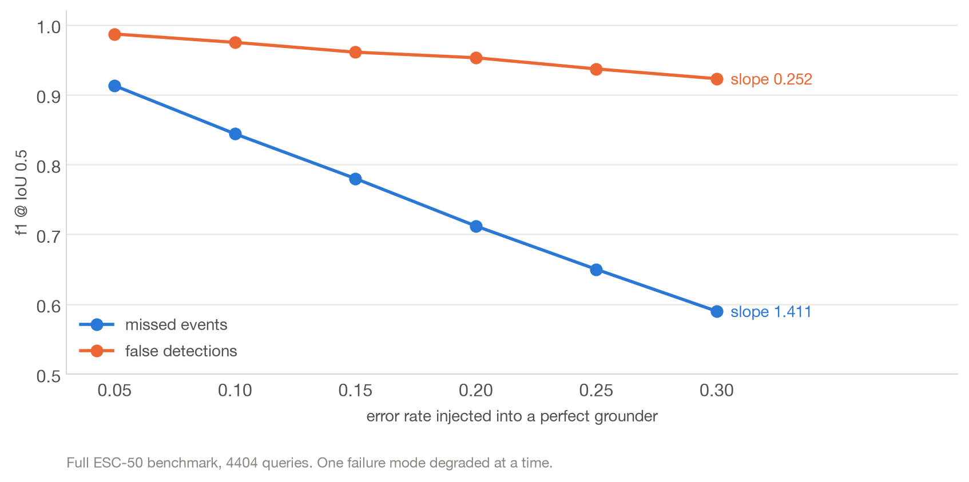
THE METHOD
Which grounding error actually costs us?
A missed event removes a correct interval *and* can corrupt every query that references it — lose the siren and “the horn after the siren” becomes unanswerable. A spurious event usually adds one wrong interval and leaves the rest intact.
Cost per unit miss rate 1.411; per unit false-alarm rate 0.252. Asymmetry 5.60×.
12

Slide 13
THE METHOD
So the objective is measured, not chosen
β = 2.37
Prediction against 3 gold intervals | f1 | F-2.37
misses one | 0.800 | 0.702
invents one | 0.857 | 0.952
β² = slope(miss) / slope(false alarm) = 1.411 / 0.252 = 5.60
β = √5.60 = 2.37 — read off the curves, not tuned
F_β = (1 + β²) · P · R / (β² · P + R)
Pinned by a unit test so it cannot quietly become a hyperparameter.
Under f1 the two are nearly equivalent. Under the measured beta they are not — and the training signal follows: the rejected side of a preference pair always under-detects.
This quantity is only measurable on a benchmark where conditions depend on a second event. New task → new measurable quantity → objective derived from it.
13

Slide 14
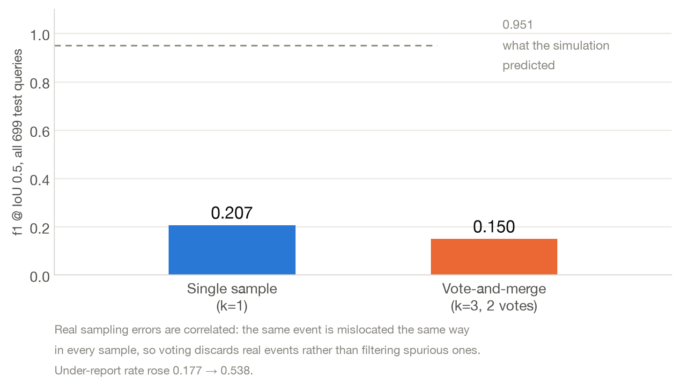
RESULT
A negative result: the decoder did not survive contact
Sampling k times and keeping intervals that appear in at least 2 samples reached 0.951 on a simulated grounder with independent noise. On the real model it scores 0.150, below single-sample decoding.
The simulation's independence assumption was the load-bearing one. The β = 2.37 finding is untouched — it is a property of the benchmark, not of the decoder — but this mechanism is reported as refuted.
14

Slide 15
STATUS, 12 SEPTEMBER 2026
Where it stands
Arm | What it is | Status
A direct prompting | Ask the model the conditional query | Run — 0.207
B decompose-and-combine | Two plain calls, condition applied locally | Run — 0.218
D hybrid | Per-type choice between A and B | Blocked — no validation split was scored
C QLoRA, text timestamps | Fine-tune the thinker, encoder frozen | Never trained — CUDA OOM
E QLoRA, atomic time tokens | One token per quantised time (per TEMPO) | Never trained — CUDA OOM
A 5 h 34 m run on two T4s completed the inference arms and failed both fine-tuning arms: backward pass out of memory on a 14.6 GB card. Neither has ever trained.
Fixes identified: gradient checkpointing and shorter audio windows, or one larger GPU. Two smaller bugs — a missing import that killed the precision sweep, and an unscored validation split that silently turned the hybrid into a copy of arm A.
15

Slide 16
LIMITATIONS
What this evidence does not yet support
Composed audio only. Sounds mixed onto a synthetic timeline. Nothing here generalises to real recordings yet — that is the critical path, not an afterthought.
One prompt, one model. No prompt-sensitivity study. TAG-Bench notes that an explicit “enumerate all intervals” instruction is an untested intervention; it should be baseline #1.
No fine-tuned arm. Every number on these slides is zero-shot or training-free.
“Cannot ground” is benchmark-specific. Another paper (2607.25355) measures Qwen2-Audio at 0.3653 mIoU zero-shot on its own task. Different data, different metric, 4-bit here — so the claim is about this benchmark and this prompt, not the model in general.
f1@0.5 conflates two failures — wrong place and wrong duration. Centre error and duration ratio are reported alongside it for that reason.
The 5.60× asymmetry is measured on this query mix. On another distribution, re-derive β rather than importing this number.
16

Slide 17
NEXT
Six-month plan
Month | Work | Why now
1 | Fix the OOM, train arms C and E; put the benchmark and the decomposition diagnosis on arXiv | TAG-Bench (Alibaba) appeared 2 Sep and is one step away
2–3 | Real recordings — derive conditional queries from DESED / AudioSet-strong, hand-verify ~300 clips, rerun every arm | The critical path. Starts in month 2, not month 4
4 | β as a verifiable GRPO reward rather than offline preference pairs; rerun recall-biased decoding with a real model | The offline-pair and voting forms are now known to be weak
5–6 | Writing and defence
Out of scope, stated as future work: large-scale annotation, long-form audio (where a flat timestamp vocabulary grows with duration), and whether the 5.60× asymmetry also holds in video — the most interesting extension, since it would generalise the claim beyond audio.
17

Slide 18
SUMMARY
Contributions, stated honestly
Novel here | Not novel — cited, not claimed
The task and benchmark: interval-set answers to conditional temporal queries over audio, with exact programmatic ground truth and rejection queries | Atomic timestamp tokens — TEMPO, TimeAudio
The ceiling diagnostic that separates “conditions are hard” from “grounding is bad”, and the per-type prediction it generates | Decompose-and-combine — CoMET-Agent, in video
The 5.60× miss/false-alarm asymmetry and the objective derived from it — measurable only on a benchmark where conditions depend on a second event | LoRA fine-tuning for grounding — standard Task framing is a port of CoMET-Bench from video; the defences are the mixing-made WHILE conditions, the ceiling diagnostic, and the asymmetry
18

