Slide 1
Compositional Temporal
Audio Grounding
Finding when a sound happens — when the question depends on another sound
Anirudh Rangavajhala · M.Tech, IIIT Dharwad
12 September 2026

Slide 2
THE TASK
A timestamp question that needs two sounds
Audio LLMs are now asked when something happens, not just what.
Today that means one sound at a time: “find the dog barking.”
Real questions are compositional — the answer depends on a second event, on order, or on overlap.
“the car horn after the siren”
“the second bark”
“the dog barking while music plays”
“the bark not followed by a door slam”
“the next bark after 4.0 s”
The answer is a set of intervals, and it can legitimately be empty — which is itself a thing to get right.
2

Slide 3
RELATED WORK · 1 OF 2
Temporal grounding in audio LLMs
Work | Contribution | Query form
TimeAudio (2511.11039) | Temporal markers, time-aware encoding, segment-level token merging | single event
SpotSound (2604.13023) | Suppresses hallucinated timestamps for absent events; SpotSound-Bench | single event
Audio-Side Time Prompt (2604.13715) | TimePro-RL: timestamps embedded in the audio features, SFT then RL | single event
TEMPO (2608.29999) | Multi-task post-training, SFT + RL across speech, music and audio | single event
Auto-AEG (2607.04383) | Synthesised clips + multi-model pseudo-labels, RL; introduces AEGBench | list all intervals of X
AudioMap (2608.09559) | Cloze-and-choice RL for time-aware dense audio captioning | dense captions
Listening with Time (2604.22245) | Global-to-local iterative reasoning over long-form audio | single event
Encode Once, Decode Never (2602.10230) | Reuses audio-LM internals to localise; 50x faster than decoding | single event
LA-RAG (2602.14612) | Event-grounded QA over long audio via structured retrieval | retrieval
SpectCount (2606.06907) | Counting via synthetic spectrotemporal signals | counts
TAG-Bench (2609.01542) | 1,750 query–recording pairs, 149.5 h, eight subsets, 7 s to 20 min | benchmark
DCASE 2026 Task 6 | Audio Moment Retrieval from Long Audio | one moment
Every one of these localises one sound named on its own. None takes a query whose answer depends on a second event.
3

Slide 4
RELATED WORK · 2 OF 2
Compositional and relational queries
Work | Contribution | What it does not do
DAQA — Fayek & Johnson, TASLP 2020 (1911.09655) | Programmatic before / after / ordinal / count questions; MALiMo model | Answers are event names, yes/no or counts — never intervals
Sridhar et al., NAACL 2025 Industry, Qualcomm (2409.06223) | GPT-4 temporal QA from AudioSet-SL; curriculum fine-tune of LTU | Free-text QA; no interval output, no IoU
TREA — Interspeech 2025 (2505.13115) | Composed ESC-50, as here; duration / ordering / counting, 600 items | Concatenation only, so no concurrency; MCQ, not intervals
Oncescu et al., ACM MM 2024 (2409.00851) | Temporal ordering in text-to-audio retrieval; TempTest sets | Retrieval, not localisation
PolyBench — Interspeech 2026 (2603.05128) | Counting, classification, detection, concurrency, duration on polyphonic audio | Multiple choice; no conditional interval sets
CompA-order — ICLR 2024 (2310.08753) | 400 audio–caption matching instances probing event order | Matching, not grounding
STAR-Bench (2510.24693), MMAU (2410.19168) | Segment reordering, spatial localisation; 27 tasks, 10k clips | Multiple choice; no grounding
CoMET-Bench (2606.15320) — video | Conditional multi-event grounding, 4 temporal + 3 spatial conditions, Rejection-F1, CoMET-Agent | Video only; no superposition-based “while”
CompSTVG (2608.30584) — video | Scene-graph synthetic curriculum plus curriculum RL | Video only
MUSEG (2505.20715), One-to-Many TG (2606.06294) — video | Multi-segment grounding; RL with completeness rewards | Video only
TREA is the closest neighbour: same ESC-50 composition. It concatenates, so concurrency cannot arise, and its answers are multiple choice.
4

Slide 5
POSITIONING
The gap the two halves leave open
 | Interval-set output | Condition on a second event | Audio
Audio grounding work (TAG-Bench, TEMPO, Auto-AEG, …) | yes | no | yes
Audio relational QA (DAQA, Sridhar et al., PolyBench) | no | yes | yes
Video compositional grounding (CoMET-Bench, CompSTVG) | yes | yes | no
This project | yes | yes | yes
Each half of the task has a neighbour; the intersection is empty in audio. The video precedent (CoMET-Bench, 2026) shows the task shape is real and worth doing.
Cited, not claimed: DAQA and Sridhar et al. are the query-generation precedents — the question templates are not new. The framing is a port of CoMET-Bench from video, and reviewers will say so.
The defence: mixing-made while conditions (impossible in video), rejection queries, the ceiling diagnostic, and the miss/false-alarm asymmetry.
5

Slide 6
METHOD
What was built
A benchmark generator. Sounds are composed onto a known timeline, so ground truth is exact — no annotation, no label noise.
Eight query types, including rejection queries whose correct answer is “no such event”.
Metrics beyond f1: union-IoU, Hungarian matching, count accuracy, under-report rate, centre error, duration ratio.
Five arms from one codebase, 40 passing tests.
Type | Query | n (test)
PLAIN | the dog bark | 96
ORDINAL | the second bark | 96
BEFORE / AFTER | the bark after the siren | 89 / 89
NEXT_AFTER | the next bark after 4.0 s | 89
WHILE | the bark while music plays | 96
NOT_FOLLOWED | a bark not followed by a slam | 96
ABSENT | (rejection queries) | 48
4404 queries over 300 composed ESC-50 clips.
6

Slide 7
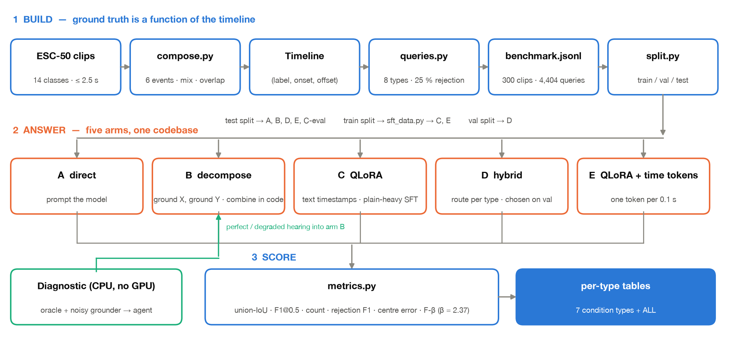
SYSTEM
Architecture, as it runs today
Three layers. Build makes the audio and therefore knows the answer. Answer is five arms from one codebase. Score is one metrics module, so every arm is measured the same way.
7

Slide 8
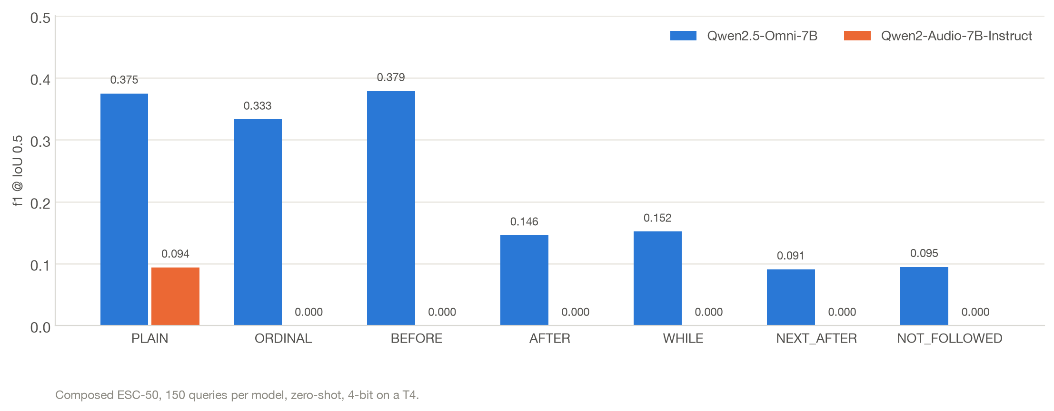
PHASE 1
Only one of the two candidate backbones can ground at all
Qwen2-Audio scores 0.094 on plain grounding and exactly 0.000 on every conditional type — it emits well-formed intervals that land nowhere near the event. SpotSound (2604.13023, §4.1) reports the same failure mode: “syntactically complete time windows … resulting in zero overlap with the ground truth.”
Qwen2.5-Omni is the backbone. It finds the sound, then drops the qualifier attached to it.
8

Slide 9
PHASE 1
The hard part is not “conditions” — it is relating two events
 | Handled | Collapses
Qwen2.5-Omni, f1@0.5 | BEFORE 0.379 ORDINAL 0.333 | WHILE 0.152 AFTER 0.146 NOT_FOLLOWED 0.095 NEXT_AFTER 0.091
ORDINAL needs only counting inside one event type. BEFORE needs one comparison against a single reference.
The four that collapse all require relating the target to a second event and then selecting among the matches. That is the specific capability that is missing.
Supporting signal: on NOT_FOLLOWED the model under-reports on 69% of queries — the highest of any type — consistent with collapsing a set of matches down to one.
9

Slide 10
THE DIAGNOSTIC
Is the model bad at conditions, or bad at hearing?
Answer the condition for the model: ground each sound separately, then apply the condition with the same predicates that define the ground truth. Then degrade the grounder on purpose.
Grounding quality given to the composer | f1@0.5, all 4404 queries
Perfect | 1.000
Boundaries jittered ±0.5 s | 0.925
25% of events missed | 0.650
25% spurious detections | 0.937
Degraded until PLAIN matches Qwen2.5-Omni | 0.263
Qwen2.5-Omni answering directly | 0.243
Perfect events give 1.000 on every condition type.
So the conditions are trivial.
Grounding quality is the binding constraint — essentially the whole gap from 1.000 to 0.26.
10

Slide 11
THE DIAGNOSTIC
Which produced a falsifiable prediction
At the model's real grounding quality the two approaches tie overall — 0.263 against 0.243 — but the per-type split is not a tie, and that is testable:
Predicted: decomposition wins | Predicted: direct prompting wins
AFTER, NEXT_AFTER, WHILE, NOT_FOLLOWED — the four needing a second event | ORDINAL, BEFORE — the two the model already handles, where decomposition pays to ground a reference it does not need
This prediction was made on CPU, from simulation only, before any of it was run on a GPU. The next slide is the test.
11

Slide 12
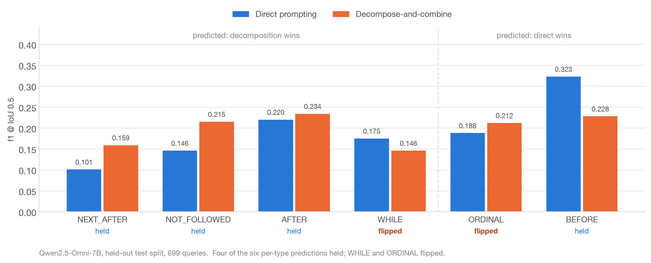
RESULT — 11 SEPTEMBER 2026, HELD-OUT TEST SPLIT
Tested on the real model: four of six predictions held
Decomposition rescues the relational types as predicted — NEXT_AFTER +57%, NOT_FOLLOWED +47% — and loses BEFORE as predicted. WHILE and ORDINAL went the other way.
Overall the arms nearly cancel (0.207 vs 0.218). The per-type structure, not the average, is the finding — and it is what a per-type hybrid should exploit.
12

Slide 13
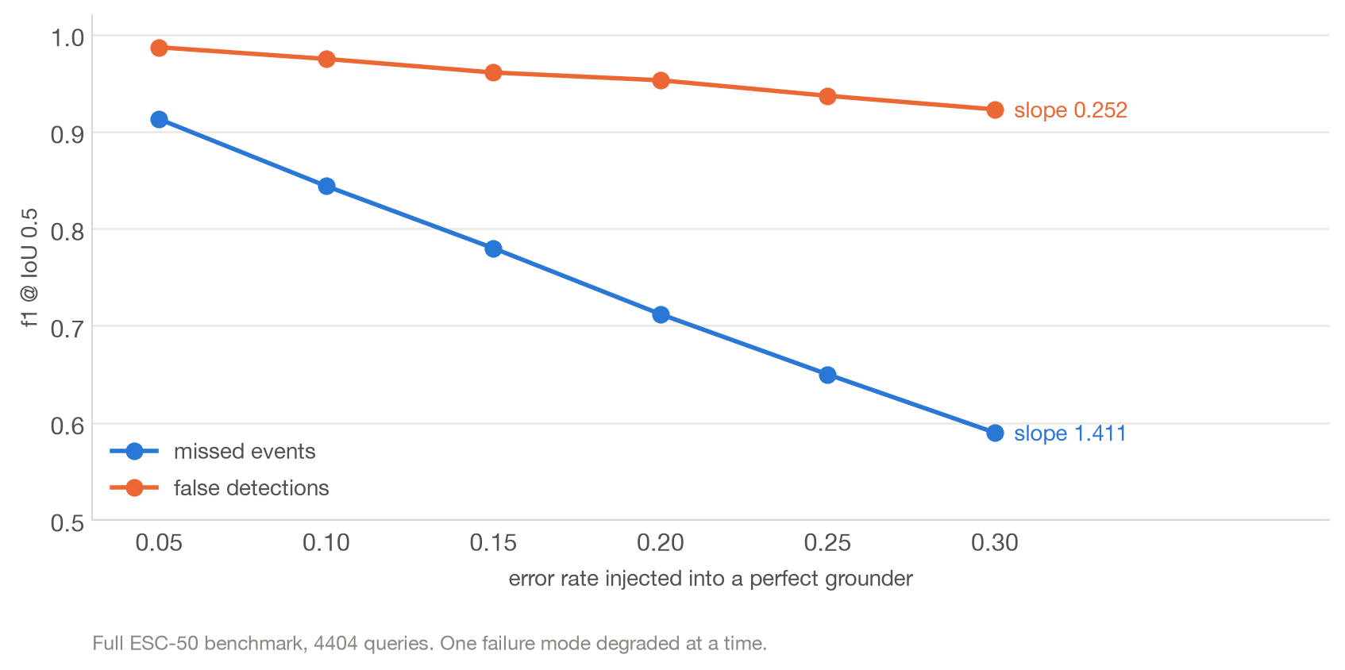
THE METHOD
Which grounding error actually costs us?
A missed event removes a correct interval *and* can corrupt every query that references it — lose the siren and “the horn after the siren” becomes unanswerable. A spurious event usually adds one wrong interval and leaves the rest intact.
Cost per unit miss rate 1.411; per unit false-alarm rate 0.252. Asymmetry 5.60×.
13

Slide 14
THE METHOD
So the objective is measured, not chosen
β = 2.37
Prediction against 3 gold intervals | f1 | F-2.37
misses one | 0.800 | 0.702
invents one | 0.857 | 0.952
β² = slope(miss) / slope(false alarm) = 1.411 / 0.252 = 5.60
β = √5.60 = 2.37 — read off the curves, not tuned
F_β = (1 + β²) · P · R / (β² · P + R)
Pinned by a unit test so it cannot quietly become a hyperparameter.
Under f1 the two are nearly equivalent. Under the measured beta they are not — and the training signal follows: the rejected side of a preference pair always under-detects.
This quantity is only measurable on a benchmark where conditions depend on a second event. New task → new measurable quantity → objective derived from it.
14

Slide 15
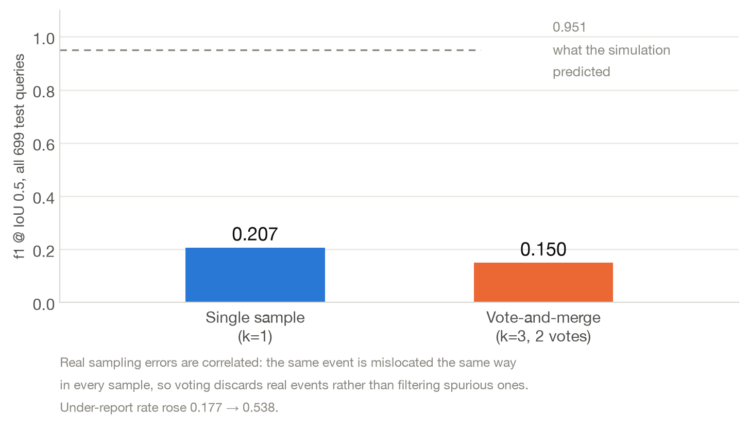
RESULT
A negative result: the decoder did not survive contact
Sampling k times and keeping intervals that appear in at least 2 samples reached 0.951 on a simulated grounder with independent noise. On the real model it scores 0.150, below single-sample decoding.
The simulation's independence assumption was the load-bearing one. The β = 2.37 finding is untouched — it is a property of the benchmark, not of the decoder — but this mechanism is reported as refuted.
15

Slide 16
STATUS, 12 SEPTEMBER 2026
Where it stands
Arm | What it is | Status
A direct prompting | Ask the model the conditional query | Run — 0.207
B decompose-and-combine | Two plain calls, condition applied locally | Run — 0.218
D hybrid | Per-type choice between A and B | Blocked — no validation split was scored
C QLoRA, text timestamps | Fine-tune the thinker, encoder frozen | Never trained — CUDA OOM
E QLoRA, atomic time tokens | One token per quantised time (per TEMPO) | Never trained — CUDA OOM
A 5 h 34 m run on two T4s completed the inference arms and failed both fine-tuning arms: backward pass out of memory on a 14.6 GB card. Neither has ever trained.
Fixes identified: gradient checkpointing and shorter audio windows, or one larger GPU. Two smaller bugs — a missing import that killed the precision sweep, and an unscored validation split that silently turned the hybrid into a copy of arm A.
16

Slide 17
LIMITATIONS
What this evidence does not yet support
Composed audio only. Sounds mixed onto a synthetic timeline. Nothing here generalises to real recordings yet — that is the critical path, not an afterthought.
One prompt, one model. No prompt-sensitivity study. TAG-Bench notes that an explicit “enumerate all intervals” instruction is an untested intervention; it should be baseline #1.
No fine-tuned arm. Every number on these slides is zero-shot or training-free.
“Cannot ground” is benchmark-specific. Another paper (2607.25355) measures Qwen2-Audio at 0.3653 mIoU zero-shot on its own task. Different data, different metric, 4-bit here — so the claim is about this benchmark and this prompt, not the model in general.
f1@0.5 conflates two failures — wrong place and wrong duration. Centre error and duration ratio are reported alongside it for that reason.
The 5.60× asymmetry is measured on this query mix. On another distribution, re-derive β rather than importing this number.
17

Slide 18
NEXT
Six-month plan
Month | Work | Why now
1 | Fix the OOM, train arms C and E; put the benchmark and the decomposition diagnosis on arXiv | TAG-Bench (Alibaba) appeared 2 Sep and is one step away
2–3 | Real recordings — derive conditional queries from DESED / AudioSet-strong, hand-verify ~300 clips, rerun every arm | The critical path. Starts in month 2, not month 4
4 | β as a verifiable GRPO reward rather than offline preference pairs; rerun recall-biased decoding with a real model | The offline-pair and voting forms are now known to be weak
5–6 | Writing and defence
Out of scope, stated as future work: large-scale annotation, long-form audio (where a flat timestamp vocabulary grows with duration), and whether the 5.60× asymmetry also holds in video — the most interesting extension, since it would generalise the claim beyond audio.
18

Slide 19
SUMMARY
Contributions, stated honestly
Novel here | Not novel — cited, not claimed
The task and benchmark: interval-set answers to conditional temporal queries over audio, with exact programmatic ground truth and rejection queries | Atomic timestamp tokens — TEMPO, TimeAudio
The ceiling diagnostic that separates “conditions are hard” from “grounding is bad”, and the per-type prediction it generates | Decompose-and-combine — CoMET-Agent, in video
The 5.60× miss/false-alarm asymmetry and the objective derived from it — measurable only on a benchmark where conditions depend on a second event | LoRA fine-tuning for grounding — standard Task framing is a port of CoMET-Bench from video; the defences are the mixing-made WHILE conditions, the ceiling diagnostic, and the asymmetry
19

