Slide 1
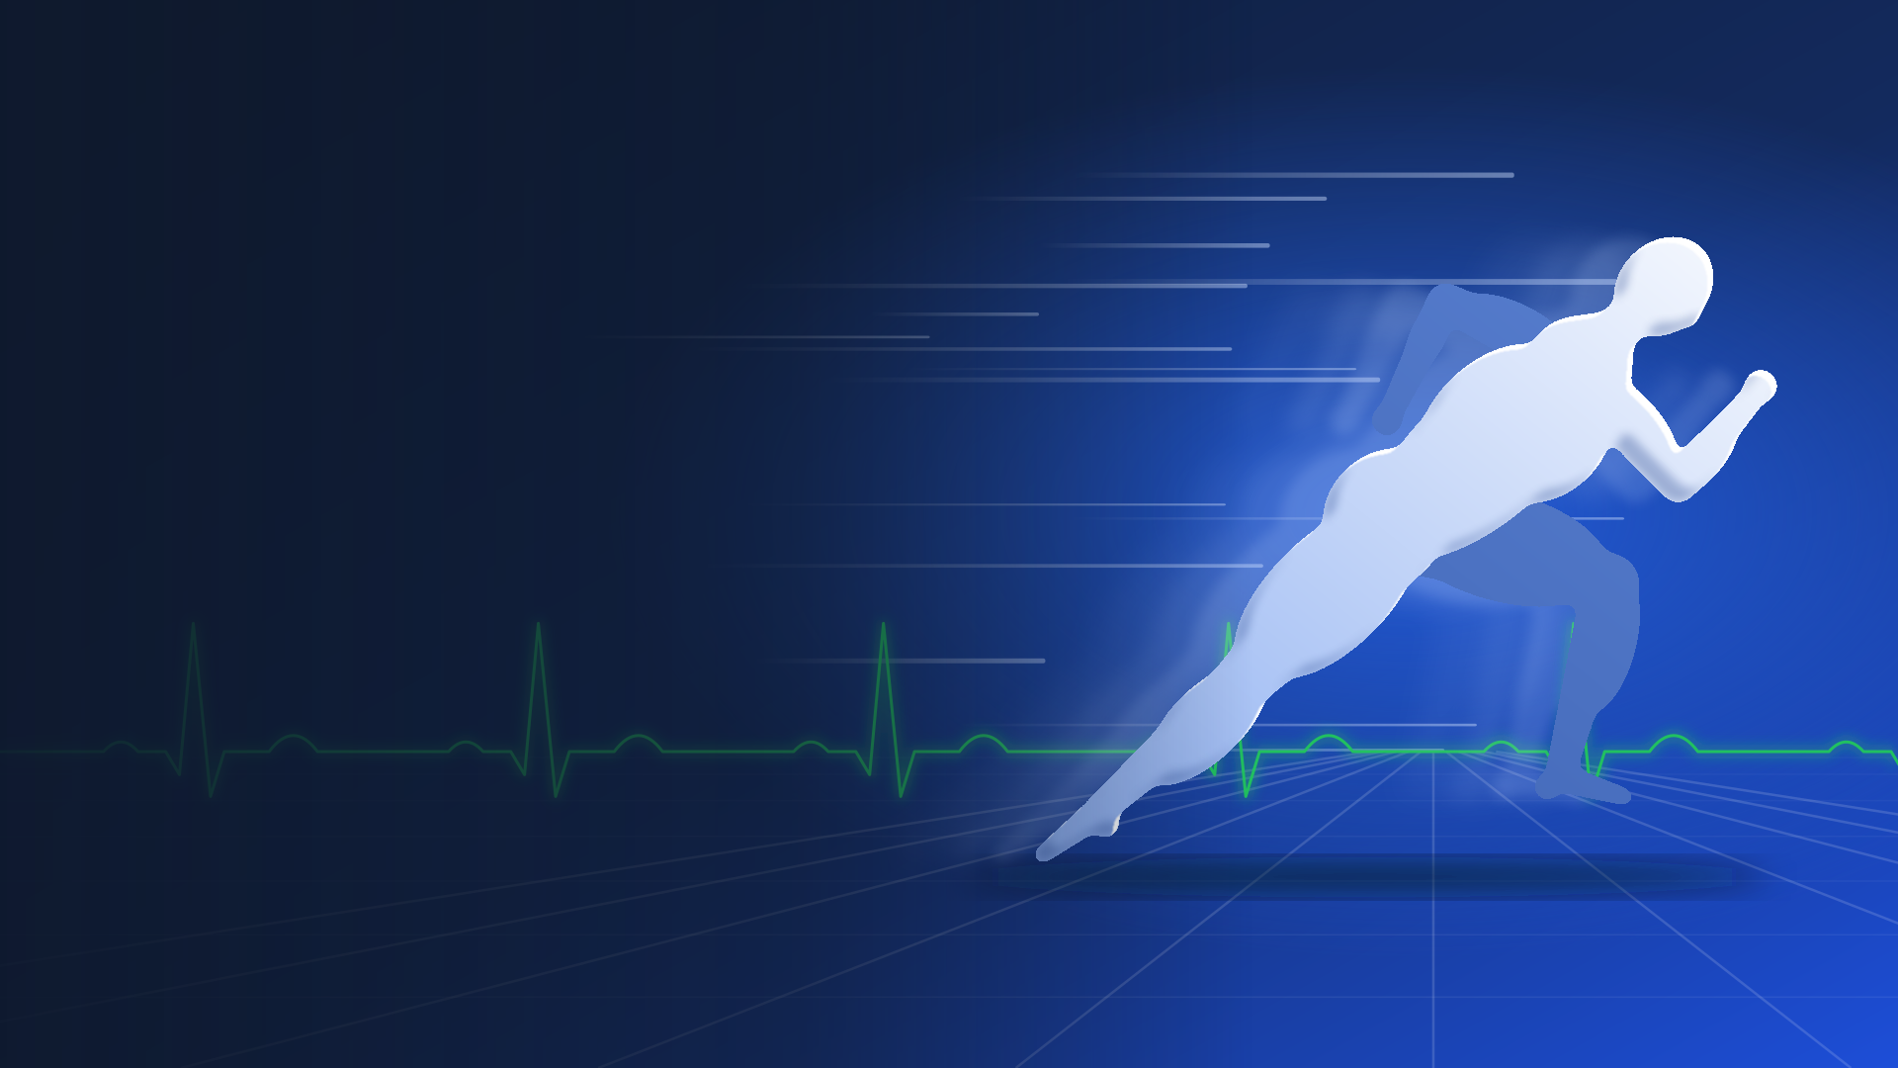
DHRUV
DIAGNOSTICS
Athlete and Physique Health Check-Up
Cardiac, muscle, hormone, longevity and tendon assessment for athletes and bodybuilders.
NABL accredited since 2011 | Technical overview for clinicians and coaches
Notes:
This deck sets out the clinical content of the Dhruv Diagnostics health check-up for athletes and bodybuilders: what is tested, why, how it is interpreted in people who train hard, and how the visit runs.

Slide 2
Athletes run higher CK than non-athletes
Mougios (2007) measured serum creatine kinase in 483 male and 245 female athletes. The upper reference limit in athletes was about twice that of non-athletes, and footballers ran higher still.
A CK of 900 U/L, flagged as high on a standard report, can be ordinary for a male athlete in season.
The same problem affects haemoglobin, creatinine, AST, ALT and ECG voltage. Reports in this plan are read against the athlete's sport and training phase.
Source: Mougios V. Br J Sports Med 2007;41:674-678. 97.5th percentile, 37 °C.
Notes:
Mougios found athlete upper limits roughly double those of moderately active non-athletes. Male footballers reached 1492 U/L against 523 U/L for swimmers, so sport matters as well as sex.

Slide 3
What each plan includes
Investigation | Base | Performance | Elite
Resting ECG, blood pressure, anthropometry | ● | ● | ●
Haemogram with reticulocytes, ferritin, vitamin D, B12 | ● | ● | ●
Glucose, HbA1c, lipid profile, liver, kidney with cystatin C, TSH | ● | ● | ●
Muscle panel: CK, CK-MB, LDH, myoglobin | CK only | ● | ●
Apo B, Lp(a), hs-CRP, homocysteine, fasting insulin |  | ● | ●
NT-proBNP |  | ● | ●
Hormone panel: testosterone, LH, FSH, SHBG, oestradiol, prolactin |  | ● | ●
hs-troponin, cortisol, IGF-1, urine albumin:creatinine |  |  | ●
Treadmill stress test (TMT) |  |  | ●
Tendon and ligament ultrasound by an MSK radiologist |  | 1 region | Up to 3 regions
Urine drugs-of-abuse screen | Add-on | Add-on | Add-on
Physician review of the full report | ● | ● | ●
Notes:
Proposed structure. Final inclusions, ultrasound region counts and prices to be confirmed by the Dhruv clinical team.

Slide 4
Treadmill stress test, Bruce protocol
Stage | Speed (km/h) | Grade (%) | METs at end, approx.
1 | 2.7 | 10 | 5
2 | 4.0 | 12 | 7
3 | 5.5 | 14 | 10
4 | 6.8 | 16 | 13
5 | 8.0 | 18 | 15
6 | 8.8 | 20 | 17
7 | 9.7 | 22 | 19
Reported
Exercise time, stage reached and estimated METs
Peak heart rate as % of age-predicted maximum
Blood-pressure response at each stage
ST-segment change and arrhythmia
Heart-rate recovery at 1 minute (12 bpm or less is abnormal)
Advised for athletes over 35, with a family history of early heart disease, or with symptoms on exertion. An equivocal test is referred for echocardiography or cardiology review.
Each stage lasts 3 minutes. METs are estimates and vary by equation.
Notes:
TMT METs also feed the longevity section: cardiorespiratory fitness measured this way was the strongest modifiable predictor of survival in the Cleveland Clinic cohort (Mandsager 2018). Heart-rate recovery cut-off from Cole et al., NEJM 1999.

Slide 5
NT-proBNP as a personal cardiac baseline
What it measures
A fragment released when heart muscle is stretched by pressure or volume load.
Use in athletes
Marathons and long rides raise it for a day or more. We sample at rest, at least 24 hours after hard training, record the value as a baseline and compare it at each repeat visit.
Cut-offs from ESC Heart Failure Association guidance, derived in breathless patients. For reference only.
Notes:
These thresholds were built to diagnose acute heart failure. In a fit athlete the value is a baseline; a sustained rise on repeat testing is what prompts echo or cardiology review.

Slide 6
Apo B counts atherogenic particles
Each LDL, VLDL, IDL and Lp(a) particle carries one Apo B molecule, so Apo B is a direct particle count.
LDL cholesterol can look normal while Apo B is high. We see this with high triglycerides, insulin resistance, very low-carbohydrate diets and anabolic steroid use.
Lp(a) is largely inherited. It is measured once in adult life and is included with the first Apo B test.
Goals from ESC/EAS 2019 dyslipidaemia guidelines. The physician assigns the risk category.
Notes:
Lp(a) once-in-a-lifetime measurement follows the EAS 2022 consensus statement.

Slide 7
Muscle damage and recovery markers
Marker | What it reflects | How we read it in athletes
CK (CPK), total | Leak from damaged muscle fibres; peaks 24 to 72 h after eccentric or unfamiliar work | Judged against athlete ranges. Above 5 times the upper limit with weakness or dark urine needs same-day review
CK-MB | Cardiac isoform, also present in regenerating skeletal muscle | A raised CK-MB with very high total CK is usually skeletal; troponin settles the question
hs-troponin I or T | Specific to heart muscle | Can rise briefly after endurance events. A rise at rest goes to cardiology
Myoglobin, serum and urine | Early marker, rises within hours of muscle injury | Myoglobin in urine with high CK signals risk to the kidneys
LDH | Muscle, red cells, liver | Supports CK. Foot-strike haemolysis in runners also raises it
AST, ALT | Found in muscle as well as liver | CK is checked before a raised AST or ALT is called liver injury
Creatinine with cystatin C | Creatinine tracks muscle mass and creatine intake | Cystatin C gives a truer kidney function in muscular people
Potassium, phosphate, uric acid | Released when muscle breaks down | Checked when CK is markedly raised
Notes:
Draw muscle markers at least 48 to 72 hours after the last hard or eccentric session, otherwise the result reflects the session and not the athlete. Rhabdomyolysis is conventionally defined as CK at least 5 times the upper limit of normal.

Slide 8
Hormones and blood in strength athletes
Marker | Why it is measured
Haemoglobin, haematocrit, reticulocytes | Androgens can push haematocrit up and thicken the blood. Endurance athletes may run low iron stores
Testosterone (total, free), LH, FSH | Shows suppression of the body's own production and its recovery after a cycle stops
SHBG, oestradiol, prolactin | Needed to interpret testosterone; oestradiol and prolactin explain many side effects
Cortisol (8 am), testosterone:cortisol | Read with training load as a guide to under-recovery
IGF-1 | Growth-hormone axis; also raised by high protein intake
TSH, free T4 | Thyroid function affects weight, energy and heart rate
GGT, bilirubin, ALT | Oral steroids and some supplements stress the liver
Oestradiol, LH, FSH, ferritin in women | Low energy availability (RED-S) disturbs menstrual hormones and bone health
Results are confidential. Telling us about supplements or enhancers helps the physician interpret them correctly.
Notes:
Draw testosterone and cortisol between 8 and 10 am. This panel is for health monitoring; it is not a doping test.

Slide 9
Markers linked to long-term health
Marker | What it adds
Fitness in METs, from the TMT | Lower fitness carried about 5 times the mortality of elite fitness in 122,007 treadmill patients
Apo B and Lp(a) | Lifetime artery risk; Lp(a) is genetic and measured once
hs-CRP | Low-grade inflammation. Repeated if raised by recent hard training or infection
HbA1c, fasting glucose, fasting insulin | HOMA-IR shows insulin resistance years before diabetes
Homocysteine | Linked to vascular risk; often reflects low B12 or folate
Uric acid | Associated with high blood pressure, gout and metabolic syndrome
Cystatin C eGFR, urine albumin:creatinine | Early kidney and small-vessel damage
Vitamin D, B12, ferritin | Deficiencies are common in India and affect bone, nerves and energy
Fitness data: Mandsager K et al. JAMA Netw Open 2018;1(6):e183605. Hazard ratio 5.04, low vs elite fitness.
Notes:
Mandsager et al. found no upper limit to the survival benefit of fitness. The study is observational, so the association does not prove causation.

Slide 10
Ultrasound of tendons and ligaments
Region | Structures examined
Shoulder | Rotator cuff, long head of biceps, subacromial bursa
Elbow | Common extensor and flexor origins, distal biceps
Hip and groin | Gluteal tendons, adductor origin, iliopsoas
Knee | Patellar and quadriceps tendons, MCL, LCL
Ankle and foot | Achilles, ATFL, peroneal tendons, plantar fascia
Findings reported
Tendon thickness compared with the other side
Hypoechoic areas and loss of fibre pattern
New vessels on Doppler (neovascularity)
Partial tears and calcific deposits
Bursal fluid
Ligament gapping on stress views
Performed and reported by a radiologist trained in musculoskeletal ultrasound. High-frequency linear probe, no radiation. The first scan is the baseline for return-to-play decisions.
Notes:
Region choice is guided by sport and symptoms: Achilles and patellar tendons for runners and jumpers, rotator cuff and distal biceps for lifters.

Slide 11
How official doping control works
When banned | WADA Prohibited List class, 2026
At all times | S0 non-approved substances, S1 anabolic agents, S2 peptide hormones and growth factors (EPO, hGH), S3 beta-2 agonists, S4 hormone and metabolic modulators, S5 diuretics and masking agents, M1 blood manipulation, M2 chemical and physical manipulation, M3 gene and cell doping
In competition | S6 stimulants, S7 narcotics (tramadol since 2024), S8 cannabinoids (CBD excepted), S9 glucocorticoids
In some sports | P1 beta-blockers, for example archery, shooting and golf
Who tests and how
NADA India tests Indian athletes; the International Testing Agency runs testing at the Olympic Games
Urine (at least 90 mL) and blood, split into A and B samples
Analysed only at WADA-accredited laboratories; in India, NDTL New Delhi
Athlete Biological Passport tracks blood, steroid and growth-hormone markers over time
Olympic samples may be stored and re-tested for up to 10 years
Dhruv Diagnostics does not carry out doping control and cannot certify an athlete as clean.
Notes:
Athletes should check every medicine against the current Prohibited List and apply for a Therapeutic Use Exemption where needed. Semaglutide and tirzepatide are on WADA's 2026 monitoring programme, not banned.

Slide 12
Urine drug screen and WADA status
Drug group screened | WADA class | Banned | Note
Amphetamine, methamphetamine | S6 stimulants | In competition
MDMA (ecstasy) | S6; substance of abuse | In competition
Cocaine | S6; substance of abuse | In competition | Screen detects benzoylecgonine
Cannabinoids (THC) | S8; THC is a substance of abuse | In competition | CBD alone is allowed; CBD products can contain THC
Opiates (morphine) | S7 narcotics | In competition | Screen also reacts to codeine, which is not banned
Tramadol | S7 narcotics | In competition | Banned since 1 January 2024
Methadone, buprenorphine | S7 narcotics | In competition
Benzodiazepines, barbiturates | Not on the List | No | Relevant to health and safety only
Immunoassay is a screen. A positive result needs confirmation by GC-MS or LC-MS/MS. This screen is for clinical and personal use and is not a doping test.
Notes:
Panel composition to be confirmed against the kit Dhruv uses. Under the 2021 Code, cocaine, heroin, MDMA and THC are Substances of Abuse, with reduced sanctions for out-of-competition use unrelated to sport.

Slide 13
Recovery Club for women members
Open to women members only at present. Men's access has not opened yet.
Sauna
Spa
Health club
Dry heat after training. Opened to a member once her blood pressure and ECG or TMT have been reviewed.
Massage and hydrotherapy between sessions to ease muscle soreness and stiffness.
Supervised strength, conditioning and mobility work planned around the check-up findings.
Sauna not advised with | Precautions for every member
Pregnancy, uncontrolled high blood pressure, recent heart event, fever or acute illness | Water and electrolytes before and after; no alcohol; leave at any dizziness
Notes:
The club is women-only for now. Sauna access follows medical clearance from the check-up; it is positioned as recovery support, not treatment.

Slide 14
Preparing for the visit
Instruction | Timing | Protects the result of
Overnight fast, water allowed | 10 to 12 h | Glucose, insulin, lipids
No hard, eccentric or very long training | 48 to 72 h before | CK, myoglobin, AST, ALT, troponin, NT-proBNP
Blood drawn early | 8 to 10 am | Testosterone, cortisol
Stop high-dose biotin (hair and skin supplements) | 72 h before | Thyroid, hormone and troponin immunoassays
Tell us about creatine use | At booking | Creatinine (cystatin C is added)
Bring a list of medicines, supplements and any TUE | On the day | Hormone panel, drug screen, physician review
Light breakfast after the blood draw; wear running shoes | TMT at least 2 h after eating | Treadmill stress test
Repeat every 6 to 12 months so results can be compared with the athlete's own baseline.
Notes:
Biotin interferes with streptavidin-based immunoassays. Order on the day: fasting bloods and urine, breakfast, ultrasound, then TMT, then physician review.

Slide 15
Sources
World Anti-Doping Agency. 2026 Prohibited List, in force 1 January 2026.
World Anti-Doping Agency. Athlete Biological Passport Operating Guidelines.
Mougios V. Reference intervals for serum creatine kinase in athletes. Br J Sports Med 2007;41:674-678.
Mandsager K et al. Cardiorespiratory fitness and long-term mortality among adults undergoing exercise treadmill testing. JAMA Netw Open 2018;1(6):e183605.
Mach F et al. 2019 ESC/EAS Guidelines for the management of dyslipidaemias. Eur Heart J 2020;41:111-188.
Mueller C et al. Heart Failure Association of the ESC practical guidance on the use of natriuretic peptide concentrations. Eur J Heart Fail 2019;21:715-731.
Kronenberg F et al. Lipoprotein(a) in atherosclerotic cardiovascular disease: EAS consensus statement. Eur Heart J 2022;43:3925-3946.
Cole CR et al. Heart-rate recovery immediately after exercise as a predictor of mortality. N Engl J Med 1999;341:1351-1357.
Press Information Bureau, Government of India. NDTL regains WADA accreditation, December 2021.
Laboratory tests are performed in a NABL-accredited laboratory. The check-up is a screening programme and does not replace a consultation with your own doctor. Dhruv Diagnostics does not perform doping control; official testing is carried out by NADA India at WADA-accredited laboratories.

Slide 16
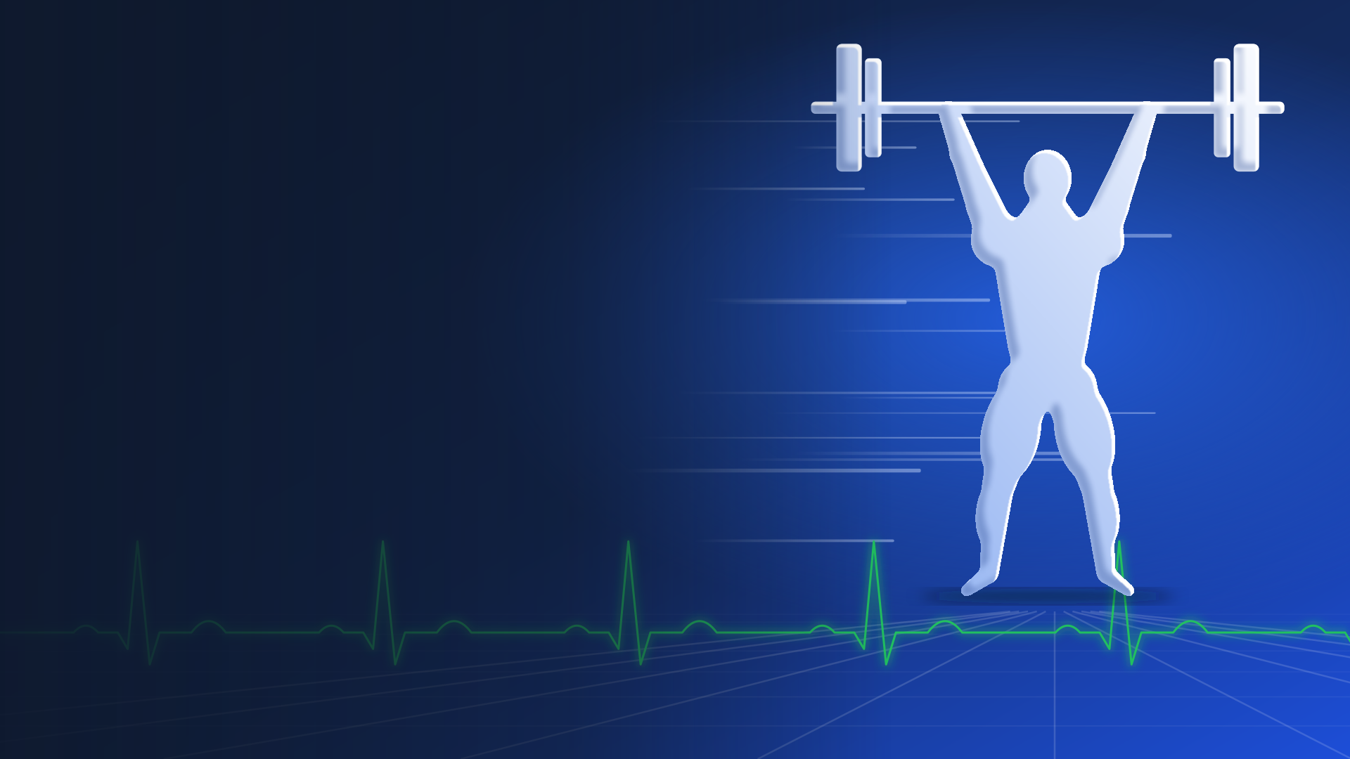

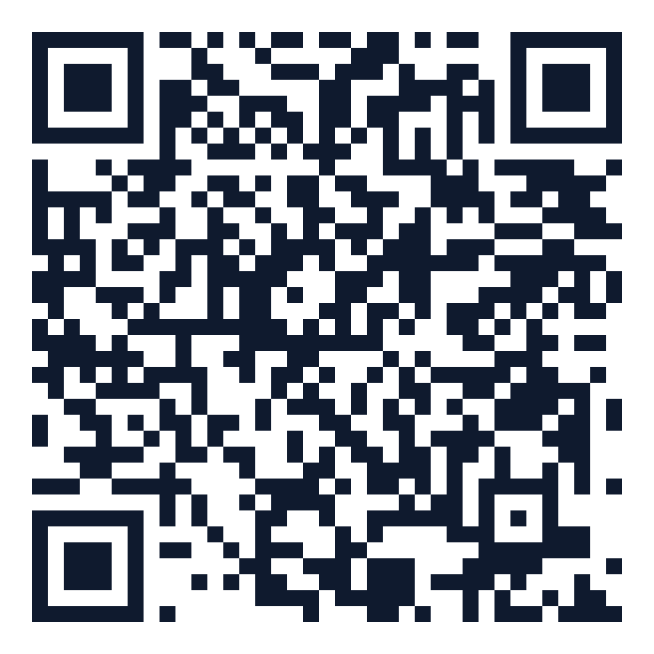
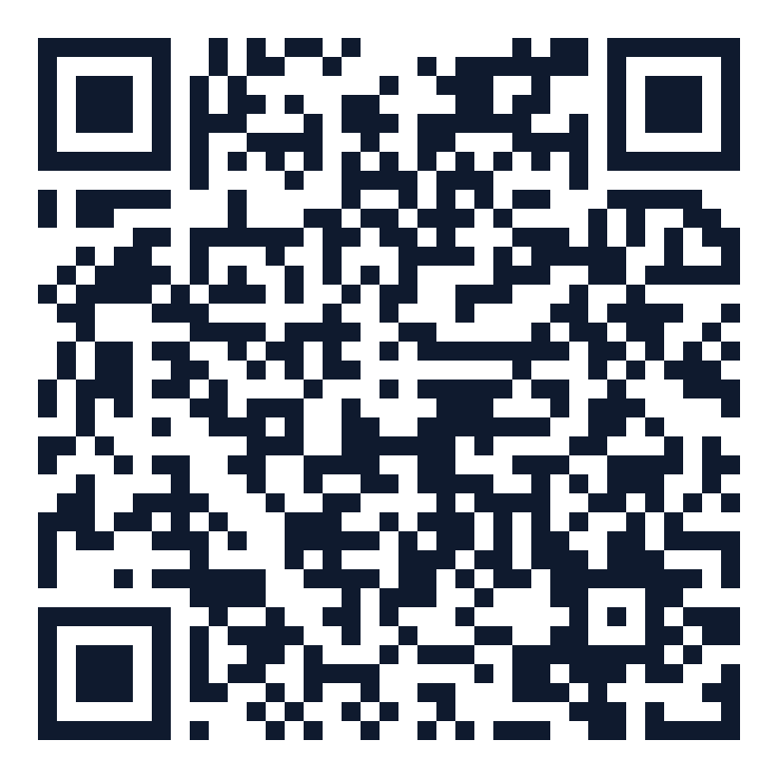
DHRUV
DIAGNOSTICS
Call to confirm your appointment
Laxmi Nagar +91 89282 95328
J-11, West High Court Road, Laxmi Nagar, Nagpur 440022
Ramdaspeth +91 99224 16303
3rd Floor, Aditya Enclave, Central Bazar Road, Ramdaspeth, Nagpur 440010
Mon-Sat 7 AM-9 PM | Sun 7 AM-5 PM | dhruvlabs@gmail.com
Website
Laxmi Nagar map
Ramdaspeth map
Notes:
Laboratory tests are performed in a NABL-accredited laboratory. The check-up is a screening programme and does not replace a consultation with your own doctor. Dhruv Diagnostics does not perform doping control; official testing is carried out by NADA India at WADA-accredited laboratories.

